Slide 1
Sales Forecasting
&
Clustering Project
Prepared by Subalakshmi

Slide 2
Project Overview
- Daily sales forecasting using XGBoost (Supervised Learning)
- KMeans clustering on sales lag features (Unsupervised Learning)
- 3+ Visualizations: Trend, Boxplot, Clusters, Feature Importance
- Preprocessing: date parsing, aggregation, lag features, scaling
- Metrics: RMSE, MAE, R²
- Cross-validation: TimeSeriesSplit
- Hyperparameter tuning using GridSearchCV

Slide 3
Tech Stack
- Python
- Pandas, NumPy
- Matplotlib
- Scikit-learn
- XGBoost
- KMeans clustering

Slide 4
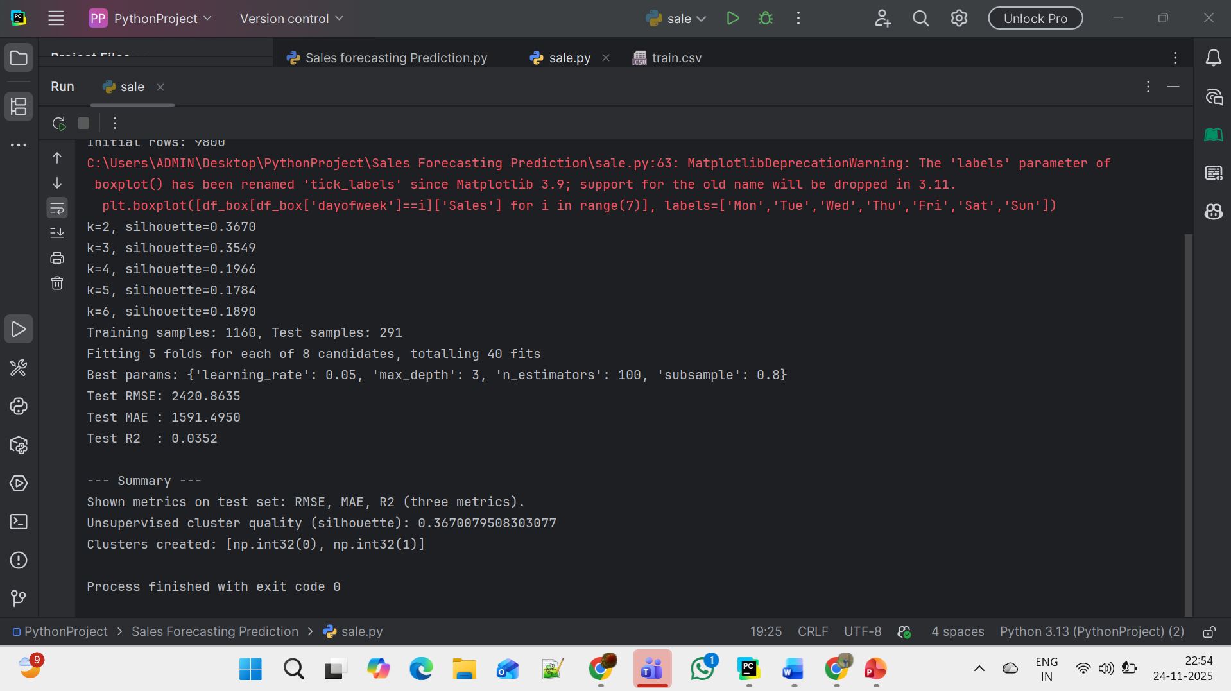
Output

Slide 5
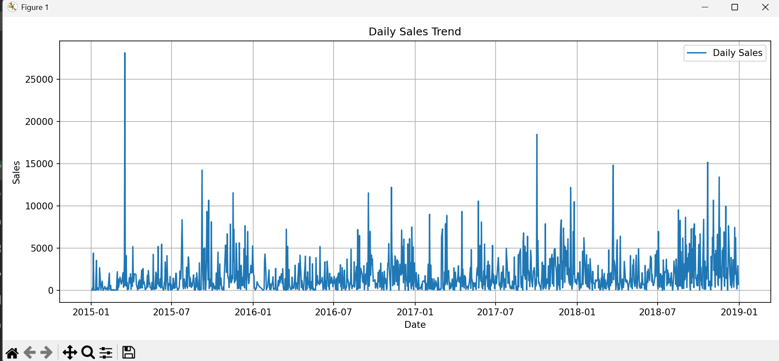
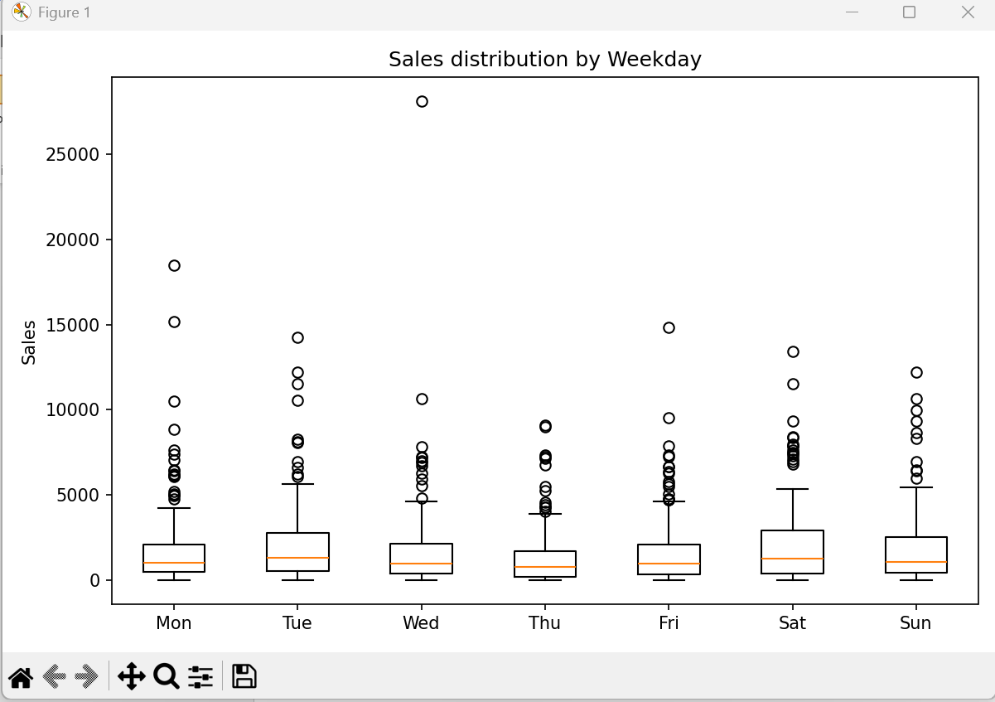

Slide 6
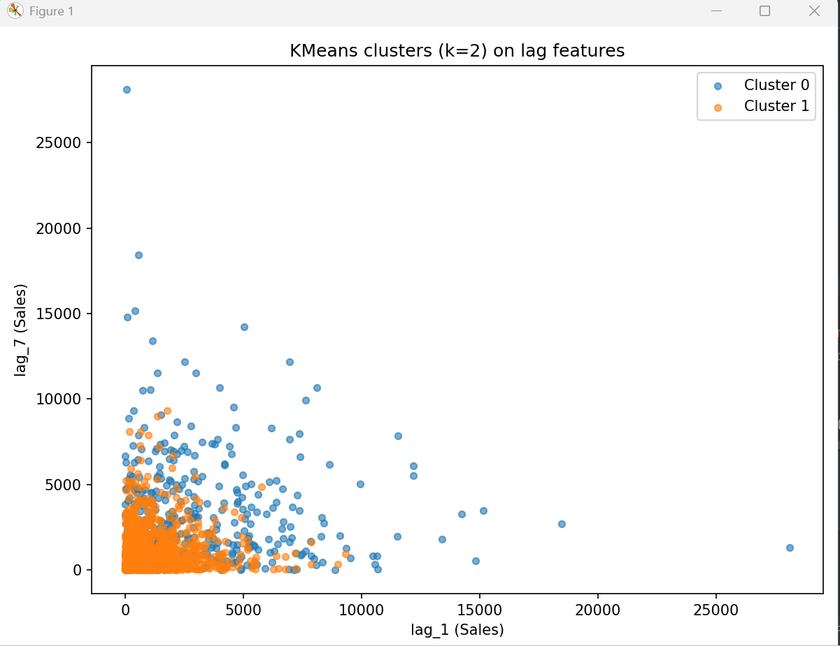
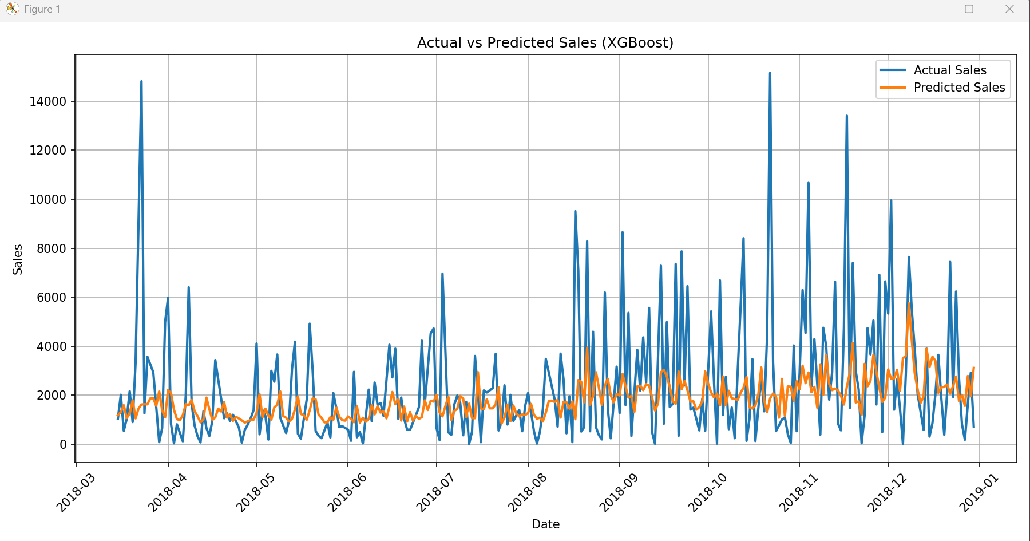

Slide 7
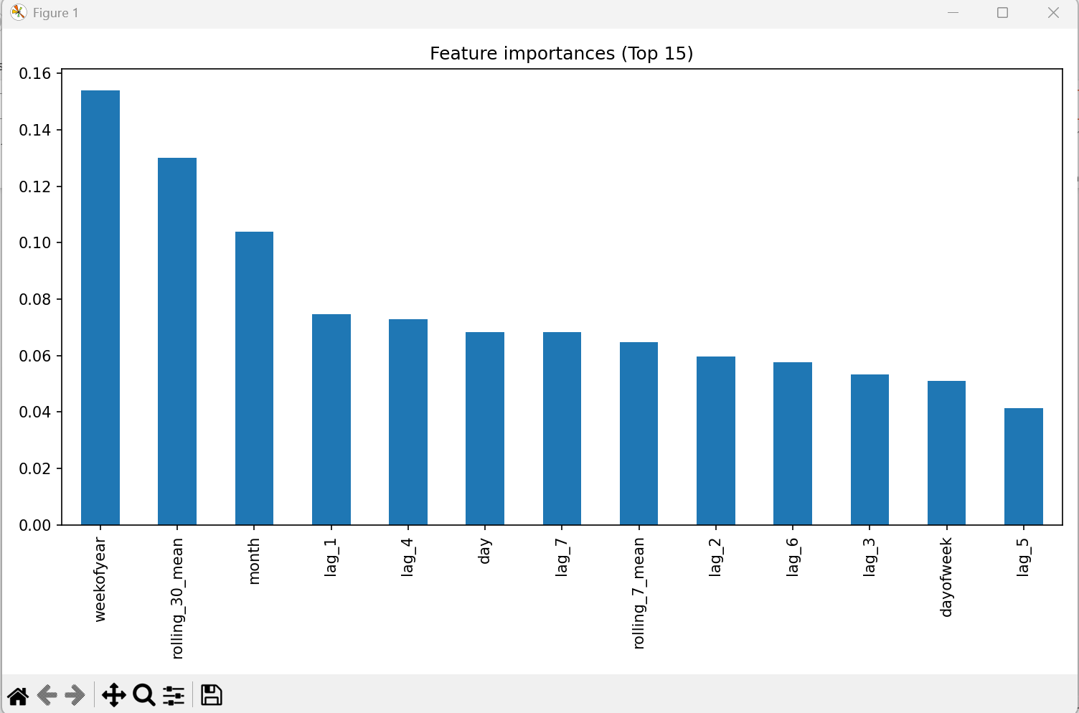
GitHub Rep : https://github.com/subalakshmi-ds/sales-forecasting-clustering-project/tree/main

