Slide 1
AWS Exam Prep Pointers

Slide 2
Code Build
AWS CodeBuild is a fully managed continuous integration service that compiles source code, runs tests, and produces software packages that are ready to deploy.
With CodeBuild, you don’t need to provision, manage, and scale your own build servers.
CodeBuild scales continuously and processes multiple builds concurrently, so your builds are not left waiting in a queue.

Slide 3
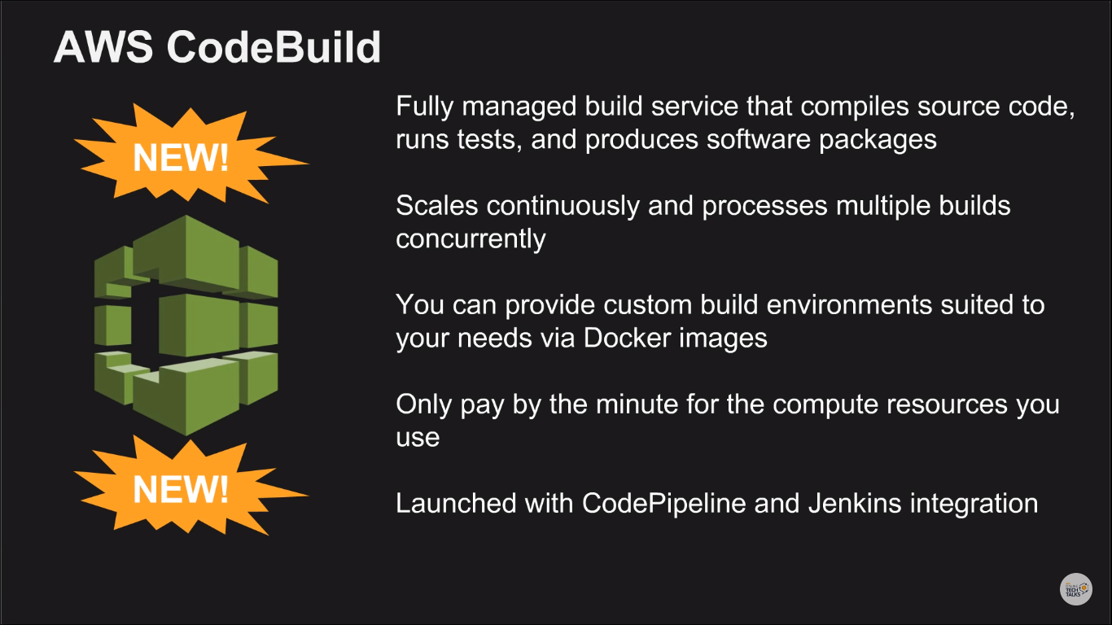

Slide 4
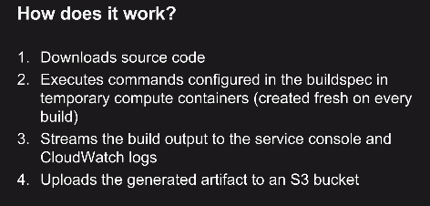
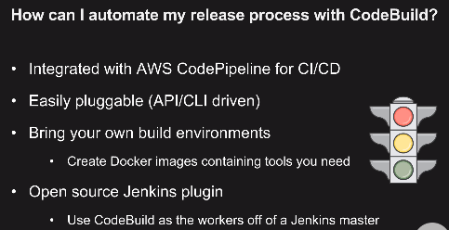
“Building” code refers to languages that require compiled binaries.
Eg: .net, Java, IOS languages, process of creating docker container images is known as “building”
Languages that do not require to be built: PHP, Node.js,Ruby, Python – these can be directly deployed.

Slide 5
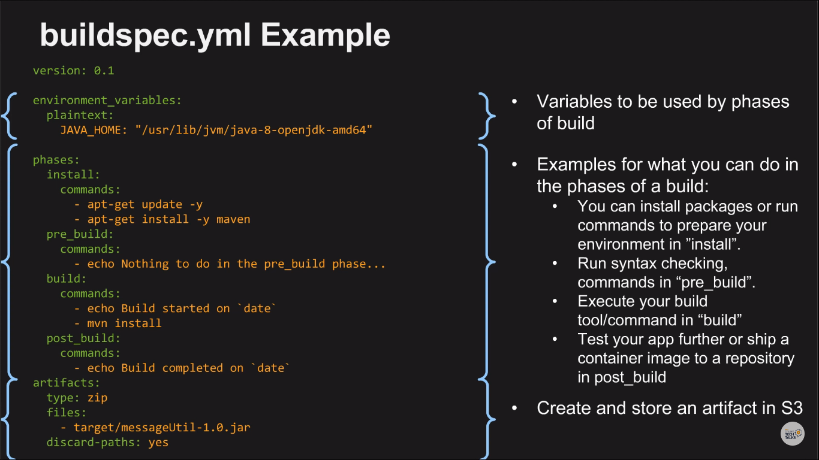

Slide 6
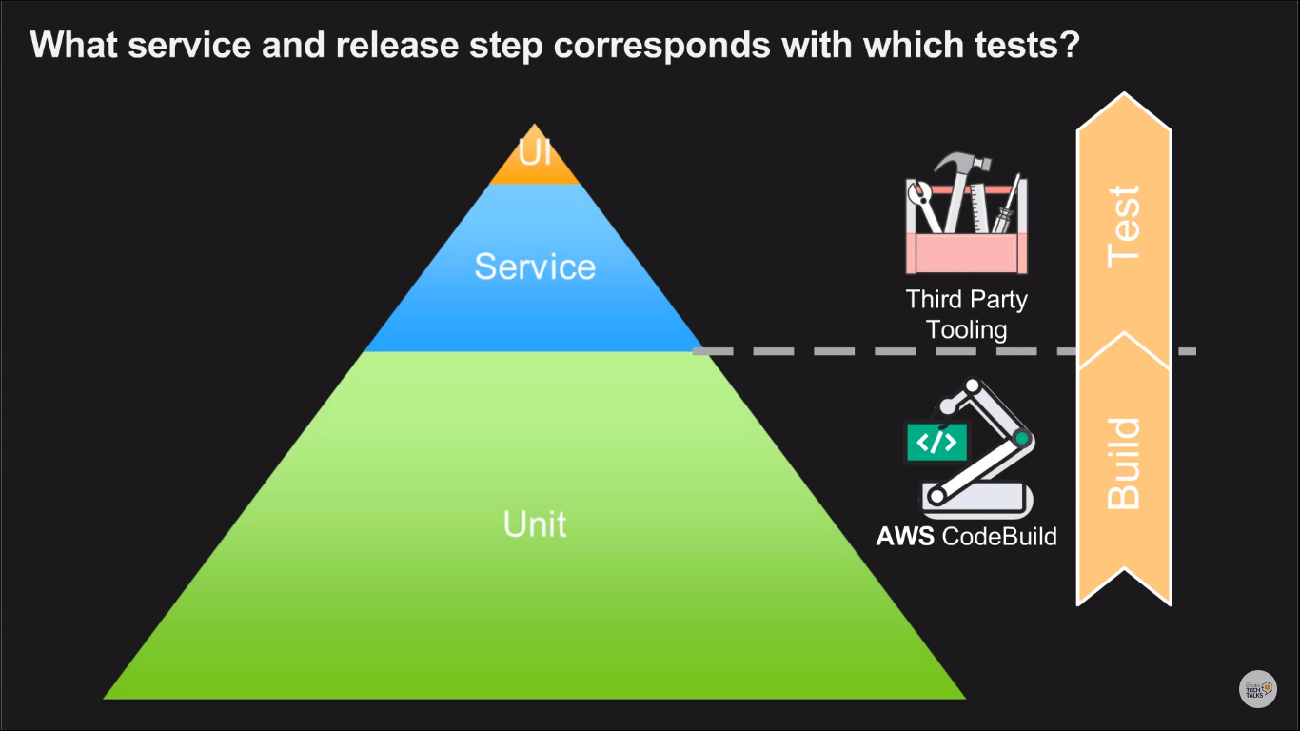

Slide 7
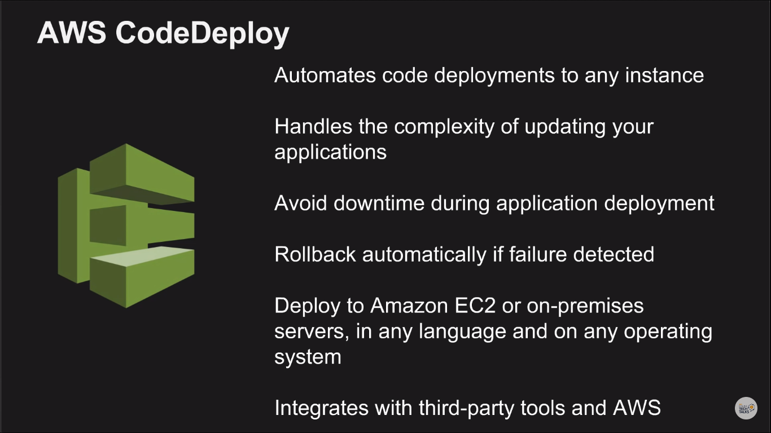

Slide 8
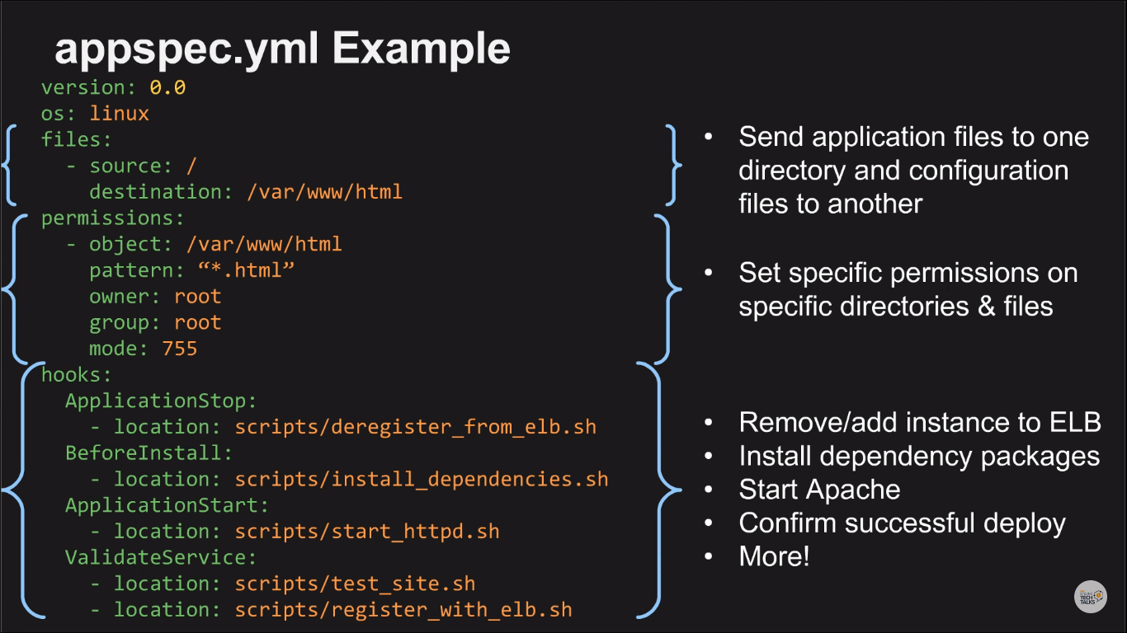

Slide 9
