Slide 1
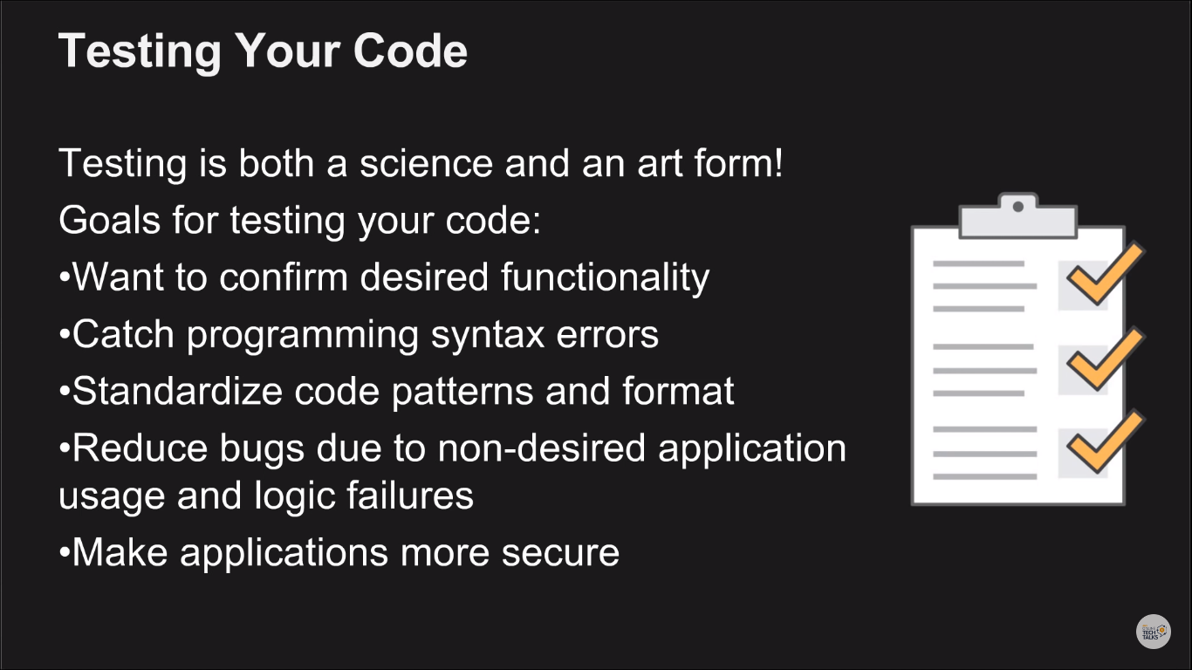

Slide 2
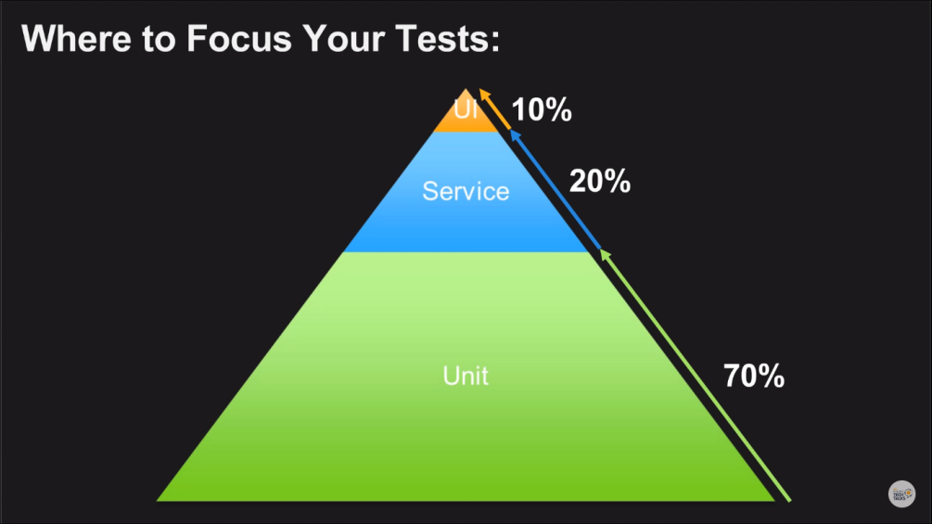
Privacy Enhanced Mail (.pem)
PuTTY Private Key (.ppk)
For CodeCommit, GitHub, and Bitbucket repositories, by convention, you must store a build spec file named buildspec.yml in the root (top level) of each repository or include the build spec declaration as part of the build project definition. Do not create a ZIP file that contains the repository's source code and build spec file.
For build input stored in S3 buckets only, you must create a ZIP file that contains the source code and, by convention, a build spec file named buildspec.yml at the root (top level) or include the build spec declaration as part of the build project definition.
If you want to use a different name for your build spec file, or you want to reference a build spec in a location other than the root, you can specify a build spec override as part of the build project definition.

Slide 3
A build project includes information about how to run a build, including where to get the source code, which build environment to use, which build commands to run, and where to store the build output.
A build environment represents a combination of operating system, programming language runtime, and tools that CodeBuild uses to run a build.
1272c23a102ff856e8efc43ff8cffff39170ac73

Slide 4
GIT
git init
git remote add origin <git url>
git remote –v
git clone <git repo url>
git add <file names> (or) git add .
git commit -m “commit message”
git push origin master

