Slide 1
Code Build
AWS CodeBuild is a fully managed continuous integration service that compiles source code, runs tests, and produces software packages that are ready to deploy.
With CodeBuild, you don’t need to provision, manage, and scale your own build servers.
CodeBuild scales continuously and processes multiple builds concurrently, so your builds are not left waiting in a queue.

Slide 2
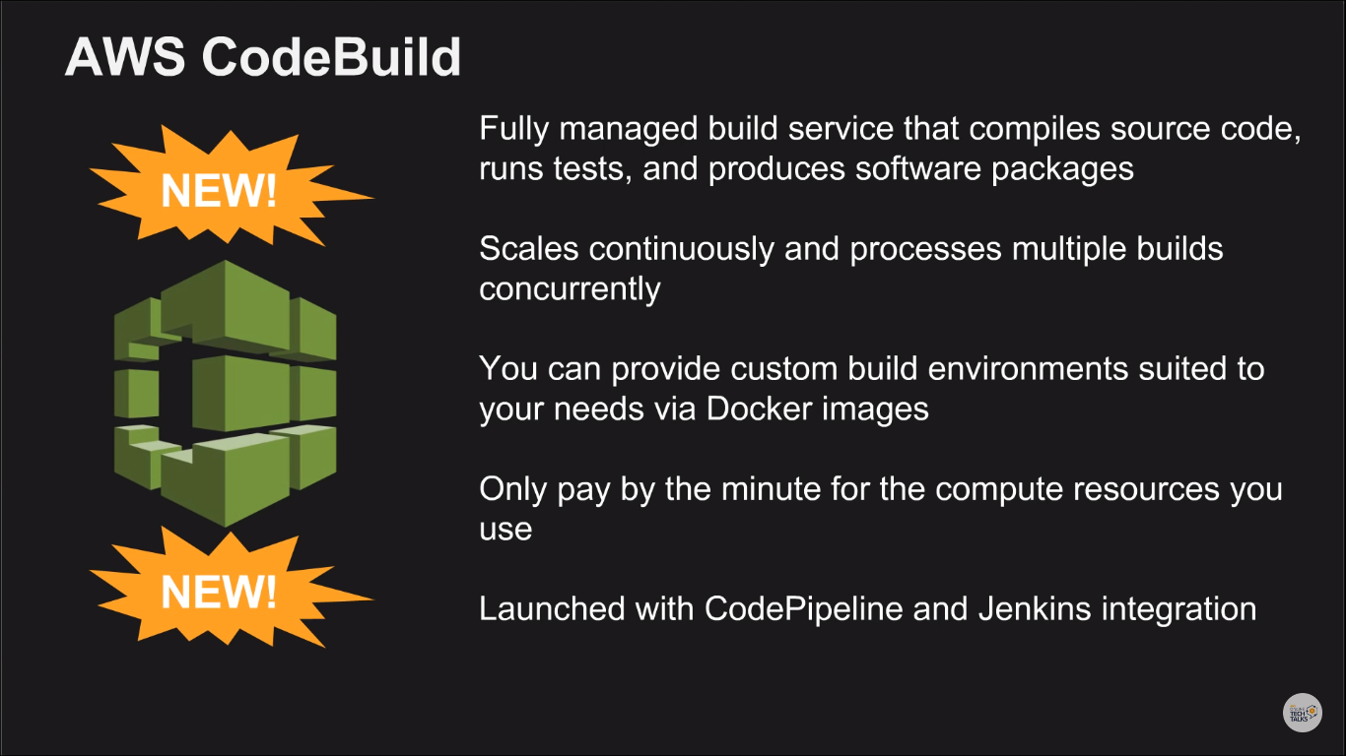

Slide 3
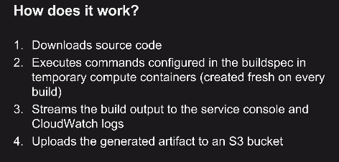
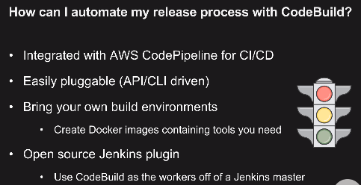
“Building” code refers to languages that require compiled binaries.
Eg: .net, Java, IOS languages, process of creating docker container images is known as “building”
Languages that do not require to be built: PHP, Node.js,Ruby, Python – these can be directly deployed.
k7a7-tznj-bbm2

Slide 4
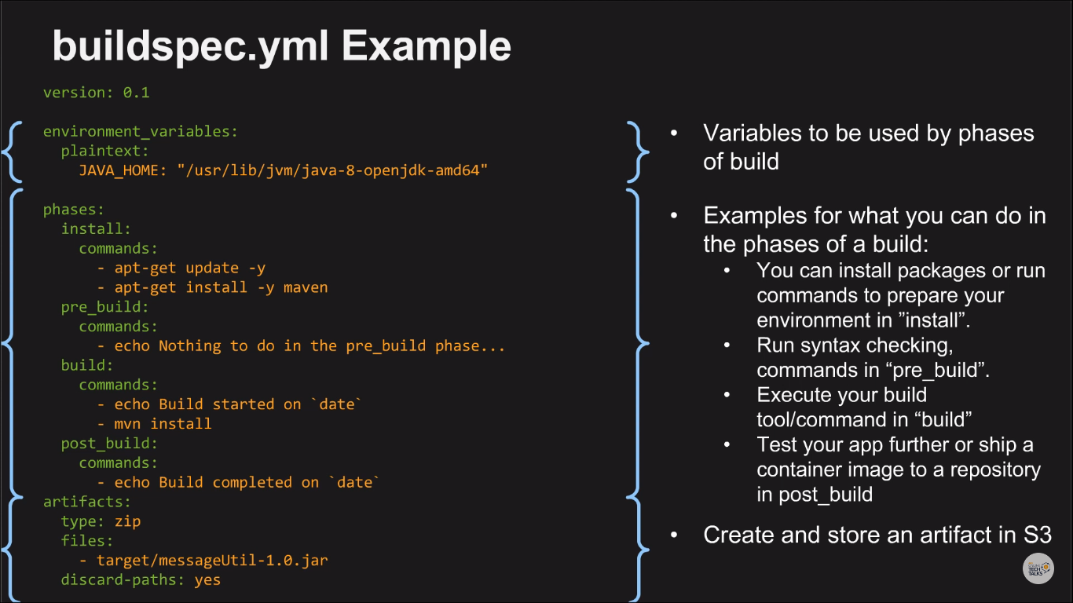

Slide 5
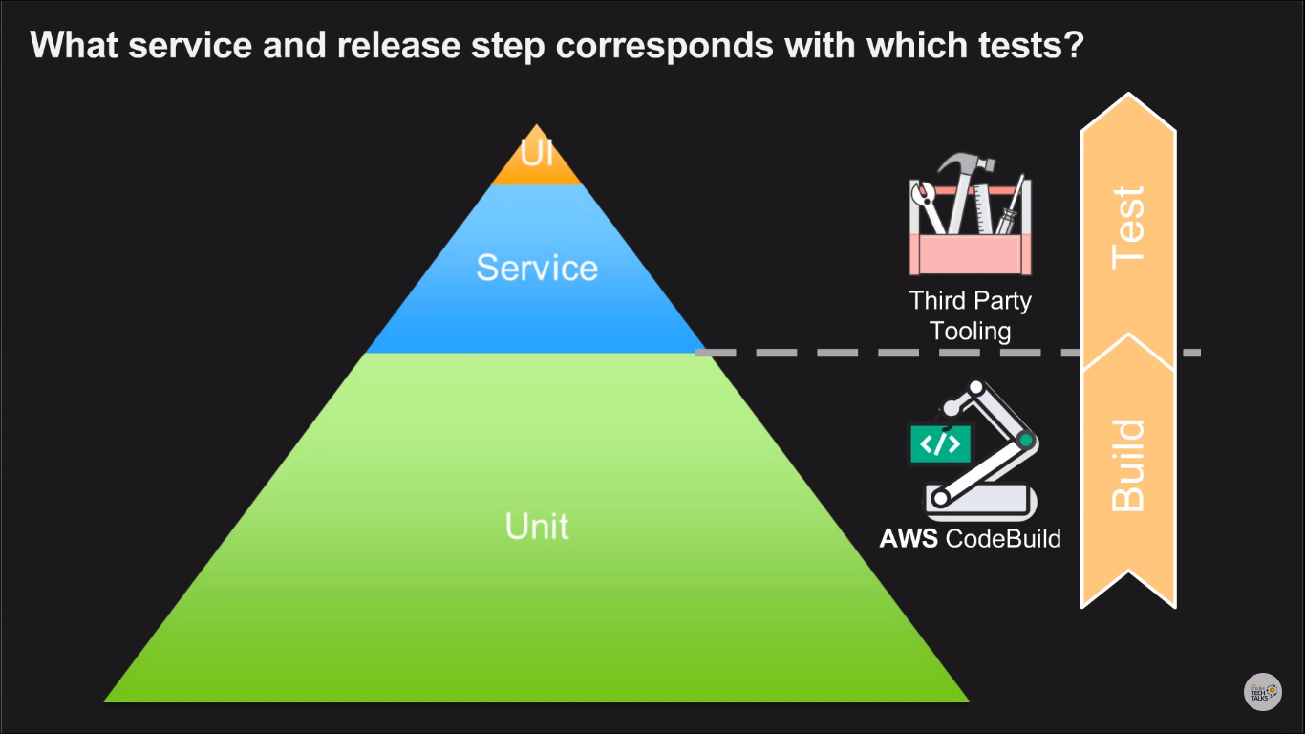

Slide 6
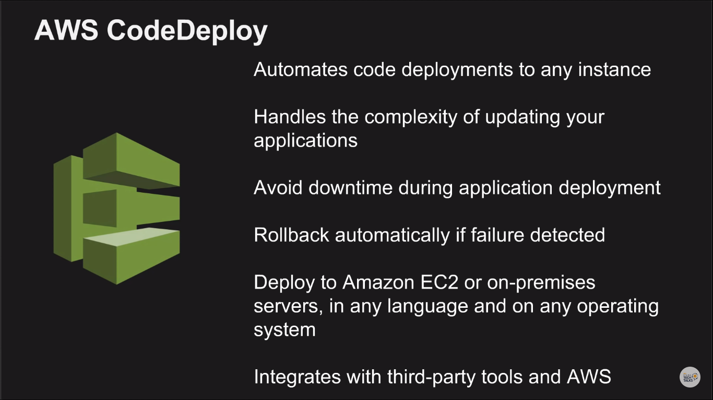

Slide 7
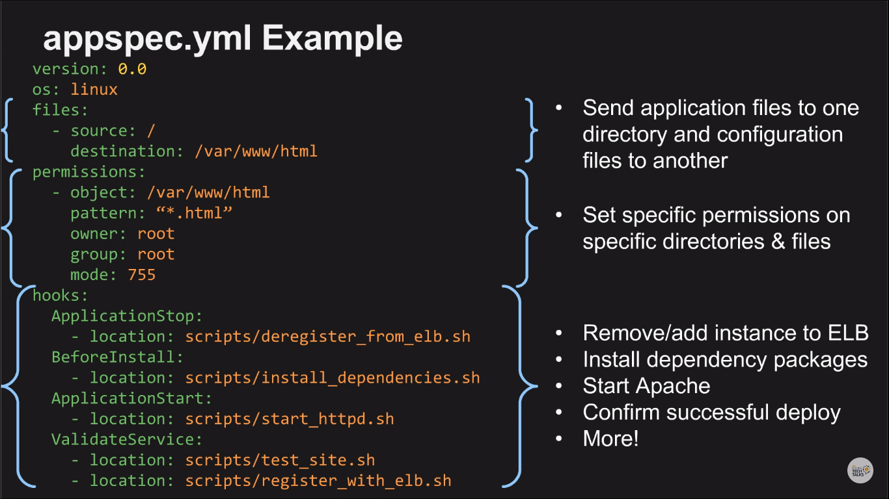

Slide 8
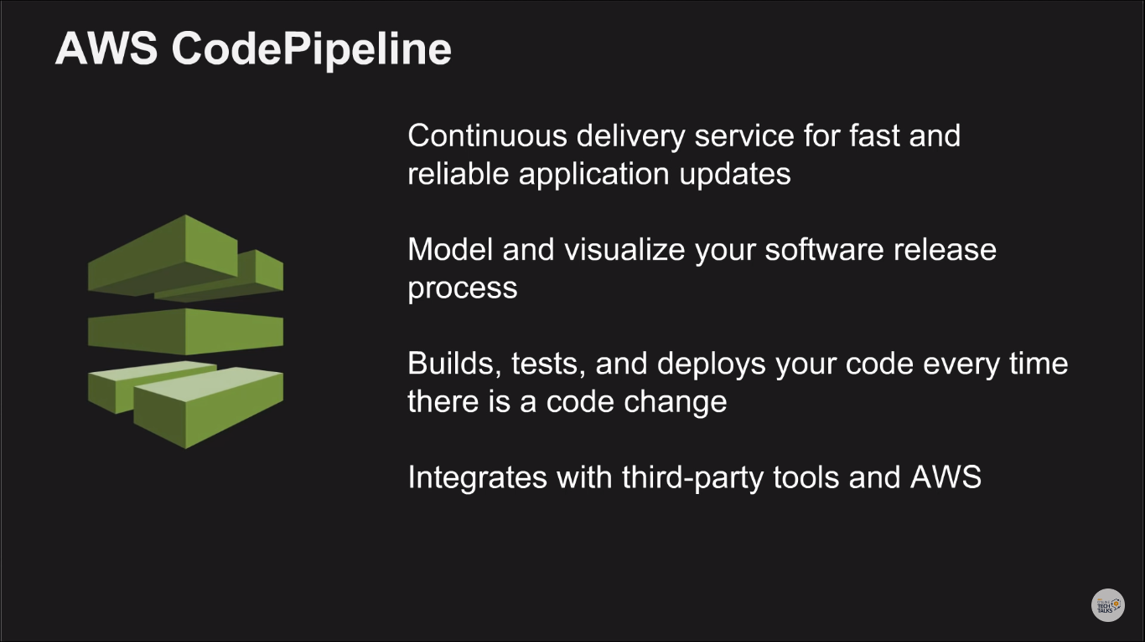

Slide 9
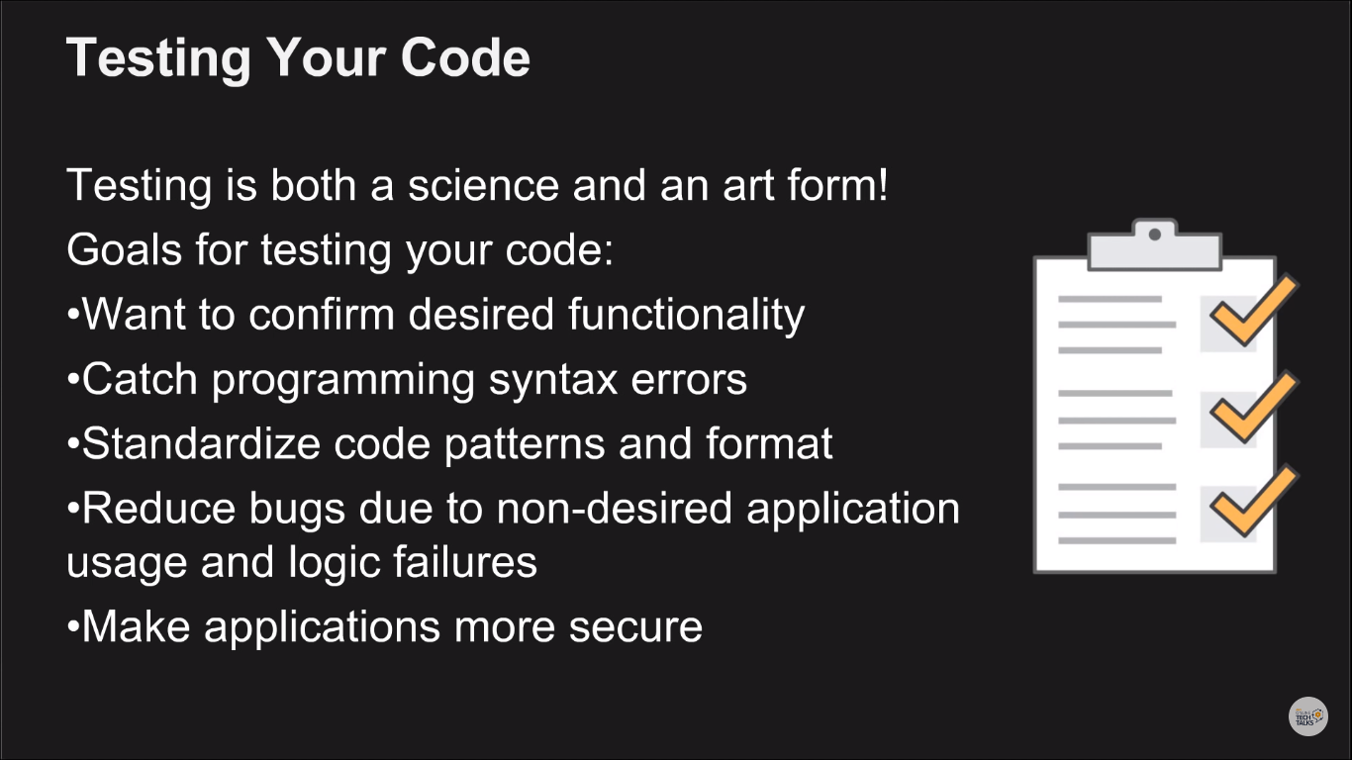

Slide 10
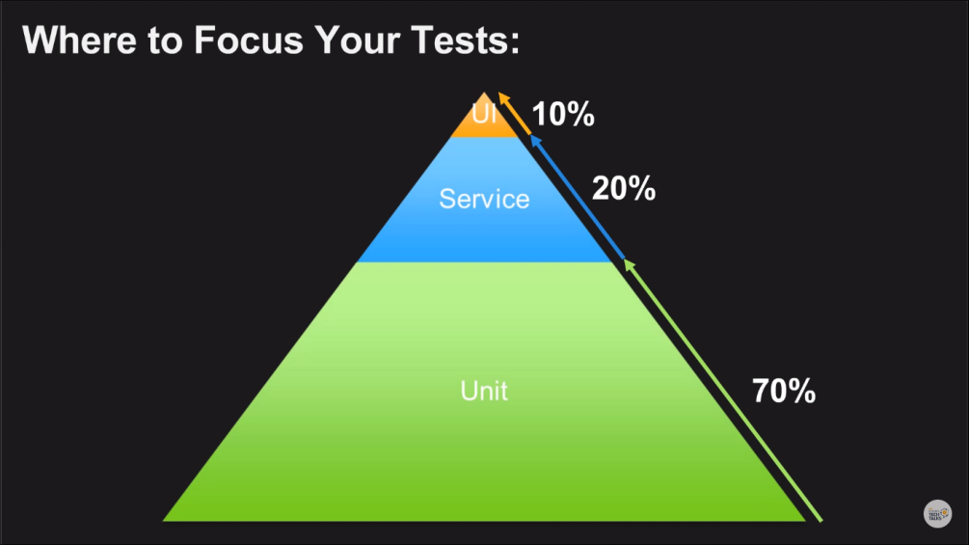
Privacy Enhanced Mail (.pem)
PuTTY Private Key (.ppk)
For CodeCommit, GitHub, and Bitbucket repositories, by convention, you must store a build spec file named buildspec.yml in the root (top level) of each repository or include the build spec declaration as part of the build project definition. Do not create a ZIP file that contains the repository's source code and build spec file.
For build input stored in S3 buckets only, you must create a ZIP file that contains the source code and, by convention, a build spec file named buildspec.yml at the root (top level) or include the build spec declaration as part of the build project definition.
If you want to use a different name for your build spec file, or you want to reference a build spec in a location other than the root, you can specify a build spec override as part of the build project definition.

Slide 11
A build project includes information about how to run a build, including where to get the source code, which build environment to use, which build commands to run, and where to store the build output.
A build environment represents a combination of operating system, programming language runtime, and tools that CodeBuild uses to run a build.
1272c23a102ff856e8efc43ff8cffff39170ac73

Slide 12
GIT
git init
git remote add origin <git url>
git remote –v
git clone <git repo url>
git add <file names> (or) git add .
git commit -m “commit message”
git push origin master

