Slide 1


EMPLOYEE MANAGEMENT SYSTEM
-PRESENTED BY
SUBAMEENA S

Slide 2

INTRODUCTION OF OUR PROJECT
The main intent of this project is to manage the list of employee details along with providing their performance with a web based Application.
It is Difficult job to Handle all employees manually for unique Venture.
This Web based application provides a Simplified task of doing this rather than manually managing the details of employee.
This simply Add, updates, delete and view the employee in an effective manner.

Slide 3

SCOPE OF PROJECT
EMPLOYEEE PROFILES
Admin will have Access to the profiles of employees and will be able to edit their Details.

Slide 4
TECHNOLOGY USED
BACKEND TECHNOLOGY
SPRINGBOOT
MYSQL
CORE JAVA

Slide 5
FRONTEND TECHNOLOGY
HTML5
BOOTSTRAP
CSS
ANGULAR

Slide 6
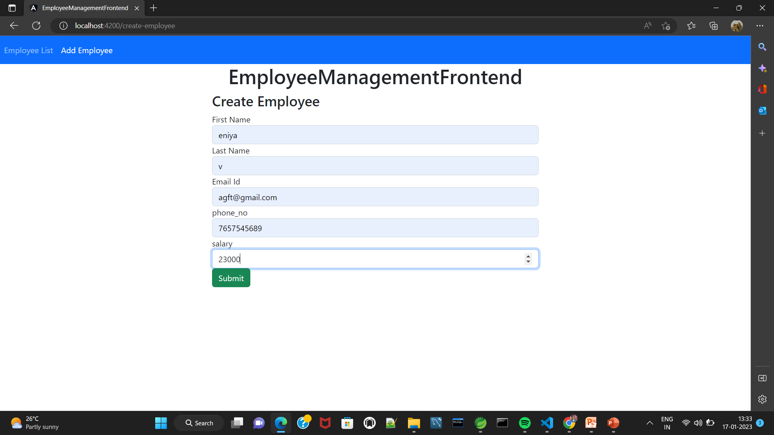
create employee

Slide 7
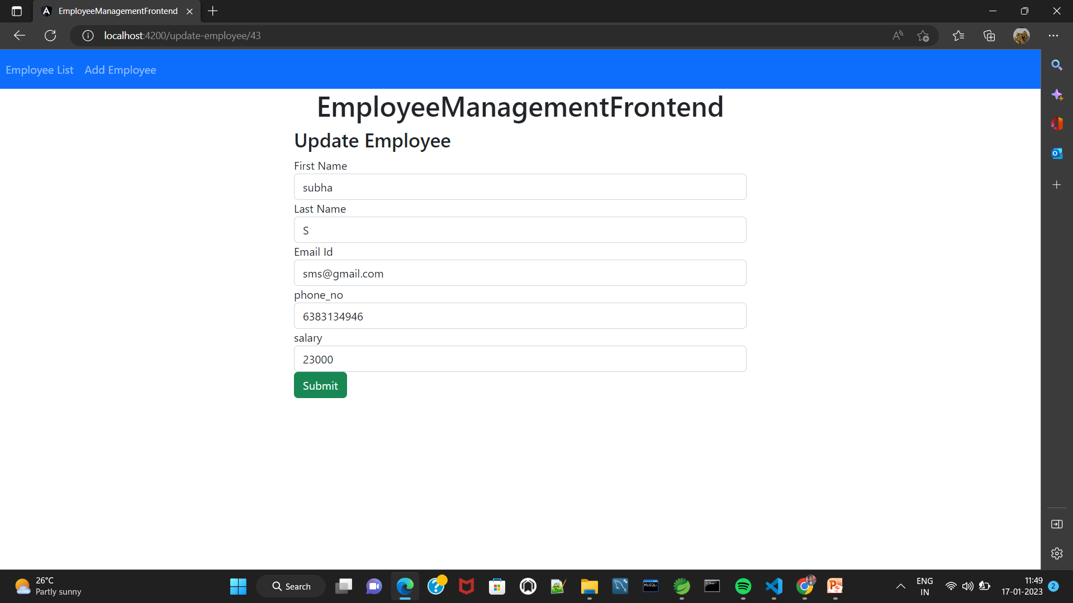
Update employee

Slide 8
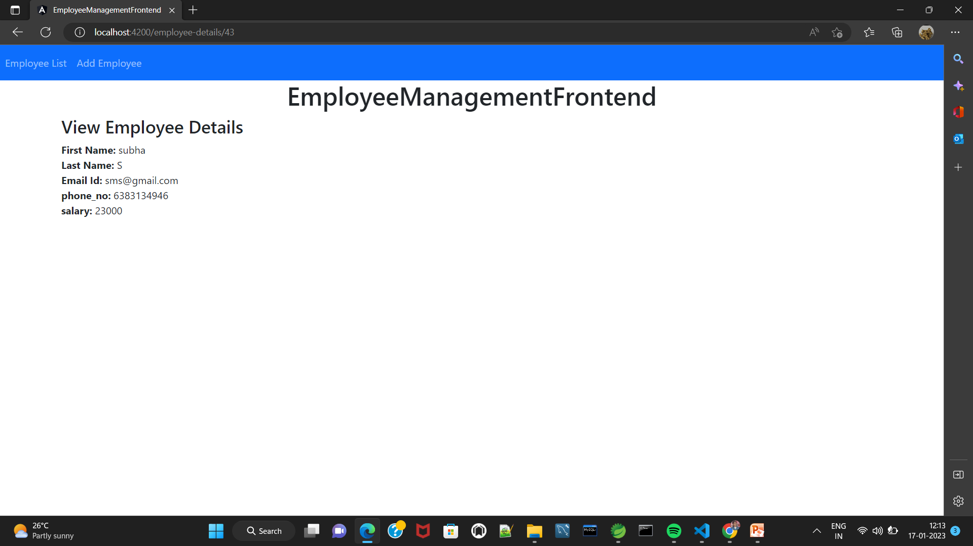
View employee

Slide 9
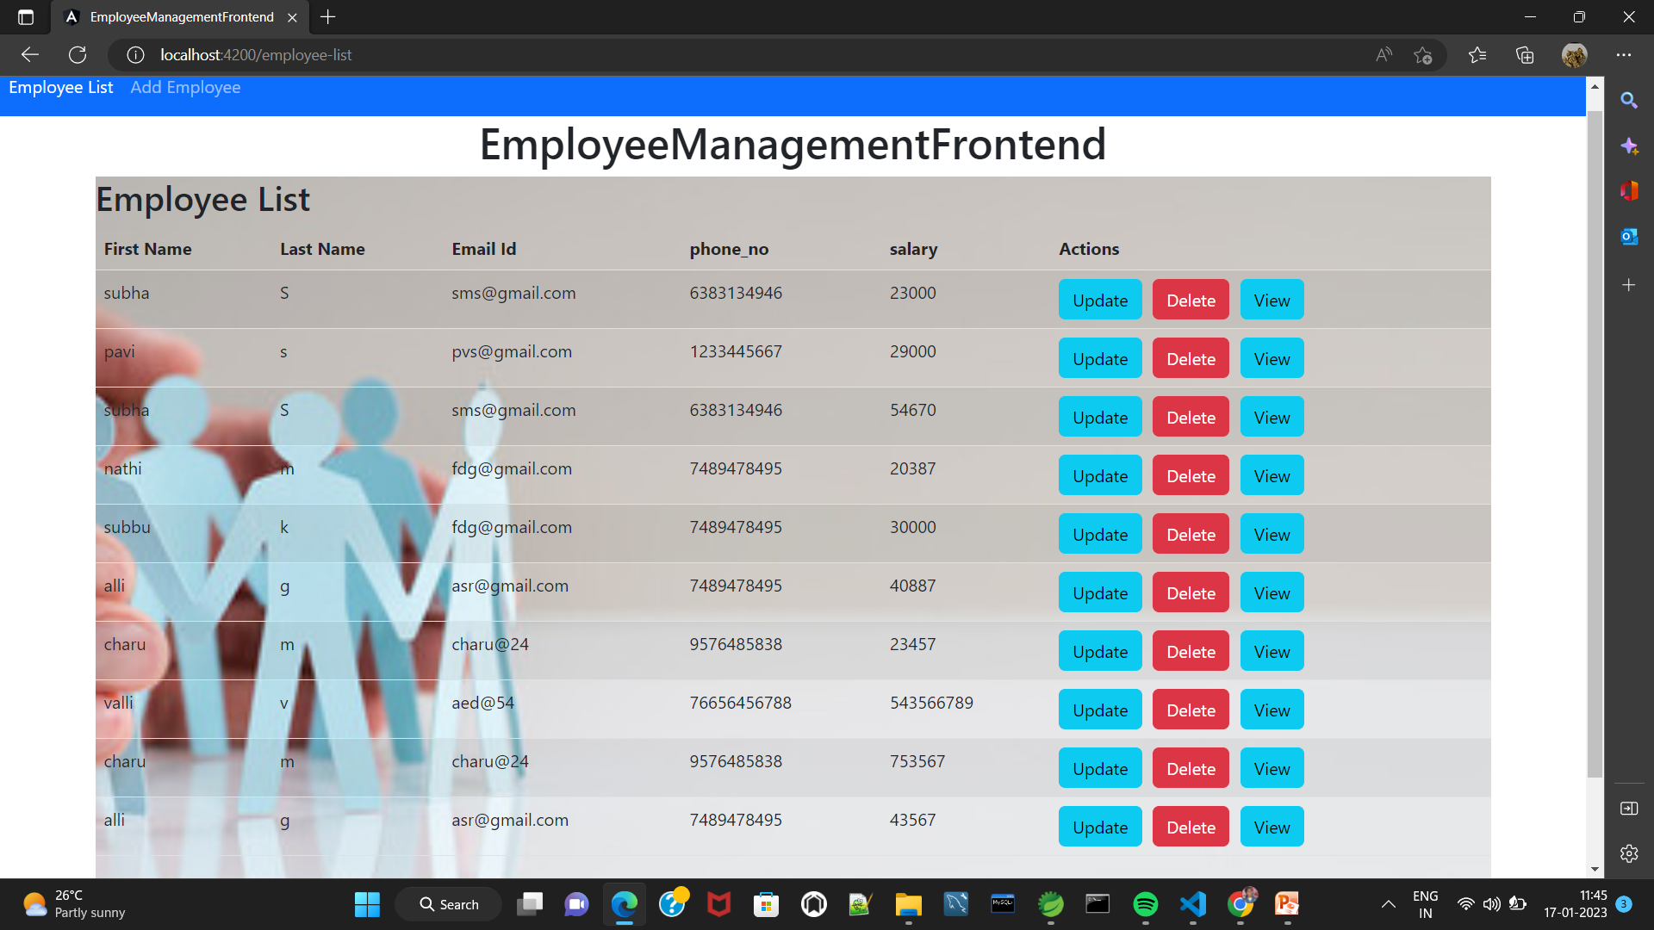
Employee list

Slide 10


