Slide 1
MARKET BASED INSIGHTS

Slide 2
PROBLEM STATEMENT
Market Basket Insights, often referred to as Market Basket Analysis (MBA) or Association Rule Mining, is a data mining and analytics technique used in retail and e-commerce to uncover relationships between products that are frequently purchased together by customers. The goal of Market Basket Insights is to understand customer behavior, increase sales, and improve marketing strategies by identifying patterns and associations in transaction data. In a retail or e-commerce setting, businesses want to gain insights into customer purchasing behavior to optimize their operations and marketing efforts

Slide 3
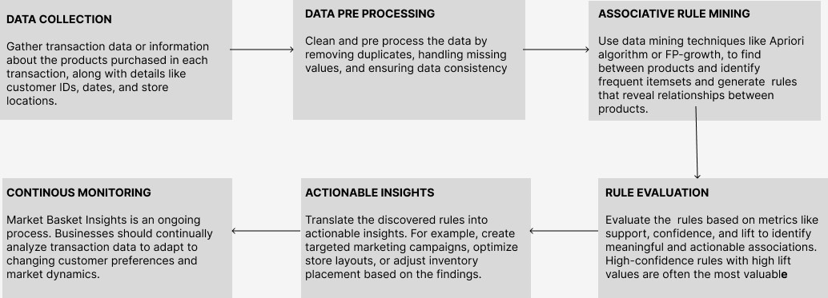
FLOW CHART

Slide 4
THANK YOU

