Slide 1
Catalan FPL Predictor: A Hybrid Approach
Combating Cognitive Bias with Machine Learning & Expert Systems
Student Name: Subanta Poudel
ID: 20048736
Module : CU6051NP Artificial Intelligence

Slide 2
The Problem
Goal: Explain why you built this.
The Context: Fantasy Premier League (FPL) has 11M+ players globally.
The Problem: Human decision-making is flawed by Cognitive Biases:
Recency Bias: "He scored last week, so he must be good."
Club Bias: Overvaluing players from supported teams.
The Objective: Create a Rational AI Agent that predicts points based purely on data, not emotion.

Slide 3
Methodology
Algorithm Selected: Multiple Linear Regression.
Why Regression? We are predicting a continuous variable (Points), not a category (Win/Loss).
Evidence from Research:
Exploratory Data Analysis (EDA) showed a linear relationship between Form and Points.
Correlation: ICT Index had a strong positive correlation (0.25) with points.
The limitation: Pure regression is "naive"—it assumes if a player is fit, they will play. Football doesn't work like that.

Slide 4
The Solution: Hybrid Architecture
Concept: Hybrid AI (Machine Learning + Rule-Based System).
Layer 1: The Statistical Base (ML)
Uses Linear Regression on historical data (75k+ rows).
Predicts Raw Performance Potential.
Layer 2: The Contextual Layer (Expert System)
Rotation Risk: Penalizes cheap attackers at big clubs (The "Semenyo Rule").
Fixture Difficulty: Boosts players vs. weak defenses (e.g., Southampton).
Starter Probability: Sigmoid curve penalizing players with <45 mins avg.

Slide 5
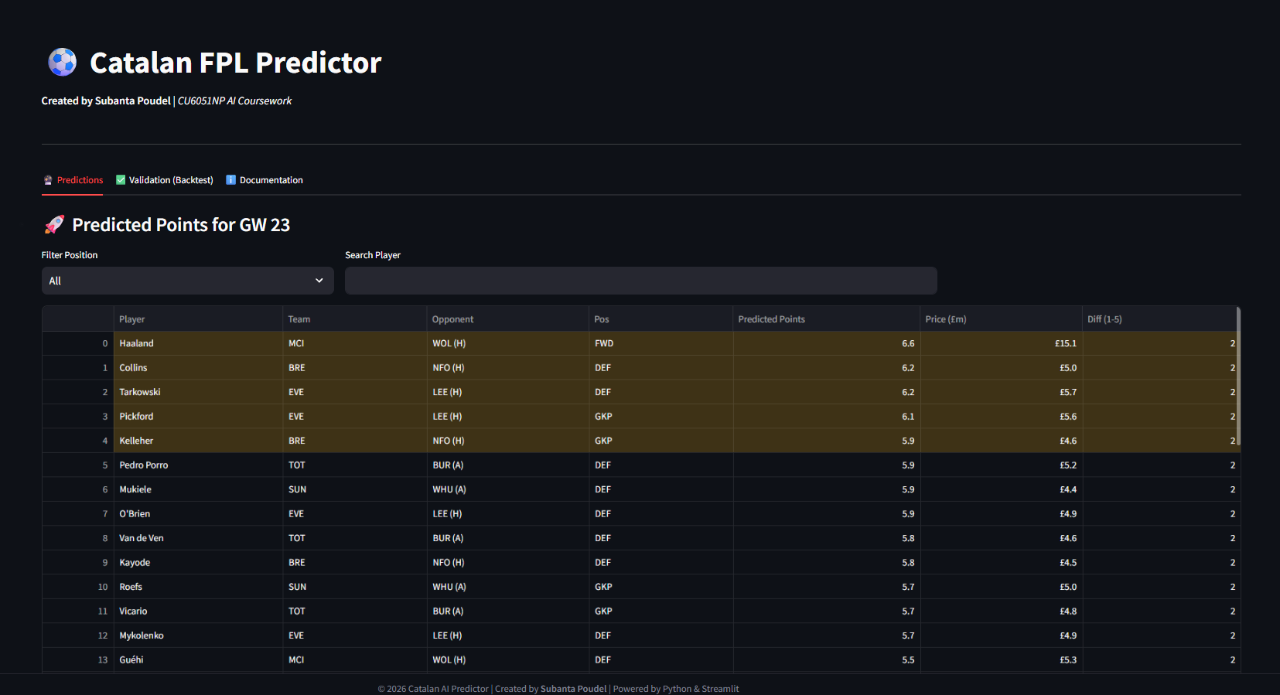
System Architecture
Input: Live FPL API (JSON).
Processing:
Data Loader: Fetches & Cleans data.
Intersection Merge: Unifies 2016-2024 data schemas.
Analysis:
Feature Engineering (Lagged Form, Rolling Averages).
Prediction Pipeline (Model + Expert Rules).
Output: Streamlit Dashboard.

Slide 6
PseudoCode
IF player.team in ["MCI", "ARS"] AND price < 9.0:
rotation_penalty = 0.75 # 25% Reduction
ELSE:
rotation_penalty = 1.0
Final_Score = (Base_Regression * Fixture_Multiplier) * rotation_penalty

Slide 7
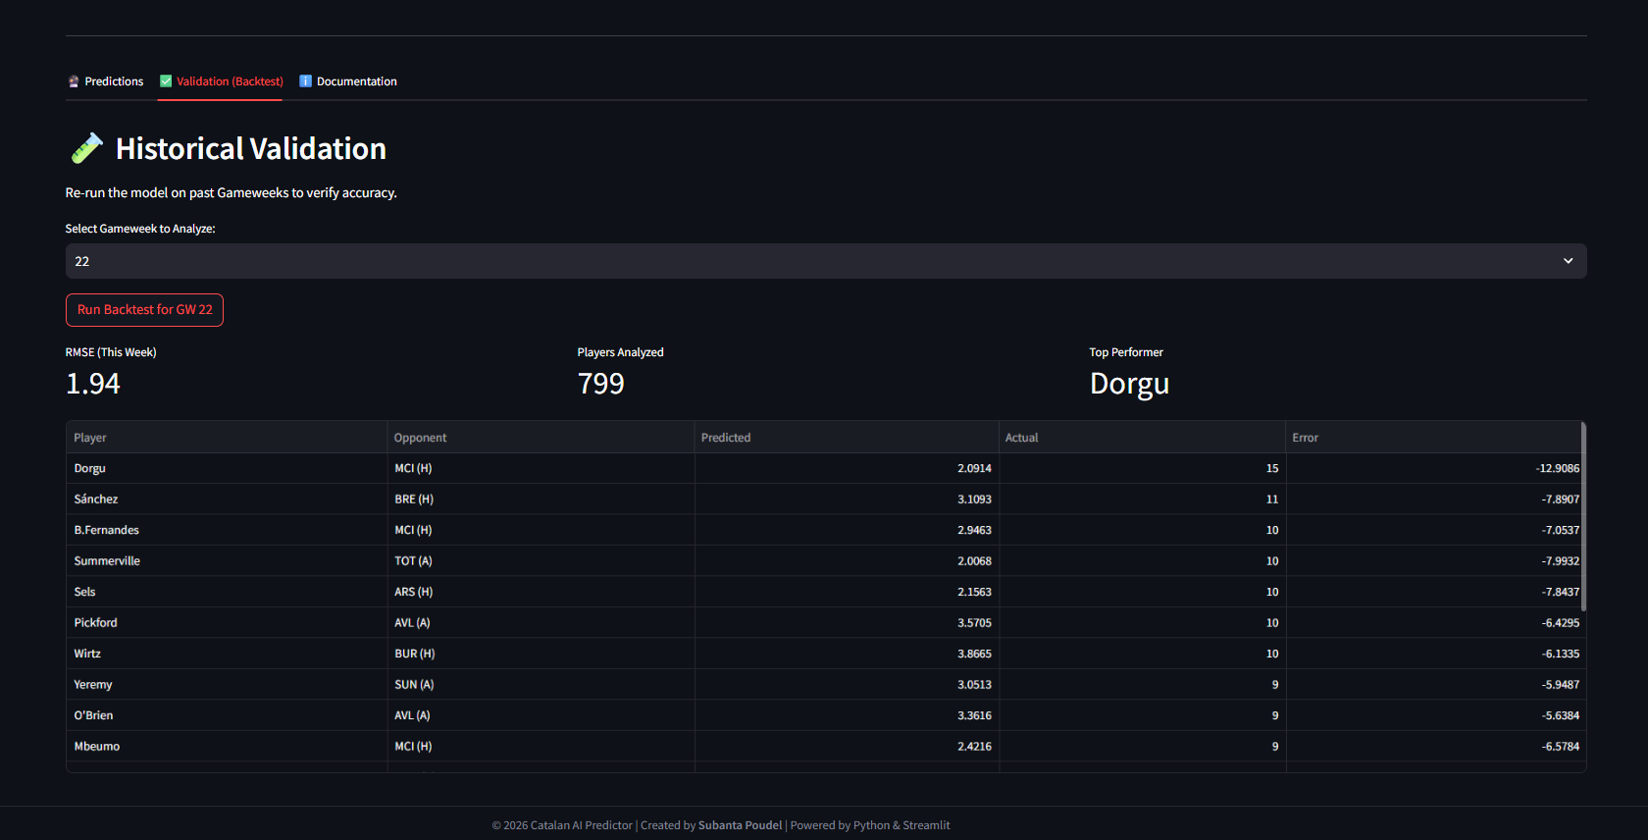
App Demonstration

Slide 8
Results
Success Metrics:
RMSE: ~2.16 (Competitive with paid tools).
Backtesting: Successfully identified "Hauls" (Haaland GW22) and "Flops" (Rotated players).
Limitations:
No Price Prediction: Cannot foresee market value changes.
Injury Lag: Relies on API flags; cannot read press conference news.
Linear Assumption: Cannot predict sudden "moments of magic" (Non-linear events)

Slide 9
Future Work
NLP Integration: Scrape Twitter/Reddit for early injury news before the official API updates.
Neural Networks: Use LSTMs (Long Short-Term Memory) to track player form sequences better than simple rolling averages.
Optimization Algorithm: Add a "Knapsack Problem" solver to automatically pick the best full squad within the £100m budget.

