Slide 1
FOODIE

Slide 2
MODULES
Insert
Add Customers, Add Hotel, Add Menu, Add Orders
Delete
Delete Hotels, Delete Menu, Delete Orders
Update
Update Orders, Pay, Update Customer Wallet
View
View Customers, View Hotels, View Menu
Search
Search Menu

Slide 3
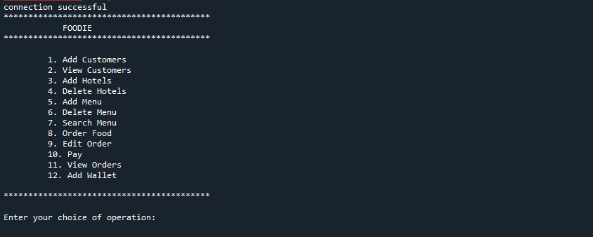
MODULES

Slide 4
TABLES
Customers
Phone_no, Name, Address, wallet
Hotels
Hotel_id, Hotel_name, Phone_no, Address,wallet
Menu
Menu_id, Menu_name, Type, Category, Price, Hotel_id
Order
Order_id, Menu_id, Hotel_id, Phone_no, Qty, Amt, Pay_status, Date

Slide 5
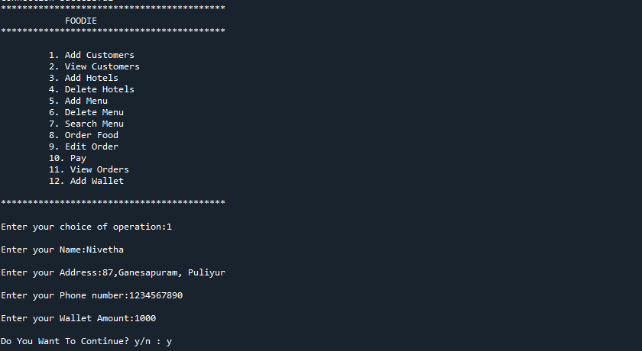

Slide 6
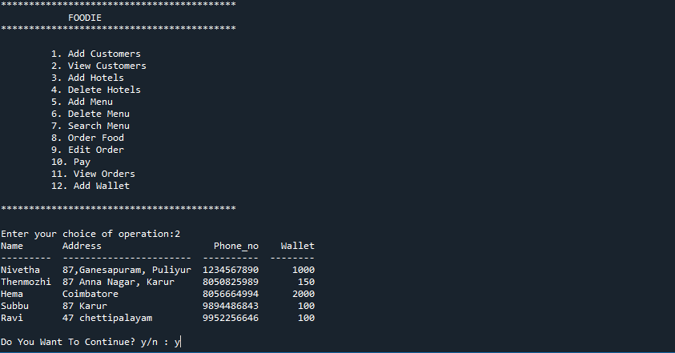

Slide 7
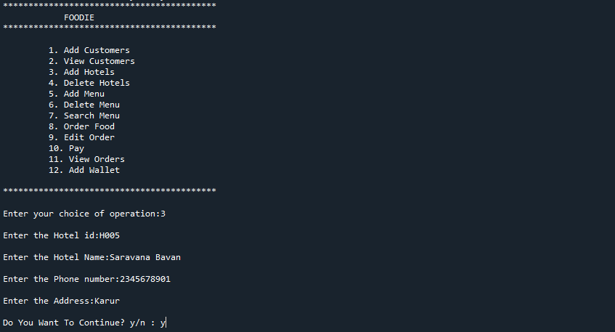

Slide 8
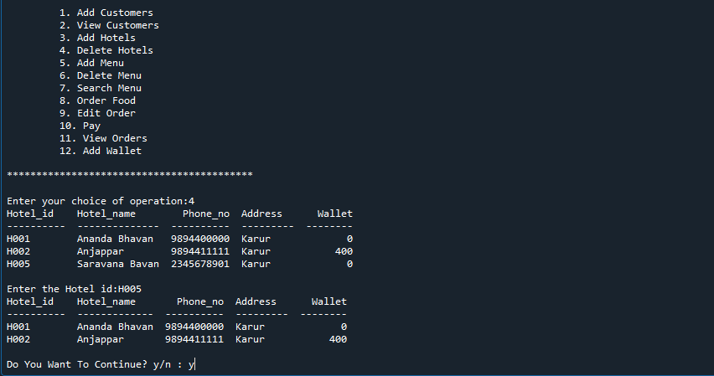

Slide 9
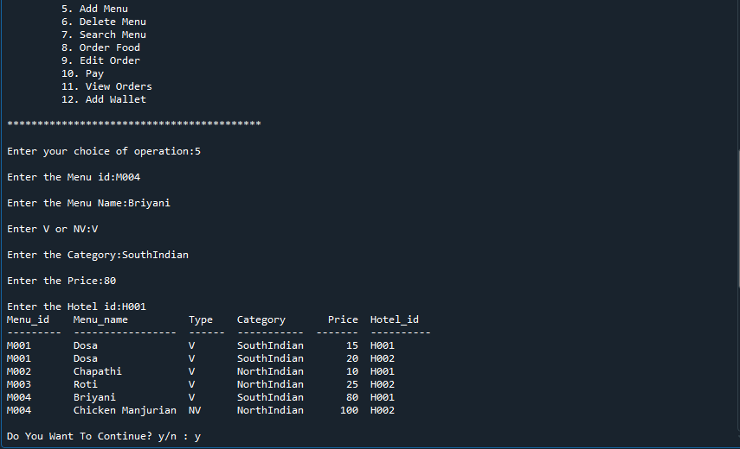

Slide 10
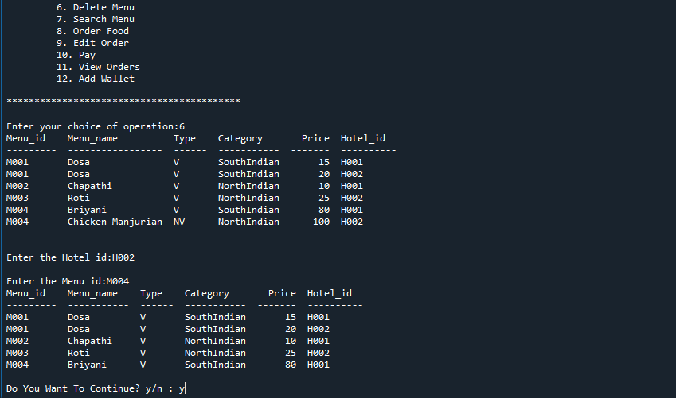

Slide 11
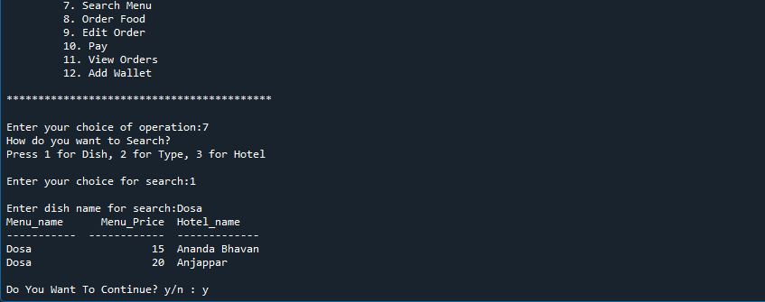

Slide 12
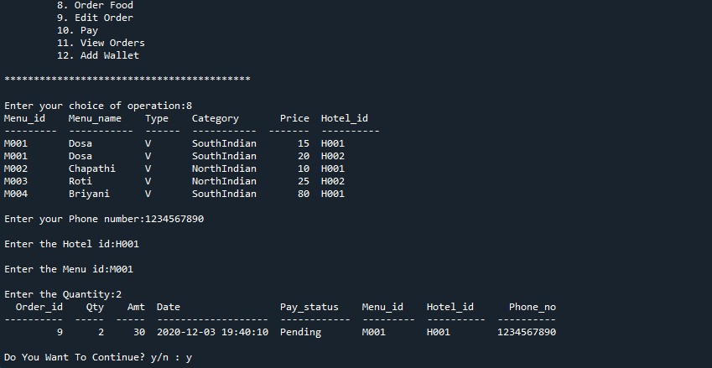

Slide 13
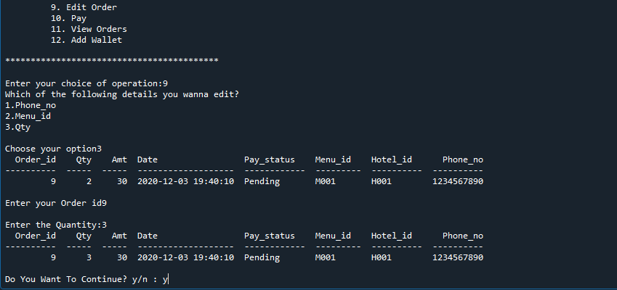

Slide 14
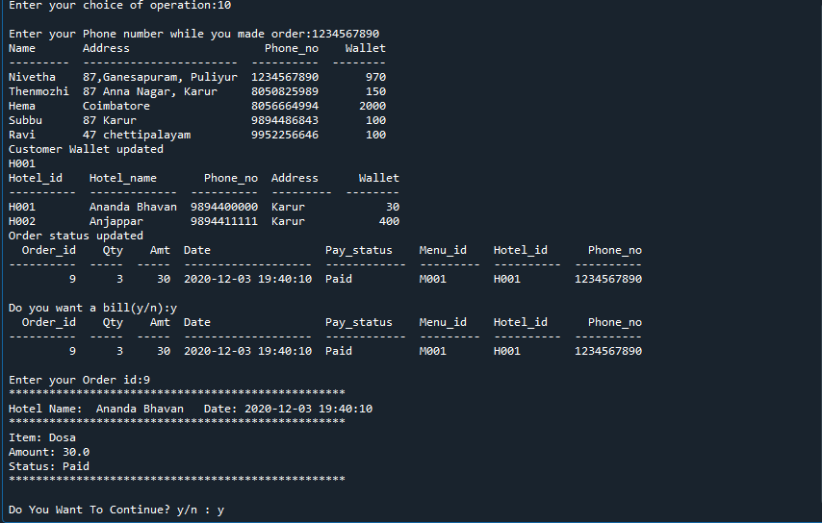

Slide 15
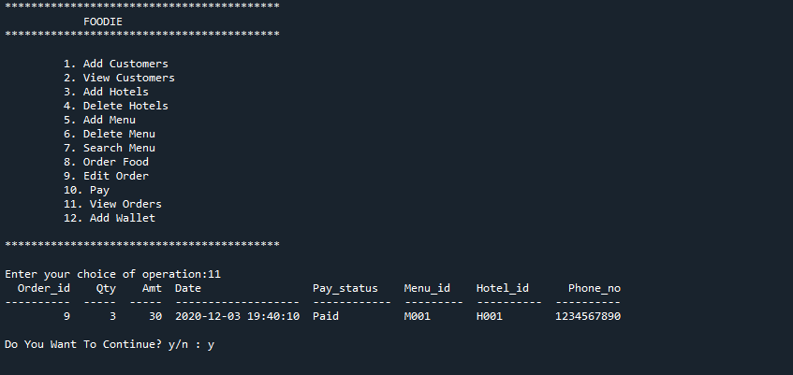

Slide 16
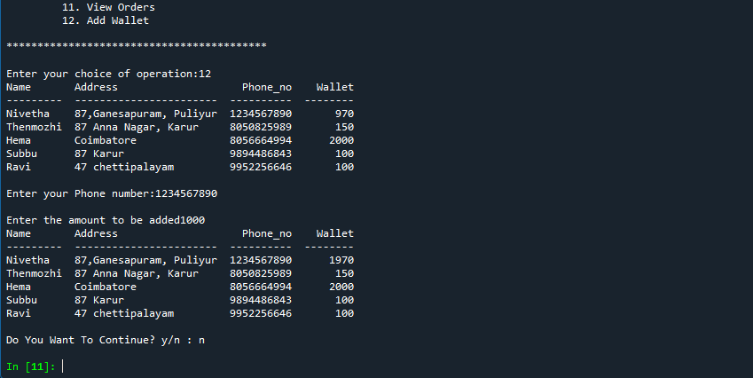

Slide 17
THANK YOU

