Slide 1

FOODIE

Slide 2
MODULES
Insert
  Add Customers, Add Hotel, Add Menu, Add Orders
Delete
  Delete Hotels, Delete Menu, Delete Orders
Update
  Update Orders, Pay, Update Customer Wallet
View
  View Customers, View Hotels, View Menu
Search
  Search Menu

Slide 3
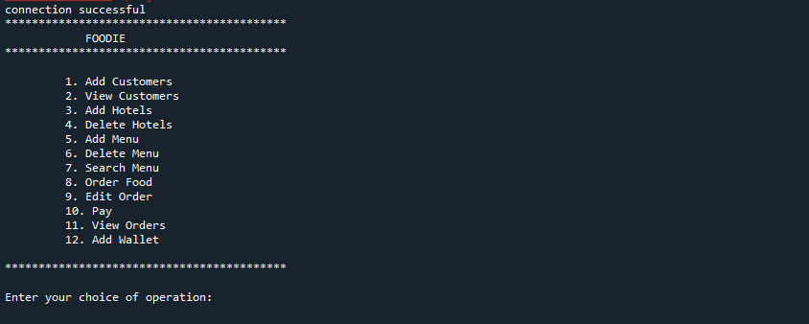
MODULES

Slide 4
TABLES
Customers
  Phone_no, Name, Address, wallet
Hotels
  Hotel_id, Hotel_name, Phone_no, Address,wallet
Menu
  Menu_id, Menu_name, Type, Category, Price, Hotel_id
Order
  Order_id, Menu_id, Hotel_id, Phone_no, Qty, Amt, Pay_status, Date

Slide 5
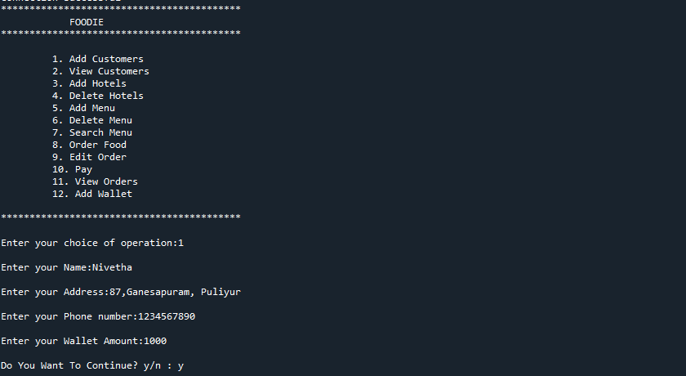

Slide 6
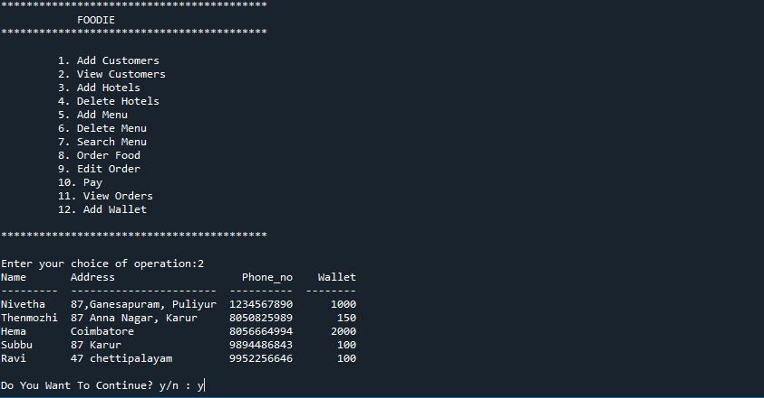

Slide 7
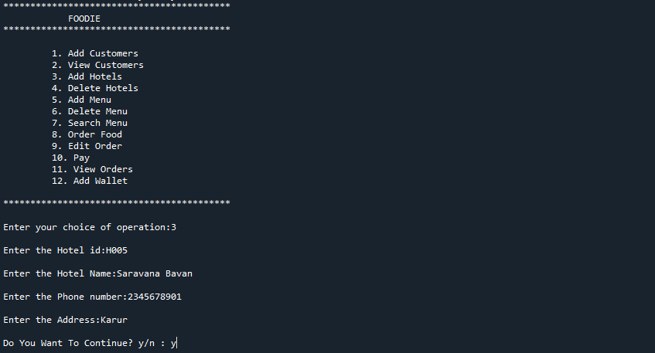

Slide 8
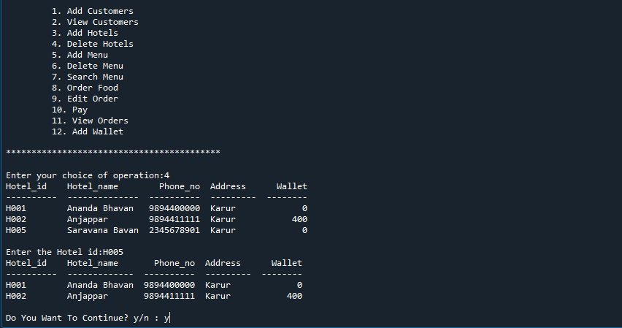

Slide 9
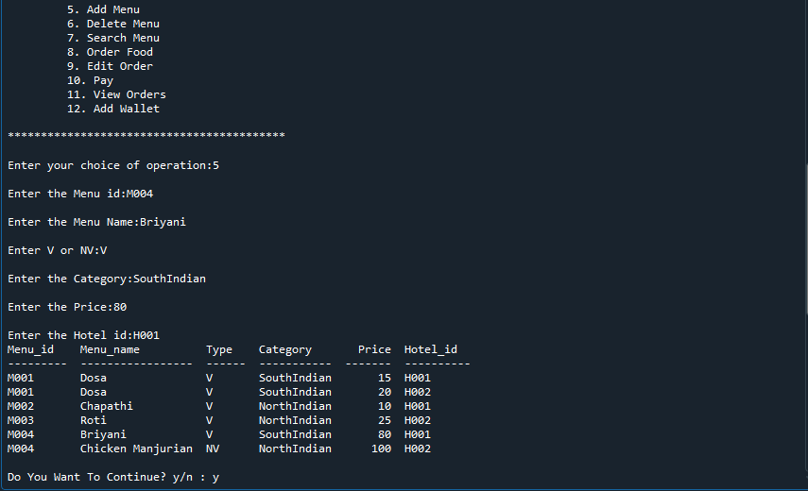

Slide 10
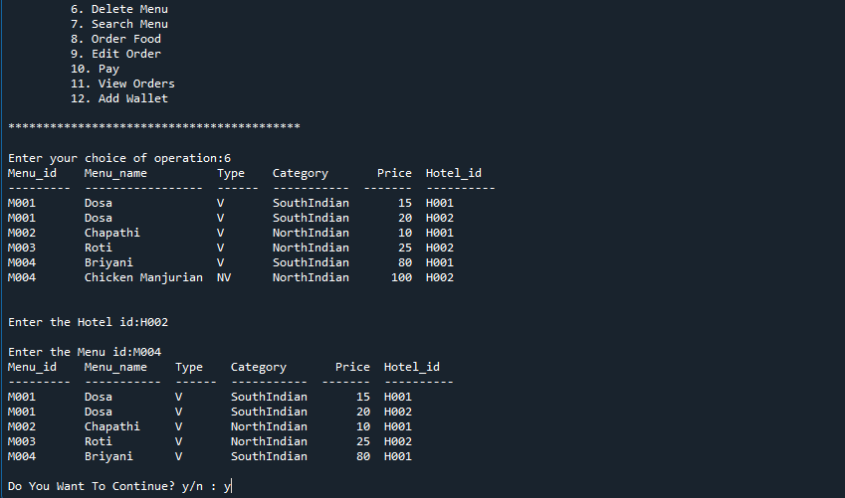

Slide 11
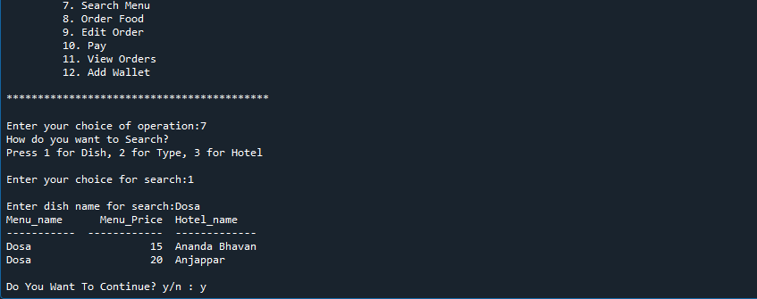

Slide 12
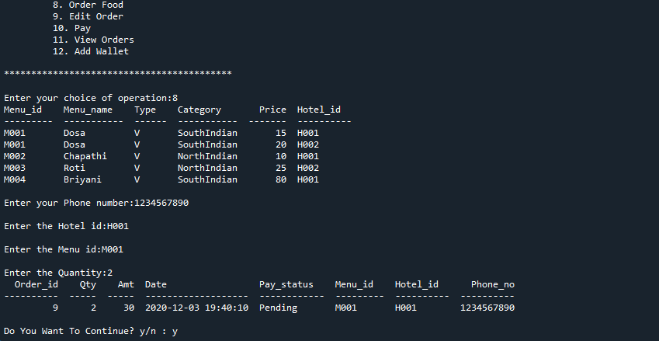

Slide 13
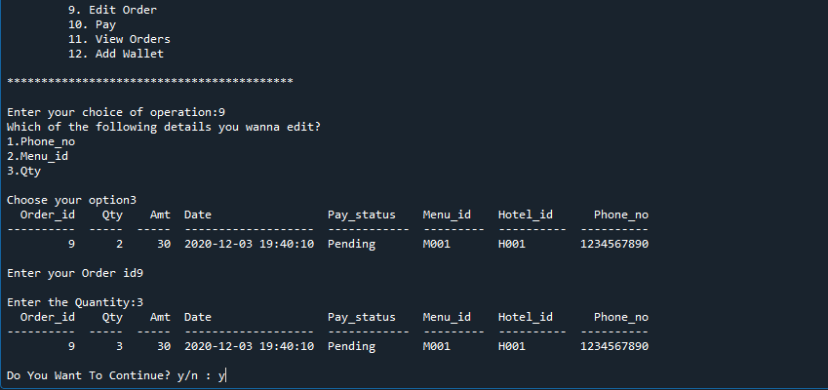

Slide 14
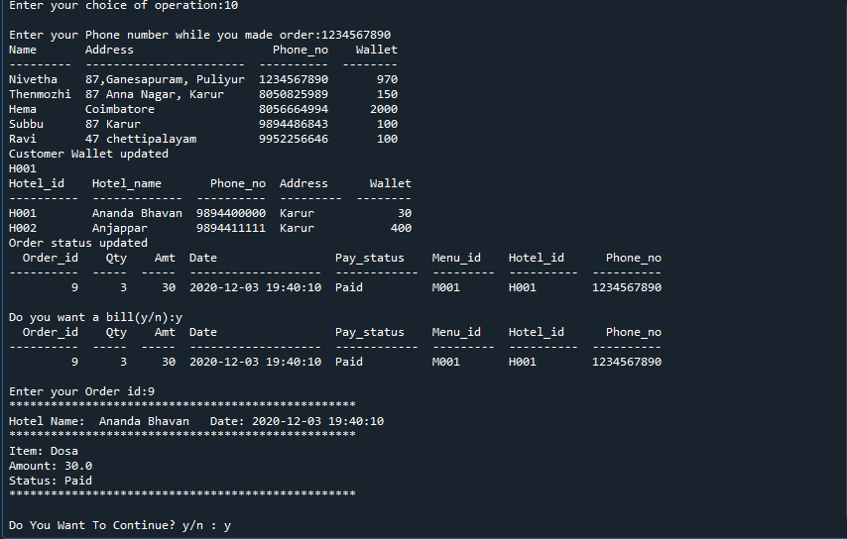

Slide 15
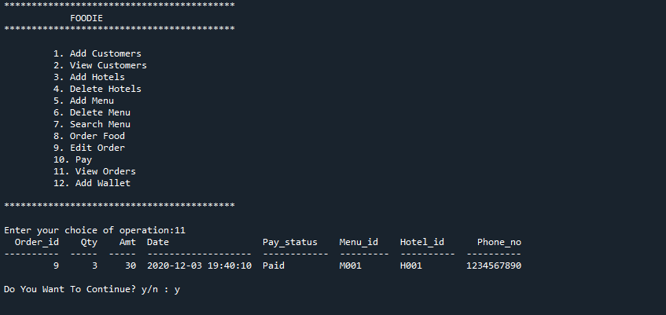

Slide 16
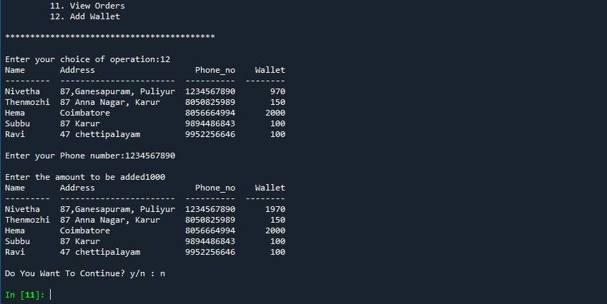

Slide 17
THANK YOU

