Slide 1
Automation Testing

Slide 2
Curriculum
Why Automation?
Scope Of Automation
Tools & IDE
Testing Framework
Scripting Language
Hands-on
Jobs

Slide 3
(Why Automation?)
To reduce the day to day activity effort.
To minimize the effort for repetitive task.
Speed up the customer deliveries.
Reducing the risk of human error in common daily task.

Slide 4
Scope Of Automation
API Automation → System Testing
Web Automation → GUI Testing

Slide 5
Tools & IDE(Integrated development environment)
Postman
Py charm
Visual Studio Code
Ubuntu

Slide 6
Testing Frameworks
Robot Framework
Python Framework

Slide 7
Scripting Language
Json Scripting
Shells Scripting
Python Scripting

Slide 8

Hands-on

Slide 9
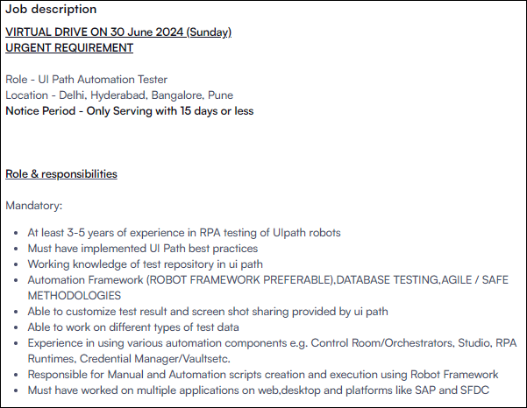
Jobs

Slide 10
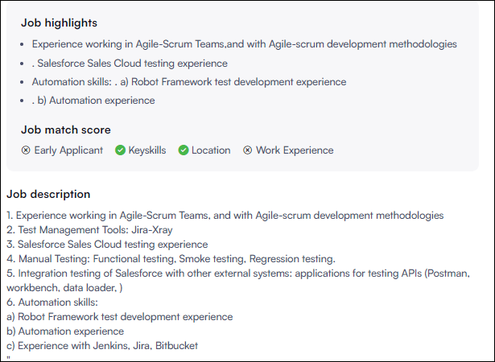

Slide 11
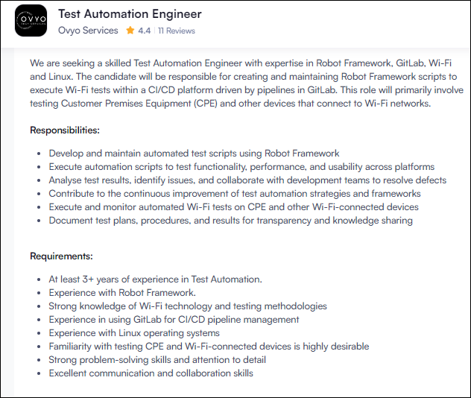

Slide 12
