Slide 1
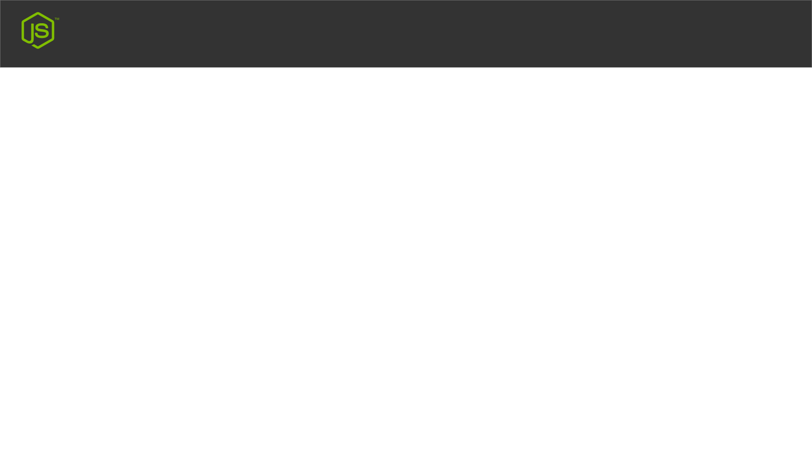
Terminal
TOOLS
Node.js
VS Code
Webstrome
TERMINAL
Windows CMD
Windows PowerShell
VS Code Terminal Option
Webstrom Terminal
Node js Terminal

