Slide 1

Node.js Module
What is module?

Slide 2
Node.js Module
Module in Node.js is a simple / complex functionality organized in
single or multiple JavaScript files.
Node.js includes three types of modules:
Core Modules
Local Modules
Third Party Modules

Slide 3
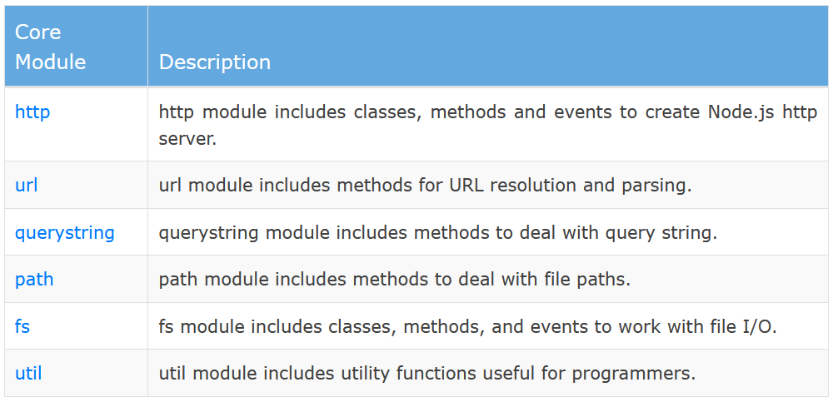
Node.js Core Module

