Slide 1
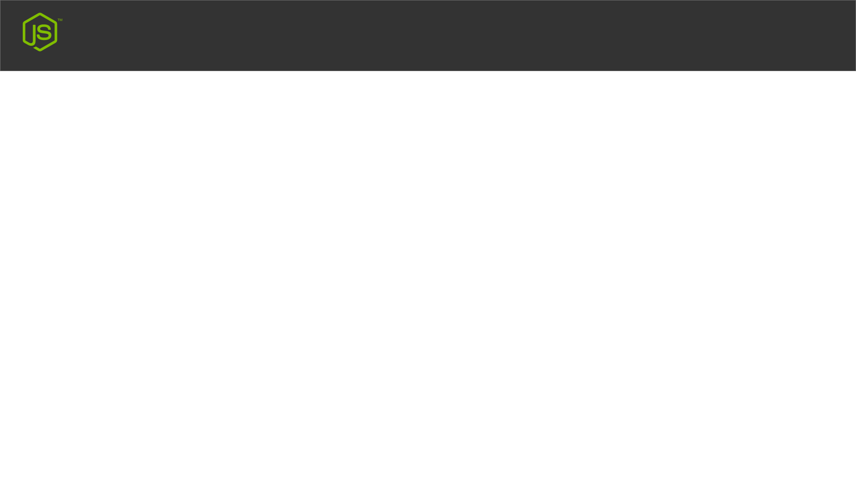
Node.js URL Module
Built-in URL Module
The URL module splits up a web address into readable parts.
http://rabbil.com/blog.html?year=2020&month=july;

