Slide 1
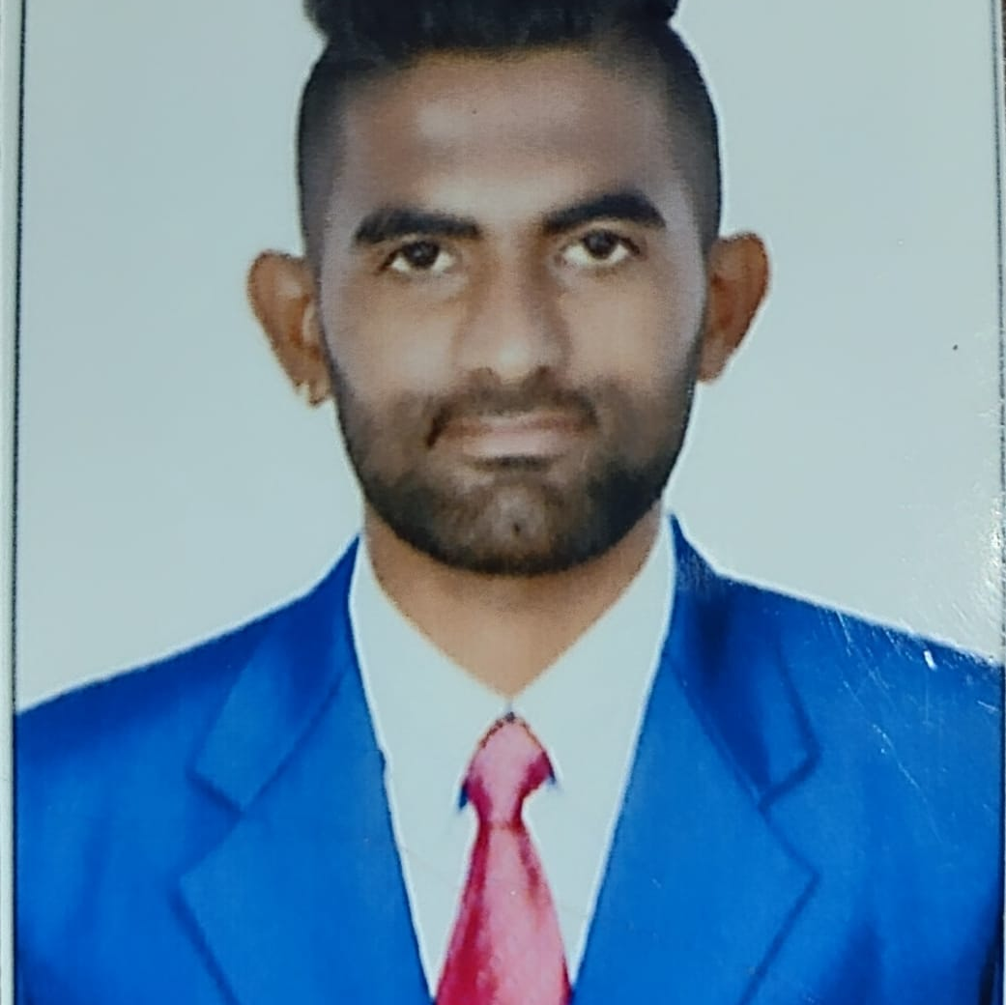



PRAJWAL S
Analyst/Software Engineer
Bachelor of Engineering
Computer Science: 2016- 2020
Skills Java 8 /J2EE
Spring Boot
Spring MVC
JPA CRUD
Bootstrap
Backend
Spring Boot
Hibernate
REST-API
Database
SQL database – MySQL,
Postgres SQL
Web Technologies
HTML5
CSS3
JavaScript
Bootstrap
AddOns
Maven
Postman
Additional Details
Leadership
Good Communication Skills
Team management
Bangalore
xxxxxxxxxx@capgemini.com
+91 xxxxxxx716
A4
Full Stack Developer
Hands on experience in developing web pages using HTML5, CSS3, Object Oriented Java script, ES6, JSON, XML.
Eager to work in a team of dedicated people and serve a key role in the enhancement and development of the project.
Has working knowledge on ReactJS , Java Microservice Development using Spring framework on an intermediate level.
Software Engineer who is Strong in design and integration with intuitive problem-solving skills. Passionate about implementing and launching new projects.
Online Sweet Shop
Completed end to end case study of Online Sweet Shop along with Postman Authentication.Material-UI and React Bootstrap used for user interface.
SENTIMENT ANALYSIS OF BILLING SWEETS
Where Customers can visit online sweet shop through online.
After Adding products to cart ,they can view the bill of
sweet products with price .
They will be prompted the payment type
By selecting the type pf payment
They can pay through online Itself
Check out my work on GitHub & Video Profile

