Slide 1
AMBA AXI4
FPGA design of AMBA AXI4 protocol for SOC
Guide:s.sridhar m.tech

Slide 2
Batch members
Y11ece118019 Ch.Harish
Y11ece118020 D.Rajeswari
Y11ece118026 E.Vasavi
Y11ece118027 E.Subashchandra
Y11ece118049 K.Rajeskhar

Slide 3
Content
Purpose of the project
AXI protocol
Introduction
AXI architecture
AXI components and topology
Block diagram
AXI3 vs. AXI4
Hardware and Software specifications
Conclusion

Slide 4
Purpose of the project
Building a generic Soc bus protocol that can be Used on any SOC.
A system on a chip (SOC) is an integrated circuit (IC) that integrates all components of a computer or other electronic system into a single chip.

Slide 5
A typical SOC consists of:
A processor core
on chip memory blocks
controller unit for offchip memories
peripherals like: Timer
External interfacing units like: USB, Ethernet, UART..
Finally A bus – To connects these blocks
standard Bus Protocols
AHB, AXI3, AXI4 from ARM
Wishbone - OpenCore
Avlon - NIOS II Processor

Slide 6
General Bus Requirements:
Provide device identification mechanism by address mapping
Provide Single Read/Write Channels
Provide Arbitration by "Request - Grant" if required

Slide 7
A Good Bus Protocol Also Provides:
Burst Mode
Device is transmitting data repeatedly without going through all the steps required to transmit each piece of data in a separate transaction.
Out of Order
Faster devices don't have to wait for slower devices. Are transactions that are ready need not wait for the uncompleted transaction that are pending.

Slide 8
AXI protocol
The AMBA AXI protocol supports high-performance, high-frequency system designs.
The AXI protocol:
• is suitable for high-bandwidth and low-latency designs
• provides high-frequency operation without using complex bridges
• meets the interface requirements of a wide range of components
• is suitable for memory controllers with high initial access latency

Slide 9
AXI Protocol supports
The key features of the AXI protocol are:
• separate address/control and data phases
• support for unaligned data transfers, using byte strobes
• uses burst-based transactions with only the start address issued
• separate read and write data channels, that can provide low-cost Direct Memory Access (DMA)
• support for issuing multiple outstanding addresses
• support for out-of-order transaction completion

Slide 10
Introduction
The AXI4 protocol is an update to AXI3 which is designed to enhance the performance and utilization of the interconnect when used by multiple masters. It includes the following enhancements:
Support for burst lengths up to 256 beats
Quality of Service signaling
Support for multiple region interfaces

Slide 11
AXI Architecture
The AXI protocol is burst-based and defines the following independent transaction channels:
• read address
• read data
• write address
• write data
• write response.

Slide 12
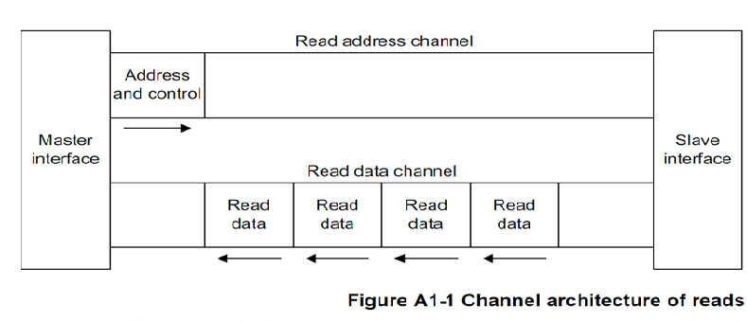
Channel architecture of reads

Slide 13
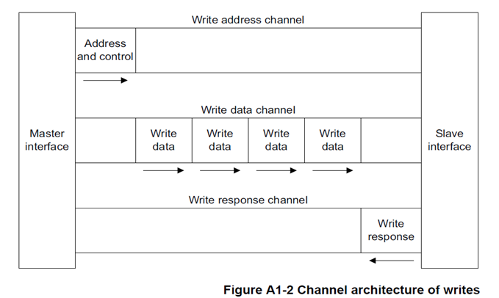
Channel architecture of writes

Slide 14
Channel definition
Each of the independent channels consists of a set of information signals and VALID and READY signals that
provide a two-way handshake mechanism.

Slide 15
Read data channel
The read data channel carries both the read data and the read response information from the slave to the master, and includes:
• the data bus, that can be 8, 16, 32, 64, 128, 256, 512, or 1024 bits wide
• a read response signal indicating the completion status of the read transaction.

Slide 16
Write data channel
The write data channel carries the write data from the master to the slave and includes:
• the data bus, that can be 8, 16, 32, 64, 128, 256, 512, or 1024 bits wide
• a byte lane strobe signal for every eight data bits, indicating which bytes of the data are valid.

Slide 17
Write response channel
A slave uses the write response channel to respond to write transactions. All write transactions require completion
signaling on the write response channel.

Slide 18
AXI components and topology
The following terms describe AXI components:
• Component.
• Master component.
• Slave component. Slave components include Memory slave components and Peripheral slave components.
• Interconnect component.

Slide 19
Master component
A component that initiates transactions.
It is possible that a single component can act as both a master component and as a slave component. For example,
a Direct Memory Access (DMA) component can be a master component when it is initiating transactions to move
data, and a slave component when it is being programmed.

Slide 20
Slave component
A component that receives transactions and responds to them.
It is possible that a single component can act as both a slave component and as a master component. For example,
a Direct Memory Access (DMA) component can be a slave component when it is being programmed and a master
component when it is initiating transactions to move data.

Slide 21
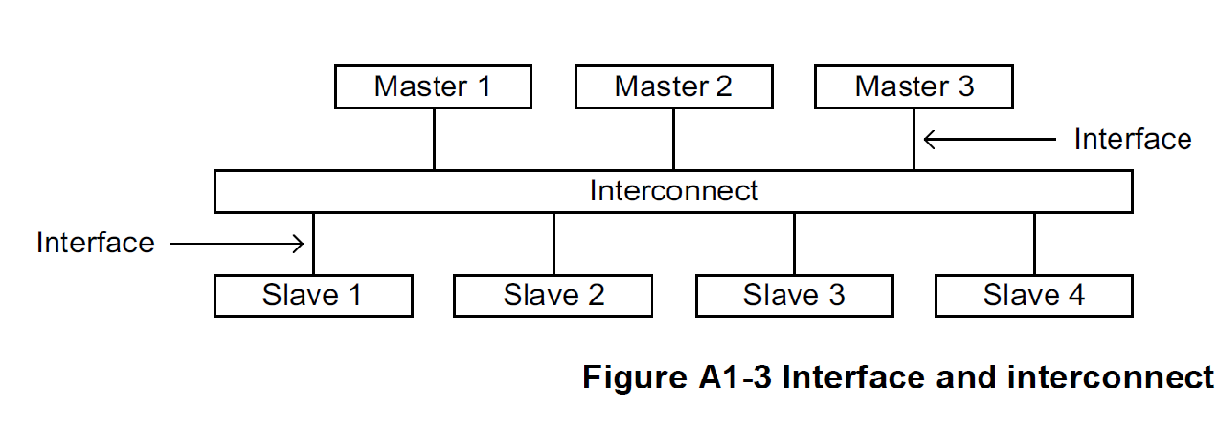
Interface and interconnect
A typical system consists of a number of master and slave devices connected together through some form of interconnect

Slide 22
Cont...
The AXI protocol provides a single interface definition, for the interfaces:
• between a master and the interconnect
• between a slave and the interconnect
• between a master and a slave.

Slide 23
AMBA AXI4 slave read/write block diagram
AXI4 slave test bench
Read Address
channel
Read Address
channel
AXI4 slave
Write/Read
Buffer
Pending Read address register
Read Address state machine
Write Address
channel
Write Address
channel
Pending Write address register
Write Address state machine
Read data
channel
Pending Write data register
Read data
channel
Write Address channel
Internal Read/Write Address and data channel signals
Read data state machine
Write address
channel
Write response channel
Write data state machine
Write response
channel

Slide 24
Cont..
The AXI4 slave consists of common read/ write buffer which stores the read/ write address and data.
This is a device which can hold a certain amount of information at once. The register will fill up completely and then pass on all this information at once.

Slide 25
Cont..
A buffer is a data area shared by hardware devicesor program processes that operate at different speeds or with different sets of priorities.
The buffer allows each device or process tooperatewithout being held up by the other. In order for a buffer to be effective, the size of the buffer and the algorithms for moving data into and out of the buffer need to be considered by the buffer designer.

Slide 26
Cont..
Pending read address register stores the remaining read addresses to be sent; pending write address register which stores the remaining write addresses to be sent and pending write data register which stores the remaining write data to be sent.

Slide 27
Cont..
In general, a state machine is any device that stores the status of something at a given time and can operate on input to change the status and/or cause an action or output to take place for any given change. A computer is basically a state machine and each machine instruction is input that changes one or more states and may cause other actions to take place. Each computer's data register stores a state. The read-only memory from which a boot program is loaded stores a state (the boot program itself is an initial state).

Slide 28
Cont..
The operating system is itself a state and each application that runs begins with some initial state that may change as it begins to handle input. Thus, at any moment in time, a computer system can be seen as a very complex set of states and each program in it as a state machine. In practice, however, state machines are used to develop and describe specific device or program interactions.

Slide 29
Cont..
To summarize it, a state machine can be described as:
An initial state or record of something stored someplace
A set of possible input events
A set of new states that may result from the input
A set of possible actions or output events that result from a new state

Slide 30
AXI3 Vs AXI4
AXI3 supports burst lengths up to 16 beats only. While AXI4 supports burst lengths of up to 256 beats.
2. AXI3 supports write interleaving. AXI4 does NOT support write interleaving
3. AXI3 supports locked transfers, AXI4 does NOT support locked transfers
4. AXI4 supports QoS, AXI3 does NOT support QoS.

Slide 31
Hard Ware Requirements
Cyclone II FPGA.
USB blaster FPGA programmer.
FPGA board with power circuit.

Slide 32
Software Requirement Specification
Altera Quartus II
ModelSim simulator

Slide 33
Conclusion

Slide 34
Thank you!

