Slide 1
The Java Message Service is a Java API that allows applications to create, send, receive, and read messages.
Designed by Sun and several partner companies, the JMS API defines a common set of interfaces that allow programs written in the Java programming language to communicate with other messaging implementations

Slide 2
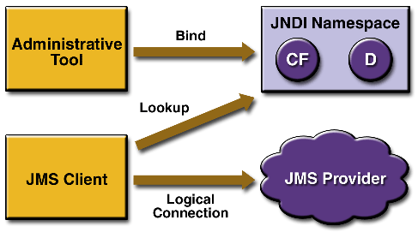
JMS Architecture

Slide 3
A JMS application is composed of the following parts :
JMS Provider : messaging system that implements the JMS interfaces and provides administrative and control features

Slide 4
JMS clients are the programs or components, written in the JavaTM programming language, that produce and consume messages
Messages are the objects that communicate information between JMS clients

Slide 5
Administered objects are preconfigured JMS objects created by an administrator for the use of clients.
The two kinds of administered objects:
Destinations
Connection factories

Slide 6
Administrative tools allow you to bind destinations and connection factories into a Java Naming and Directory InterfaceTM (JNDI) API namespace.
A JMS client can then look up the administered objects in the namespace and then establish a logical connection to the same objects through the JMS provider

Slide 7
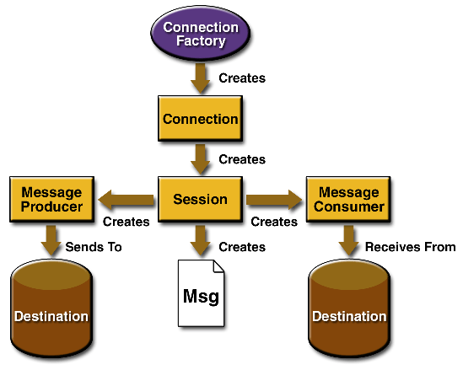

Slide 8
Administrative objects :
Connection Factories :
A connection factory is the object a client uses to create a connection with a provider.
A connection factory encapsulates a set of connection configuration parameters that has been defined by an administrator

Slide 9
Destinations :
A destination is the object a client uses to specify the target of messages it produces and the source of messages it consumes.
In the PTP messaging domain, destinations are called queues . A JMS application may use multiple queues

Slide 10
Connections :
A connection encapsulates a virtual connection with a JMS provider. A connection could represent an open TCP/IP socket between a client and a provider service daemon. You use a connection to create one or more sessions

Slide 11
When an application completes, you need to close any connections that you have created. Failure to close a connection can cause resources not to be released by the JMS provider. Closing a connection also closes its sessions and their message producers and message consumers

Slide 12
Session :
A session is a single-threaded context for producing and consuming messages.
You use sessions to create message producers, message consumers, and messages.

Slide 13
Message Producers :
A message producer is an object created by a session and is used for sending messages to a destination
Message Consumers :
A message consumer is an object created by a session and is used for receiving messages sent to a destination.

Slide 14
Message Listeners :
A message listener is an object that acts as an asynchronous event handler for messages.
This object implements the MessageListener interface, which contains one method, onMessage.
In the onMessage method, you define the actions to be taken when a message arrives.

Slide 15
Message Selectors :
If your messaging application needs to filter the messages it receives, you can use a JMS API message selector, which allows a message consumer to specify the messages it is interested in
Messages :
The ultimate purpose of a JMS application is to produce and to consume messages that can then be used by other software applications.

Slide 16
A JMS message has three parts:
Message Headers :
A JMS message header contains a number of predefined fields that contain values that both clients and providers use to identify and to route messages.
For example, every message has a unique identifier, represented in the header field JMSMessageID.

Slide 17
Message Properties :
You can create and set properties for messages if you need values in addition to those provided by the header fields
Message Bodies :
The JMS API defines five message body formats, also called message types, which allow you to send and to receive data in many different forms
Ex : TextMessage, BytesMessage

Slide 18
J2EE Application with Queue process
An application client that sends several messages to a queue
A message-driven bean that asynchronously receives and processes the messages

Slide 19
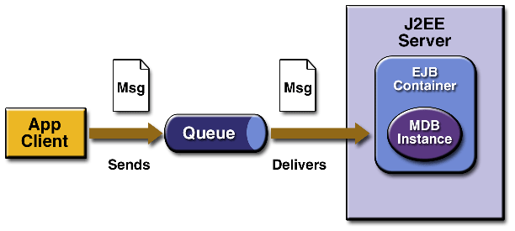

Slide 20
The application client sends messages to the queue, which is created administratively
the J2EE server--delivers the messages to the message-driven bean instances, which then process the messages

Slide 21
Application Client: SimpleClient.java
The application client class, SimpleClient.java, is almost identical to SimpleQueueSender.java.
The only significant differences are as follows :

Slide 22
You do not specify the queue name on the command line. Instead, the client obtains the queue name through a JavaTM Naming and Directory InterfaceTM (JNDI) API lookup.
You do not specify the number of messages on the command line; the number of messages is set at 3 for simplicity, and no end-of-messages message is sent.

Slide 23
The message-driven bean class, MessageBean.java, implements the methods setMessageDrivenContext, ejbCreate, onMessage, and ejbRemove.
The onMessage method, almost identical to that of TextListener.java, casts the incoming message to a TextMessage and displays the text.

Slide 24
The only significant difference is that it calls the message DrivenContext.setRollbackOnly method in case of an exception.
This method rolls back the transaction so that the message will be redelivered.

