Slide 1
H2O Utilities Part 1 – E-Learning Course
Notes:
Welcome to the H2O utilities Part 1 Elearning Course

Slide 2
Course Objectives
At the end of this course, you will be able to
List the H2O utilities
Describe CommonProperties and its usage
Describe Log4debug and its usage
Describe MessageManager and its usage
Describe LogServer and its usage
Describe DataSource Factory and its usage
H2O Utilities Part 1
Notes:
Course Objectives
At the end of this course, you will be able to
List the H2O utilities
Describe log4debug and its usage
Describe CommonProperties and its usage
Describe MessageManager and its usage
Describe LogServer and its usage
Describe DataSource Factory and its usage

Slide 3
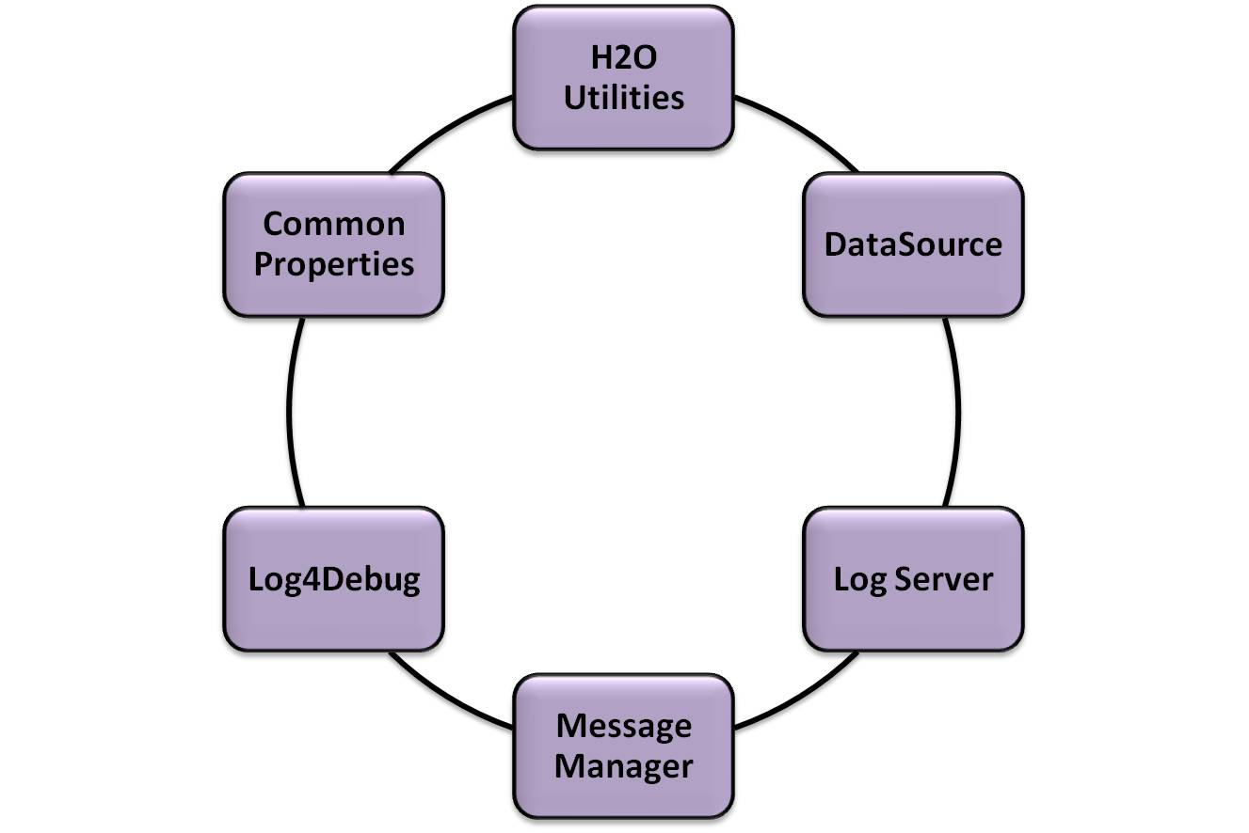
Course Outline
H2O Utilities Part 1
Notes:
Course Outline
Lesson 1: H2O Utilities
Lesson 2: Common Properties
Lesson 3: Log4Debug
Lesson 4: Message Manager
Lesson 5: LogServer
Lesson 6: DataSource

Slide 4


Lets Start Learning H2O Utilities
H2O Utilities Part 1
Notes:
Lets start learning now!

Slide 5
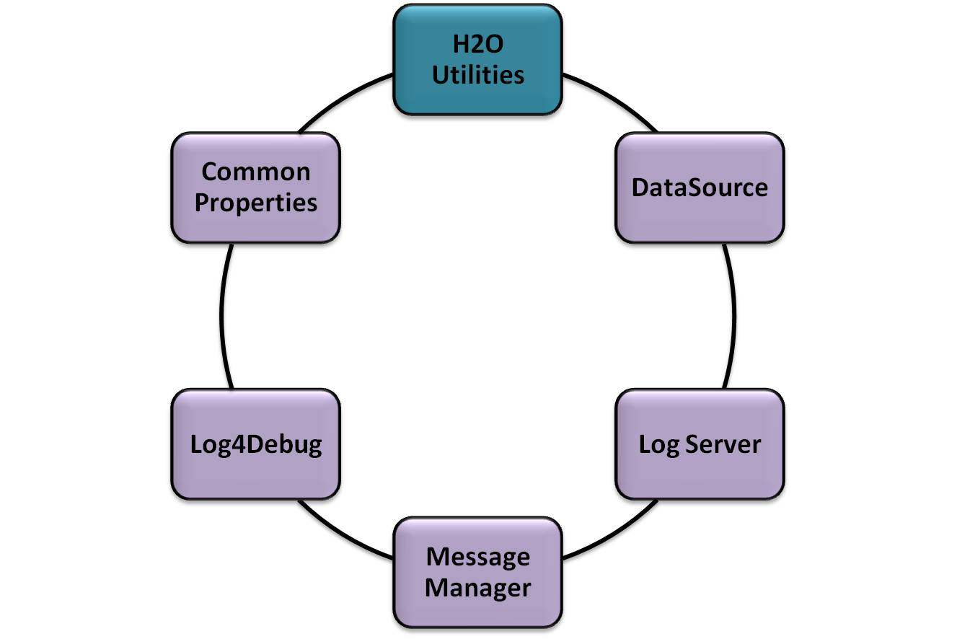
H2O Utilities
H2O Utilities Part 1
Notes:
Welcome to Lesson 01: About H2O Utilities

Slide 6




H2O Utilities
What is H2O utilities?
List the different H2O Utilities
What is H2O Utility?
H20 Utilities Part 1
Notes:
In this lesson, we are going to learn about
What is H2O utilities?
List the different H2O Utilities

Slide 7
1. What is H2O utility?
H2O Utilities are a collection of small Java APIs
These utilities can be used across H2O Applications.
The main objective of H2O Utilities is, code reusability
H20 Utilities Part 1
Notes:
What is H2O utility?
H2O Utilities are a collection of small Java APIs
These utilities can be used across H2O Applications.
The main objective of H2O Utilities is, code reusability

Slide 8
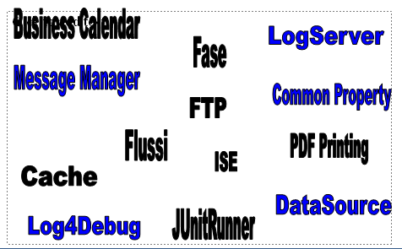
2. List the different H2O Utilities
H20 Utilities Part 1
Notes:
Different utilities available in H2O are
Business Calendar
Cache
CommonProperties
DataSourceFactory
Fase
Flussi
FTP Classes
ISE
JMapper
JunitRunner
Log Server
Log4Debug
Message Manager
PDF Printing

Slide 9
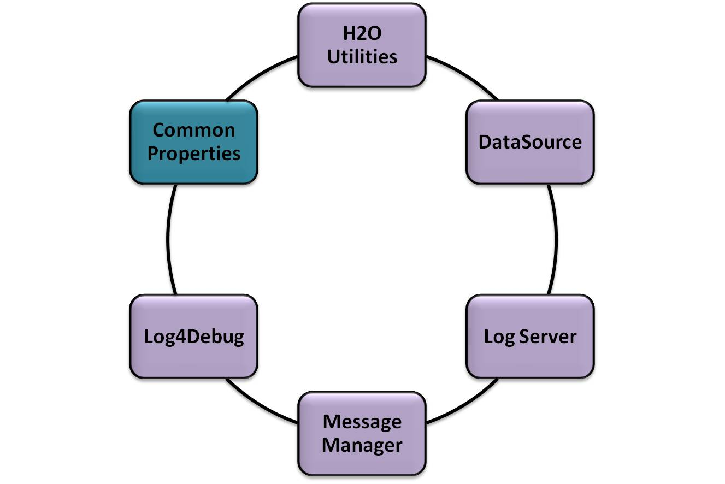
Using Common Properties
H20 Utilities Part 1
Notes:
Welcome to Lesson 02: Using Common Properties

Slide 10
Using common properties
When to use Property File?
Resource Bundle in Java
What is Common Properties?
Usage of Common Properties
How to use Common Properties in H2O
Code Snippet of Common Properties
Scenarios When the common property can be used
H20 Utilities Part 1
Notes:
In this lesson, we are going to learn about
When to use Property File?
Resource Bundle in Java
What is Common Properties?
Usage of Common Properties
How to use Common Properties in H2O
Code Snippet of Common Properties
Scenarios When the common property can be used

Slide 11


1. When to use Property file?
Whenever some String literals often change and don't want to recompile any class or rebuild jars again and again.
Eliminate dependencies on hardcoded paths for configuration data
When to use Property File
H20 Utilities Part 1
Notes:
When to use Property file?
Whenever some String literals often change and don't want to recompile any class or rebuild jars again and again.
Eliminate dependencies on hardcoded paths for configuration data

Slide 12

2. How to implement in java ?
It is Resource Bundle
Resource Bundle
H20 Utilities Part 1
Notes:
How to implement the property file in java?
It is Resource Bundle

Slide 13
2.1 Resource bundles
Resource bundles provide a simple key-value lookup and may be provided via .class or .properties files
Lookup of resources is a two step process:
  load resource list and
  Search
H20 Utilities Part 1
Notes:
Resource bundles
Resource bundles provide a simple key-value lookup and may be provided via .class or .properties files
Lookup of resources is a two step process:
load resource list and
Search

Slide 14
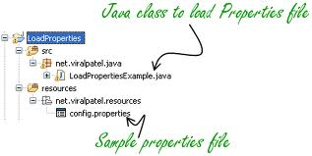
2.2 Folder structure
H20 Utilities Part 1
Notes:
Folder structure of managing a property files.

Slide 15
2.3 Disadvantage of Resource Bundle
Fails to reload when the property file is modified.
In order to reflect the changes we need to restart the weblogic server.
H20 Utilities Part 1
Notes:
Disadvantage of Resource Bundle
Fails to reload when the property file is modified.
In order to reflect the changes we need to restart the weblogic server.

Slide 16

3. What is H2O Common Properties?
CommonProperties is as similar as ResourceBundle Object.
A framework that helps to access property files located in project-name-config-core-1.0.0.jar.
Additionally it allows to change the properties at run time using the Common Properties Admin application.
Changes are not persistent and it is for in-flight change and is to be accompanied by an update to file.
What is Common Property
H20 Utilities Part 1
Notes:
What is H2O Common Properties?
CommonProperties is as similar as ResourceBundle Object.
A framework that helps to access property files located in project-name-config-core-1.0.0.jar.
Additionally it allows to change the properties at run time using the Common Properties Admin application.
Changes are not persistent and it is for in-flight change and is to be accompanied by an update to file

Slide 17
4. Usage of Common Properties
The properties that can be modified by System Administrator can be implemented using CommonProperties Utility.
Developer dependent properties can be implemented using ResourceBundle. Also the property file can be included in the jar itself. (Because developer dependent properties will not be changed by System Administrator.)
H20 Utilities Part 1
Notes:
Usage of Common Properties
The properties that can be modified by System Administrator can be implemented using CommonProperties Utility.
Developer dependent properties can be implemented using ResourceBundle. Also the property file can be included in the jar itself. (Because developer dependent properties will not be changed by System Administrator.)

Slide 18
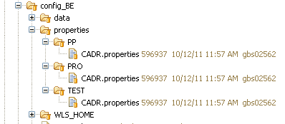
5. How to use Common Properties in H2O
CommonProperties.properties
Java File with call to commonProperties interface
H20 Utilities Part 1
Notes:
How to use Common Properties in H2O
CommonProperties.properties
Java File with call to commonProperties interface
3 .CommonProperties bundle must be committed under projectname/config_BE/properties/
4. The bundles for different environments must be committed under subfolders TEST, PP, PRO

Slide 19
5.1 CommonProperties.properties file
subSystem.properties=\
properties.file=c:/weblogic/myclass/subSystem.propertie,\
reload.time=1000
where
properties.file is the file path of your property file and
reload.time is the time the property should be reloaded after it is modified.
reload.time is in MilliSeconds.
  (reload.time= -1 indicates never reload the property file even it is modified)
  (reload.time=0 indicates reload as soon as the property file is modified)
H20 Utilities Part 1
Notes:
CommonProperties.properties file
1. subSystem.properties with properties.file location And reload time=1000
2. The first time that a CommonProperties object is found than it is cached so next calls are much less expensive.
3. reload.time is the time the property should be reloaded after it is modified.
reload.time is in MilliSeconds.
(reload.time= -1 indicates never reload the property file even it is modified)
(reload.time=0 indicates reload as soon as the property file is modified)

Slide 20
5.2 How to call CommonProperties Interface?
CommonProperties cp =
CommonPropertiesFactory.getInstance()
.getCommonProperties("subSystem");
String properyValue = cp.getProperty("anyKey");
H20 Utilities Part 1
Notes:
How to call CommonProperties Interface
This method returns a CommonProperties object providing the commonProperties name as an argument.
The common properties file read depends on the factory implementation used, depending whether the configuration file CommonProperties.properties is present or not.
In case the configuration file is found, the CommonProperties configuration is taken from there; the specified commonPropertiesName is used
as a logic name that must be matched with the real commonProperties configuration defined in the configuration file.
This configuration defines a property file, maybe with a different name, its path and other possible configuration values,
see CommonProperties.properties.

Slide 21
5. 3 CommonProperties Interface
public interface CommonProperties
{
//1. return the propery value for the key.
if key not found null is returned.
public abstract String getProperty(String key);
//2. return the propery value for the key.
if key not found defaultValue is returned.
public abstract String getProperty(String key, String defaultValue);
//3. returns all the keys Enumeration
public abstract Enumeration properties();
}
H20 Utilities Part 1
Notes:
Interface for CommonProperties

Slide 22
5.4 Search of subsystem.properties
1. properties.file location.
2. WLS-home. (Weblogic Sever home)
3. Weblogic Classpath
If the properties file is not found in 1 then it the search goes to 2.
If the property file is not found in 1 and 2 then it the search goes 3.
If the property file is not found in all the 3 cases
CommonPropertiesException will be thrown.
As of now the search 1 and 2 are only reloadable; search 3 is not reloadable
H20 Utilities Part 1
Notes:
Search of subsystem.properties
1. properties.file location.
2. WLS-home. (Weblogic Sever home)
3. Weblogic Classpath
If the properties file is not found in 1 then it the search goes to 2.
If the property file is not found in 1 and 2 then it the search goes 3.
If the property file is not found in all the 3 cases
CommonPropertiesException will be thrown.
As of now the search 1 and 2 are only reloadable; search 3 is not reloadable

Slide 23
6. Code Snippet of Common Properties
1. Property file Configuration
AllarmiCrediti.properties=\
properties.file=./classes/AllarmiCrediti.properties,\
reload.time=1000
2. AllarmiCrediti.properties
RATE_INSOLUTE=it.sella.allarmicrediti.internal.dto.
MutuiAllarmViewImpl
3. Invoking the commonProperty
private static final CommonProperties commonProperties = CommonPropertiesFactory.getInstance().
getCommonProperties("AllarmiCrediti");
final String query = commonProperties.getProperty("RATE_INSOLUTE");
H20 Utilities Part 1
Notes:
Code samples for using common property
Property file configuration
Mapping the key and value in the property file
Each property is composed by a key and a value and can be retrieved through its key.If a key is not present, the returned value will always be a null value.
Lot of different methods gives you the possibility to read the property value directly as Long, Double, Boolean, Class, Object, array of property values or nested CommonProperties
Invoking the commonproperty H2O API

Slide 24
7. Scenarios When the common property can be used
To eliminate dependencies on hard coded paths for configuration data
Application has a user interface and it contains many locale-specific objects. Objects that vary with Locale
H20 Utilities Part 1
Notes:
Scenarios When the common property can be used
To eliminate dependencies on hardcoded paths for configuration data
Application has a user interface and it contains many locale-specific objects. Objects that vary with Locale

Slide 25


Summary
Key Points we discussed are
  Resource bundles in Java
  Disadvantage of Resource bundle
  What is common properties
  How to use common properties utility
H20 Utilities Part 1
Notes:
Summary
Key Points we discussed are
Resource bundles in Java
Disadvantage of Resource bundle
What is common properties
How to use common properties utility

Slide 26
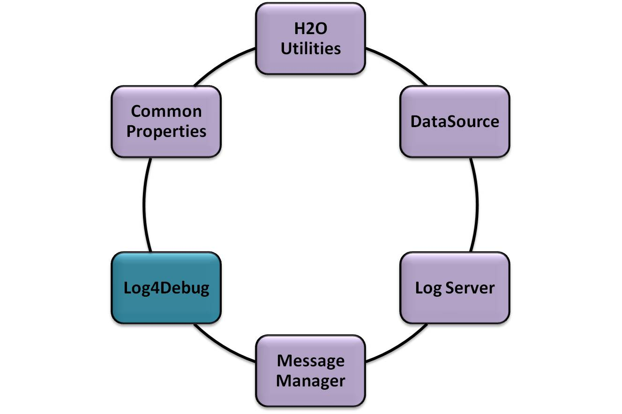
Using Log4debug
H2O Utilities Part 1
Notes:
Welcome to Lesson 03: Using Log4debug

Slide 27
Using Log4Debug
What is Log4debug?
Architecture of Log4J framework
Why Log4debug in H2O?
How to use Log4debug in H2O
Code Snippet for log4Debug
Scenario in the usage of Log4debug
Best Practices on Log4debug
H20 Utilities Part 1
Notes:
Using Log4Debug
What is Log4debug?
Components of the Log4debug framework
What are Log Levels?
How to use Log4debug in H2O
Code Snippet for log4Debug
Scenario in the usage of Log4debug
Best Practices on Log4debug

Slide 28
1. What is Log4Debug
Log4J is an Open Source logging framework from the apache foundation.
It can be used by the Java programmers to add logging functionality in the projects .
Can easily use Log4J in their code to log the error and information messages into a log file.
Can control the logging message with the help of external configuration file e.g. log4.xml or log4j.properties file
H20 Utilities Part 1
Notes:
Log4J is an Open Source logging framework from the apache foundation. It's a Java based framework and can be used in any java program.
It can be used by the Java programmers to add logging functionality in the projects. These days most of the Java projects uses Apache Log4J for logging.
It provides powerful yet efficient and fast API for the Java programmers. Java programmers easily uses Log4J in their code to log the error and information messages into a log file.
Log4j simply inserts a log statement in the application code and manage them externally without going back to its application source code. Programmer's can control the logging message with the help of external configuration file e.g. log4.xml or log4j.properties file.

Slide 29
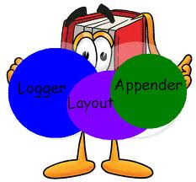
2. Architecture of Log4J framework
The architecture of Log4J framework is layered and consists of three main components.
There components of the Log4J are:
  Logger
  Appender
  Layout
H20 Utilities Part 1
Notes:
Architecture of Log4J framework is layered and consists of three main components
There components of the Log4J are:
Logger
Appender
Layout
These components help the developers to have maximum control over the log statements, i.e., when the log statements should appear, in what format, and to which channel they will be routed to.

Slide 30
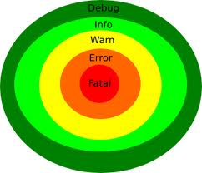
2.1 Logger
Logger is responsible for capturing the logging information.
5 Levels of logger are:
  Debug
  Info
  Warn
  Error
  Fatal
H20 Utilities Part 1
Notes:
Architecture of Log4J framework is layered and consists of three main components
Logger is the most essential component of the logging process. It is responsible for capturing the logging information. There are 5 different log levels of the Logger.
The level of Logger are as following:
DEBUG : Most useful to debug an application.
INFO : It provides informational messages.
WARN : It provides that application may have harmful events.
ERROR : It provides that application having error events but that might allow it to continue running.
FATAL : It denotes the severe error events which lead the application to abort
In addition, there are two special levels also they are:
ALL : It is intended to turn on all logging
OFF : It is intended to turn off logging
You can also set the logger level by putting a simple code like
logger.setLevel((Level)Level.WARN);

Slide 31
2.1 Logger
There are two special levels also they are:
  ALL : It is intended to turn on all logging
  OFF : It is intended to turn off logging
Set the logger level by including a code like
logger.setLevel((Level)Level.WARN);
H20 Utilities Part 1
Notes:
In addition, there are two special levels also they are:
ALL : It is intended to turn on all logging
OFF : It is intended to turn off logging
You can also set the logger level by putting a simple code like
logger.setLevel((Level)Level.WARN);

Slide 32
2.2 Appenders
Appender is responsible for publishing the log to a destination.
It controls how the logging provides the output.
Some list of appenders are
  Console Appender
  File Appender
  Writer Appender
H20 Utilities Part 1
Notes:
Appenders
Appender is responsible for publishing the log to a destination.
It controls how the logging provides the output.
Some list of appenders are
ConsoleAppender is used as:
ConsoleAppender appender = new ConsoleAppender(new PatternLayout());
FileAppender is used as:
FileAppender appender = new FileAppender(new PatternLayout(),"filename");
WriterAppender is used as:
appender = new WriterAppender(new PatternLayout(),new FileOutputStream("filename"));

Slide 33
2.3 Layouts
The Layout is responsible for formatting the log output in different layouts.
User can control the output format by modifying the Log4J configuration file.
There are basically three types of Layout:
  HTMLLayout
  PatternLayout
  SimpleLayout
H20 Utilities Part 1
Notes:
For each Appender it needs to have an associated Layout, which guides how to format the output.
The Layout is responsible for formatting the log output in different layouts.
User can control the output format by modifying the Log4J configuration file.
There are basically three types of Layout:
HTMLLayout : It formats the output in the HTML table
PatternLayout : It formats the output in the conversion pattern
SimpleLayout : It formats the output in a simple manner, it prints the level then place a dash and then the user specified log message.

Slide 34

3. Why Log4debug in H2O?
Log4Debug is a wrapper over Apache’s Log4j project.
It is mainly used for printing the debugging statements into our applications
H20 Utilities Part 1
Notes:
Log4Debug is a wrapper over Apache’s Log4j project. It is mainly used for printing the debugging statements into our applications. It is powerfully customizable according to our logging requirements.
From the next slide, we will introduce the structure and interface details for using H2O Log4debug

Slide 35
4. How to use log4debug in H2O
Logger Settings in Log4j.properties
To interact with log4j using the logger settings
H20 Utilities Part 1
Notes:
configuration segments of a typical testing environment
Interaction with log4j, using these logger settings

Slide 36
4.1 Logger Settings
# default configuration
log4j.rootLogger=DEBUG,A1
log4j.appender.A1=org.apache.log4j.ConsoleAppender
log4j.appender.A1.layout=org.apache.log4j.PatternLayout
log4j.appender.A1.layout.ConversionPattern=%p [%t] %c %m%n
#override for it.sella.H2Omail
log4j.logger.it.sella.h2omail=WARN,A2
log4j.appender.A2=org.apache.log4j.FileAppender
log4j.appender.A2.File=Log4.log
log4j.appender.A2.Append=false
log4j.appender.A2.layout.ConversionPattern=[%c] - %m%n
H20 Utilities Part 1
Notes:
This set specifies that:
The root logger, which is the one received by a Logger.getLogger() when no override is specified, designates A1 as the appender and DEBUG as the message printing level.
A1 is mapped to the console. This means, messages to the default logger will flow to the console.
Messages printed to A1 will be of the format %p [%t] %c - %m%n. For details about these and other format specifiers, refer to the published documentation.
The Logger.getLogger() call from any classes within it.sella.h2omail package should use WARN as the log level and A2 as the appender. This simply overrides the log4j.rootLogger setting.
A2 is mapped to a non-rotating log file called log4j.log.
Messages printed to A2 will be of the format [%c] - %m%n.

Slide 37
4.2 Java API
Log4Debug log = Log4DebugFactory.
getLog4Debug(<<Class Name>>);
log.debug(<String>)
log.warnStackTrace(exception);
H20 Utilities Part 1
Notes:
Java API for accessing log4j properties are
Log4Debug log = Log4DebugFactory.getLog4Debug
(<<Class Name>>);
log.debug(<String>)

Slide 38
5. Code Snippet for log4Debug
class LDHelper
{
public Record getRecord(String name, String server){
Log4Debug log = Log4DebugFactory.getLog4Debug(LDHelper.class);
log.debug(‘Looking up LDAP server ‘, server,
‘ for name ‘, name);
if (server == null || server.trim().length() == 0) {
log.warn("LDAP Ser not specified, looking up def");
server = getDefaultServer();
}
H20 Utilities Part 1
Notes:
The following points about the structure of the client code are evident from this example.
The logger reference is retrieved as Log4Debug, using the Log4DebugFactory.getLog4Debug() call, passing the class reference as parameter. This is the only correct way to retrieve the logger reference for our environment.
Logging is accomplished through the debug(), warn(), severe() calls for simple messages,
Multiple parameters are not concatenated - they are sent as successive parameters; log4j runtime will decide if this log is to be printed based on the context’s level setting and do the concatenation only if necessary.

Slide 39
5. Code Snippet …..(Contd)
try {
rec = lookup(name, server);
} catch (LDAPLookupException exception) {
log.warnStackTrace(exception);
throw new SystemException(exception);
}
if (rec == null) {
log.severe("name not found");
throw new LDAPException("Name not found");
}
H20 Utilities Part 1
Notes:
Logging is accomplished through the debug(), warn(), severe() calls for simple messages, and debugStackTrace, warnStackTrace, severeStackTrace() for exception stack traces, which print the text in the corresponding log levels.

Slide 40

6. Scenario when to use Log4Debug in H2O
Logging is required to track programming flow.
It is very difficult to track code flow or
to find faults in Big applications
Messages that should not be printed
when the application is in production
Warning messages which are logged
to some log but the application is able
to carry on without a problem
Error messages which are also logged
to some log but, still, the application can hobble along
Critical messages, after logging of which the application quits abnormally
H20 Utilities Part 1
Notes:
Scenario when to use Log4Debug in H2O
Logging is required to track programming flow. It is very difficult to track code flow or to find faults in Big applications
Messages that should not be printed when the application is in production
Warning messages which are logged to some log but the application is able to carry on without a problem
Error messages which are also logged to some log but, still, the application can hobble along
Critical messages, after logging of which the application quits abnormally

Slide 41

7. Best Practices
ServereStackTrace must be removed, in case of Re-Throwing the exception
If it is not re-thrown, severeStackTrace
must be replace with the debug/warn
with the correct error message
Debug or Warn stack trace should
be replaced with the debug/warn
error message with the inputs to
cause the exception,
H20 Utilities Part 1
Notes:
Some of the best practices
ServereStackTrace must be removed, in case of Re-Throwing the exception or transferring to other exceptions and rethrow it, this is mandatory, irrespective of Exception type even in case of RemoteException
If it is not re-thrown, severeStackTrace must be replace with the debug/warn with the correct error message with the inputs which causes the exception. No stackTrace!!
Debug or Warn stack trace should be replaced with the debug/warn error message with the inputs to cause the exception, i.e having a debugstacktrace or warnStacktrace should be avoided even in executers or controllers.

Slide 42
7. Best Practices
Do not use System.out.println for logging,
always use log4Debug
Don’t Log whole collections
Do not explicitly convert object
to String while logging
Do not concatenate objects
while logging.
H20 Utilities Part 1
Notes:
Never use System.out.println for logging, always use log4Debug even if your applications are written to run outside the application server.
Logging of whole collections or loop-concatenated trace message strings is prohibited at all levels.
Do not explicitly convert object to String while logging, let the Log4Debug to do it automatically do it for you
Do not concatenate objects while logging. Use Overloaded Log4Debug Constructors.

Slide 43
Summary
Key Points we discussed are
  Why log4debug
  Components of log4debug
  About Log levels
  How to use H2O log4debug utility
H20 Utilities Part 1
Notes:
Summary
Key Points we discussed are
Why log4debug
Components of log4debug
About Log levels
How to use H2O log4debug utility

Slide 44
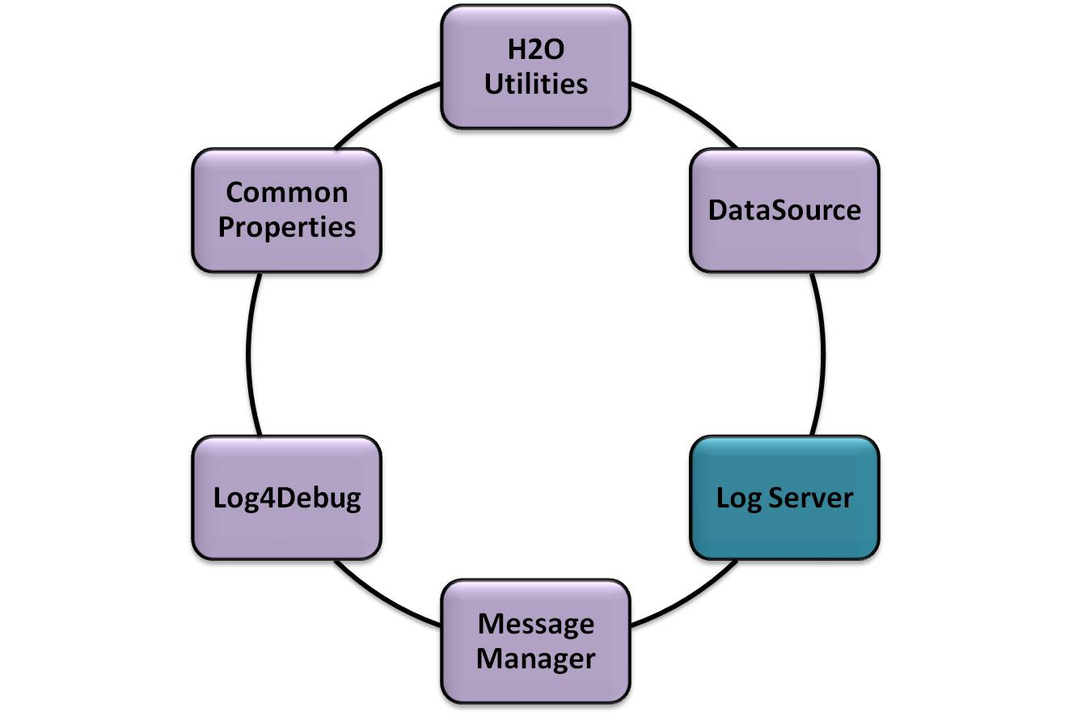
Using LogServer
H2O Utilities Part 1
Notes:
Welcome to Lesson 05: Using LogServer

Slide 45
Using LogServer
1. Why LogServer?
2. What information's to be logged?
3. How does Log Server work?
4. Structure of the logserver
5. LogServer API
6. Code snippet on invoking Java API
7. How can I log a failed operation?
H20 Utilities Part 1
Notes:
Using LogServer
1. Why LogServer?
2. What information's to be logged?
3. How does Log Server work?
4. Structure of the logserver
5. LogServer API
6. Code snippet on invoking Java API
7. How can I log a failed operation?

Slide 46
1. Why LogServer?
LOG Server is a H2O component, it services
To record the events that take place within the Information system of GBS
To provide the log information for the Ispettorato (GBS and Banca d’Italia)
H20 Utilities Part 1
Notes:
What is LogServer?
LOG Server is a H2O component, it services
To record the events that take place within the Information system of GBS
To provide the log information for the Ispettorato (GBS and Banca d’Italia)

Slide 47
2. What information's to be logged?
The subject that carries out the operation (who/chi)
The type of operation carried out (what/cosa)
The input provided to the operation (how/come)
The temporality of the operation (when/quando)
The locality of the operation (where/dove)
The result of the operation – in case of negative result to indicate an error code (or a brief explanation of the same)
  Eg: SUCCESS
  Eg: FAILURE : The input data to the method is NULL
The output of the operation
H20 Utilities Part 1
Notes:
2. What information's to be logged?
The subject that carries out the operation (who)
The type of operation carried out (what)
The input provided to the operation (how)
The temporality of the operation (when)
The locality of the operation (where)
The result of the operation – in case of negative result to indicate an error code (or a brief explanation of the same)
Eg: SUCCESS
Eg: FAILURE : The input data to the method is NULL
The output of the operation

Slide 48
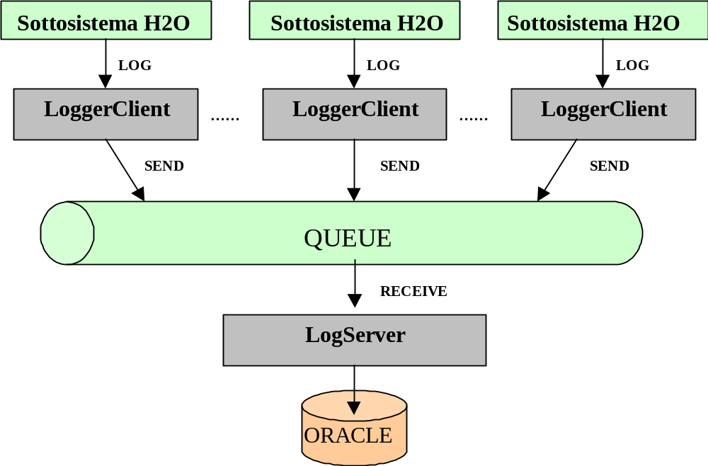
3. How does Log Server work?
Log Server is smart enough to LOG failure cases while inserting information.
Op-Code : LOGS-EXCP
H20 Utilities Part 1
Notes:
The Log Server is based on the management of a queue of messages as support service for the distributed logging.
A subsystem utilizing the LoggerClient sends an XML string corresponding to the content (the obligatory fixed part excluded) of the record to be recorded.
The LoggerClient deposits the string of Log in an asynchronous queue of messages (PTP queues asynchronous messaging model) .
The subsystems that is must not await the effective delivery and persistent storing of the message sent

Slide 49
4. Structure of the logserver
The log records are organized according to the following sub-division/structure:
  Obligatory fixed part
  Optional fixed part
  Variable part
H20 Utilities Part 1
Notes:
The log records are organized according to the following sub-division/structure:
Obligatory fixed part
Optional fixed part
Variable part

Slide 50
4.1. Obligatory fixed part
Codice utente | (LG_USER_ID) - (must be passed from/by the calling application only in case of pkg SQL)
Ora e data | (LG_LOG_TIME).
Ruolo of the user | (LG_ROLE).
Identificativo della Banca | (LG_ID_BANCA) - (must be passed from/by the caller application under the form of ABI code in case of utilization of the SQL or of the tag JSP)
Id Soggetto | ( LG_ID_SOGGETTO)
Nome di rete del PC | ( LG_TERMINAL_NAME). (if the data is available)
IP address | (LG_IP_ADDRESS) must be passed by the caller only if pkg SQL.
MAC address | (LG_MAC_ADDRESS). (if the data is available)
Lid | ( LG_LID) (this information may not be present)
Codice della Succursale | ( LG_ID_SUCCURSALE) - may not be present.
CDR dell’Utente | ( LG_CDR_NAME) - for some roles user may not be present
H20 Utilities Part 1
Notes:
This section contains the following fields (available from Sicurezza or got directly by LOG Server itself):
Since the operations from batch or applications the following information may not be present:
user code
Time and date
Role of the user
Bank Identifier
id Subject
Network name of the PC
IP address
MAC address
lid
Branch Code
CDR User

Slide 51
4.2 . Optional fixed part
Codice log * <OPERATION_CODE/> | identifies the operation carried out, must always be compiled
Risultato dell’operazione *<OPERATION_RESULT/> | must always be compile
Id dell’Anagrafe del soggetto trattato <ID_SOGGETTO_TRATTATO/> | (LG_ID_SOGGETTO_TRATTATO) - should always be valued for all those operations that operate on a subject the register id: to identify the subject on which you are performing the operation - similar to the concept of 8-digit host.
Numero di conto di partenza dell’operazione <NUMERO_CONTO_PARTENZA/> | (LG_NUMERO_CONTO_PARTENZA) – (mandatory for accounting operations)
Divisa conto di partenza dell’operazione <DIVISA_PARTENZA/> | (LG_DIVISA_PARTENZA) – (mandatory for accounting operations)
Importo conto di partenza dell’operazione <IMPORTO_PARTENZA/> | (LG_IMPORTO_PARTENZA) - (mandatory for accounting operations)
Numero di conto di destinazione dell’operazione <NUMERO_CONTO_ARRIVO/> | (LG_NUMERO_CONTO_ARRIVO) -(mandatory for accounting operations)
Divisa conto di destinazione dell’operazione <DIVISA_ARRIVO/> | (LG_DIVISA_PARTENZA) –(mandatory for accounting operations)
Importo conto di destinazione dell’operazione <IMPORTO_ARRIVO/> | (LG_IMPORTO_ARRIVO) – (mandatory for accounting operations)
Valuta dell’operazione <VALUTA_OPERAZIONE/> | (LG_VALUTA_OPERAZIONE) - (mandatory for accounting operations)
Tipo Titolo <TIPO_TITOLO/> | (LG_TIPO_TITOLO) - It must always be enhanced in the presence of transactions in securities.
Numero Ordine <NUMERO_ORDINE/> | (LG_NUMERO_ORDINE) - It must always be enhanced in the presence of a number 'order given or a progressive.
Codice dipendente che autorizza <ID_AUTORIZZANTE/> | (LG_ID_AUTORIZZANTE) - should always be valued for operations that require an authorization code
H20 Utilities Part 1
Notes:
In dependence of the event(Accountant, Not accounting or reading ), some or all the following information must be stored, in the respective fields
code lof
result of
Id of the Registry of the subject matter
Account number starting operation
Divided into account starting operation
Account of the departure of the transaction amount
Account number as target
Divided into account as target
Amount into account as target
Currency of transaction
Type Title
Order Number
Code employee authorizing

Slide 52
4.3. Optional fixed part - Codice log
It is mandatory to valorize the field Codice log
  Maximum 20 characters (space is not allowed),
  Composed of two strings, separated by ‘-‘ (hyphen) or by '_' (underscore),
  First is composed of a variable number between 2 and 6 (possibly 4) alphanumerical characters (upper cases advised) - identifies the application / component.
Second of a variable number from 2 to 15 (possible 4) alphanumerical characters (upper cases advised) - identifies the specific operation
Examples: the log code ANAG-RCPF identifies the operation ‘Ricerca Persona Fisica(=Search Individual person)’ of the Anagrafe component
H20 Utilities Part 1
Notes:
It is mandatory to valorize the field Codice log
Maximum 20 characters (space is not allowed),
Composed of two strings, separated by ‘-‘ (hyphen) or by '_' (underscore),
First is composed of a variable number between 2 and 6 (possibly 4) alphanumerical characters (upper cases advised) - identifies the application / component.
Second of a variable number from 2 to 15 (possible 4) alphanumerical characters (upper cases advised) - identifies the specific operation
Examples: the log code ANAG-RCPF identifies the operation ‘Ricerca Persona Fisica(=Search Individual person)’ of the Anagrafe component

Slide 53
4.4. Optional fixed part – Operation Result
The field Risultato dell’operazione(=Result of the operation) will assume the values “SUCCESS” in the case of operation terminated correctly.
“FAILURE” plus a concise explanation of the error shown by the operation, in the case of failure of the operation itself.
H20 Utilities Part 1
Notes:
The field Risultato dell’operazione(=Result of the operation) will assume the values “SUCCESS” in the case of operation terminated correctly.
“FAILURE” plus a concise explanation of the error shown by the operation, in the case of failure of the operation itself.

Slide 54
4.5. Code Snippet for Optional part
<LOG>
<LOG_OPTIONAL_SECTION>
< OPERATION_CODE >
BNFC-ITAL
</OPERATION_CODE >
<NUMERO_CONTO_PARTENZA>
50O1611004190
</NUMERO_CONTO_PARTENZA>
<DIVISA_PARTENZA>
EUR
</DIVISA_PARTENZA>
<IMPORTO_PARTENZA>
15000.35
</IMPORTO_PARTENZA>
<NUMERO_CONTO_ARRIVO>
35O1812016180
</NUMERO_CONTO_ARRIVO>
<VALUTA_OPERAZIONE>
12/07/2001
</VALUTA_OPERAZIONE>
<ID_AUTORIZZANTE>
BSXY9
</ID_AUTORIZZANTE>
<OPERATION_RESULT>
SUCCESS
</OPERATION_RESULT>
</LOG_OPTIONAL_SECTION>
<LOG_VARIABLE_SECTION>
<CAUSALE>TASSE SCUOLA</CAUSALE>
</LOG_VARIABLE_SECTION >
</LOG>
H20 Utilities Part 1
Notes:
Log XML format for the optional part of the log server

Slide 55
4.6. Variable part
All the specific variable information of the particular event of LOG must be in XML format.
The variable parts, can in some cases be omitted in part when they are not considered significant for the event that is being recorded.
H20 Utilities Part 1
Notes:
All the specific variable information of the particular event of LOG must be in XML format.
The variable parts, can in some cases be omitted in part when they are not considered significant for the event that is being recorded.

Slide 56
4.7. Example for variable part
<ESTERO_MERCI_OPERATION>
<ESME-LCI-ACCEPT>
<NR_PRATICA>LCI00134</NR_PRATICA>
<DETTAGLI_DELL_ACCETTAZIONE>
<ID_DOC_RICEVUTO>2598</ID_DOC_RICEVUTO>
<IMPORTO_ACC>2500.0</IMPORTO_ACC>
<DATA_ACC>03/01/2008</DATA_ACC>
<NOTE>Acceptance</NOTE>
</DETTAGLI_DELL_ACCETTAZIONE>
</ESME-LCI-ACCEPT>
</ESTERO_MERCI_OPERATION>
H20 Utilities Part 1
Notes:
XML format for the variable part of logserver

Slide 57
5. LogServer API
Java API
  Java metods to write in the table of Log of Back-End in asynchronous modality
Oracle API
  For external applications: SQL Oracle package (for applications not in Java technology)
Tag JSP for the applications of FE non standard H2O
H20 Utilities Part 1
Notes:
Java API
Java metods to write in the table of Log of Back-End in asynchronous modality
Oracle API
For external applications: SQL Oracle package (for applications not in Java technology)
Tag JSP for the applications of FE non standard H2O

Slide 58
5.1 Java API
public class LoggerClient{
/** * get a LoggerClient instance */
public static LoggerClient getInstance()
/** Log the xml as String:does not throw Remote Ex*/
public void log(String xmlDoc) throws LoggerException
}
H20 Utilities Part 1
Notes:
Java API
Java methods to write in the table of Log of Back-End in asynchronous modality

Slide 59
5.2 Oracle API
Package - lg_pa_external_interface
PROCEDURE insertlogdetails (
i_usercode IN VARCHAR2, i_codiceabi IN VARCHAR2, i_operation_code IN VARCHAR2, i_operation_result IN VARCHAR2,
i_channel IN VARCHAR2,i_ip_address IN VARCHAR2,
i_numero_conto_partenza IN VARCHAR2,
i_divisa_partenza IN VARCHAR2,i_importo_partenza IN NUMBER,
i_numero_conto_arrivo IN VARCHAR2,i_divisa_arrivo IN VARCHAR2,
i_importo_arrivo IN NUMBER,i_valuta_operazione IN VARCHAR2, i_tipo_titolo IN VARCHAR2,
i_numero_ordine IN VARCHAR2,i_xml_data IN CLOB,
i_id_autorizzante IN VARCHAR2,i_idsoggettotrattato IN NUMBER,o_strerror OUT VARCHAR2);
H20 Utilities Part 1
Notes:
Oracle API
For external applications: SQL Oracle package (for applications not in Java technology)

Slide 60
5.3 JSP API
The possibility is given of recalling the Oracle package also through tag library, recallable directly from the JSP
<%@ taglib uri="LogTag.tld" prefix="lt" %>
<lt:makeSecurityLog abi="03268" operationCode="LS01-DDNN"
operationResult="SUCCESS" />
H20 Utilities Part 1
Notes:
Tag JSP for the applications of FE non standard H2O

Slide 61
6. Code snippet on invoking Java API
import it.sella.logserver.*;
Operation operation = new Operation(true, "TEST-OP") .transaction(new Transaction() .partenza("0253644511786", 12.74, "EUR") .arrivo("0275644511786", 15.22, "USD") ) .valutaOperazione(new Date())
.tipoTitolo("019876")
.idAutorizzante("SHB819") .idSoggettoTrattato(188968L)
.numeroOrdine("875422") .xmlData("<EXAMPLE><A>a</A><B>b</B><C>some info here...</C></EXAMPLE>");
operation.log();
H20 Utilities Part 1
Notes:
This code provides the java API for the operation of log server.

Slide 62
6.1 Java API
Advantages
The code required to log is more clear and clean
Don't have to know exactly the correct name of the database table's fields
H20 Utilities Part 1
Notes:
Advantages
The code required to log is more clear and clean
Don't have to know exactly the correct name of the database table's fields

Slide 63
7. How can I log a failed operation?
Operation class has a constructor that takes three parameters: Operation(boolean isOk, String operationCode, String failureReason)
Can use that constructor when we have to log a failed operation:
Operation operation = new Operation(true, "TEST-OP", "Conto di partenza non trovato
In that case we will find on the "logger table" a record with "operation result" as: FAILURE - Conto di partenza non trovato
H20 Utilities Part 1
Notes:
7. How can I log a failed operation?
Operation class has a constructor that takes three parameters: Operation(boolean isOk, String operationCode, String failureReason)
Can use that constructor when we have to log a failed operation:
Operation operation = new Operation(true, "TEST-OP", "Conto di partenza non trovato
In that case we will find on the "logger table" a record with "operation result" as: FAILURE - Conto di partenza non trovato

Slide 64
Summary
Key Points we discussed are
Information's to be logged
Structure of the logserver
LogServer API
Logging a failed operation
H20 Utilities Part 1
Notes:
Summary
Key Points we discussed are
Information's to be logged
Structure of the logserver
LogServer API
Logging a failed operation

Slide 65
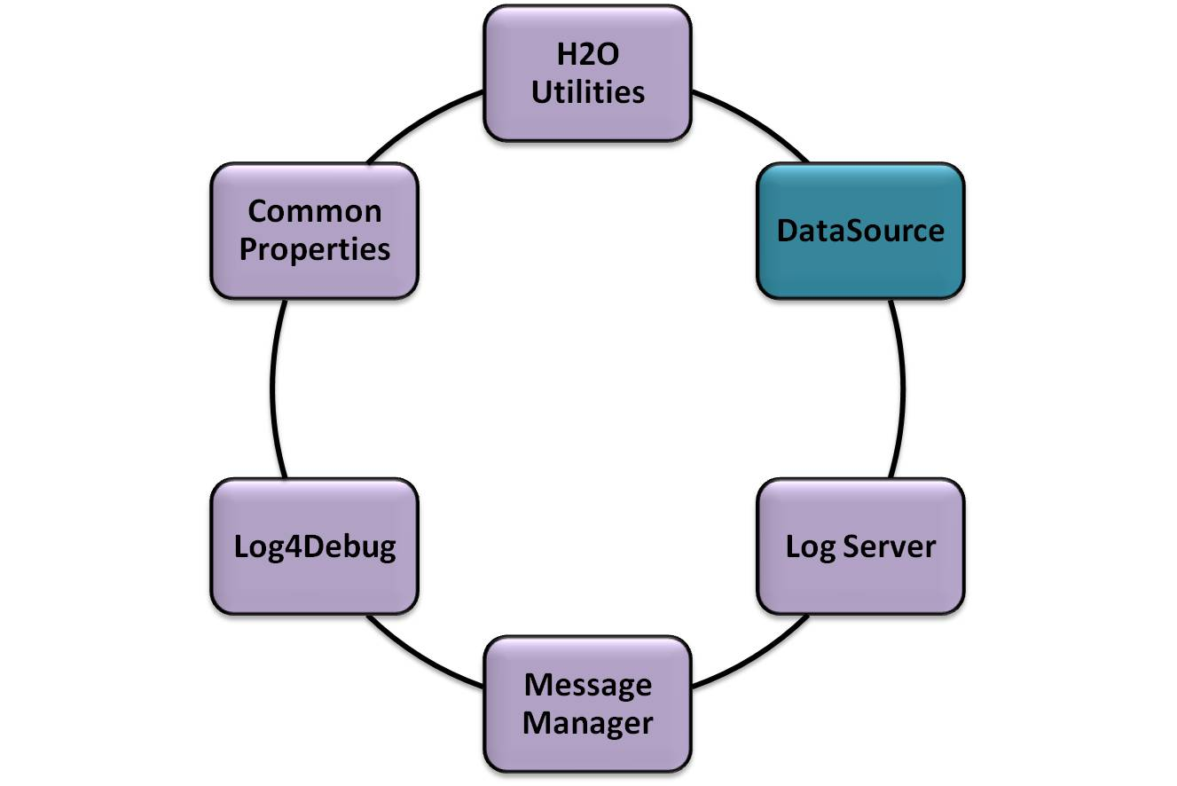
Using DataSource
H2O Utilities Part 1
Notes:
Welcome to Lesson 06: Using DataSource

Slide 66
Using DataSource
1. What is DataSource Utility?
2. Why DataSource in H20?
3. How to use DataSource in H2O?
4. Advantages of DataSource object over the DriverManager
5. Connection Pool and Advantages
6. Types of DataSource Implementations
7. Using DataSource in H2O
8. Code Snippet for Using DataSource
9. Config for Connection Pool
H20 Utilities Part 1
Notes:
Using DataSource
1. What is DataSource Utility?
2. Why DataSource in H20?
3. How to use DataSource in H2O?
4. Advantages of DataSource object over the DriverManager
5. Connection Pool and Advantages
6. Types of DataSource Implementations
7. Using DataSource in H2O
8. Code Snippet for Using DataSource
9. Config for Connection Pool

Slide 67
1. What is DataSource?
A DataSource object is the representation of a data source in the Java
DataSource object can be thought of as a factory for connections to the particular data source that the DataSource instance represents.
Using a DataSource object is the preferred alternative to using the DriverManager for establishing a connection to a data both have methods for creating a connection, methods for getting and setting a timeout limit for making a connection, and methods for getting and setting a stream for logging
H20 Utilities Part 1
Notes:
What is DataSource?
A DataSource object is the representation of a data source in the Java. In basic terms, a data source is a facility for storing data.
A factory for connections to the physical data source that this DataSource object represents. An alternative to the DriverManager facility, a DataSource object is the preferred means of getting a connection. An object that implements the DataSource interface will typically be registered with a naming service based on the JavaTM Naming and Directory (JNDI) API.
Using a DataSource object is the preferred alternative to using the DriverManager for establishing a connection to a data both have methods for creating a connection, methods for getting and setting a timeout limit for making a connection, and methods for getting and setting a stream for logging
http://www.javapractices.com/topic/TopicAction.do?Id=127

Slide 68
2. Why DataSource in H2O?
DataSource utility module is used to get the required datasource.
Advantages :
1. The datasource is cached when it is called first time.
2. This utility makes sure to cache the datasource independent of the subsystem.
H20 Utilities Part 1
Notes:
This utility module is used to get the the required datasource.
This is very useful when we need to get various datasource from various connection pool.
Advantages :
1. The datasource is cached when it is called first time.
Hence no further look up is needed thus it improves performance.
2. This utility makes sure to cache the datasource independent of the subsystem.
Even if the subsystem caches the datasources it is advisable to change to the datasorce utility, when conisidering H2O as a whole, we can reduce the lookup to the datasource done by each subsystem .

Slide 69
3. How to use DataSource in H2O?
DataSource ds = DataSourceFactory.getInstance().
getDataSource();
DataSource JNDI Name in DataSource.properties
H20 Utilities Part 1
Notes:
Using Datasource in H2O using Java API and configuring the JNDI Name

Slide 70
4. Advantages of DataSource object over the DriverManager
An application doesnot need to register the driver information as like database manager.Datasource object register the logical name with JNDI.
Datasource provides the connection pooling feature. Connection pooling can increase the performance by reusing the connections.
DataSource object provide Distributed transaction feature. Distributed transaction allows an application to do the heavy duty database work of large enterprises
H20 Utilities Part 1
Notes:
Advantages of DataSource object over the DriverManager
An application doesnot need to register the driver information as like database manager. Datasource object register the logical name with JNDI.The application uses only the logical name to retrieve the Datasource object associated with that name.
Datasource provides the connection pooling feature. Connection pooling can increase the performance by reusing the connections instead of getting physical connection each time when requested. Creating a new physical connection is costlier
DataSource object provide Distributed transaction feature. Distributed transaction allows an application to do the heavy duty database work of large enterprises

Slide 71
5. Connection Pool and Advantages
The connection pool which contains a group of JDBC connections that applications reserve, use, and then return the connections to the pool after finishing its work.
The connection pool and the connections are created when the connection pool is registered, usually when starting up WebLogic Server or when deploying the data soruce.
Advantages
Using connection pools is more efficient than creating a new connection. While creating new connection each client each time they need to access the database
No need to hard code details such as the DBMS username and password in your application.
We can limit the number of connections to your DBMS
We can change the DBMS you are using without changing your application code.
H20 Utilities Part 1
Notes:
What is Connection Pool?
The connection pool which contains a group of JDBC connections that applications reserve, use, and then return the connections to the pool after finishing its work.
The connection pool and the connections are created when the connection pool is registered, usually when starting up WebLogic Server or when deploying the data soruce
Advantages
Using connection pools is more efficient than creating a new connection. While creating new connection each client each time they need to access the database
No need to hard code details such as the DBMS username and password in your application.
We can limit the number of connections to your DBMSThis can be useful for managing licensing restrictions on the number of connections to your DBMS.
We can change the DBMS you are using without changing your application code.

Slide 72
6. Types of DataSource Implementations
Basic DataSource Implementations
  Provided by driver
Connection pooling implementation
  Provided by application server vendor or Driver vendor.
Distributed transaction implementation
  Provided by application server vendor such as EJB Vendor server
H20 Utilities Part 1
Notes:
. Basic DataSource Implementations
Provided by driver vendor.In a basic DataSource implementation, a call to the method DataSource.getConnection() returns a Connection object.
Connection pooling implementation
DataSource objects that implement connection pooling likewise produce a connection to the particular data source that the DataSource class

Slide 73
6.1. Connection pooling implementation
Provided by application server vendor or Driver vendor.
DataSource objects that implement connection pooling likewise produce a connection to the particular data source.
Connection object returns a PooledConnection object rather than being a physical connection.
An application uses the Connection object.Connection pooling has no effect whatever on application code except that a pooled connection
When an application closes a connection that is pooled, the connection joins a pool of reusable connections.
The next time DataSource.getConnection is called, a handle to one of these pooled connections will be returned if one is available.
H20 Utilities Part 1
Notes:
Provided by application server vendor or Driver vendor.
DataSource objects that implement connection pooling likewise produce a connection to the particular data source.
Connection object returns a PooledConnection object rather than being a physical connection.
An application uses the Connection object.Connection pooling has no effect whatever on application code except that a pooled connection
When an application closes a connection that is pooled, the connection joins a pool of reusable connections.
The next time DataSource.getConnection is called, a handle to one of these pooled connections will be returned if one is available.

Slide 74
6.2. Distributed transaction implementation
Provided by application server vendor such as EJB Vendor server.
To get distributed transactions need to implement Distributed transaction implementation with Connection object
Like connection pooling, transaction management is handled internally, so using distributed transactions is easy.
when a transaction is distributed (involves two or more data sources), the application cannot call the methods commit or rollback. It also cannot put the connection in auto-commit mode
H20 Utilities Part 1
Notes:
Provided by application server vendor such as EJB Vendor server.
To get distributed transactions need to implement Distributed transaction implementation with Connection object
Like connection pooling, transaction management is handled internally, so using distributed transactions is easy.
when a transaction is distributed (involves two or more data sources), the application cannot call the methods commit or rollback. It also cannot put the connection in auto-commit mode. The reason for these restrictions is that a transaction manager begins and ends a distributed transaction under the covers, so an application cannot do anything that would affect when a transaction begins or ends
6. The next time DataSource.getConnection is called, a handle to one of these pooled connections will be returned if one is available.

Slide 75
7. Using DataSource in H2O
Method 1:
  DataSource ds = DataSourceFactory.getInstance().
  getDataSource("YourDataSource");
  Connection connection = ds.getConnection();
Method 2:
  DataSource ds = DataSourceFactory.getInstance()
  .getDataSource();
  Connection connection = ds.getConnection();
H20 Utilities Part 1
Notes:
In accessing the datasource using method 1 then it returns the data source specified in DataSource.properties
In accessing the datasource using method 2 then it returns the default data source specified in DataSource.properties

Slide 76
7. Using DataSource in H2O (Cont…)
DataSource JNDI Name should be specified in DataSource.properties as below.
DefaultDataSource=weblogic.jdbc.jts.clientPool
YourDataSource=weblogic.jdbc.jts.yourPool
Note: DataSource.properties has to be in WLS-home or in classpath
#<modified>
YourDataSource=weblogic.jdbc.jts.clientPool
#</modified>
H20 Utilities Part 1
Notes:
The property file has a Key-value for your default connection pool as
( DefaultDataSource=weblogic.jdbc.jts.clientPool)

Slide 77
8. Code Snippet for Using DataSource
private static final String ORAFIN_JNDI_NAME ="gpnosXAPool" ;
public static Connection getConnection() throws DAOException{
try {
return DataSourceFactory.getInstance().
getDataSource(ORAFIN_JNDI_NAME)
.getConnection();
} catch (SQLException e) {
} catch (DataSourceFactoryException e) {
}
H20 Utilities Part 1
Notes:
Source code to get the H2O datasource with JNDI name

Slide 78
9. Config for Connection Pool
Parameter | Description
Initial Capacity | No of physical connections to create when creating connection pool.
Maximum Capacity | maximum number of physical connections that this connection pool can contain
Capacity Increment | number of connections created when new connections are added to the connection pool
Statement Cache Type | The algorithm used for maintaining the prepared statements stored in the statement cache
Statement Cache Size | The number of prepared and callable statements stored in the cache.
H20 Utilities Part 1
Notes:
1. Initial Capacity
No of physical connections to create when creating connection pool. Connection pool creation will be fail, if unable to create no of connections.
Minimum value: 0
Maximum value: 2147483647
2. Maximum Capacity
The maximum number of physical connections that this connection pool can contain.
3. Capacity Increment
The number of connections created when new connections are added to the connection pool.
When there are no more available physical connections to satisfy connection requests, WebLogic Server creates this number of additional
physical connections and adds them to the connection pool.
Minimum value: 1
Maximum value: 2147483647
4. Statement Cache Type
The algorithm used for maintaining the prepared statements stored in the statement cache.
Options are:
LRU - when a new prepared or callable statement is used, the least recently used statement is replaced in the cache.
FIXED - the first fixed number of prepared and callable statements are cached.
5. Statement Cache Size
The number of prepared and callable statements stored in the cache.
WebLogic Server can reuse statements in the cache without reloading the statements, which can increase server performance.
Each connection in the connection pool has its own cache of statements.
Setting the size of the statement cache to 0 turns off statement caching.
Minimum value: 0
Maximum value: 1024

Slide 79
Summary
Key Points we discussed are
  DataSource Utility in H2O
  Advantages of DataSource object
  over the DriverManager
  Connection Pool and Advantages
  Types of DataSource Implementations
H20 Utilities Part 1
Notes:
Summary
Key Points we discussed are
DataSource Utility in H2O
Advantages of DataSource object over the DriverManager
Connection Pool and Advantages
Types of DataSource Implementations

Slide 80

References
http://docs.oracle.com/javase/6/docs/api/java/util/ResourceBundle.html
http://www.tutorialspoint.com/log4j/log4j_overview.htm
http://docs.oracle.com/javase/6/docs/api/javax/sql/DataSource.html
http://reports.bansel.it/fmpdoc/Util/documentation/API/
H20 Utilities Part 1
Notes:
List of links referred

Slide 81

Thank You!!!
Congratulations you have successfully completed H2O Utilities Part 1 Course!!!!!
H20 Utilities Part 1
Notes:
Congratulations you have successfully completed H2O Utilities Part 1 Course!!!!!

