Slide 1

Oracle 9i
Day 2

Slide 2

Topics
Transaction Control Language.
Queries.
SubQueries
Joins.

Slide 3

Transactions
A transaction is a logical unit of work that comprises one or more SQL statements run by a single user.
According to the ANSI/ISO SQL standard, with which Oracle is compatible, a transaction begins with the user's first executable SQL statement.
A transaction ends when it is explicitly committed or rolled back by that user.

Slide 4

Transactions (Contd.)
A transaction begins when the first DML statement is encountered, and ends when one of the following occurs:
A COMMIT or ROLLBACK statement is issued
A DDL statement, such as CREATE, is issued
A DCL statement is issued
The user exits SQL*Plus

Slide 5
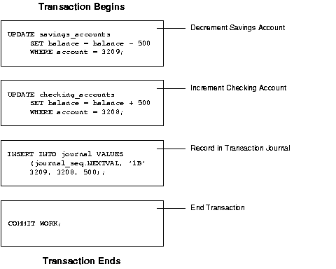

Slide 6
Transactions (Contd.)
Commit and Roll Back Transactions
The changes made by the SQL statements that constitute a transaction can be either committed or rolled back. After a transaction is committed or rolled back, the next transaction begins with the next SQL statement.
Committing a transaction makes permanent the changes resulting from all SQL statements in the transaction.
Rolling back a transaction retracts any of the changes resulting from the SQL statements in the transaction.
Savepoints
Savepoints divide a long transaction with many SQL statements into smaller parts.

Slide 7
Transaction Control Language
COMMIT
SAVEPOINT name
ROLLBACK
ROLLBACK TO SAVEPOINT name

