Slide 1

ORACLE PERFORMANCE MANAGEMENT
BY
Krishnaprakash N

Slide 2


Why is a COMMIT statement faster than a
ROLLBACK statement?
Before COMMIT or ROLLBACK
  Redo logs are written.
  The database is changed.
  Rollback is written.
On COMMIT
  Rollback is deleted.
On ROLLBACK
  Rollback is recorded in the redo logs.
  Rollback is applied to the database.
  Rollback is deleted.

Slide 3

Why is a TRUNCATE can be much faster than DELETE?
Truncating a table drops the contents of a table without producing rollback information.
Deleting all rows from a table using the DELETE statement does produce rollback, and thus TRUNCATE can be much faster than DELETE.

Slide 4
What is the high water mark?
High-water mark is an indicator or pointer up to which table has ever
contain data.
The high water mark for a table is the largest number of blocks ever allocated
to a table. As rows are added to a table, the high water mark (number of blocks
used)‏ increases. When data is deleted from that table using the DELETE
command, the high water mark does not decrease.
1.High water mark can be reset with a truncate table
2.if the table is moved to another tablespace.
3.Additionally, in 10g the following option to shrink a segment was introduced
to reset the high water mark.
eg. ALTER TABLE <tablename> SHRINK SPACE;

Slide 5
What Are Row Chaining and Row Migration?
Chaining
Occurs when the row is too large to fit into one data block when it is first
inserted. In this case, Oracle stores the data for the row in a chain of data
blocks (one or more) reserved for that segment. Row chaining most often occurs
with large rows, such as rows that contain a column of data type LONG, LONG RAW,
LOB, etc. Row chaining in these cases is unavoidable.
Migration
Occurs when a row that originally fitted into one data block is updated so
that the overall row length increases, and the block's free space is already
completely filled. In this case, Oracle migrates the data for the entire row
to a new data block, assuming the entire row can fit in a new block. Oracle
preserves the original row piece of a migrated row to point to the new block
containing the migrated row: the rowid of a migrated row does not change.

Slide 6
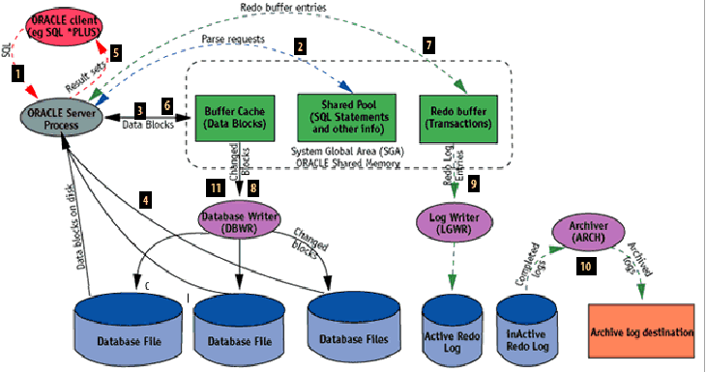
Process Flow With Instance

Slide 7

What causes poor database performance?
The most common causes of Oracle performance problems are applications that cause the database engine to do much more work than is necessary to achieve the desired result
Poorly-designed databases.
  Excessive CPU consumption due to too many logical I/Os (visits to database blocks in memory)‏
  Excessive disk reads due to missing indexes
  Excessive contention for shared resources.

Slide 8

What are the technical components of performance tuning?
Technical architecture
  Server and network tuning
Application architecture
  Integration of middle tier.
Database architecture
  Instance tuning
    Tuning the Oracle SGA is the next step
  Object tuning
    This phase of tuning looks at the setting for Oracle tables and indexes. Settings such as PCTFREE, PCTUSED
  SQL tuning

Slide 9
Thank You

