Slide 1
EJB 3.0 Session Beans And Annotations
BY
K.Subashini

Slide 2
Session Beans
What is session bean ?
Characteristics of session beans.
What are the types of session beans ?
Stateless session bean
Stateful session bean
Life cycle methods of stateless session bean.
Life cycle methods of stateful session bean.
Difference between stateless and stateful session beans.
Difference between EJB 2.x and EJB 3.0 session beans.

Slide 3
What is session bean ?
A session bean is one type of enterprise bean
Contains business logic of enterprise application. eg: Validating a credit card,online bidding.
The client access the application deployed in the server by invoking the session bean methods.

Slide 4
Characteristics of session bean
Session beans are relatively short lived components.
Session bean can neither be shared nor persists its value.
A session can have only one client.

Slide 5
Types of session beans
Session beans are of two types.
Stateless session bean:
Stateless session bean don’t retain conversational state in between client invocation of the session bean methods.
Stateful session bean:
Stateful session bean retain conversational state in between client invocation of the session bean methods.

Slide 6
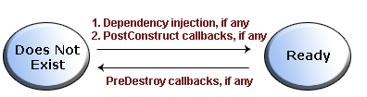
Life cycle of a stateless session bean
A stateless session bean generates the following life-cycle events.
        PostConstruct callback.
        PreDestroy callback.

Slide 7
Life cycle of a stateful
session bean
A stateful session bean generates the following life-cycle events.
        PostConstruct callback.
        PreDestroy callback.
        PostActivate callback.
        PrePassivate callback.

Slide 8
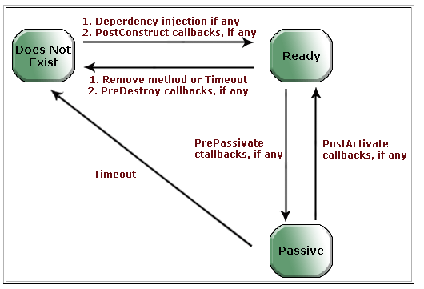

Slide 9
Difference between stateless and stateful session beans
Sateful Session Bean | Sateless Session Bean
Stateful session beans are not scalable. | Stateless session beans are scalable.
These type of beans requires more memory. | These types of beans requires less memory.

Slide 10
Session Beans
Compare EJB 2.1 vs EJB 3.0

Slide 11
Ejb 2.1 Requirements
These are all the things required in EJB 2.1
Home interface
Remote/Local interface
Bean class
XML Deployment descriptor

Slide 12
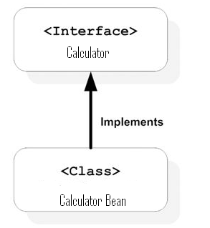
Business Interface
Bean Implementation class
EJB 3.0 Requires

Slide 13
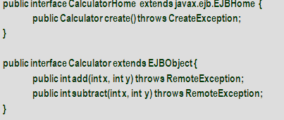
EJB 2.1 Required Interfaces

Slide 14
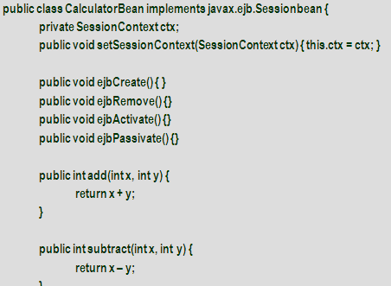
EJB2.1 Bean Class

Slide 15
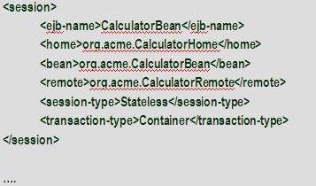
EJB 2.1 Deployment Descriptor

Slide 16
Ejb 3.0 Goals
Remove unnecessary interfaces
Remove unnecessary callbacks
Make deployment descriptors optional

Slide 17
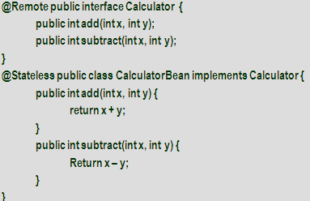
Required Interfaces

Slide 18
Thank you

