Slide 1
DIGITAL PORTFOLIO
STUDENT NAME: S.SUBASHINI
REGISTER NO AND NMID: 24131131802522017/asanm11324131131802522017
DEPARTMANT: B.SC COMPUTER SCIENCE
COLLEGE NAME AND UNIVERSITY: 113-VALLALAR ARTS AND SCIENCE COLLEGE,ANNAMALAI UNIVERSITY

Slide 2
PROJECT TITLE:
SPACE TOURISUM
PORTFOLIO

Slide 3
AGENDA:
1.Problem Statement
2.Project Overview
3.End Users
4.Tools and Technologies
5.Portfolio design and Layout
6.Features and Functionality
7.Results and Screenshots
8.Conclusion
9.Github Link

Slide 4
PROBLEM STATEMENT:
Space tourism is often seen as inaccessible and lacks engaging platforms for the public. This project creates an interactive portfolio website using HTML, CSS, and JavaScript to simulate space travel experiences.

Slide 5
PROJECT OVERVIEW:
Designed a responsive space tourism portfolio website using HTML, CSS, and JavaScript.
Showcases travel packages like Earth Orbit, Moon Flyby, and Mars Preview.
Includes interactive booking alerts to simulate user engagement.
Features mission details and contact form with alert messages.
Built as a creative portfolio project to demonstrate web design and development skills.

Slide 6
END USERS:
Space enthusiasts curious about tourism opportunities.
Recruiters or companies reviewing my portfolio projects.
Students and learners exploring creative web design ideas.

Slide 7
TOOLS AND TECHNIQUES:
HTML5 – Structure of the website
CSS3 – Styling and responsive design
JavaScript – Interactivity and alerts
Unsplash Images – High-quality space visuals

Slide 8
PORTFOLIO DESIGN AND LAYOUT:
Clean, modern, and space-themed UI with dark background.
Responsive grid layout for travel packages.
Sticky navigation bar for smooth access.
Hero section with background image and tagline.

Slide 9
FEATURES AND FUNCTIONALITY:
Provides a hero section with inspiring space imagery and tagline.
Displays multiple travel packages (Earth Orbit, Moon Flyby, Mars Preview) in a responsive grid.
Includes interactive booking buttons with alert messages for simulation.
Features a contact form with input validation and alert-based messaging.
Designed with hover effects, smooth transitions, and sticky navigation for better user experience.
Fully responsive layout, optimized for both desktop and mobile devices.

Slide 10
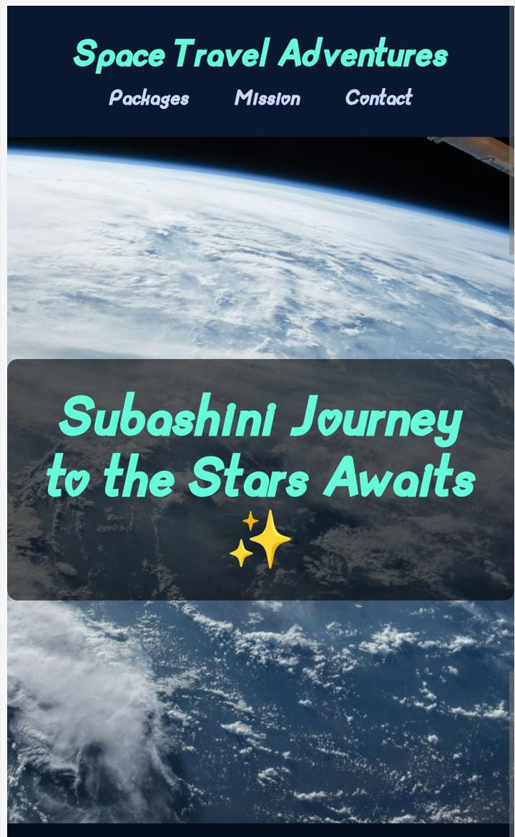
RESULTS AND SCREENSHORT:
Built a responsive and interactive space tourism portfolio website using HTML, CSS, and JavaScript.
Showcased features like booking alerts, travel packages, and contact form with a space-themed design.

Slide 11
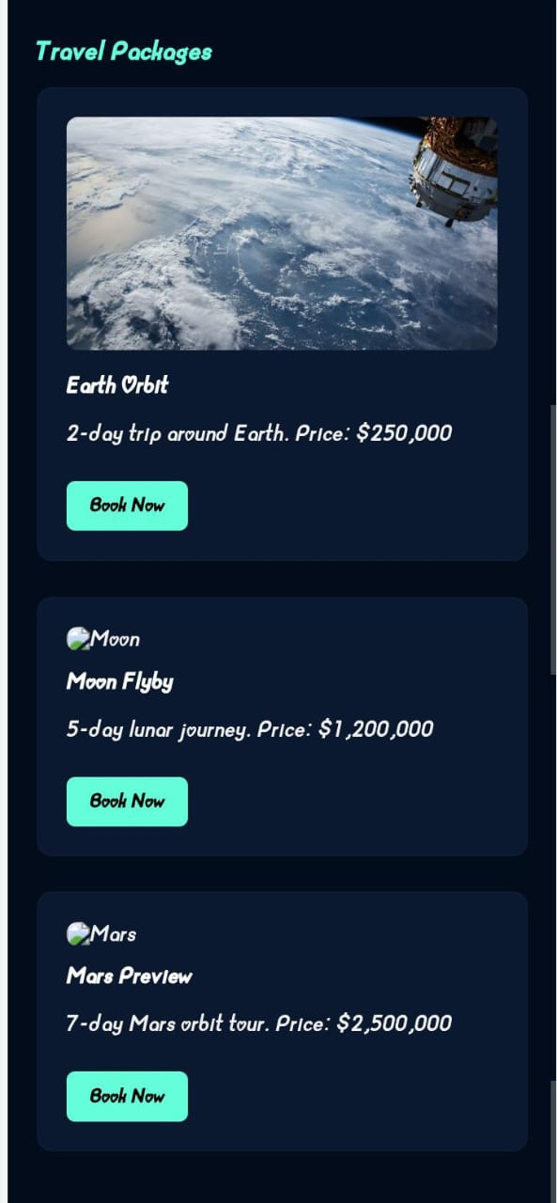
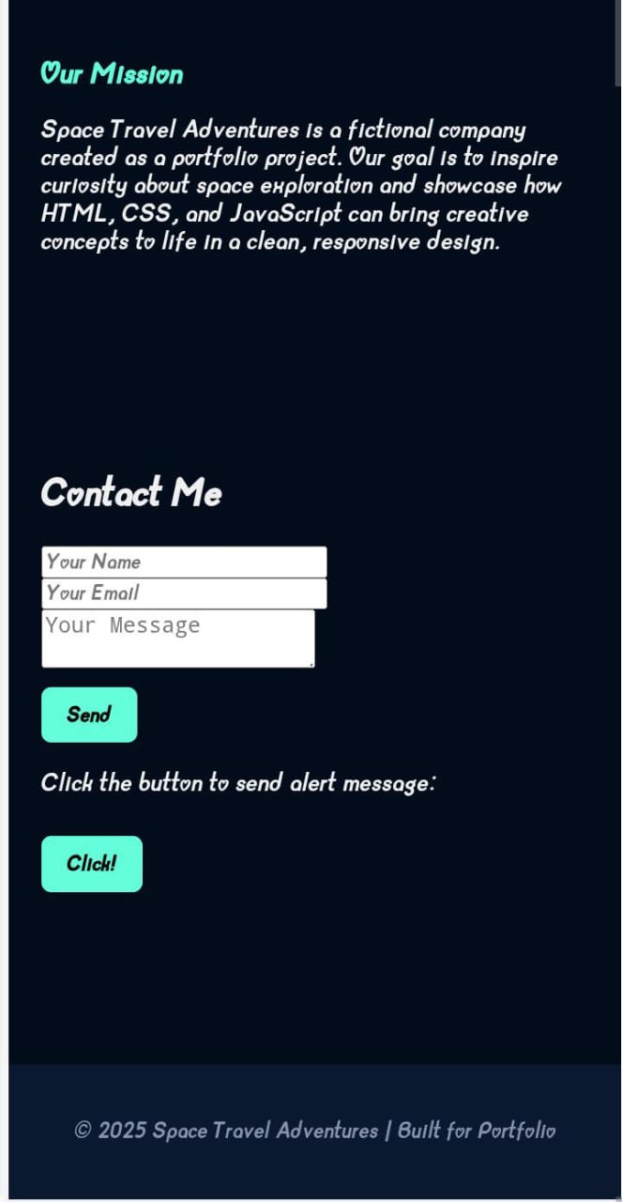

Slide 12
CONCLUSION:
This project demonstrates how HTML, CSS, and JavaScript can be used to design an engaging portfolio website. The space tourism theme highlights creativity while showcasing interactive features like booking alerts and contact forms. It reflects both technical skills and innovative design for portfolio presentation.

