Slide 1
AGRHI
Mobile Application

Slide 2
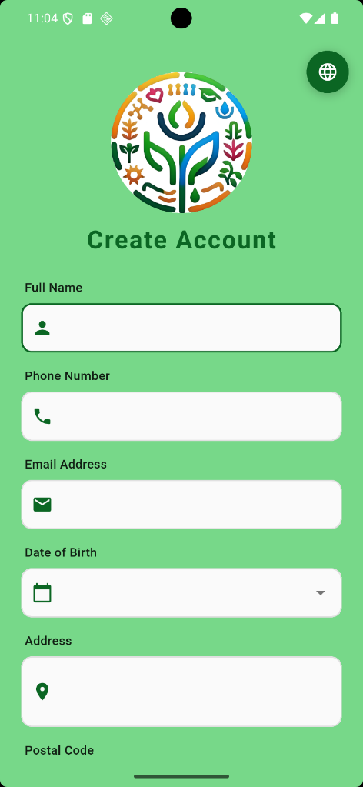
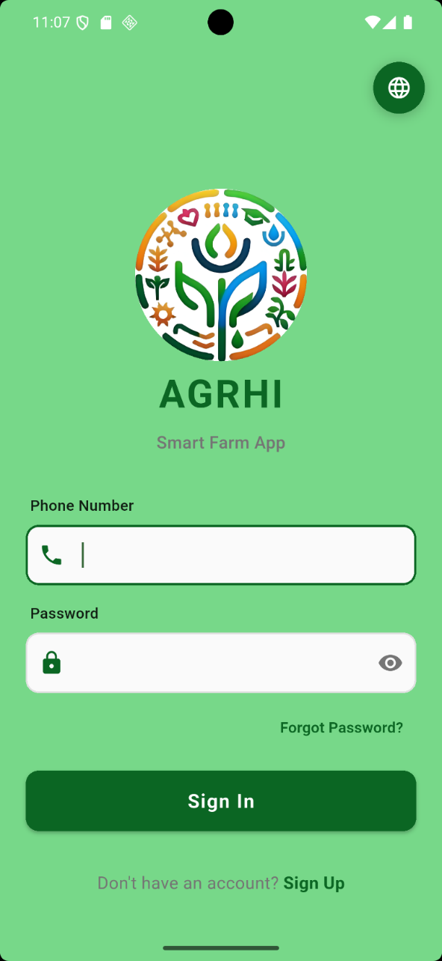
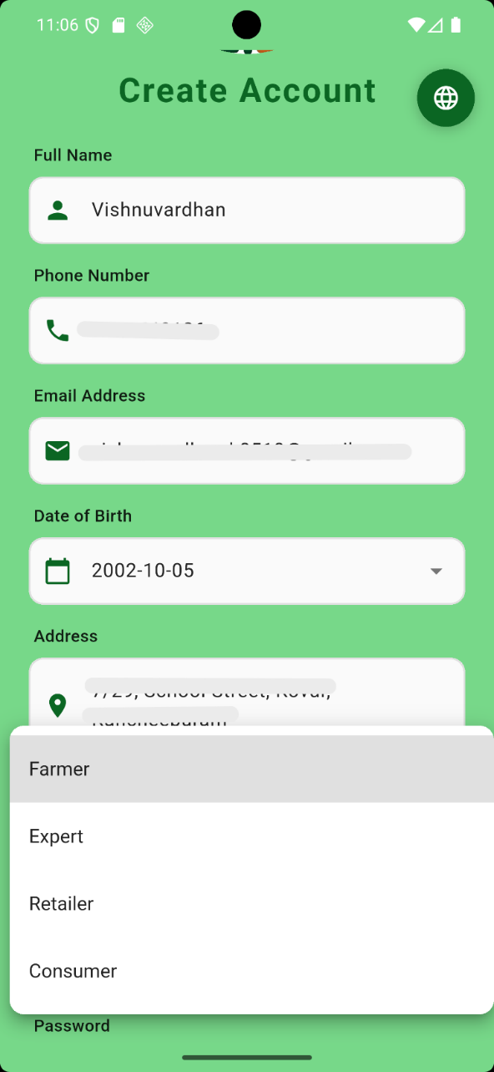
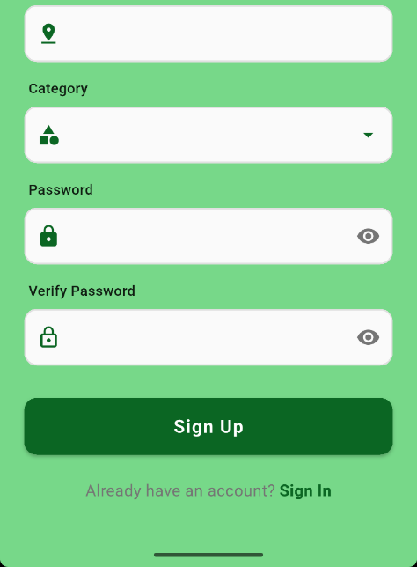
1
REGISTER AND LOGIN
Open AGRHI and choose Sign Up to create a new account, or Sign In if you already have one.
For registration, fill Full Name, Phone Number, Email Address, Date of Birth, Address, and Postal Code.
Select your Category from the list: Farmer / Expert / Retailer / Consumer.​
Create a Password and re-enter it in Verify Password; use the eye icon to show/hide password text.​
Tap Sign Up to register, then use Sign In to log in with your phone number and password.

Slide 3
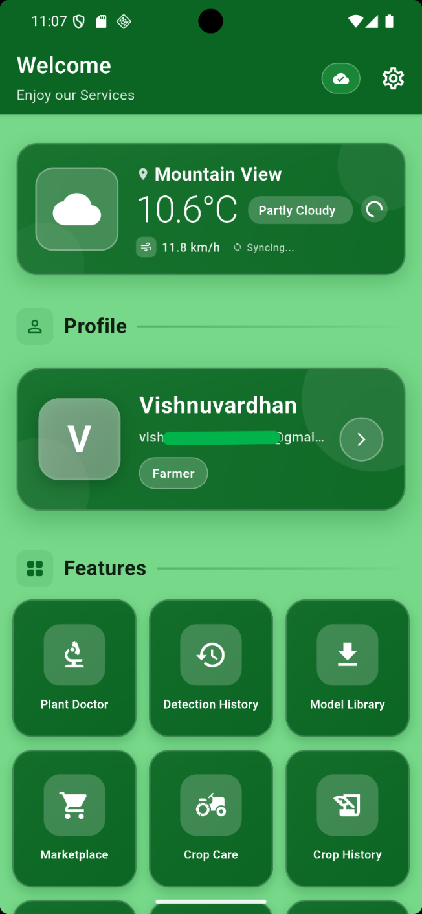
2
DASHBOARD
Weather card
After a successful Sign In, you are redirected to the Dashboard.​
On the Dashboard, you can view the Weather card which had current weather conditions, you can view Profile card, and the available app Features.​
Tap the Profile card to open your Profile page.
Profile card
App Features

Slide 4
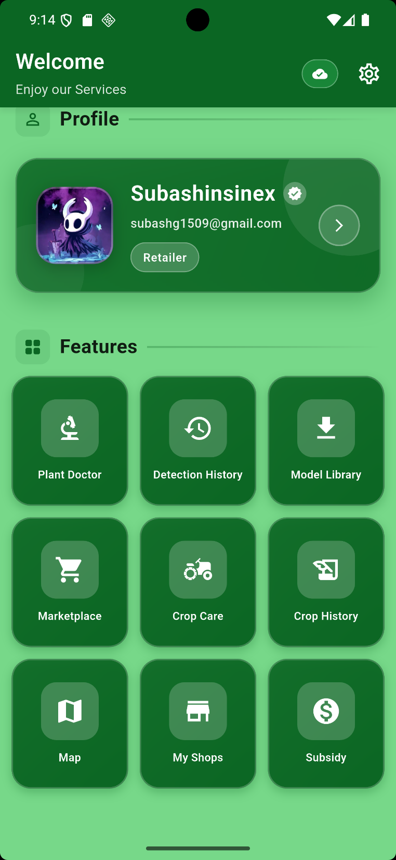
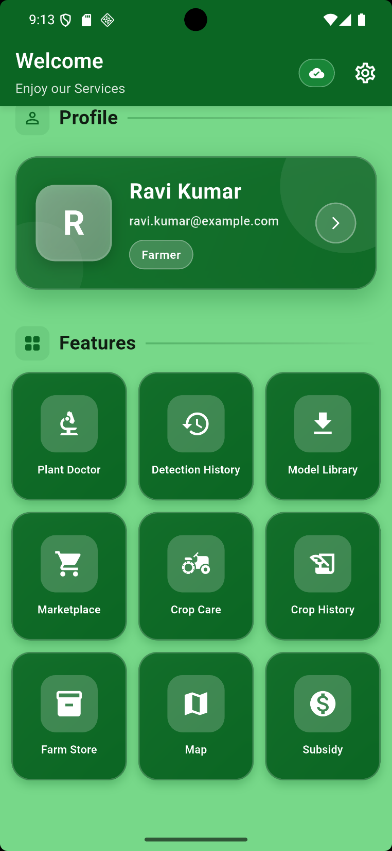
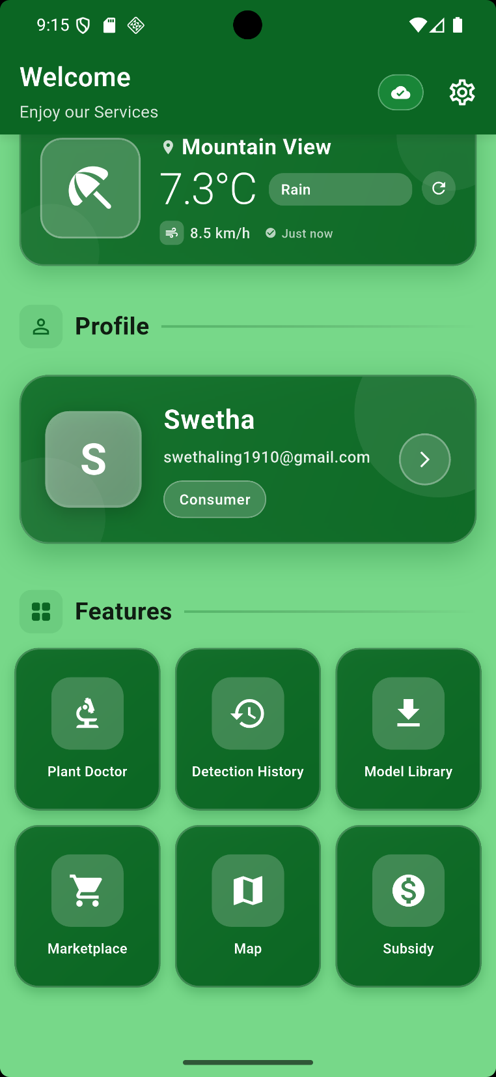
3
RETAILER
FARMER
CONSUMER

Slide 5
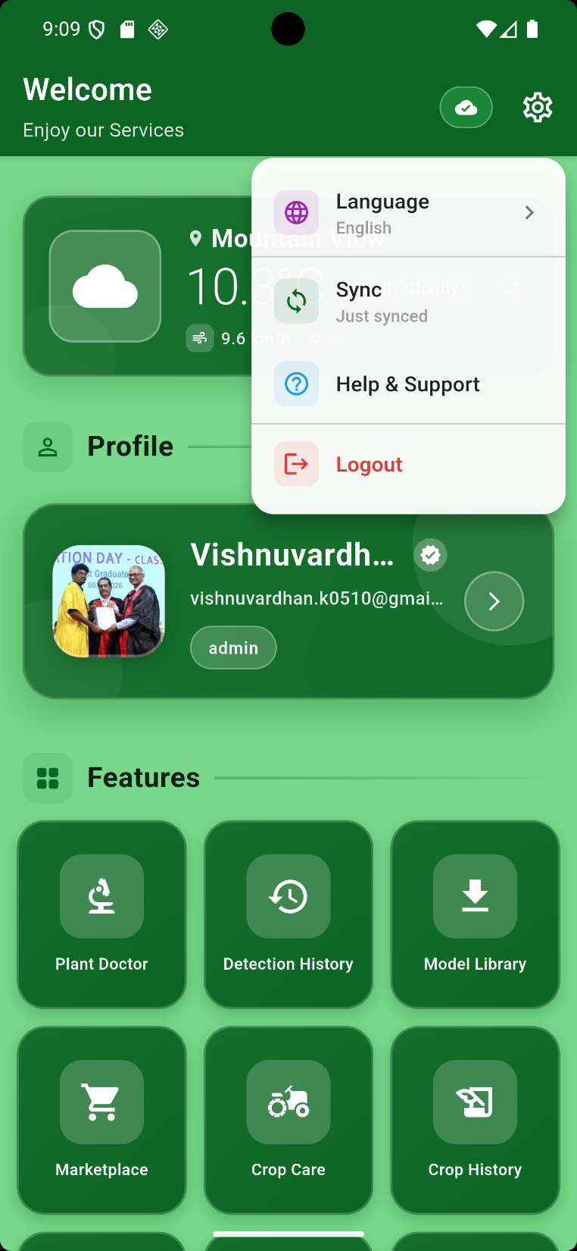
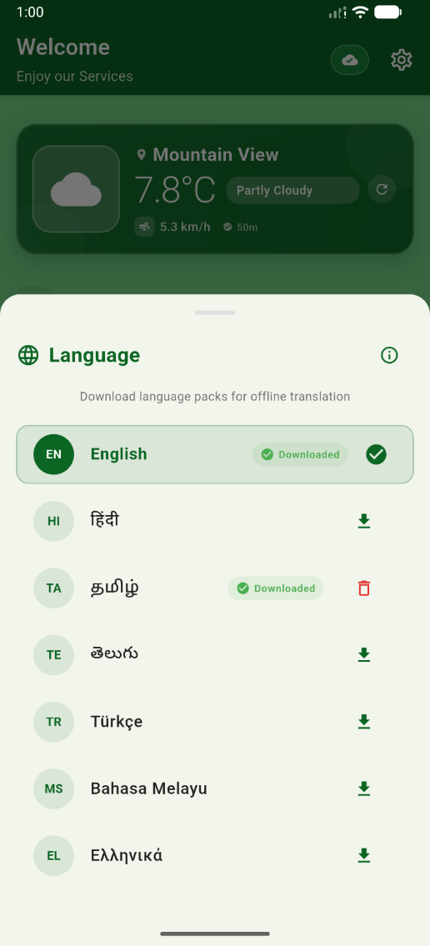
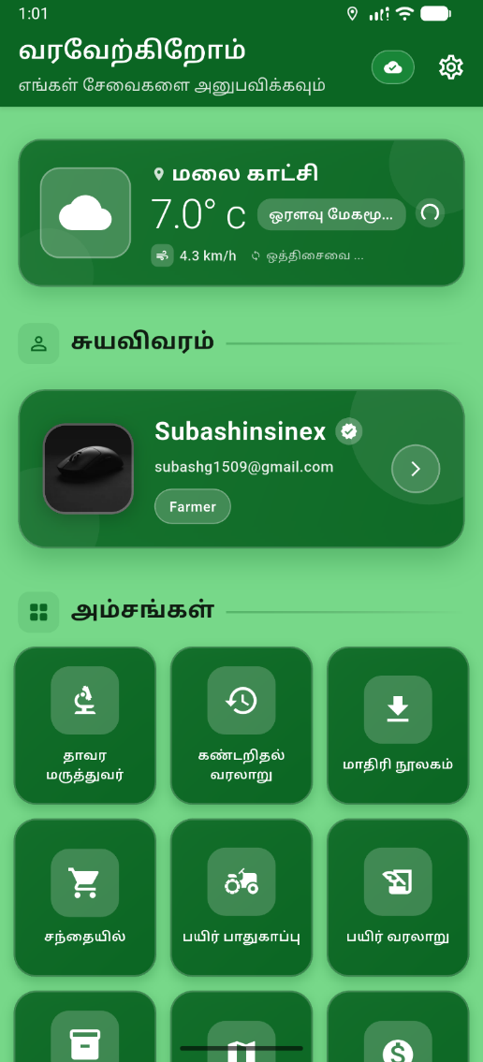
4
MULTILINGUAL FEATURE
AGRHI supports seven languages: Tamil, English, Hindi, Telugu, Greek, Turkish, and Malay - available as downloadable content (20 MB per language).
Users can select preferred language during setup and switch anytime.
All interface elements and notifications are localized for cultural appropriateness.

Slide 6
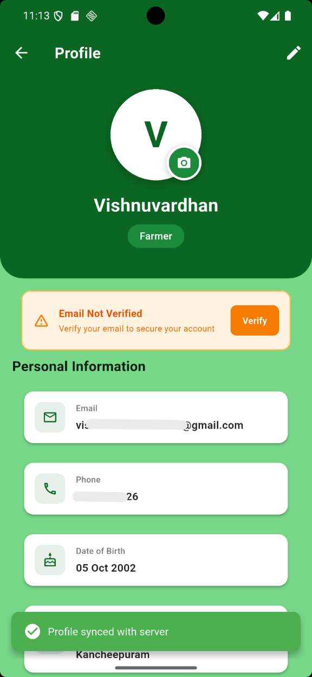
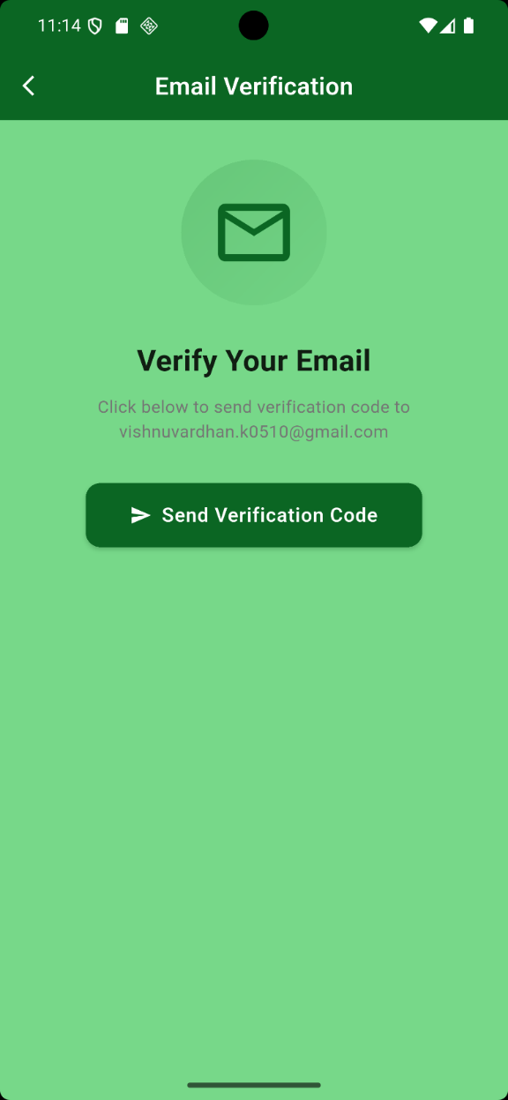
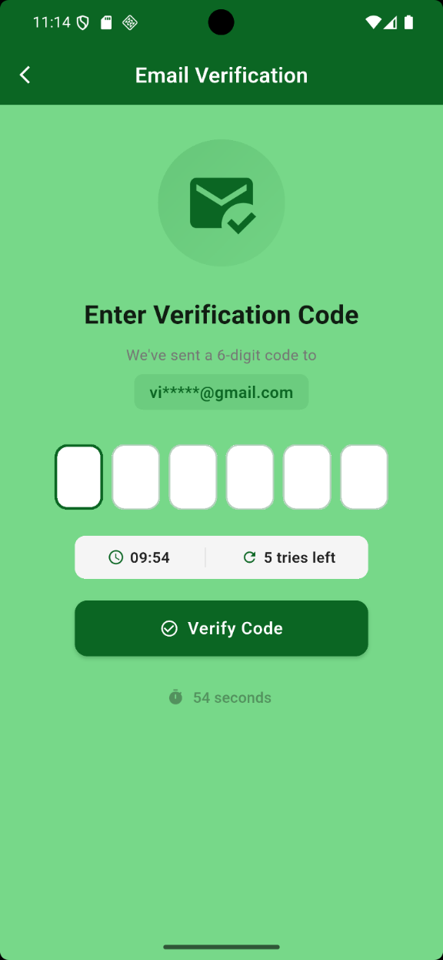
5
PROFILE PAGE AND EMAIL VERIFICATION
In the Profile page, check your personal details (email, phone, and date of birth) and verify your mail address.
If your email is not verified,
Tap verify, and it will direct to this page
Tap this and a verification code has sent to your mail address.
enter the 6-digit OTP, and tap Verify Code to complete email verification.

Slide 7
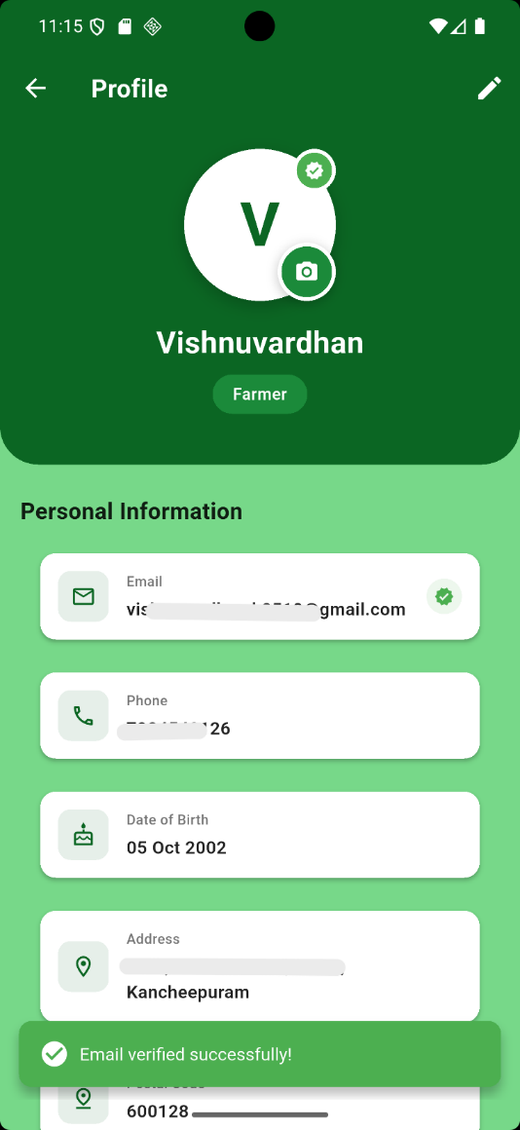
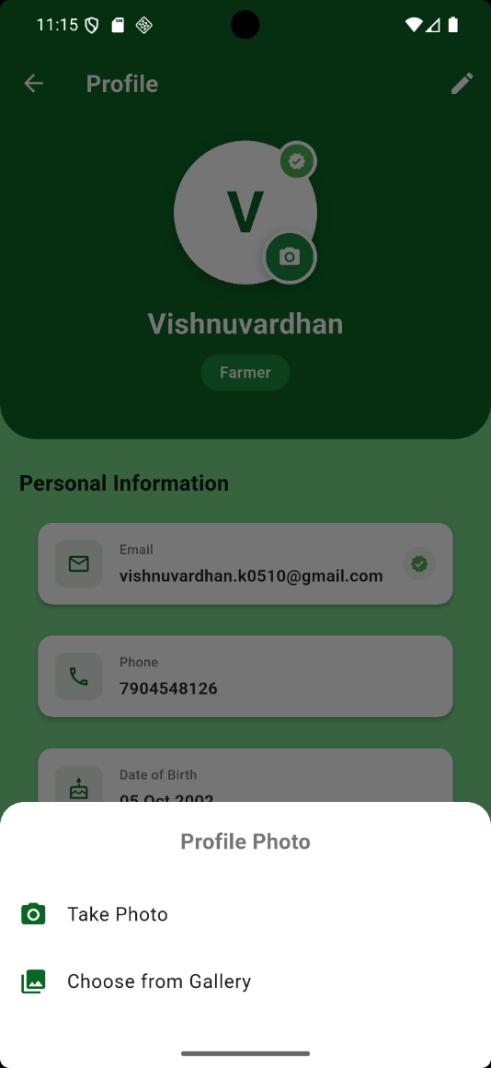
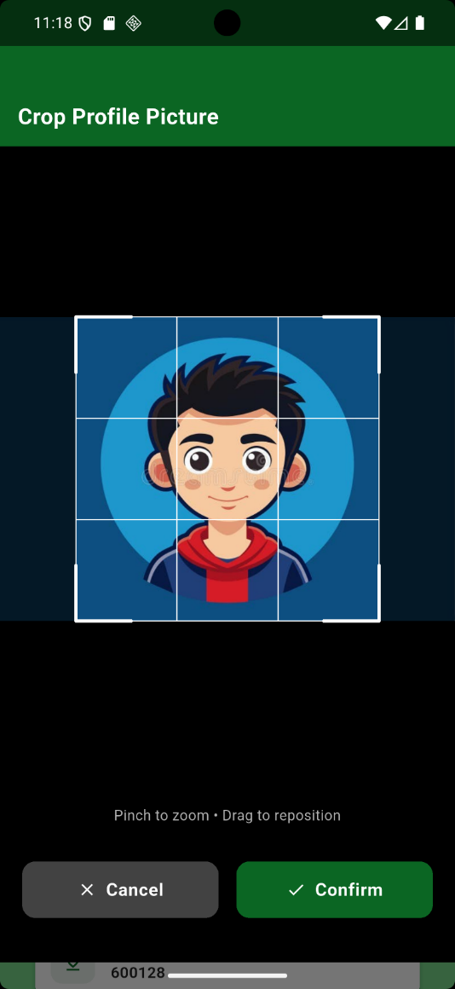
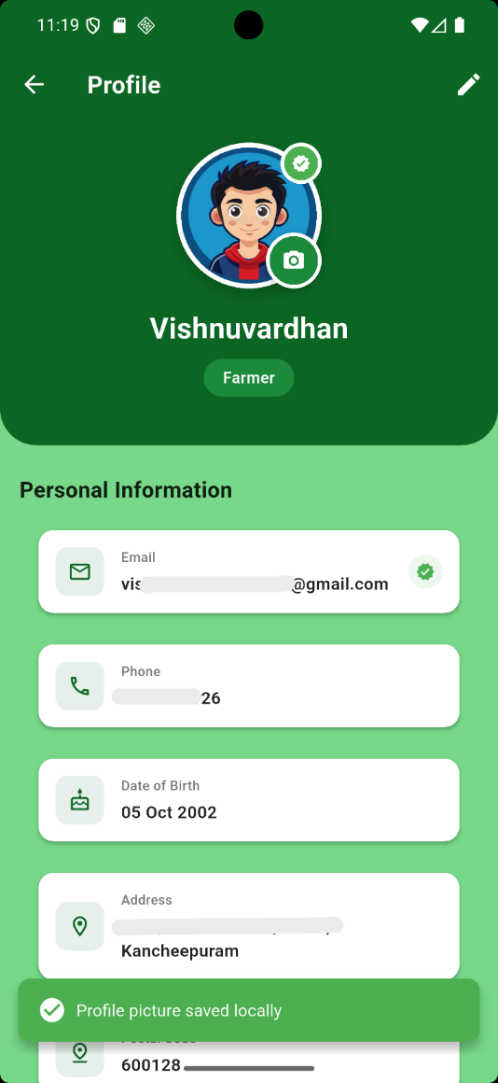
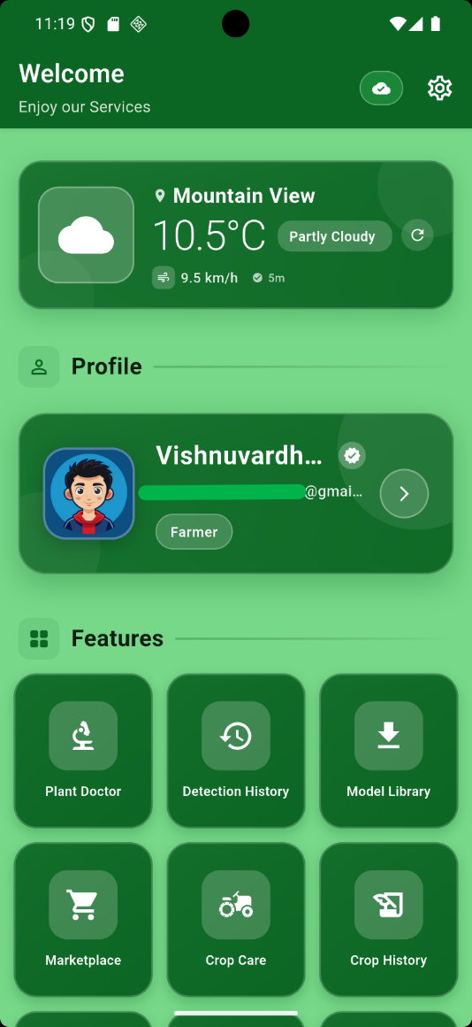
SET YOUR PROFILE PHOTO
6
Tap the camera icon on the profile avatar to update your profile photo.
2. Choose a source:
Take Photo (use camera) or Choose from Gallery (select an existing image).
3. Adjust the image in the crop screen (pinch to zoom and drag to reposition),then tap Confirm to apply the photo.
4. Verify the update is saved by checking the new profile picture on the Profile page and in dashboard.

Slide 8

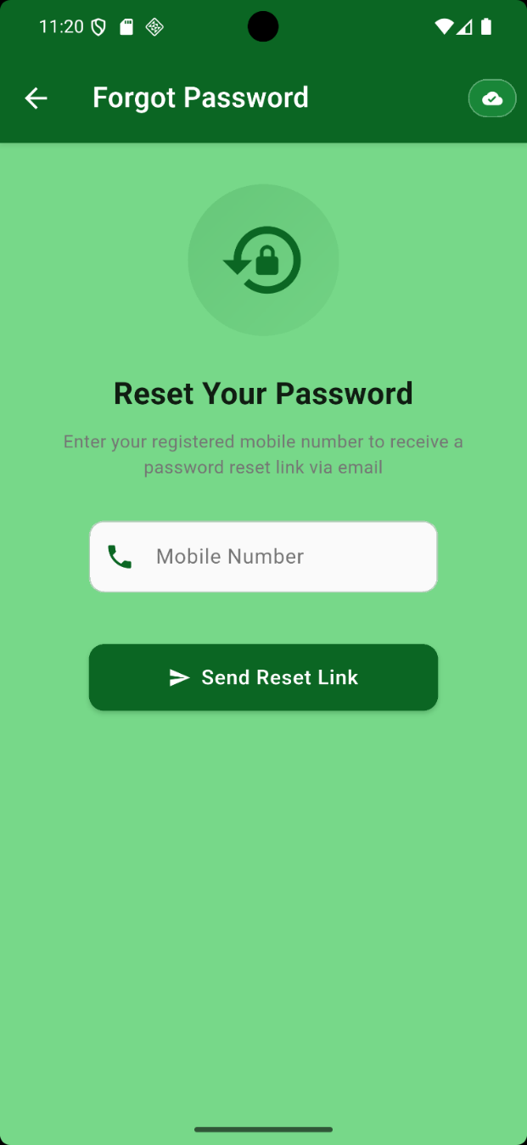
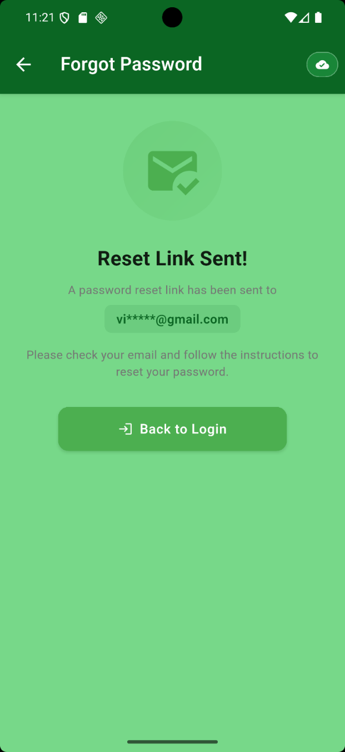
FORGOT PASSWORD
7
If you forgot the password while login, tap Forgot Password? to open the password recovery page.
Enter your registered mobile number and tap Send Reset Link.
Check your email inbox for the “Reset Your Password” message and open it.

Slide 9
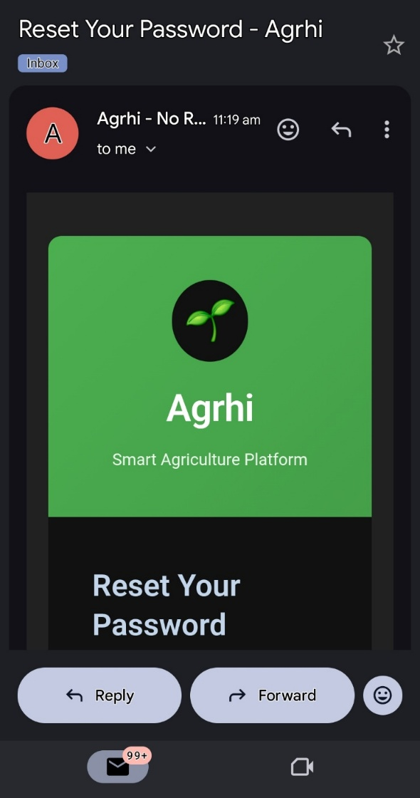
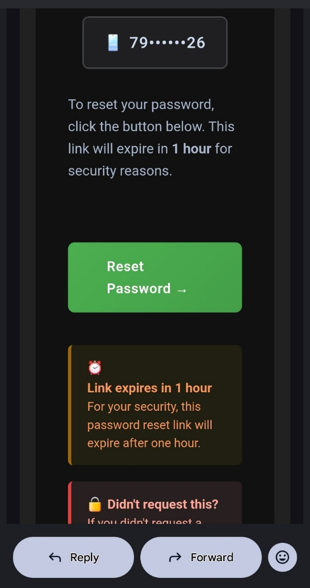
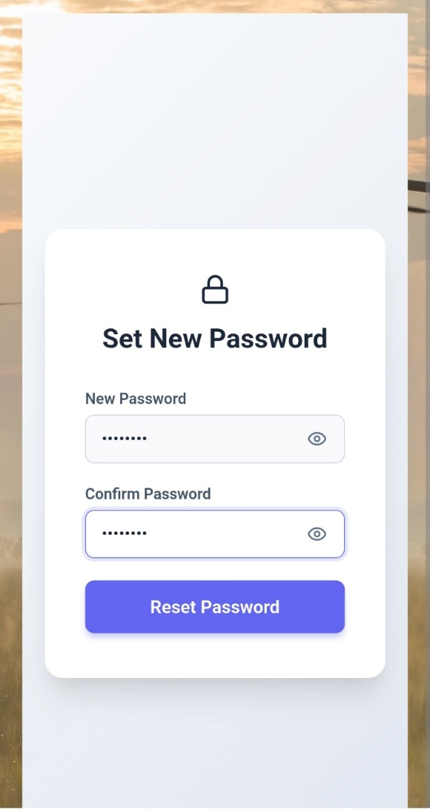
8
Tap the Reset Password button in the email to open the password reset webpage.​
On the “Set New Password” page, enter and confirm your new password, tap Reset Password.
Then return to the mobile app and sign in using the updated password.

Slide 10

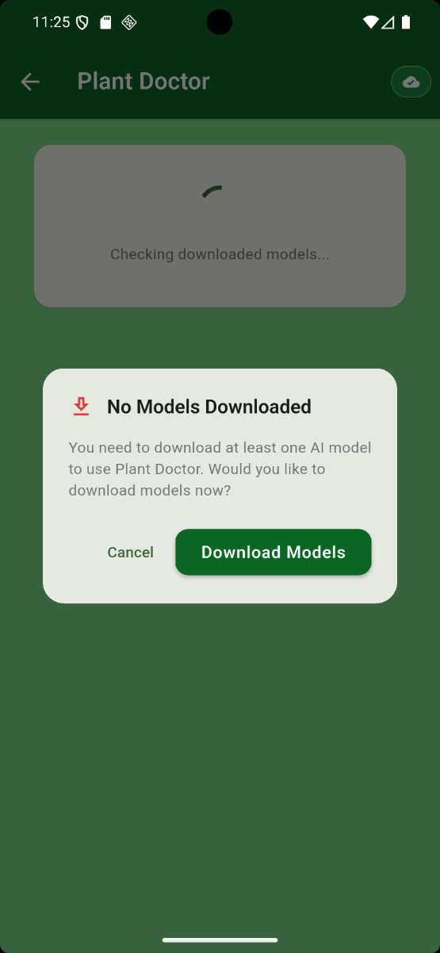
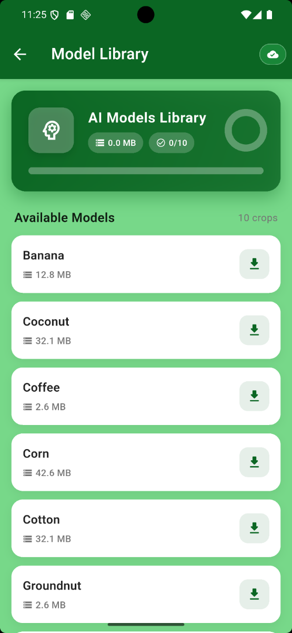
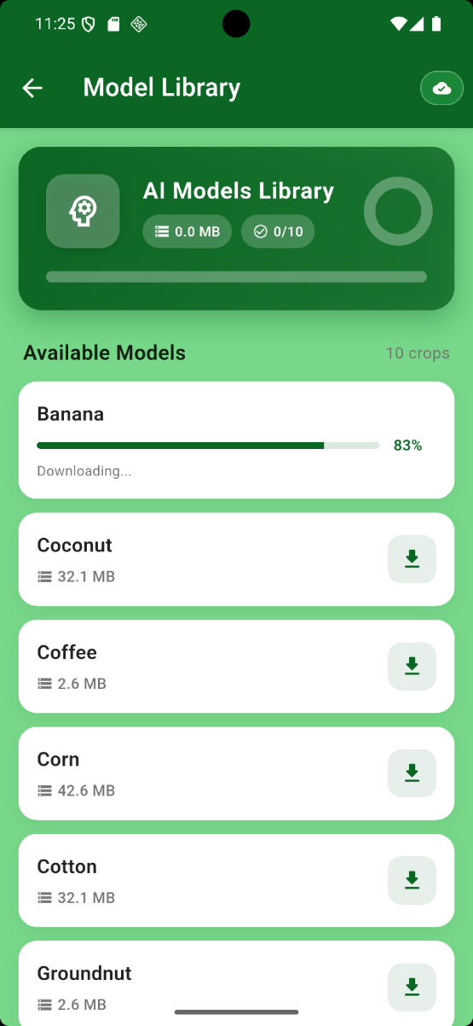
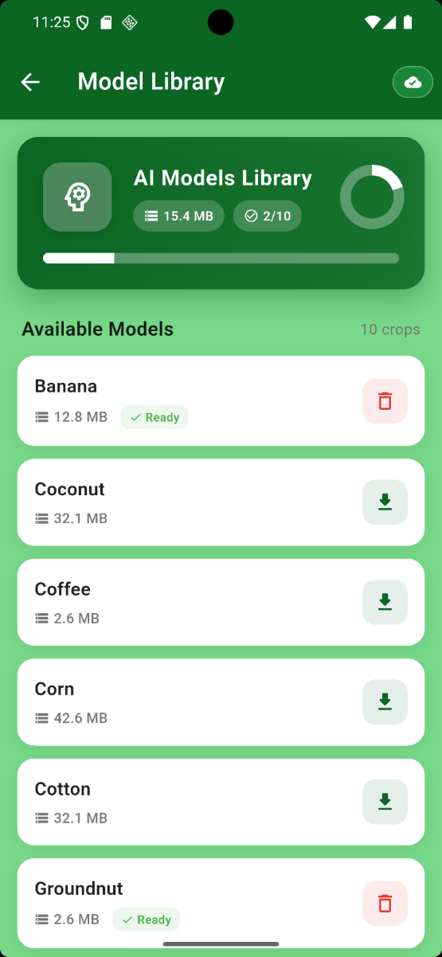
MODEL LIBRARY
9
1. From the Dashboard, tap Plant Doctor for crop disease detection.
2. If no ML models are available, a “No Models Downloaded” message appears; tap Download Models to open the Model Library.
In AI Models Library, select the required crop model from the 10 available options and download it until the status shows Ready.
Once ready, return to Plant Doctor and start disease detection using the downloaded model.

Slide 11
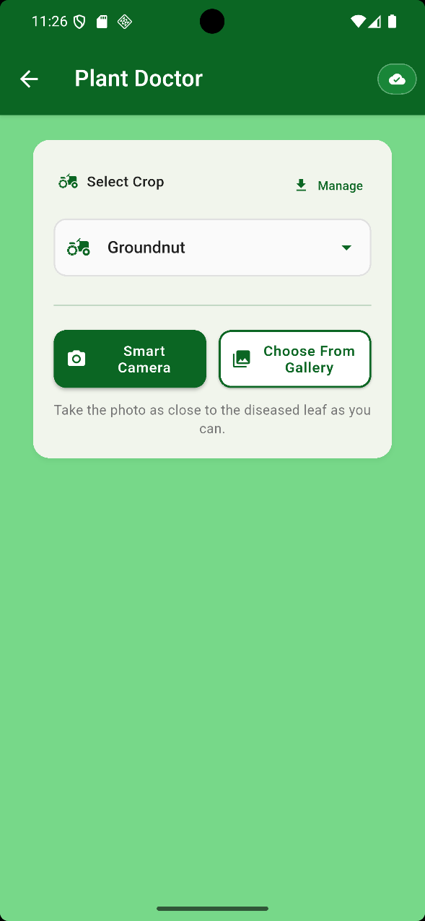
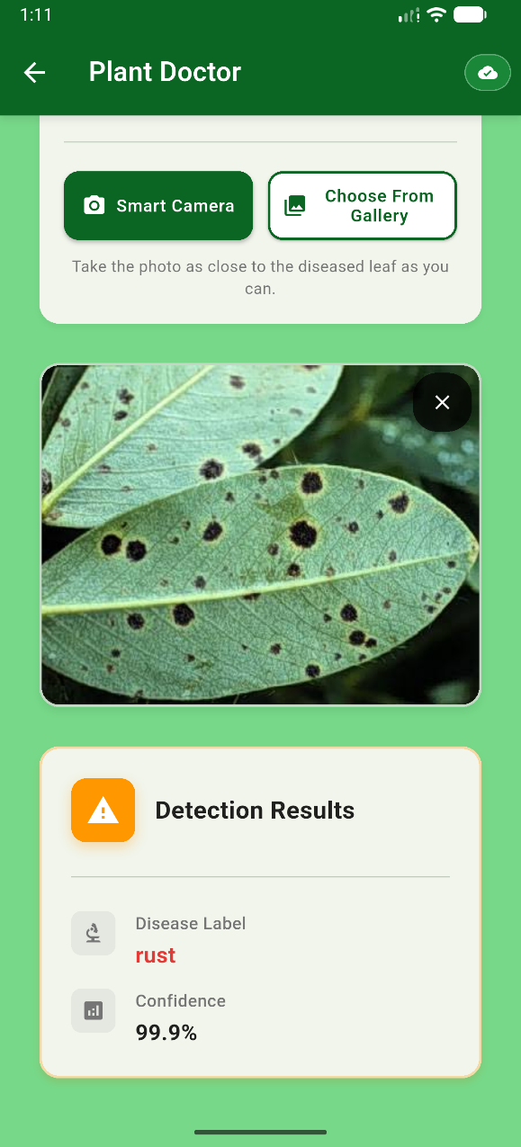
PLANT DOCTOR
(CROP DISEASE DETECTION MODULE)
10
In Plant Doctor, select the required crop model from Select Crop (ensure the correct model is chosen for your crop).​
Tap Choose From Gallery and select a clear leaf image for analysis.​
The app processes the image and displays the Detection Results, including the detected disease label and confidence score.

Slide 12
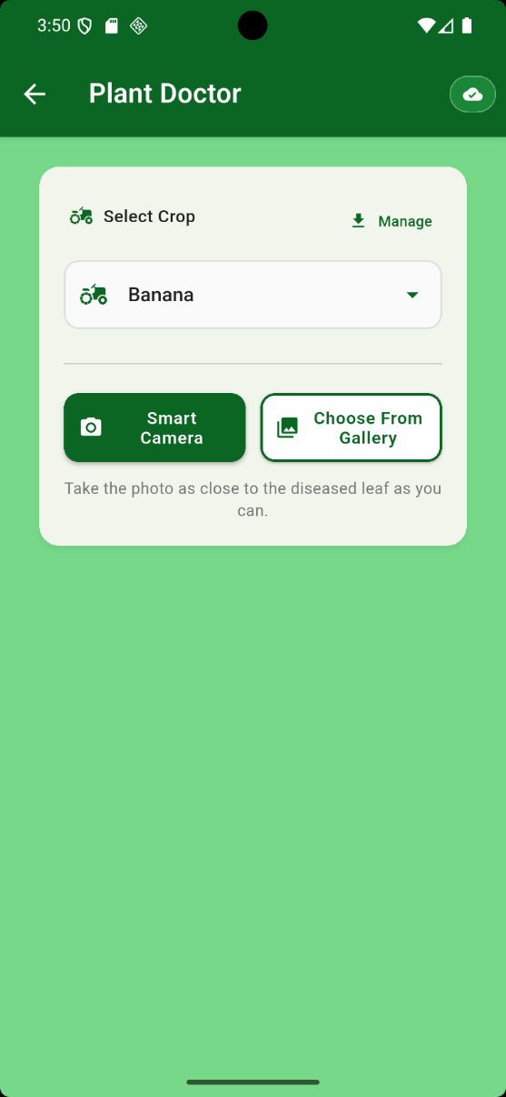
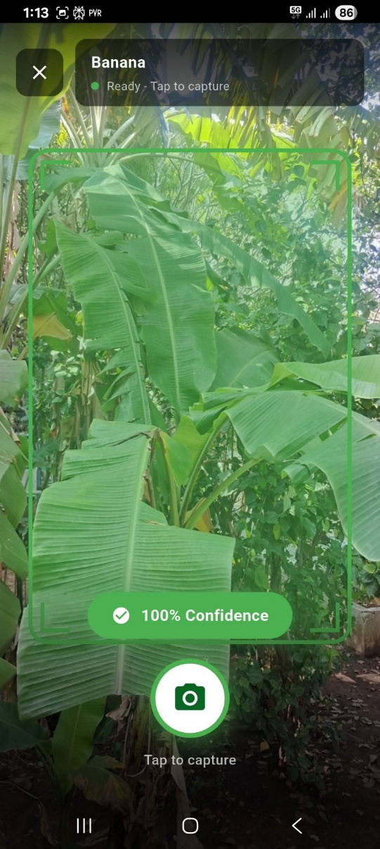
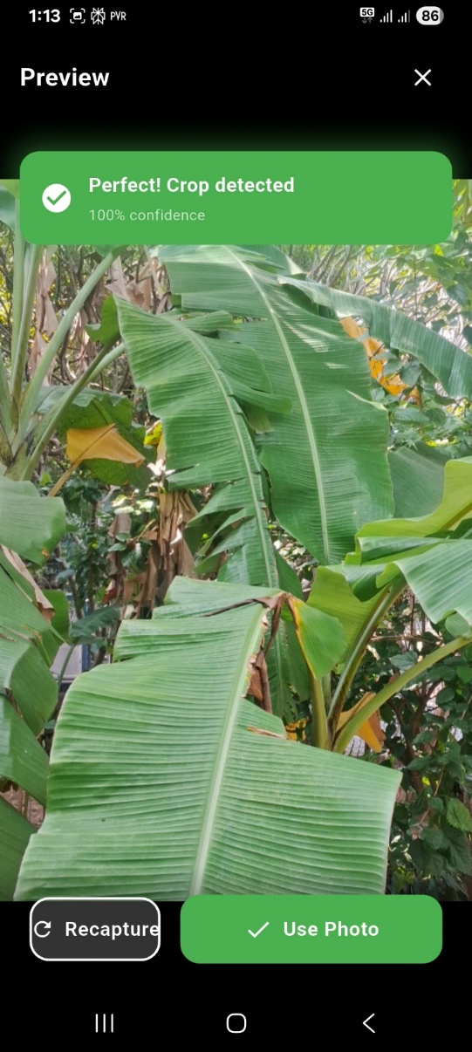
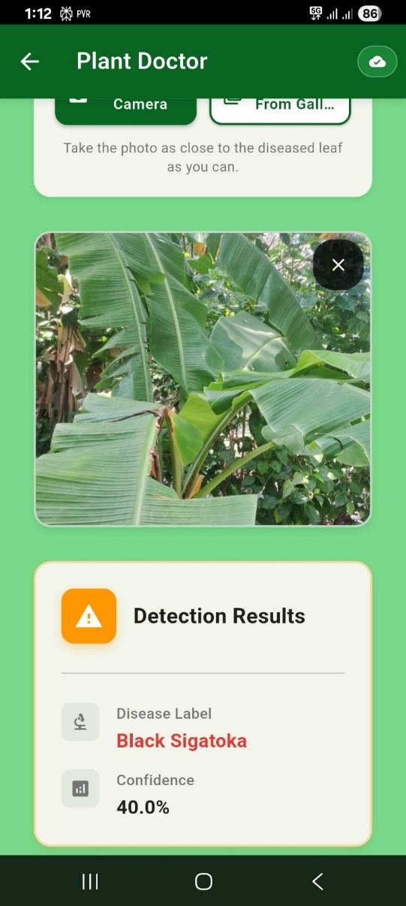
SMART CAMERA
11
1. In Plant Doctor, select the crop model (e.g., Banana) and tap Smart Camera to start plant/leaf detection.
2. Point the camera at the leaf; the integrated ML model validates the frame in real time and allows capture only when a plant/leaf is detected (status shows “Ready” with confidence).
3. Tap to capture, confirm with Use Photo, and view the Detection Results showing the identified disease and confidence level.

Slide 13
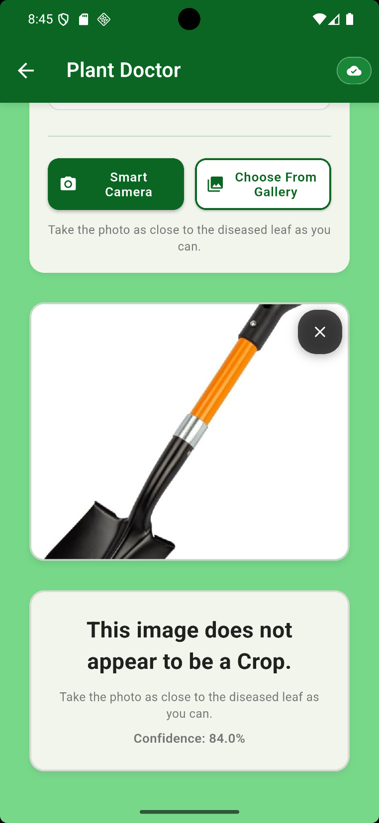
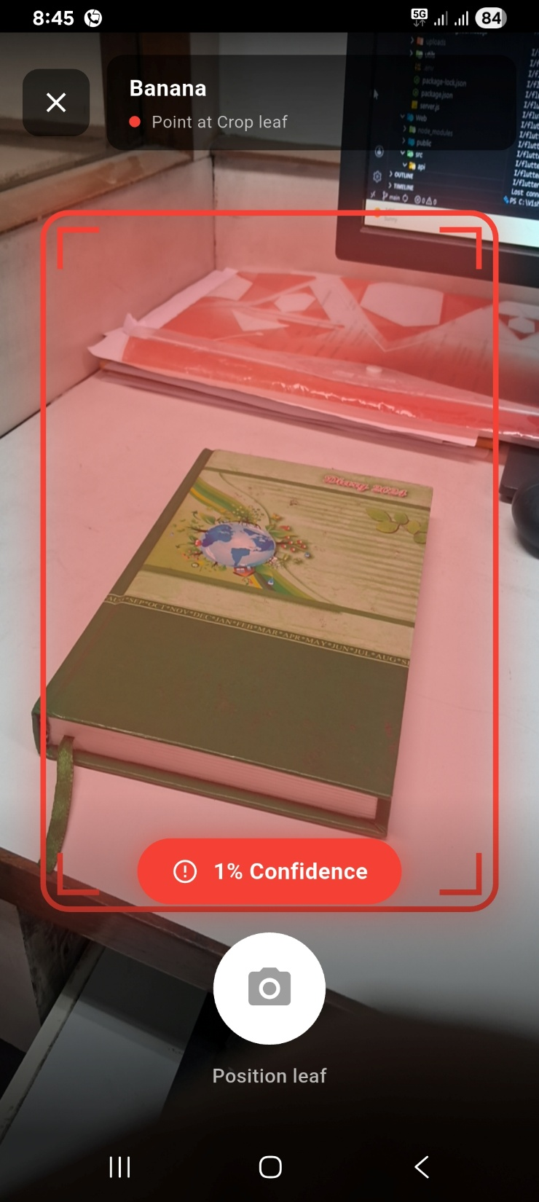
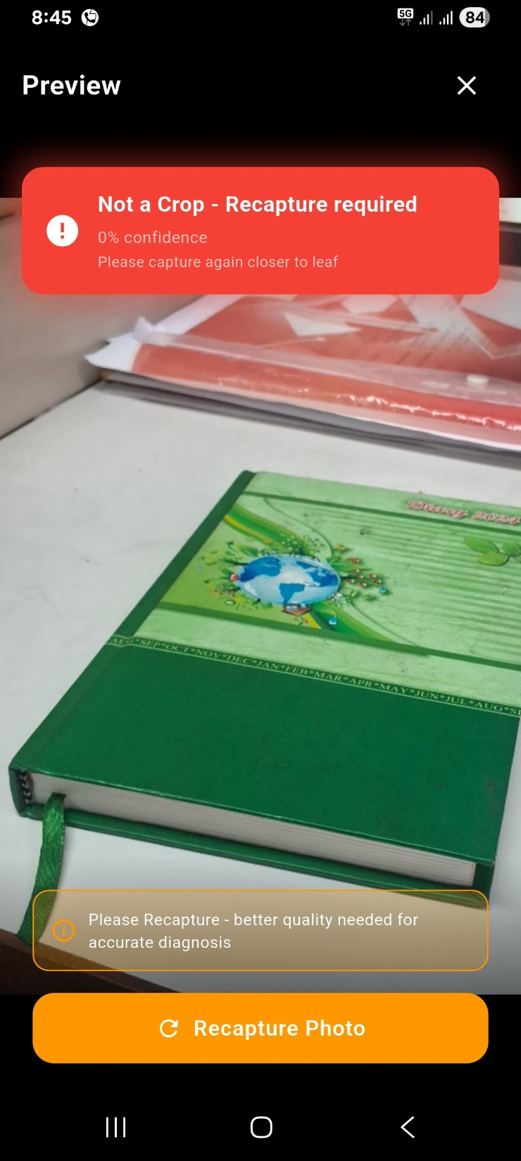
NON-PLANT DETECTION
12
If we upload a non-plant image, the model detects it as non-plant and could not predict with the disease detection models.
The result has been shown like this.
In Smart Camera module, if we try to capture non-plant image, The model predicts it as non-crop and requires recapture of crop image

Slide 14
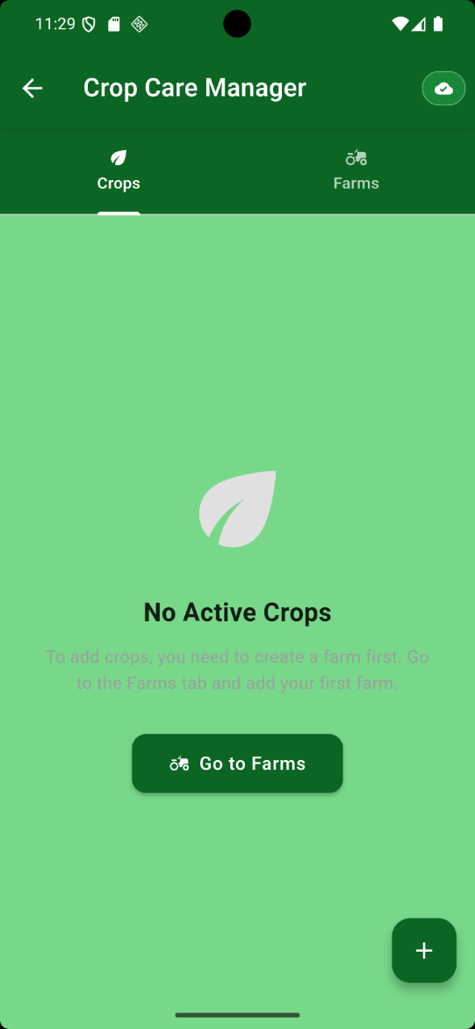
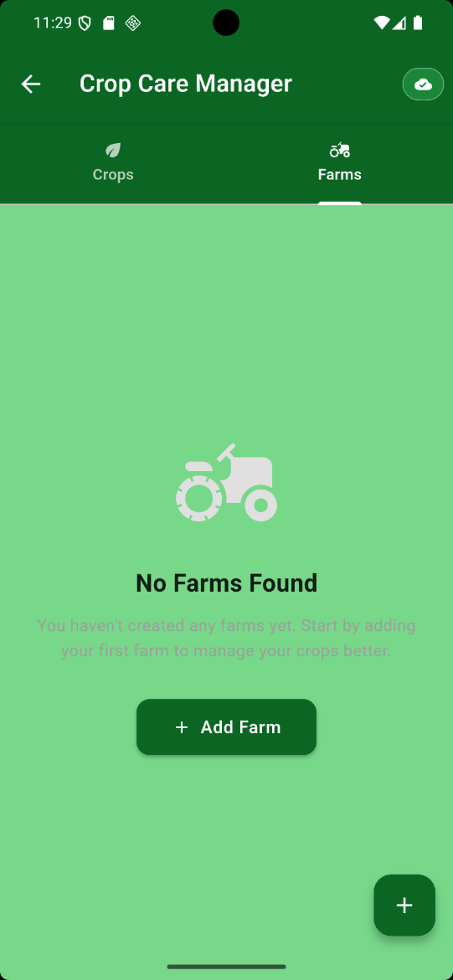
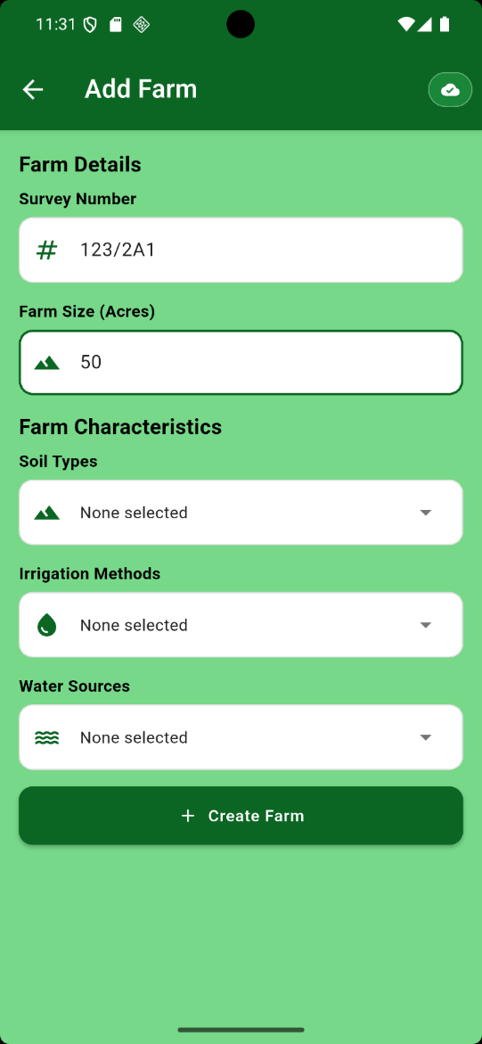
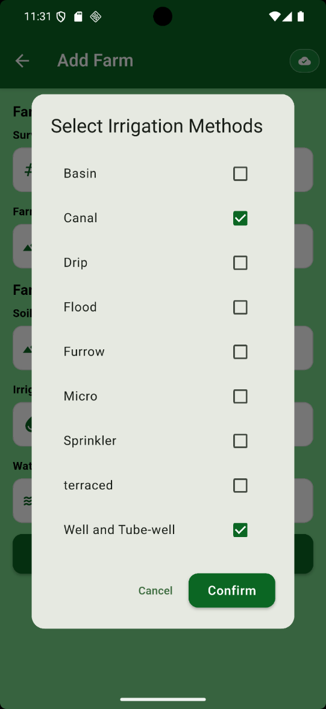
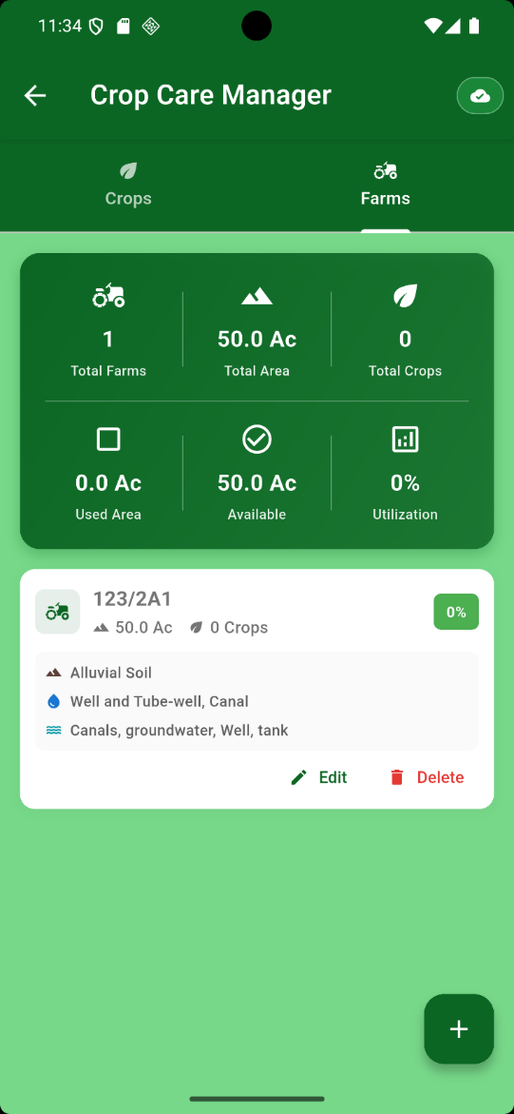
CROP CARE MANAGER
(FARM AND CROP MANAGEMENT)
13
Open Crop Care Manager and go to the Farms tab; tap Add Farm to start creating your first farm.​
Enter the farm details (Survey Number, Farm Size, Soil Type, Irrigation Methods, and Water Sources) and confirm your selections, then tap Create Farm.
3. After the farm is created, the dashboard provides the summary of farm assets.

Slide 15
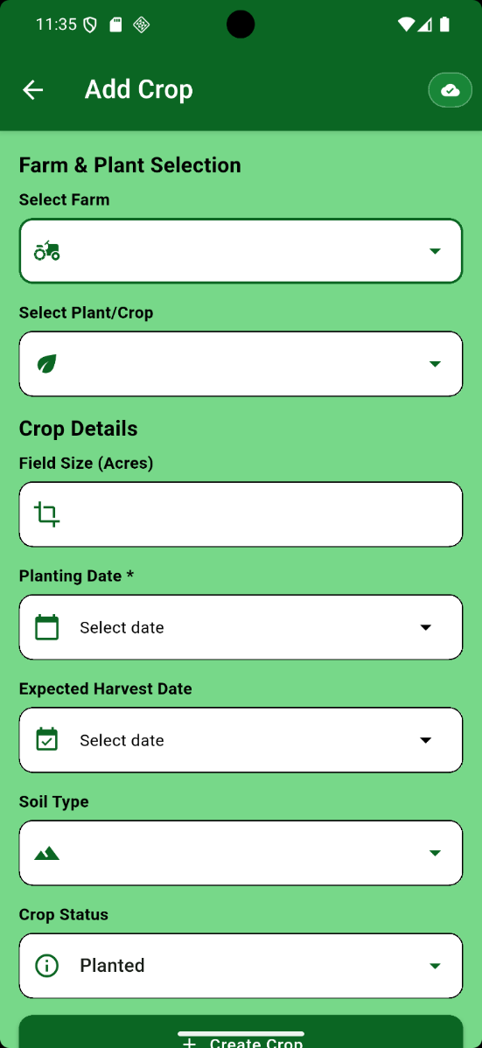
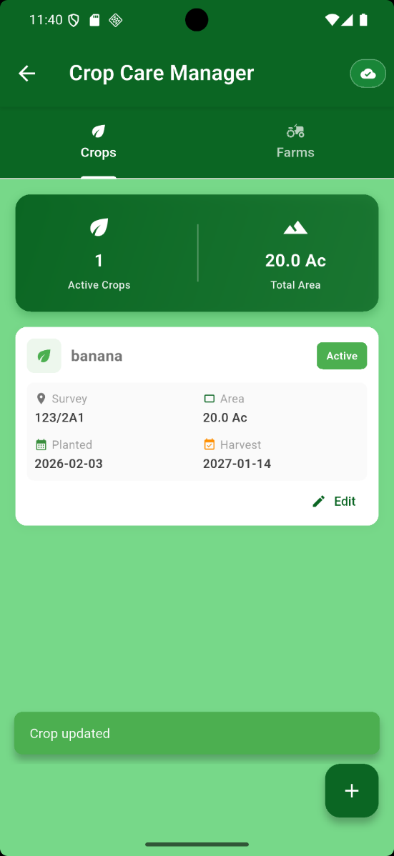
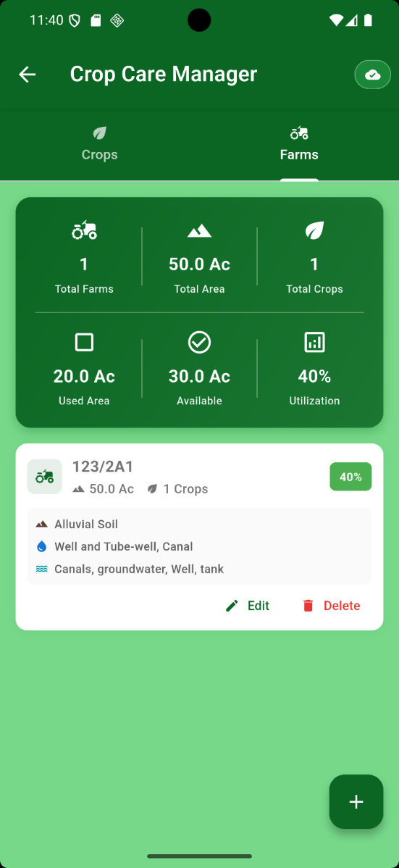
14
Open Add Crop: Now, in crops section, Add Crop.
Enter Details: Select the farm which was created in farms section, crop type and specify the field size in acres.
Set Schedule: Choose the planting and expected harvest dates, then tap "Create Crop" to save.

Slide 16

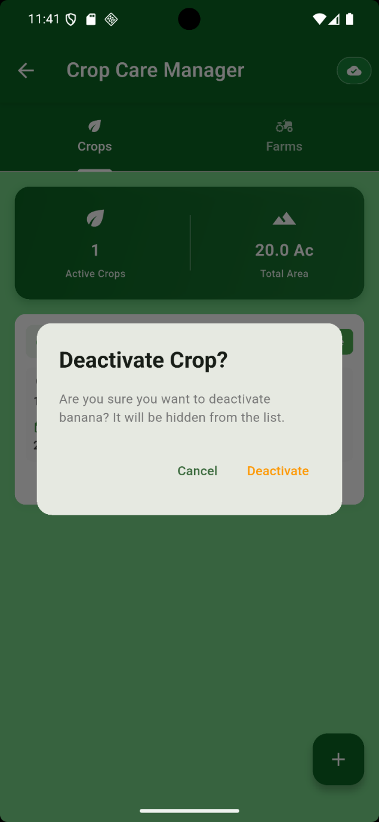
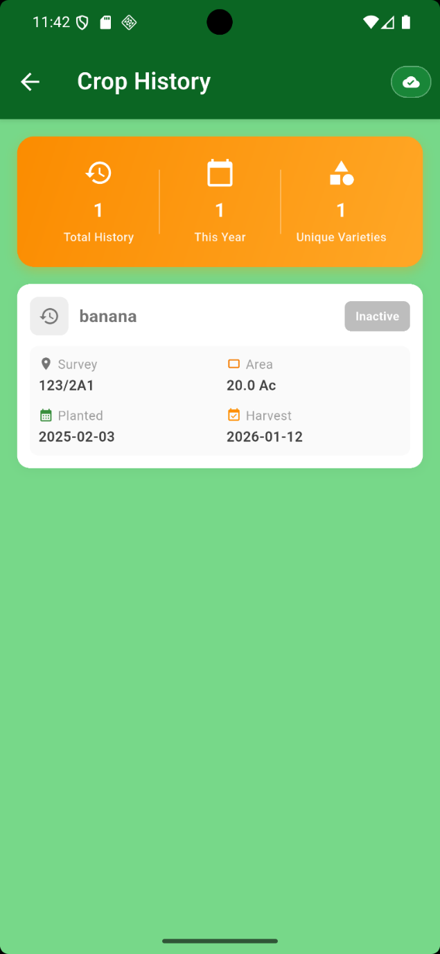
15
Once the crop is created, we can deactivate the crop manually.
Tap this to deactivate
If we deactivated the crop, it will store in crop history module.

Slide 17
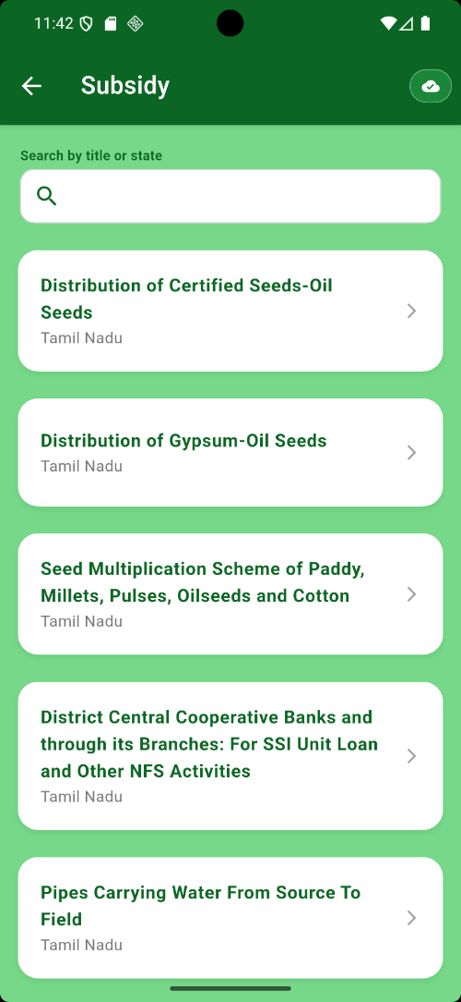
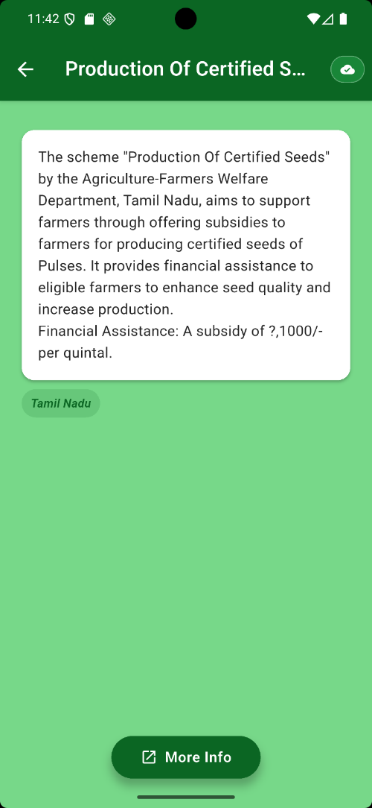
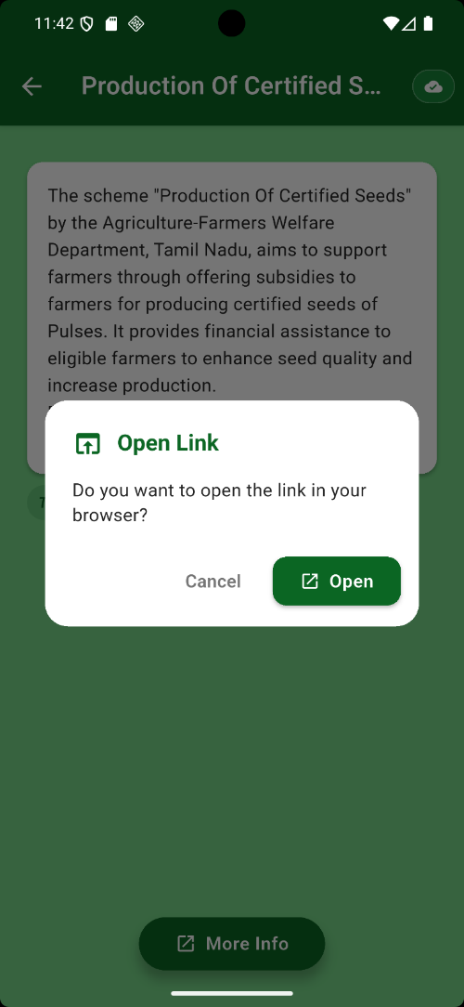

16
SUBSIDIES MODULE
Tap the subsidy card to get details.
To get more details, tap more info and it will redirect to official govt website

Slide 18



17
FARM STORE
Open the app.
On the Welcome Dashboard, tap Farm Store under Features.
If store location is not set, you will be redirected to Farm Store Setup.
NOTE: This is your permanent selling location. Set carefully.
Step 1: Open Location Setup
Tap Get My Exact Location.
Step 2: Read Important Notice
Review the information popup.
Tap I Understand to continue.
Tap Farm Store
Tap Get My Exact Location
Tap I Understand

Slide 19


18
STEP 3
Your current GPS location appears on the map.
Tap anywhere within 100 meters to adjust if needed.
STEP 5
Review coordinates in the confirmation popup.
STEP 4
Verify the address displayed under Your Selling Location.
Tap Confirm
Tap Confirm Location

Slide 20



19
STEP 2:
Choose:
Camera (take photo)
Gallery (select existing image)
Note: Use clear, well-lit images.
STEP 3: Enter product Information
(Product name, variety, description, price, unit and quantity)
Tap Create Product
STEP 1: Open My Farm Products
Go to Farm Store.
Tap Add or Add Product button.

Slide 21




MY SHOPS
(RETAIL MANAGEMENT)
20
If you are a retailer, you can access My shops feature to add your shop.
Tap Add Shop to create the shop
Tap to capture shop image Note: While you capture the image, your GPS location can captured automatically
Verify your Shop Image, GPS coordinates and location on the map.
Tap My Shops

Slide 22



21
2. If your shop is added, your retail details should be verified by admin based on the shop image, location, phone number and registration details.
Tap Create Shop
1. While creating the shop Enter shop phone number, shop address and Business Type. Enter Optional Registration details for verification purposes.
Note: The verification has done within 24 hours by admin.
3. Once Admin verified your shop, you can add the products

Slide 23




22
1. Tap Add Product
2. Enter Product Information (Add Image, Product Name, Brand, Category, Description, Price, Unit and Quantity)
3. Tap Create Product
4. Now you can visit your products. 5. Toggle on/off products based on the availability.

Slide 24




MAP MODULE
23
To zoom in and zoom out
To centre your location
Tap directions and it will redirect to google maps to fetch the directions.
Tap this icon to see the nearby stores.
You can adjust the distance range.
You can see the shop address and location

Slide 25



MARKETPLACE
24
Tap this icon to adjust your range.
Tap this icon to call the seller
Tap a product card to see the product details.
In Marketplace module, you can see the farm and retail products within your range.
Tap Open in Maps to locate the seller’s location
Tap this icon to call the seller

Slide 26




HELP AND SUPPORT
25
Enter your message and queries here
Toggle here, if it is issue or not
Tap submit feedback
Tap here to give feedback or ask help and support from admin
In Feedback history, you can view your past queries, feedbacks and responses from admin. NOTE: Admin will respond within 24 hours.

Slide 27
26
HARDWARE AND SOFTWARE REQUIREMENTS
Mobile Device (Farmer/User):
Minimum Requirements:
Android Operating System version 8.0 or higher.
2GB RAM (Random Access Memory).
200MB free storage space.
Mobile camera for disease detection.
Recommended Requirements:
Android version 10 or higher.
8GB RAM.
1GB free storage space.
High-resolution camera for better image quality.
4G/5G mobile connectivity for synchronization.
Offline mode requires no internet (core functionality works without connection).

Slide 28
27
EXISTING DATASET
RICE
SUGARCANE
BANANA
TOMATO
Disease | Image Count
Bacterial leaf blight | 1,386
Brown spot | 1,480
Healthy | 1,491
Leaf blast | 1,801
Leaf scald | 1,670
Narrow brown spot | 1,416
Neck blast | 1,000
Rice hispa | 1,461
Sheath blight | 1,578
Tungro | 1,740
Total | 14,738
Disease | Image Count
Healthy | 522
Mosaic | 462
RedRot | 518
Rust | 514
Yellow | 505
Total | 2,521
Disease | Image Count
Black Sigatoka | 1,479
Yellow Sigatoka | 1,528
Cordana | 904
Panama disease | 1,121
Healthy | 1,130
Total | 6,162
Disease | Image Count
Bacterial spot | 1,702
Early blight | 1,920
Late blight | 1,851
Leaf mold | 1,882
Target Spot | 1,827
Black spot | 1,745
Healthy | 1,926
Total | 13,053
WHEAT
COFFEE
Disease | Image Count
Healthy | 2,618
Brown Rust | 1,256
Septoria | 1,662
Yellow Rust | 2,689
Total | 8,225
Disease | Image Count
Healthy | 2,373
Phoma | 2,700
Leaf Rust | 2,700
Cerscospora | 2,700
Total | 10,473

Slide 29
28
GROUNDNUT
COCONUT
Disease | Image Count
Early leaf spot | 1,384
Late leaf spot | 1,516
Nutrition deficiency | 1,332
Rust | 2,557
Healthy | 982
Total | 7,771
Disease | Image Count
Bud Root Dropping | 514
Bud Rot | 470
Gray Leaf spot | 2,135
Leaf Rot | 1,673
Stem Bleeding | 1,006
Total | 6,798
COTTON
CORN
Disease | Image Count
Bacterial blight | 448
Curl virus | 418
Fussarium wilt | 419
Healthy | 426
Total | 1,711
Disease | Image Count
Common Rust | 1,306
Gray Leaf Spot | 574
Blight | 1,146
Healthy | 1,162
Total | 4,188

Slide 30


29
DATASET REQUIREMENTS
Problem: Lab-to-Field Gap
We had leaf-only images which is insufficient for farmer-facing deployment because:
• Farmers capture photos at varying distances and angles
• Real field images include cluttered backgrounds (soil, sky, neighboring plants, tools)
• Smartphone photos have variable lighting, motion blur, and occlusion
• Disease symptoms vary in severity and presentation in field conditions
• A model trained only on lab data exhibits significant accuracy drop on field images

Slide 31
30
Image Capture Guidelines
Device and Format:
Captured using smartphone cameras (standard devices farmers use)
JPEG format, 720P, 1080p or higher resolution
Natural outdoor lighting conditions (sun, shade, mixed)
No special equipment (macro lenses, studio setups, controlled lighting)
Capture Scenarios (Per Disease/Healthy Class):
For each crop–disease–healthy combination, collect images across three view types:
Close-up leaf view (15–30 cm distance): Individual leaf clearly visible, background includes partial plant/soil
Mid-range plant view (50–100 cm distance): Multiple leaves visible, entire plant section or crown visible, like your Corn Health example
Plot/field view (1–3 meters distance): Whole plant or plant row, field/farm context visible
Target Image Count Per Class
Minimum (Starting Point):
200–300 field images per disease/healthy class
Total per crop: ~1,000–1,500 images (mix of diseases + healthy)
Recommended (Good Deployment Performance):
1500–2,500 field images per disease/healthy class
Total per crop: ~8,500–10,000 images
Priority Order for Initial Collection:
High Priority (First Phase): Coconut (Healthy, Bud Rot, Gray Leaf spot, Leaf Rot, Stem Bleeding, White fly), Cotton (Bacterial Blight, Curl virus, Fussarium wilt, Healthy), Corn (Grey Leaf Spot)
Medium Priority (Phase 2): Coffee (field images), Tomato (field images)
Lower Priority (Phase 3): Sugarcane (all classes), Wheat (Brown Rust, Septoria)
We need field-captured images of all crops and their diseases.

Slide 32
31
Other Major Crops and its diseases – dataset required
Crop | Diseases
Sunflower | Sclerotinia stem rot, Downy mildew, Charcoal rot, Bacterial stalk rot, Rust
Chickpeas | Ascochyta blight, Fusarium wilt, Botrytis gray mold, Root rots, Rust
Onions | Onion yellow dwarf virus, Leek yellow stripe virus, Shallot latent virus, Iris yellow spot virus, Smut
Olives | Verticillium wilt, Olive knot, Olive anthracnose, Peacock spot, Cycloconium leaf spot
Tea | Blister blight, Root rot, Pink disease, Brown blight, Gray blight
Rubber | White root disease, Red root disease, Basal stem rot, Black stripe, Pink disease
Potatoes | Potato virus Y, Late blight, Potato leafroll virus, Potato virus M, Potato virus S

Slide 33
THANK YOU !

