Slide 1

B.Tech Project Evaluation-2, VIIIth Sem
LANE AND VEHICLE DETECTION USING HOUGH TRANSFORM AND YOLOv3
Presented By:
Subash kr. Shah (2018000119)
Kartikeya (2018007496)
Agrima Yadav (2018006287)
Nikhil Gupta (2019006638)
Under the Supervision of:-
Mr. Sunil Kumar
Assistant Professor CSE
Sharda University, Gr.Noida
DEPARTMENT OF COMPUTER SCIENCE & ENGINEERING
SCHOOL OF ENGINEERING AND TECHNOLOGY
Feb 2022

Slide 2

Approval from guide for the evaluation

Slide 3
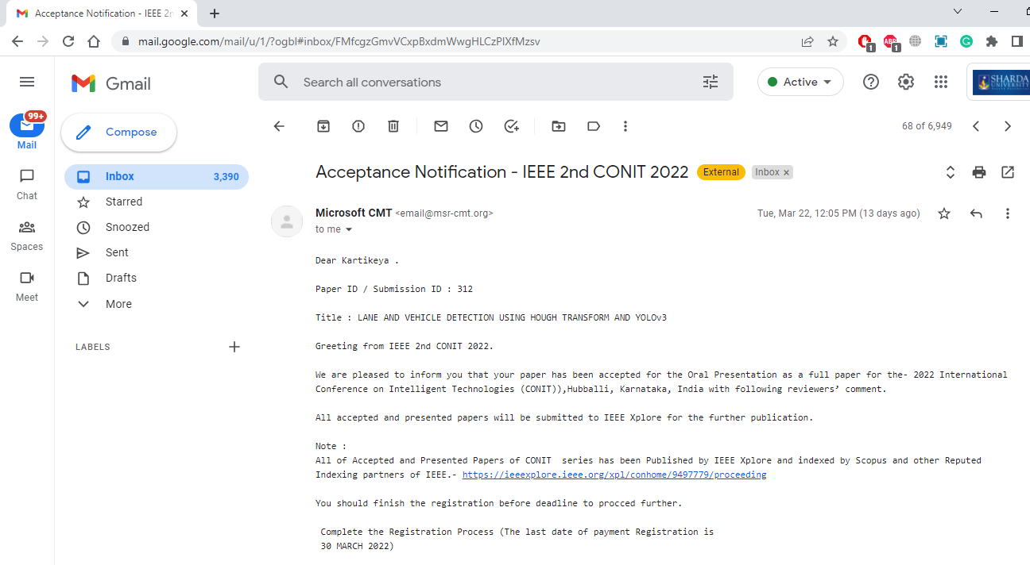
Proof of paper accepted or communicated

Slide 4
Workload Distribution of the team
Name Of Student | Work Done | Algorithms
Subash Kumar Shah | Implementation And Research paper on Vehicle Detection | YOLO v3
Agrima Yadav | Implementation And Research paper on Vehicle Detection | YOLO v3
Kartikeya | Implementation And Research paper on Lane Detection | Hough Transform And Canny Edge Detection
Nikhil Gupta | Implementation And Research paper on Lane Detection | Hough Transform And Canny Edge Detection

Slide 5
Introduction and origin of the research problem
Driver support system is one of the most important feature of the modern vehicles to ensure driver safety and decrease vehicle accident on roads. Apparently, the road lane detection or road boundaries detection is the complex and most challenging tasks. It is includes the localization of the road and the determination of the relative position between vehicle and road. A vision system using on-board camera looking outwards from the windshield is presented in this paper. The system acquires the front view using a camera mounted on the vehicle and detects the lanes by applying few processes. The lanes are extracted using Hough transform through a pair of hyperbolas which are fitted to the edges of the lanes. The proposed lane detection system can be applied on both painted and unpainted roads as well as curved and straight road in different weather conditions.

Slide 6
Motivation to research problem
There are many researchers who have worked and are working on creating and developing many techniques in intelligent transportation systems with advanced driving assistance system which are able to ensure the safety in the roads and congested traffic conditions.
The road accidents are the main causes for the sudden death in this world. Even though we have many good and advanced techniques in this world, we are left over with something to make it better than before. There are chances from different angles. The road lane detection and object detection is also the other important way that we can improve the safety in roads.
So in our research we provide the way to improve the lane detection and object detection in vehicles is import ants then rest of the other categories that may avoid the many road accidents.
Lane should have to be detected clearly even with the external factors in consideration. The object detection will provide driving person confidences even in the different lighting and different environments situations by improved techniques to detect the objects. Thought you can provide the safety in roads to achieve a safer environment and in traffic congested conditions
In our thesis we have motivated to improve the intelligent vehicle assistance with improved accuracy for lane and object detections as an important aspect to avoid the road accidents and improving the safety on roads.

Slide 7
LANE Detection: Hough-Transform
The Hough Transform (HT) is a robust method for finding lines in images that was developed by Paul Hough.
Hough Transform is a popular technique to detect any shape, if you can represent that shape in mathematical form. It can detect the shape even if it is broken or distorted a little bit.
Hough transform is a computer vision technique used for the purpose of feature isolation of particular shapes in images and videos i.e. it is a technique that can be successfully used to identify specific shapes in images – e.g. lines, circles, ellipses, etc. However, the trivial and original implementation of Hough Transform deals with detecting straight lines.

Slide 8
Canny Edge Detection
Canny edge detection is a method to take out useful structural information from different vision objects and significantly decrease the amount of data to be processed.
After edge detection by canny edge detection algorithm, we can see that the obtained edge not only includes the required lane line edges, but also includes other unnecessary lanes and the edges of the surrounding fences. This method can increase the speed and accuracy of the system.

Slide 9
Approaches
There are two types of approaches used in lane detection:
The feature based approach
The model based approach
The features based approach detects the lane in the road images by detecting the low level features such as lane edges or highlighted lanes etc. This approach requires well highlighted lines or strong lane edges, otherwise it will fail. This approach may suffer from occlusion or noise.
The geometric parameters such as assuming the shape of lane can be presented by straight line or curves are used by the model based approached.

Slide 10
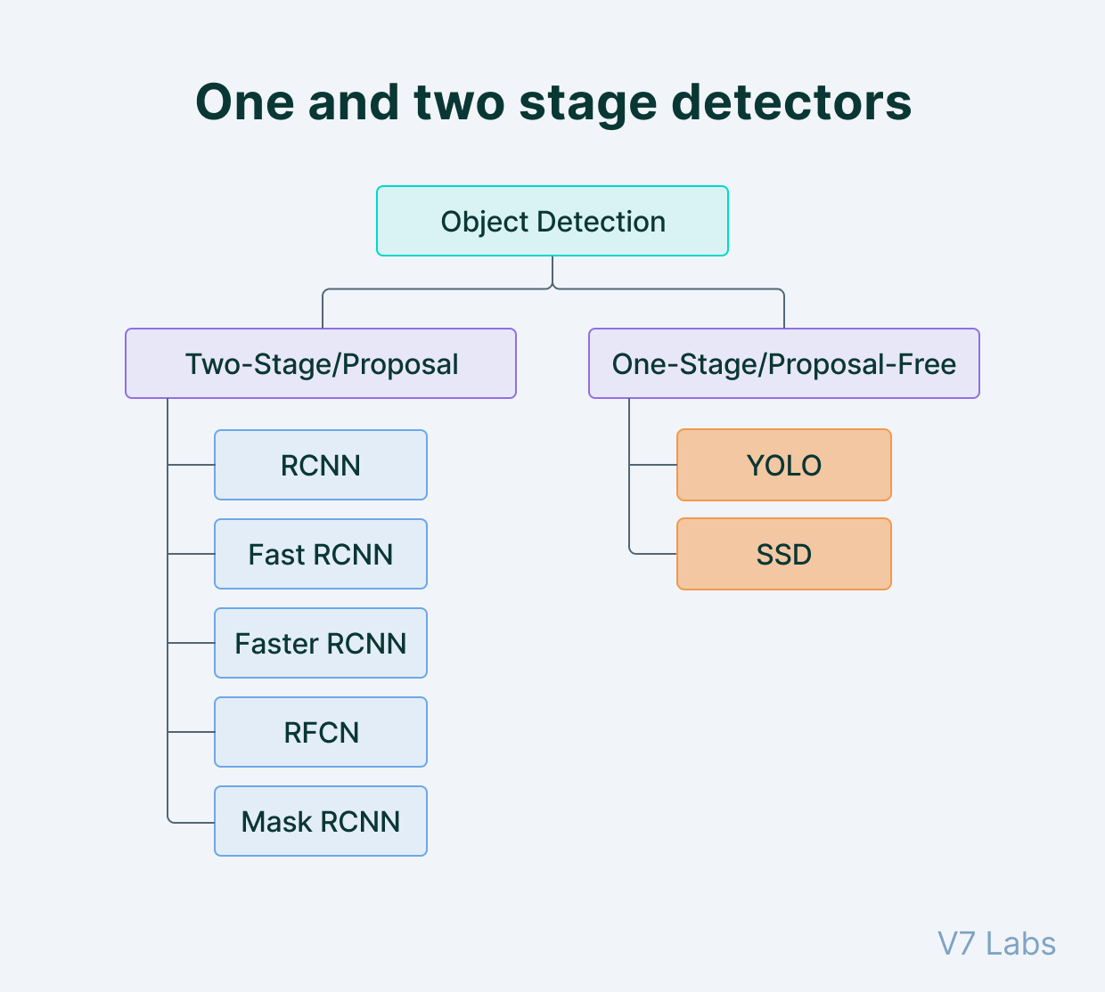
Vehicle Detection

Slide 11
YOLOv3 for Object Detection
YOLO is an algorithm that uses neural networks to provide real-time object detection. This algorithm is popular because of its speed and accuracy. It has been used in various applications to detect traffic signals, people, parking meters, and animals.
YOLO is an abbreviation for the term ‘You Only Look Once’. This is an algorithm that detects and recognizes various objects in a picture (in real-time). Object detection in YOLO is done as a regression problem and provides the class probabilities of the detected images.
YOLO algorithm employs convolutional neural networks (CNN) to detect objects in real-time. As the name suggests, the algorithm requires only a single forward propagation through a neural network to detect objects. This means that prediction in the entire image is done in a single algorithm run. The CNN is used to predict various class probabilities and bounding boxes simultaneously. The YOLO algorithm consists of various variants.

Slide 12
Why the YOLO algorithm is important
YOLO algorithm is important because of the following reasons:
Speed: This algorithm improves the speed of detection because it can predict objects in real-time.
High accuracy: YOLO is a predictive technique that provides accurate results with minimal background errors.
Learning capabilities: The algorithm has excellent learning capabilities that enable it to learn the representations of objects and apply them in object detection.

Slide 13
How the YOLO algorithm works
YOLO algorithm works using the following three techniques:
Residual blocks
Bounding box regression
Intersection Over Union (IOU)
Residual blocks:-
First, the image is divided into various grids. Each grid has a dimension of S x S. The following image shows how an input image is divided into grids.

Slide 14
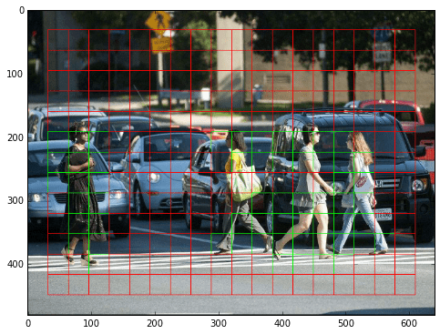
Residual blocks
First, the image is divided into various grids. Each grid has a dimension of S x S. The following image shows how an input image is divided into grids.
In the image above, there are many grid cells of equal dimension. Every grid cell will detect objects that appear within them. For example, if an object center appears within a certain grid cell, then this cell will be responsible for detecting it.

Slide 15
Bounding box regression
A bounding box is an outline that highlights an object in an image.
Every bounding box in the image consists of the following attributes:
Width (bw)
Height (bh)
Class (for example, person, car, traffic light, etc.)- This is represented by the letter c.
Bounding box center (bx,by)
3) The following image shows an example of a bounding box. The bounding box has been represented by a yellow outline.

Slide 16
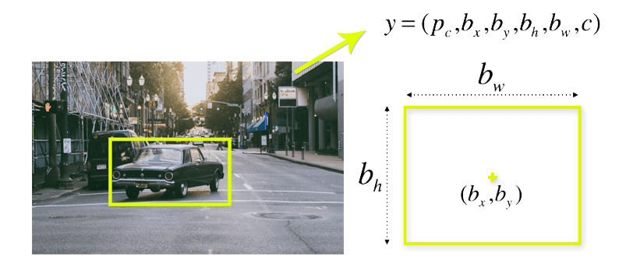
YOLO uses a single bounding box regression to predict the height, width, center, and class of objects. In the image above, represents the probability of an object appearing in the bounding box.

Slide 17
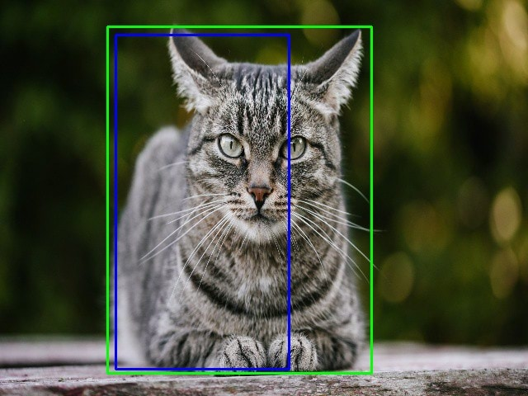
Intersection over union (IOU)
Intersection over union (IOU) is a phenomenon in object detection that describes how boxes overlap. YOLO uses IOU to provide an output box that surrounds the objects perfectly.
Each grid cell is responsible for predicting the bounding boxes and their confidence scores. The IOU is equal to 1 if the predicted bounding box is the same as the real box. This mechanism eliminates bounding boxes that are not equal to the real box.
The following image provides a simple example of how IOU works.
In the image above, there are two bounding boxes, one in green and the other one in blue. The blue box is the predicted box while the green box is the real box. YOLO ensures that the two bounding boxes are equal.

Slide 18
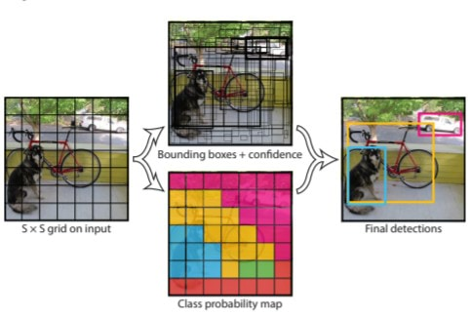
Combination of the three techniques
The following image shows how the three techniques are applied to produce the final detection results.

Slide 19
First, the image is divided into grid cells. Each grid cell forecasts B bounding boxes and provides their confidence scores. The cells predict the class probabilities to establish the class of each object.
For example, we can notice at least three classes of objects: a car, a dog, and a bicycle. All the predictions are made simultaneously using a single convolutional neural network.
Intersection over union ensures that the predicted bounding boxes are equal to the real boxes of the objects. This phenomenon eliminates unnecessary bounding boxes that do not meet the characteristics of the objects (like height and width). The final detection will consist of unique bounding boxes that fit the objects perfectly.
For example, the car is surrounded by the pink bounding box while the bicycle is surrounded by the yellow bounding box. The dog has been highlighted using the blue bounding box.

Slide 20
Features of YOLO
Fast. Good for real-time processing.
Process frames at the rate of 45 fps(larger network) to 150 fps(smaller network) which is better than real-time.
Predictions (object locations and classes) are made from one single network. Can be trained end-to-end to improve accuracy.
YOLO is more generalized. It outperforms other methods when generalizing from natural images to other domains like artwork.
Region proposal methods limit the classifier to the specific region. YOLO accesses to the whole image in predicting boundaries. With the additional context, YOLO demonstrates fewer false positives in background areas.
YOLO detects one object per grid cell. It enforces spatial diversity in making predictions.

Slide 21
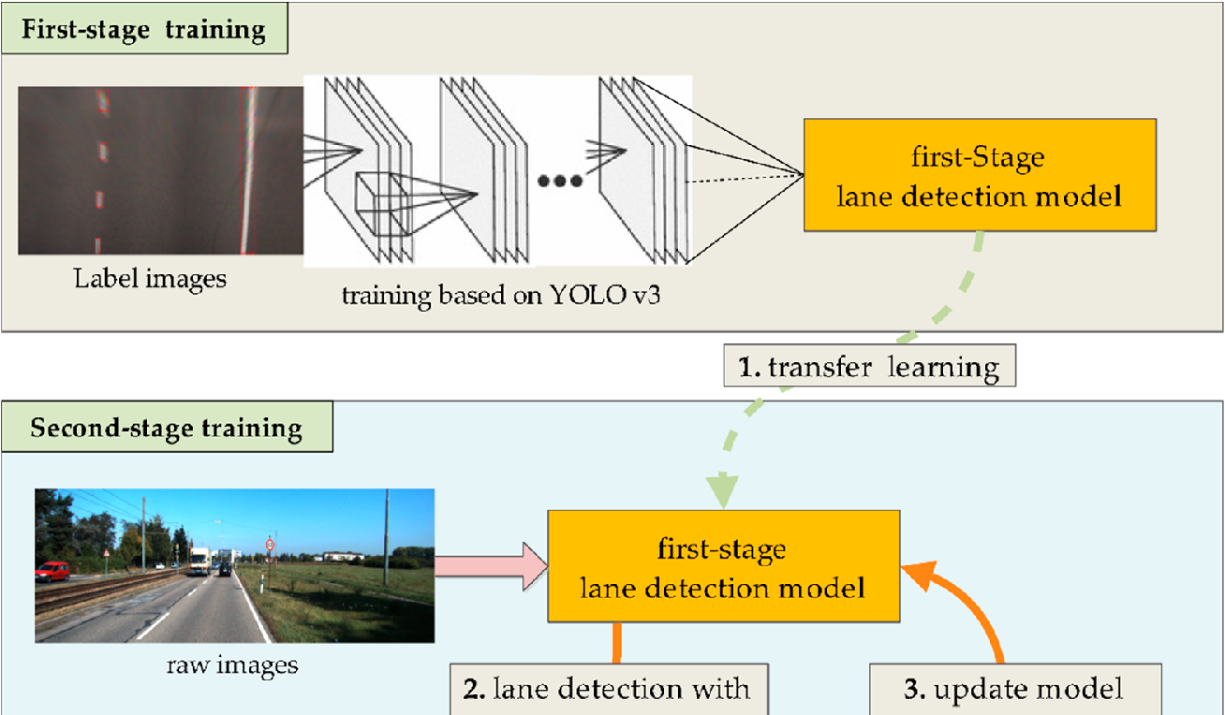
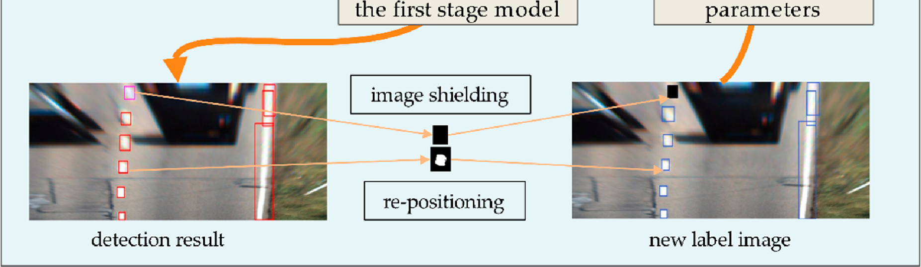
Flowchart Object detection using Yolov3

Slide 22
Flow Chart
Start
Lane Detection
Vehicle Detection
ROI Region
Grayed Image
Video Frame
Yolo
Tracking by IOU
Lane Detection using Hough Transform
Define Road Direction
No
Video Frame Completed?
Fitting Lane
Calculating speed and classify road type
Yes
Stop

Slide 23
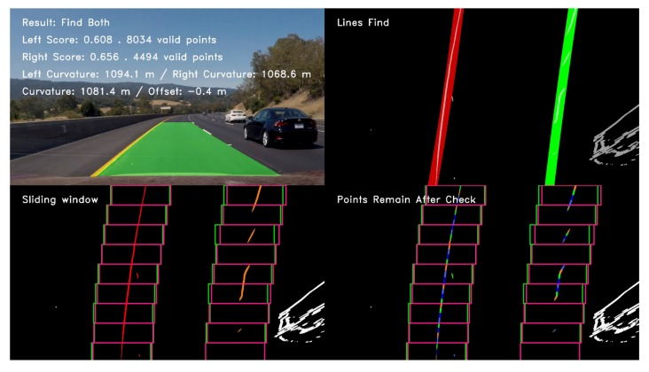
Results / Outputs
Figure1: The test result of a typical detected frame in the highway driving video.

Slide 24
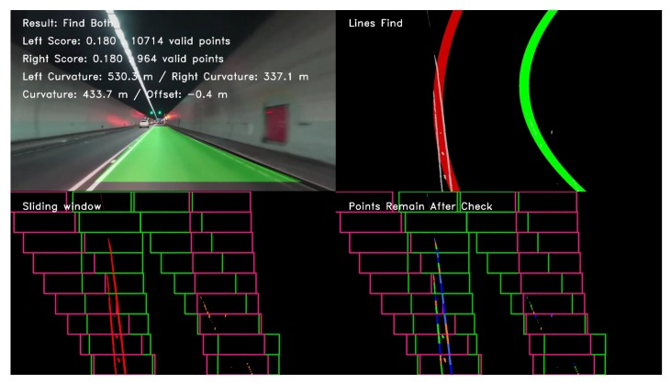
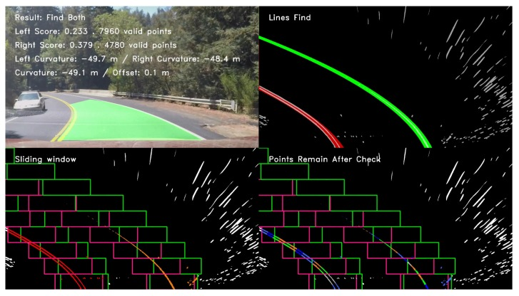
Figure 2: The test result of a typical detected frame in the tunnel road driving video.
Figure 3: The test result of a typical detected frame in the mountain road driving video.

Slide 25
Benefits of Lane Detection:
Gives assistance and details to pedestrians and drivers.
Uniformity of the markings is an important factor in minimizing confusion and uncertainty about their meaning .
Allows vehicular drivers to drive safely

Slide 26
Future Scope
In this report, generalized vision-based lane detection system is summarized taking into consideration the literature of various authors and test results. Only the most widely adopted techniques and algorithms have been discussed. The importance of perception sensors, algorithms and their integration to achieve the optimized results for a lane detection system are the primary outputs of this short analysis. A lot of research work is being done in the field of lane detection. Advance study on efficient integration of sensors to minimize computation time, cost and increase effective perception is required. A focus on highly secure ADAS to reduce misuse of technology and data theft is need of the hour

Slide 27
Conclusion
The assessment of travel demand factors is indeed a critical component of roadway construction and management, and also signalized intersections measures for current facilities. Various methods, including those of static location monitoring and "sensor automobile information" devices, could be used to gather traffic information. Furthermore, Wardrop's moving observer method (MOM) may be employed as a traffic information acquisition approach. Although as usually recognized, artificial intelligence (AI) with deep learning (DL) are widely employed in a wide range of real scenarios, notably automobile classification and tracking. In order to address the issue that standard border tracking algorithms need not take recognition rate and productivity is affected into account, this work proposes a protection system adaptive routing yolov3 approach. Below are the primary enhancements:
1. Based on the features of traffic line pictures' uneven transverse and longitudinal dispersion frequency, it really is recommended to partition the pictures across s * 2S squares to increase height recognition intensity.
2. The sensor size has been limited to four sensor scales: 13 * 13, 26 * 26, 52 * 52104 * 104, which is more suited for detecting tiny objects also including lane dividers.
3. The basic yolov3 device's fully connected layers are reduced from 53 to 49 tiers, simplifying the system and improving system efficiency.
4. Parameters including such closest cluster location and transfer functions have been modified, making them more meaningful and suited for traffic line recognition environments. The real test results reveal that perhaps the revised method has high detection accuracy while identifying level roads, however, the identification is easily influenced whenever the roadways have considerable gradients. As a result, the next report will concentrate on fixing the situation of lane line recognition in huge gradient sceneries.

Slide 28
Literature Survey
Sr. No | Paper Reference No. | Year | Methods Used | Advantages | Accuracy
1 | 1 | 2018, IET Jour. | CNN, pre-processing, feature detection, fitting tracking, kalman filter, particle filter. | It gives high accuracy. Better results for detecting curved lanes. | 91%
2 | 2 | 2018, IEEE | Feature extraction, model fitting, Random Sample Consensus (RANSAC) technique | Better computation efficiency, High accuracy | 82%
3 | 3 | 2018, IEEE | Principle Component Analysis Technique | Real-time performance within a low computation hardware platform | 85%
4 | 4 | 2018, Hindawi Journal | Kalman filter, Hough transform, Feature extraction, color extraction | Better accuracy and faster processing speed | 95%
5 | 5 | 2017 | LDWS Algorithm, Canny's Algorithm, Hough Transform Technique | High accuracy and robustness against noise and model imperfection | 92%
6 | 6 | 2017 iEEE | Gabor filter, Hough transform method, Sobel operator, least squares algorithm | System is real-time, efficient and enhance the adaptability for the changing environment of road scene. | 93%

Slide 29
7 | 7 | 2017, IEEE | Spatio-Temporal incremental clustering algorithm, PCA technique | Accurately detects straight as well as curved lanes, Algorithm does not require database for storing images | 95%
8 | 8 | 2017, IEEE | Histograms of oriented gradients, SVM Classifier, kalman filter | Accurately detects straight as well as curved lanes | 96.3%
9 | 9 | 2017, IEEE | Kalman filter, SVM Classifier | High Accuracy | 98%
10 | 10 | 2016,IEEE | CNNs | System can achieve higher recall and accuracy in real scenes videos | 90.7%
11 | 11 | 2016,IEEE | SVM model | Can detect the normal and abnormal lane changes instances | 90%
12 | 12 | 2015 | Gaussian mixture model, RANSAC method | Detects lanes even in sunny and shadow road | 95.7%
13 | 13 | 2019 | Hough transform, Canny's Algorithm | Better accuracy | 98%

Slide 30
Work Done in 7th and 8th Sem
Written Research Paper on Lane And Vehicle Detection Using Hough Transform And YOLOv3.
Completed our implementation done for Lane Detection and Vehicle detection.
Improvements are made in the review paper as suggested by the panel members

Slide 31
Thank You

