Slide 1
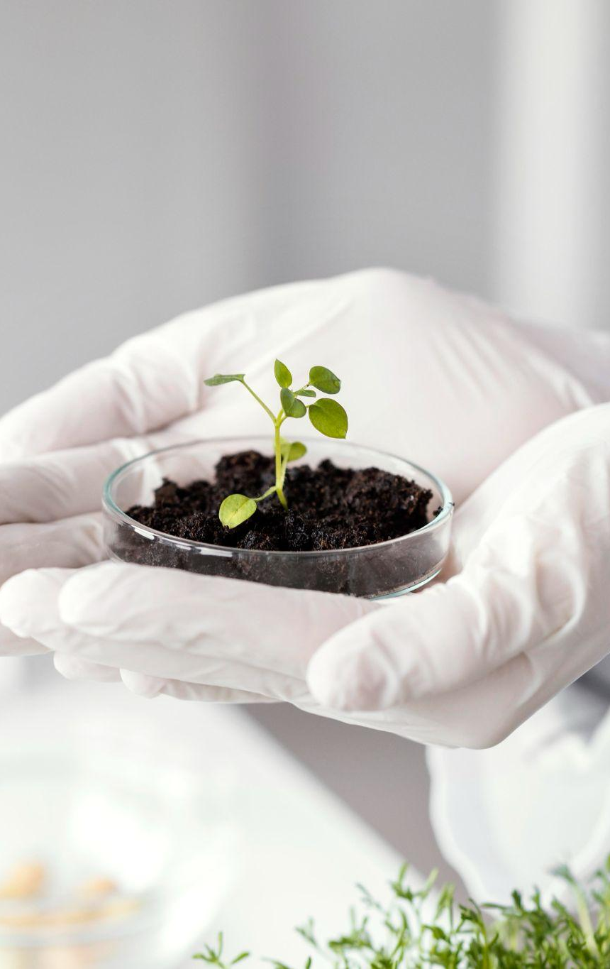
Agro-Tech Hub Project Proposal
Team Members: Parash Parajuli
Subash Poudel
Nishchal Sharma

Slide 2
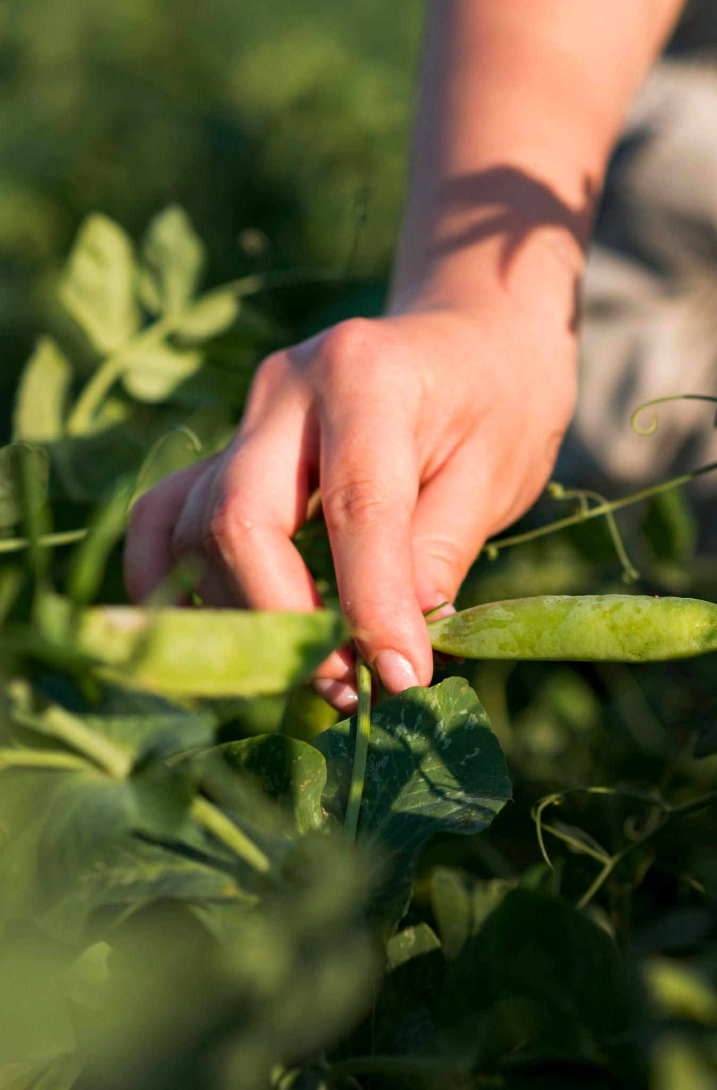
Introduction
Agriculture is Nepal’s economic backbone.
Farmers face problems like poor access to markets, outdated practices, and low tech usage.
Agro-Tech Hub aims to bridge traditional farming with digital innovation.
Uses tools like mobile apps, AI, and data analytics.

Slide 3
Problem Statement
High costs of tech tools.
Lack of awareness and training.
Complicated tech systems.
Lacks interaction with the experts digitally.

Slide 4
Background Study
Nepalese farmers use outdated methods due to poor resources.
Existing tools are not localized or user-friendly.
Agro-Tech Hub will be a centralized, accessible platform for all farming needs.

Slide 5
Objectives
Provide a localized digital tool for farmers.
Offer real-time AI farming advice.
Facilitate direct buyer-farmer interaction.
Promote community learning and sustainable practices.

Slide 6
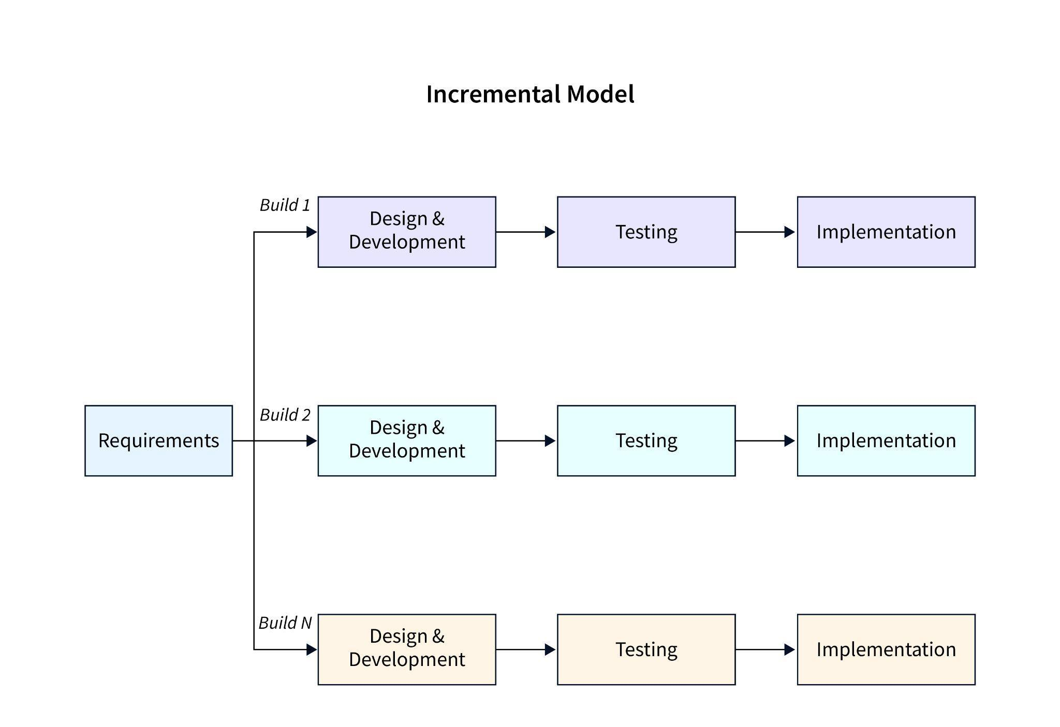
Methodology
Incremental Model used for software development.
Delivers features step-by-step with early feedback.
Reduces risks and allows adaptability.
Suitable for evolving requirements.

Slide 7
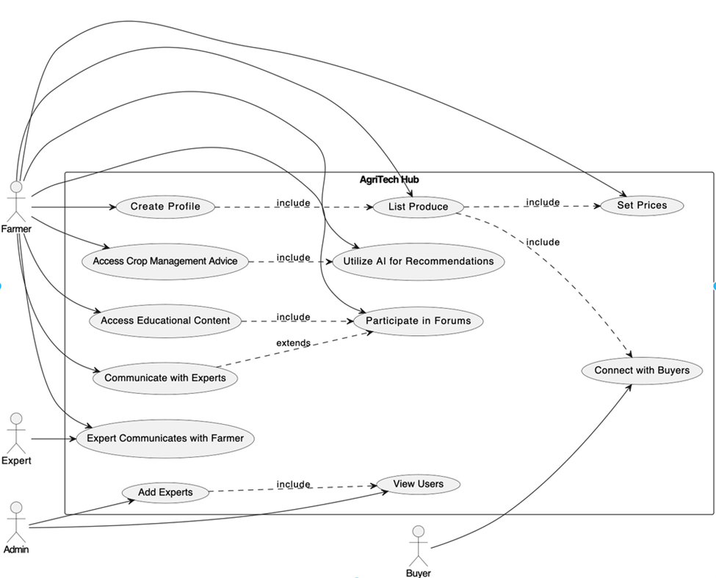
Block Diagram

Slide 8
Deliverables
Mobile App: Offline/online, farmer-friendly.
AI Advisory System: Personalized crop/weather advice.
Market Linkage: Connects farmers with buyers.
Community Forum: Comments, success stories, peer support.
Experts Engagement: Suggestions and advices to farmers from experts.

Slide 9
Limitations
The platform is easy to use but the local farmers may find it difficult though.
Local language support may not be included.

Slide 10
Conclusion
Agro-Tech Hub addresses core challenges in Nepalese farming.
Aims to empower farmers with information, tools, and networks.
Promotes sustainable agriculture and better income.
A step toward a tech-driven agricultural future.

Slide 11
THANK YOU !

