Slide 1
UCS1603 Introduction to Machine Learning
MINI PROJECT
ON
Loan Eligibility Prediction

Slide 2
Introduction
Loans are the core business of banks. The loan companies grant a loan after an intensive process of verification and validation.
Validation is based on a set of criteria such as Loan amount, dependents, marital status, applicant income, credit history and etc., which takes a huge amount of time.
We’ll build a predictive model to predict if an applicant is able to repay the lending company or not based on information from the loan application.
We will prepare the data using Jupyter Notebook and use various algorithms to predict the target variable.

Slide 3
METHODOLOGY

Slide 4
1. Getting the system ready and loading the data
Language: Python
Libraries Used:
Pandas
Numpy
Matplotlib / Seaborn
ScikitLearn
Data: (CSV)
1. Train file :
Used for training the model, i.e. our model will learn from this file.
It contains all the independent variables and the target variable.
2. Test file:
Contains all the independent variables, but not the target variable.
We will apply the model to predict the target variable for the test data.

Slide 5
2. Understanding the data
12 independent variables and 1 target variable, i.e. Loan_Status in the training dataset.
Similar features in the test dataset as the training dataset except for the Loan_Status. We will predict the Loan_Status using the model built using the train data.
Different types of variables:
Categorical features: These features have categories (Gender, Married, Self_Employed, Credit_History, Loan_Status)
Ordinal features: Variables in categorical features having some order involved (Dependents, Education)
Numerical features: These features have numerical values (ApplicantIncome, Co-applicantIncome, LoanAmount, Loan_Amount_Term)

Slide 6
3. Exploratory Data Analysis
1. Univariate Analysis
For each independent variable
Example:
        - Around 65% of the applicants in the dataset are married (Categorical)
        - Around 80% of the applicants are Graduate (Ordinal)
        - The majority of co-applicants income ranges from 0 to 5000 (Numerical)
2. Bivariate Analysis
Categorical Independent Variable vs Target Variable
Example: The proportion of married applicants is higher for approved loans.
Numerical Independent Variable vs Target Variable
Example: Lesser the amount to be paid monthly to repay the loan, the higher the
chances of loan approval.
All these can be be analysed using graphs, histograms,
barcharts, boxplots and etc.

Slide 7
4. Handling missing values
Missing values present in Gender, Marital_Status, Dependents, Self_Employed, LoanAmount, Loan_Amount_Term, and Credit_History.
Methods to fill missing values:
Numerical Variables:
Imputation using mean or median
Categorical Variables:
Imputation using mode

Slide 8
5. Outlier treatment
Having outliers often has a significant effect on the mean and standard deviation (Eg: 1,2,2,3,4 & 1,2,2,3,100)
and hence affecting the distribution.
We must remove outliers from our data sets.
One way to remove the skewness is by doing the log transformation.
As we take the log transformation, it does not affect the smaller values much but reduces the larger values. So, we get a distribution similar to normal distribution.

Slide 9
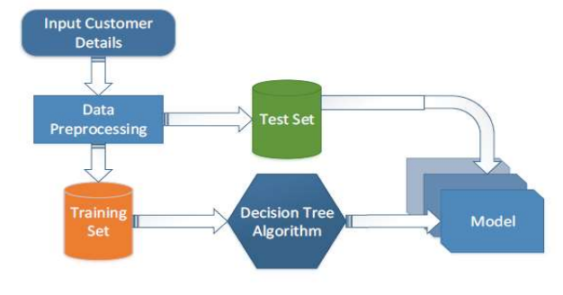
6. Model building
Supervised Learning- Classification Algorithms:
Used when a categorical prediction is to be made
Decision Tree
Naive Bayes

Slide 10
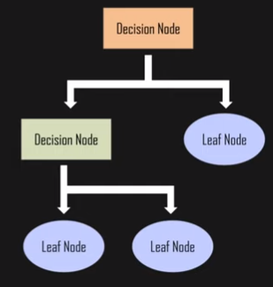
Decision Tree Classification
Internal node represent attributes
of data set
Branch represents the outcome
of the test
Each leaf node represents a class label
Asks a question and answers
it in yes or no

Slide 11
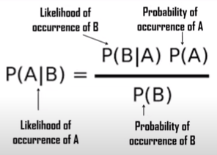
Naive Bayes Classification
Simple, fast, accurate and reliable classification algorithm
Probabilistic ML algorithm based on Bayes Theorem
Assumption made:
Each feature makes an
Independent
Equal
contribution to the outcome

Slide 12
Thank you!

