Slide 1

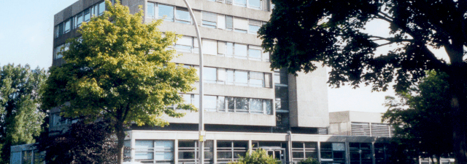
Simulation of CFRP elements heated by moving laser heat source in Abaqus
Suba Siva Chandran, Kalimuthu, 10.05.2021

Slide 2
Simulation of CFRP elements heated by moving laser heat source in Abaqus
Resin (0.001 mm)
Moving laser heat source is implemented in ABAQUS by FORTRAN subroutine DFLUX
Gaussian model describing the laser beam heat source is implemented based on research article “Application of Abaqus to analysis of the temperature field in elements heated by moving heat sources”
Moving laser heat source
2
Traversing
path
25
25
Simulation model setup
Material properties used:
 | Density (kg/m³) | Sp.heat (J/kg K) | Conductivity (W/mK)
Thermoset resin | 1,31e³ | 1100 | 0,25
CFRP (~65% c-fiber) (~35% resin) | 1,62e³ ^{1,78} ^{1,31} | 950 | 4,5 (in fiber direct.) 0,67 (perpendicular to fibers)

Slide 3
Simulation of CFRP elements heated by moving laser heat source in Abaqus
Laser (Heat source) parameters:
Radius (mm) | Power (W) | Velocity of heat source (mm/s)
1,5 | 7 | 10

