Slide 1
Swiggy Instamart Sales Analysis
Prepared by Subasree

Slide 2
Project Overview
This project analyzes Swiggy Instamart sales data using Power BI.
The dashboard provides insights into sales performance, orders, ratings, shop types, city tiers, and product categories.

Slide 3
Objectives
- Analyze total sales and order trends
- Understand performance by city tier and shop size
- Identify top-performing product categories
- Evaluate customer satisfaction using ratings

Slide 4
Key KPIs
- Total Sales: 1.20M
- Total Orders: 8.52K
- Average Sales: 141.01
- Average Rating: 3.92

Slide 5
Sales by City Tier
Tier 3 cities contribute the highest sales.
Tier 2 cities show moderate performance.
Tier 1 cities contribute comparatively lower sales.

Slide 6
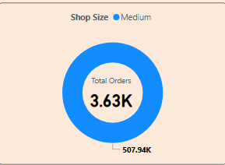
Orders by Shop Size
Medium-sized shops receive the highest number of orders.
Small shops come next, followed by high-sized shops.

Slide 7
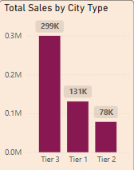
Category-wise Sales
Top categories:
- Fruits & Vegetables
- Snack Foods
- Household Products
Lowest sales observed in soft drinks and meat categories.

Slide 8
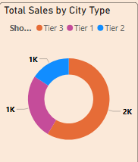
Shop Type Performance
Supermarket Type 2 shows the highest average sales.
Grocery stores maintain consistent ratings and order volumes.

Slide 9
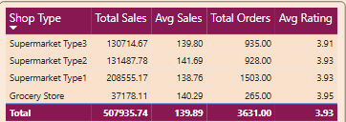
Time Trend Analysis
Number of shops opened decreased from 2021 to 2024.
This indicates market saturation or strategic expansion control.

Slide 10
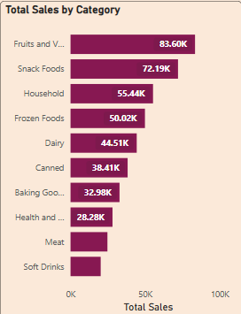
TOTAL SALES BY CATEGORY
Each bar represents a different product category
The length of the bar shows the total sales amount for the category
The highest bar indicates the top performing category

Slide 11
Shops opening Year
To analyze performance based on outlet
To check whether newly opened shops
The X-axis represents the outlet establishment year
The y-axis represent total sales or number of outlets

Slide 12
Conclusion
The dashboard helps identify sales patterns and customer behavior.
It supports data-driven decisions for inventory planning,
city-level expansion, and category focus.

