Slide 1
STAYWISE · HOTEL BOOKING CANCELLATION
More predictable stays.
• A practical decision-support system for hotel reservations.
• Group presentation · IT3051 · October 2026
StayWise · Reservation intelligence · IT3051
01
Notes:
Introduce the group and state the problem in plain language. Confirm institution and presenter names before submission.

Slide 2
THE BUSINESS PROBLEM
A booking is not guaranteed occupancy.
• Cancellations change expected room demand.
• Uncertainty complicates staffing and room planning.
• Reservation teams need a way to prioritize follow-up.
StayWise · Reservation intelligence · IT3051
02
Notes:
Explain a realistic example without inventing financial loss figures.

Slide 3
WHO USES THE SOLUTION?
Built for reservation teams.
• Staff enter the details currently known about a booking.
• Managers receive a cancellation estimate and next action.
• People remain responsible for customer decisions.
StayWise · Reservation intelligence · IT3051
03
Notes:
The current model uses room assignments and booking changes, so discuss when those details are available.

Slide 4
DATA WE ANALYSED
Historical bookings provide the evidence.
• 119,390 original records · City Hotel and Resort Hotel.
• 87,396 records remain after exact duplicate removal.
• 27.49% canceled in the cleaned data.
• Arrivals span July 2015 to August 2017.
StayWise · Reservation intelligence · IT3051
04
Notes:
Credit Mostipak’s Kaggle distribution and Antonio, de Almeida and Nunes (2019), DOI 10.1016/j.dib.2018.11.126. Raw cancellation rate is 37.04%; do not confuse the two populations.

Slide 5
HOW THE SOLUTION WORKS
A consistent path from details to risk.
• Enter booking details → validate the input.
• Apply the same preparation as the trained model.
• Return estimated risk, likely outcome and follow-up.
• Download the assessment for demonstration records.
StayWise · Reservation intelligence · IT3051
05
Notes:
Explain no retraining occurs during a request. Four features are computed: total nights, long stay, weekend stay and high lead time.

Slide 6
MODEL CHOICE
We selected the strongest validation result.
• Compared four approaches on the same training folds.
• Tuned Random Forest: validation ranking score 0.9125.
• Baseline Random Forest: 0.9097; Extra Trees: 0.9058.
• An untouched test partition checks the final choice.
StayWise · Reservation intelligence · IT3051
06
Notes:
ROC-AUC measures ranking; it is not percentage accuracy. Logistic Regression and Decision Tree were also compared. Engineering did not improve validation AUC.

Slide 7
HELD-OUT RESULTS
Useful evidence, with visible mistakes.
• 85.1% overall accuracy on 17,480 test bookings.
• Identified 3,258 of 4,805 actual cancellations.
• Missed 1,547 cancellations.
• Flagged 1,061 bookings that were actually kept.
StayWise · Reservation intelligence · IT3051
07
Notes:
Recall is 67.8% and precision is 75.4%. Explain why staff judgement matters.

Slide 8
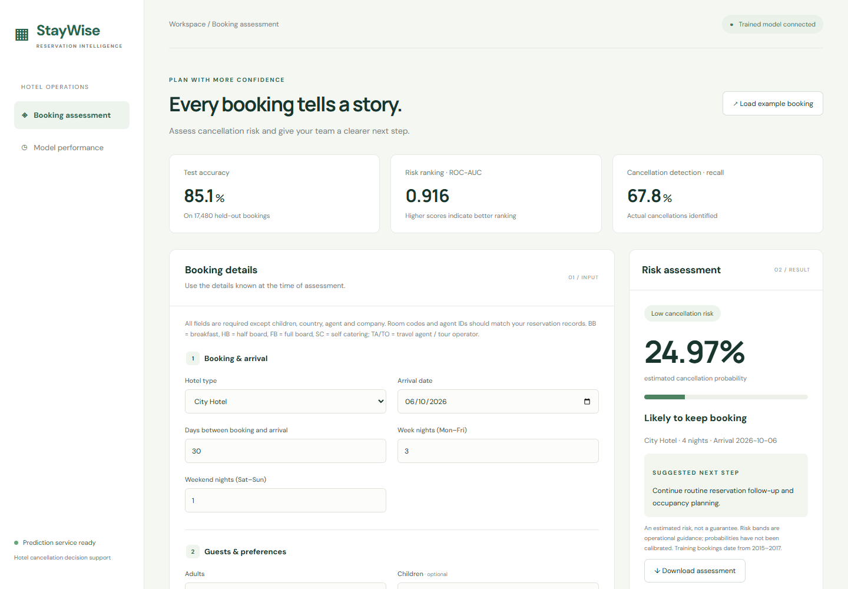
LIVE DEMONSTRATION
See a booking assessment in action.
• Load the example booking and assess its risk.
• Explain probability, outcome and suggested follow-up.
• Change an input and reassess; show a validation error.
• Download the assessment as JSON.
StayWise · Reservation intelligence · IT3051
08
Notes:
Open http://127.0.0.1:5000. Do not promise that changing one input must increase risk. Demonstrate zero guests and a required missing field.

Slide 9
BUSINESS RECOMMENDATION
Turn risk into proportionate action.
• Higher risk: prioritize a courteous confirmation.
• Moderate risk: monitor changes and send reminders.
• Lower risk: continue routine follow-up.
• Pilot the workflow before changing business policies.
StayWise · Reservation intelligence · IT3051
09
Notes:
Risk bands are interface conventions; predictions do not justify denying a booking. No measured financial gain is claimed.

Slide 10
SYSTEM VALIDATION
Reliable software is part of the solution.
• Seven automated service tests pass.
• Twenty historical bookings match direct model predictions.
• Invalid values and missing fields receive clear errors.
• Frontend and backend run together on one local service.
StayWise · Reservation intelligence · IT3051
10
Notes:
Show tests/test_app.py and SYSTEM_TEST_RESULTS.md. Model accuracy comes from the notebook, not the software tests.

Slide 11
LIMITS & NEXT STEPS
Validate locally before wider use.
• Historical data may differ from today’s hotel operations.
• Scores are not calibrated guarantees.
• New hotels and identifiers require validation.
• Next: recent data, temporal tests and a monitored pilot.
StayWise · Reservation intelligence · IT3051
11
Notes:
Discuss subgroup analysis, cost-based thresholds and production deployment as future work.

Slide 12
TEAM CONTRIBUTIONS & QUESTIONS
Every member owns their decisions.
• Manoharan Subasthican · IT23810778
• Kuganesan Kageepan · IT23717572
• Gowsika Surendran · IT23794566
• Kokulan Seyon · IT23752672
• Confirm each member’s actual work before submission.
StayWise · Reservation intelligence · IT3051
12
Notes:
Use the team guide for study allocation, not evidence of code authorship. Disclose coding-assistant support according to institutional rules. Each member explains an actual contribution and decision.

