Slide 1
Python
Rajitha Pogiri
Haripriya A

Slide 2
AGENDA
Basics of programming
Introduction to Python
Python Variables,keywords,identifiers.
Python Arithmetic Operators
Python Data Types and Strings
Python Collections (List ,Tuple ,Set ,Dictionary)
Loops
Python Modules
Python RegExpressions
Advanced data structures : NUMPY and PANDAS

Slide 3
WHAT IS PROGRAM
Usually, one or more algorithms written in a programming language that can be translated to run on a real machine
We sometimes call programs software

Slide 4
WHAT IS PROGRAMMING LANGUAGE?
A programming language is somewhat like a natural language, but with a very limited set of statements and strict syntax rules.
Has statements to implement sequential, conditional and iterative processing - algorithms
Examples: FORTRAN, COBOL, Lisp, Basic, Pascal, C, C⁺⁺, Java, C#, Python, …

Slide 5
COMPILER
A compiler is a program that converts a program written in a programming language into a program in the native language, called machine language, of the machine that is to execute the program.

Slide 6
From Algorithms to Hardware (with compiler)
Algorithm
Translate (by a human being)
Program
Translate (by compiler program)
A real computer

Slide 7
The Program Development Process (Data Flow)
Algorithm
Editor
Program in programming language
Compiler
Program in machine’s language
A real computer
Input
Output

Slide 8
The Program Development Process (Control Flow)
Edit
Syntax errors
Compile
Run
Input
Output
Runtime errors

Slide 9
Three kinds of errors
Syntax error : Some statement in the program is not a legal statement in the language.
Runtime error : An error occurs while the program is executing, causing the program to terminate (divide by zero, etc.)
Logic error : The program executes to completion, but gives incorrect results.

Slide 10
Interpreter
An alternative to a compiler is a program called an interpreter. Rather than convert our program to the language of the computer, the interpreter takes our program one statement at a time and executes a corresponding set of machine instructions

Slide 11
Interpreter
Edit
Syntax or runtime errors
Input
Interpreter
Output

Slide 12
Language terminology
Syntax: The formal rules for legal statements in the language.
Semantics: The meaning of the statements - what happens when the statement is executed.

Slide 13
Three major control constructs of programming (Execution flow of instructions)
Sequential: Simply do steps one after the other in order they are listed.
Conditional: Decide which statement to do next based on some true/false test.
Iterative: A set of statements is repeated over and over until some condition is met.

Slide 14
Sequential Operations “Atomic”
Step i
Input
Computation
Output
Step i+1
Step i+2

Slide 15
The Basic Pattern
Most of our programs will use the basic pattern of
Get some user input
Perform some algorithm on the input
Provide results as output

Slide 16
INTRODUCTION
Python is a high-level programming language
Open source and community driven
Dynamic typed
Source can be compiled or run just-in-time
Similar to Perl, ruby
It has simple easy-to-use syntax.
It has wide range of applications from Web development, scientific and mathematical computing (SciPy, NumPy)

Slide 17
Python
Python uses an interpreter. Not only can we write complete programs, we can work with the interpreter in a statement by statement mode enabling us to experiment quite easily.
Python is especially good for our purposes in that it does not have a lot of “overhead” before getting started.
It is easy to jump in and experiment with Python in an interactive fashion.

Slide 18
WHY PYTHON?
Unlike AML and Avenue, there is a considerable base of developers already using the language
“Tried and true” language that has been in development since 1991
Can interface with the Component Object Model (COM) used by Windows
Can interface with Open Source GIS toolsets
Notes:
1. If a fund transfer is conducted between two accounts opened in the same bank, the bank decreases the account balance of the sender of funds and increases the account balance of the recipient. In this case, a funds transfer is completed without actually moving any money.

Slide 19
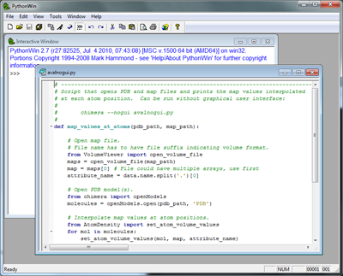
Python Interfaces
IDLE(Integrated Development and Learning Environment) – a cross-platform Python development environment
Python Win – a Windows only interface to Python

Slide 20
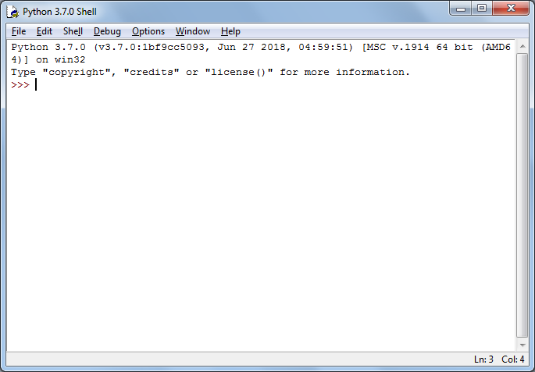
Python Interfaces
Python Shell – running 'python' from the Command Line opens this interactive shell

Slide 21
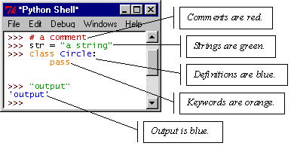
IDLE – Development Environment
IDLE helps you program in Python by:
color-coding your program code
debugging
auto-indent
interactive shell

Slide 22
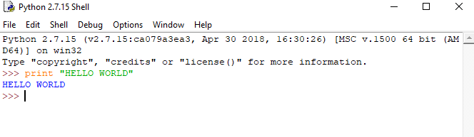
Example Python
Hello World
print “hello world”
Prints hello world to standard out
Open IDLE and try it out yourself
Follow along using IDLE

Slide 23
MORE THAN JUST PRINTING
Python is an object oriented language
Practically everything can be treated as an object
“hello world” is a string
Strings, as objects, have methods that return the result of a function on the string

Slide 24
Identifiers
Identifiers are names of various program elements in the code that uniquely identify the elements. They are the names of things like variables or functions to be performed. They're specified by the programmer and should have names that indicate their purpose.
In Python, identifiers
Are made of letters, digits and underscores
Must begin with a letter or an underscore
Examples: temperature, myPayrate, score2

Slide 25
Keywords
Keywords are reserved words that have special meaning in the Python language. Because they are reserved, they can not be used as identifiers. Examples of keywords are if, while, class, import.

Slide 26
Variables in Python
A variable has
A name – identifier
A data type - int, float, str, etc.
Storage space sufficient for the type.

Slide 27
Numeric Data Types
int This type is for whole numbers, positive or negative. Examples: 23, -1756
float This type is for numbers with possible fraction parts. Examples: 23.0, -14.561

Slide 28
Integer operators
The operations for integers are:
+ for addition
- for subtraction
* for multiplication
/ for integer division: The result of 14/5 is 2
% for remainder: The result of 14 % 5 is 4
*, /, % take precedence over +, -
x + y * z will do y*z first
Use parentheses to dictate order you want.
(x+y) * z will do x+y first.

Slide 29
Integer Expressions
Integer expressions are formed using
Integer Constants
Integer Variables
Integer Operators
Parentheses

Slide 30
Python Assignment Statements
In Python, = is called the assignment operator and an assignment statement has the form <variable> = <expression>
Here
<variable> would be replaced by an actual variable
<expression> would be replaced by an expression
Python: age = 19

Slide 31
Python Assignment Statement
Syntax: <variable> = <expression>
Note that variable is on left
Semantics:
Compute value of expression
Store this as new value of the variable
Example: Pay = PayRate * Hours
10
40
400
Payrate
Hours
Pay

Slide 32
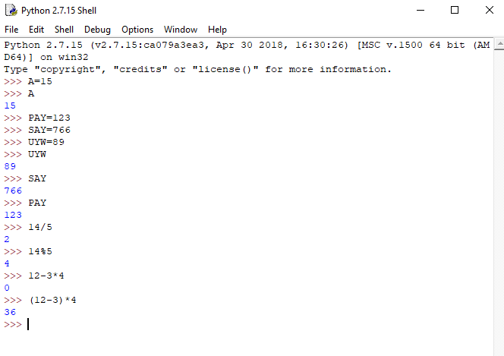
EXAMPLE
>>>PAY=13
>>>PAY
>>>13

Slide 33
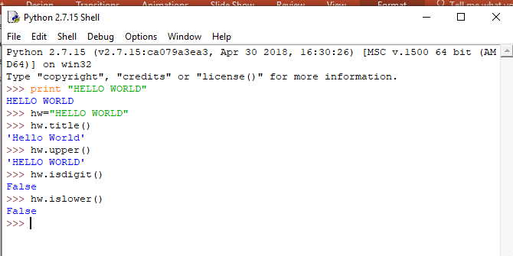
STRING METHODS
Assign a string to a variable
In this case “hw”
hw.title()
hw.upper()
hw.isdigit()
hw.islower()

Slide 34
STRING METHODS
The string held in your variable remains the same
The method returns an altered string
Changing the variable requires reassignment
hw = hw.upper()
hw now equals “HELLO WORLD”

Slide 35
OTHER OBJECTS /ADVANCED DATASTRUCTUERS
Lists (mutable sets of strings)
var = [] # create list
var = [‘one’, 2, ‘three’, ‘banana’]
Tuples (immutable sets)
var = (‘one’, 2, ‘three’, ‘banana’)
Dictionaries (associative arrays or ‘hashes’)
var = {} # create dictionary
var = {‘lat’: 40.20547, ‘lon’: -74.76322}
var[‘lat’] = 40.2054
Each has its own set of methods

Slide 36
LISTS
Think of a list as a stack of cards, on which your information is written
The information stays in the order you place it in until you modify that order
Methods return a string or subset of the list or modify the list to add or remove components
Written as var[index], index refers to order within set (think card number, starting at 0)
You can step through lists as part of a loop
The syntax for creating lists in Python is [...]:
listName = [val1, val2, val3]

Slide 37
LIST METHODS
Adding to the List
var[n] = object
replaces n with object
var.append(object)
adds object to the end of the list
Removing from the List
var[n] = []
empties contents of card, but preserves order
var.remove(n)
removes card at n
var.pop(n)
removes n and returns its value

Slide 38
TUPLES
Like a list, tuples are iterable arrays of objects
Tuples are immutable – once created, unchangeable
To add or remove items, you must redeclare
Example uses of tuples
County Names
Land Use Codes
Ordered set of functions

Slide 39
SET
Set is unordered collection of elements.
It doesn’t allow duplicates, if it is present it will remove those elements. Set is mutable.
Or
It will store multiple unique values {}.
Operations: INSERTION, UNION, DIFFERENCE.
Two ways to create a set:
1.list []
2.set {}

Slide 40
Dictionaries
Dictionaries are sets of key & value pairs
Allows you to identify values by a descriptive name instead of order in a list
Keys are unordered unless explicitly sorted
Keys are unique:
var[‘item’] = “apple”
var[‘item’] = “banana”
print var[‘item’] prints just banana
The syntax :
dictionaryName = {key1:val1, key2:val2,...}

Slide 41
Indentation and Blocks
Python uses whitespace and indents to denote blocks of code
Lines of code that begin a block end in a colon:
Lines within the code block are indented at the same level
To end a code block, remove the indentation
You'll want blocks of code that run only when certain conditions are met

Slide 42
Conditional Branching
if and else
if variable == condition: #do something based on v == c
else:
#do something based on v != c
elif allows for additional branching
if condition:
elif another condition:
…
else: #none of the above

Slide 43
Looping with For
For allows you to loop over a block of code a set number of times
For is great for manipulating lists:
a = ['cat', 'window', 'defenestrate'] for x in a: print x, len(x)

Slide 44
Results:
cat 3
window 6
defenestrate 12

Slide 45
Looping with For
We could use a for loop to perform geoprocessing tasks on each layer in a list
We could get a list of features in a feature class and loop over each, checking attributes
Anything in a sequence or list can be used in a For loop
Just be sure not to modify the list while looping

Slide 46
MODULES
Modules are additional pieces of code that further extend Python’s functionality
A module typically has a specific function
additional math functions, databases, network…
Python comes with many useful modules
ArcGIS scripting is the module we will use to load ArcGIS toolbox functions into Python

Slide 47
MODULES
Modules are accessed using import
import sys, os # imports two modules
Modules can have subsets of functions
os.path is a subset within os
Modules are then addressed by modulename.function()
sys.argv # list of arguments
filename = os.path.splitext("points.txt")
filename[1] # equals ".txt"

Slide 48
Files
Files are manipulated by creating a file object
f = open("points.txt", "r")
The file object then has new methods
print f.readline() # prints line from file
Files can be accessed to read or write
f = open("output.txt", "w")
f.write("Important Output!")
Files are iterable objects, like lists

Slide 49
ERROR CAPTURE
Check for type assignment errors, items not in a list, etc.
Try & Except
try:
a block of code that might have an error
except: code to execute if an error occurs in "try"
Allows for graceful failure – important in ArcGIS

Slide 50
REGULAR EXPRESSION
Regular expression is a sequence of character(s) mainly used to find and replace patterns in a string or file.
supported by most of the programming languages like python, perl, R, Java and many others.
Regular expressions use two types of characters:
a) Meta characters: As the name suggests, these characters have a special meaning, similar to * in wild card.
b) Literals (like a,b,1,2…)
In Python, we have module “re” that helps with regular expressions. So you need to import library re before you can use regular expressions in Python.
Command to import re:
Import re

Slide 51
USES/METHODS OF REGULAR EXPRESSION
The most common uses of regular expressions are:
Search a string (search and match)
Finding a string (findall)
Break string into a sub strings (split)
Replace part of a string (sub)
METHODS:
re.match()
re.search()
re.findall()
re.split()
re.sub()
re.compile()

Slide 52
ADVANCED DATA STURCTURE : NUMPY
Numpy is written in C and use for mathematical or numeric calculation.
It is faster than other Python Libraries
Numpy is the most useful library for Data Science to perform basic calculations.
Numpy is nothing but array data type which performs the most basic operation like sorting, shaping, indexing, etc.
Commands to install NUMPY:
pip --no-cache-dir install numpy
or
pip install numpy

Slide 53
NUMPY ARRAY
Numpy array is a powerful N-dimensional array object which is in the form of rows and columns. We can initialize numpy arrays from nested Python lists and access it elements.
Single-dimensional Numpy Array:
import numpy as np
a=np.array([1,2,3])
print(a)
Output – [1 2 3]
Multi-dimensional Array:
import numpy as np
a=np.array([(1,2,3),(4,5,6)])
print(a)
O/P – [[ 1 2 3]
[4 5 6]]

Slide 54
Python NumPy Array v/s List
We use python numpy array instead of a list because of the below three reasons:
Less Memory
Fast
Convenient

Slide 55
Python NumPy Operations
ndim
itemsize
Dtype
size
Shape
Reshape
Slicing
Linespace
Max/min
Python Numpy Special Functions
matplotlib

Slide 56
PANDAS
Pandas is used for data manipulation, analysis and cleaning. Python pandas is well suited for different kinds of data, such as:
Tabular data with heterogeneously-typed columns
Ordered and unordered time series data
Arbitrary matrix data with row & column labels
Unlabelled data
Any other form of observational or statistical data sets
COMMAND TO INSTALL PANDAS:
pip install pandas
or
pip --no-cache-dir install pandas

Slide 57
PANDAS OPERATIONS
SLICING
MERGING & JOINING
CONCOTINATION
CHANGING THE INDEX
CHANGE COLUMN HEADER
DATA MUNGING

Slide 58
Q & A

Slide 59
Thank You

