Slide 1
Python
Rajitha Pogiri
Haripriya A

Slide 2
AGENDA
Introduction to Python
Python Variables,keywords,identifiers.
Python Data Types
Indentation and blocks
Loops
Python Modules
Python RegExpressions
Advanced data structures : NUMPY and PANDAS

Slide 3
INTRODUCTION
Python is a high-level programming language
Open source
Dynamic typed
interpreted language

Slide 4
WHY PYTHON?
1) Readable and Maintainable Code
2) Multiple Programming Paradigms
3) Compatible with Major Platforms and Systems
4) Robust Standard Library
5) Many Open Source Frameworks and Tools
6) Simplify Complex Software Development

Slide 5
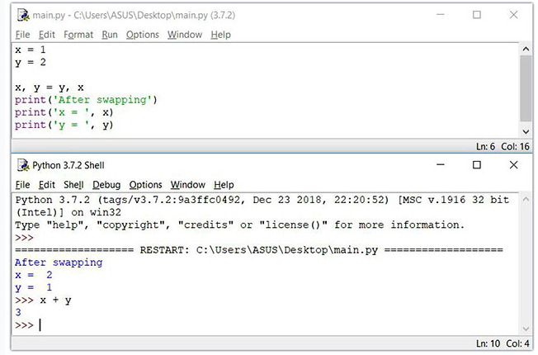
Python Interfaces
IDLE(Integrated Development and Learning Environment) – a cross-platform Python development environment
When you install Python, IDLE is also installed by default. This makes it easy to get started in Python. IDLE is a decent IDE for learning as it's lightweight and simple to use. However, it's not for optimum for larger projects.

Slide 6
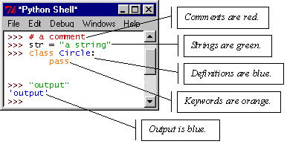
IDLE – Development Environment
IDLE helps you program in Python by:
color-coding your program code
debugging
auto-indent
interactive shell

Slide 7
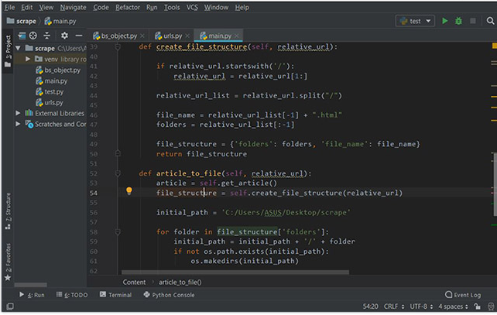
PyCharm:
PyCharm is an IDE for professional developers. It is created by JetBrains, a company known for creating great software development tools.
There are two versions of PyCharm:
Community - free open-source version, lightweight, good for Python and scientific development
Professional - paid version, full-featured IDE with support for Web development as well

Slide 8
Identifiers
A Python identifier is a name used to identify a variable, function, class, module or other object.
An identifier starts with a letter A to Z or a to z or an underscore (_) followed by zero or more letters, underscores and digits (0 to 9).
Python does not allow punctuation characters such as @, $, and % within identifiers.
Python is a case sensitive programming language.
Thus, Manpower and manpower are two different identifiers in Python

Slide 9
Here are naming conventions for Python identifiers
Class names start with an uppercase letter. All other identifiers start with a lowercase letter.
Starting an identifier with a single leading underscore indicates that the identifier is private.
Starting an identifier with two leading underscores indicates a strongly private identifier.
If the identifier also ends with two trailing underscores, the identifier is a language-defined special name.

Slide 10
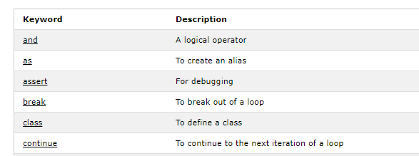
Keywords
Keywords are the reserved words in Python. We cannot use a keyword as a variable name, function name or any other identifier.
They are used to define the syntax and structure of the Python language.
In Python, keywords are case sensitive.
Examples of keywords are

Slide 11

Variables in Python
Variables are containers for storing data values.
Unlike other programming languages, Python has no command for declaring a variable.
A variable is created the moment you first assign a value to it.
Ex:
x = 5
y = "John"
print(x)
print(y)
output:

Slide 12
Variable Names
A variable can have a short name (like x and y) or a more descriptive name (age, carname, total_volume).
Rules for Python variables:
A variable name must start with a letter or the underscore character
A variable name cannot start with a number
A variable name can only contain alpha-numeric characters and underscores (A-z, 0-9, and _ )
Variable names are case-sensitive (age, Age and AGE are three different variables)

Slide 13
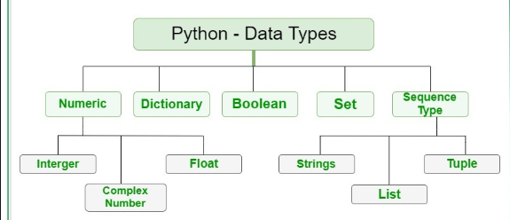
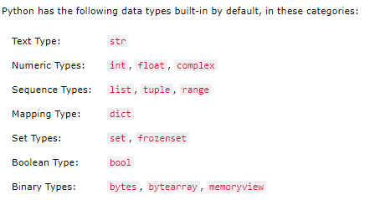
Python Data Types

Slide 14
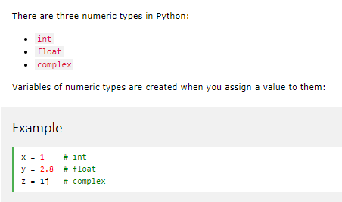
Numeric

Slide 15
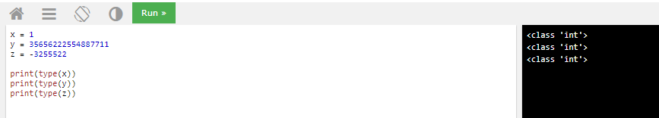
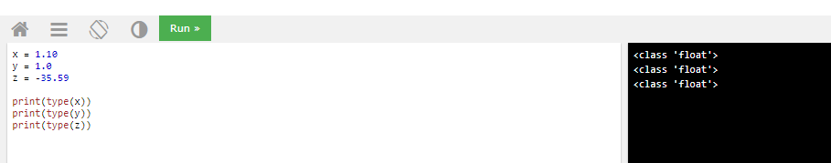
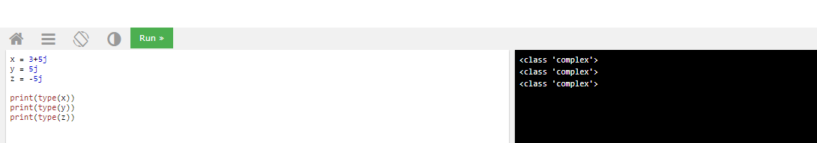
Int:
Float:
Complex:

Slide 16
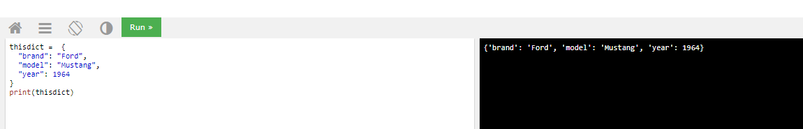
Dictionaries
A dictionary is a collection which is unordered, changeable and indexed. In Python dictionaries are written with curly brackets, and they have keys and values.

Slide 17
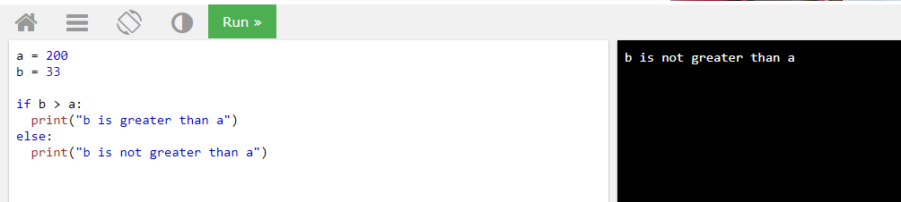
Python Booleans
Booleans represent one of two values: True or False.
In programming you often need to know if an expression is True or False.
You can evaluate any expression in Python, and get one of two answers, True or False.

Slide 18
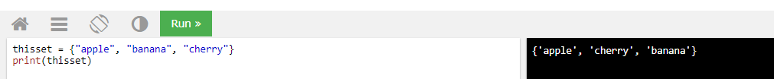

SET
Set is unordered collection of elements.
It doesn’t allow duplicates, if it is present it will remove those elements. Set is mutable.
Operations:

Slide 19
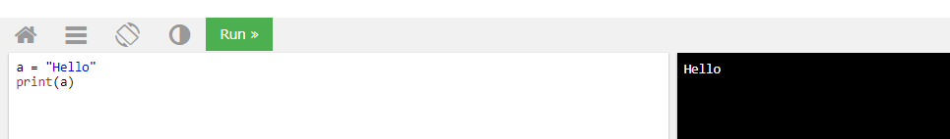
Sequence type :Strings
String literals in python are surrounded by either single quotation marks, or double quotation marks.
'hello' is the same as "hello".

Slide 20
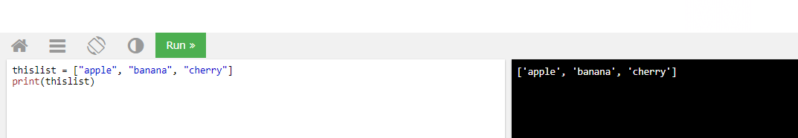
Sequence type :LISTS
List is a collection which is ordered and changeable. Allows duplicate members.
In Python lists are written with square brackets.

Slide 21
LIST METHODS
Adding to the List
var[n] = object
replaces n with object
var.append(object)
adds object to the end of the list
Removing from the List
var[n] = []
empties contents of card, but preserves order
var.remove(n)
removes card at n
var.pop(n)
removes n and returns its value

Slide 22
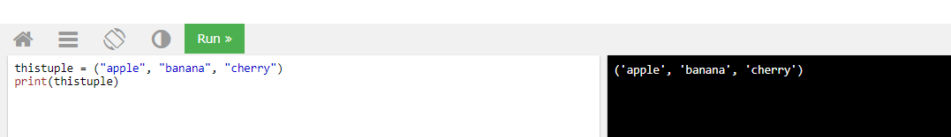
TUPLES
Like a list, tuples are iterable arrays of objects
A tuple is a collection which is ordered and unchangeable. In Python tuples are written with round brackets.
Tuples are immutable – once created, unchangeable
To add or remove items, you must redeclare

Slide 23
INDENTATION AND BLOCKS
Python uses whitespace and indents to denote blocks of code
Lines of code that begin a block end in a colon:
Lines within the code block are indented at the same level
To end a code block, remove the indentation
You'll want blocks of code that run only when certain conditions are met.
Example: if a==1:
print(a)
if b==2:
print(b)
print('end')

Slide 24
CONDITIONAL BRANCHING
If, Else and elif statements enable your program to be smart and make decisions.
Syntax:
if and else
if variable == condition: #do something based on v == c
else:
#do something based on v != c
elif allows for additional branching
if condition:
elif another condition:
…
else: #none of the above

Slide 25
LOOPING WITH FOR
For allows you to loop over a block of code a set number of times
For is great for manipulating lists:
a = ['cat', 'window', 'defenestrate'] for x in a: print x, len(x)
Results:
cat 3
window 6
defenestrate 12

Slide 26
LOOPING WITH FOR
We could use a for loop to perform reprocessing tasks on each layer in a list
We could get a list of features in a feature class and loop over each, checking attributes
Anything in a sequence or list can be used in a For loop
Just be sure not to modify the list while looping
Syntax:
for i = 1 to 10
<loop body>

Slide 27
LOOPING WITH FOR
Example:
fruits = ["apple", "banana", "cherry"]
for x in fruits:
print(x)
if x == "banana":
break
Results:
apple
banana

Slide 28
MODULES
Modules are additional pieces of code that further extend Python’s functionality
A module typically has a specific function
additional math functions, databases, network…
Python comes with many useful modules

Slide 29
MODULES
Modules are accessed using import
import sys, os # imports two modules
Modules can have subsets of functions
os.path is a subset within os
Modules are then addressed by modulename.function()
sys.argv # list of arguments
filename = os.path.splitext("points.txt")
filename[1] # equals ".txt"

Slide 30
Files
Files are manipulated by creating a file object
f = open("points.txt", "r")
The file object then has new methods
print f.readline() # prints line from file
Files can be accessed to read or write
f = open("output.txt", "w")
f.write("Important Output!")
Files are iterable objects, like lists

Slide 31
ERROR CAPTURE
Check for type assignment errors, items not in a list, etc.
Try & Except
try:
a block of code that might have an error
except: code to execute if an error occurs in "try"
Allows for graceful failure

Slide 32
REGULAR EXPRESSION
Regular expression is a sequence of character(s) mainly used to find and replace patterns in a string or file.
supported by most of the programming languages like python, perl, R, Java and many others.
Regular expressions use two types of characters:
a) Meta characters: As the name suggests, these characters have a special meaning, similar to * in wild card.
b) Literals (like a,b,1,2…)
In Python, we have module “re” that helps with regular expressions. So you need to import library re before you can use regular expressions in Python.
Command to import re:
Import re

Slide 33
USES/METHODS OF REGULAR EXPRESSION
The most common uses of regular expressions are:
Search a string (search and match)
Finding a string (findall)
Break string into a sub strings (split)
Replace part of a string (sub)
METHODS:
re.match()
re.search()
re.findall()
re.split()
re.sub()
re.compile()

Slide 34
ADVANCED DATA STURCTURE : NUMPY
Numpy is written in C and use for mathematical or numeric calculation.
It is faster than other Python Libraries
Numpy is the most useful library for Data Science to perform basic calculations.
Numpy is nothing but array data type which performs the most basic operation like sorting, shaping, indexing, etc.
Commands to install NUMPY:
pip --no-cache-dir install numpy
or
pip install numpy

Slide 35
NUMPY ARRAY
Numpy array is a powerful N-dimensional array object which is in the form of rows and columns. We can initialize numpy arrays from nested Python lists and access it elements.
Single-dimensional Numpy Array:
import numpy as np
a=np.array([1,2,3])
print(a)
Output – [1 2 3]
Multi-dimensional Array:
import numpy as np
a=np.array([(1,2,3),(4,5,6)])
print(a)
O/P – [[ 1 2 3]
[4 5 6]]

Slide 36
Python NumPy Array v/s List
We use python numpy array instead of a list because of the below three reasons:
Less Memory
Fast
Convenient

Slide 37
Python NumPy Operations
ndim
itemsize
Dtype
size
Shape
Reshape
Slicing
Linespace
Max/min
Python Numpy Special Functions
matplotlib

Slide 38
PANDAS
Pandas is used for data manipulation, analysis and cleaning. Python pandas is well suited for different kinds of data, such as:
Tabular data with heterogeneously-typed columns
Ordered and unordered time series data
Arbitrary matrix data with row & column labels
Unlabelled data
Any other form of observational or statistical data sets
COMMAND TO INSTALL PANDAS:
pip install pandas
or
pip --no-cache-dir install pandas

Slide 39
PANDAS OPERATIONS
SLICING
MERGING & JOINING
CONCOTINATION
CHANGING THE INDEX
CHANGE COLUMN HEADER
DATA MUNGING

Slide 40
.
Q & A

Slide 41
Thank You

