Slide 1

CGI All Payments- Kafka Brief Overview May, 2019

Slide 2
Agenda
Introduction
MQ/JMS - Kafka differences
Kafka Architecture
NBC Kafka Deployment

Slide 3
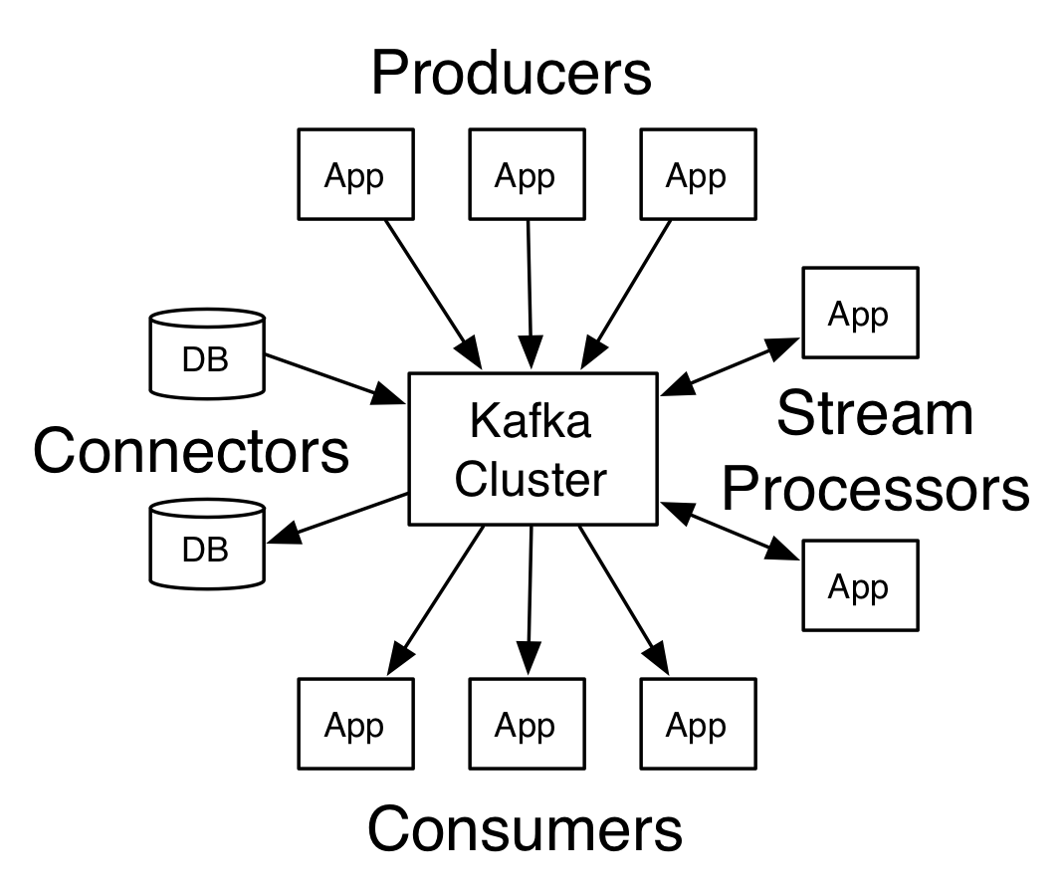
Introduction
Kafka originated at LinkedIn and later became an open-source Apache project in 2011, then a first-class Apache project in 2012.
Kafka is written in Scala and Java. It aims at providing a high-throughput, low-latency platform for handling real-time data feeds.
Key Terminology
Producers of the messages publishes to the Topics
Consumers subscribes to the Topics
Messages are array of bytes. They can be JSON objects, Strings etc
Topics are logs of messages
Kafka is run as a Cluster of servers each of which is called a Broker

Slide 4
MQ/JMS - Kafka differences
No concept of Queue in Kafka i.e., no P2P model
Message Persistence
Topic partitioning
Message sequencing
Message reads
Load balancing
Automatic failover & High availability

Slide 5
Architecture
Producer
Producer
Broker
Broker
ZK
Broker
Broker
Consumer
Consumer

Slide 6
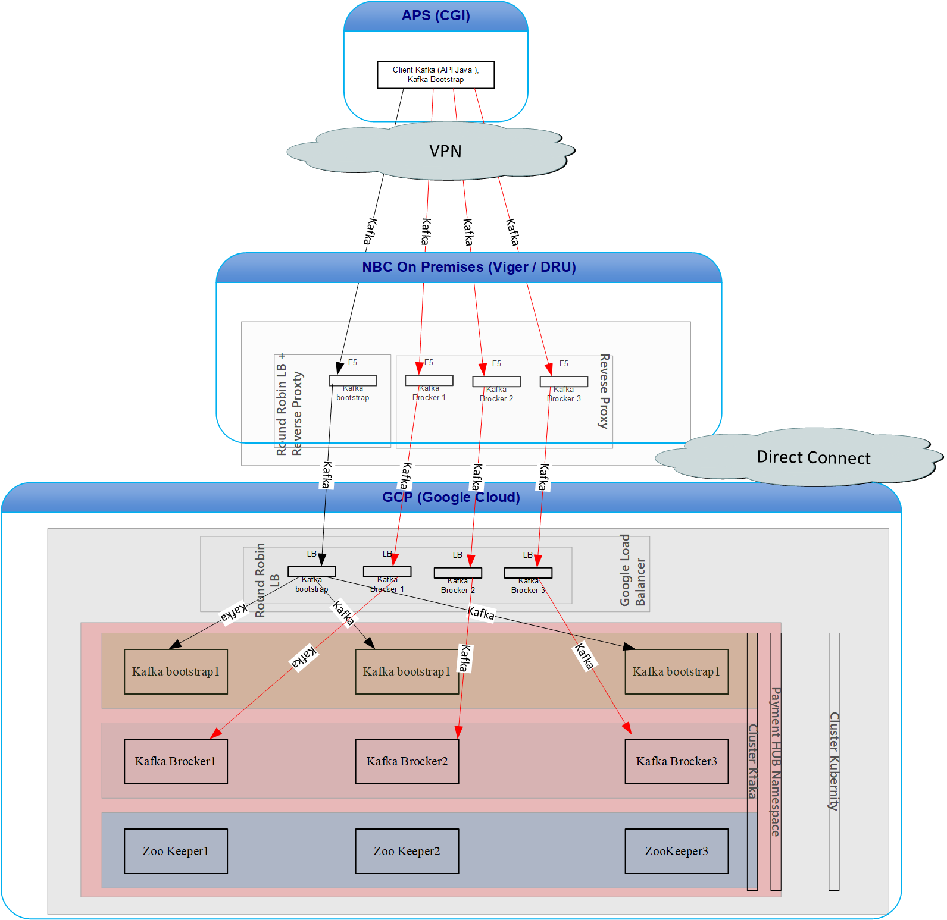
NBC Kafka Deployment

Slide 7
Q & A

