Slide 1

CGI GIT Brief Overview June, 2020

Slide 2
Agenda
Overview of CGI GIT
Request to use CGI GIT
Check-In and Check-Out of Code
Explore repositories within CGI GIT
Q&A

Slide 3
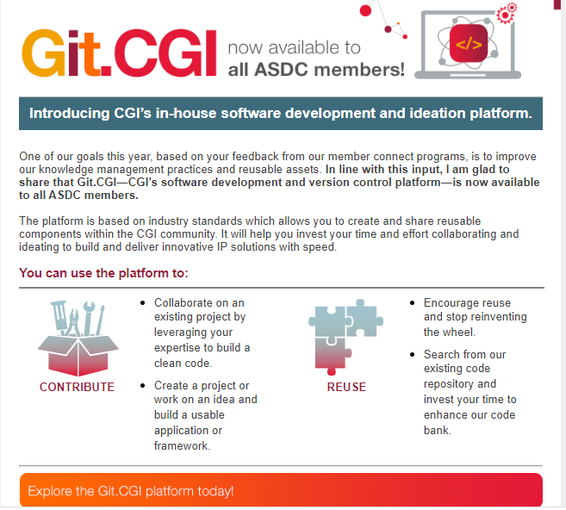
Overview of CGI GIT

Slide 4
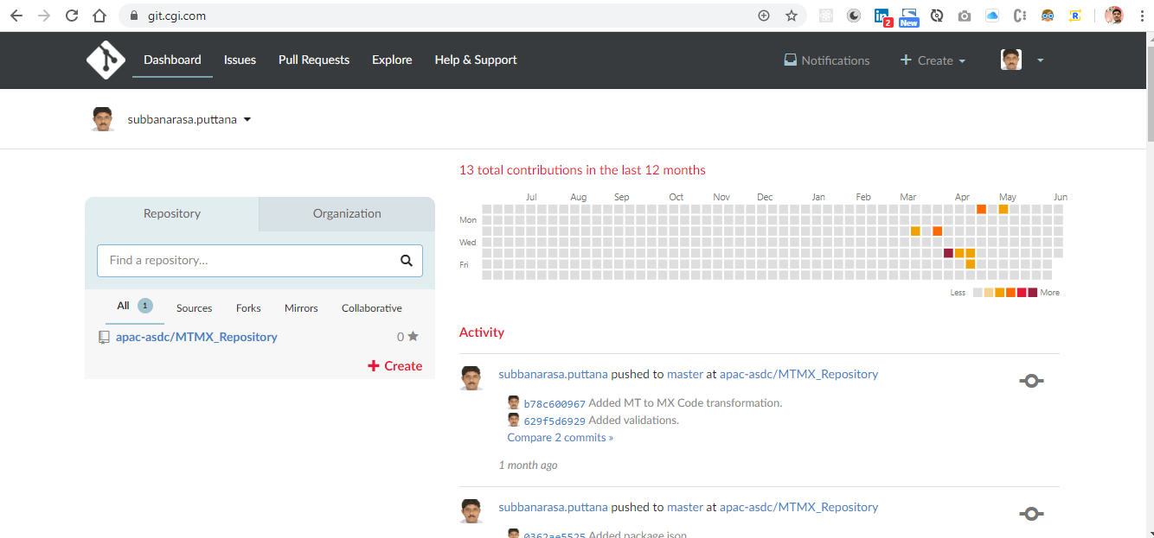
Overview cont.

Slide 5
Request to use CGI GIT
Send an email to Govardhan Chakravarthy with below details.
Name : MTMX Transformation.
Description : Transforming SWIFT MT Messages to ISO 20022 MX Messages.
List of Contributors: Subbanarasa.puttana@cgi.com and hariharakumar.kondaveeti@cgi.com
Owner: vikas.jalan@cgi.com

Slide 6
Check-In and Check-Out of Code
Basic GIT commands
Check out a repository Ex: git clone https://git.cgi.com/apac-asdc/MTMX_Repository.git
Add files Ex: git add *
Commit Ex: git commit -m "Commit message“
Push Ex: git push origin master
Status Ex: git status

Slide 7
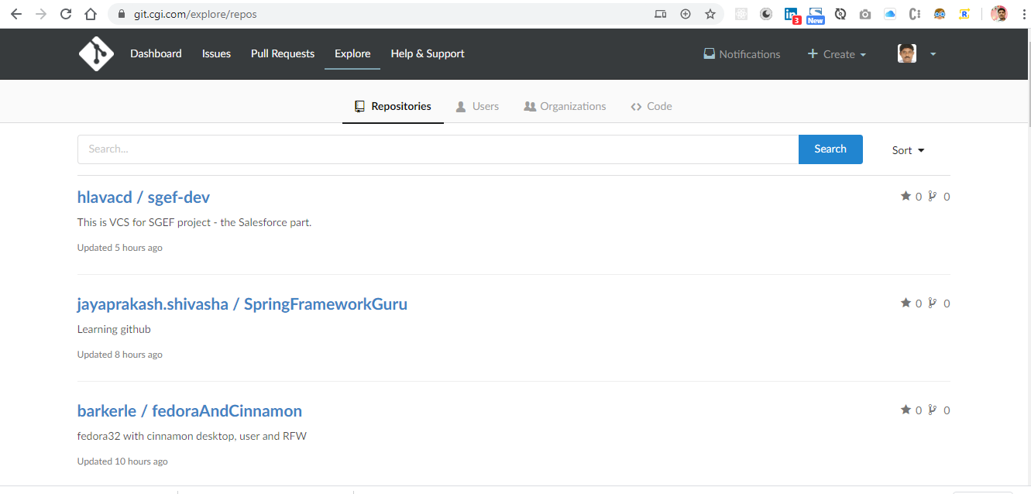
Explore repositories within CGI GIT

Slide 8
Q & A

