Slide 1
Microservices Patterns By Subba

Slide 2
Agenda
Monolithic Architecture
Microservice architecture
The Scale Cube
Patterns
Decomposition
Data management
Deployment patterns
Communication Patterns
Cross cutting concerns
References

Slide 3
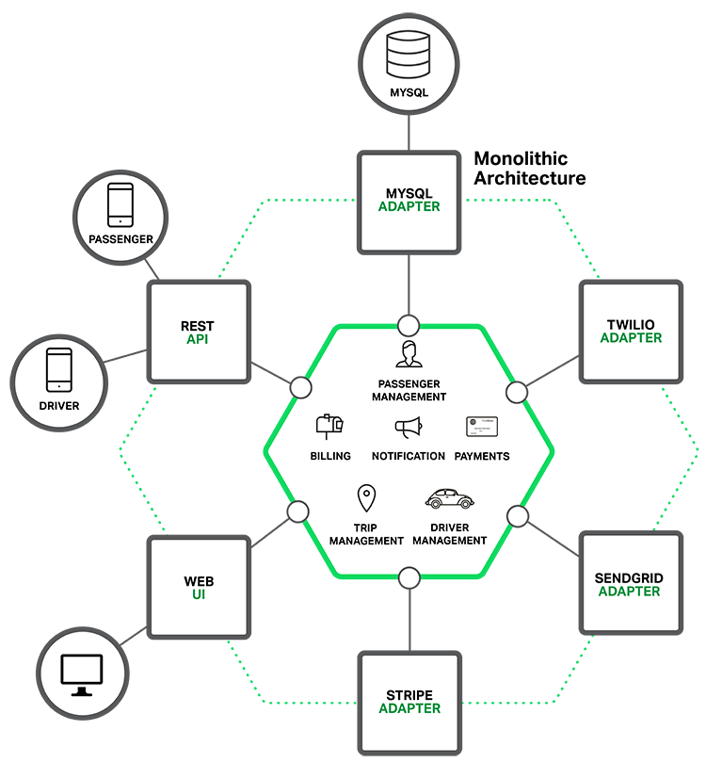
Monolithic architecture
Benefits:
Simple to develop
Simple to deploy
Simple to scale
Drawbacks:
Overloaded web container
Overloaded IDE
Continuous deployment is difficult
Scaling the application can be difficult
Obstacle to scaling development
Requires a long-term commitment to a technology stack

Slide 4
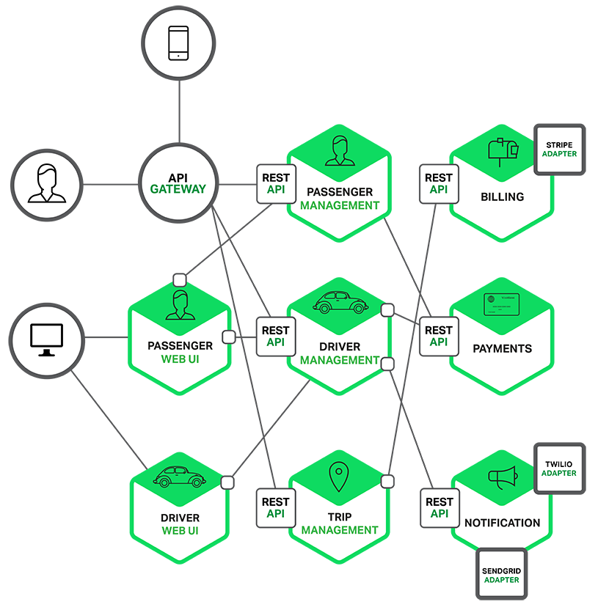
Microservice architecture
Benefits:
Easier to develop and understand
Less Jar/Class path hell -- who needs OSGI ?
Faster to build and deploy
Reduced startup time
Scales development/scale/deploy
It improves fault isolation
Eliminates long term commitment to a single technical stack.
Easily try other technologies
Drawbacks:
Complexity
Multiple Databases and Transaction management.
Complexity of Testing in distribution management
Complexity of deploying and operating a distributed system.
Developing features that span multiple services requires careful coordination.
Deciding when to adopt the microservice architecture is difficult.

Slide 5
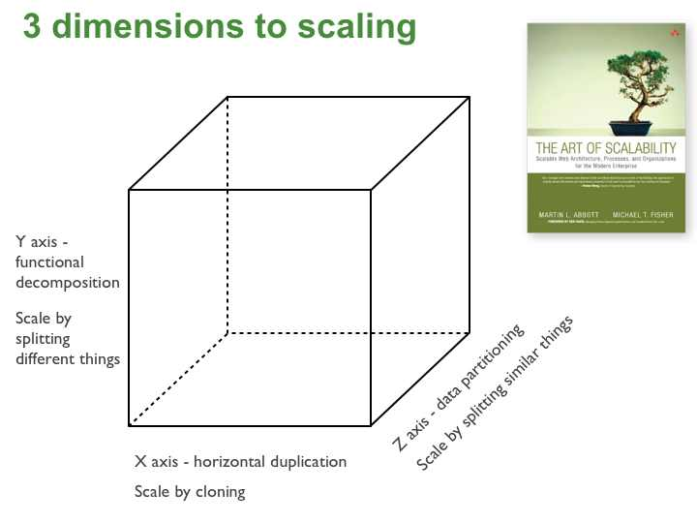
The Scale Cube

Slide 6
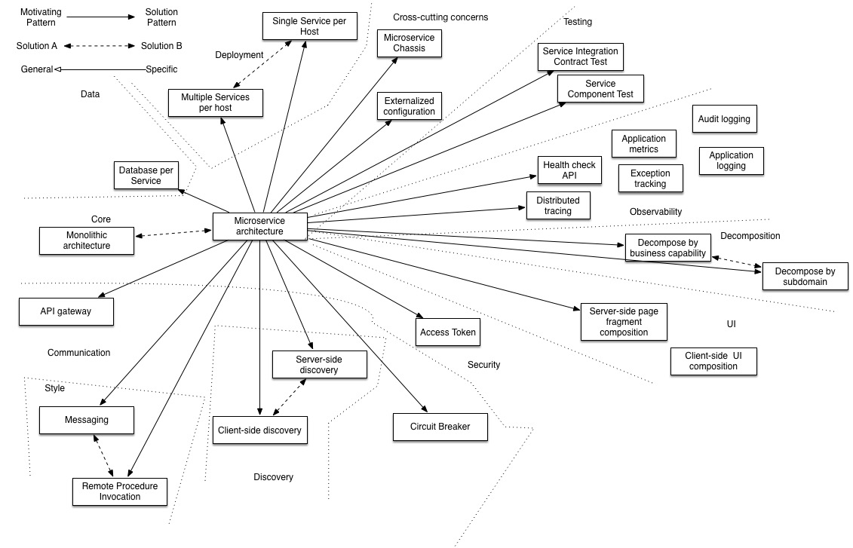
Patterns
Decomposition patterns
Decompose by business capability
Decompose by subdomain
The Database per Service pattern describes how each service has its own database in order to ensure loose coupling.
The API Gateway pattern defines how clients access the services in a microservice architecture.
The Client-side Discovery and Server-side Discovery patterns are used to route requests for a client to an available service instance in a microservice architecture.
The Messaging and Remote Procedure Invocation patterns are two different ways that services can communicate.
The Single Service per Host and Multiple Services per Host patterns are two different deployment strategies.
Cross-cutting concerns patterns: Microservice chassis pattern and Externalized configuration
Testing patterns: Service Component Test and Service Integration Contract Test
Circuit Breaker
Access Token
Observability patterns:
Log aggregation
Application metrics
Audit logging
Distributed tracing
Exception tracking
Health check API
Log deployments and changes
UI patterns:
Server-side page fragment composition
Client-side UI composition

Slide 7
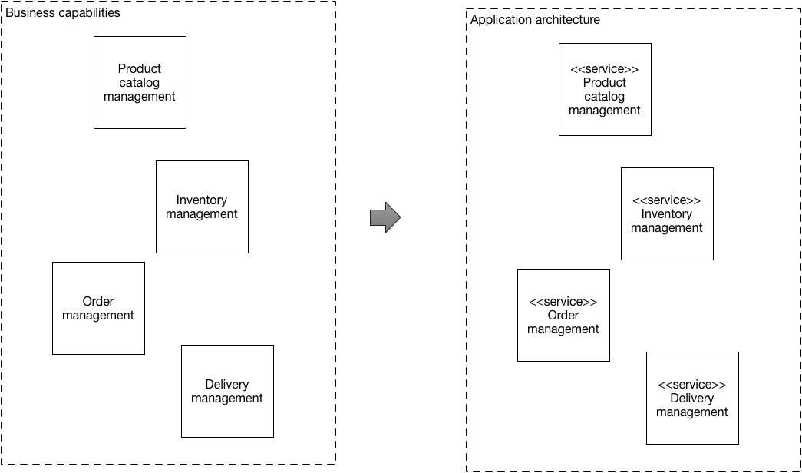
Decomposition
Strategies
Avoid big bang and go incrementally
New functionality as service.
Split frontend and backend.
Extract service -- service which changes more frequent and requires scaling

Slide 8
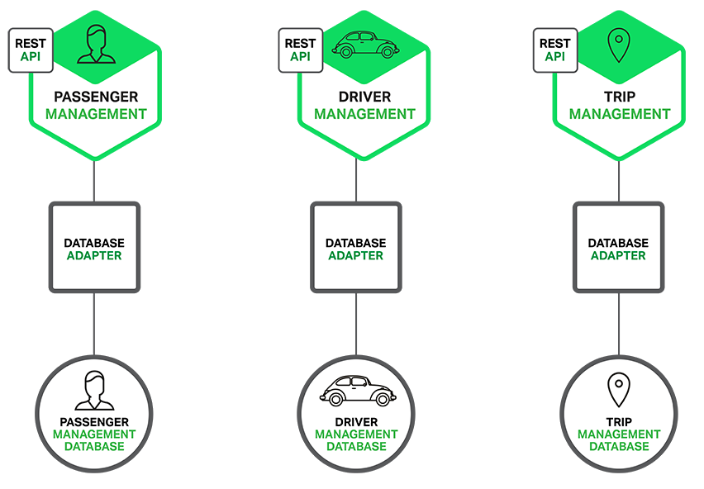
Data management
Shared Database
Database per service
Private-tables-per-service
Schema-per-service
Database-server-per-service
Saga
Choreography
Orchestration

Slide 9
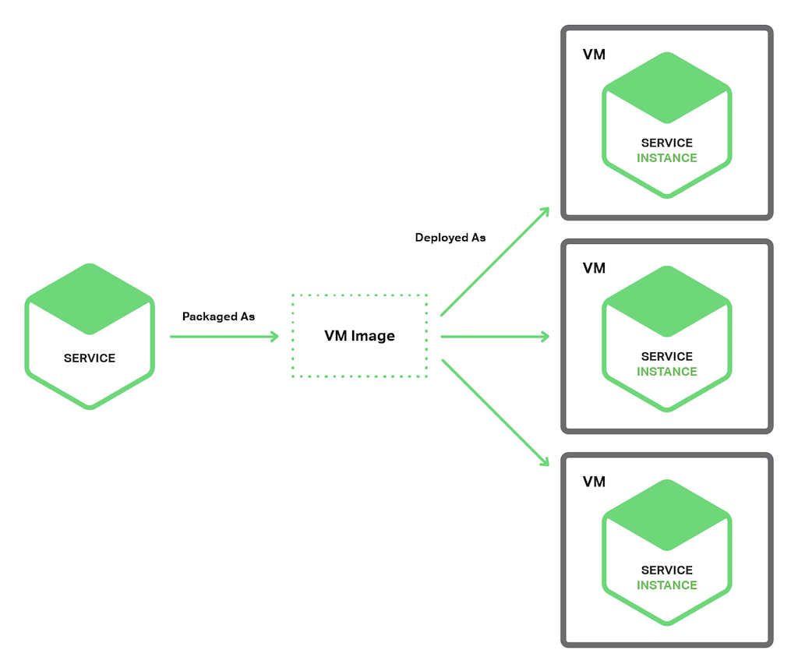
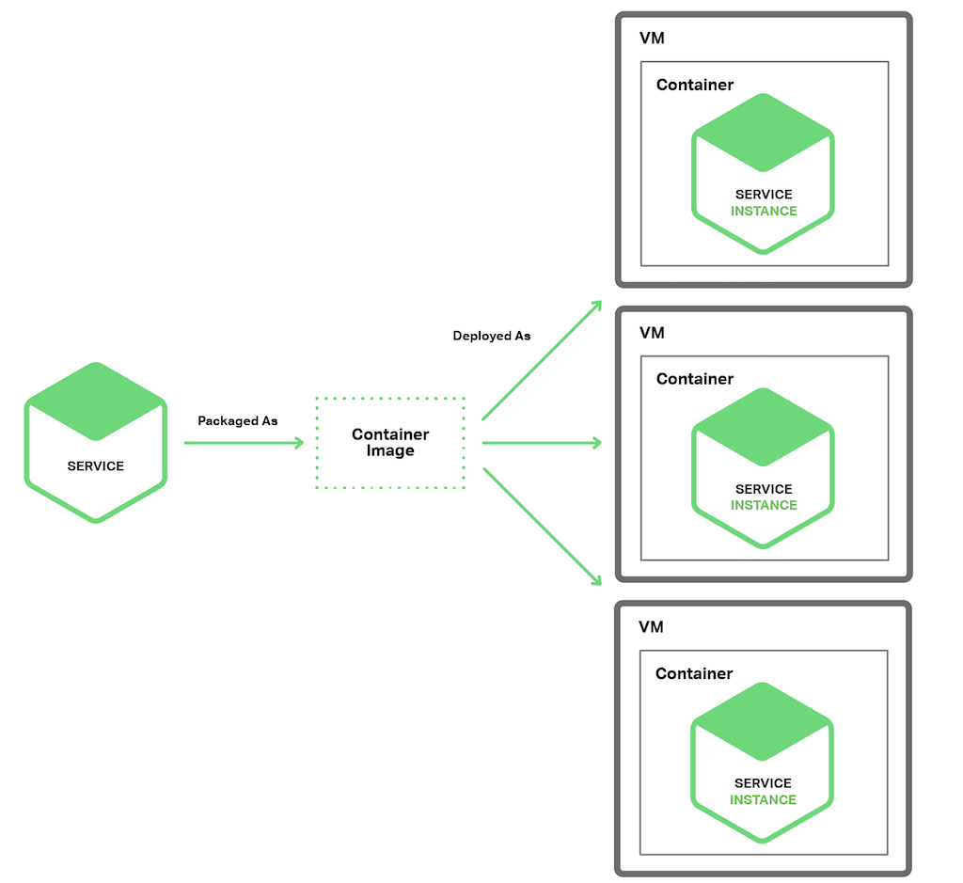
Deployment patterns
Multiple Service Instances per Host
Service Instance per Virtual Machine Amazon EC2 AMI
Service Instance per Container.
Serverless Deployment -- AWS Lambda

Slide 10
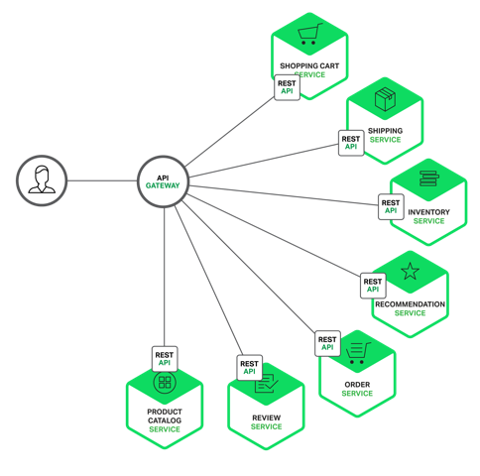
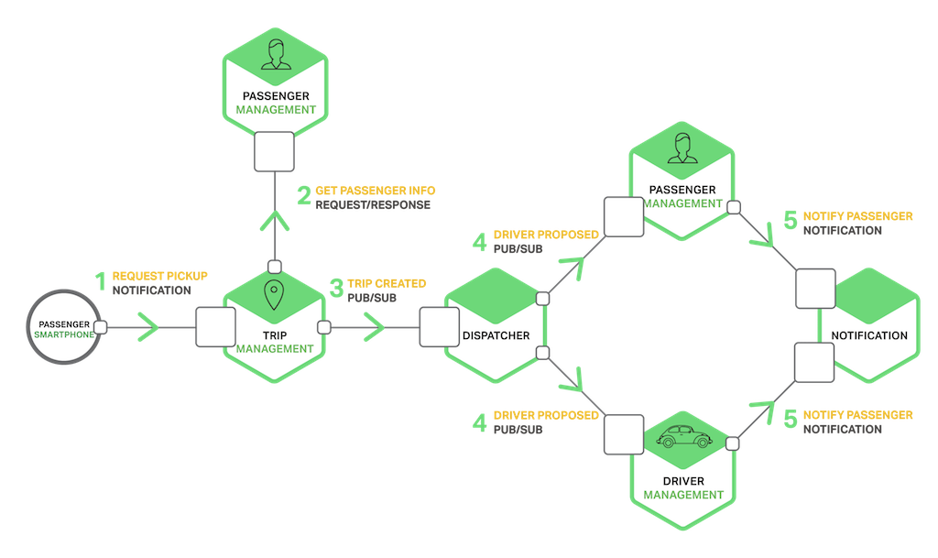
Communication Patterns
API Gateway
Style of messaging (sync/async or api/event)
Discovery service
Client side
Server side Ex: ELB and Nginx
Registry Ex: Eureka, Zookeeper

Slide 11
Cross cutting concerns
Externalize configuration
Logging
Metrics
Circuit breakers
Health checks

Slide 12
References
https://netflixtechblog.com/
http://highscalability.com/amazon-architecture
https://www.nginx.com/blog/introduction-to-microservices/
https://microservices.io/
http://theartofscalability.com/
https://martinfowler.com/bliki/DomainDrivenDesign.html

