Slide 1
Technical Certifications
Java
Oracle Certified Associate Java Programmer
Oracle Certified Professional Java Programmer
Oracle Certified Professional, Java EE 7 Application Developer
Spring
Spring Certified Professional
Kafka
Certified Developer for Apache Kafka
Confluent Certified Administrator
Elastic
Elastic Certified Engineer
Elastic Certified Analyst
Elastic Certified Observability Engineer

Slide 2
DevOps
Certified Kubernetes Administrator (CKA)
Certified Kubernetes Application Developer (CKAD)
Cassandra
Administrator Certification
Developer Certification
Azure Certification Path
Exam AZ-900: Microsoft Azure Fundamentals
Exam AZ-103: Microsoft Azure Administrator
Exam AZ-203: Developing Solutions for Microsoft Azure
Microsoft Certified: Azure Solutions Architect Expert

Slide 3
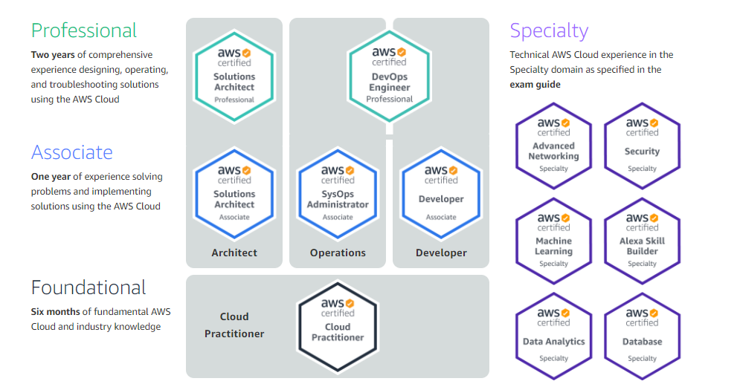
AWS Certification Path

