Slide 1
BudView

Slide 2
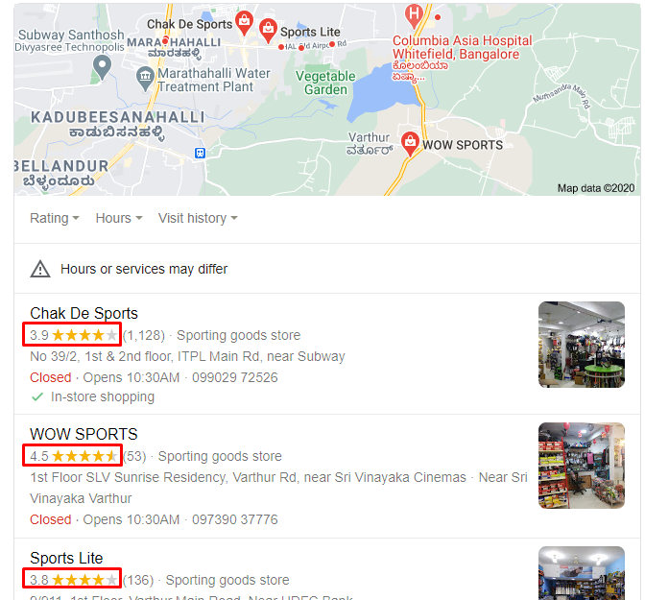
Why we need ?

Slide 3
How it works ?
Have a situation
Get real time updates
Make a decision
Share link with friends
Create Survey

Slide 4
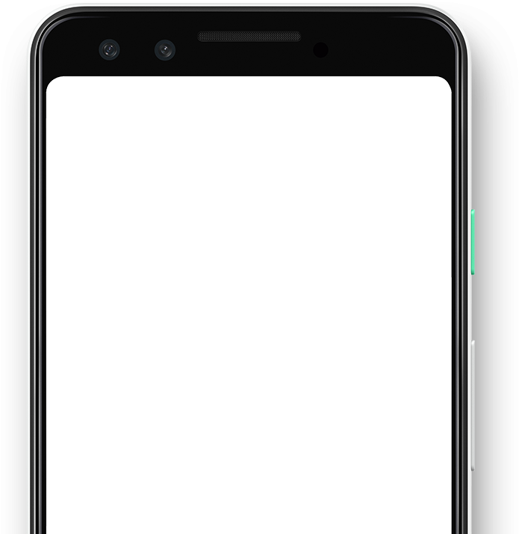
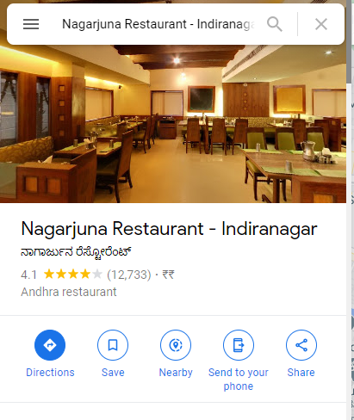

Slide 5
Who will get Benefit?
Users
Shops
Company

Slide 6
Q&A

