Slide 1
Grafana Knowledge transfert
Version 1.0 – October 2019

Slide 2
Overview
Datasource Setup with UI and using YAML configuration file
Creating dashboards with Graphs, Singlestat and Table
Data Export in JSON and CSV
Variables and Filters
Security & Authentication
Users, Organization, Roles and Permissions

Slide 3
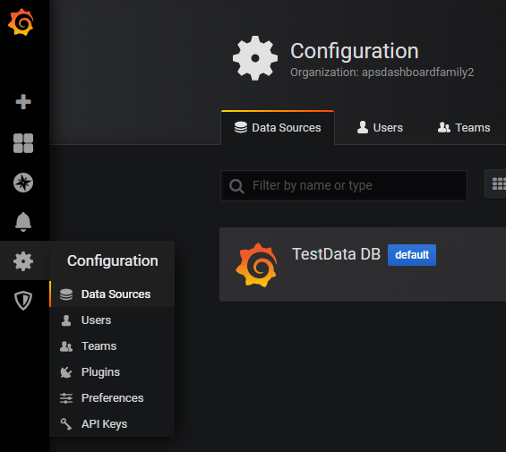
Datasource setup
https://grafana.com/docs/features/datasources/elasticsearch/

Slide 4
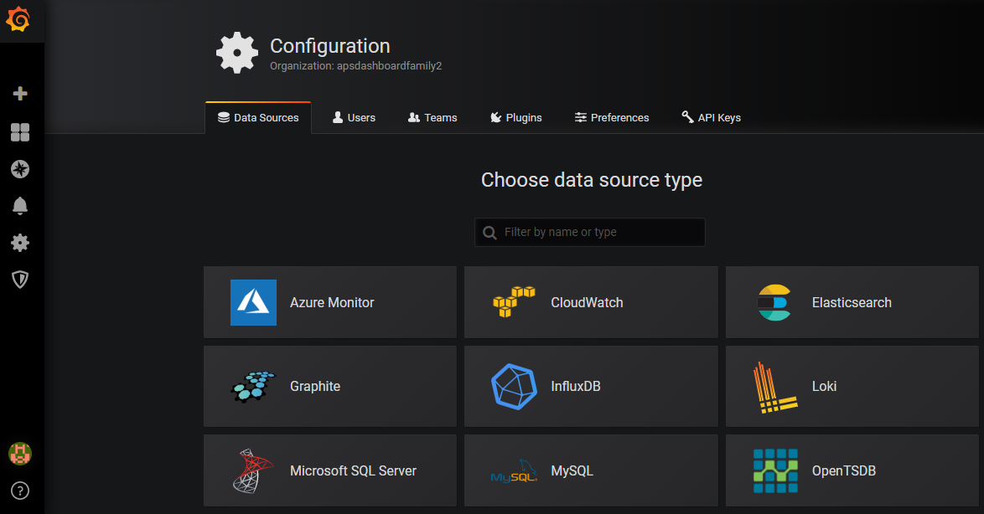
Datasource setup

Slide 5
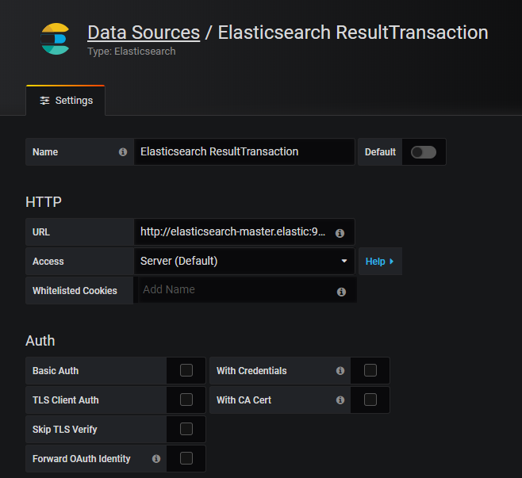
Adding a datasource

Slide 6
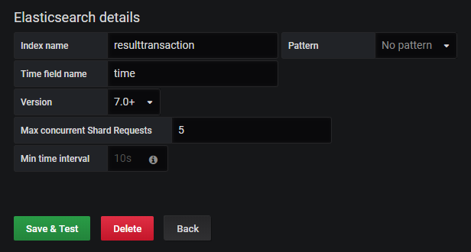
Adding a datasource

Slide 7
Datasource – YAML configuration
File location:
\Program Files\GrafanaLabs\grafana\conf\provisioning\datasources
apiVersion: 1
datasources:
- name: "Elasticsearch splunkresult"
type: elasticsearch
typeLogoUrl: public/app/plugins/datasource/elasticsearch/img/elasticsearch.svg
access: proxy
url: http://elasticsearch-master.elastic:9200
user:
database: splunkresult
isDefault: false
jsonData:
esVersion: 70
timeField: time
keepCookies: []
editable: true

Slide 8
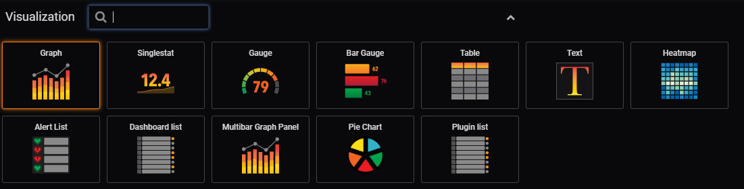
Metrics & Visualization

Slide 9
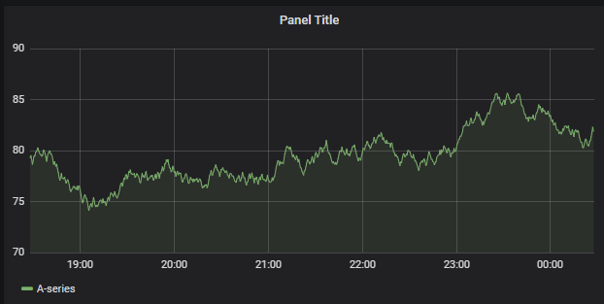
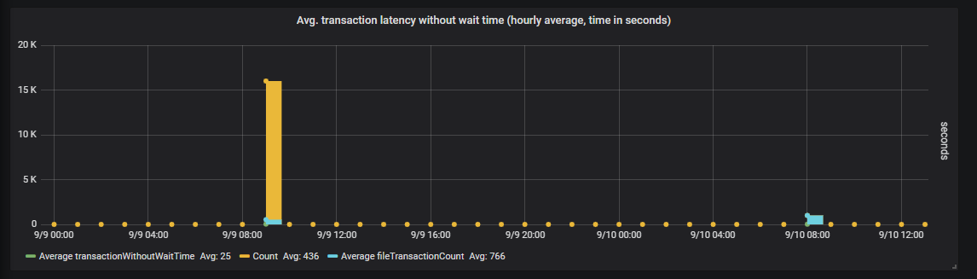
Graph panel
https://grafana.com/docs/features/panels/graph/

Slide 10
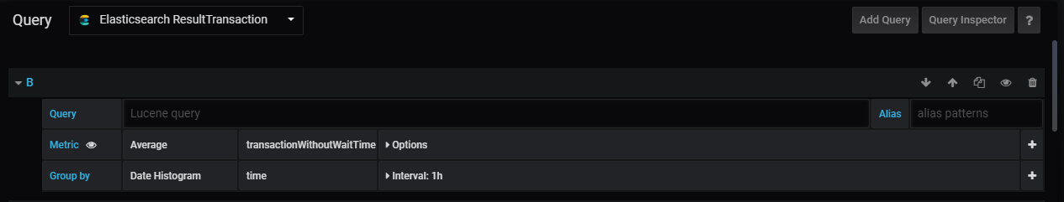
Graph panel - Query

Slide 11
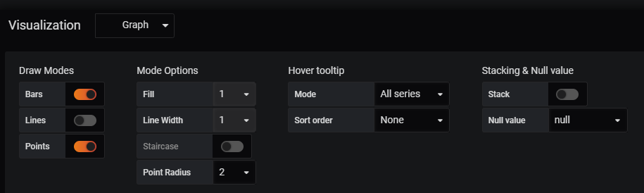
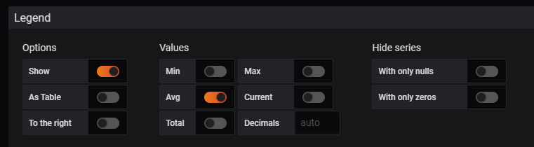
Graph panel - Visualization

Slide 12
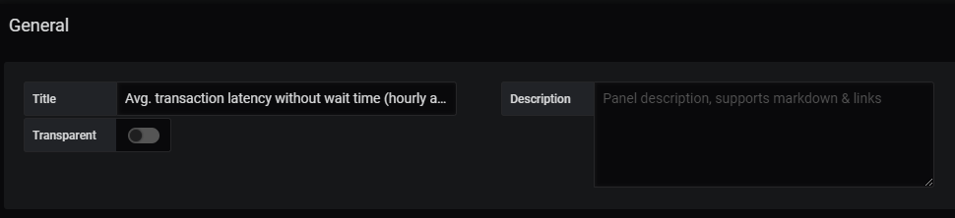
Graph panel – General

Slide 13
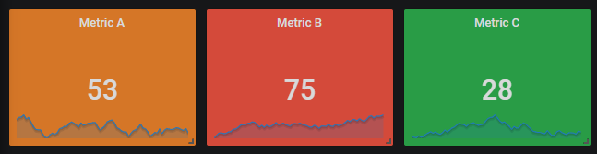
Single stats panel

Slide 14
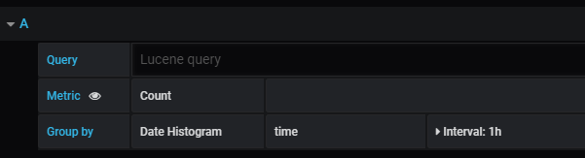
Single stats panel - Query

Slide 15
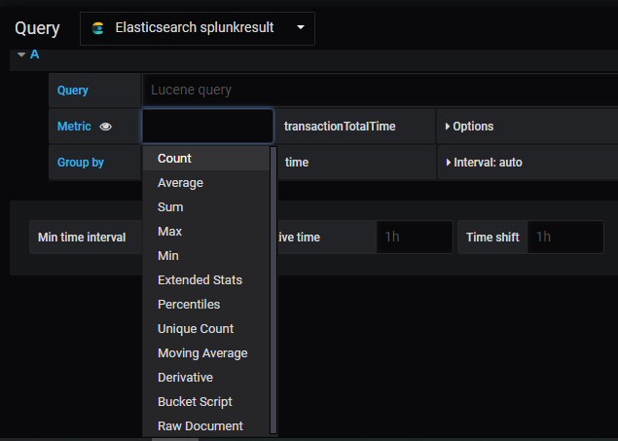
Single stats panel - Query

Slide 16
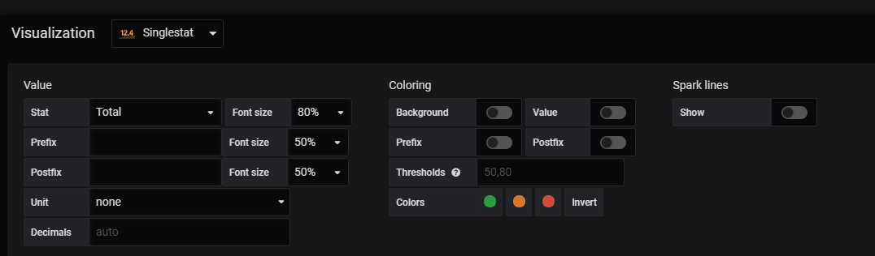
Single stats panel – Visualization

Slide 17
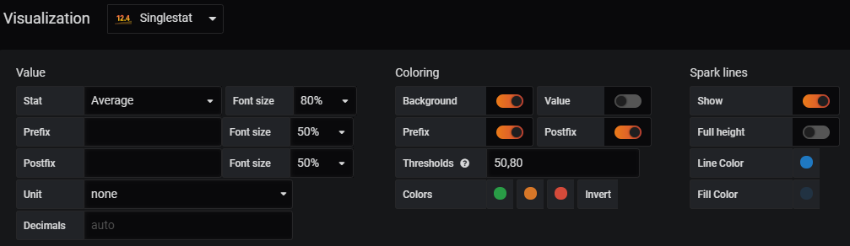
Single stats panel – Coloring

Slide 18
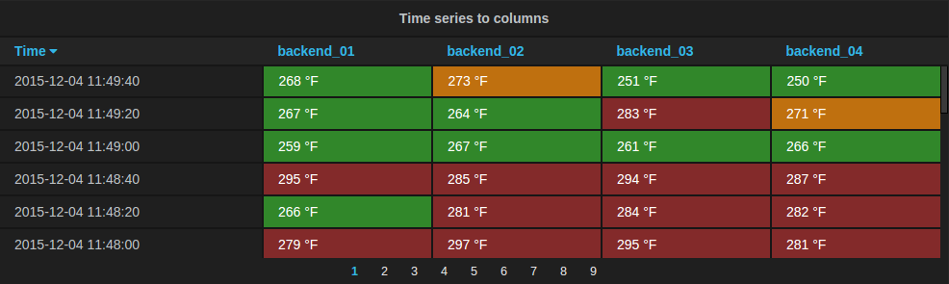
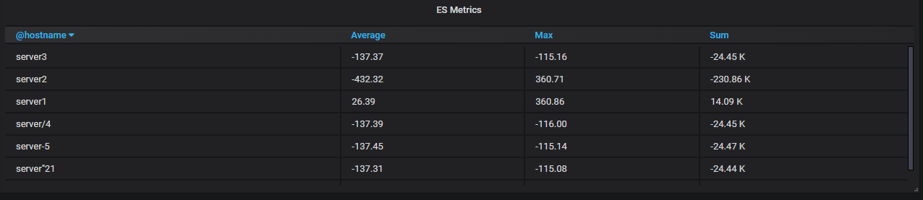
Table panel

Slide 19
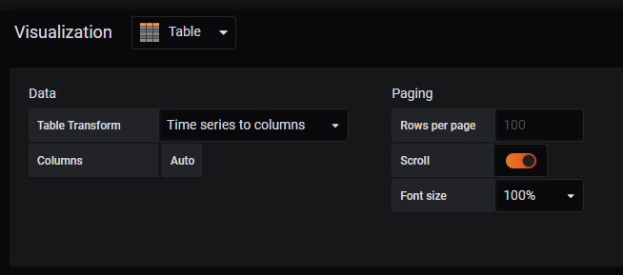
Table panel - Visualization

Slide 20
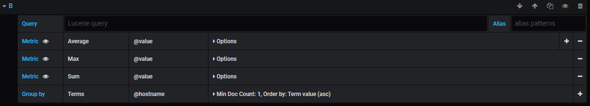
Table panel - Visualization

Slide 21
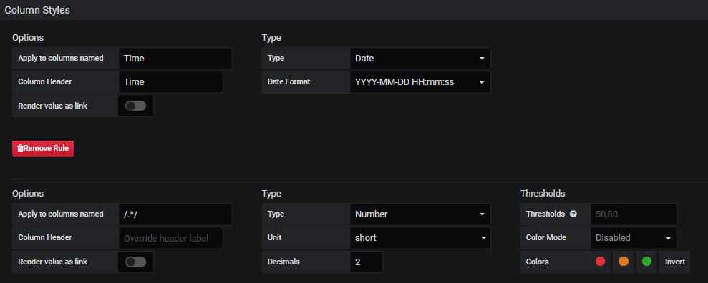
Table panel – Column Styles

Slide 22
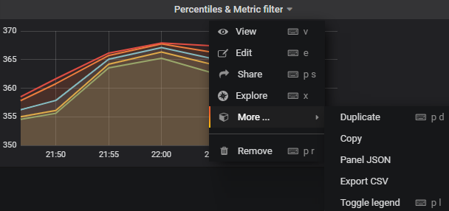
Data Export

Slide 23
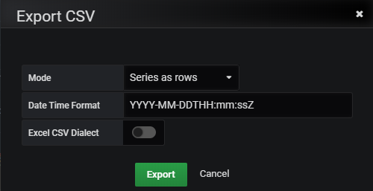
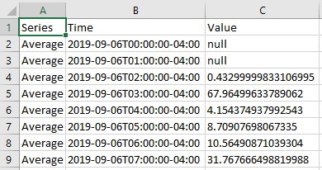
Data Export to CSV

Slide 24
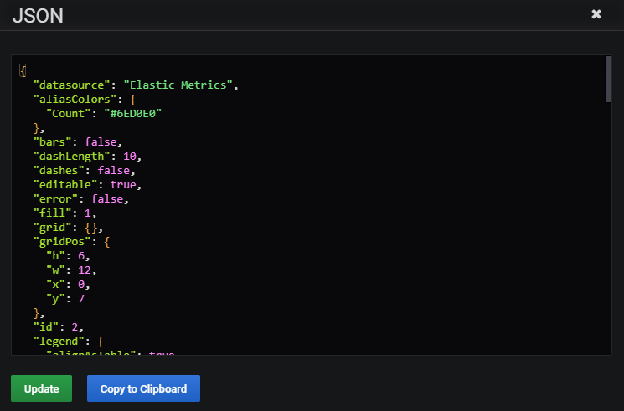
Export Panel to JSON

Slide 25
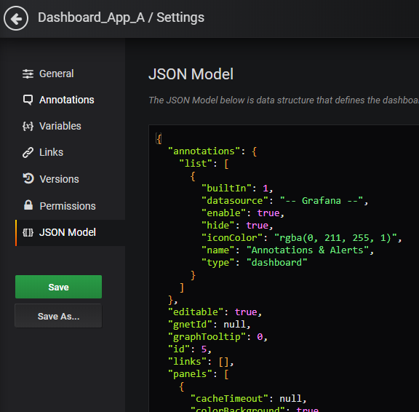
Dashboard export to JSON

Slide 26
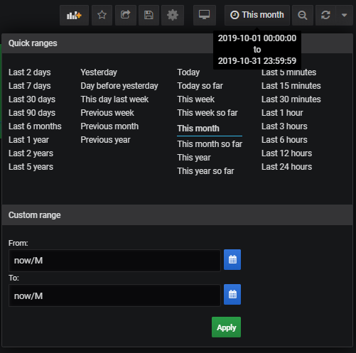
Variables, Filters and time range

Slide 27
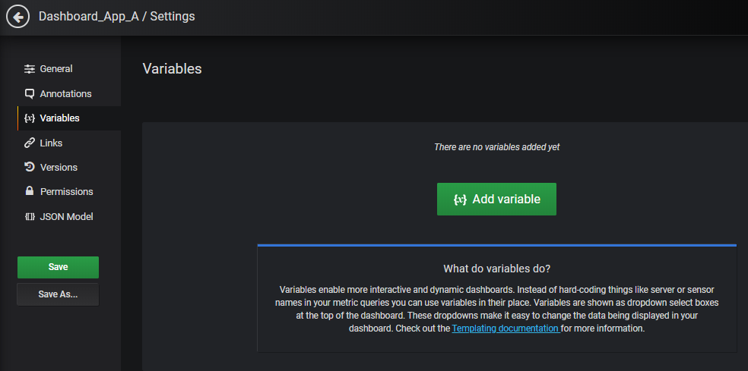
Variables, Filters and time range

Slide 28
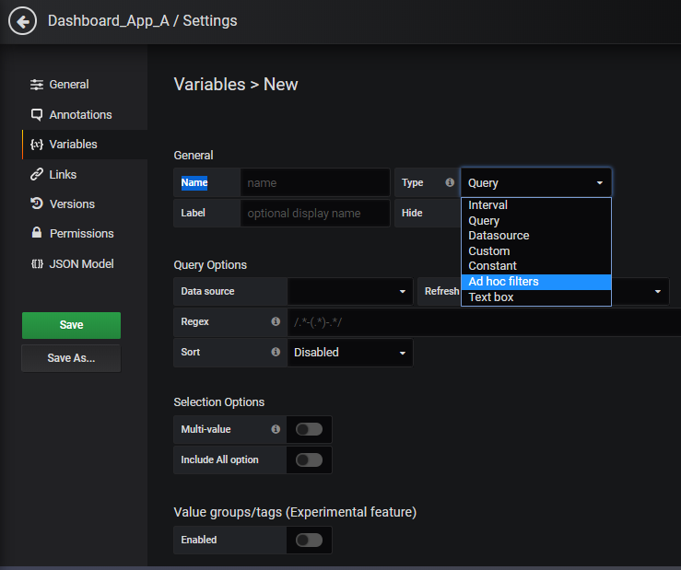
Variables, filters and time range

Slide 29
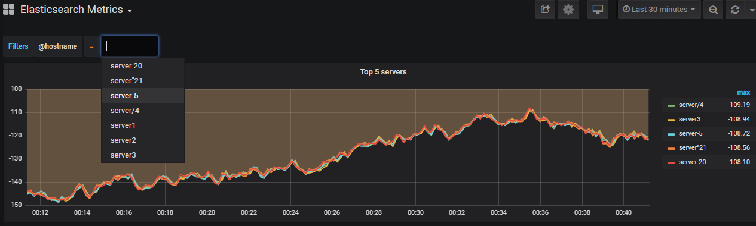
Variables, filters and time range

Slide 30
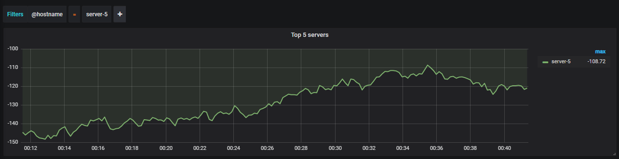
Variables, filters and time range

Slide 31
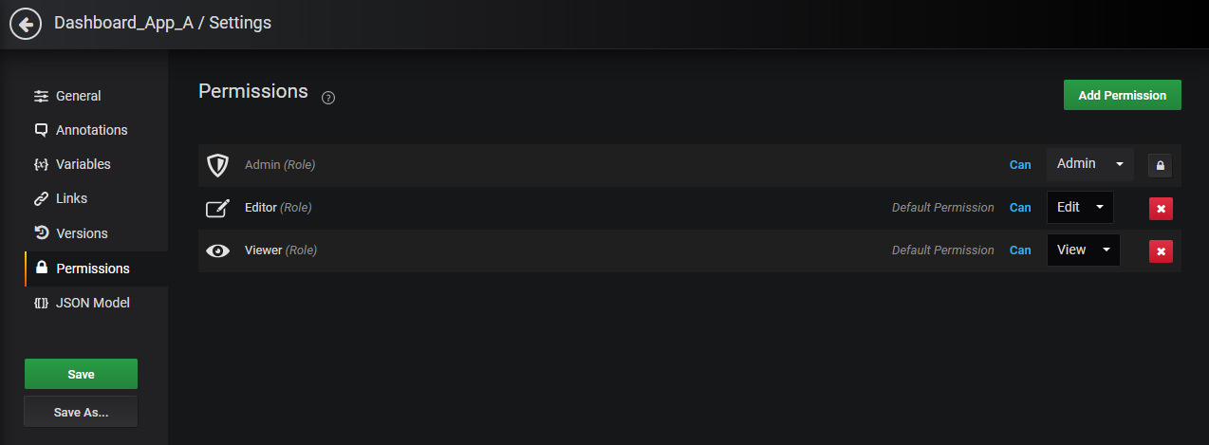
Dashboard Permissions

Slide 32
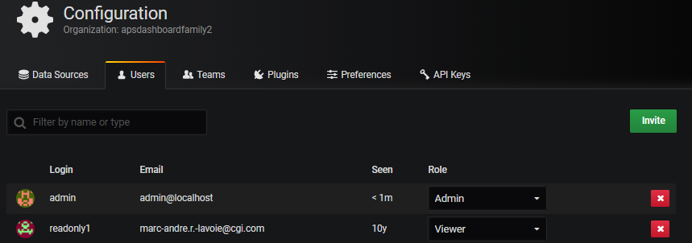
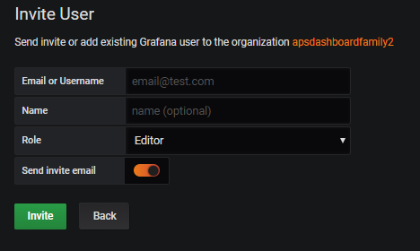
Users configuration

Slide 33
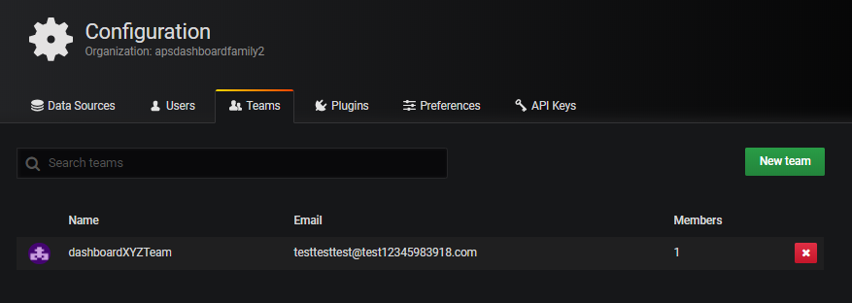
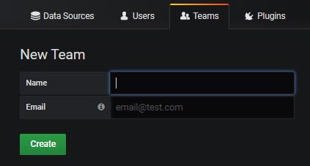
Teams configuration

Slide 34
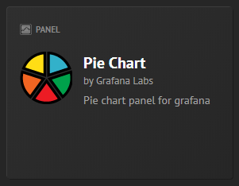
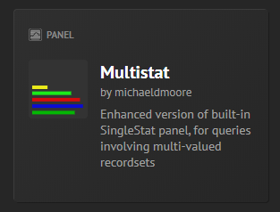
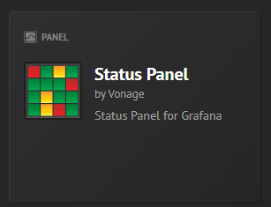
Installing plugins
https://grafana.com/docs/plugins/installation/
https://grafana.com/grafana/plugins?type=panel

Slide 35
References
https://grafana.com/docs/
https://grafana.com/docs/installation/configuration/
https://grafana.com/docs/auth/overview/
https://grafana.com/docs/permissions/overview/
https://grafana.com/docs/features/panels/graph/
https://grafana.com/docs/features/panels/singlestat/
https://grafana.com/docs/features/panels/table_panel/

