Slide 1
Unveiling Steganography: The Art of Covert Communication
Content
1. Understanding Steganography
2. Techniques of Steganography
3. Applications and Implications

Slide 2
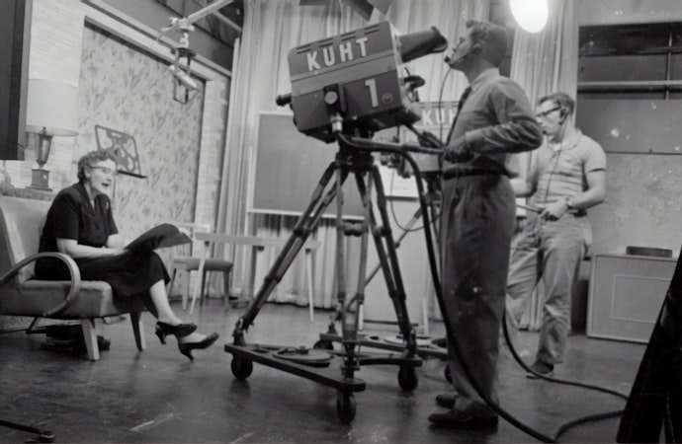

What is Steganography?
Concealed Communication
Steganography is the art of concealing messages within other non-secret data, such as images or text, to avoid detection. It operates on the principle of hiding the existence of the message.
Historical Roots
Steganography has a rich history, dating back to ancient times, where secret messages were hidden within wax tablets or tattooed on a messenger's scalp.

Slide 3
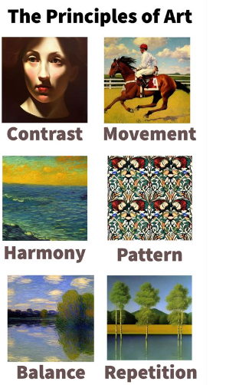
Principles of Steganography
01 Covert Nature
Unlike cryptography, which focuses on making data unreadable, steganography aims to keep the existence of the message secret.
02 Mediums of Concealment
Steganography can involve various mediums, including images, audio files, video files, and even text, making it a versatile tool for hidden communication.
03 Deception and Concealment
The primary purpose of steganography is to deceive, making it a valuable asset in fields such as cybersecurity and intelligence operations.

Slide 4
Steganography vs. Cryptography
01 Distinct Objectives
While cryptography aims to render data unreadable to unauthorized parties, steganography focuses on hiding the existence of the message.
02 Complementary Techniques
Steganography and cryptography can be used in conjunction to provide dual-layered security, with steganography concealing the message and cryptography protecting its content.
03 Applications in Security
The combination of steganography and cryptography is widely used in secure communication, digital watermarking, and copyright protection.

Slide 5
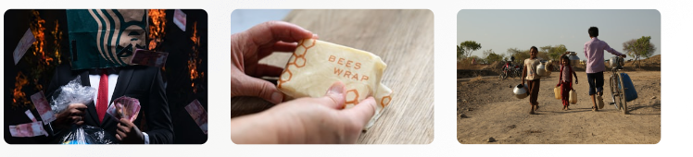
Risks and Ethical Considerations
Misuse and Exploitation
Steganography, like any powerful tool, can be misused for malicious purposes, including covert communication for criminal activities.
Ethical Implications
The ethical considerations of steganography revolve around the balance between privacy, security, and the potential for misuse by bad actors.
Regulatory Challenges
Governments and regulatory bodies face the challenge of balancing the need for privacy and security with the risks posed by covert communication techniques.

Slide 6

Image Steganography
Concealing Data in Images
Image steganography involves hiding information within digital images, leveraging the fact that small changes in pixel values are imperceptible to the human eye.
Techniques and Tools
Various methods, such as Least Significant Bit (LSB) insertion and masking, are employed to embed data within the pixels of an image.
Applications and Detection
Image steganography finds applications in secure image transmission and copyright protection, while detection methods involve statistical analysis and visual inspection.

Slide 7
Audio Steganography
01 Embedding Data in Audio Files
Audio steganography conceals information within audio signals, exploiting the imperceptibility of alterations in audio waveforms.
02 Frequency Domain Techniques
Methods such as phase coding and spread spectrum are utilized to embed data within the frequency domain of audio signals.
03 Challenges and Advancements
Detecting hidden data in audio files poses challenges, leading to ongoing advancements in steganalysis and countermeasures.

Slide 8
Text Steganography
Concealed Textual Communication Text steganography involves hiding messages within seemingly innocuous text, often by modifying the spacing, punctuation, or formatting of the text.
Whitespace and Formatting
Techniques include altering the whitespace between words, using invisible characters, or manipulating the font attributes to embed hidden messages.
Usage and Limitations
Text steganography is employed in scenarios where the exchange of overtly encrypted messages might raise suspicion, but it has limitations in terms of the volume of data that can be concealed.

Slide 9
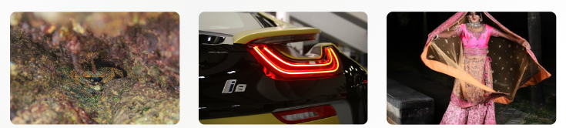
Digital Media Steganography
Multifaceted Concealment
Digital media steganography encompasses the concealment of data within various forms of digital media, including images, audio, video, and even executable files.
Hybrid Techniques
Advanced methods involve combining multiple forms of digital media to embed and transmit hidden information, posing challenges for detection and analysis.
Emerging Trends
The evolution of digital media steganography is influenced by advancements in multimedia technologies, encryption algorithms, and the proliferation of digital content.

Slide 10

Cybersecurity and Data Protection
Secure Communication
Steganography is utilized in secure communication channels, enabling covert transmission of sensitive information within seemingly innocuous data.
Digital Watermarking
The embedding of copyright information and ownership details within digital media using steganography serves as a tool for intellectual property protection.
Challenges in Detection
The use of steganography poses challenges for cybersecurity professionals, requiring advanced steganalysis techniques to detect hidden data.

Slide 11
Challenges in Detection
The use of steganography poses challenges for cybersecurity professionals, requiring advanced steganalysis techniques to detect hidden data.
Espionage and Covert Operations
01 Covert Communication
Intelligence agencies and espionage operatives leverage steganography for covert communication and information exchange in clandestine operations.
02 Counterintelligence Measures
The detection and prevention of steganographic communication form a critical aspect of counterintelligence and national security efforts.
03 Ethical Dilemmas
The ethical considerations of employing steganography in espionage activities raise questions about privacy, surveillance, and international law.

Slide 12
THANK YOU
S.SUBBA RAO

