Slide 1

Student Interaction Workshop EPAM
GVS Sreenadh

Slide 2
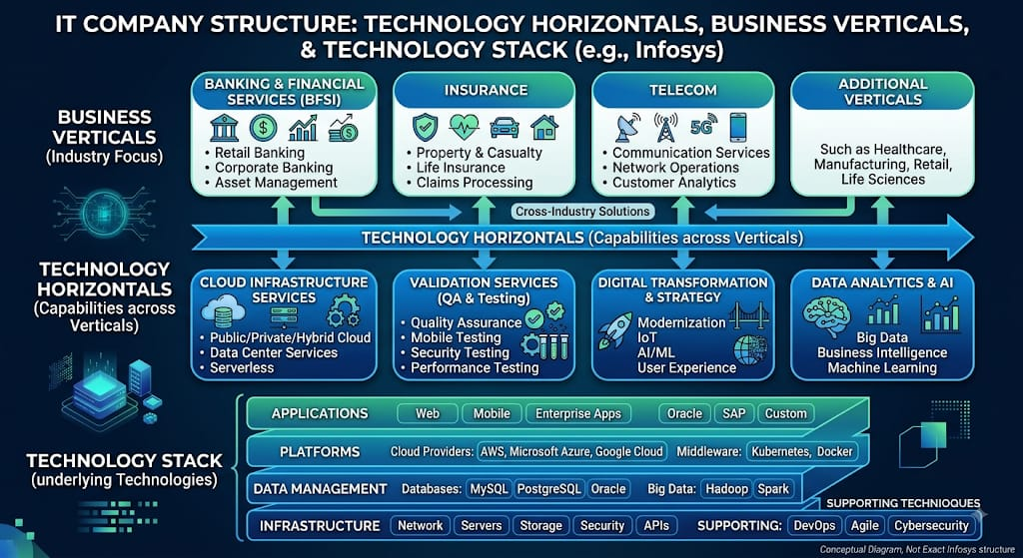

Slide 3
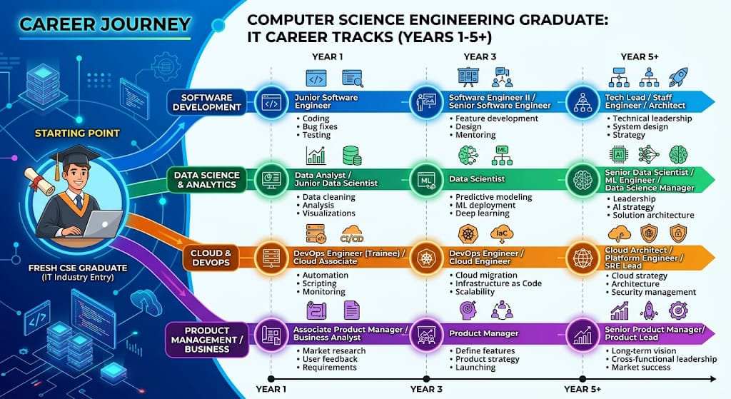

Slide 4
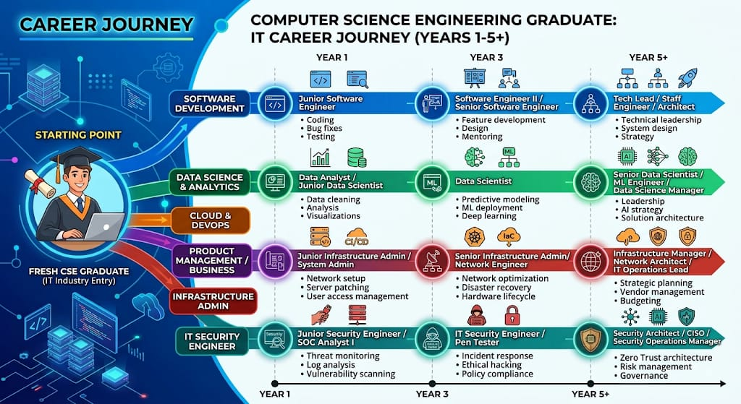

Slide 5
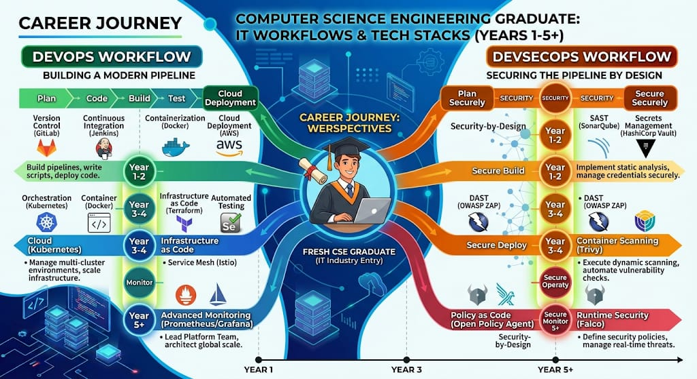

Slide 6
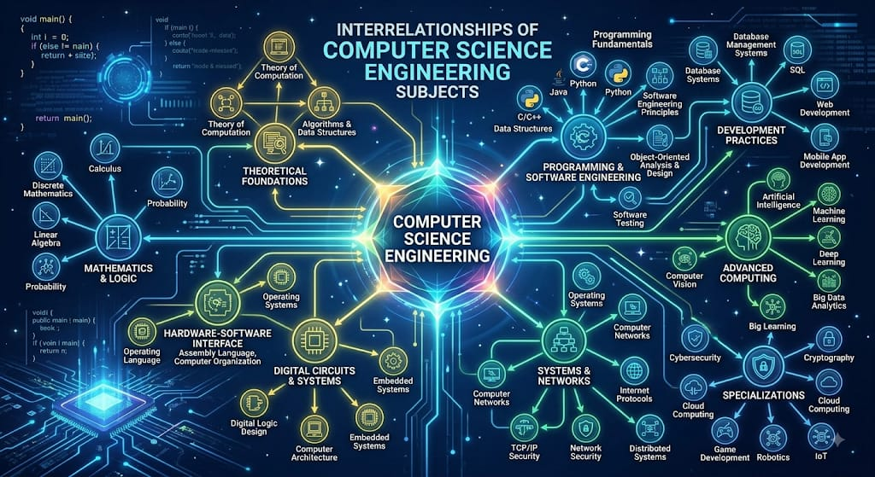

Slide 7
30-60-90 Day IT Interview Roadmap
A structured, stream-by-stream action plan tailored for Computer Science Freshers to crack technical & role-specific interviews.

Slide 8









Career Streams Overview
Software Dev
Data Science
Cloud & DevOps
Focuses on Data Structures, Algorithms, Core CS (OOP, OS, DBMS), and full-stack web/app development projects.
Emphasizes SQL, Python, applied statistics, machine learning algorithms, and interactive business dashboards.
Builds hands-on skills in Linux CLI, networking protocols, cloud basics (AWS/Azure), and CI/CD pipelines.
Product / Business
IT Security
Phase Breakdown
Focuses on product sense, wireframing (Figma), business metrics (CAC, LTV), PRD creation, and app teardowns.
Covers network security, vulnerability scanning, OWASP Top 10, log analysis (SIEM), and hands-on CTFs.
Days 1-30: Foundations & Core CS
Days 31-60: Applied Projects & Tools
Days 61-90: Portfolio & Mock Interviews

Slide 9




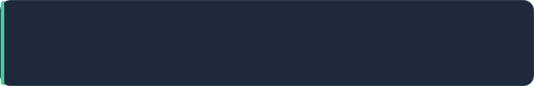
Software Development Roadmap
Days 1 – 30 Core CS & Data Structures
Master Arrays, HashMaps, Trees, and Strings. Revise OOPs, Operating Systems, and SQL queries. Solve 50+ Easy/Medium LeetCode problems.
Days 31 – 60 Advanced DSA & Full-Stack Project
Cover Dynamic Programming and Graphs. Build 2 production-ready projects (React/Node or Python/Django) with Git version control and unit testing.
Days 61 – 90 System Design & Mock Interviews
Learn Low-Level Design (LLD) basics & REST API design. Participate in 5+ technical mock interviews and optimize resume for ATS.

Slide 10

Data Science & Analytics Roadmap
Days 1 – 30 Math & SQL Foundations
Master Python/R, complex SQL (Window functions, JOINs), and probability & hypothesis testing. Practice Pandas & NumPy for data wrangling.
Days 31 – 60 Machine Learning & Dashboards
Build interactive dashboards using PowerBI or Tableau. Implement supervised ML models (Regression, Decision Trees) with Scikit-Learn.
Days 61 – 90 End-to-End Kaggle Portfolio
Deliver 2 full data analytics projects on real Kaggle datasets. Publish clean GitHub repositories and practice explaining business insights.

Slide 11
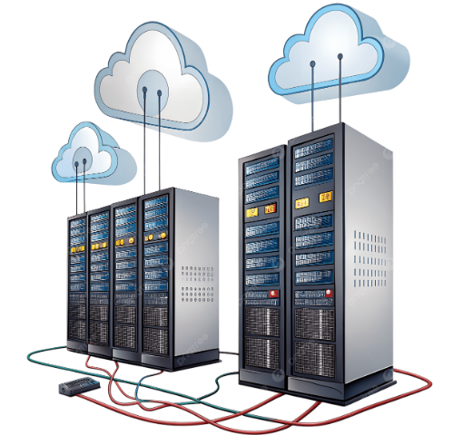
Cloud & DevOps Roadmap
Days 1 – 30 Linux Administration & Networking
Master Linux CLI commands, shell scripting, TCP/IP, DNS, and user access control. Set up virtual Linux servers locally.
Days 31 – 60 Cloud Infrastructure & Automation
Learn core AWS/Azure services (EC2/VMs, S3, IAM, VPC). Automate server patching and environment setup using Bash or Ansible scripts.
Days 61 – 90 CI/CD Pipelines & Certifications
Prepare for AWS Cloud Practitioner or CompTIA Linux+. Build an automated CI/CD pipeline deploying a web app to cloud servers.

Slide 12
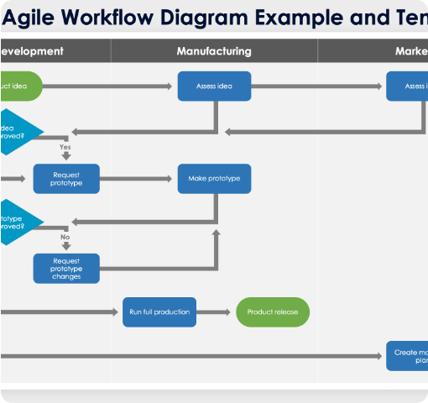
Product Management Roadmap
Days 1 – 30 PM Frameworks & Metrics
Study frameworks (CIRCLES, BUS), key metrics (CAC, LTV, Retention, DAU/MAU), and Agile/Scrum workflows. Practice writing clean PRDs.
Days 31 – 60 Product Sense & Wireframing
Perform teardowns of 3 popular consumer apps. Create interactive UI/UX wireframes in Figma and use SQL for basic data-driven decisions.
Days 61 – 90 Teardowns & Case Interviews
Publish 2 comprehensive product teardowns online. Conduct mock interviews focusing on product design, execution, and behavioral questions.

Slide 13

IT Security Engineer Roadmap
Days 1 – 30 Security & Web Fundamentals
Study OSI model, network protocols, OWASP Top 10 web vulnerabilities, and cryptography basics. Configure a Kali Linux lab.
Days 31 – 60 Log Monitoring & Tooling
Learn SIEM tools (Splunk/Elastic) for threat log analysis. Practice packet inspection with Wireshark and vulnerability scanning with Nmap.
Days 61 – 90 CTF Challenges & Certifications
Solve room challenges on TryHackMe or Hack The Box. Prepare for entry certs (CompTIA Security+ / eJPT) and incident response drills.

Slide 14

Streams Execution Matrix
Stream Track | Core Tools / Tech | Primary Deliverable | Target Entry Role
Software Dev | Java/Python, DSA, SQL, Git, React | 2 Full-Stack GitHub Projects | Junior Software Engineer
Data Science | Python, SQL, Pandas, Tableau, Scikit-Learn | End-to-End Kaggle Analysis | Data Analyst / Jr. Data Scientist
Cloud & DevOps | Linux, AWS, Bash Scripting, Docker | Automate Cloud Web Server | Jr. Infrastructure / System Admin
Product Mgmt | Figma, SQL, PRDs, Product Frameworks | 2 Published Product Teardowns | Associate Product Manager
IT Security | Kali Linux, Wireshark, Nmap, Splunk | TryHackMe / CTF Write-ups | Junior Security Engineer / SOC Analyst

Slide 15
Roadmap Success Checklist
Consistency Over Intensity: Dedicate 3 to 4 focused hours daily to your chosen stream track without skipping foundational concepts.
Build Public Deliverables: Ensure all projects, teardowns, CTF write-ups, or code samples are hosted publicly on GitHub, Kaggle, or LinkedIn.
Conduct Mock Interviews: Complete at least 5 live mock interviews during Days 61-90 to build communication confidence and problem-solving agility.
Tailor Your ATS Resume: Customize your resume keywords specifically for the entry-level job description of your target stream.

Slide 16





Image Sources
https://img.magnific.com/premium-photo/software-developer-coding-laptop-tablet-modern-workspace-closeup-programming-workflow-software-engineering-debugging-source-code-multidevice-application-development_528263-8956.jpg?semt=ais_hybrid&w=740&q=80
Source: www.magnific.com
https://as2.ftcdn.net/v2/jpg/06/25/14/97/1000_F_625149768_2zbgagLKFFei6juPNQyLsViwXbjuUaP3.jpg
Source: www.posters.cz
https://png.pngtree.com/png-clipart/20250508/original/pngtree-cloud-computing-server-digital-data-storage-and-network-infrastructure-png-image_20945994.png
Source: pngtree.com
https://www.smartsheet.com/sites/default/files/2024-09/IC-Swimlane-Agile-Workflow-Diagram-Example-and-Template-12203.png
Source: www.smartsheet.com
https://images.presentationgo.com/2025/05/cybersecurity-hacker-darkroom.jpg
Source: www.presentationgo.com

