Slide 1
BUILD YOUR
PROFESSIONAL
IDENTITY
Resume • LinkedIn • GitHub • Personal Brand
HANDS-ON WORKSHOP
Your degree gets you into the race.
Your professional identity helps you get noticed.

Slide 2
OPENING CHALLENGE
Google Yourself. Right Now.
🔍 yourname
SEARCH
Recruiter sees…
A professional profile?
Recruiter sees…
Only a college resume?
Recruiter sees…
Nothing useful?
TURN YOUR DIGITAL PRESENCE INTO EVIDENCE.

Slide 3
REALITY CHECK
The Recruiter Test
60
1. RESUME
What can you do?
2. LINKEDIN
Who are you?
3. GITHUB
Can you prove it?
SECONDS
If all three tell the SAME story → credibility.
If they tell DIFFERENT stories → confusion.
Your mission today: make your story consistent.

Slide 4
THE BIG PICTURE
Your Professional Identity = 4 Connected Signals
RESUME
Gets attention
LINKEDIN
Builds visibility
GITHUB
Shows evidence
PERSONAL BRAND
Creates recall
ONE CAREER STORY

Slide 5
RESUME
Resume: Stop Listing. Start Proving.
❌ COLLEGE-STYLE
“Developed an e-commerce website using React and Node.js.”
Too generic.
No scale. No problem. No evidence.
✅ JOB-READY
“Built a full-stack e-commerce app using React, Node.js and MongoDB with authentication, search and order management.”
Specific. Technical. Believable.
ACTION + TECHNOLOGY + PROBLEM/FEATURE + EVIDENCE

Slide 6
HANDS-ON
🔥 Resume Challenge
OPEN YOUR RESUME
Rewrite ONE bullet
1. What did I build?
2. What technology?
3. What problem/feature?
4. What evidence/result?
Choose ONE project
3 MINUTES → ONE BETTER BULLET

Slide 7
LINKEDIN
LinkedIn: Your Professional Story
YOUR NAME
CSE Student | Aspiring Cloud & DevOps Engineer
AWS • Linux • Docker • GitHub
Building cloud projects and sharing what I learn.
PHOTO
Professional + clear
HEADLINE
Career direction + skills
ABOUT
Story + projects + goal
DON'T WRITE “STUDENT”. SHOW WHERE YOU'RE GOING.

Slide 8
HANDS-ON
🔥 Create Your LinkedIn Headline
[WHO YOU ARE] | [CAREER] | [3 SKILLS] | [WHAT YOU BUILD]
❌ AVOID
“Student at XYZ College”
✅ TRY
“CSE Student | Aspiring Data Analyst | Python • SQL • Power BI | Building Data Projects”
UPDATE YOUR HEADLINE

Slide 9
GITHUB
GitHub: Show What You Can Build
⭐ pinned-project
E-Commerce-App
README.md
✓ Problem / purpose
✓ Tech stack
✓ Screenshots / demo
✓ Setup instructions
✓ What I learned
PROFILE
Clear bio + photo
REPOSITORY
Best work pinned
README
Explain before they read code
YOUR CODE IS EVIDENCE.

Slide 10
HANDS-ON
🔥 GitHub Recruiter Check
☐ Profile / bio
☐ Best project pinned
☐ README exists
☐ Screenshots / demo
☐ Tech stack clear
☐ Setup instructions
60-SECOND TEST: CAN I UNDERSTAND YOUR PROJECT?

Slide 11
PERSONAL BRAND
Personal Branding: Be Remembered for Something
I AM
+
I CAN
+
I BUILD
+
I SHARE
EXAMPLE
“I am a CSE student. I can build web applications. I build React + Node.js projects. I share what I learn through GitHub and LinkedIn.”
NOT INFLUENCE. → IDENTITY.

Slide 12
FINAL CHALLENGE
🔥 The Recruiter Scorecard
Career goal
1 point
LinkedIn headline
1 point
Resume projects
2 points
GitHub profile
1 point
Documented project
1 point
Consistent story
2 points
Professional presence
2 points
MY SCORE: ____ / 10
What is the ONE thing you will fix first?

Slide 13
TAKE ACTION
🚀 Your 30-Day Professional Identity Challenge
WEEK 1
RESUME
Rewrite projects
WEEK 2
LINKEDIN
Headline + About
WEEK 3
GITHUB
README + demo
WEEK 4
BRAND
2 posts + 20 connections
DON’T JUST SAY YOU HAVE SKILLS. SHOW THEM.
RESUME → LINKEDIN → GITHUB → OPPORTUNITY

Slide 14
YOUR NAME
What should a recruiter remember about you?
Don’t wait for final year.
Start building your professional identity today.
BUILD • SHOW • SHARE • REPEAT

Slide 15
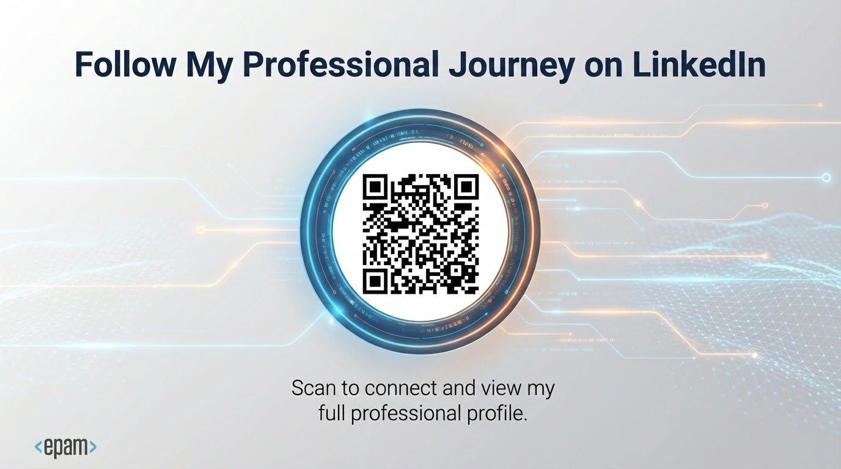

Slide 16
AI Changes the Speed, Not the Responsibility

