Slide 1
SMART FARMING ADVICE agent
IBM AICTE PROJECT
Presented By:
Student name : Guggilam.Subbarao
College Name : Narasaraopeta Engineering College
Department : Artificial Intelligence

Slide 2
OUTLINE
Problem Statement
Technology used
Wow factor
End users
Result
Conclusion
Git-hub Link
Future scope
IBM Certifications

Slide 3
Problem Statement
Farmers, agricultural advisors, and rural professionals often struggle to keep up with the rapidly growing volume of farming information, government schemes, weather updates, crop advisories, and market trends. Manually gathering, filtering, and understanding this data from multiple sources is time-consuming and inefficient.
Proposed Solution: Our solution is an AI Research Agent that leverages Natural Language Processing (NLP) and Retrieval-Augmented Generation (RAG) to simplify and accelerate the research process. It helps users conduct efficient literature reviews, generate concise summaries, identify key research gaps, and discover relevant papers, datasets, or potential collaborators. This AI-driven assistant reduces manual workload and boosts research productivity for students, scholars, and professionals.

Slide 4
Technology used
IBM cloud lite services
Natural Language Processing (NLP)
Retrieval Augmented Generation (RAG)
IBM Granite model

Slide 5
IBM cloud services used
IBM Cloud Watsonx AI Studio
IBM Cloud Watsonx AI runtime
IBM Cloud Agent Lab
IBM Granite foundation model

Slide 6
Wow factors
This agent will empower small-scale farmers with timely, localized advice that improves crop yield, reduces agricultural risks, and increases income. It bridges the gap between expert knowledge and grassroots farming by offering real-time support in local languages, even in low-resource regions. It transforms traditional farming into data-driven smart agriculture.
Unique features:
Localized crop recommendation based on soil type, weather patterns, and season
Real-time weather and rainfall alerts for proactive planning
Pest and disease diagnostics using natural language queries
Market rate updates from nearby mandis to help sell at the right time and price
Guidance on government schemes with simple explanations and eligibility checks
Multilingual support, enabling interaction in regional Indian languages
Offline/low-connectivity fallback mode for remote area usability
Voice input compatibility for illiterate or semi-literate users

Slide 7
End users
Small-Scale and Marginal Farmers
Agri-Tech Startups and Companies
Government Agricultural Departments
NGOs and Farmer Welfare Organizations

Slide 8
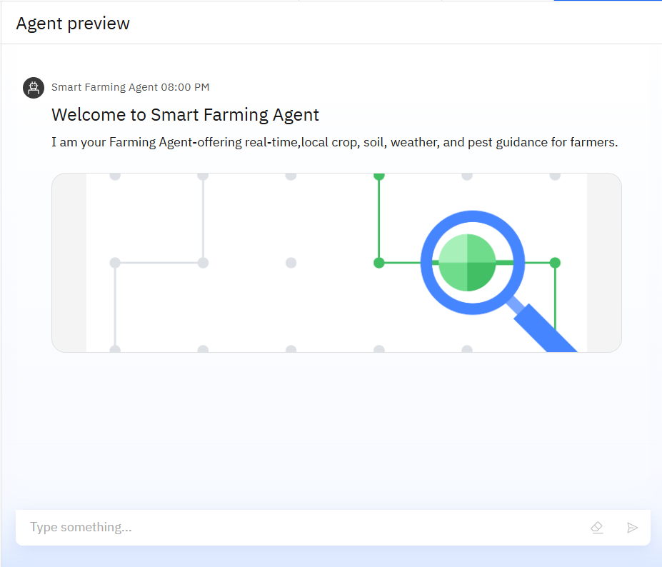
Results

Slide 9
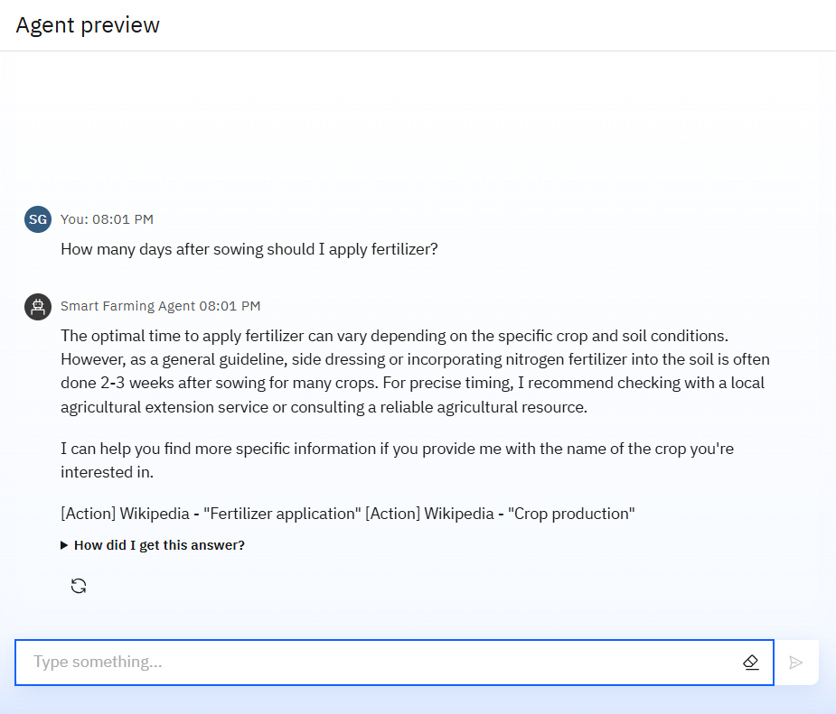
Results

Slide 10
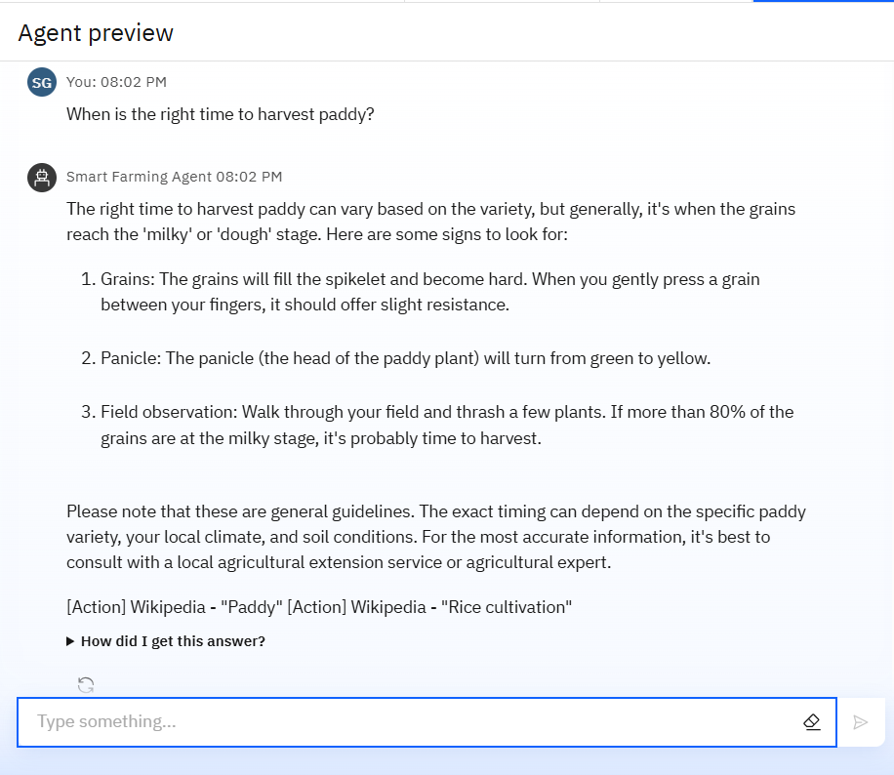
Results

Slide 11
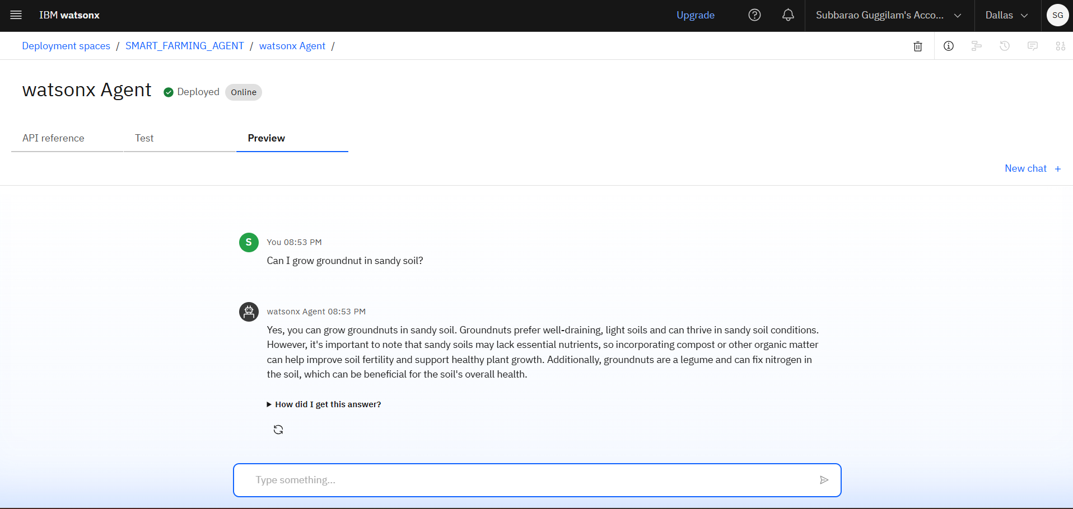
Results
Deployed AI Agent

Slide 12
Conclusion
The agent provides personalized crop suggestions, pest control guidance, and real-time weather updates.
It saves farmers time by automating data retrieval from trusted agricultural, meteorological, and market sources.
Smart Farming Agents improve yield, reduce risk, and support sustainable and data-driven agriculture.

Slide 13
Future scope
Multilingual Expansion
Voice-Activated Research Assistant
Real-Time Expert Collaboration
Crop Disease Early Warning System
Integration with Agri-Tech Platforms
AI-Powered Farm Planning

Slide 14
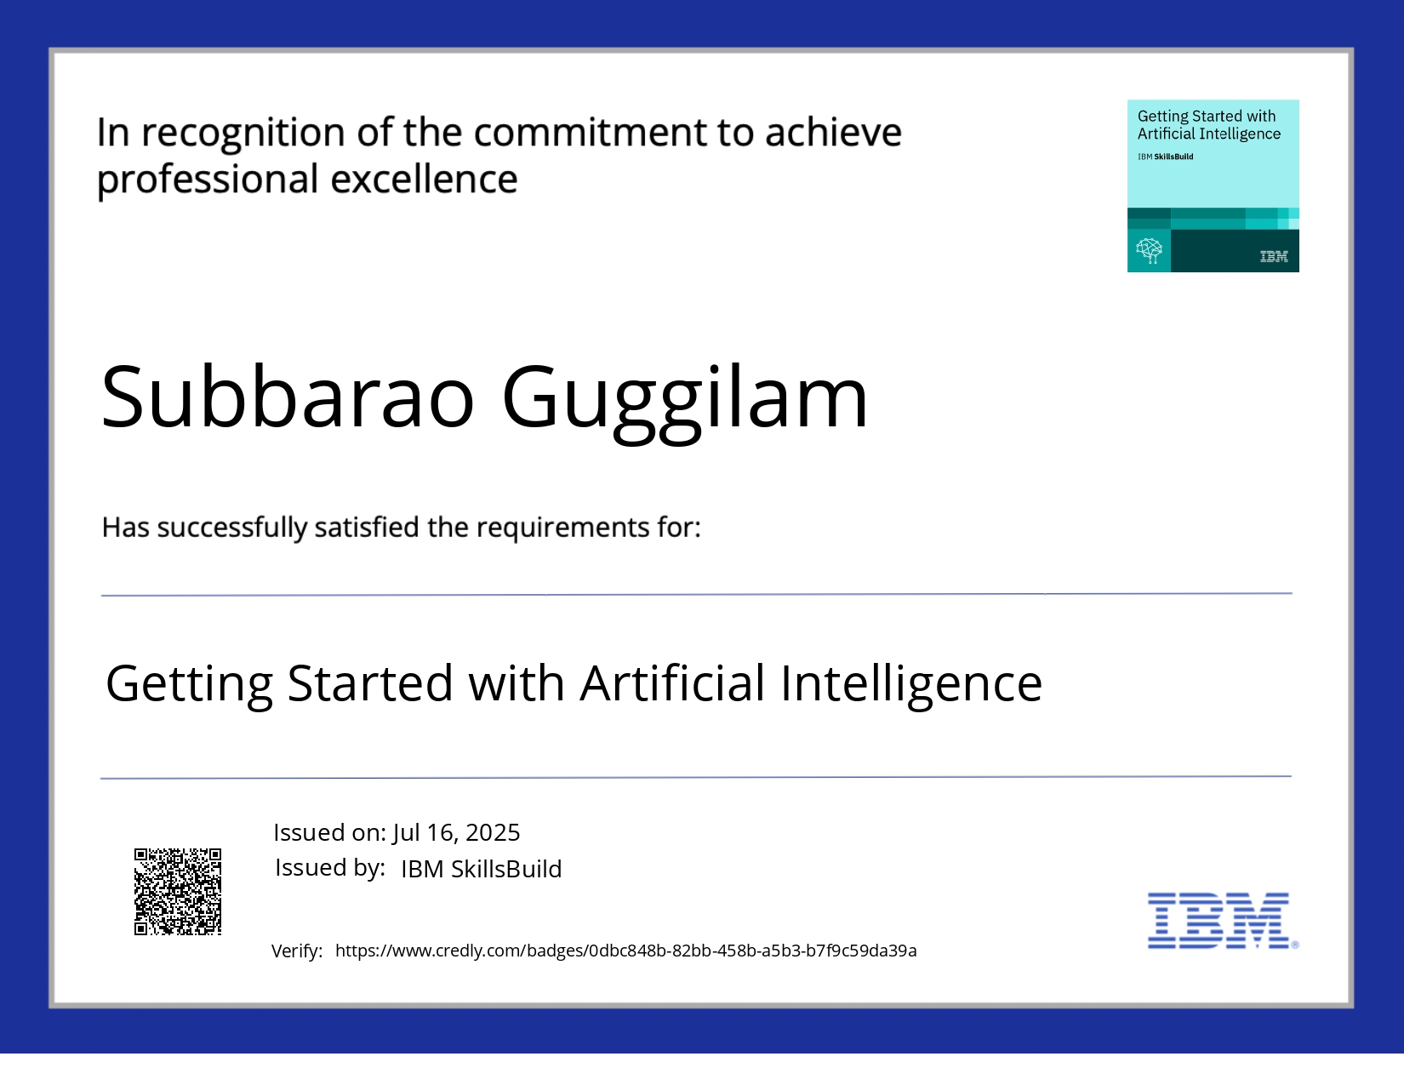
IBM Certifications
Getting Started with Artificial Intelligence

Slide 15
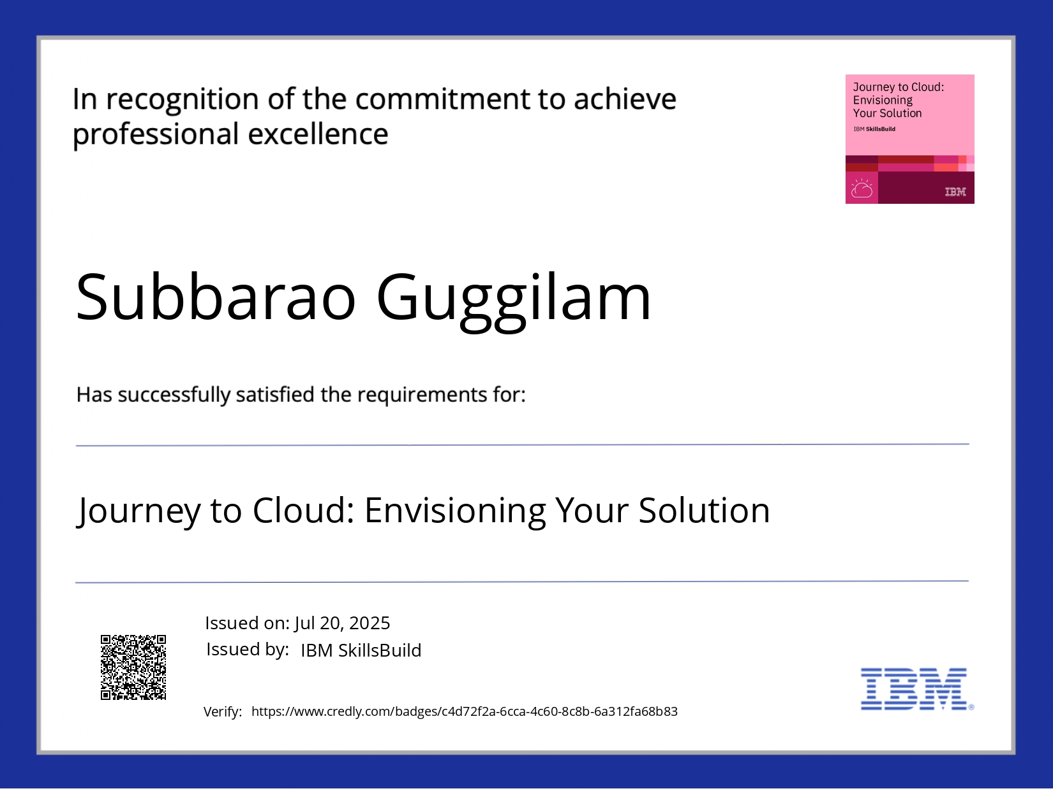
IBM Certifications
Journey to Cloud: Envisioning Your Solution

Slide 16
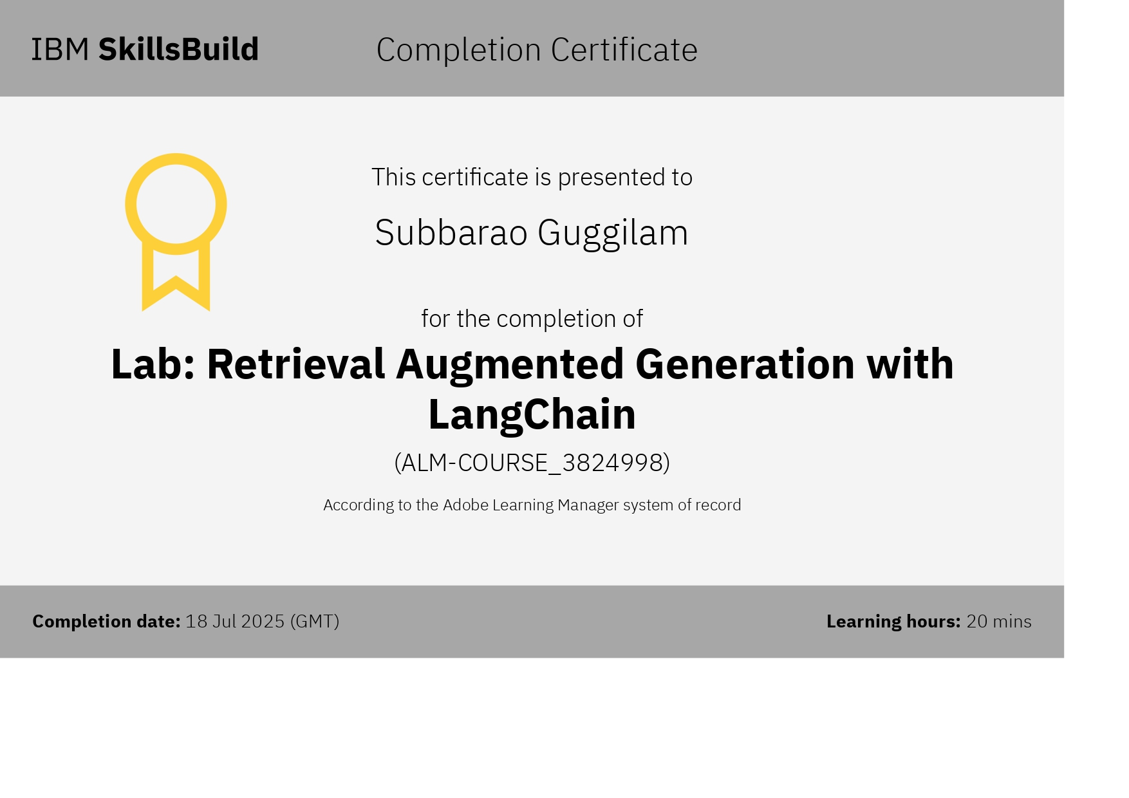
IBM Certifications
LAB : Retrieval Augmented Generation with LangChain

Slide 17
Git hub lik : https://https://github.com/subbaraoguggilam/smart-farming-agent

Slide 18
GitHub Link
Make sure that there should be readme file

Slide 19
"AI cannot till your land, but it can show you better ways to do it.“ THANK YOU

