Slide 1


Brain Alignment:
Insights from Multi-Modal and Instruction-Tuned LLMs
Raju Bapi & Subba Reddy Oota
IIIT-Hyderabad, India & TU Berlin, Germany
raju.bapi@iiit.ac.in
subba.reddy.oota@tu-berlin.de

Slide 2
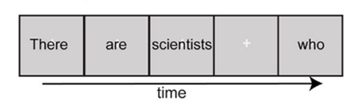
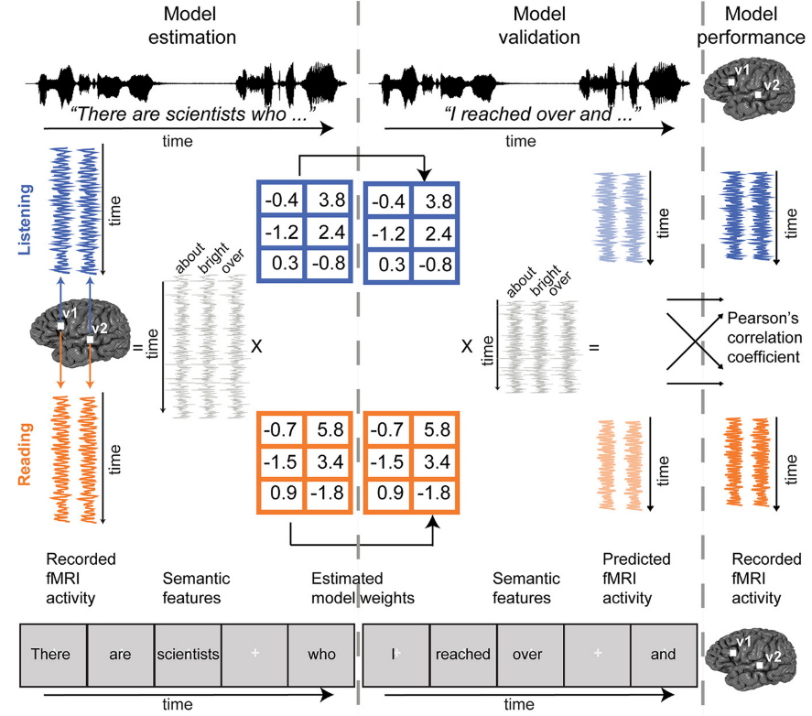





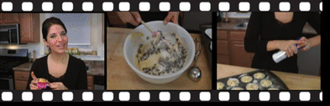
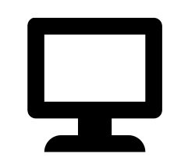




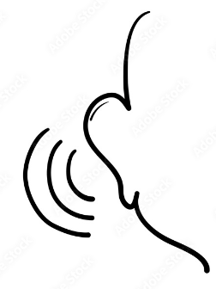




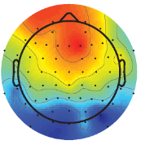
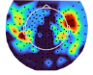
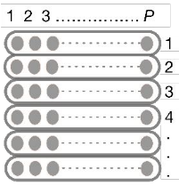
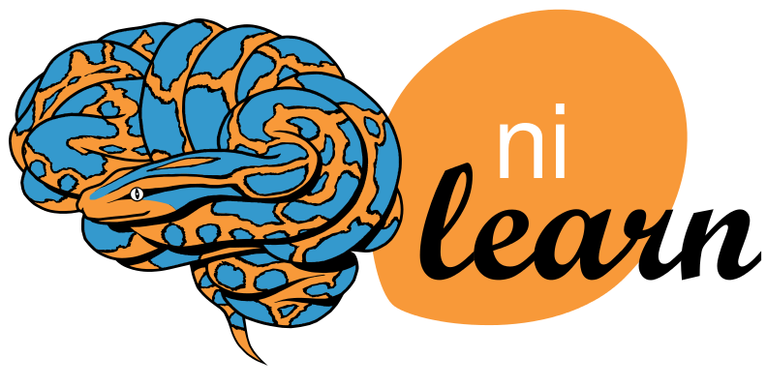
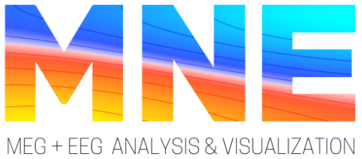
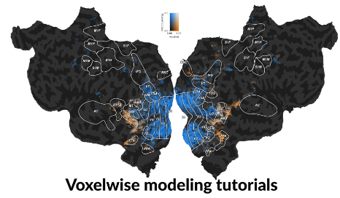

DNN Model Representations
Neuro-AI Pipeline
Human Brain Recordings
Stimulus
Multimodal
Reading
Listening
Language
Audio
Visual
Static Image
Video clip (with or without audio)
DNN Models
Language Model
Audio Model
Vision Model
Multimodal Model
Visual
Auditory
Down sampling: Interpolation of the feature matrix
Stimulus
Feature Space
HRF estimation: use of FIR model, different delays
fMRI
EEG
MEG
Evaluation Metrics
PCC, R², 2V2 Accuracy, RDM, CKA, Noise Ceiling, Normalized brain alignment
fMRI: Whole brain, ROI level, Sub-ROI level, task-specific voxels
MEG: Sensor recordings over time points
EEG: Electrode signals recorded over time
Linear
Ridge
Bootstrap Ridge
Banded Ridge
Visualization Tools
Oota et al (2025). Deep Neural Networks and Brain Alignment: Brain Encoding and Decoding (Survey) [TMLR]
Encoding Models
Lasso
PLS
Kernel Ridge
Decoding Models
Multi-Layer Perceptron
DNN Models
Non-Linear
https://openreview.net/pdf?id=YxKJihRcby
Notes:
CKA: centered kernel alignment; CCA: Canonical Correlation Analysis; R^2: The coefficient of determination is a statistical measure that indicates how well a model predicts an outcome in a regression analysis; RDM: Representational Dissimilarity Matrix (Analysis)

Slide 3
Language models (LMs) are trained to predict missing words
jumps
Language model
The
quick
brown
fox
[MASK]
Notes:
These language models are trained to [Keep clicking]
predict missing words over millions of text documents.

Slide 4
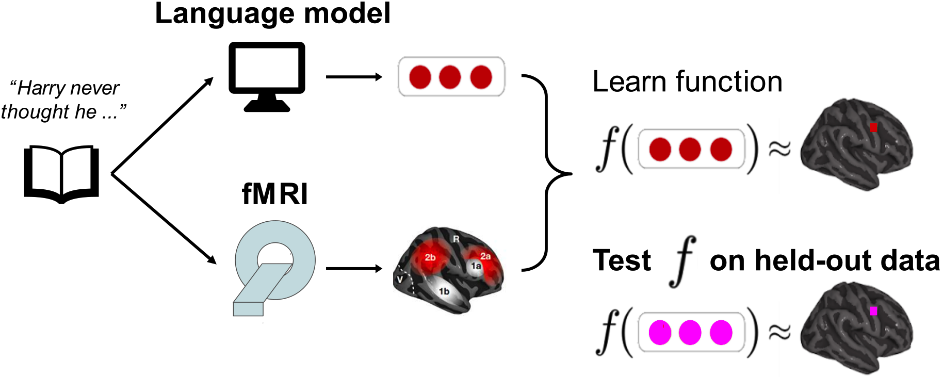
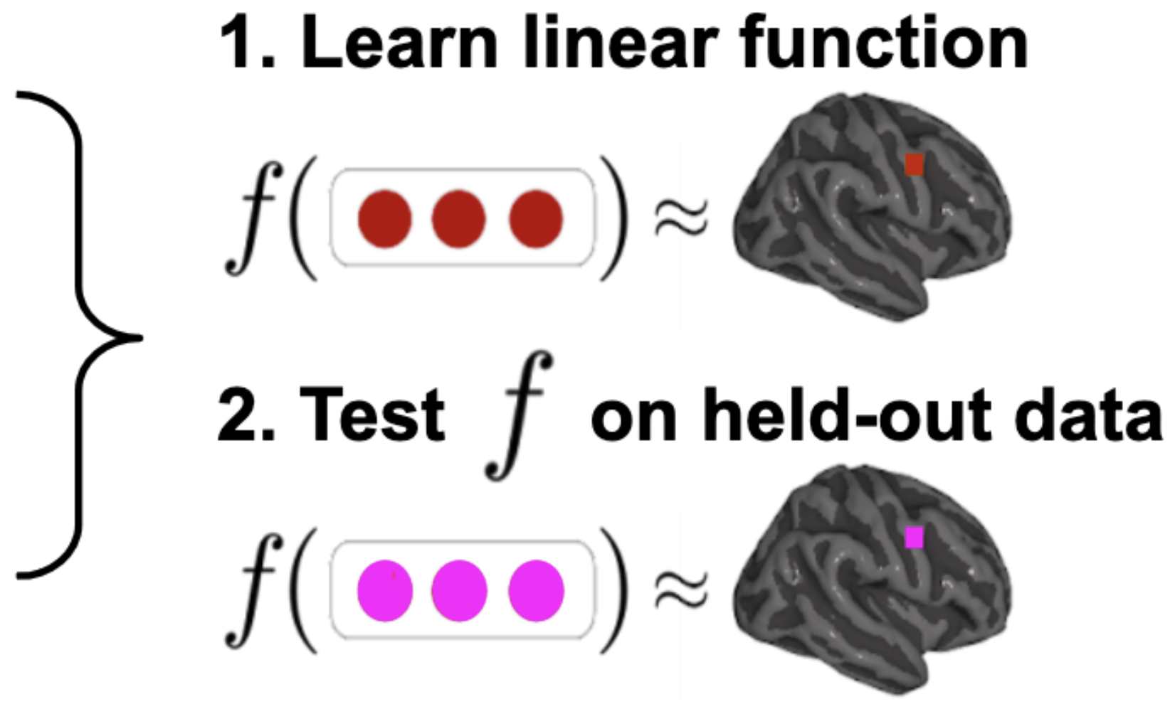
Language models (LMs) predict brain activity evoked by complex
language tasks (e.g. listening to a story) to an impressive degree
time
Once
upon
a
Brain alignment of an LM ⇒ how similar its representations are to a human brain
Wehbe et al. 2014,
Jain and Huth 2018,
Gauthier and Levy 2019
Toneva and Wehbe 2019,
Caucheteux et al. 2020,
Toneva et al. 2020
Jain et al. 2020,
Schrimpf et al. 2021,
Goldstein et al. 2022
...
Notes:
Several works shown that LMs predict brain activity recorded when participants listen to or read a complex language stimulus, such as a short story. This ability to predict brain activity is what we refer to as brain alignment”.

Slide 5
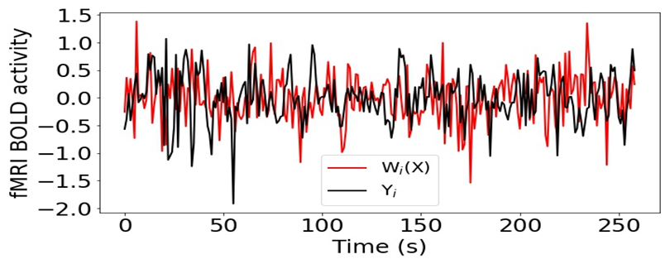
Language models (LMs) predict brain activity evoked by complex
language tasks (e.g. listening to a story) to an impressive degree
brain alignment_{i} = Pearson corr(true v_{i}, pred v_{i})
Jain and Huth. Incorporating context into language encoding models for fMRI. (NeurIPS 2018)
Toneva and Wehbe. Interpreting and improving natural-language processing (in machines) with natural language-processing (in the brain). (NeurIPS 2019)
Notes:
The brain alignment for an x,y,z coordinate in the brain is measured as the Pearson correlation between the corresponding predicted and true brain data, across all held out instances”

Slide 6

Neuro-AI: Questions
Although participants experience stimuli in one modality (ex., image), evoked brain response is rich!
Is it possible to align representations from unseen modalities (ex., image captions)? [Ooota et al., COLING 2022a; Oota et al. COLING 2022b]
Engagement of the brain with the stimulus material is rich! While viewing an image, there may be evoked activity corresponding to reflection on the content of the image (summarization, etc).
Do task-based representations from DL models have better alignment than representations from pre-trained models? [Oota et al., NAACL 2022 (Language); Oota et al., Interspeech 2023 (Speech); Oota et al., NeurIPS 2023 (Language)]
More work is needed to explore true multi-modal models that integrate both modalities (🎥 and 🔊) with balanced knowledge transfer and deeper brain-like understanding 🧠.
Do recent advances in multimodality and instruction-tuning lead to improved brain alignment of a LM? [Focus of this talk!]
Notes:
Overall, our work has several implications for neuro-AI

Slide 7



2025
Multi-modal brain encoding models for multi-modal stimuli
Subba Reddy Oota Khushbu Pahwa Mounika Marreddy
Maneesh Singh Manish Gupta Raju S. Bapi
subba.reddy.oota@tu-berlin.de

Slide 8
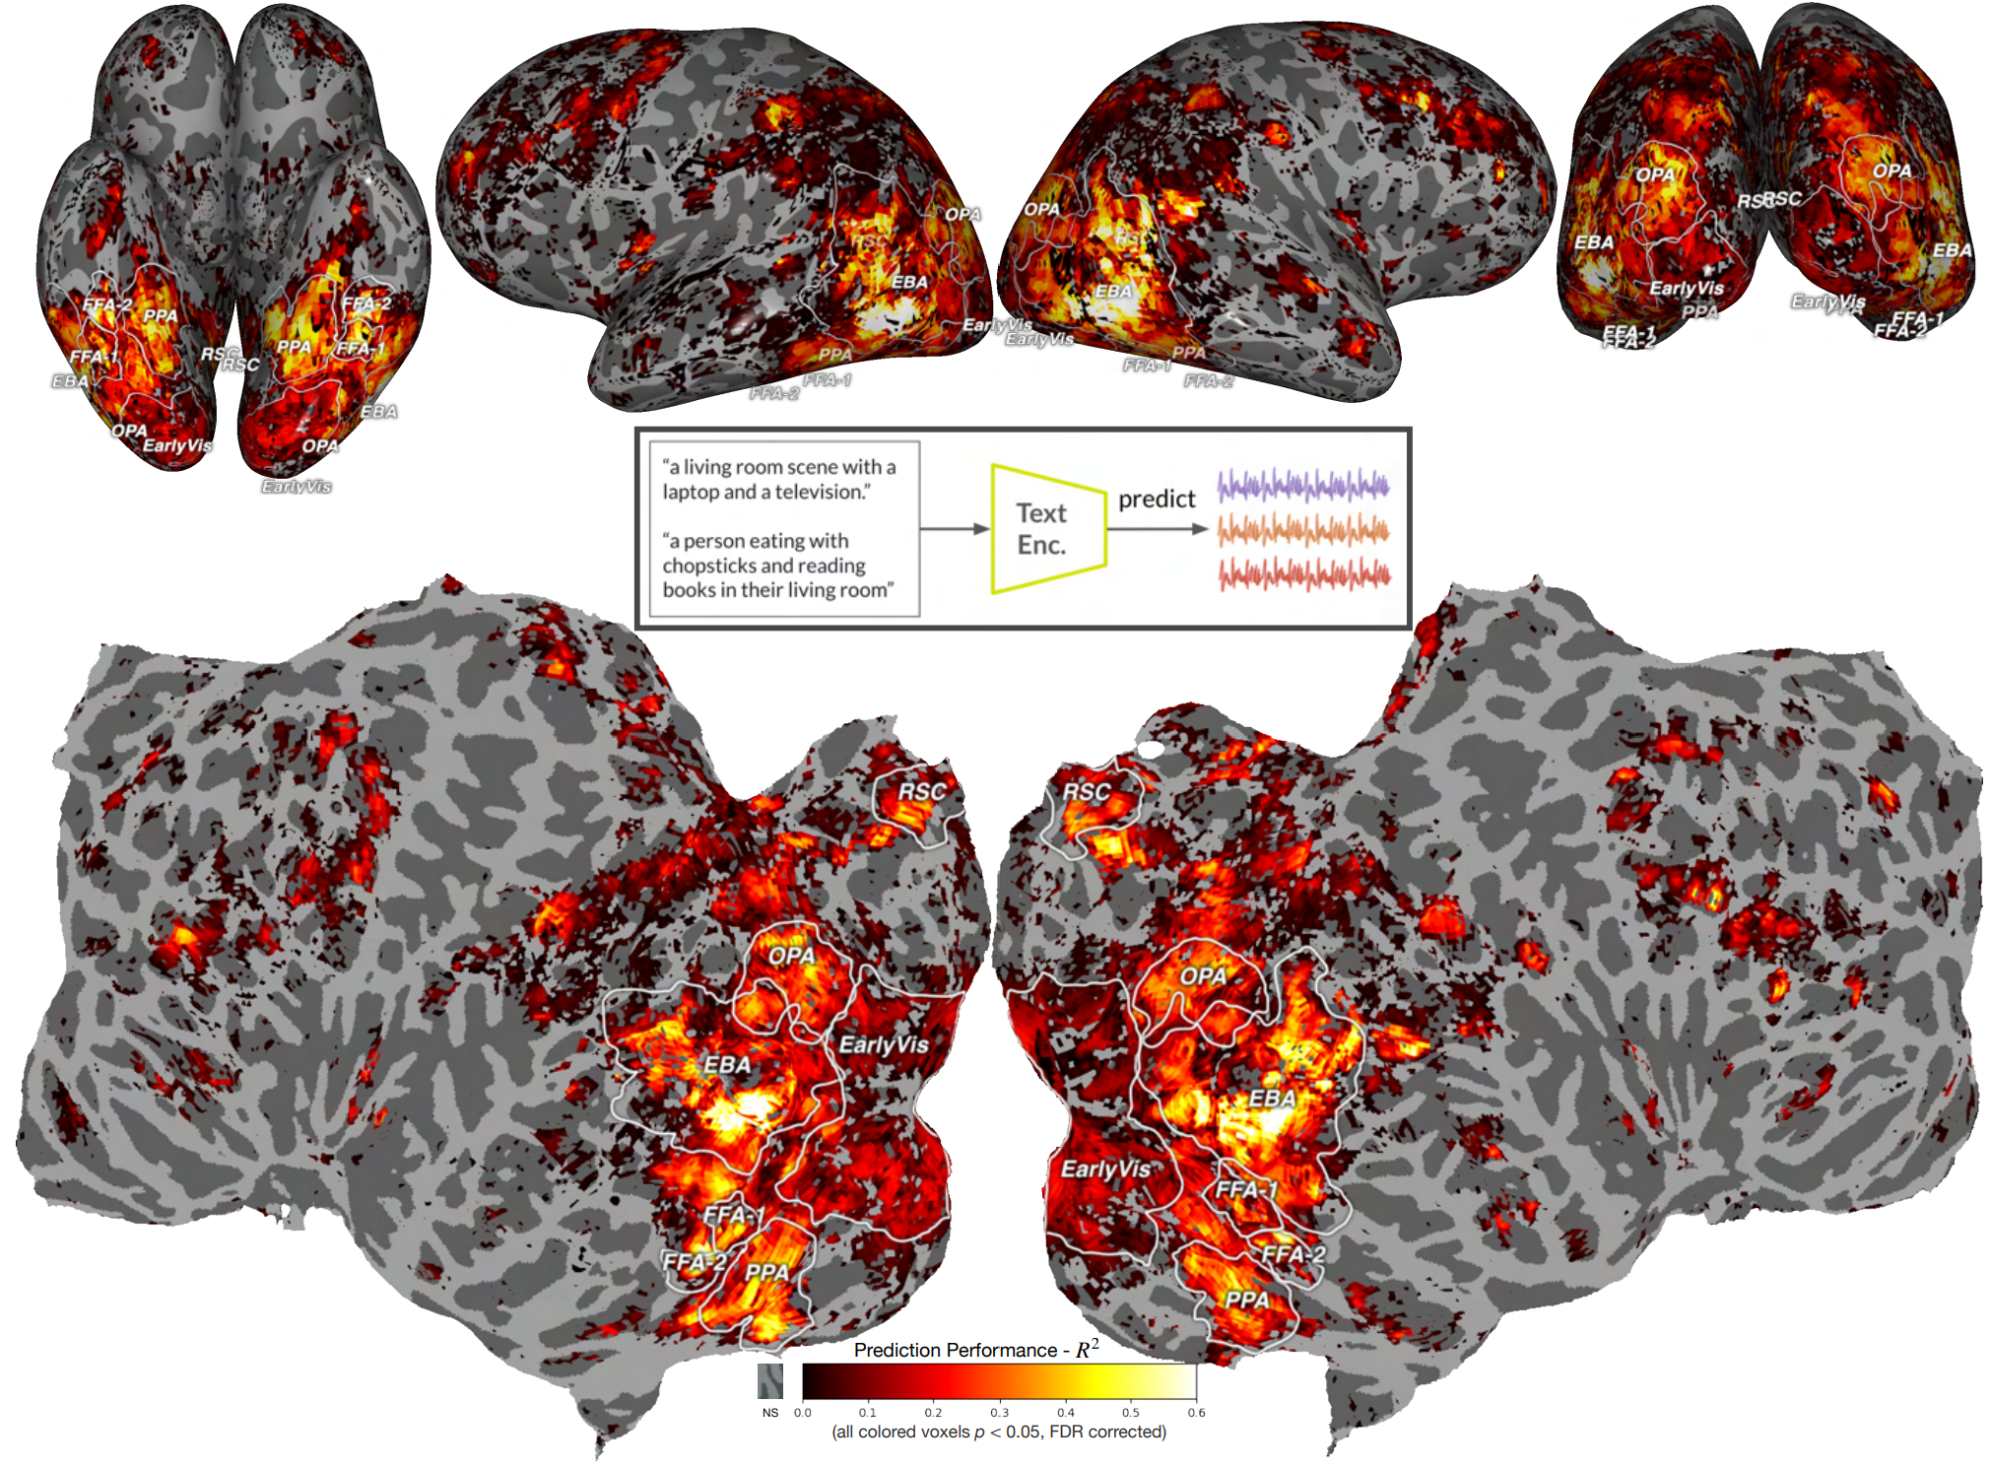
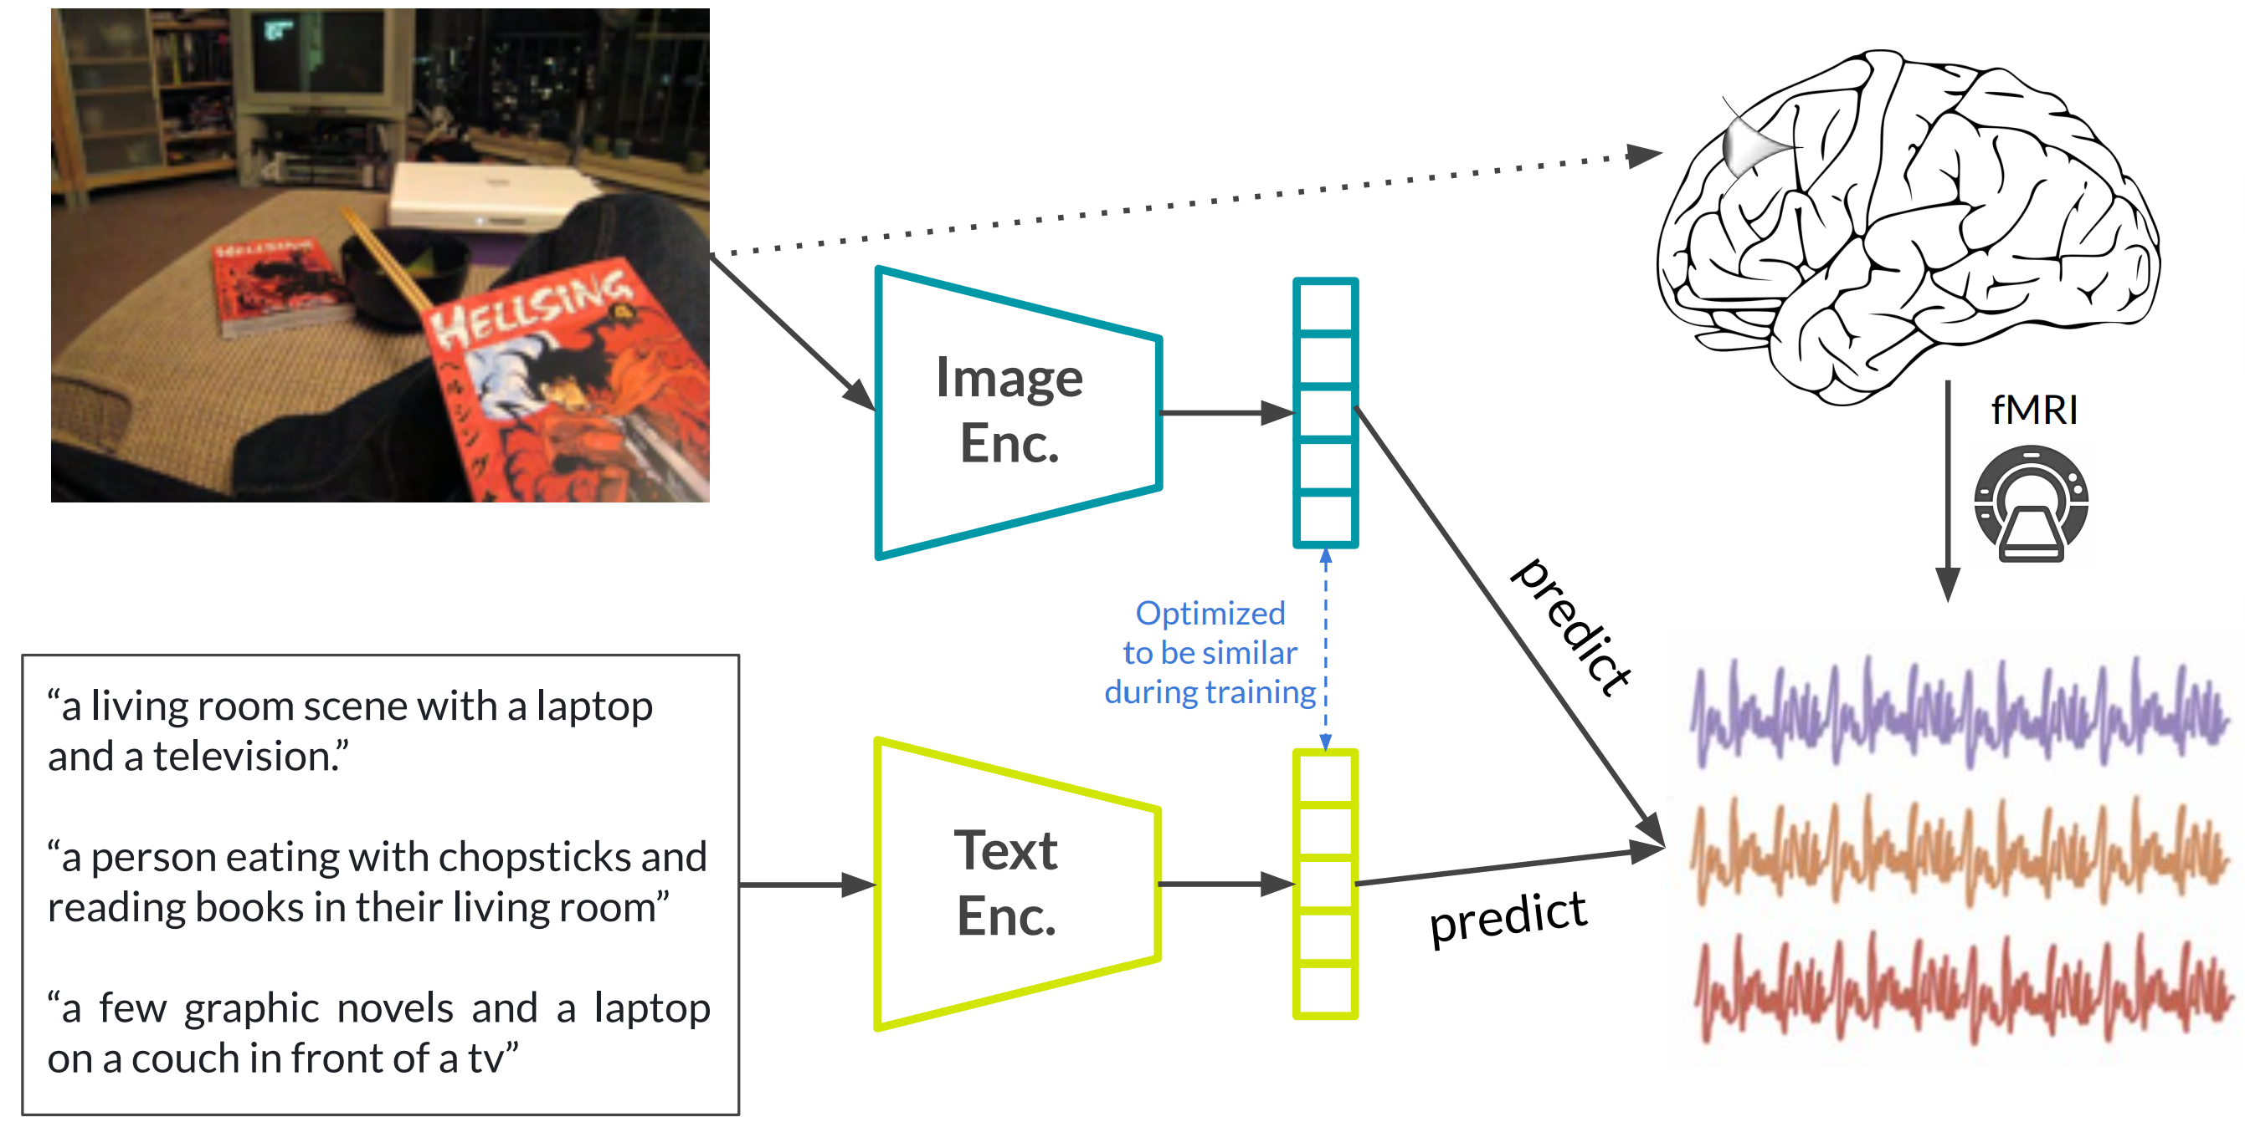
Multi-modal Transformer models can predict visual brain activity impressively well, even with text modality representations
How accurately do multi-modal models predict brain activity evoked by multi-modal stimuli?
Aria Y. Wang, Kendrick Kay. "Incorporating natural language into vision models." Bioarxiv 2023.
Notes:
Recently, for single modality stimuli—such as people viewing images—representations from multimodal models exhibit a higher degree of brain alignment compared to unimodal models in the high-level visual cortex. Notably, even text representations from multimodal models demonstrate better brain alignment.

Slide 9







Multi-modal vs. Unimodal models: Brain alignment
Visual regions
Auditory regions
Language regions
“The wolf of wall street”
movie video clip
fMRI
Actual brain
activations
Uni-modal Video Model (VM)
Ridge Regression ($f_{1}$)
$$f_{1}\left(VM(X)\right)≈$$
Uni-modal Speech Model (SM)
Ridge Regression ($f_{2}$)
$$f_{2}\left(SM(X)\right)≈$$
Video Encoder
Video included with Audio
Cross-modality
Model (CM)
Ridge Regression (g)
$$g\left(CM(X)\right)≈$$
Audio Encoder
Multi-modal naturalistic stimulus
+
Jointly-pretrained Model (JM)
Ridge Regression (h)
$$h\left(JM(X)\right)≈$$
How well do multi-modal models predict multi-modal stimulus-evoked brain activity over unimodal models?
How our brains separates and integrates information across modalities through a hierarchy of early sensory regions to higher cognition (language regions)?

Slide 10

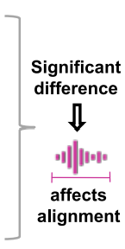
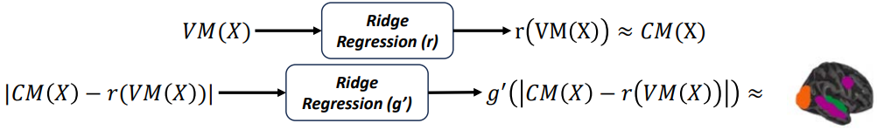
Which modality of representations in multi-modal models leads to high brain alignment?
Investigate via a residual approach
“The wolf of wall street”
movie video clip
Video Encoder
Cross-modality
Model (CM)
Ridge Regression (g)
$$g\left(CM(X)\right)≈$$
Audio Encoder
Video included with Audio
Multi-modal naturalistic stimulus
Toneva et al. 2022 Nature Computational Science, Oota et al. 2023 NeurIPS
Notes:
We investigated this question via a perturbation approach

Slide 11
Datasets & Models
Brain: fMRI recordings from NeuroMod Movie10 [St-Laurent et al. 2023]
Passively watching 4 movies
N=6
3 unimodal video-based Transformer models
VideoMAE
ViViT
ViT-H
2 unimodal Audio-based Transformer models
Wav2Vec2.0
AST
2 multi-modal Transformer models
Cross-modal model (ImageBind)
Jointly-pretrained model (TVLT)
“The wolf of wall street”
movie video clip
Video included with Audio
Multi-modal naturalistic stimulus
To quantify model predictions, we have an estimate of the explainable variance and use that to measure normalize brain alignment.
Notes:
For this purpose, we present a systematic study of the brain alignment across movie10 fMRI dataset of naturalistic movies and different multimodal and unimodal models. We compare the brain alignment for 3-video and 2-speech models for multimodal stimuli.

Slide 12
Multi-modal stimulus: How do multi-modal and unimodal models differ in their ability to predict brain activity in late language regions, higher visual regions and early sensory regions?
Notes:
We investigate our research question: “How do multi-modal and unimodal models differ in their ability to predict brain activity in late language regions, higher visual and early sensory regions?
?
”

Slide 13
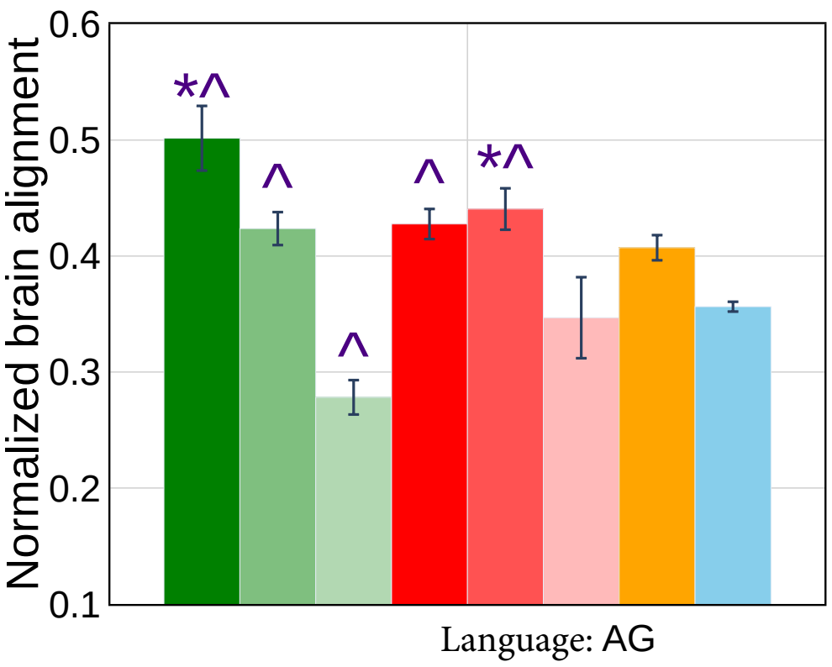
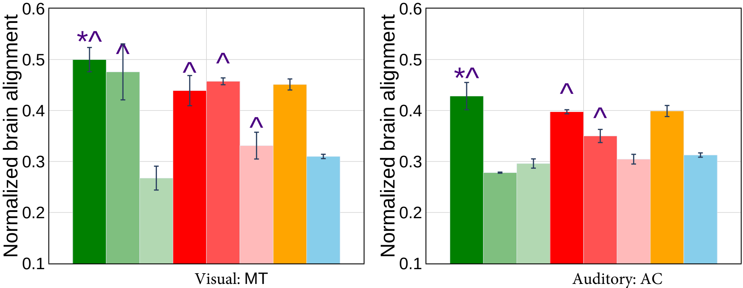
Result: Multi-modal vs. Unimodal models & brain alignment
Language region (AG)
Both types of multi-modal models show higher brain alignment than unimodal video and speech models with language regions (PTL, IFG), but audio models trail behind video models.
Higher-visual (MT) and Early-sensory (AC)
Cross-Modal Models: Concat embeddings improve alignment, while jointly-pretrained models perform similar to unimodal video models.
In AC, surprisingly, unimodal video models show improved brain alignment over unimodal speech models.

Slide 14
Result: Multi-modal vs. Unimodal models & brain alignment
Which brain regions process unimodal versus multi-modal information?
Language region (AG)
Both types of multi-modal models show higher brain alignment than unimodal video and speech models with language regions (PTL, IFG), but audio models trail behind video models.
Higher-visual (MT) and Early-sensory (AC)
Cross-Modal Models: Concat embeddings improve alignment, while jointly-pretrained models perform similar to unimodal video models.
In AC, surprisingly, unimodal video models show improved brain alignment over unimodal speech models.

Slide 15
Result: Which brain regions process unimodal versus multi-modal information?
Multi-modal models
Improved alignment in semantic language regions such as AG, PCC and dmPFC
Improved alignment in syntactic language regions such as PTL and IFG
Multi-modal and Unimodal models
Both models exhibit similar brain alignment in several language regions such as ATL, IFGOrb and MFG, visual regions such as PPA (scene visual area), and EVC (early visual cortex).
Multi-modal effects: In general, multimodal models have better predictivity in the language regions
Unimodal effects: Unimodal models have higher predictivity in the early sensory regions (visual and auditory)

Slide 16
Result: Which brain regions process unimodal versus multi-modal information?
Multi-modal models
Improved alignment in semantic language regions such as AG, PCC and dmPFC
Improved alignment in syntactic language regions such as PTL and IFG
Multi-modal & Unimodal models
Both models exhibit similar brain alignment in several language regions such as ATL, IFGOrb and MFG, visual regions such as PPA (scene visual area), and EVC (early visual cortex).
Which modality of representations in multi-modal models lead to high brain alignment?
Multi-modal effects: In general, multimodal models have better predictivity in the language regions
Unimodal effects: Unimodal models have higher predictivity in the early sensory regions (visual and auditory)

Slide 17
How is the alignment between brain recordings and multi-modal model representations affected by the elimination of modality-specific features?
Notes:
We investigate our research question: “How is the alignment between brain recordings and multi-modal model representations affected by the removal of unimodality stimulus features?
”

Slide 18
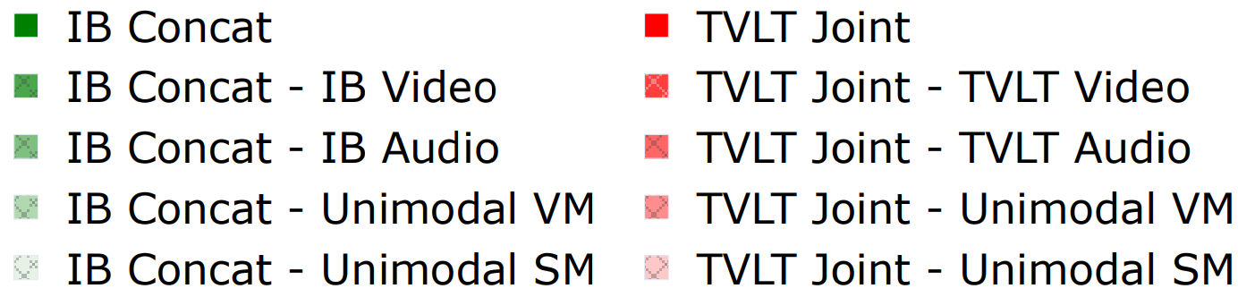
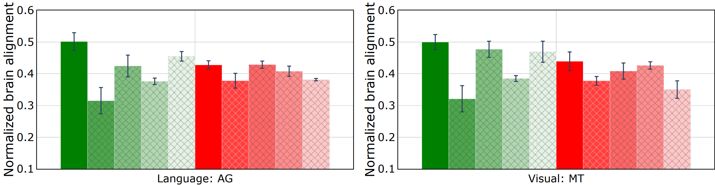
Result: Modality-specific contribution in language and visual regions
Cross-modal models
Brain alignment is partially explained by video features, but removal of speech features does not lead to drop in brain alignment.
Jointly-pretrained models
Brain alignment is partially explained by both video and audio features.

Slide 19
Result: Modality-specific contribution in language and visual regions
Cross-modal models
Alignment with language and visual regions is only partially explained by video modality features.
Model relies heavily on visual information for improved brain alignment.
Jointly-pretrained models
Alignment with language and visual regions is only partially explained by both video modality and audio modality features.
Model is capturing more high-level abstract and semantic information that goes beyond specific features of just one modality.

Slide 20
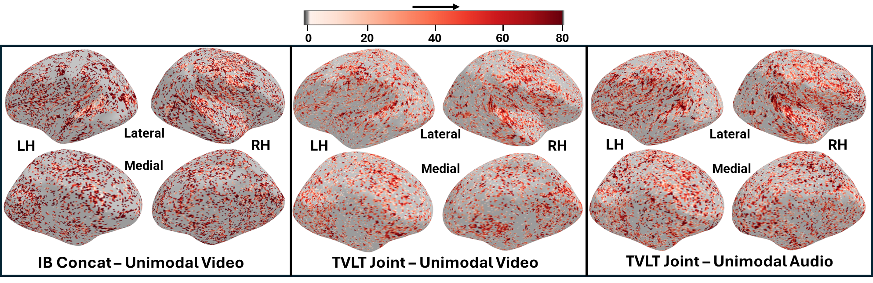
Qualitative Analysis: Effect of removal of modality-specific features
Cross-modal model: removal of unimodal video features leads to a significant drop in visual regions
Jointly-pretrained model: removal of unimodal video and audio features leads to a significant drop in language regions

Slide 21
Interim Conclusions: Multimodal Alignment
Improved alignment in cross-modal models is mainly driven by the removal of 🎥 features, not 🔊 features:
Jointly-pretrained model reflects human-like learning via simultaneous multi-modal experiences 👀👂.
But more work is needed to explore true multi-modal models that integrate both modalities (🎥 and 🔊) with balanced knowledge transfer and deeper brain-like understanding 🧠.
Notes:
Overall, our work has several implications for neuro-AI

Slide 22


Correlating instruction-tuning (in multimodal models) with vision-language processing (in the brain)
Subba Reddy Oota Akshett Jindal Ishani Mondal Khushbu Pahwa
Satya Sai Srinath Manish Shrivastava Maneesh Singh Raju S.Bapi Manish Gupta

Slide 23
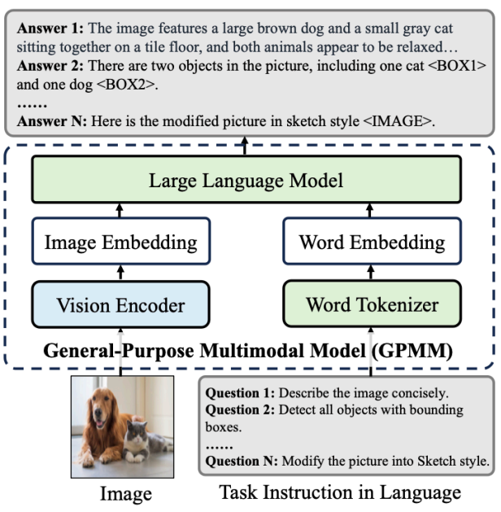

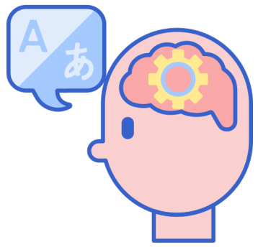
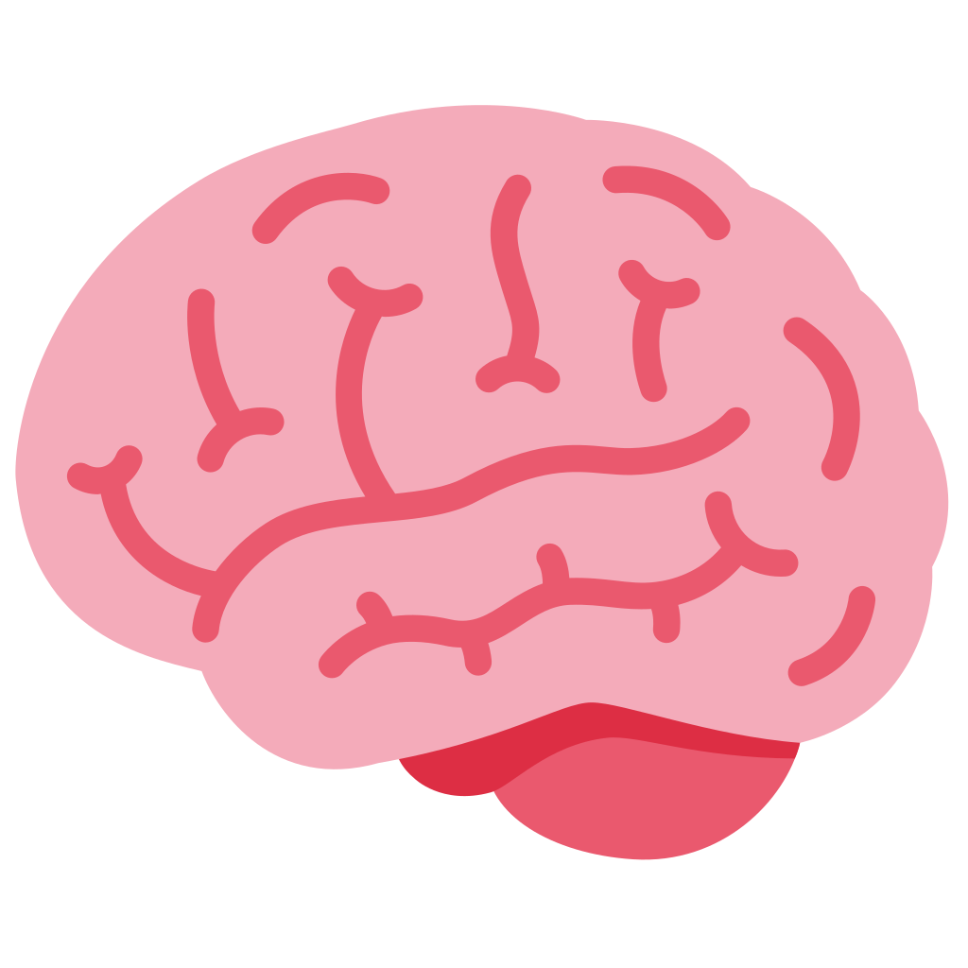

Multimodal instruction tuning enables models to generalize to new tasks by following unseen instructions
?
?
How do multimodal instruction-tuned LLMs process visual images when guided by natural language task instructions?
How does the brain integrate information during the processing of visual images?
Do multimodal instruction-tuned models prompted with natural language improve brain alignment and capture instruction-specific representations?
Shukang Yin, Chaoyou Fu, Sirui Zhao, Ke Li, Xing Sun, Tong Xu, Enhong Chen. "A Survey on Multimodal Large Language Models." Arxiv 2024.

Slide 24
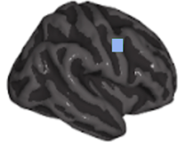

Multi-modal Instruction-tuned LLMs (MLLMs): brain alignment
Image Captioning:
What is the caption of the image?
Image Understanding:
Describe the most dominant color in the image.
Visual Relationship:
What objects are being used by the largest animal in this image?
Instruction Embedding
Multimodal instruction-tuned model (MLLM)
estimate alignment
$$f\left(MLLM\right)≈$$
Early Visual
NSD dataset naturalistic Image stimulus
Task-specific instructions
How well do MLLMs predict brain activity evoked by visual stimuli under task-specific instructions compared to unimodal and multimodal models?
Do instruction-specific representations in MLLMs differentiate visual brain regions involved in processing, thereby aligning with the mechanisms of human visual cognition?

Slide 25
Datasets & Models
Brain: fMRI recordings from NSD dataset [St-Laurent et al. 2023]
Passively watching natural scene images
N=4
3 multimodal instruction-tuned large language models
InstructBLIP
mPLUG-Owl
IDEFICS
unimodal and multi-modal models
ViT-H
CLIP
NSD dataset naturalistic Image stimulus
To quantify model predictions, we have an estimate of the explainable variance and use that to measure normalize brain alignment.
Notes:
For this purpose, we present a systematic study of the brain alignment across movie10 fMRI dataset of naturalistic movies and different multimodal and unimodal models. We compare the brain alignment for 3-video and 2-speech models for multimodal stimuli.

Slide 26
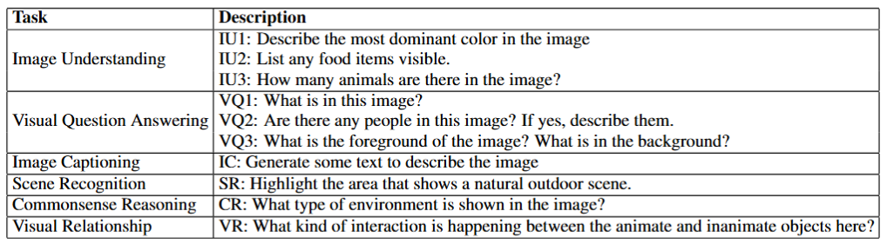
Task-specific natural instructions
These tasks which are generally applicable to any image regardless of the contents in the image

Slide 27
How do MLLMs, unimodal and multi-modal models differ in their ability to predict brain activity in higher visual and early visual regions?
Notes:
We investigate our research question: “How do text-based and speech-based language models differ in their ability to predict brain activity in late language regions and early sensory regions?
?
”

Slide 28
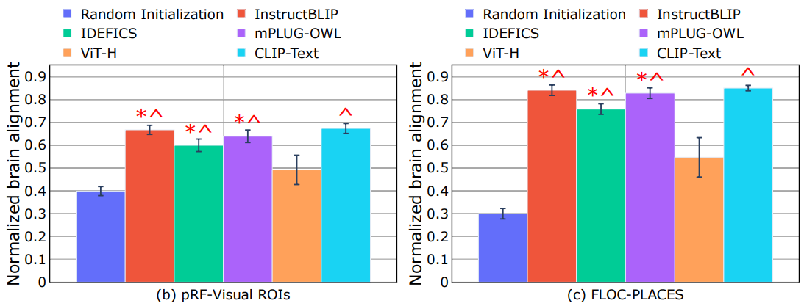
Result: MLLMs vs. Unimodal vs. Multi-modal models & brain alignment
Early-visual regions:
Both MLLMs and multi-modal models show significantly high brain alignment than baseline and unimodal video models
Surprisingly, brain alignment of random initialization of MLLMs is closer to that of unimodal video models
Higher-visual regions:
Both MLLMs and multi-modal models show better brain relevant representations (∼0.8) than early visual areas (∼0.6).

Slide 29
Result: MLLMs vs. Unimodal vs. Multi-modal models & brain alignment
Which task-specific instructions are highly correlated to visual function localizers?
Early-visual regions:
Both MLLMs and multi-modal models show significantly high brain alignment than baseline and unimodal video models
Surprisingly, brain alignment of random initialization of MLLMs is closer to that of unimodal video models
Higher-visual regions:
Both MLLMs and multi-modal models show better brain relevant representations (∼0.8) than early visual areas (∼0.6).

Slide 30
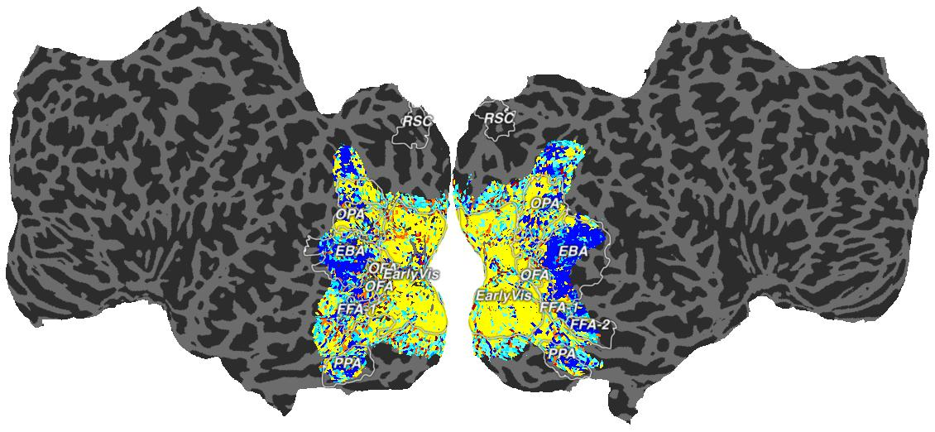
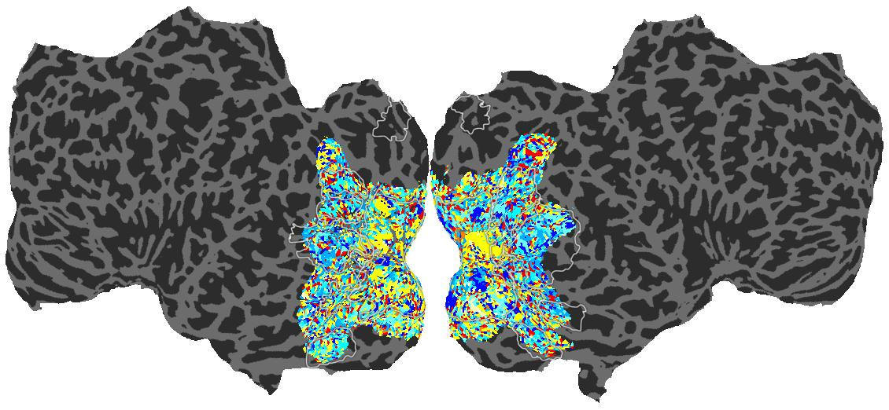
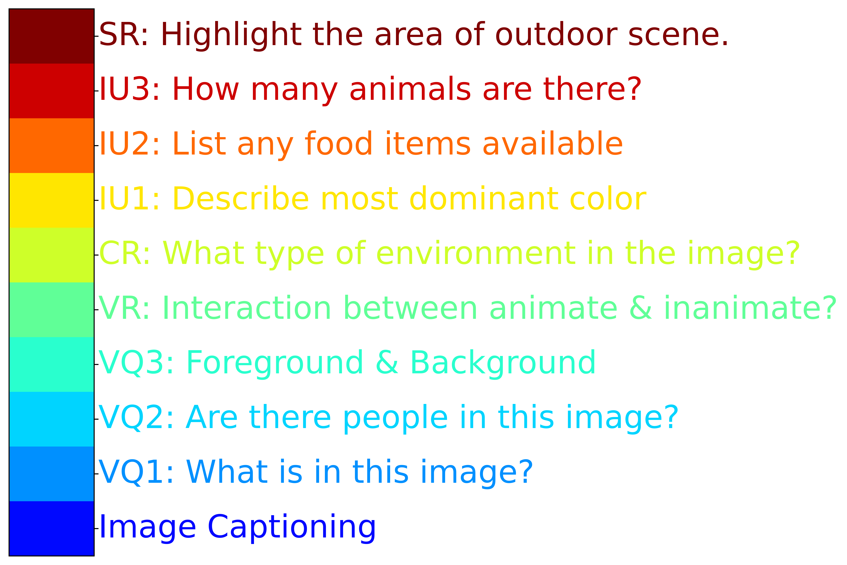
Result: Which task-specific instructions are highly correlated to visual function localizers?
S1: InstructBLIP
S1: mPLUG-Owl
Early-visual regions:
Image understanding instruction shows significantly high brain alignment across MLLMs
Higher-visual regions:
Image captioning instruction shows significantly high brain alignment in the EBA, PPA, and FFA regions
Visual question answering instructions shows significantly high brain alignment in the PPA, and FFA regions
Not all instructions lead to increased brain alignment across all regions

Slide 31
Result: Which task-specific instructions are highly correlated to visual function localizers?
Do task-specific instructions from MLLMs account for visual concepts understanding?
S1: InstructBLIP
S1: mPLUG-Owl
Early-visual regions:
Image understanding instruction shows significantly high brain alignment across MLLMs
Higher-visual regions:
Image captioning instruction shows significantly high brain alignment in the EBA, PPA, and FFA regions
Visual question answering instructions shows significantly high brain alignment in the PPA, and FFA regions
Not all instructions lead to increased brain alignment across all regions

Slide 32
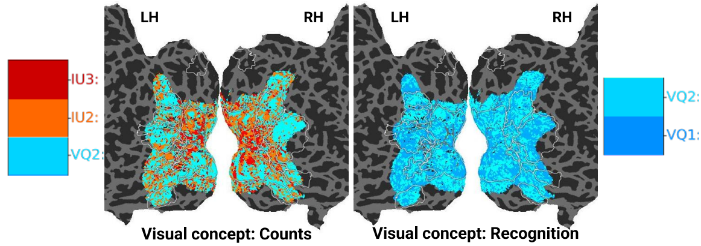
Result: MLLMs capture count- and recognition-related visual concepts effectively across instructions
Visual concept-Count:
VQ2 instruction shows significantly high brain alignment in high-level visual regions, while IU2 and IU3 instructions show higher alignment in early visual regions
Visual concept-Recognition:
Both VQ1 and VQ2 instruction show significantly high brain alignment across high-level and early-visual regions

Slide 33
What is the unique and shared variance of each task-specific instruction to brain responses?

Slide 34
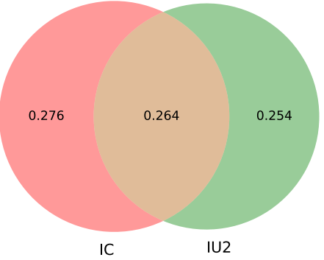
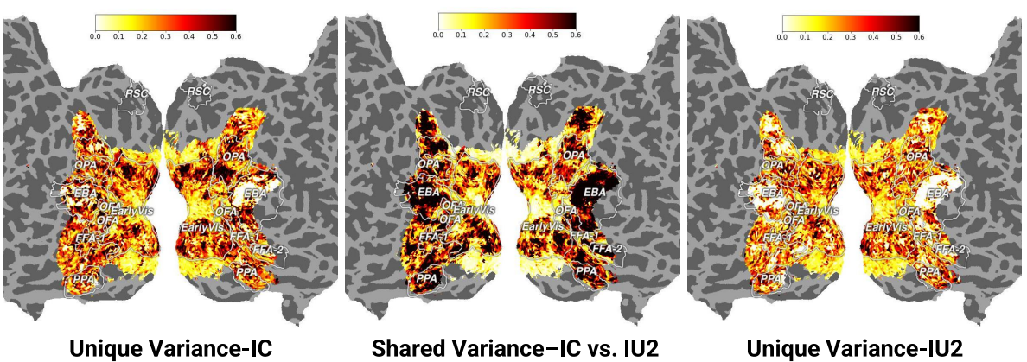
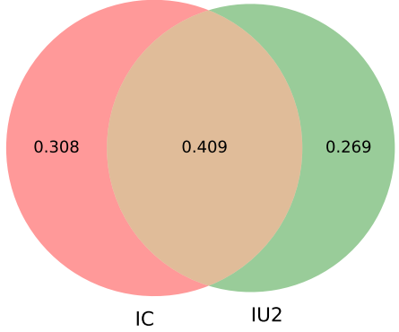
Result-4: Partitioning explained variance between task-specific instructions
Between Image Captioning (IC) and Image Understanding (IU2): there is no unique variance for IU2 in the EBA region (higher-visual), while IC retains some unique variance.
Task-specific instructions exhibit moderate shared variance in the early visual cortex, while shared variance is significantly higher in higher visual ROIs

Slide 35
Interim Conclusions: Instruction-tuned Multimodal model Alignment
🗣️ MLLMs generate task-specific output tokens based on instructions, but not all instructions lead to better brain alignment
👁️‍🗨️ They capture multiple visual concepts, yet exhibit similar brain alignment across different types of visual stimuli
The variance in brain alignment is shared across task-specific instructions: ▸ Moderate in 🧠 early visual areas ▸ Higher in 🧠 high-level visual regions
But, more work to do - especially in enhancing MLLMs’ ability to differentiate between instruction types in terms of neural alignment
Notes:
Overall, our work has several implications for neuro-AI
Speech models ARE useful

Slide 36
Summary & Concluding Thoughts
Cross-modal encoding models are feasible from uni-modal brain responses.
Task-based representations give raise to better encoding models.
Representations from multimodal and instruction-tuned MLLMs exhibit impressive alignment performance.
Is it possible to look at multilingual representation of language using such naturalistic tasks?
Can we characterize how neurodegenerative disorders affect degradation of language function using DL model alignment?
EEG Brain decoding for BCI applications.
Notes:
Overall, our work has several implications for neuro-AI

Slide 37
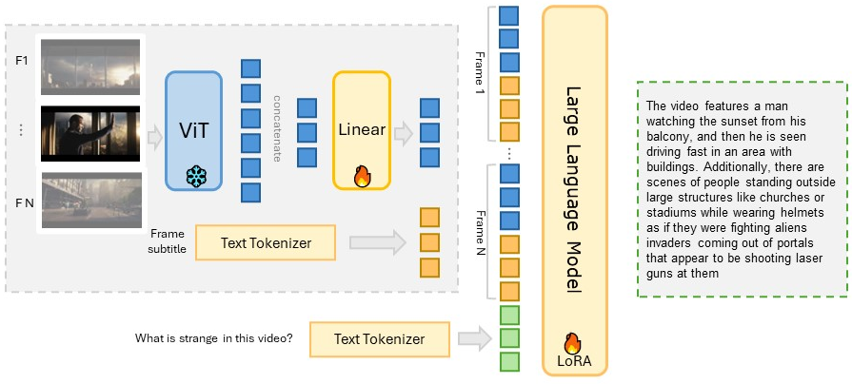
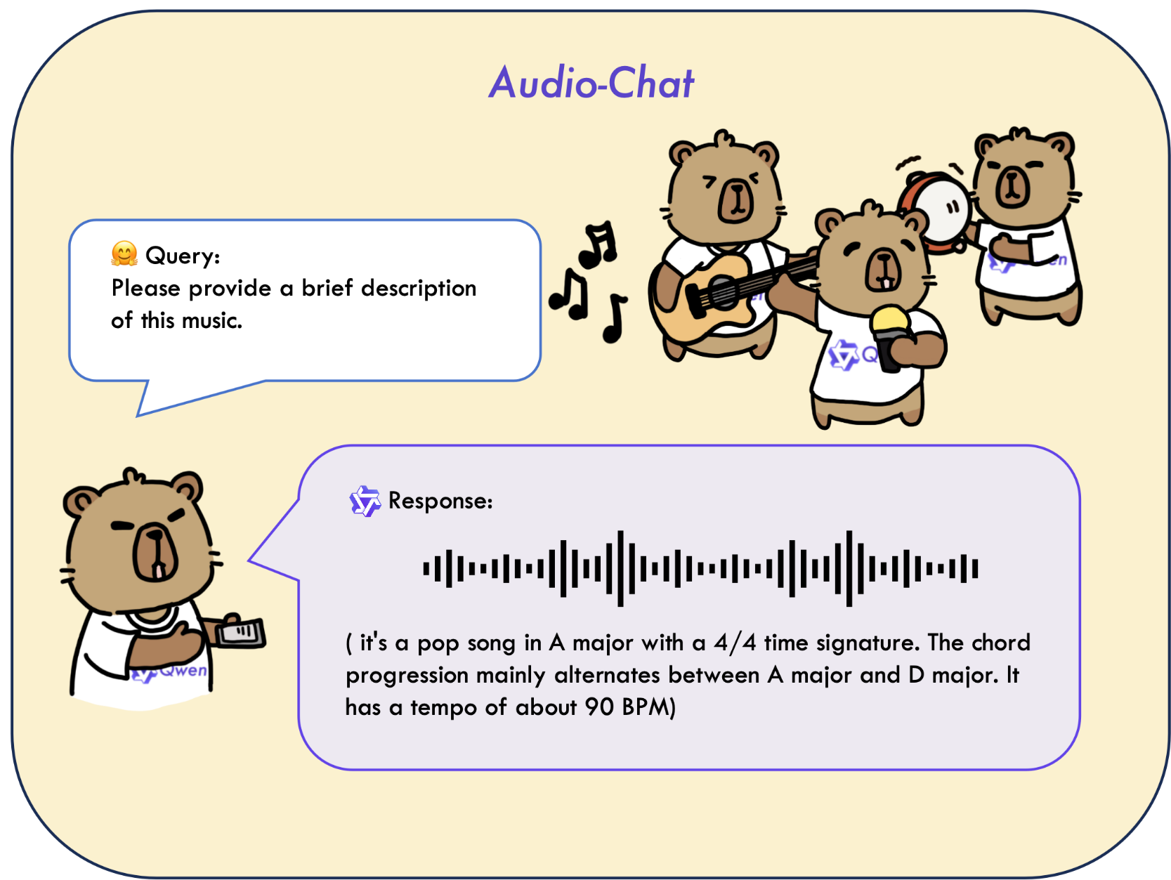
Instruction-tuned MLLMs for Video and Audio
Instruction-tuned video MLLM
INPUT: <video> Describe this video in detail
OUTPT: <long descriptions>
Instruction-tuned audio MLLM
INPUT: <audio> Describe this audio in detail
OUTPT: <long descriptions>

Slide 38
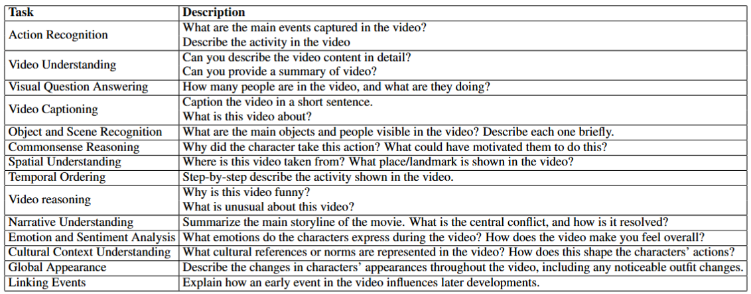
Video: Task-specific natural instructions

Slide 39
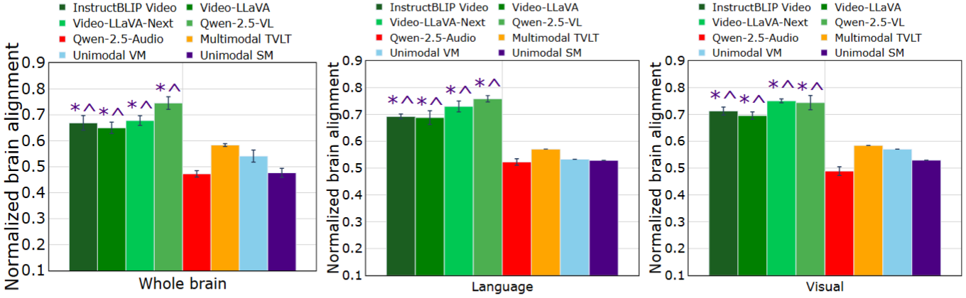
Instruction-tuned Video MLLMs have improved brain alignment across language, visual and auditory regions

Slide 40
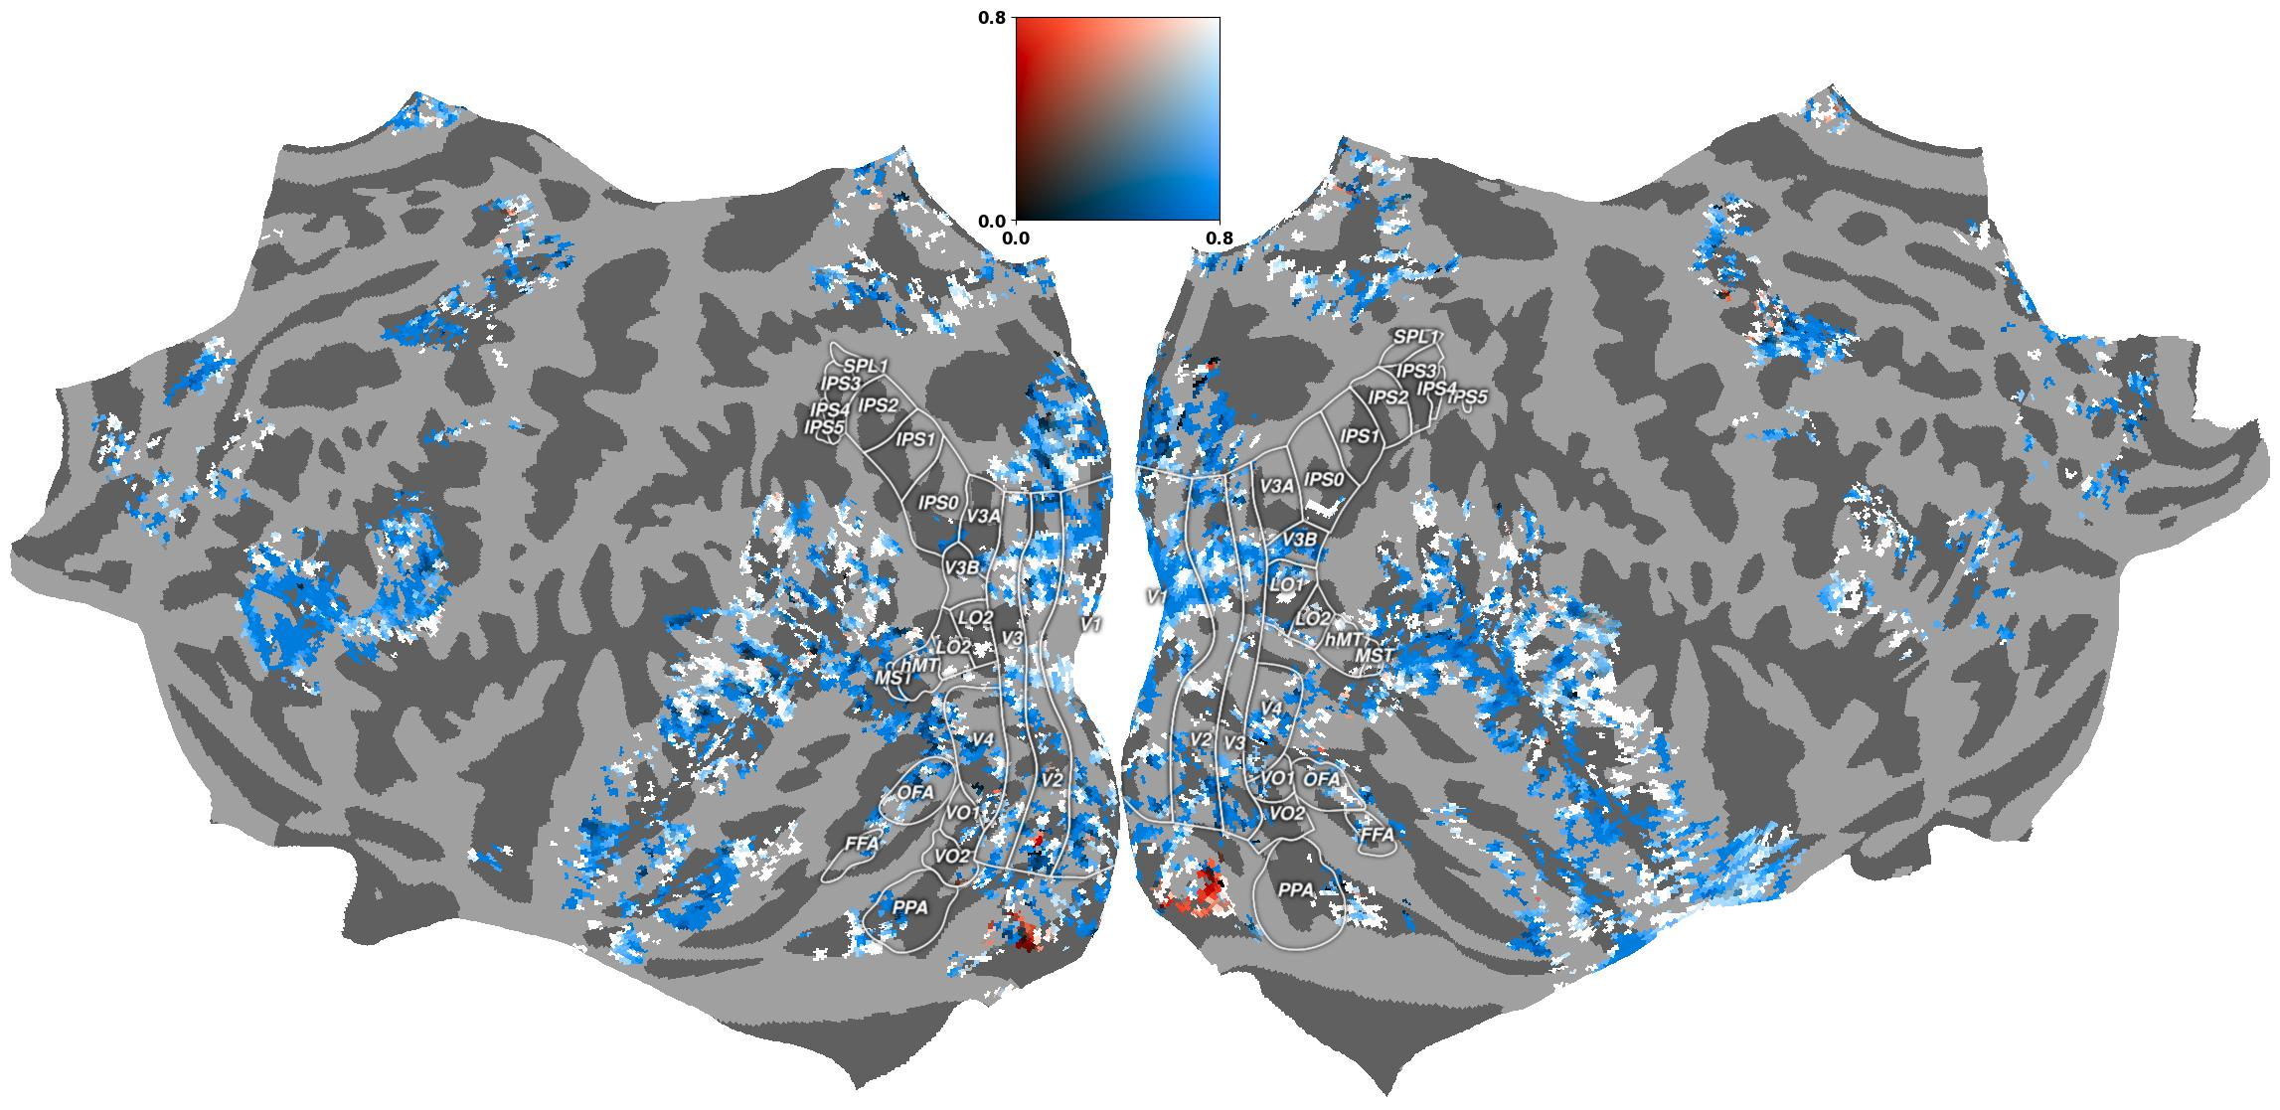
Instruction-tuned Video MLLMs have improved brain alignment across language, visual and auditory regions
TVLT
MFG
Qwen-2.5-VL
MFG
IFGOrb
IFGOrb
IFG
AG
AG
IFG
LTC
LTC

Slide 41











Manish Gupta
Mariya Toneva
Xavier Hinaut
Mounika Marreddy
Satya Sai Srinath
Maneesh Singh
Khushbu Pahwa
Ishani Mondal
Fatma Deniz
Frederic Alexandre
Manish Shrivastava

