Slide 1




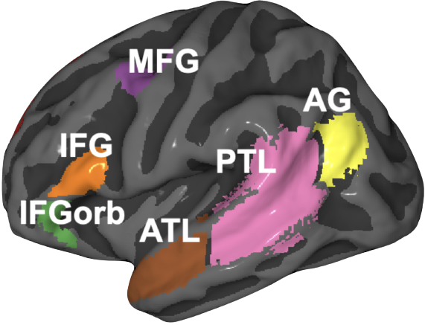
Characterizing similarities and differences between language processing in brains and language models.
Subba Reddy Oota
Postdoctoral Researcher
TU Berlin, Germany
Artificial
Biological

Slide 2
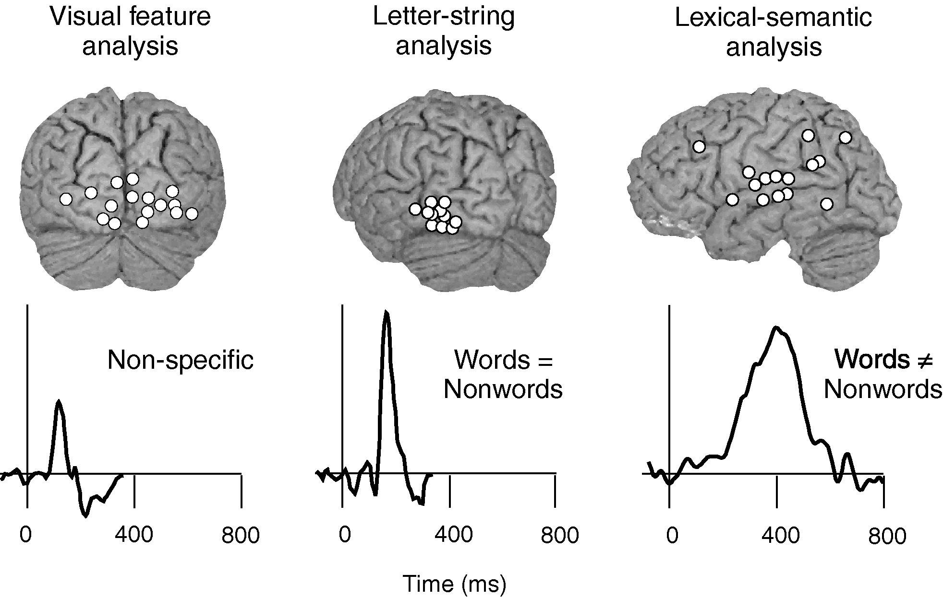
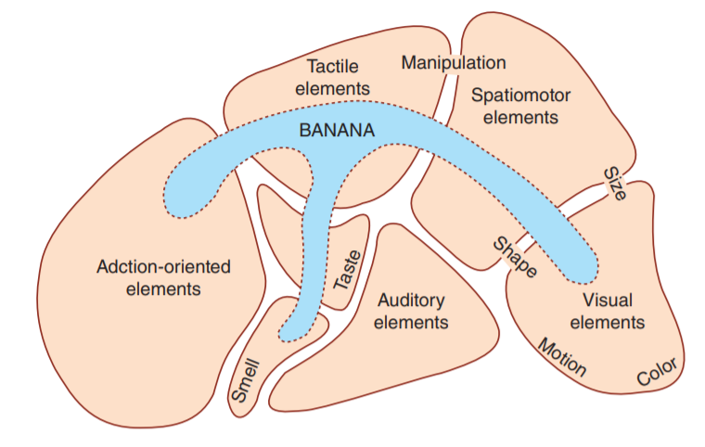
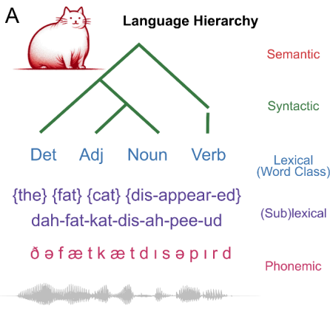
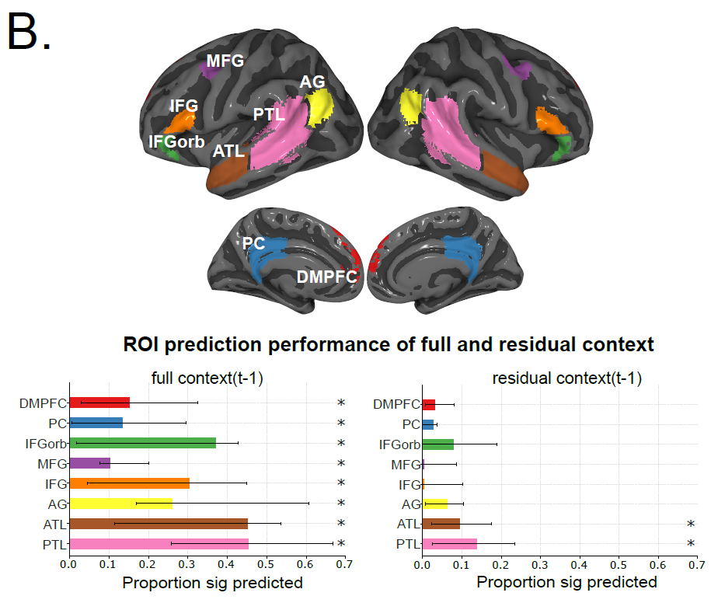
Mechanistic understanding of language processing in the brain: four big questions
What
When
Where
How
Notes:
Fundamental questions about what information is processed where, when, and how in the brain

Slide 3
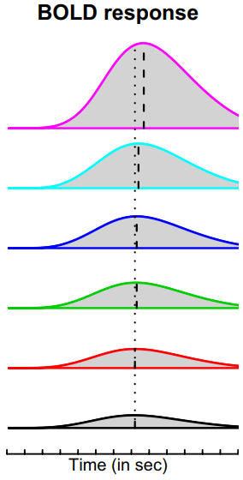
Typical studies of language processing with controlled experiments
How the human brain computes and encodes syntactic structures?
Syntax: how do words structurally combine to form sentences and meaning?
Controlled experiments
Structured complex sentence
Word lists
I believe that you should accept the proposal of your new associate
thing very tree where of watching copy tensed they states heart plus
Pallier et al. 2011
Notes:
controlled experiments that design artificial stimuli to separate the brain activation
such as comparing structured complex sentences or phrases with word lists
many valuable findings and have identified several brain regions, including the left temporal lobe and the left frontal lobe, that are involved in syntactic structure building
However, as designing artificial stimuli can only separate situations with or without structurebuilding

Slide 4

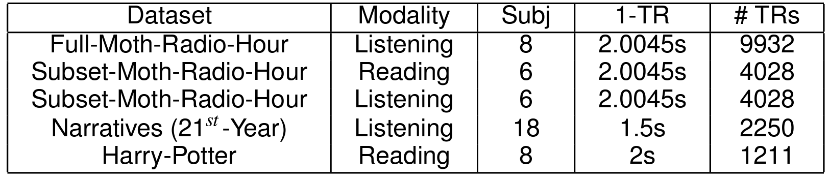
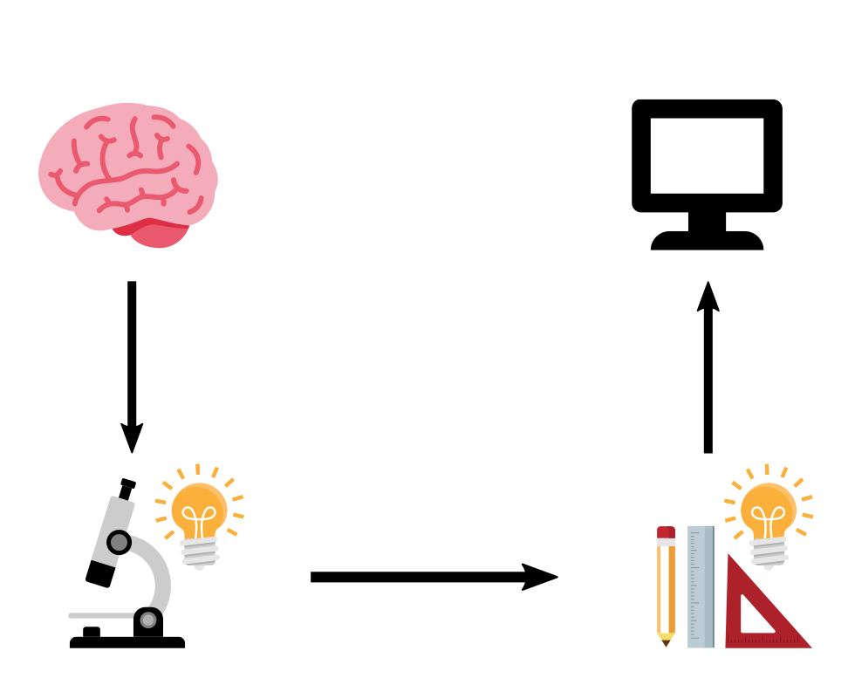

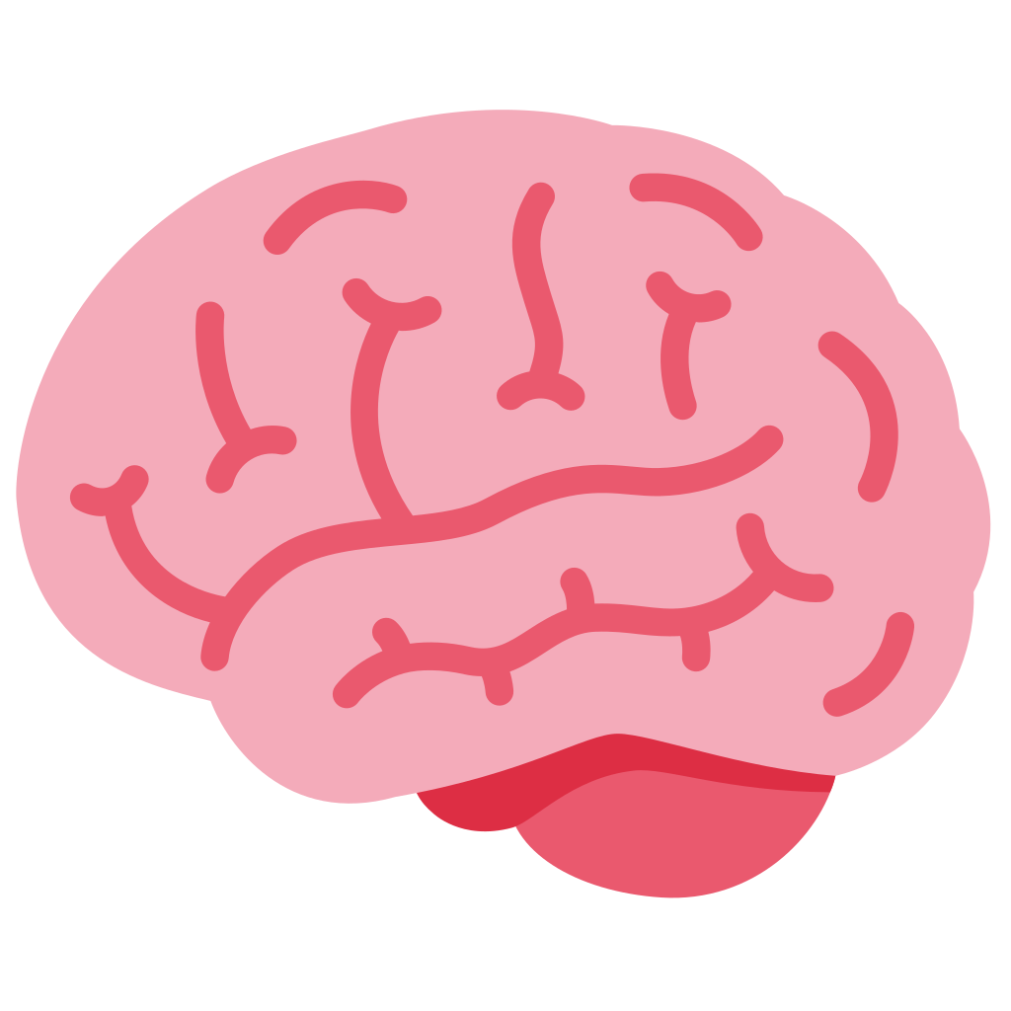
Increasingly available open source ecological stimuli datasets
With advancement of ecological stimuli datasets and open source language models, recent studies looked at interesting open questions?
?
?
Is the “how” of the NLP system process language comprehension the same as “how” of the brain process language comprehension?
How is information aggregated by the brain during language comprehension?
Deniz et al. 2019
Lebel et al. 2022
Nastase et al. 2021
Li et al. 2022
Zhang et al. 2021
Notes:
ecological stimuli -> reading books, listening to stories, watching a movie
The properties of the stimulus that affect brain activity are increasing, so simple representations of the stimuli capture less variance of the brain activity
Meanwhile we have huge progress in deep learning in the last 10 years that gives us AI models that can do many tasks. Of course they are not perfect, and are sometimes flawed, but there is the question of whether we can use their internal representations of the world as rich stimulus representations that perhaps capture some of the properties that are also relevant for the processing in the brain.
Here comes to encoding model

Slide 5
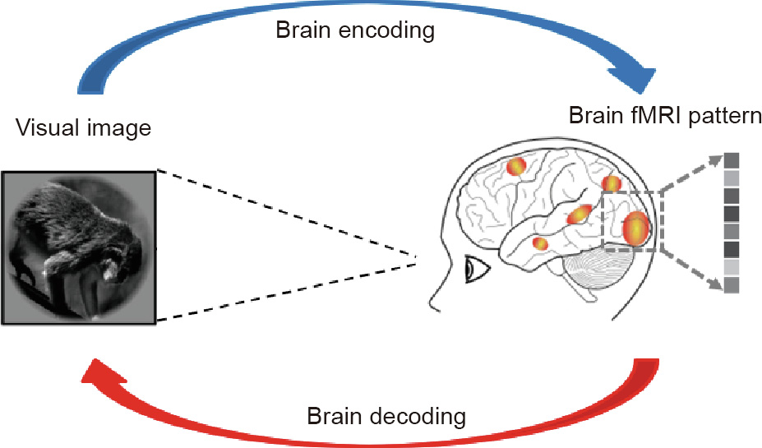
Brain Encoding and Decoding
How is the stimulus represented in the brain?
Reconstruct the stimulus, given the brain response?
Ivanova et al. 2022

Slide 6
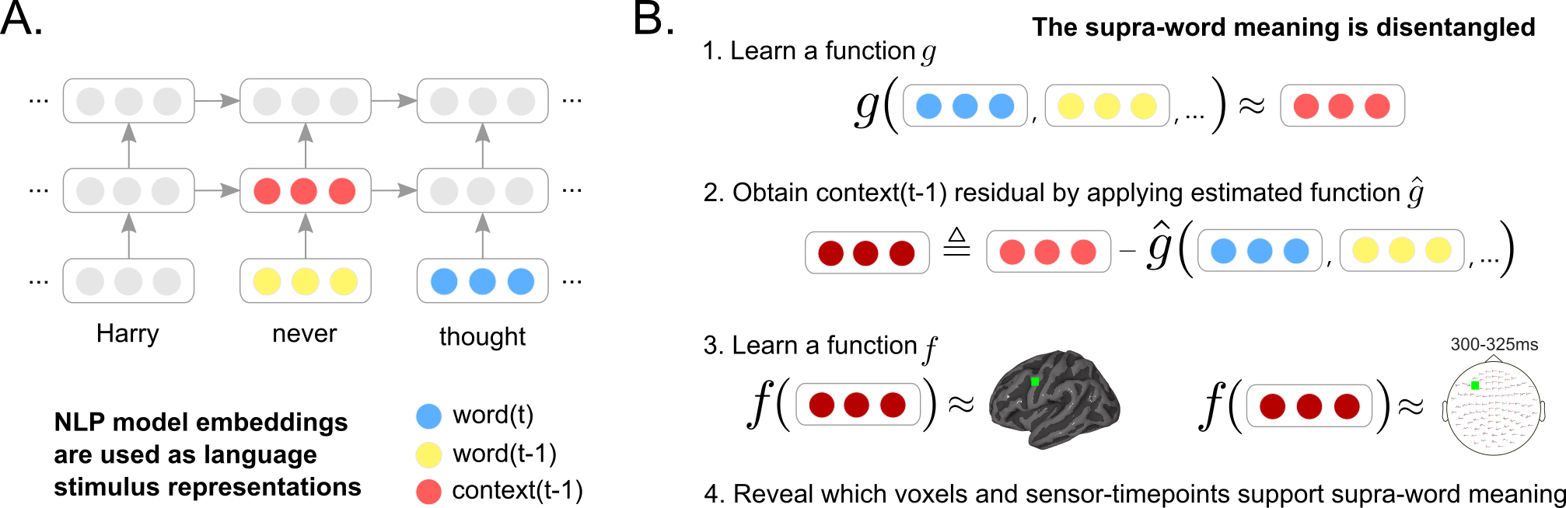

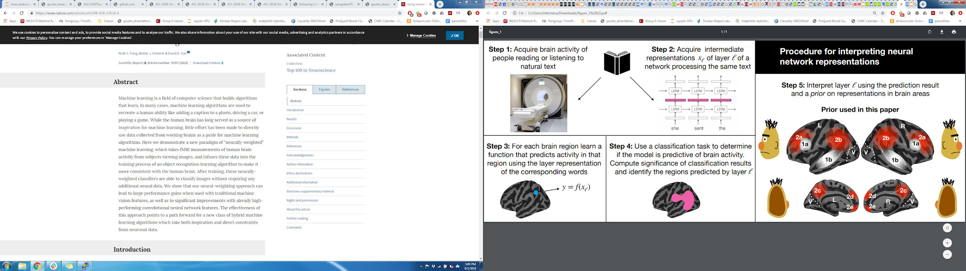
Deep neural networks and brain alignment: brain encoding and decoding
Multimodal ecological stimulus
Deep learning system
A priori locations in DL system and brain
Data-driven encoding model
how are they related?
fMRI
Wehbe et al. 2014,
Jain and Huth 2018,
Gauthier and Levy 2019
Toneva and Wehbe 2019,
Caucheteux et al. 2020,
Toneva et al. 2020
Jain et al. 2020,
Schrimpf et al. 2021,
Goldstein et al. 2022
...

Slide 7
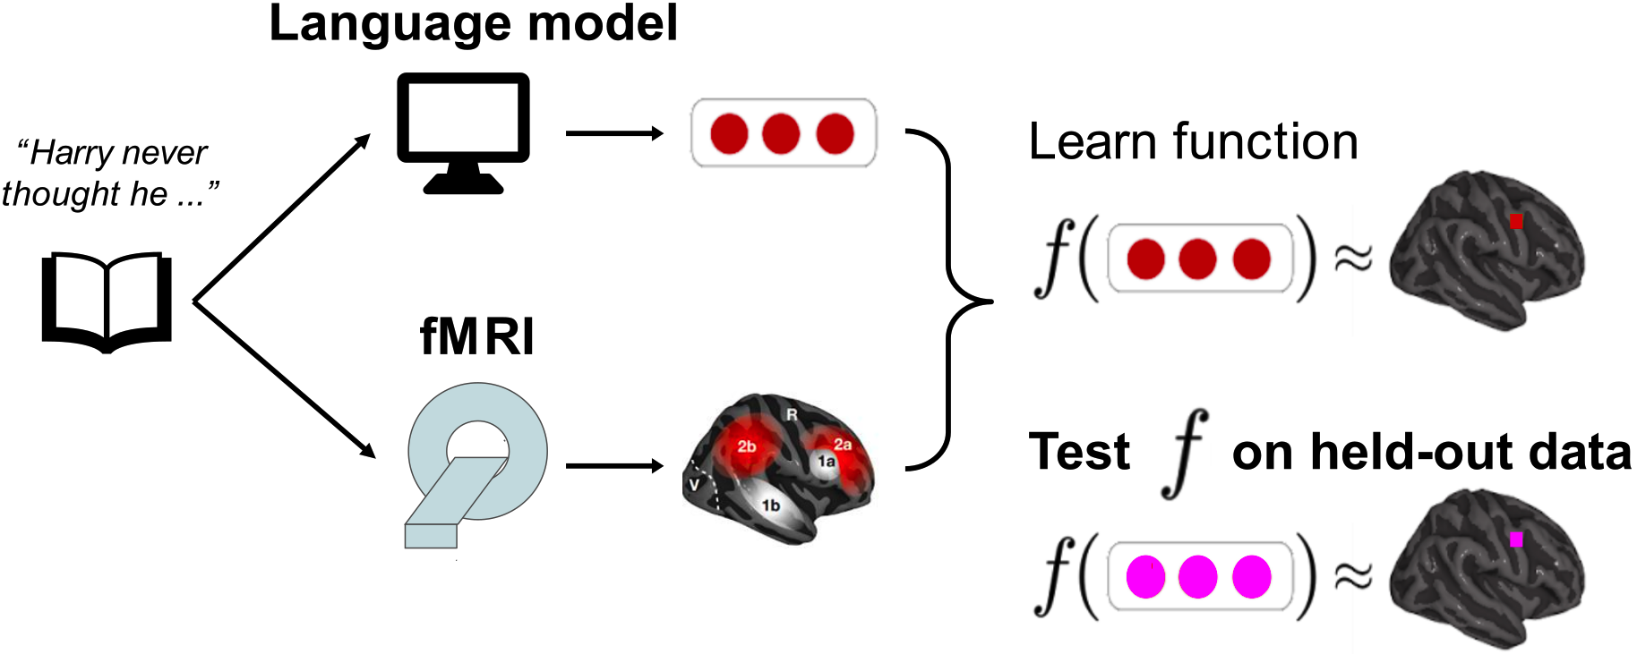
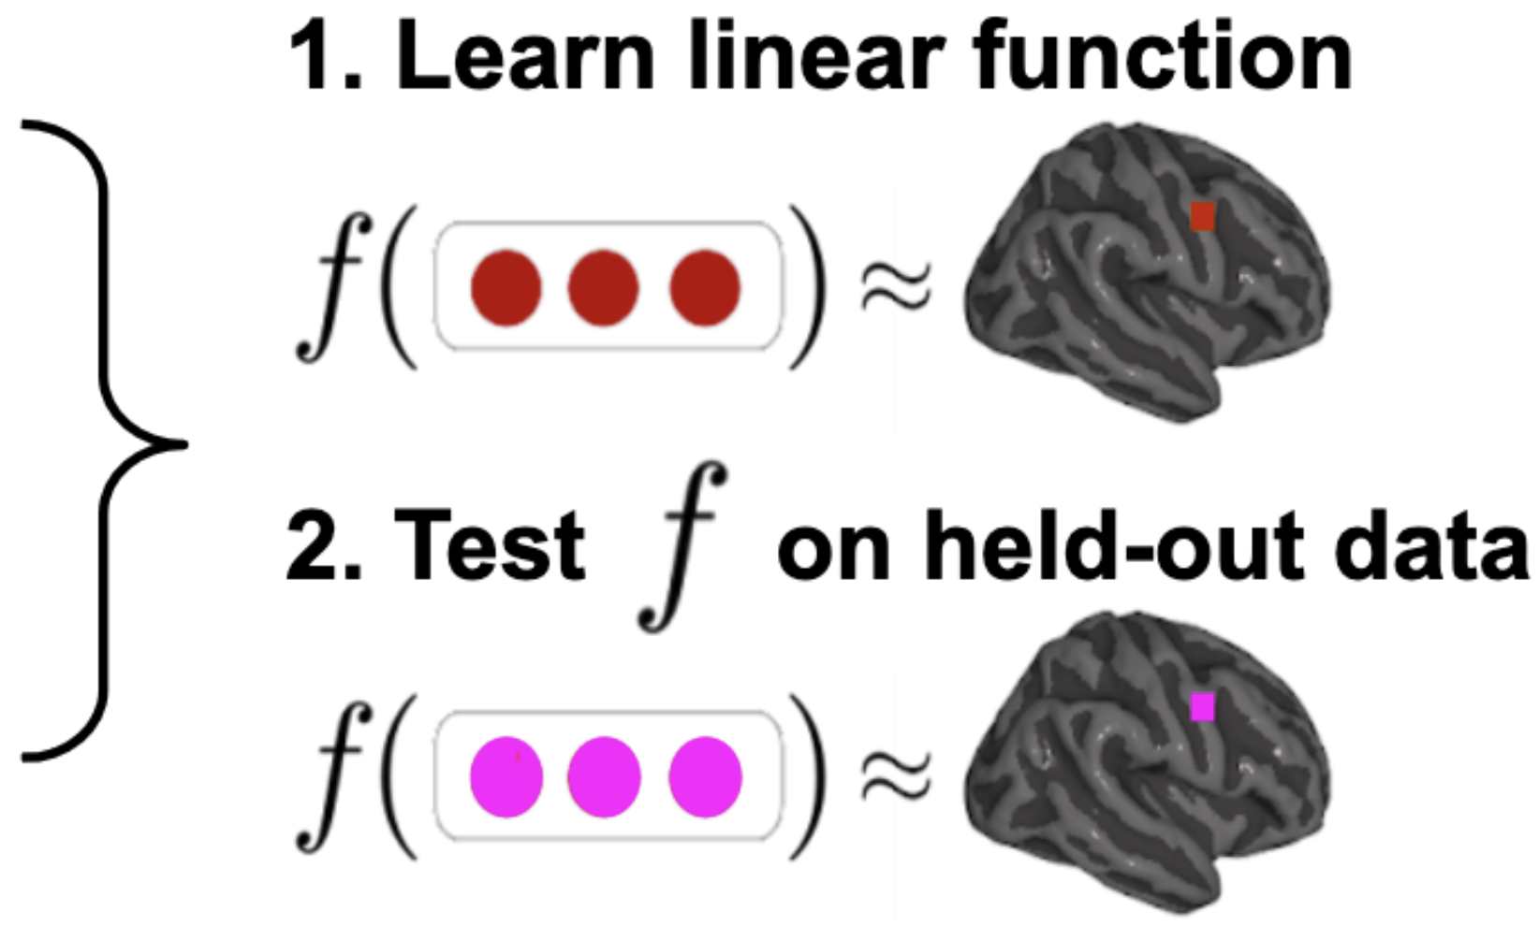
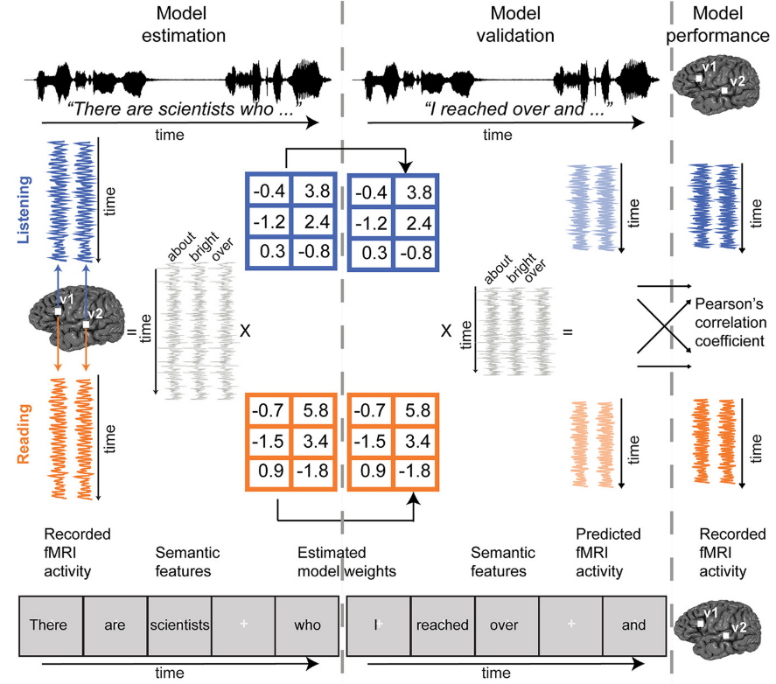

Language models (LMs) predict brain activity evoked by complex
language (e.g. listening a story) to an impressive degree
time
Once
upon
a
Wehbe et al. 2014,
Jain and Huth 2018,
Gauthier and Levy 2019
Toneva and Wehbe 2019,
Caucheteux et al. 2020,
Toneva et al. 2020
Jain et al. 2020,
Schrimpf et al. 2021,
Goldstein et al. 2022
...
Notes:
Several works shown that LMs predict brain activity recorded when participants listen to or read a complex language stimulus, such as a short story. This ability to predict brain activity is what we refer to as brain alignment”.

Slide 8
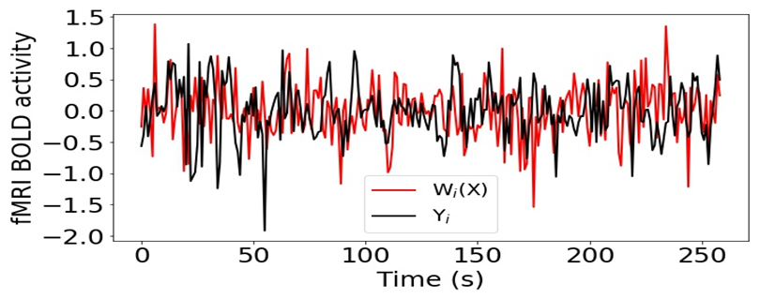
Language models (LMs) predict brain activity evoked by complex
language (e.g. listening a story) to an impressive degree
Brain alignment of a LM ⇒ Why do language models have better brain alignment? What are the reasons?
Jain and Huth. Incorporating context into language encoding models for fMRI. (NeurIPS 2018)
Toneva and Wehbe. Interpreting and improving natural-language processing (in machines) with natural language-processing (in the brain). (NeurIPS 2019)
Notes:
The brain alignment for an x,y,z coordinate in the brain is measured as the Pearson correlation between the corresponding predicted and true brain data, across all held out instances”
This poses a question of what are the reasons for this better brain alignment? Why do data-driven language model predict brain activity better?

Slide 9
Focusing on two research questions
Artificial
Biological
What are the reasons behind better similarity between language models and brains?
What types of information underlie the brain alignment of language models observed across brain regions?
Notes:
These language models are trained to [Keep clicking]
predict missing words over millions of text documents.

Slide 10



Artificial
Biological
What are the reasons behind better similarity between language models and brains?
Joint processing of linguistic properties in brains and language models
Subba Reddy Oota Manish Gupta Mariya Toneva
Notes:
Today, I am presenting our paper, titled: “Training language models to summarize narratives improves brain alignment”.

Slide 11
Language models (LMs) are trained to predict missing words
jumps
Language model
The
quick
brown
fox
[MASK]
Notes:
These language models are trained to [Keep clicking]
predict missing words over millions of text documents.

Slide 12
Interpreting BERT and beyond
Can we unveil the representations learned by BERT to linguistics structure?
Understand the reason behind the success of BERT but also its limitations.
Guide the design of improved architectures.

Slide 13
Hierarchy of Linguistic Info - Setting
If the prediction accuracy is good, then the model might be capturing the sentence length feature
Conneau et al., ACL’18 - Build diagnostic classifier to predict if a linguistic property is encoded in the given sentence representation.
Features:
Surface – Sentence Length, Word Content
Syntactic – Bigram shift, Tree depth, Top constituent
Semantic – Tense, Subject Number, Object Number, Coordination Inversion and Semantic Odd Man Out.
predict sentence length
Simple classifier
BERT layer

Slide 14
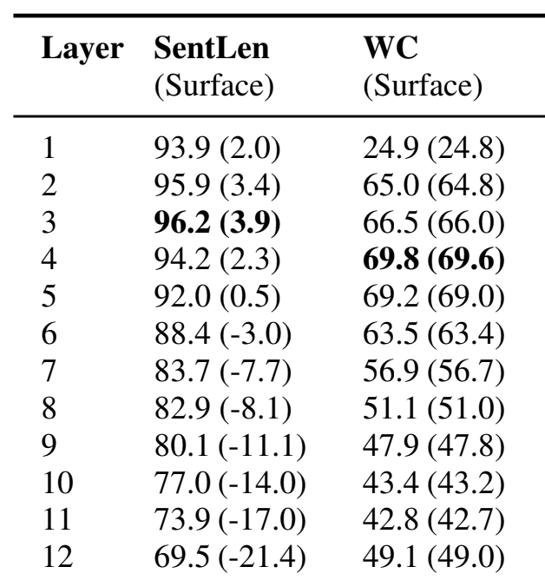
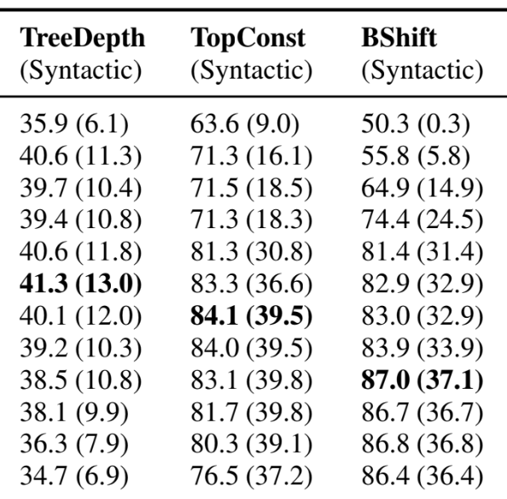
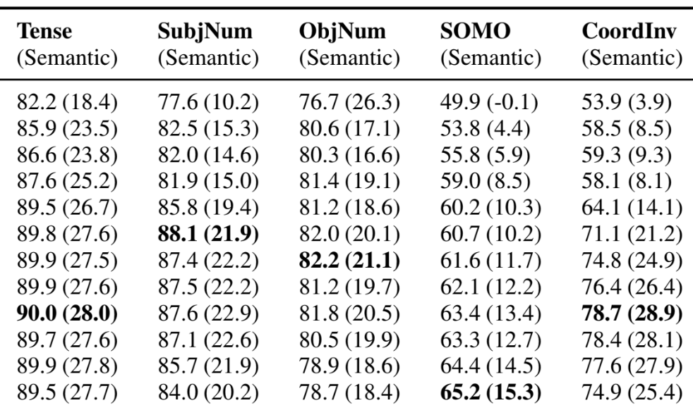
Language models (LMs) are trained to predict missing words
Surface
Syntactic
Semantic
jumps
Language model
The
quick
brown
fox
[MASK]
BERT composes a hierarchy of linguistic signals ranging from surface to semantic features.
Notes:
The BERTology studies shown that BERT captures hierarchy of linguistic signals
[CLICK] early layers capture surface properties
[CLICK] middle layers capture syntactic properties
[CLICK] and later layers capture semantic properties

Slide 15
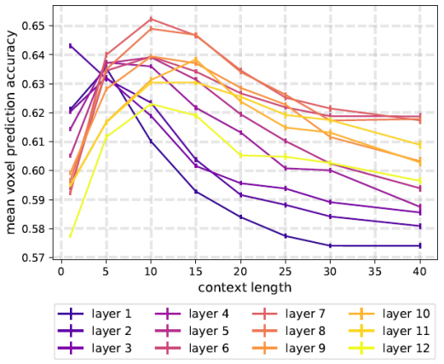
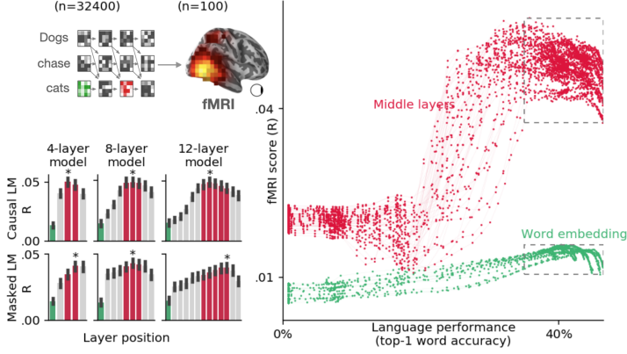
The strongest alignment with high-level language brain regions has consistently been observed in middle layers
Toneva et al. 2019
Caucheteux et al. 2022
BERT
XLM
Across several types of large NLP systems, best alignment with fMRI in middle layers
Notes:
More recently, researchers have begun to study the alignment of these brain language regions with the layers of language models, and found that the best alignment was achieved in the middle layers of these models.
These findings open up the question of what linguistic information underlies the observed alignment between brains and language models.

Slide 16





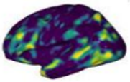
What are the reasons for this observed brain alignment?
Investigate via a perturbation approach
Linguistic property
Residual =
Residual encoding performance
Significant difference ⇒ Ling. prop. affects alignment
This is Los Angeles. And it's the …
Original encoding performance
Language model
Naturalistic stimulus
fMRI

Slide 17
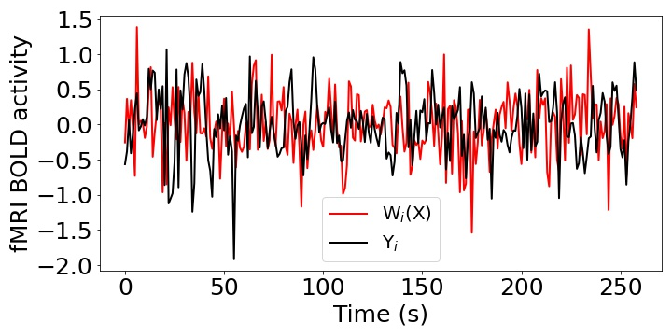
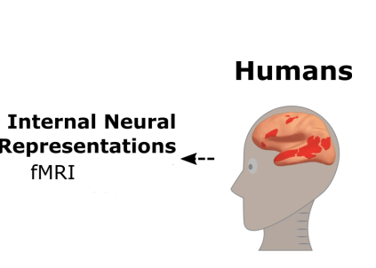
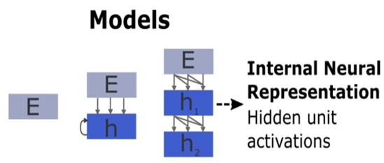
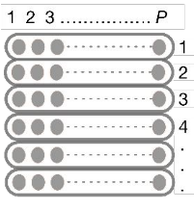
Brain Encoding Schema?
Pearson Correlation (R) = Corr(Y, W(X))
Stimulus
Stimulus
Input
Present
X
W
Y
Input
Ridge Regression
Output

Slide 18
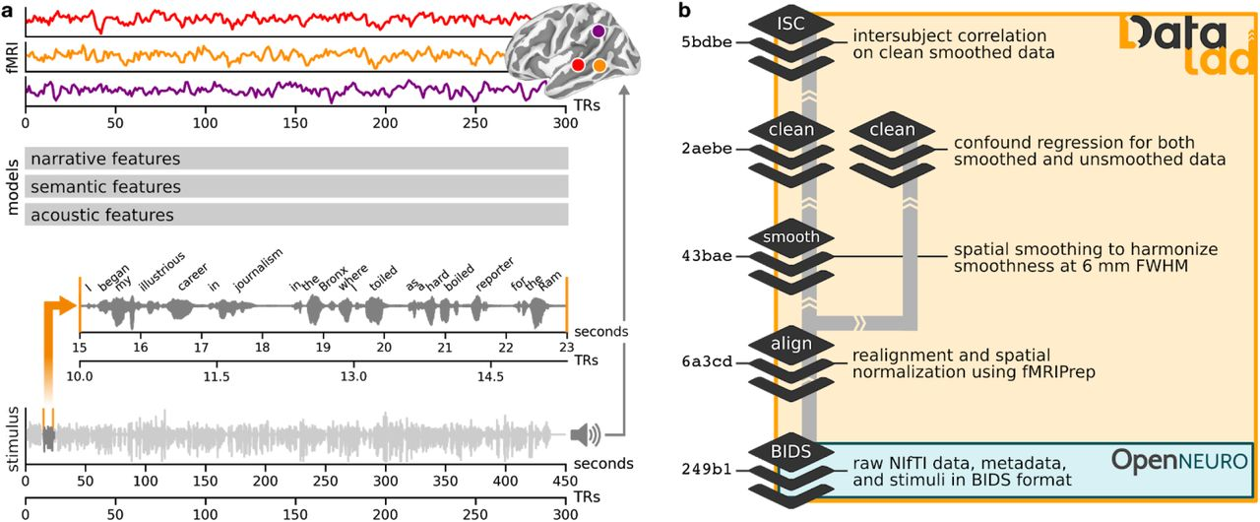
Brain alignment – 4-fold Cross-Validation + Ridge regression
8267 words x 768 ⇒ LM representations
Downsample from word-level representations to TR-level (taken every 1.5s)
2226 fMRI time intervals x 768
Concatenate LM representations for previous 8 TRs ⇒ fMRI response from brain activity peaks about 6 seconds after stimulus onset
2226 fMRI intervals x 81924 voxels ⇒ fMRI predictions (same dimensions as actual brain activity)
18 participants
(1) Narratives 21st year story
(3) 4-fold Cross-Validation
(2) Brain Alignment: Dataset Curation

Slide 19
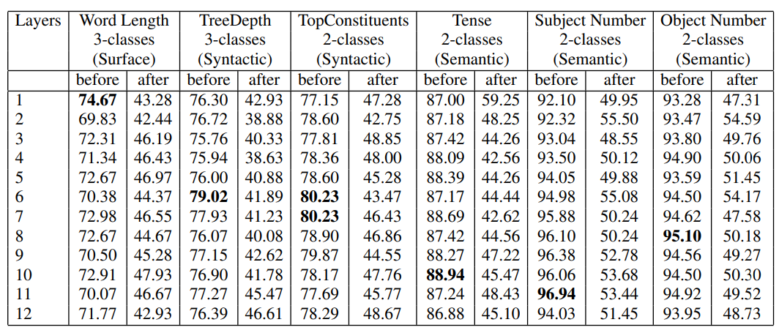
What are the reasons behind the success of LMs?
Surface
Syntactic
Semantic
Successful removal of linguistic properties from pretrained BERT

Slide 20
Does the removal of a linguistic property affects the alignment between a language model and the brain across all layers?
Notes:
We investigate our research question: “Does the removal of a linguistic property affects the alignment between LM and brain across all layers?
”

Slide 21
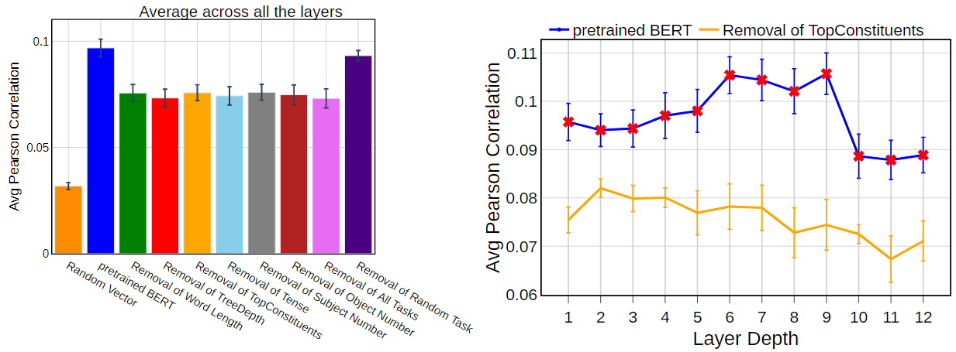
Result-1
Removal of each linguistic property leads to a significant decrease in brain alignment on average across layers.
Notes:
In our first result figure, we present the average brain alignment across all layers of pretrained BERT before and after the removal of each linguistic property.
Blue bars represent the pretrained BERT, and orange bars represent the brain alignment after removal of Topconstituents property.
The left plot shows that there is a sig impact of each property on brain alignment ON AVERAGE across layers and all regions in the brain.
So, we next look at the layer-wise performance for pretrained BERT before and after the removal of one representative linguistic property–TopConstituents, and
we see the greatest impact on alignment in the middle layers.

Slide 22
Result-1
Removal of each linguistic property leads to a significant decrease in brain alignment on average across layers.
Greatest impact on brain alignment in the middle layers
Notes:
In our first result figure, we present the average brain alignment across all layers of pretrained BERT before and after the removal of each linguistic property.
Blue bars represent the pretrained BERT, and orange bars represent the brain alignment after removal of Topconstituents property.
The left plot shows that there is a sig impact of each property on brain alignment ON AVERAGE across layers and all regions in the brain.
So, we next look at the layer-wise performance for pretrained BERT before and after the removal of one representative linguistic property–TopConstituents, and
we see the greatest impact on alignment in the middle layers.

Slide 23
Result-1
Which linguistic properties have the most influence on the trend of brain alignment across BERT layers?
Removal of each linguistic property leads to a significant decrease in brain alignment on average across layers.
Greatest impact on brain alignment in the middle layers
Notes:
the previous results don’t show a difference between different properties on average across layers, but it is possible that they have different effects in different layers.

Slide 24
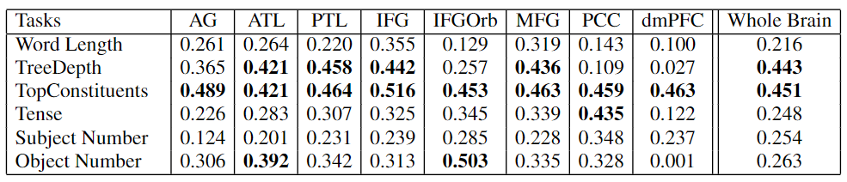
Result-2
Corr_{task} (∆ probing accuracy_{task} , ∆ brain alignment_{task})
Syntactic
Semantic
ROI-Level Analysis
Syntactic properties have the largest effect on the trend of brain alignment across model layers
Notes:
We perform both quantitative and qualitative analyses by measuring the correlation across layers between the differences in decoding task performance from pretrained and residual BERT and the differences in brain alignment of pretrained BERT and residual BERT.
A high correlation for a specific linguistic property suggests a strong relationship between the presence of this property across layers in the model and its corresponding effect on the layer-wise brain alignment.
The columns are different regions in the brain that are thought to process language, but their individual contribution to language processing is not well understood.
The table shows several insights
Both TreeDepth and TopConstituents are responsible for the bump in brain alignment not just for the entire brain but also for several language ROIs
Although semantic properties are not shown to be responsible for the shape in brain alignment at the whole-brain level, but the affect of alignment more specifically to several language ROIs.

Slide 25
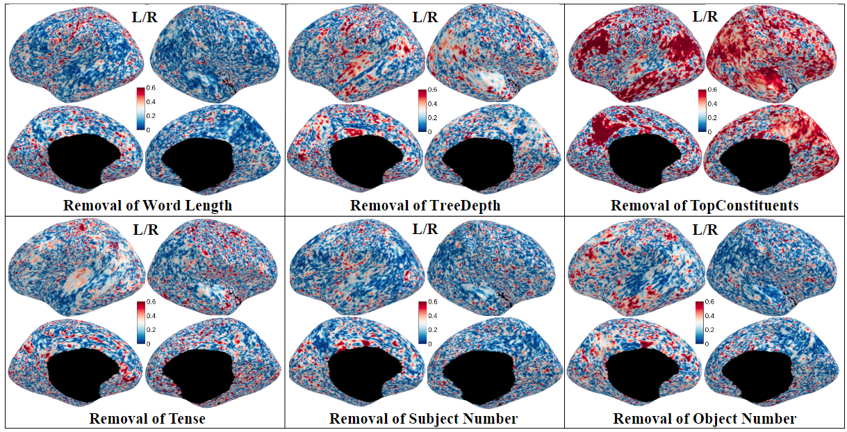
Qualitative Analysis: Effect of each linguistic property
effect of surface property
effect of syntactic property
effect of semantic property
Notes:
To present the correlations at an even finer grain, we show them now at the voxel-wise level for each linguistic property.
The effect of Top Constituents, and Object Number is more localized to the canonical language regions in the left hemisphere and is more distributed in the right hemisphere.

Slide 26
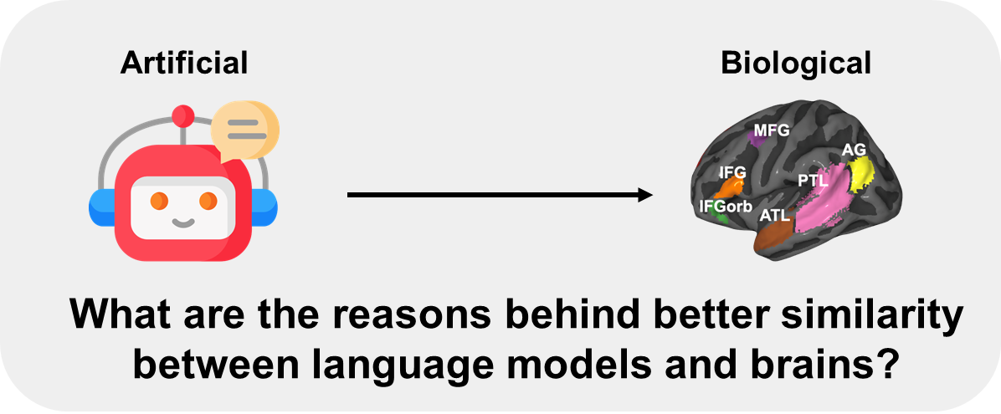
Conclusions for neuro-AI research field
AI-engineering:
guide linguistic feature selection,
facilitate improved transfer learning,
help in the development of cognitively plausible AI architectures
Computational modeling in Neuroscience
enables cognitive neuroscientists to have more control over using language models as model organisms of language processing
Model interpretability
the addition of linguistic features by our approach can further increase the model interpretability using brain signals (Toneva & Wehbe 2019)
Notes:
Our work has implications for several research areas such as AI engineering, neuroscience and model interpretability.
AI-engineering: investigates the relationship between representations in the brain and representations learned from language models.
Our insights can,
Computational modeling: Researchers have started viewing language models as useful model organisms for human language processing. Ou work,
Model Interpretability: We hope that our approach can be used to better understand the necessary and sufficient properties that lead to significant alignment between brain recordings and language models.

Slide 27

Artificial
Biological
What types of information underlie the brain alignment of language models observed across brain regions?
Speech-based language models lack brain-relevant semantics
Subba Reddy Oota Emin Celik Fatma Deniz Mariya Toneva

Slide 28
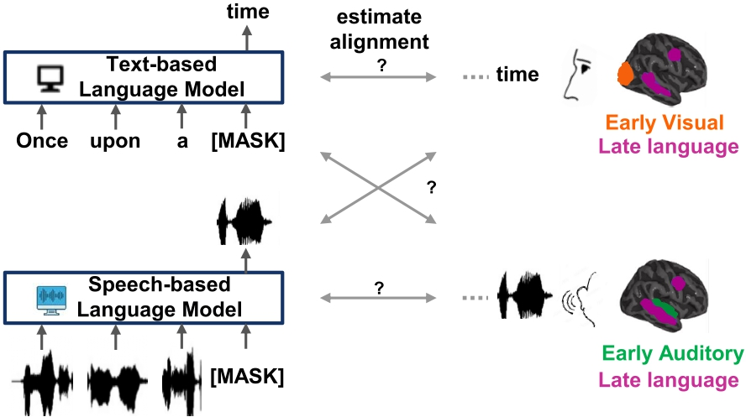
Text- vs. Speech-based language models

Slide 29
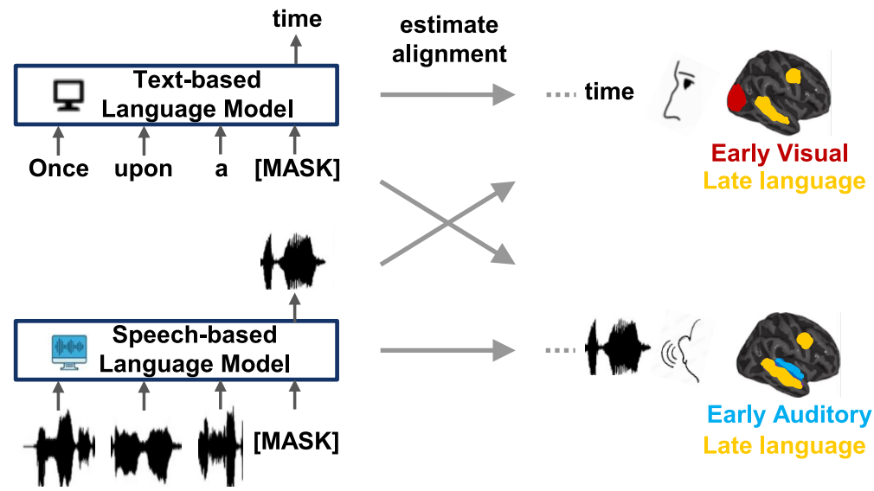
Text- vs. Speech-based language models : brain alignment
Notes:
Instead of evaluating whether these models aligned with brain recordings illustrated by text/speech differenetly/similary.

Slide 30
Datasets & Model
Brain: fMRI recordings from Moth-Radio-Hour [Deniz et al. 2019]
Reading & Listening to the same short stories
N=6
3 text-based language models
BERT-base
GPT-2
FLAN-T5
2 speech-based language models
Wav2Vec2.0
Whisper

Slide 31
How can we quantify model predictions within a voxelwise encoding model?
To quantify model predictions within a voxelwise encoding model, we can compute variance:
Estimate noise ceiling:
If we have data from multiple participants, we can predict the brain activity of one pariticipant using the data from remaining participants.
This can offer an upper bound for each voxel for a target participant, and it is related to a quantity called the noise ceiling estimate.
Normalized predictivity: percent of explained variance (model predictions/noise ceiling estimate)

Slide 32
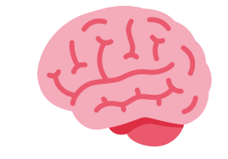
Cross-subject prediction: shared info between participants (A&B)
10 Stories - B
10 Stories - A
Present
Present
3737 TRs
X_train
Ridge Regression
Y_train
Input
Output
11th Story - B
X_test
Y_test
11th Story - A
291 TRs
291 TRs
Pearson Correlation (R) = Corr(Y, W(X))

Slide 33
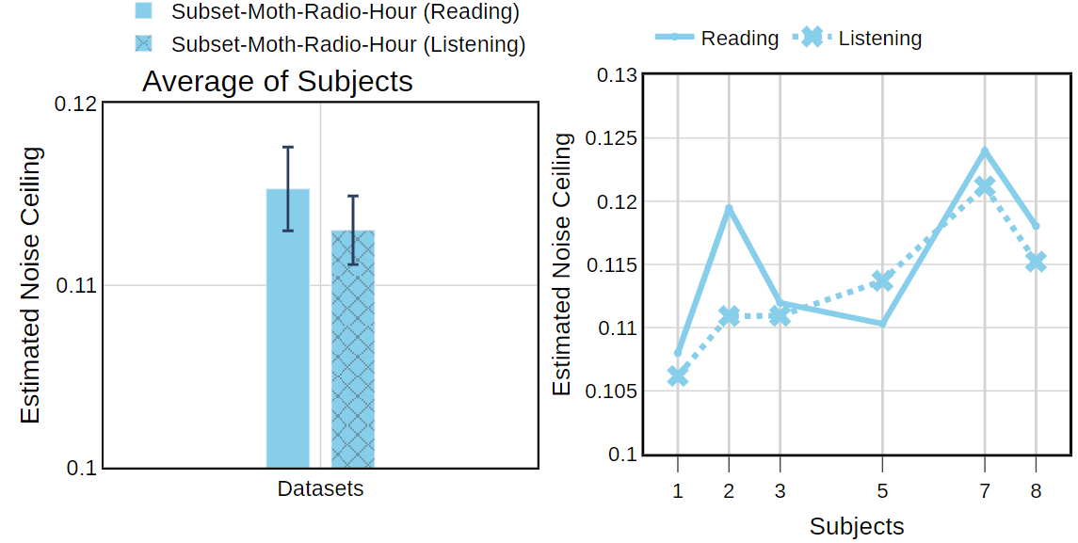
Estimated Noise Ceiling

Slide 34
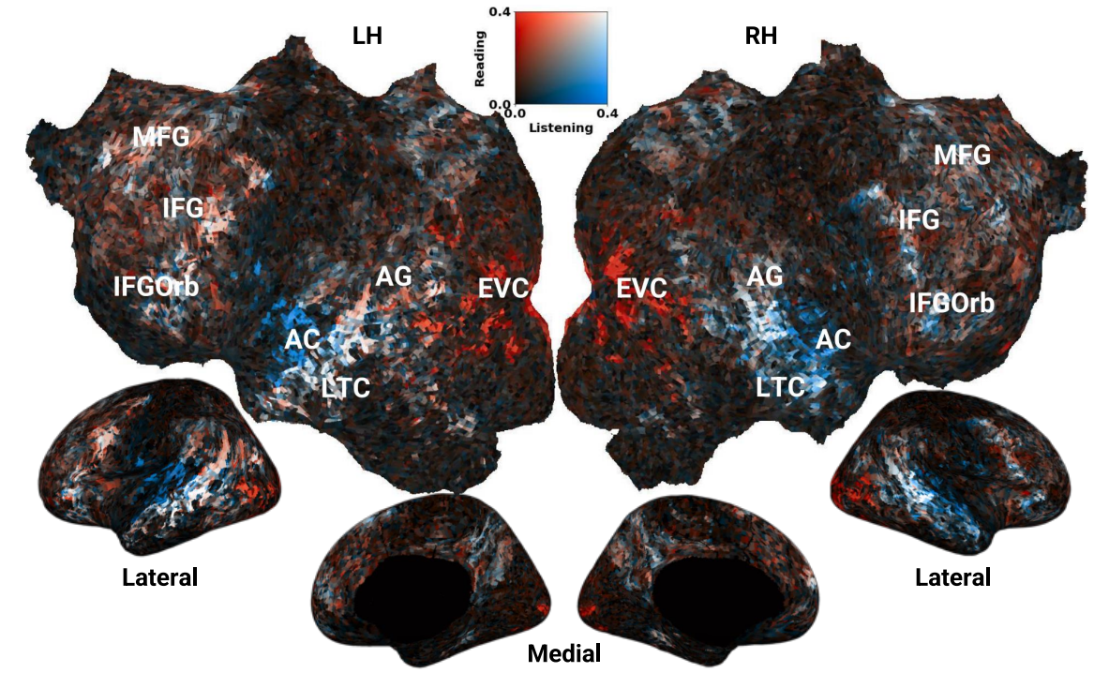
S08: Cross-subject prediction accuracy (Reading vs. Listening)
BLUE-AC and Orange-VC voxels are well predicted in estimated noise-ceiling.

Slide 35
Research questions
𝐖𝐡𝐲 𝐝𝐨 𝐭𝐞𝐱𝐭-𝐛𝐚𝐬𝐞𝐝 (📖) 𝐥𝐚𝐧𝐠𝐮𝐚𝐠𝐞 𝐦𝐨𝐝𝐞𝐥𝐬 𝐡𝐚𝐯𝐞 𝐢𝐦𝐩𝐫𝐞𝐬𝐬𝐢𝐯𝐞 𝐩𝐞𝐫𝐟𝐨𝐫𝐦𝐚𝐧𝐜𝐞 𝐢𝐧 𝐭𝐡𝐞 𝐞𝐚𝐫𝐥𝐲 𝐚𝐮𝐝𝐢𝐭𝐨𝐫𝐲 𝐜𝐨𝐫𝐭𝐞𝐱?
𝐃𝐨 𝐭𝐞𝐱𝐭-𝐛𝐚𝐬𝐞𝐝 (📖) 𝐚𝐧𝐝 𝐬𝐩𝐞𝐞𝐜𝐡-𝐛𝐚𝐬𝐞𝐝 (🔊) 𝐥𝐚𝐧𝐠𝐮𝐚𝐠𝐞 𝐦𝐨𝐝𝐞𝐥𝐬 𝐡𝐚𝐯𝐞 𝐭𝐡𝐞 𝐬𝐚𝐦𝐞 𝐝𝐞𝐠𝐫𝐞𝐞 𝐨𝐟 𝐩𝐫𝐞𝐝𝐢𝐜𝐭𝐢𝐯𝐢𝐭𝐲 𝐢𝐧 𝐭𝐡𝐞 𝐥𝐚𝐧𝐠𝐮𝐚𝐠𝐞 𝐫𝐞𝐠𝐢𝐨𝐧𝐬 𝐨𝐟 𝐭𝐡𝐞 🧠?
More generally, w𝐡𝐚𝐭 𝐭𝐲𝐩𝐞𝐬 𝐨𝐟 𝐢𝐧𝐟𝐨𝐫𝐦𝐚𝐭𝐢𝐨𝐧 𝐝𝐨 𝐥𝐚𝐧𝐠𝐮𝐚𝐠𝐞 𝐦𝐨𝐝𝐞𝐥𝐬 𝐭𝐫𝐮𝐥𝐲 𝐩𝐫𝐞𝐝𝐢𝐜𝐭 𝐢𝐧 𝐭𝐡𝐞 🧠?

Slide 36
Low-level Stimulus Features
Textual Features
Speech Features
Visual Features
Phonemes
Num of Phonemes
Diphones
FBANK
MFCC
Mel-Spectrogram
PowSpec
Phonological
Articulation
Letters
Num of Letters
Num of Words
Word Length STD
Motion Energy

Slide 37
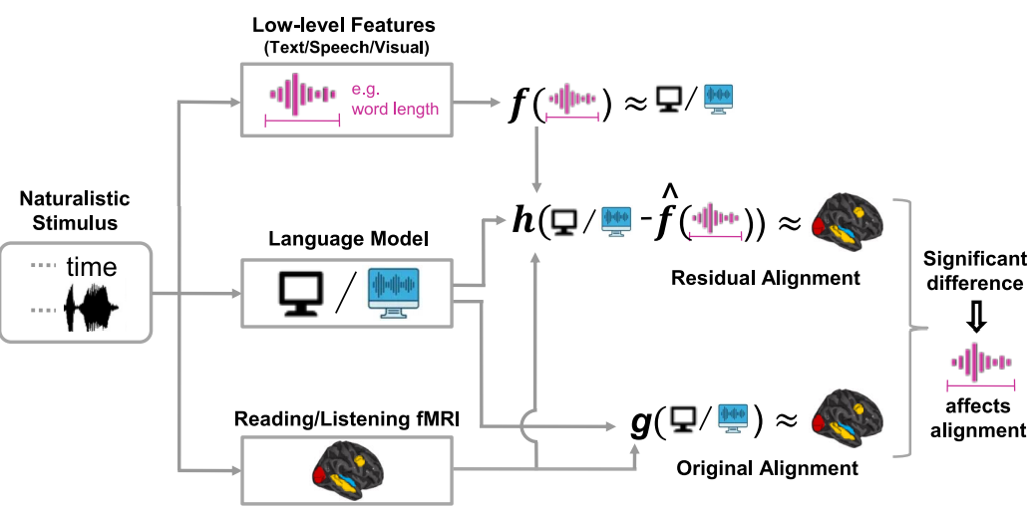
What types of information are present in these models,
leading to high brain alignment?
Investigate via a perturbation approach

Slide 38
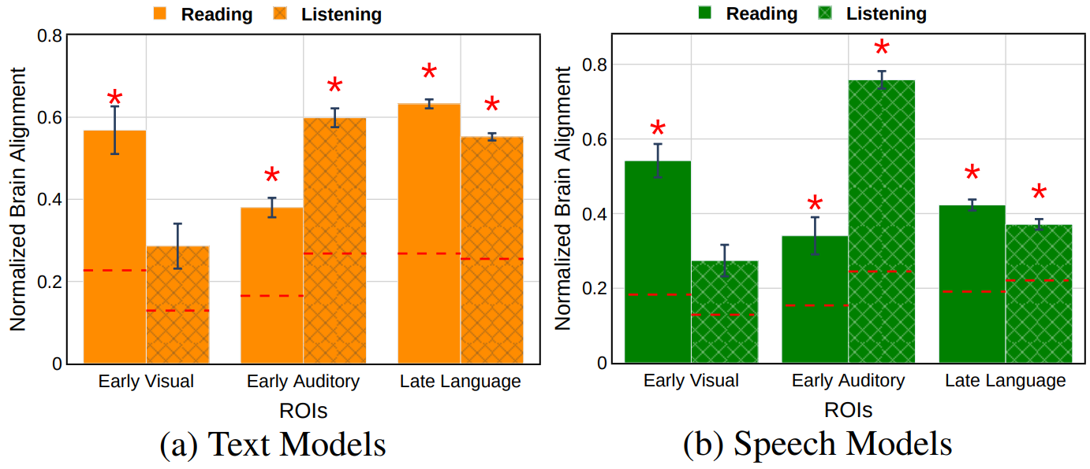
Text vs. Speech-based language models & brain alignment
Both models show high brain alignment with late language regions, but speech models trails behind text models
Both models highly predict early visual and auditory regions.

Slide 39
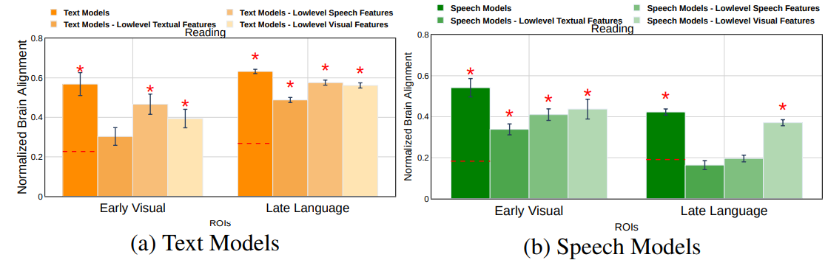
Reading condition in early visual & late language regions
Text models alignment with late language regions due to brain-relevant semantics, while speech models alignment due to low-level stimulus features.
Text models alignment with early visual regions mostly due to low-level textual features, while speech models alignment is only partially explained by these features.

Slide 40
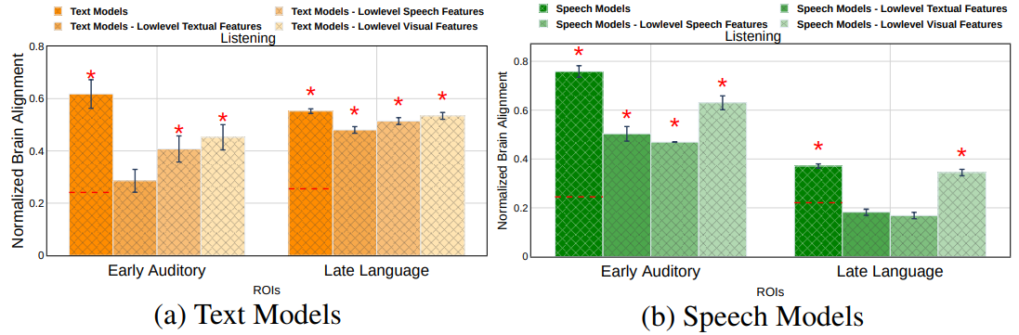
Listening condition in early auditory & late language regions
Text models alignment with late language regions due to brain-relevant semantics, while speech models alignment due to low-level stimulus features.
Text models alignment with early auditory regions mostly due to low-level textual features, while speech models alignment is only partially explained by these features.

Slide 41
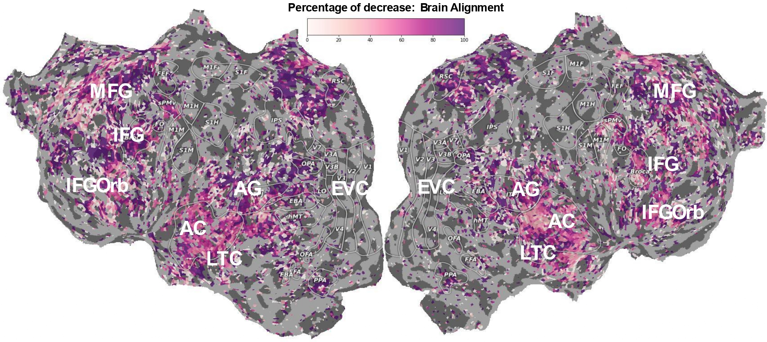
Phonological properties account for most of the alignment between speech models and the human brain
Notes:
The impressive predictive performance of speech models in the early auditory cortex is NOT entirely accounted for by low-level features. 40-50% of the explainable variance in the early auditory cortex is left to explain after removing the low-level features we consider.
This shows that speech-based models capture additional features that are important for early auditory cortex and understanding these further can help us better understand this part of the brain.
Another surprising result is that, in contrast to the alignment of speech-based models in the early auditory cortex, the alignment in late language regions is almost entirely due to low-level features.

Slide 42
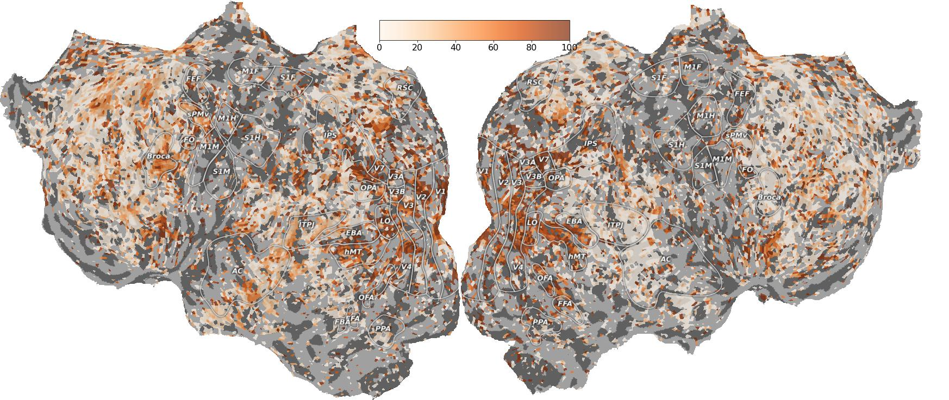
Text-based language models have more information shared with late language regions beyond number of letters feature.
Notes:
The decrease is much large in EVC
Our work clearly demonstrates the importance of careful consideration of the reasons behind the alignment that is observed between models and human brain recordings.

Slide 43
Conclusions for neuro-AI research field
The impact of low-level stimulus features:
text model alignment is marginal, speech models alignment is entirely driven by these features
The surprising alignment of models with incongruent modality sensory regions is driven by low-level features
Models show varying alignments with their corresponding sensory regions

Slide 44
Final Conclusions
Speech models (🔊) useful for modeling early listening: investigate speech models to learn more about AC
Text models (📖) useful for modeling late language in both listening and reading
But, more work to do for a complete end-to-end model of reading and listening in 🧠

Slide 45









Collaborators
Subba Reddy Oota
Nathan Trouvain
Manish Gupta
Bapi Raju Surampudi
Mariya Toneva
Fatma Deniz
Gael Jobard
Xavier Hinaut
Frederic Alexandre

