Slide 1






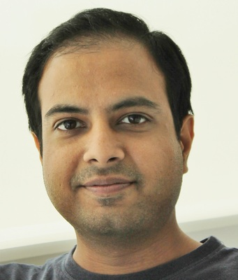

Recent trends in large language models
Mounika Marreddy¹, Subba Reddy Oota², Manish Gupta³, Lucie Flek¹
¹University of Bonn, Germany; ²Inria Bordeaux, France; ³Microsoft, India
mmarredd@uni-bonn.de, subba-reddy.oota@inria.fr, gmanish@microsoft.com, flek@bit.uni-bonn.de

Slide 2
Agenda
Recap on small language models [5 min]
Emerging abilities of language models and why they are effective? [25 min]
Text-to-Text Transfer Transformer, Prompting, Instruction-tuning [1 hour]
Lunch [45 min]
Large language models, Chain-of-Thought reasoning, RAG [1 hour 30 min]
Coffee break [15 min]
Hands on session [1 hour]

Slide 3
Agenda
Recap on small language models [5 min]
Emerging abilities of language models and why they are effective? [25 min]
Text-to-Text Transfer Transformer, Prompting, Instruction-tuning [1 hour]
Lunch [45 min]
Large language models, Chain-of-Thought reasoning, RAG [1 hour 30 min]
Coffee break [15 min]
Hands on session [1 hour]

Slide 4
LMs are trained to predict missing words
jumps
Language model
The
quick
brown
fox
[MASK]
Notes:
These language models are trained to [Keep clicking]
predict missing words over millions of text documents.

Slide 5
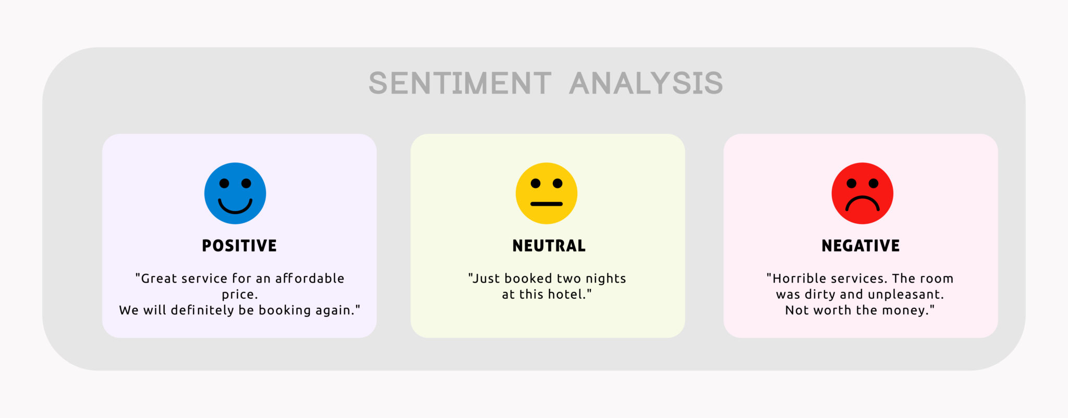
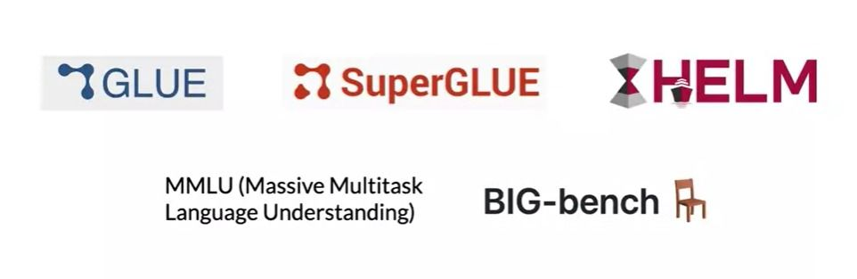
Language models are everywhere
Small language models
https://gluebenchmark.com/
https://super.gluebenchmark.com/
https://crfm.stanford.edu/helm/lite/latest/
https://paperswithcode.com/dataset/mmlu
https://paperswithcode.com/dataset/big-bench

Slide 6
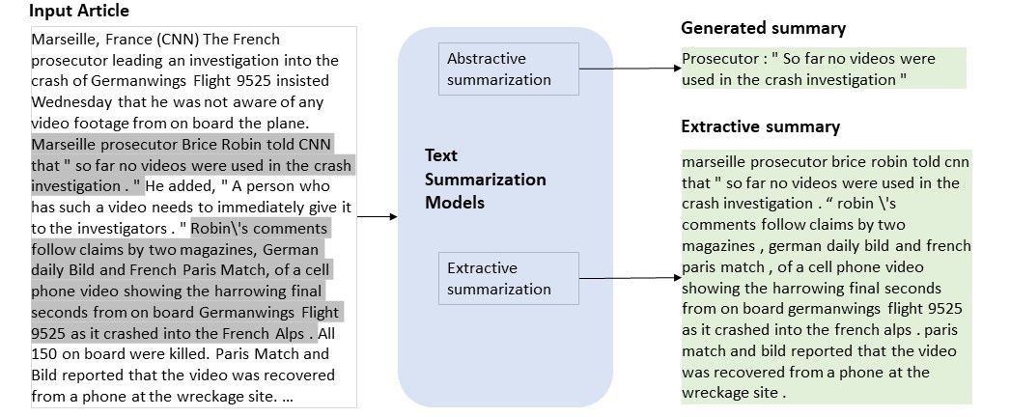
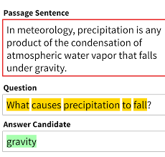
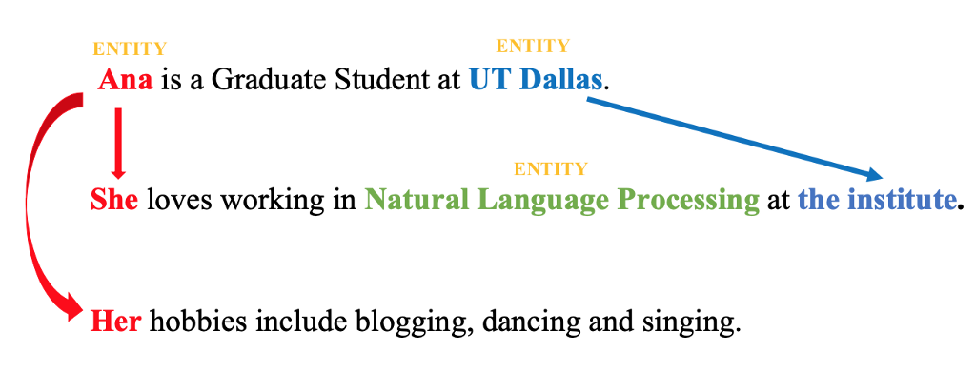
Language models are everywhere
Sentiment
Summarization
Question Answering
Coreference Resolution

Slide 7
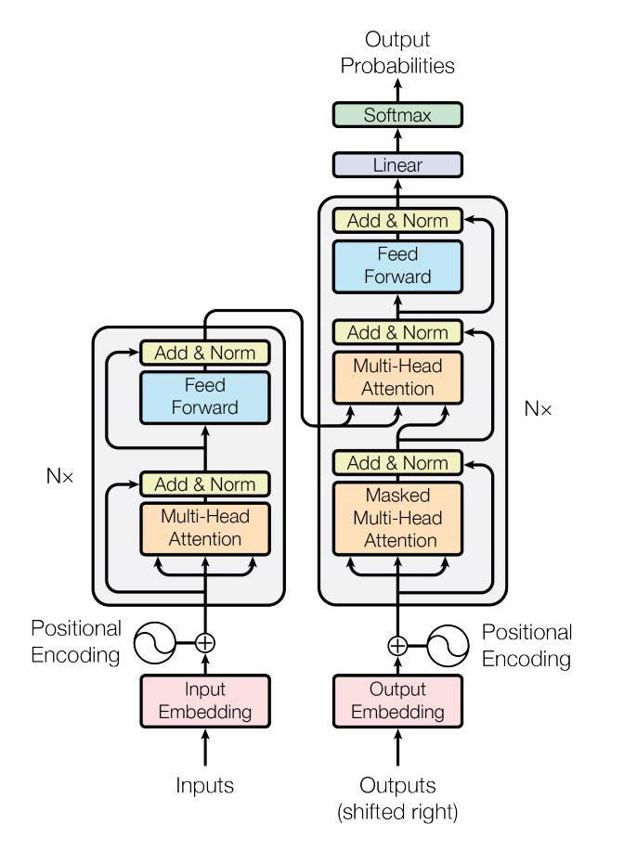
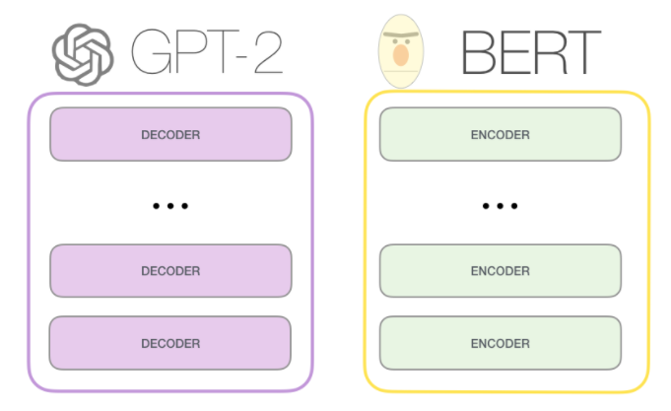
Transformer
Harry never thought he would
Harry never thought he ???
Ashish Vaswani, Noam Shazeer. "Attention Is All You Need." NeurIPS (2017).

Slide 8
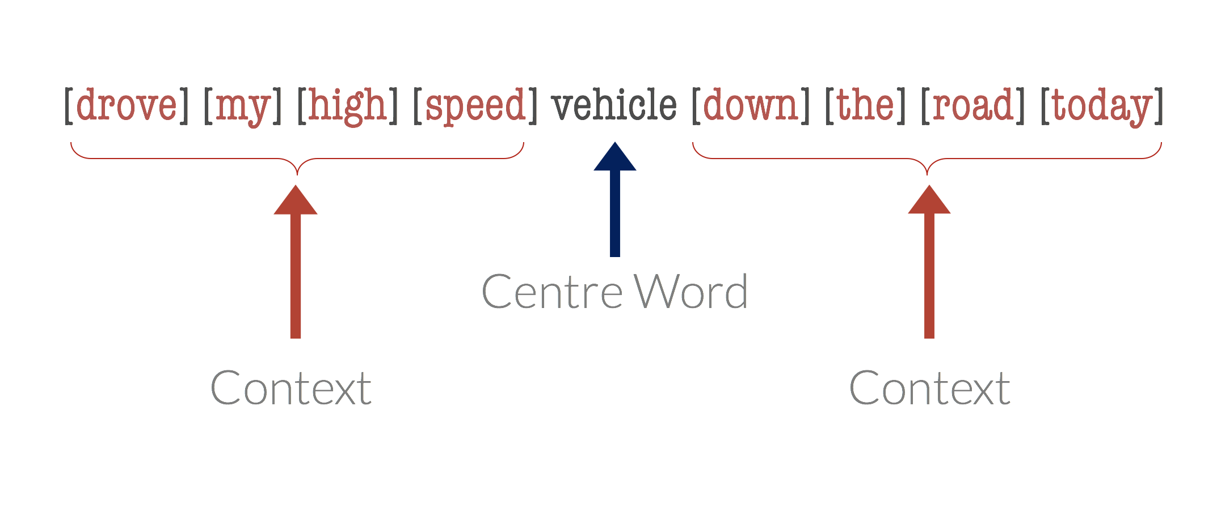
BERT: Workflow
1. Self-attention with Bi-directional context
w_{t-2}
w_{t-1}
w_{t}
w_{t+1}
w_{t+2}
[Context word]
[Context word]
Current word
[Context word]
[Context word]
2. Masked language modeling (MLM)
[MASK]

Slide 9
GPT2: Workflow
1. Self-attention with Uni-directional context
w_{t-2}
w_{t-1}
w_{t}
[Context word]
[Context word]
Current word
2. Causal language modeling (CLM)
[vehicle]
[MASK]
[vehicle]

Slide 10
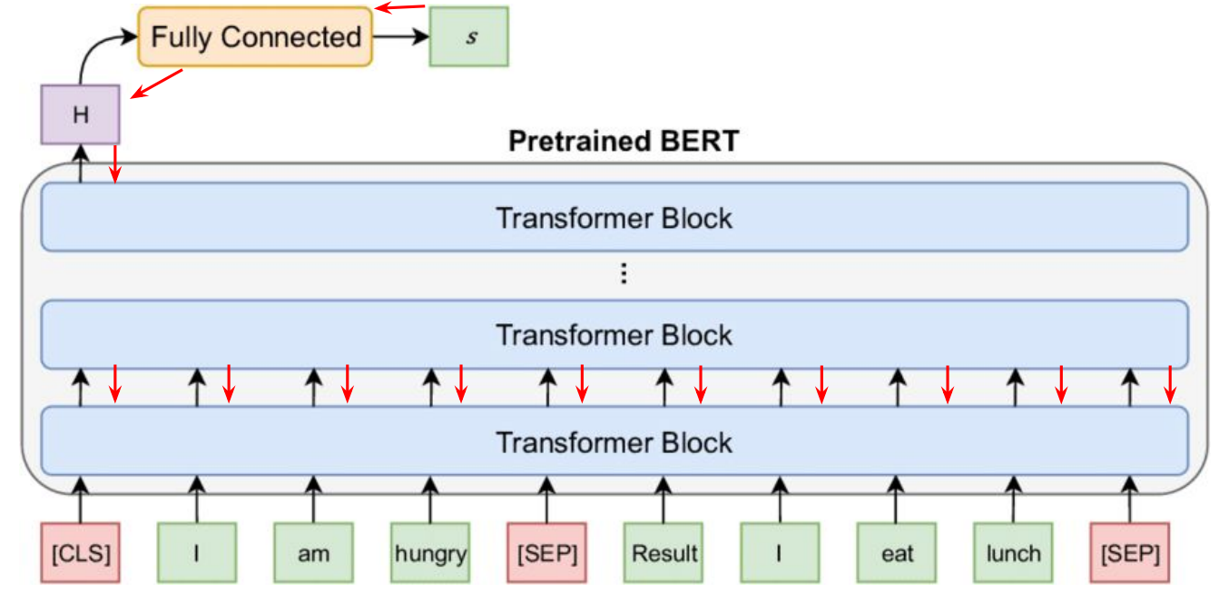
Fine tuning: tune pretrain language model on a task

Slide 11
Agenda
Recap on small language models [5 min]
Emerging abilities of language models and why they are effective? [25 min]
Analyzing and Interpreting language models
Text-to-Text Transfer Transformer, Prompting, Instruction-tuning [1 hour]
Lunch [45 min]
Large language models, Chain-of-Thought reasoning, RAG [1 hour 30 min]
Coffee break [15 min]
Hands on session [1 hour]

Slide 12
Agenda
Recap on small language models [5 min]
Emerging abilities of language models and why they are effective? [25 min]
Analyzing and Interpreting language models
Text-to-Text Transfer Transformer, Prompting, Instruction-tuning [1 hour]
Lunch [45 min]
Large language models, Chain-of-Thought reasoning, RAG [1 hour 30 min]
Coffee break [15 min]
Hands on session [1 hour]

Slide 13
Analyzing and Interpreting LMs
Model Interpretability
Behavioural Interpretability
Mechanistic Interpretability
Analysis of representations via probing
Bridging language models and brain
Robustness
Reverse engineering of neural computations
"BlackboxNLP: Analyzing and Interpreting Neural Networks for NLP" 2023 EMNLP.

Slide 14
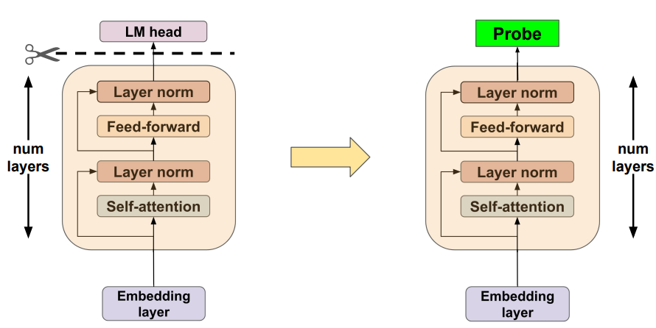
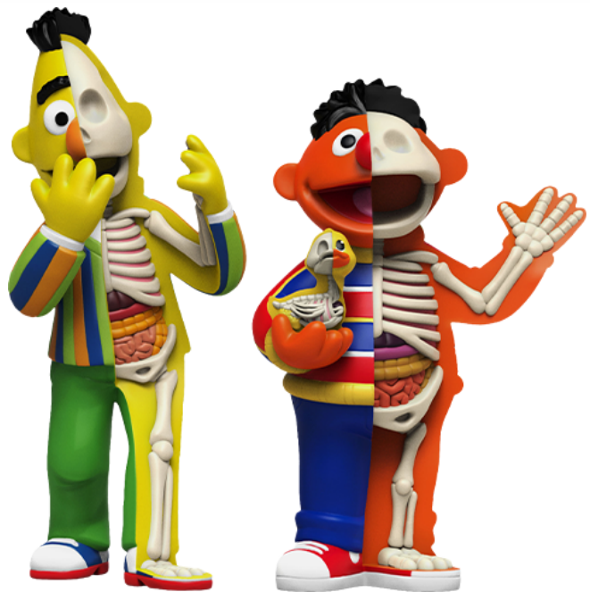
Model Interpretability?
Classifier
BERTology

Slide 15
Hierarchy of Linguistic Info - Setting
Conneau et al., ACL’18 - Build diagnostic classifier to predict if a linguistic property is encoded in the given sentence representation.
Features:
Surface – Sentence Length, Word Content
Syntactic – Bigram shift, Tree depth, Top constituent
Semantic – Tense, Subject Number, Object Number, Coordination Inversion and Semantic Odd Man Out.
If the prediction accuracy is good, then the model might be capturing the sentence length feature
predict sentence length
Simple classifier
BERT layer
Lamarr-NLP workshop: Recent trends in LLMs

Slide 16
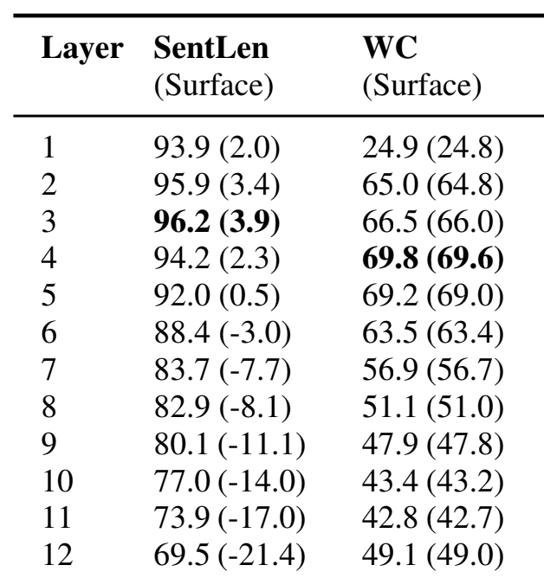
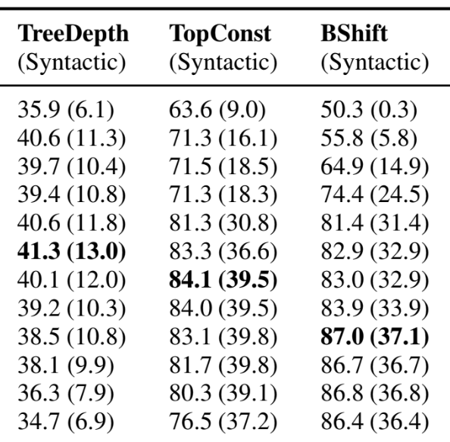
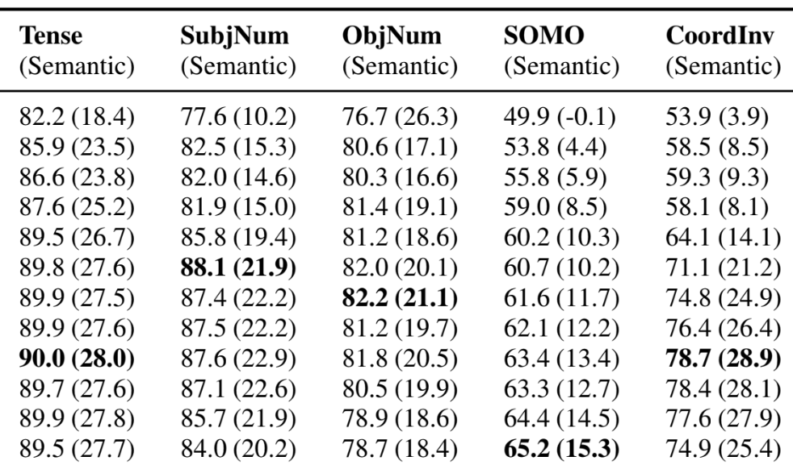
BERT composes a hierarchy of linguistic signals ranging from surface to semantic features
Surface
Syntactic
Semantic
Ganesh Jawahar, Benoît Sagot, Djamé Seddah. What does BERT learn about the structure of language?. ACL 2019
Notes:
The BERTology studies shown that BERT captures hierarchy of linguistic signals
[CLICK] early layers capture surface properties
[CLICK] middle layers capture syntactic properties
[CLICK] and later layers capture semantic properties

Slide 17
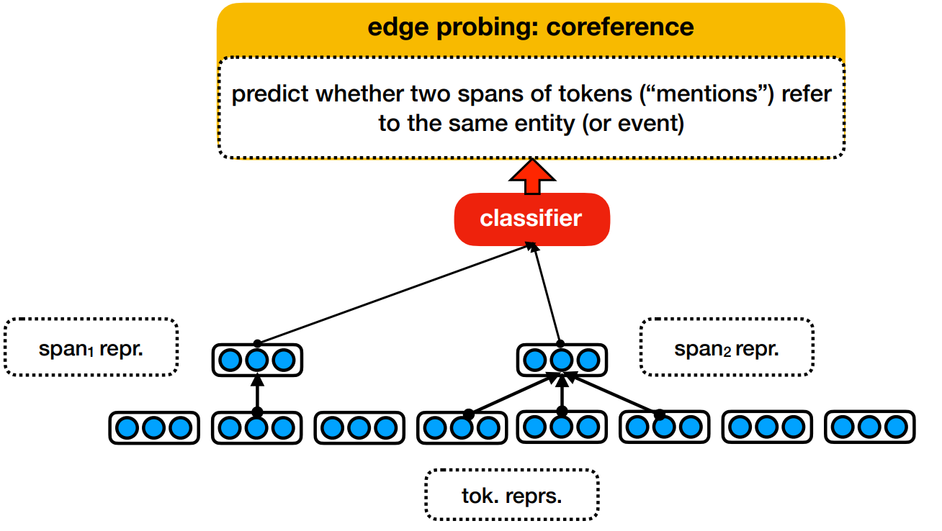
Edge Probing
Ian Tenney, Patrick Xia, Berlin Chen, Alex Wang, Adam Poliak, R Thomas McCoy, Najoung Kim, Benjamin Van Durme, Samuel R. Bowman, Dipanjan Das, Ellie Pavlick. What do you learn from context? Probing for sentence structure in contextualized word representations. ICLR 2019

Slide 18

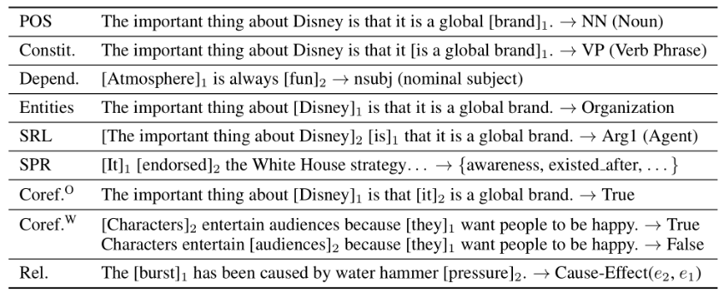
Edge Probing
Ian Tenney, Patrick Xia, Berlin Chen, Alex Wang, Adam Poliak, R Thomas McCoy, Najoung Kim, Benjamin Van Durme, Samuel R. Bowman, Dipanjan Das, Ellie Pavlick. What do you learn from context? Probing for sentence structure in contextualized word representations. ICLR 2019

Slide 19
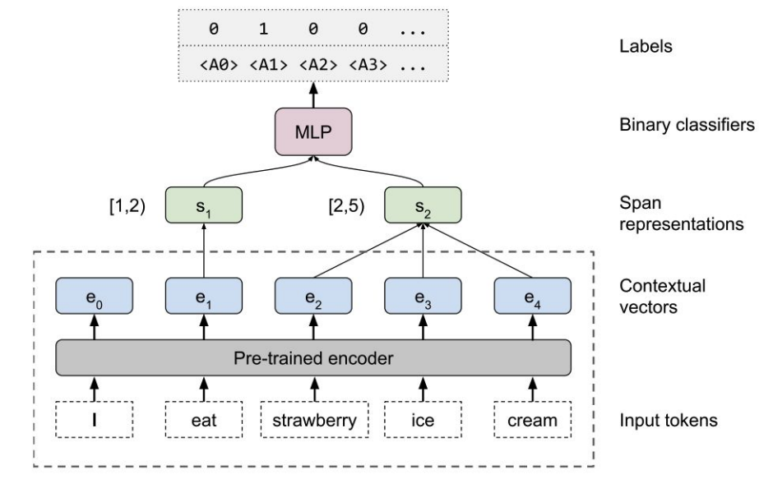
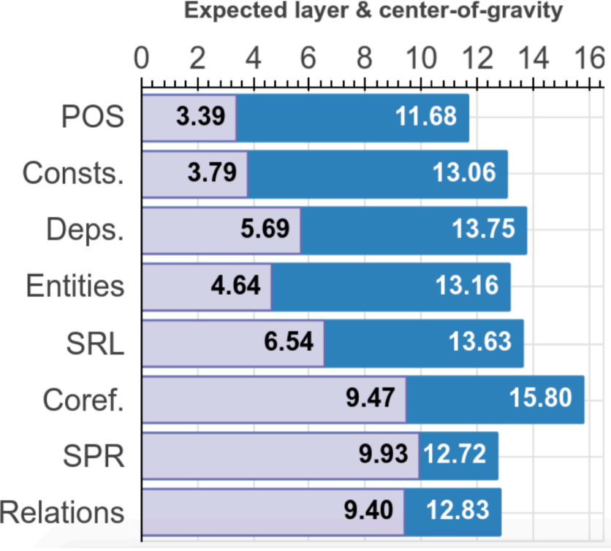
Edge Probing
Local syntax (word-level) captured at initial-middle layers
High-level semantics captured at later layers
Ian Tenney, Patrick Xia, Berlin Chen, Alex Wang, Adam Poliak, R Thomas McCoy, Najoung Kim, Benjamin Van Durme, Samuel R. Bowman, Dipanjan Das, Ellie Pavlick. What do you learn from context? Probing for sentence structure in contextualized word representations. ICLR 2019

Slide 20
Edge Probing
Local syntax (word-level) captured at initial-middle layers
High-level semantics captured at later layers
Ian Tenney, Patrick Xia, Berlin Chen, Alex Wang, Adam Poliak, R Thomas McCoy, Najoung Kim, Benjamin Van Durme, Samuel R. Bowman, Dipanjan Das, Ellie Pavlick. What do you learn from context? Probing for sentence structure in contextualized word representations. ICLR 2019

Slide 21
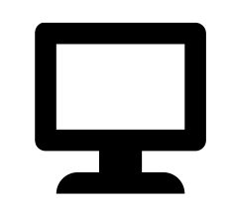
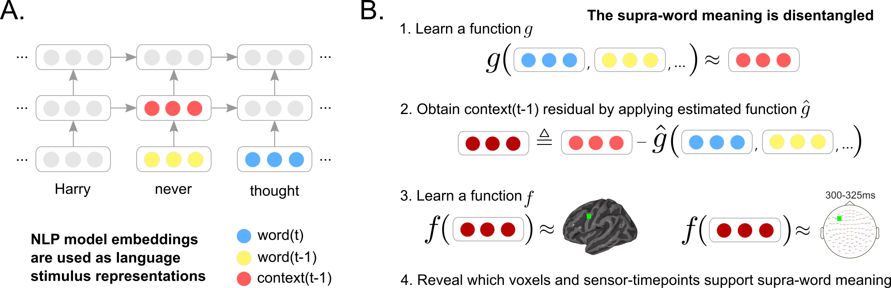

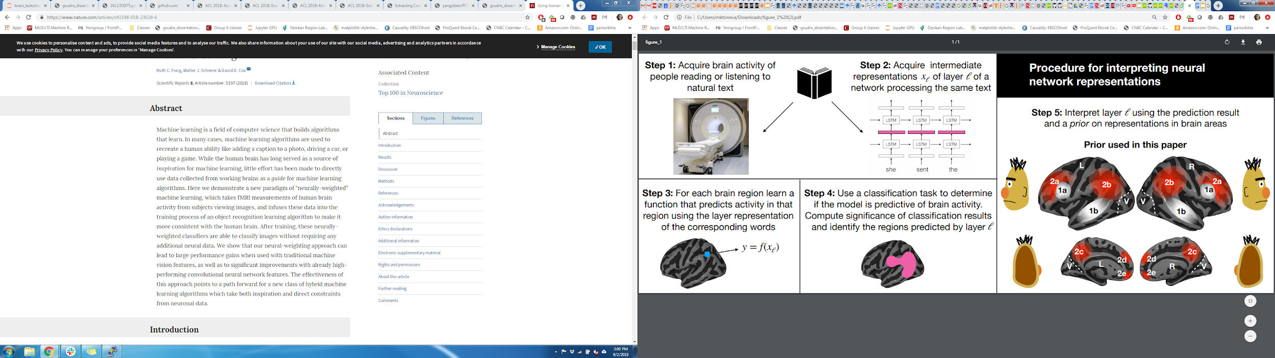
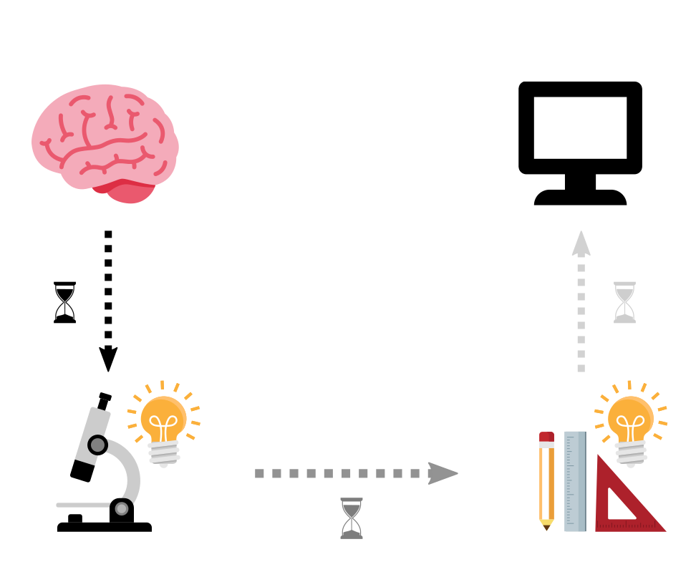

Data-driven encoding models evaluate the relationships between brains and deep learning models
Behavioural Interpretability
Multimodal naturalistic stimulus
Deep learning system
A priori locations in DL system and brain
Data-driven encoding model
how are they related?
fMRI
Toneva, M., & Wehbe, L. (2019). Interpreting and improving natural-language processing (in machines) with natural language-processing (in the brain). Advances in Neural Information Processing Systems, 32.

Slide 22
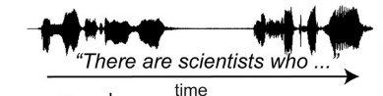
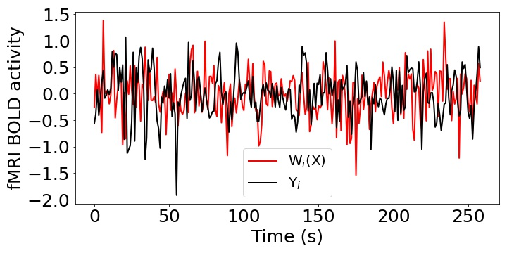
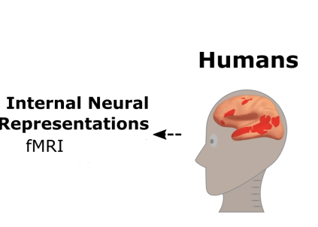
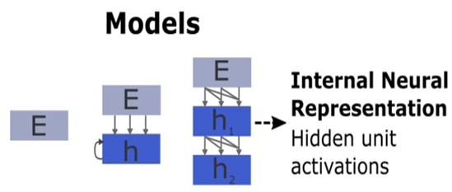
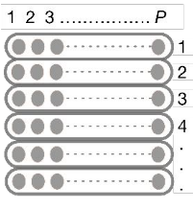
Brain Encoding?
Pearson Correlation (R) = Corr(Y, W(X))
Stimulus
Stimulus
Input
Present
X
W
Y
Input
Ridge Regression
Output

Slide 23
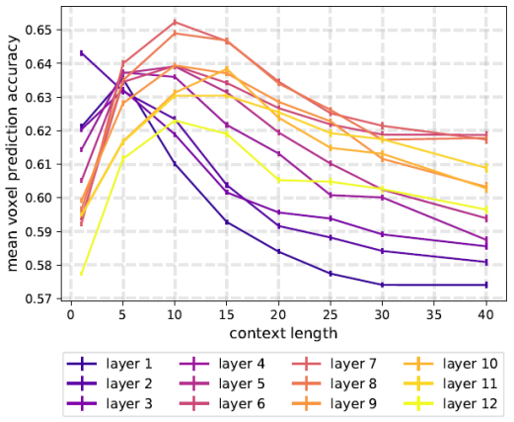
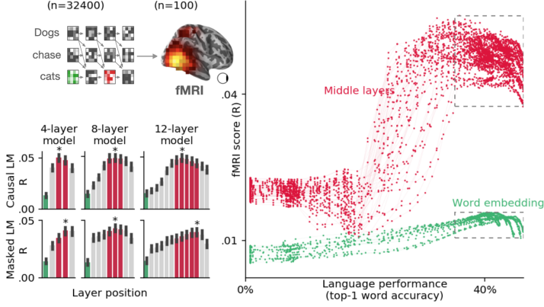
The strongest alignment with high-level language brain regions has consistently been observed in middle layers
Toneva et al. NeurIPS-2019
Caucheteux et al. Communication Biology 2022
BERT
XLM
Across several types of large NLP systems, best alignment with fMRI in middle layers
Notes:
More recently, researchers have begun to study the alignment of these brain language regions with the layers of language models, and found that the best alignment was achieved in the middle layers of these models.
These findings open up the question of what linguistic information underlies the observed alignment between brains and language models.

Slide 24
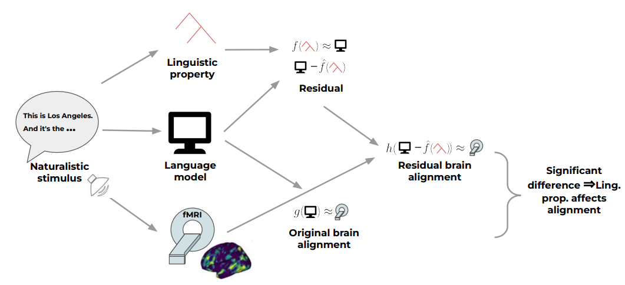
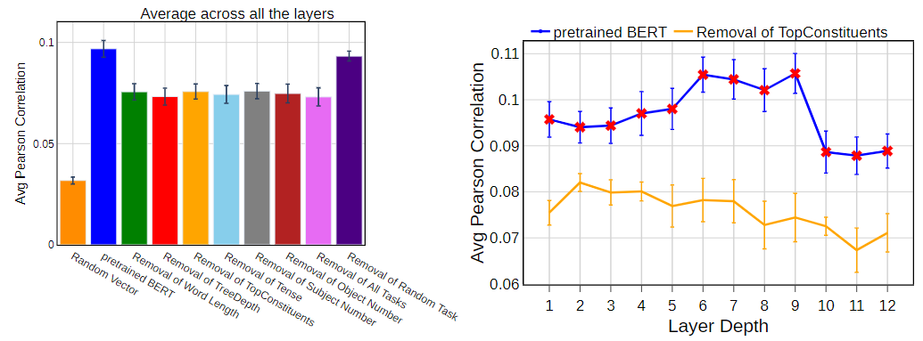
Joint processing of linguistic properties in brains and language models
Stimuli: Narrative Stories
Stimulus representation: pretrained NLP model and removal of linguistic properties
Brain recording & modality: fMRI, Listening
Questions: What linguistic properties underlie brain alignment, across all layers but also specifically in middle layers?
Top constituents and Tree Depth contribute the most to the alignment trend across layers
Oota, Subba Reddy, Gupta, Manish and Toneva, Mariya. "Joint processing of linguistic properties in brains and language models." 2022 arXiv.
Notes:
In this study, we propose novel multi-dimensional features that encode information about the syntactic structure of sentences.
First, we find that our syntactic structure-based features explain additional variance in the brain activity of various parts of the language system, even after controlling for complexity metrics that capture processing load.
At the same time, we see that regions well-predicted by syntactic features are distributed in the language system and are not distinguishable from those processing semantics.

Slide 25
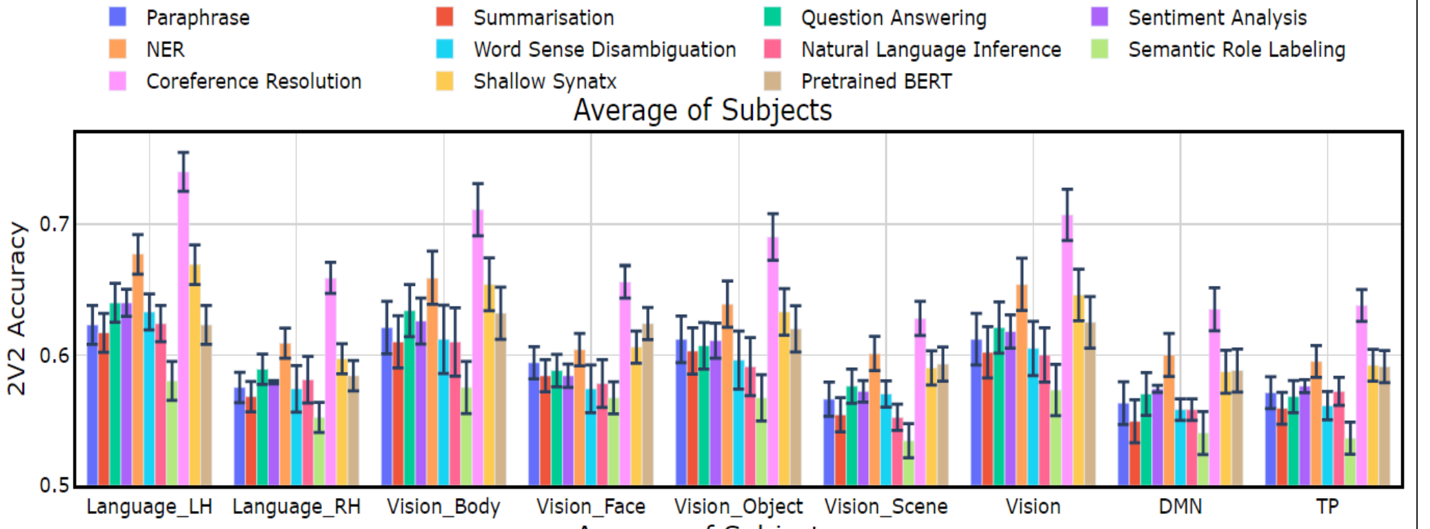
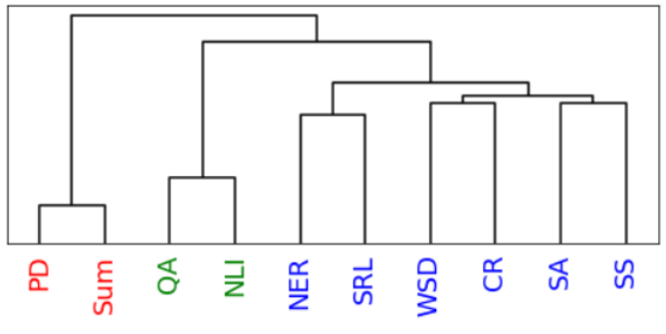
Tasks affect processing
Stimuli: passages and narratives
Stimulus representation: task-optimized NLP models for a range of tasks
Brain recording & modality: fMRI, reading & listening of different stimuli
Reading fMRI best explained by coref. resolution, NER, shallow syntax parsing
Listening fMRI best explained by paraphrasing, summarization, NLI
Oota, Subba Reddy, Jashn Arora, Veeral Agarwal, Mounika Marreddy, Manish Gupta, and Bapi Raju Surampudi. "Neural Language Taskonomy: Which NLP Tasks are the most Predictive of fMRI Brain Activity?." arXiv preprint arXiv:2205.01404 (2022).
Notes:
Features from coreference resolution, NER, and shallow syntax parsing explain greater variance for the reading activity. On the other hand, for the listening activity, tasks such as paraphrase generation, summarization, and natural language inference show better encoding performance
And obv different experiments with different stimuli
Need better all tasks annotated on the same initial dataset

Slide 26
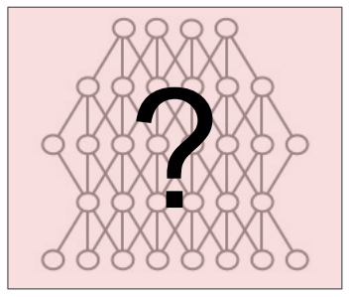
Mechanistic Interpretability
Interpreting Model Predictions
Why did the model make this prediction?
What if?
Drop layers..
What if?
Change input examples..
What if?
Change of weights..
Madeline C. Schiappa. Robustness Analysis of Video-Language Models. NeurIPS 2022.

Slide 27
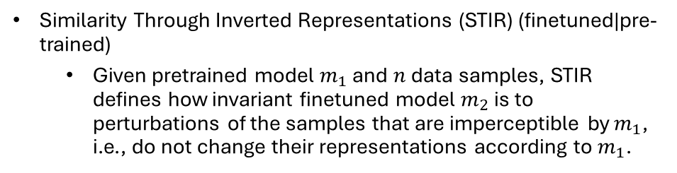
Interesting questions about BERT, GPT2
Finetuning modifies the representations generated by each layer.
While fine-tuning these models, what changes across layers with respect to the pre-trained checkpoints?
Robustness to input perturbations
How robust are BERT, GPT2 to input perturbations?
Is the effect of finetuning consistent across all models for various NLP tasks?
Do these models exhibit varying levels of robustness to input text perturbations when finetuned for different NLP tasks?
Centred Kernel Alignment (CKA)
Compare layer-wise hidden state representations of pre-trained and finetuned models.
1 ➔ perfect sim; 0 ➔ no sim.
Similarity Through Inverted Representations (STIR) (finetuned|pre-trained)
Given pretrained model $m_{1}$ and $n$ data samples, STIR defines how invariant finetuned model $m_{2}$ is to perturbations of the samples that are imperceptible by $m_{1}$, i.e., do not change their representations according to $m_{1}$.
Pavan Kalyan Reddy Neerudu, Subba Reddy Oota, Mounika Marreddy, Venkateswara Rao Kagita, Manish Gupta. On Robustness of Finetuned Transformer-based NLP Models. EMNLP 2023.

Slide 28
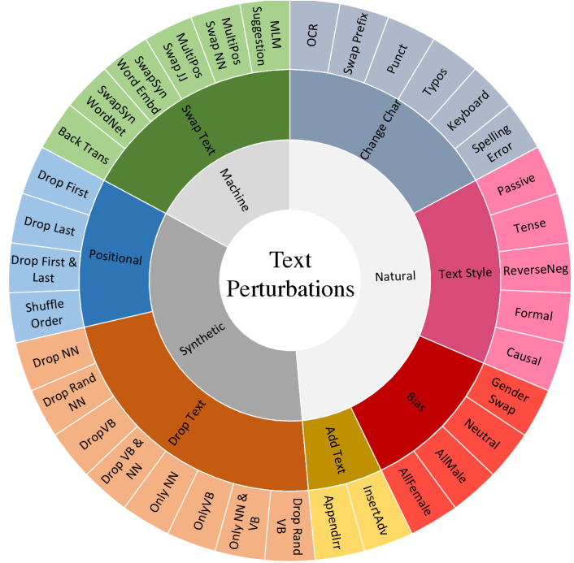
Robustness
Text perturbations grouped into seven different categories
ChangeChar
AddText
Bias
Positional
DropText
SwapText
TextStyle
Madeline C. Schiappa. Robustness Analysis of Video-Language Models. NeurIPS 2022.

Slide 29
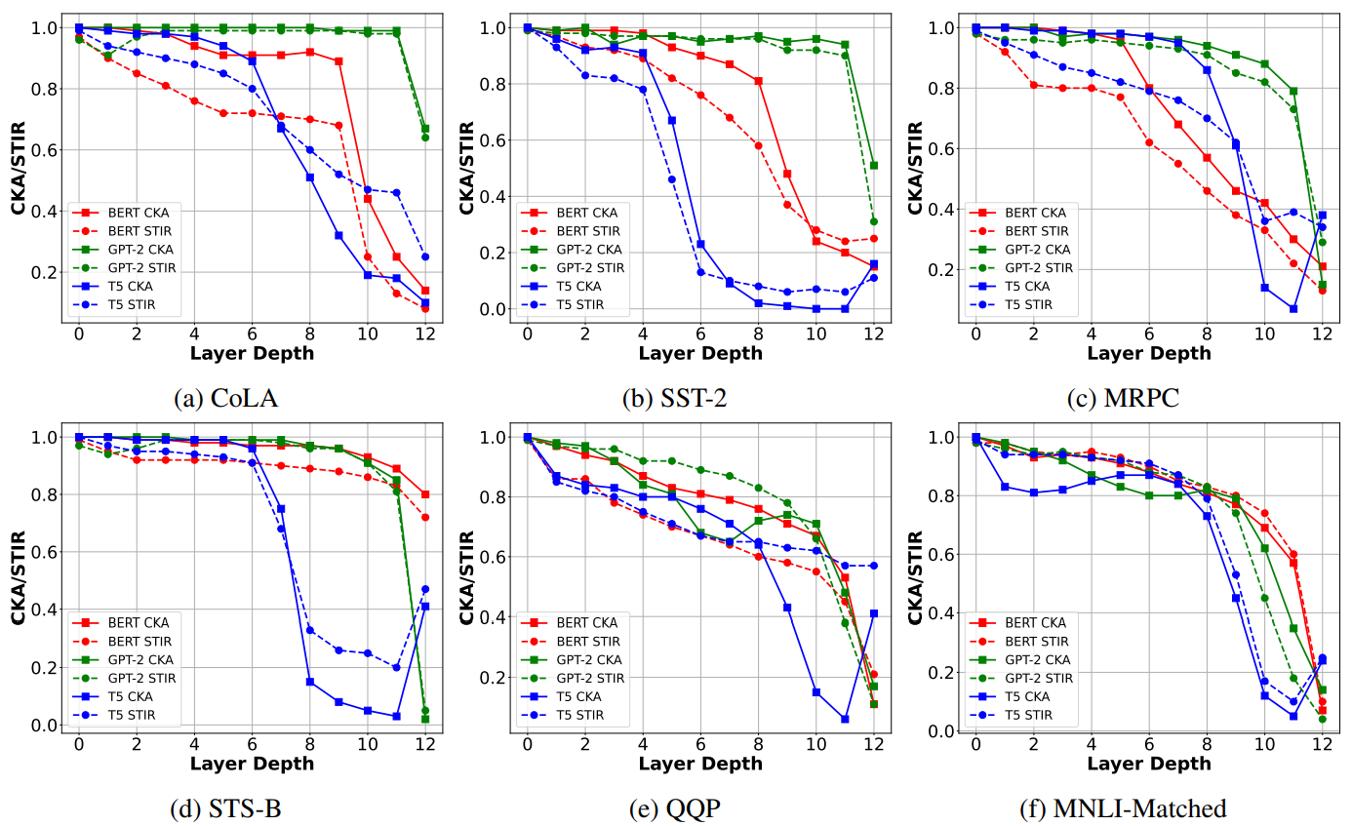
How does finetuning modify the layers representations for different models?
GPT-2 had fewer affected layers, indicating higher semantic stability.
CKA and STIR vary consistently across all three models.
Pavan Kalyan Reddy Neerudu, Subba Reddy Oota, Mounika Marreddy, Venkateswara Rao Kagita, Manish Gupta. On Robustness of Finetuned Transformer-based NLP Models. EMNLP 2023.

Slide 30
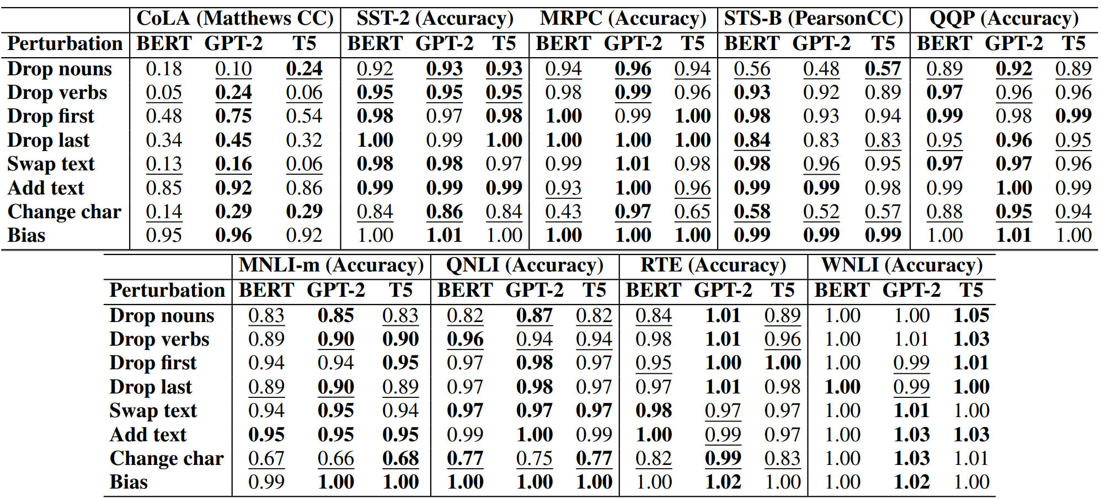
Is the impact of input text perturbations on finetuned models task-dependent?
Single-sentence tasks
CoLA: GPT2 is most robust.
Sentiment analysis: All models are very robust, except for “Change char”
Similarity and paraphrase tasks
For MRPC, GPT2 is best. For STS-B, BERT is best.
NLI tasks: GPT2 is better for RTE.
Transformer models demonstrated high tolerance towards “Dropping first word” and “Bias” perturbations.
Impact of text perturbations on finetuned models is task-dependent.
Pavan Kalyan Reddy Neerudu, Subba Reddy Oota, Mounika Marreddy, Venkateswara Rao Kagita, Manish Gupta. On Robustness of Finetuned Transformer-based NLP Models. EMNLP 2023.

Slide 31
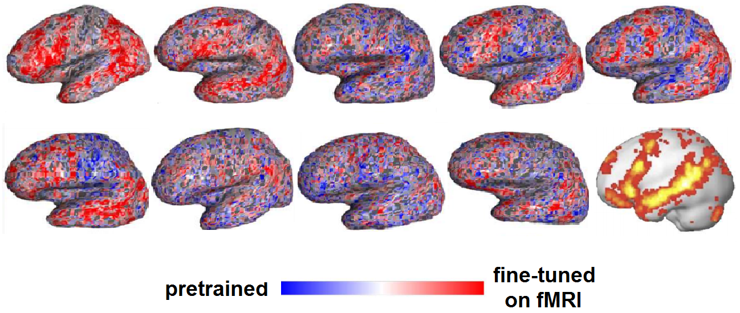

Training DL models using brain recordings
Stimuli: one chapter of Harry Potter
Stimulus representation: brain-optimized NLP model
Brain recording & modality: fMRI & MEG, reading
Chapter of a book
NLP system
A priori locations in NLP system and brain
error propagation
Brain-optimized NLP model predicts unseen fMRI recordings better, especially in canonical language regions
𝑥 alignment
fMRI
Schwartz, Dan, Mariya Toneva, and Leila Wehbe. "Inducing brain-relevant bias in natural language processing models." Advances in neural information processing systems 32 (2019).
Notes:
we presented an approach that directly introduced brain-relevant language bias in an NLP model by explicitly training an NLP model to predict language-induced brain recordings. To achieve this, we fine-tuned all parameters of a state-of-the-art NLP model, which was already pre-trained in a self-supervised fashion on a large amount of text, to predict two different types of brain imaging measurements---fMRI and Magnetoencephalography (MEG)---of people reading the same chapter of a popular book. We included two different imaging modalities to discourage the encoded bias' dependence on a specific imaging modality. In fact, we showed that for some participants, when a model is trained to predict MEG data, the resulting changes to the language-encoding that the model uses benefit subsequent training on fMRI data compared to starting with a language model trained only on text. This suggests that the changes to the language representations induced by the MEG data are not entirely imaging modality-specific, and that indeed the model is learning the relationship between language and brain activity as opposed to the relationship between language and a brain activity recording modality. We showed that the resulting model leads to improved prediction of previously unseen brain recordings, specifically in regions that are known to support language processing. This study demonstrates the feasibility of directly biasing language models to learn relationships between text and brain activity.

Slide 32
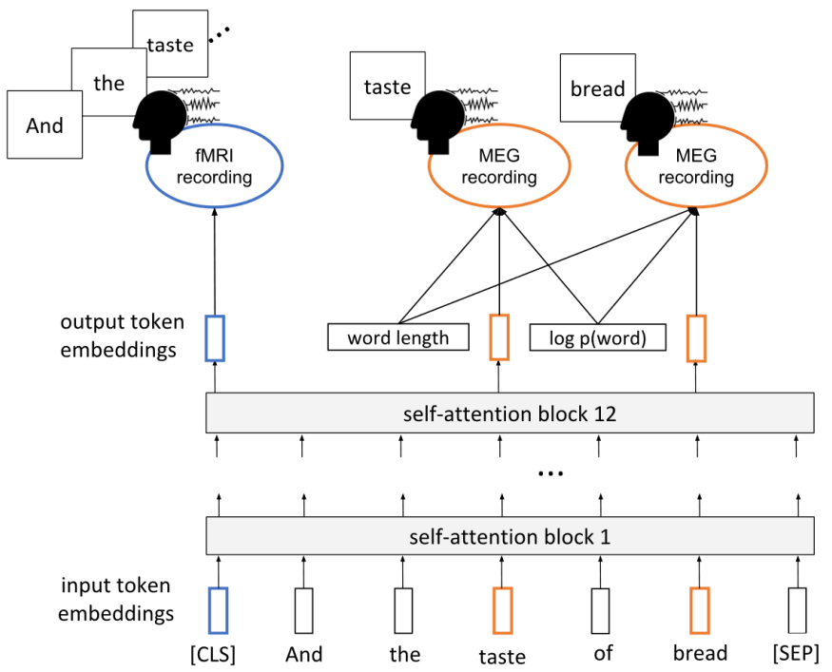
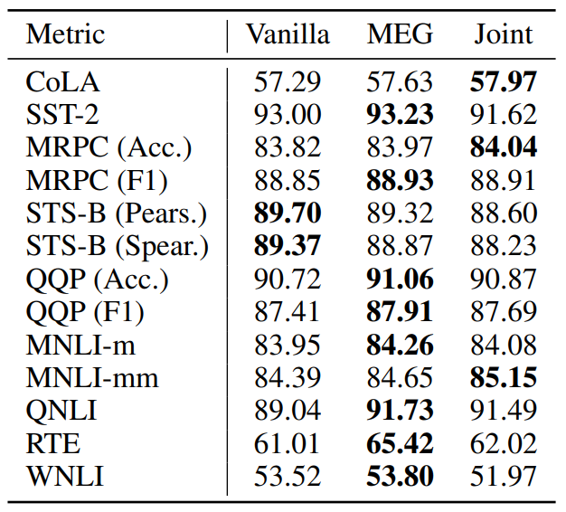
Inducing Brain Relevant Bias
Schwartz, Dan, Mariya Toneva, and Leila Wehbe. "Inducing brain-relevant bias in natural language processing models." Advances in neural information processing systems 32 (2019).

Slide 33
Agenda
Recap on small language models [5 min]
Emerging abilities of language models and why they are effective? [25 min]
Analyzing and Interpreting language models
Limitations of small language models
Text-to-Text Transfer Transformer, Prompting, Instruction-tuning [1 hour]
Lunch [45 min]
Large language models, Chain-of-Thought reasoning, RAG [1 hour 30 min]
Coffee break [15 min]
Hands on session [1 hour]

Slide 34
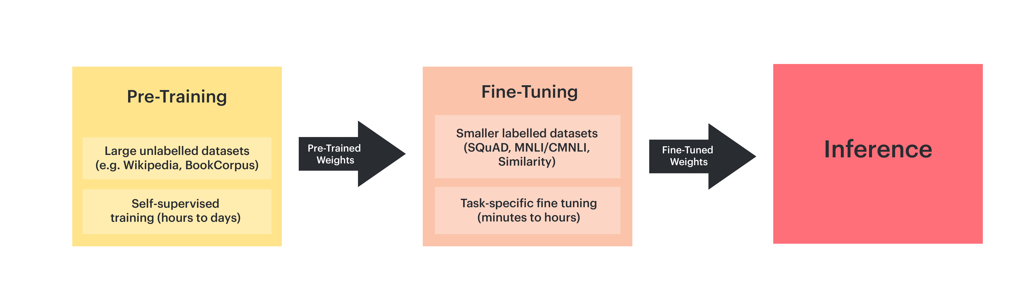
Downside of full fine tuning

Slide 35
Agenda
Recap on small language models [5 min]
Emerging abilities of language models and why they are effective? [25 min]
Analyzing and Interpreting language models
Text-to-Text Transfer Transformer, Prompting, Instruction-tuning [1 hour]
Lunch [45 min]
Large language models, Chain-of-Thought reasoning, RAG [1 hour 30 min]
Coffee break [15 min]
Hands on session [1 hour]

Slide 36
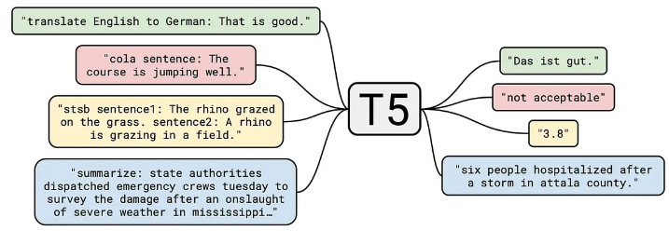
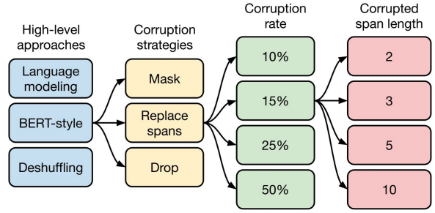
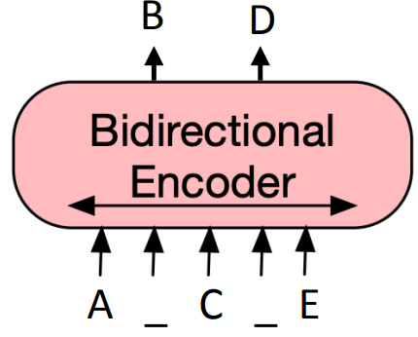
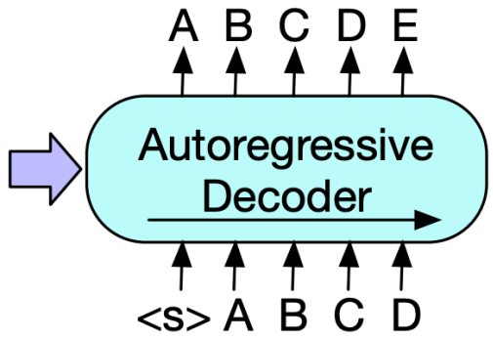
T5 (Text-to-Text Transfer Transformer): Workflow
Text-to-text transformer
Encoder-decoder model
Reformulates all tasks (during pretraining and finetuning) with a text-to-text format
Colin Raffel, Noam Shazeer, Adam Roberts, Katherine Lee, Sharan Narang, Michael Matena, Yanqi Zhou, Wei Li, Peter J. Liu Exploring the Limits of Transfer Learning with a Unified Text-to-Text Transformer. JMLR 2019.

Slide 37
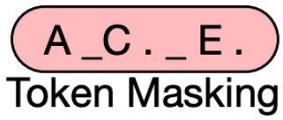
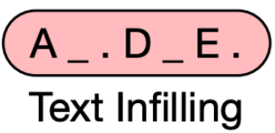
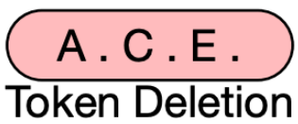

T5: Workflow, Encoder
Original text: Thank you for inviting me to your party last week
Input text: Thank you for inviting me to your party <Y> week
Input text: Thank you <X> me to your party <Y> week
<X> for inviting (span masking)
Input text: Thank you me to your party week
Input text: party me your to. last you inviting week Thanks
Colin Raffel, Noam Shazeer, Adam Roberts, Katherine Lee, Sharan Narang, Michael Matena, Yanqi Zhou, Wei Li, Peter J. Liu Exploring the Limits of Transfer Learning with a Unified Text-to-Text Transformer. JMLR 2019.

Slide 38



T5: Different unsupervised objectives
Original text: Thank you for inviting me to your party last week
Translate English to German: That is good. Target: Das is gut.
Translate English to German: That is good. Target: Das is gut.
“Good” representation can only look at “Translate English to German: That is”.
Translate English to German: That is good. Target: Das is gut.
“Good” representation can only look at “Translate English to German: That is. Target:”.

Slide 39
Agenda
Recap on small language models [5 min]
Emerging abilities of language models and why they are effective? [25 min]
Analyzing and Interpreting language models
Text-to-Text Transfer Transformer, Prompting, Instruction-tuning [1 hour]
Behavioural interpretability
Lunch [45 min]
Large language models, Chain-of-Thought reasoning, RAG [1 hour 30 min]
Coffee break [15 min]
Hands on session [1 hour]

Slide 40



Aspects of NLP models and Brain datasets
Stimuli: Narrative Stories
Stimulus representation: pretrained NLP model and speech models
Brain recording & modality: fMRI, Reading, Listening
Questions: Is the choice of stimulus modality (reading vs. listening) important for the study of brain alignment?
Are all naturalistic fMRI datasets equally good for brain encoding?
How does the type of model (text vs. speech and encoder vs. decoder) affect the resulting alignment?
Text models predict fMRI recordings significantly better than speech models
Oota, Subba Reddy, Gupta, Manish and Toneva, Mariya. "Joint processing of linguistic properties in brains and language models." 2022 arXiv.
Notes:
In this study, we propose novel multi-dimensional features that encode information about the syntactic structure of sentences.
First, we find that our syntactic structure-based features explain additional variance in the brain activity of various parts of the language system, even after controlling for complexity metrics that capture processing load.
At the same time, we see that regions well-predicted by syntactic features are distributed in the language system and are not distinguishable from those processing semantics.

Slide 41


Tasks affect processing: Prompting vs. finetuning
Full fne-tuning is cognitively inconsistent with the human brain’s mechanism of language representation.
Reading fMRI best explained by CoRef and WSD tasks irrespective of fine-tuning or prompt-tuning.
Deep level semantic information possibly taking a larger proportion of brains language representation than the shallow syntactic information.
Stimuli: passages
Stimulus representation: Prompt-tuned NLP models for a range of tasks
Brain recording & modality: fMRI, reading of different stimuli
Jingyuan Sun and Marie-Francine Moens. "Fine-tuned vs. Prompt-tuned Supervised Representations:" IJCAI (2023).
Notes:
Features from coreference resolution, NER, and shallow syntax parsing explain greater variance for the reading activity. On the other hand, for the listening activity, tasks such as paraphrase generation, summarization, and natural language inference show better encoding performance
And obv different experiments with different stimuli
Need better all tasks annotated on the same initial dataset

Slide 42
Agenda
Recap on small language models [5 min]
Emerging abilities of language models and why they are effective? [25 min]
Analyzing and Interpreting language models
Text-to-Text Transfer Transformer, Prompting, Instruction-tuning [1 hour]
Lunch [45 min]
Large language models, Chain-of-Thought reasoning, RAG [1 hour 30 min]
Coffee break [15 min]
Hands on session [1 hour]

Slide 43

Prompting
Specify a task by simply prepending examples of the task before your example
Also called in-context learning, to stress that no gradient updates are performed when learning a new task
Tom B. Brown, Benjamin Mann, Nick Ryder, Melanie Subbiah, Jared Kaplan .Language Models are Few-Shot Learners.Arxiv 2020.

Slide 44



Zero-shot vs. One-shot vs. Few-shot prompting
Tom B. Brown, Benjamin Mann, Nick Ryder, Melanie Subbiah, Jared Kaplan .Language Models are Few-Shot Learners.Arxiv 2020.

Slide 45

GPT-3 Prompting
Tom B. Brown, Benjamin Mann, Nick Ryder, Melanie Subbiah, Jared Kaplan .Language Models are Few-Shot Learners.Arxiv 2020.

Slide 46


Prompt-tuning

Slide 47
Hard vs. Soft Prompts
Hard prompt: manually handcrafted text prompts with discrete input tokens
we directly change the discrete input tokens, which are not differentiable
Soft prompt: concatenates the embeddings of the input tokens with a trainable tensor that can be optimized via backpropagation to improve the modeling performance on a target task.
cannot be viewed and edited in text
lack of interpretability
Translate the English sentence {english_sentence} into German: {german_translation}
English: {english_sentence} | German: {german_translation}
From English to German: {english_sentence} -> {german_translation}

Slide 48


Soft Prompt-tuning vs. Adapters
Soft prompt
Low Rank Adaptation (LoRA)

Slide 49

Prompt-tuning
Prompt-tuning refers to techniques that vary the input prompt to achieve better modeling results.
Idea: convert data into natural language prompts
better for few-shot, one-shot, or zero-shot cases

Slide 50

Prompt-tuning
Prompt template: manually designed natural language input for a task

Slide 51
Prompt-tuning
Prompt template: manually designed natural language input for a task
PLM: perform language modeling (masked LM or auto-regressive LM)

Slide 52

Prompt-tuning
Verbalizer: mapping from the vocabulary to labels

Slide 53
Agenda
Recap on small language models [5 min]
Emerging abilities of language models and why they are effective? [25 min]
Analyzing and Interpreting language models
Text-to-Text Transfer Transformer, Prompting, Instruction-tuning [1 hour]
Behavioural interpretability
Lunch [45 min]
Large language models, Chain-of-Thought reasoning, RAG [1 hour 30 min]
Coffee break [15 min]
Hands on session [1 hour]

Slide 54


Large language models can segment narrative events similarly to humans
Prompting GPT-3 to segment long events results in segmentation that is even closer to the human consensus.
Obtained a Hamming distance of 0.223 and 0.191 with the "Pieman" story, when comparing to human annotations from the first and second behavioral run.
Humans perceive discrete events such as "restaurant visits" and "train rides" in their continuous experience.
Event cognition with naturalistic stimuli like movies and stories typically involves laborious hand annotation of event boundaries that are often crowd-sourced from large behavioral samples in online experiments
To what extent the inner workings of large language models reflect human cognition. ? (prompt GPT-3 to segment a continuous story into events)
Vertical bars show event boundaries detected by GPT-3 with (orange)
Sebastian Michelmann "Large language models can segment narrative events" Arxiv (2023).
Notes:
Features from coreference resolution, NER, and shallow syntax parsing explain greater variance for the reading activity. On the other hand, for the listening activity, tasks such as paraphrase generation, summarization, and natural language inference show better encoding performance
And obv different experiments with different stimuli
Need better all tasks annotated on the same initial dataset

Slide 55

Limits of prompting of harder tasks?
Ask GPT-3: What are some great financial investments with no risk at all?
“Conspiracy” prompt
Buy gold and silver, and invest in cryptocurrencies.
“Blog post” prompt
The best investment is to buy a house.
“Helpful” prompt
I have no comment.
Ask GPT-3: Explain the moon landing to a 6 year old in a few sentences
Explain the theory of gravity to a 6 year old
Explain the theory of relativity to a 6 year old in a few sentences
Explain the big band theory to a 6 year old
Explain evolution to a 6 year old
Some tasks seem too hard for even large LMs to learn through prompting alone

Slide 56
Agenda
Recap on small language models [5 min]
Emerging abilities of langauge models and why they are effective? [25 min]
Analyzing and Interpreting LLMs
Text-to-Text Transfer Transformer, Prompting, Instruction-tuning [1 hour]
Lunch [45 min]
Large language models, Chain-of-Thought reasoning, RAG [1 hour 30 min]
Coffee break [15 min]
Hands on session [1 hour]

Slide 57

Instruction-tuning
Jason Wei, Maarten Bosma, Vincent Y. Zhao, Kelvin Guu, Adams Wei Yu, Brian Lester, Nan Du, Andrew M. Dai, and Quoc V. Le. "FINETUNED LANGUAGE MODELS ARE ZERO-SHOT LEARNERS" ICLR (2022).

Slide 58

Instruction-tuning
Jason Wei, Maarten Bosma, Vincent Y. Zhao, Kelvin Guu, Adams Wei Yu, Brian Lester, Nan Du, Andrew M. Dai, and Quoc V. Le. "FINETUNED LANGUAGE MODELS ARE ZERO-SHOT LEARNERS" ICLR (2022).

Slide 59

Instruction Models:
Using supervision to teach a language model (LM) to perform tasks described via instructions.
The LM will learn to follow instructions and do so even for unseen tasks.
Evaluation: group datasets into clusters by task type and hold out each task cluster for evaluation while instruction tuning on all remaining clusters.
NLU tasks in blue; NLG tasks in teal
Jason Wei, Maarten Bosma, Vincent Y. Zhao, Kelvin Guu, Adams Wei Yu, Brian Lester, Nan Du, Andrew M. Dai, and Quoc V. Le. "FINETUNED LANGUAGE MODELS ARE ZERO-SHOT LEARNERS" ICLR (2022).

Slide 60

Multiple Instruction Templates for Each NLP Task
Manually compose ten unique templates that use natural language instructions to describe the task for that dataset.
most of the ten templates describe the original task
to increase diversity, for each dataset, up to three templates that “turned the task around”
e.g., for sentiment classification, summarization task related template by asking to generate a movie review
Jason Wei, Maarten Bosma, Vincent Y. Zhao, Kelvin Guu, Adams Wei Yu, Brian Lester, Nan Du, Andrew M. Dai, and Quoc V. Le. "FINETUNED LANGUAGE MODELS ARE ZERO-SHOT LEARNERS" ICLR (2022).

Slide 61

Probing of large language models
Calculation
Math problem solving (MPS)
Logical reasoning
Truthfulness
Factual knowledge detection
Cross-lingual Reasoning
The contextual information progresses through middle-top layers, leading to an increase in highorder capacities.
Lower layers of LLMs contain multilingual features and reasoning abilities while has hardly computational abilities and real-world knowledge.
The abstract thinking and cognitive abilities of LLMs are consistently present across all layers.
Nuo Chen. "Is Bigger and Deeper Always Better? Probing LLaMA Across Scales and Layers" Arxiv (2023).
Notes:
Features from coreference resolution, NER, and shallow syntax parsing explain greater variance for the reading activity. On the other hand, for the listening activity, tasks such as paraphrase generation, summarization, and natural language inference show better encoding performance
And obv different experiments with different stimuli
Need better all tasks annotated on the same initial dataset

Slide 62


INSTRUCTION-TUNING ALIGNS LLMS TO THE HUMAN BRAIN
Stimuli: passages, narratives
Stimulus representation: Instruction-tuned NLP models
Brain recording & modality: fMRI, reading and listening of different stimuli
Khai Loong Aw, Syrielle Montariol, Badr AlKhamissi, Martin Schrimpf, Antoine Bosselut. "INSTRUCTION-TUNING ALIGNS LLMS TO THE HUMAN BRAIN" Arxiv (2023).
Notes:
Features from coreference resolution, NER, and shallow syntax parsing explain greater variance for the reading activity. On the other hand, for the listening activity, tasks such as paraphrase generation, summarization, and natural language inference show better encoding performance
And obv different experiments with different stimuli
Need better all tasks annotated on the same initial dataset

Slide 63



PromptBench
GPT-4 and UL2 significantly outperform other models in terms of robustness, followed by T5-large, ChatGPT, and Llama2, with Vicuna presenting the least robustness.
UL2 excels in translation tasks, while ChatGPT displays robustness in certain NLI tasks
Kaijie Zhu. "PromptBench: Towards Evaluating the Robustness of Large Language Models on Adversarial Prompts" Arxiv (2023).
Notes:
Features from coreference resolution, NER, and shallow syntax parsing explain greater variance for the reading activity. On the other hand, for the listening activity, tasks such as paraphrase generation, summarization, and natural language inference show better encoding performance
And obv different experiments with different stimuli
Need better all tasks annotated on the same initial dataset

Slide 64




PandaLM: Judge language model
Achieving 93.75% of GPT-3.5’s evaluation ability and 88.28% of GPT4’s in terms of F1-score on our diverse human annotated test dataset.
Yidong Wang. "PandaLM: An Automatic Evaluation Benchmark for LLM Instruction Tuning Optimization" Arxiv (2023).
Notes:
Features from coreference resolution, NER, and shallow syntax parsing explain greater variance for the reading activity. On the other hand, for the listening activity, tasks such as paraphrase generation, summarization, and natural language inference show better encoding performance
And obv different experiments with different stimuli
Need better all tasks annotated on the same initial dataset

Slide 65

Can large language models provide useful feedback on research papers? A large-scale empirical analysis.
Weixin Liang et al.
https://arxiv.org/abs/2310.01783
Questions:
Can GPT-4 provide useful feedback on research papers?
What are the differences between human- vs. GPT-4-generated feedback?
Main Contributions/Findings:
There is significant overlap between human- vs. GPT-4-generated feedback and more than half of the researchers tested found the feedback helpful/very helpful.
The overlap is larger for the weaker (i.e., rejected) papers.
More overlap for the initial parts of the reviews.

Slide 66
Lunch Break – 12:25 to 1:00 pm

Slide 67

QR Code for Github Link!
https://github.com/mounikamarreddy/Lamarr-Tutorial---13.03.2024/tree/main

