Slide 1


Characterizing similarities and differences between language processing in brains and language models.
Subba Reddy Oota
Ph.D. Student
Inria-Research, France
Notes:
I am really happy to join

Slide 2
Agenda
Introduction to alignment between language models and brains [review paper, under review]
Joint processing of linguistic properties in brains and language models [NeurIPS-2023]
Speech-based language models lack brain-relevant semantics, [under review]

Slide 3


Finally, a Machine That Can Finish Your Sentence
The New York Times, November, 2018
Will ChatGPT make lawyers obsolete? (Hint be afraid)
Reuters, December, 2022

Slide 4
Language models (LMs) are trained to predict missing words
jumps
Language model
The
quick
brown
fox
[MASK]
Notes:
These language models are trained to [Keep clicking]
predict missing words over millions of text documents.

Slide 5
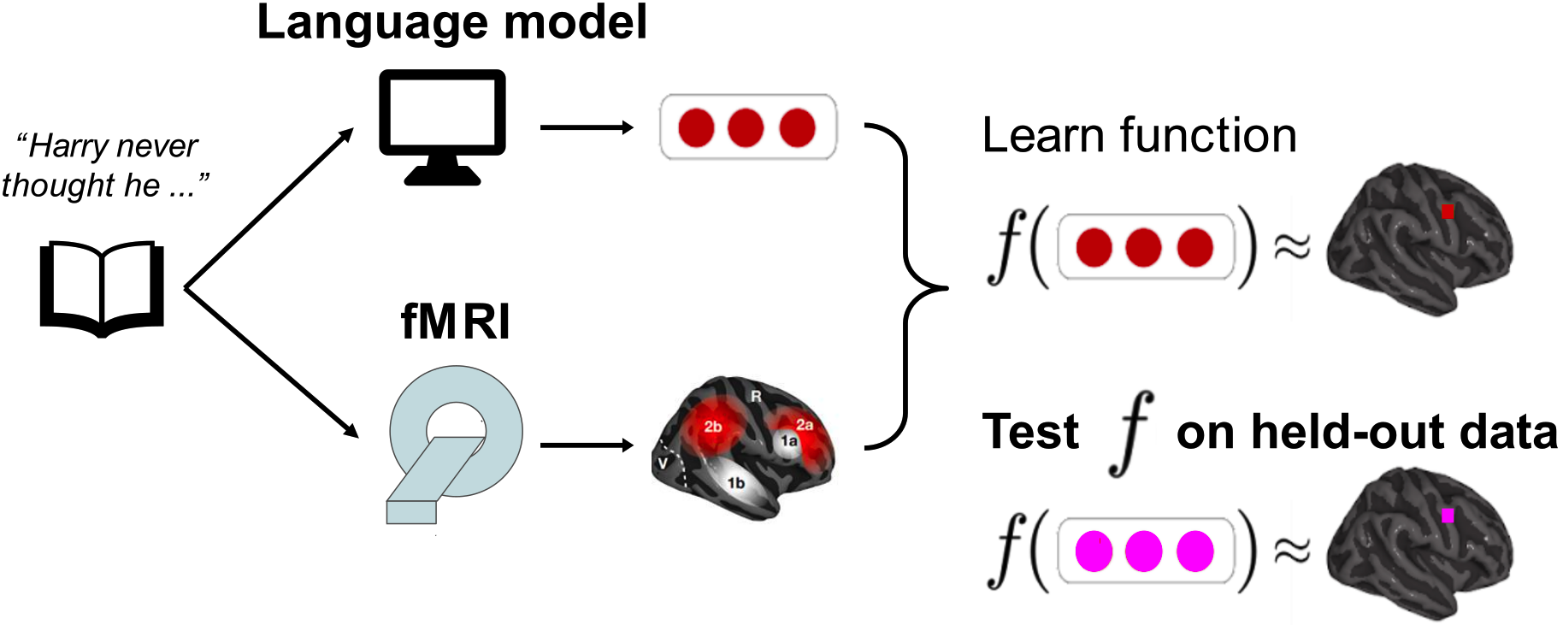
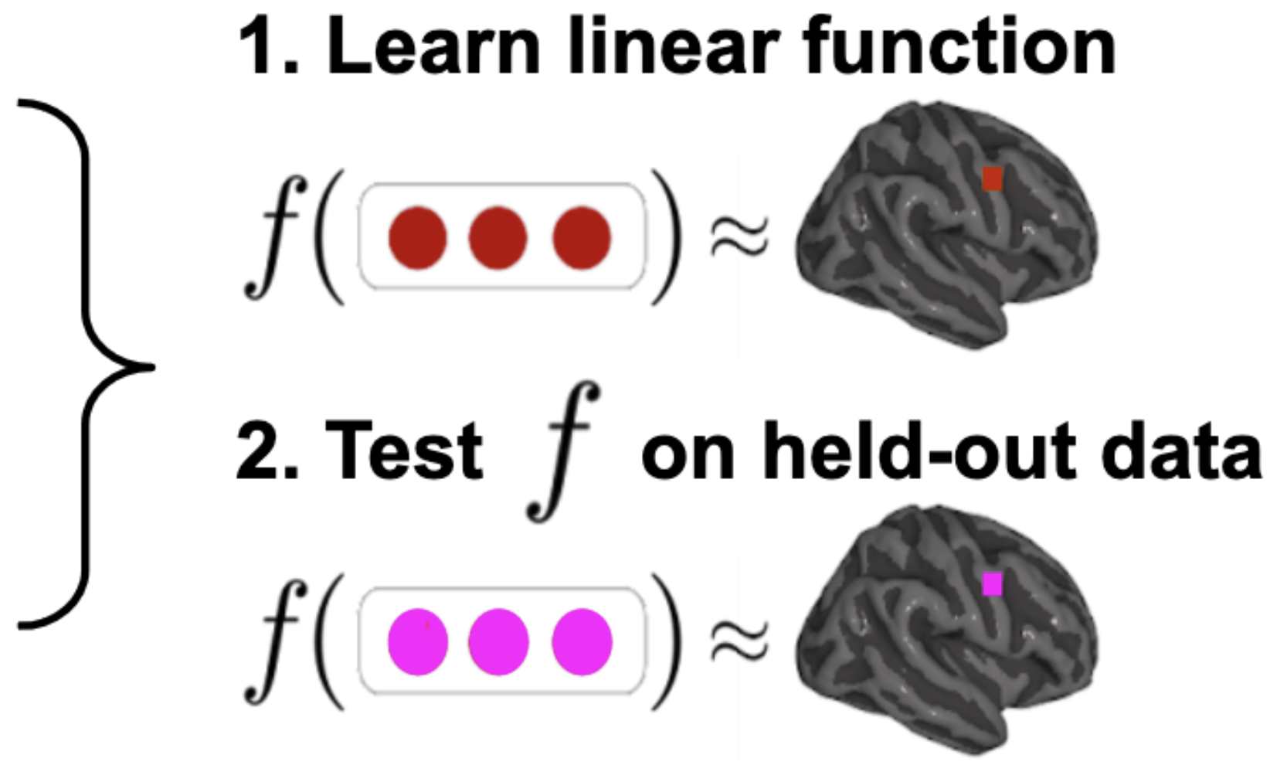
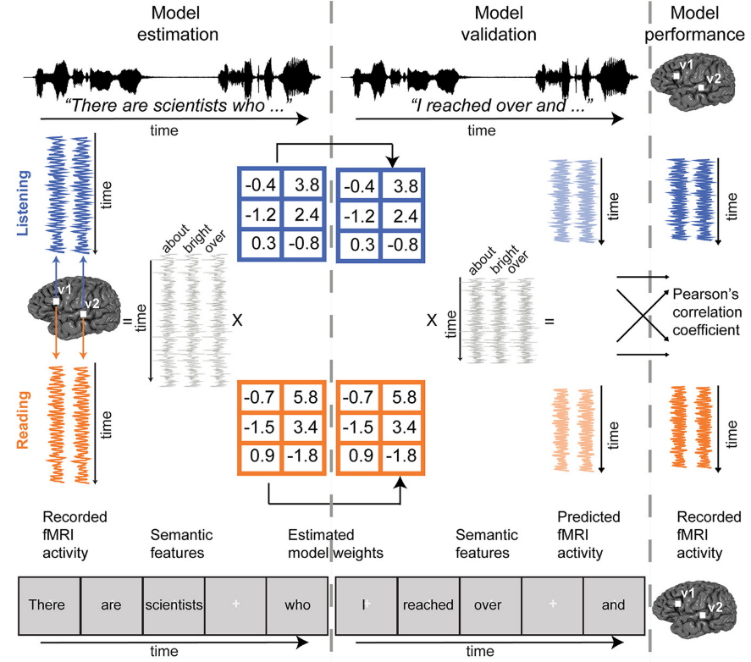

Language models align with human brain recordings to an impressive degree
time
Once
upon
a
Wehbe et al. 2014
Jain and Huth 2018
Gauthier and Levy 2019
Toneva and Wehbe 2019
Caucheteux et al. 2020
Toneva et al. 2020
Jain et al. 2020
Schrimpf et al. 2021
Goldstein et al. 2022
Notes:
Several works shown that LMs predict brain activity recorded when participants listen to or read a complex language stimulus, such as a short story. This ability to predict brain activity is what we refer to as brain alignment”.

Slide 6

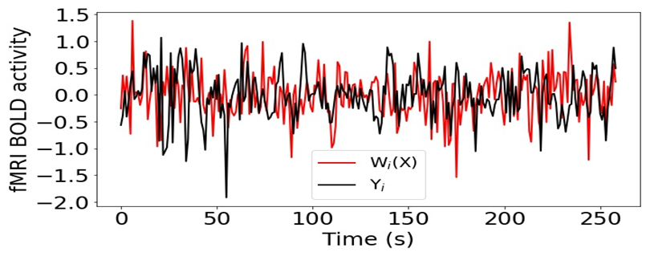
Method for evaluating alignment between brain recordings and language models
Training: cross validation (CV), regularization parameter chosen via nested CV
Evaluation: 1) make predictions for heldout data
2) correlate predictions with true brain data
3) hypothesis testing (permutation test + correct multi comparisons)
Jain and Huth. Incorporating context into language encoding models for fMRI. (NeurIPS 2018)
Toneva and Wehbe. Interpreting and improving natural-language processing (in machines) with natural language-processing (in the brain). (NeurIPS 2019)
Notes:
The brain alignment for an x,y,z coordinate in the brain is measured as the Pearson correlation between the corresponding predicted and true brain data, across all held out instances”
This poses a question of what are the reasons for this better brain alignment? Why do data-driven language model predict brain activity better?

Slide 7
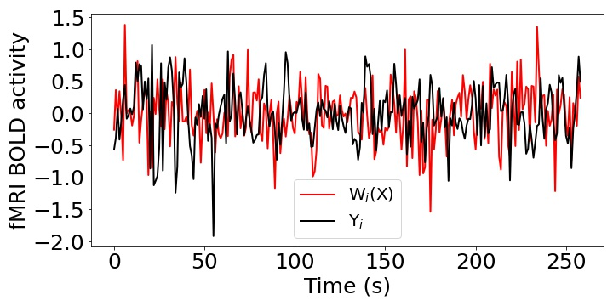
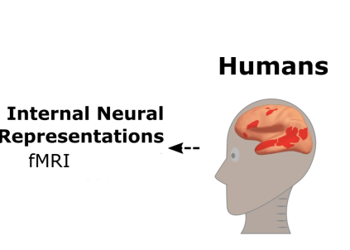
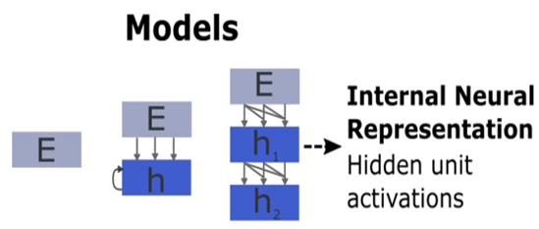
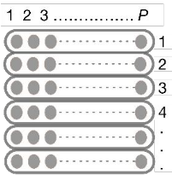
Brain encoding schema
Pearson Correlation (R) = Corr(Y, W(X))
Stimulus
Stimulus
Input
Present
X
W
Y
Input
Ridge Regression
Output
Schrimpf et al. 2021

Slide 8
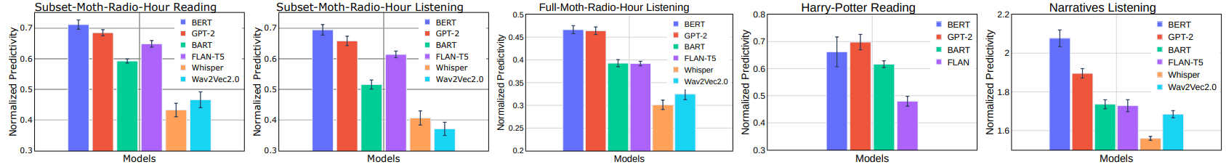
Similarities between LMs and human brains
LMs predict 60-70% of the explainable variance in regions of the brain that process language
[Oota & Toneva, CCN-2023]

Slide 9
Agenda
Introduction to alignment between language models and brains
Joint processing of linguistic properties in brains and language models [NeurIPS-2023]
Speech language models lack brain-relevant semantics, under review

Slide 10
Language models (LMs) predict brain activity evoked by complex
language (e.g. listening a story) to an impressive degree
time
Once
upon
a
Brain alignment of a LM ⇒ Why do language models have better brain alignment? What are the reasons?
Notes:
Several works shown that LMs predict brain activity recorded when participants listen to or read a complex language stimulus, such as a short story. This ability to predict brain activity is what we refer to as brain alignment”.

Slide 11
Language models (LMs) are trained to predict missing words
jumps
Language model
The
quick
brown
fox
[MASK]
Notes:
These language models are trained to [Keep clicking]
predict missing words over millions of text documents.
* language models are pre-trained on vast amounts of diverse text data. This pre-training allows them to learn the underlying structures and patterns of language.

Slide 12
Interpreting BERT and beyond
Can we unveil the representations learned by BERT to linguistics structure?
Understand the reason behind the success of BERT but also its limitations.
Guide the design of improved architectures.

Slide 13
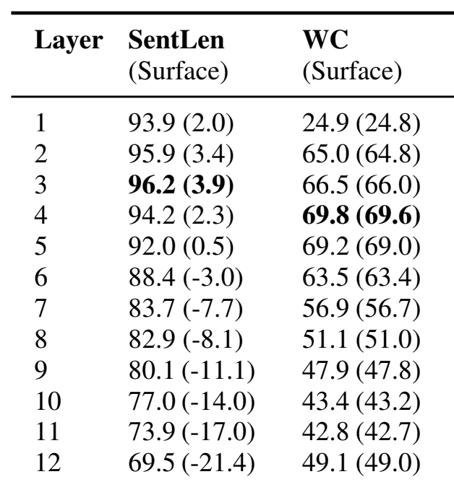
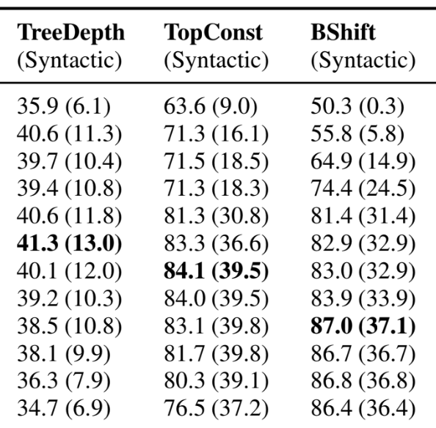
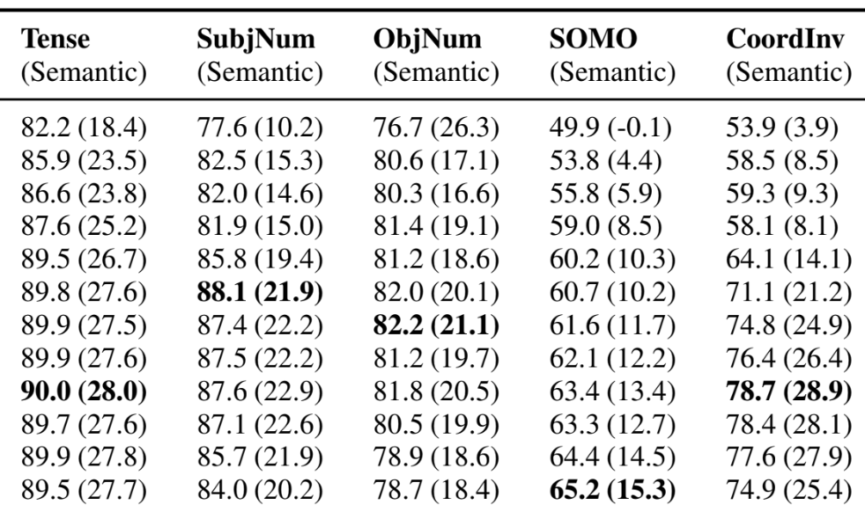
BERT composes a hierarchy of linguistic signals ranging from surface to semantic features
Surface
Syntactic
Semantic
jumps
Language model
The
quick
brown
fox
[MASK]
Jawahar et al. 2019 ACL
Notes:
The BERTology studies shown that BERT captures hierarchy of linguistic signals
[CLICK] early layers capture surface properties
[CLICK] middle layers capture syntactic properties
[CLICK] and later layers capture semantic properties

Slide 14
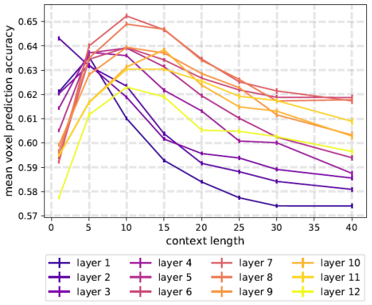
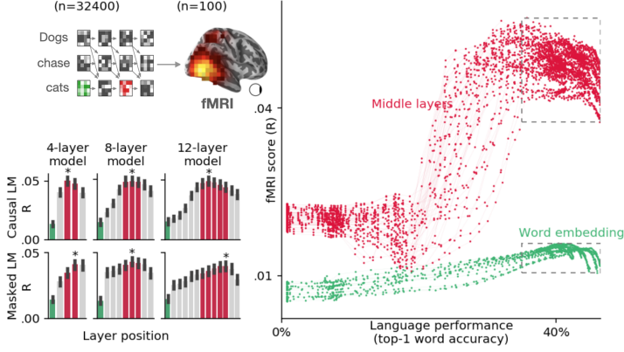
The strongest alignment with high-level language brain regions has consistently been observed in middle layers
Toneva et al. 2019
Caucheteux et al. 2022
BERT
XLM
Across several types of large NLP systems, best alignment with fMRI in middle layers
Notes:
More recently, researchers have begun to study the alignment of these brain language regions with the layers of language models, and found that the best alignment was achieved in the middle layers of these models.
These findings open up the question of what linguistic information underlies the observed alignment between brains and language models.

Slide 15
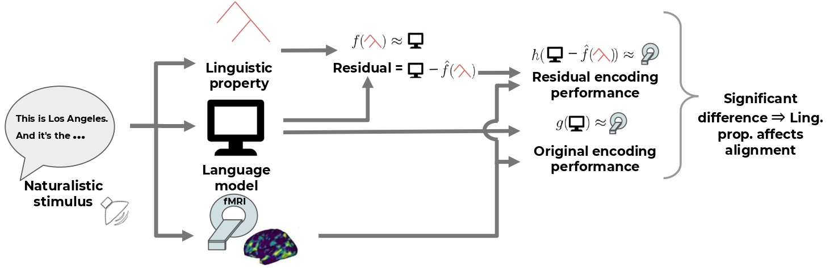
What are the reasons for this observed brain alignment?
Investigate via a perturbation approach

Slide 16
Datasets & Model
Brain: fMRI recordings from Narratives 21st year [Nastase et al. 2021]
Listening to the naturalistic story
N=18
Text-based model
BERT-base
6 linguistic properties
Surface
Word length
Syntactic
TreeDepth
TopConstituents
Semantic
Tense
Subject number
Object number

Slide 17
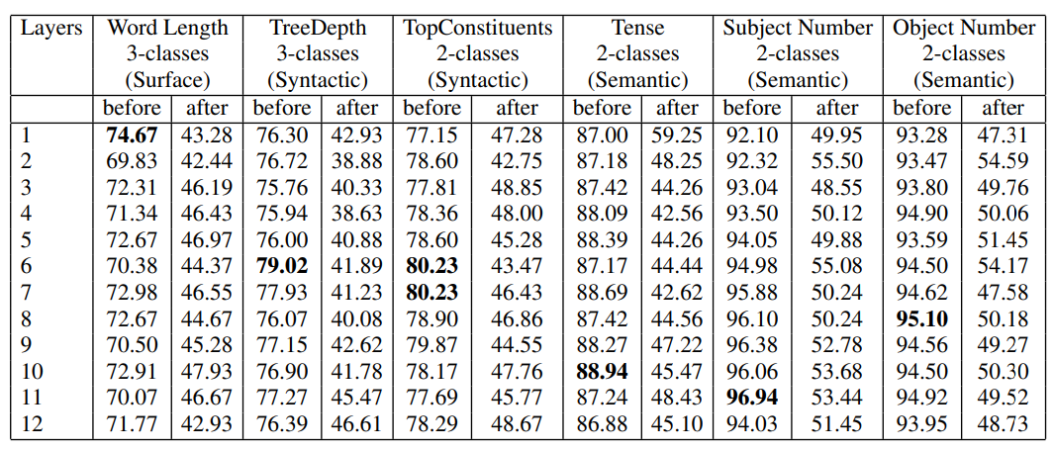
Successful removal of linguistic properties from pretrained BERT
Surface
Syntactic
Semantic

Slide 18
Does the removal of a linguistic property affects the alignment between a language model and the brain across all layers?
Notes:
We investigate our research question: “Does the removal of a linguistic property affects the alignment between LM and brain across all layers?
”

Slide 19
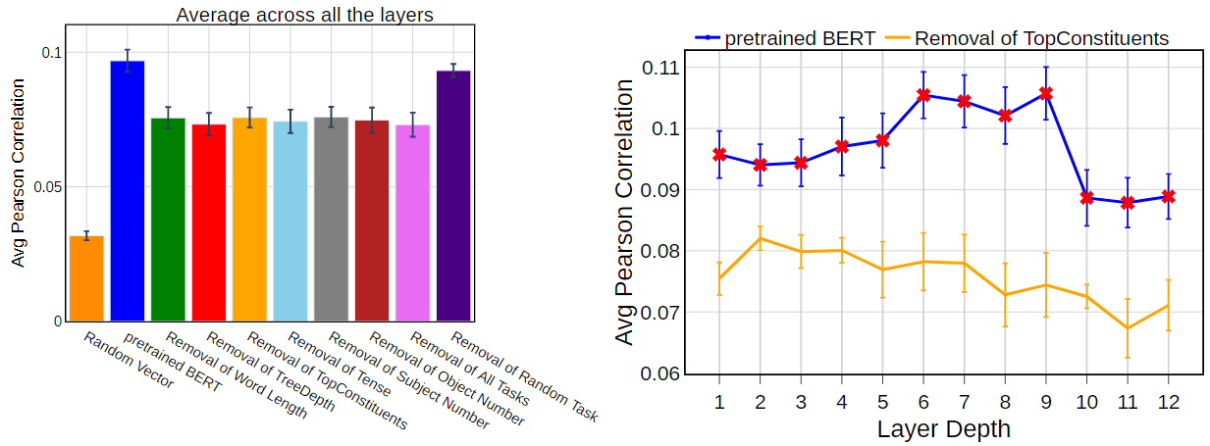
Result-1
Removal of each linguistic property leads to a significant decrease in brain alignment on average across layers.
Notes:
In our first result figure, we present the average brain alignment across all layers of pretrained BERT before and after the removal of each linguistic property.
Blue bars represent the pretrained BERT, and orange bars represent the brain alignment after removal of Topconstituents property.
The left plot shows that there is a sig impact of each property on brain alignment ON AVERAGE across layers and all regions in the brain.
So, we next look at the layer-wise performance for pretrained BERT before and after the removal of one representative linguistic property–TopConstituents, and
we see the greatest impact on alignment in the middle layers.

Slide 20
Does the removal of a linguistic property affects the alignment between a language model and the brain across all layers?
Removal of each linguistic property leads to a significant decrease in brain alignment on average across layers.
Greatest impact on brain alignment in the middle layers
Notes:
In our first result figure, we present the average brain alignment across all layers of pretrained BERT before and after the removal of each linguistic property.
Blue bars represent the pretrained BERT, and orange bars represent the brain alignment after removal of Topconstituents property.
The left plot shows that there is a sig impact of each property on brain alignment ON AVERAGE across layers and all regions in the brain.
So, we next look at the layer-wise performance for pretrained BERT before and after the removal of one representative linguistic property–TopConstituents, and
we see the greatest impact on alignment in the middle layers.

Slide 21
Result-1
Which linguistic properties have the most influence on the trend of brain alignment across BERT layers?
Removal of each linguistic property leads to a significant decrease in brain alignment on average across layers.
Greatest impact on brain alignment in the middle layers
Notes:
the previous results don’t show a difference between different properties on average across layers, but it is possible that they have different effects in different layers.

Slide 22
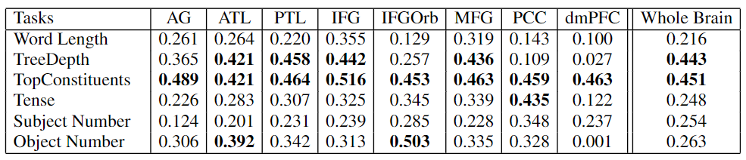
Which linguistic properties have the most influence on the trend of brain alignment across BERT layers?
Corr_{task} (∆ probing accuracy_{task} , ∆ brain alignment_{task})
Syntactic
Semantic
ROI-Level Analysis
Syntactic properties have the largest effect on the trend of brain alignment across model layers
Notes:
We perform both quantitative and qualitative analyses by measuring the correlation across layers between the differences in decoding task performance from pretrained and residual BERT and the differences in brain alignment of pretrained BERT and residual BERT.
A high correlation for a specific linguistic property suggests a strong relationship between the presence of this property across layers in the model and its corresponding effect on the layer-wise brain alignment.
The columns are different regions in the brain that are thought to process language, but their individual contribution to language processing is not well understood.
The table shows several insights
Both TreeDepth and TopConstituents are responsible for the bump in brain alignment not just for the entire brain but also for several language ROIs
Although semantic properties are not shown to be responsible for the shape in brain alignment at the whole-brain level, but the affect of alignment more specifically to several language ROIs.

Slide 23
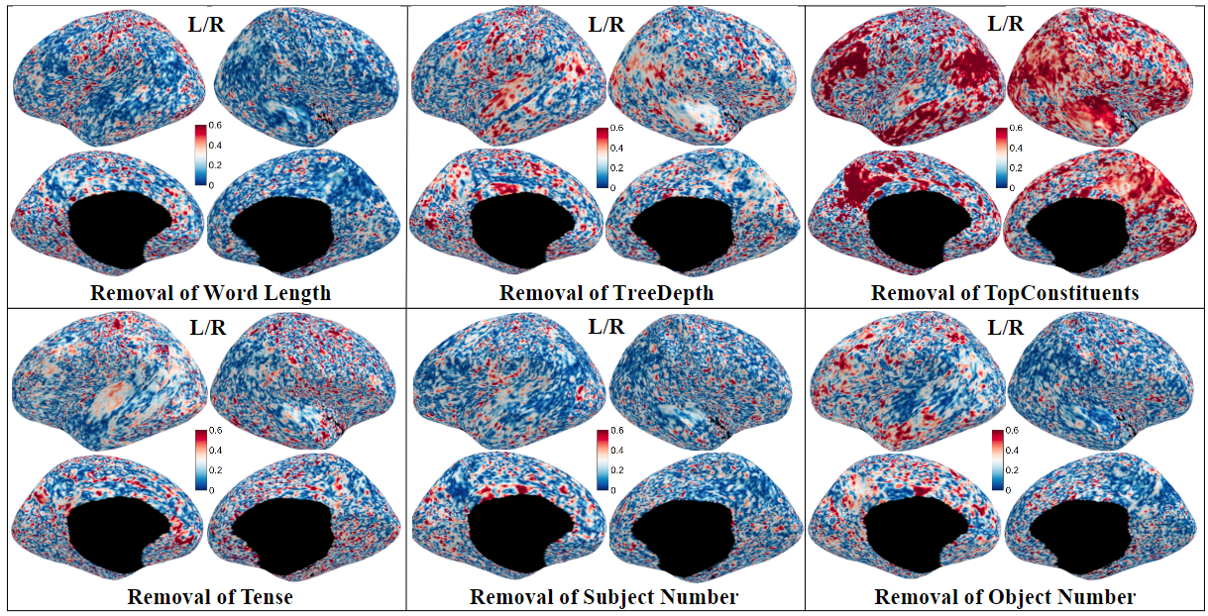
Qualitative Analysis: Effect of each linguistic property
effect of surface property
effect of syntactic property
effect of semantic property
TopConstituent property is more localized to the canonical language regions in the left hemisphere and is more distributed in the right hemisphere
Notes:
To present the correlations at an even finer grain, we show them now at the voxel-wise level for each linguistic property.
The effect of Top Constituents, and Object Number is more localized to the canonical language regions in the left hemisphere and is more distributed in the right hemisphere.

Slide 24
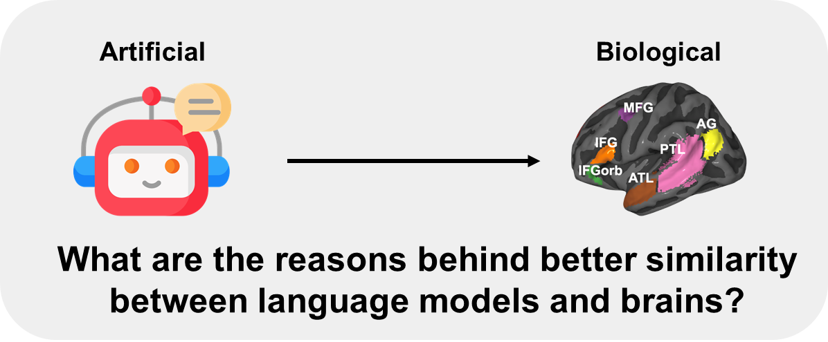
Conclusions for neuro-AI research field
AI-engineering:
guide linguistic feature selection,
facilitate improved transfer learning,
help in the development of cognitively plausible AI architectures
Computational modeling in Neuroscience
enables cognitive neuroscientists to have more control over using language models as model organisms of language processing
Model interpretability
the addition of linguistic features by our approach can further increase the model interpretability using brain signals (Toneva & Wehbe 2019)
Notes:
Our work has implications for several research areas such as AI engineering, neuroscience and model interpretability.
AI-engineering: investigates the relationship between representations in the brain and representations learned from language models.
Our insights can,
Computational modeling: Researchers have started viewing language models as useful model organisms for human language processing. Ou work,
Model Interpretability: We hope that our approach can be used to better understand the necessary and sufficient properties that lead to significant alignment between brain recordings and language models.

Slide 25
Agenda
Introduction to alignment between language models and brains [Review paper, under review]
Joint processing of linguistic properties in brains and language models [NeurIPS-2023]
Speech-trained language models lack brain-relevant semantics, [under review]

Slide 26
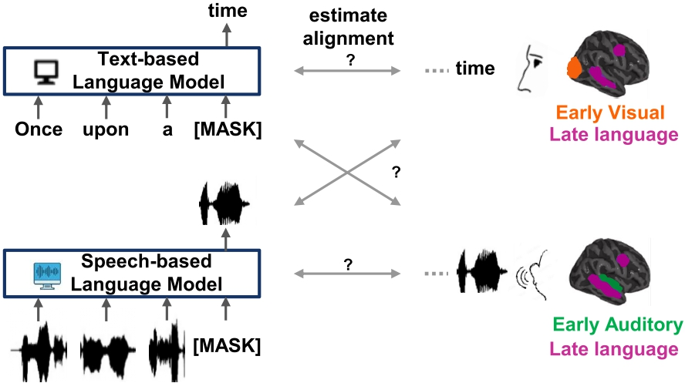
Text- vs. Speech-based language models

Slide 27
Text- vs. Speech-based language models : brain alignment
Notes:
Instead of evaluating whether these models aligned with brain recordings illustrated by text/speech differenetly/similary.

Slide 28
Datasets & Model
Brain: fMRI recordings from Moth-Radio-Hour [Deniz et al. 2019]
Reading & Listening to the same short stories
N=6
3 text-based models
BERT-base
GPT-2
FLAN-T5
2 speech-based models
Wav2Vec2.0
Whisper

Slide 29
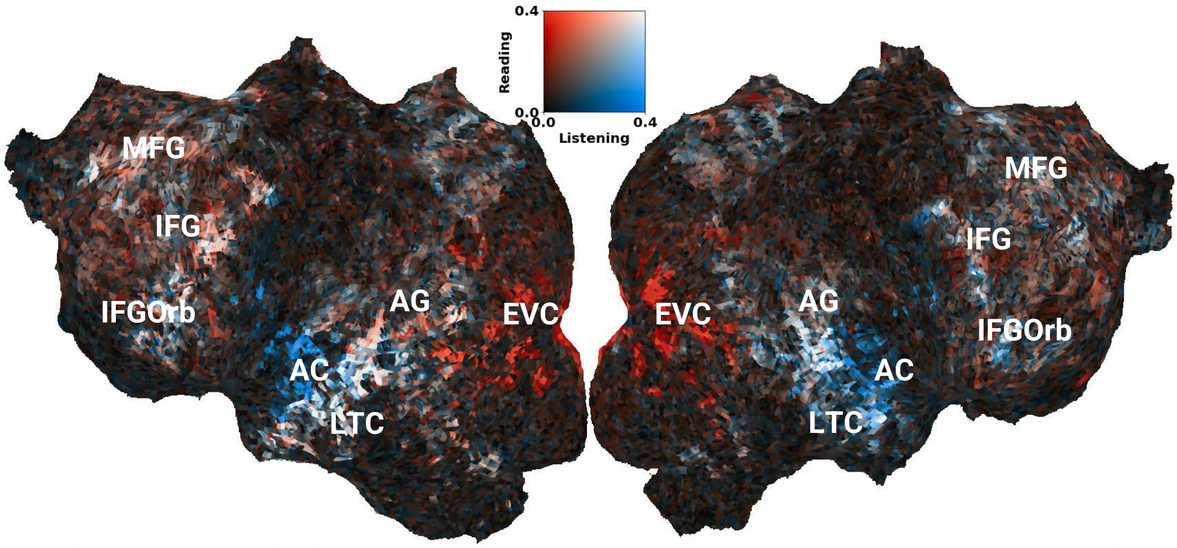
S08: Estimated Noise Ceiling (Reading vs. Listening)
Oota, Celik, Deniz & Toneva, [Under Review]

Slide 30
Low-level Stimulus Features
Textual Features
Speech Features
Visual Features
Letters
Num of Letters
Num of Words
Word Length STD
Phonemes
Num of Phonemes
Diphones
FBANK
MFCC
Mel-Spectrogram
PowSpec
Phonological
Articulation
Motion Energy

Slide 31
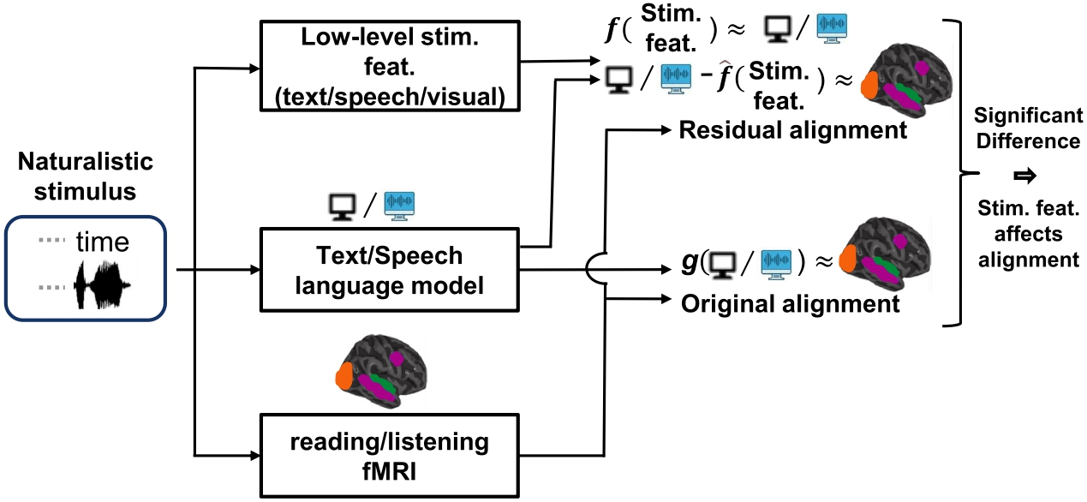
What are the reasons for this observed brain alignment?
Investigate via a perturbation approach

Slide 32
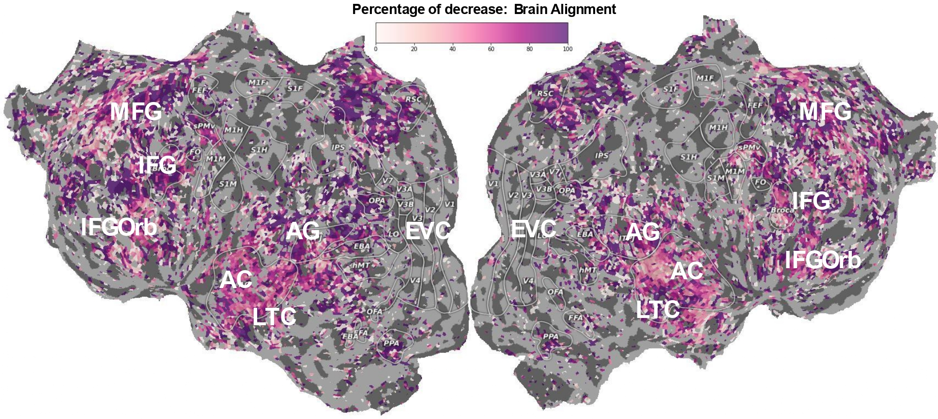
Phonological properties account for most of the alignment between speech models and the human brain
Oota, Celik, Deniz & Toneva, [Under Review]
Notes:
The impressive predictive performance of speech models in the early auditory cortex is NOT entirely accounted for by low-level features. 40-50% of the explainable variance in the early auditory cortex is left to explain after removing the low-level features we consider.
This shows that speech-based models capture additional features that are important for early auditory cortex and understanding these further can help us better understand this part of the brain.
Another surprising result is that, in contrast to the alignment of speech-based models in the early auditory cortex, the alignment in late language regions is almost entirely due to low-level features.

Slide 33
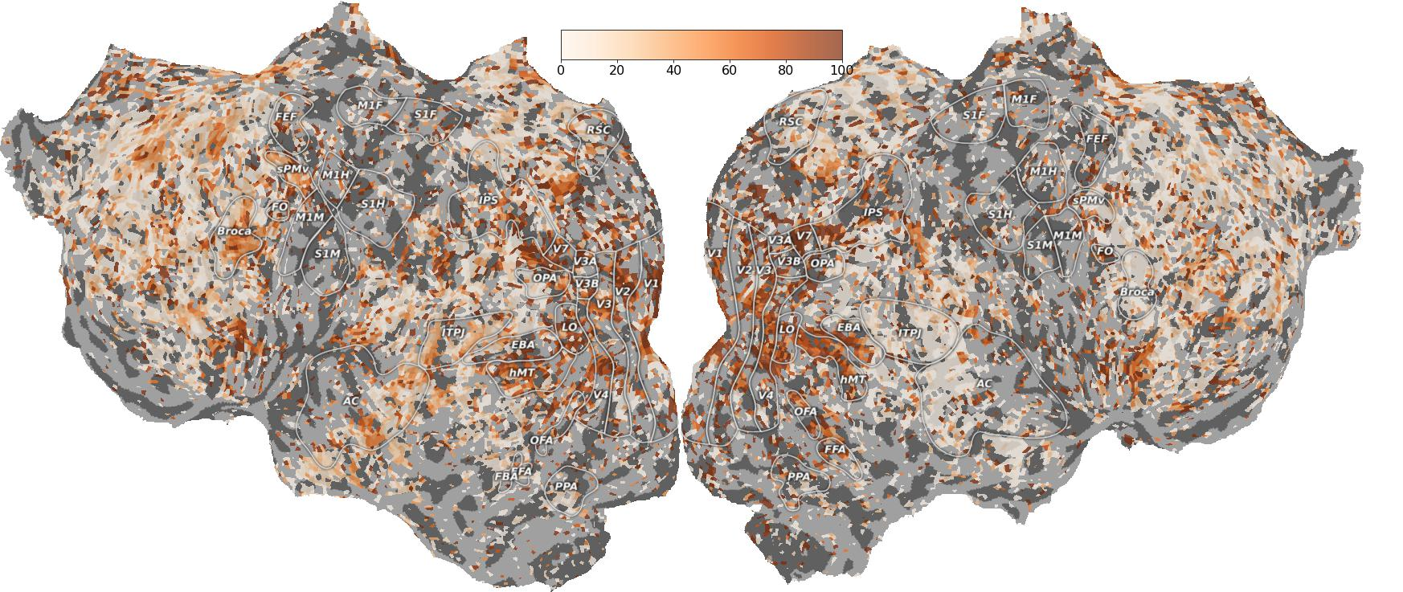
Text-based language models have more information shared with late language regions beyond number of letters feature.
Oota, Celik, Deniz & Toneva, [Under Review]
Notes:
The decrease is much large in EVC
Our work clearly demonstrates the importance of careful consideration of the reasons behind the alignment that is observed between models and human brain recordings.

Slide 34
What are the reasons for these similarities?
Joint processing of syntactic properties [Oota, Gupta & Toneva NeurIPS-2023]
For speech-trained language models mostly entirely low-level features and not semantics [Oota, Celik, Deniz & Toneva Under Review]

