Slide 1



Multi-view and Cross-view Brain Decoding
August 13, 2022
COLING 2022
Subba Reddy Oota^{1,2}, Jashn Arora², Manish Gupta^{2,3}, Bapi Raju Surampudi²
¹Inria Bordeaux France, ²IIIT-Hyderabad, ³Microsoft India

Slide 2
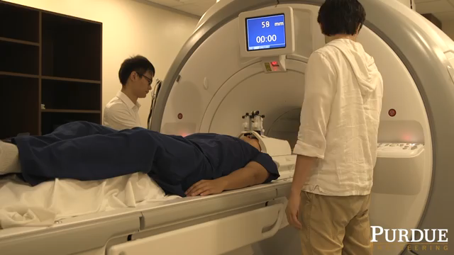
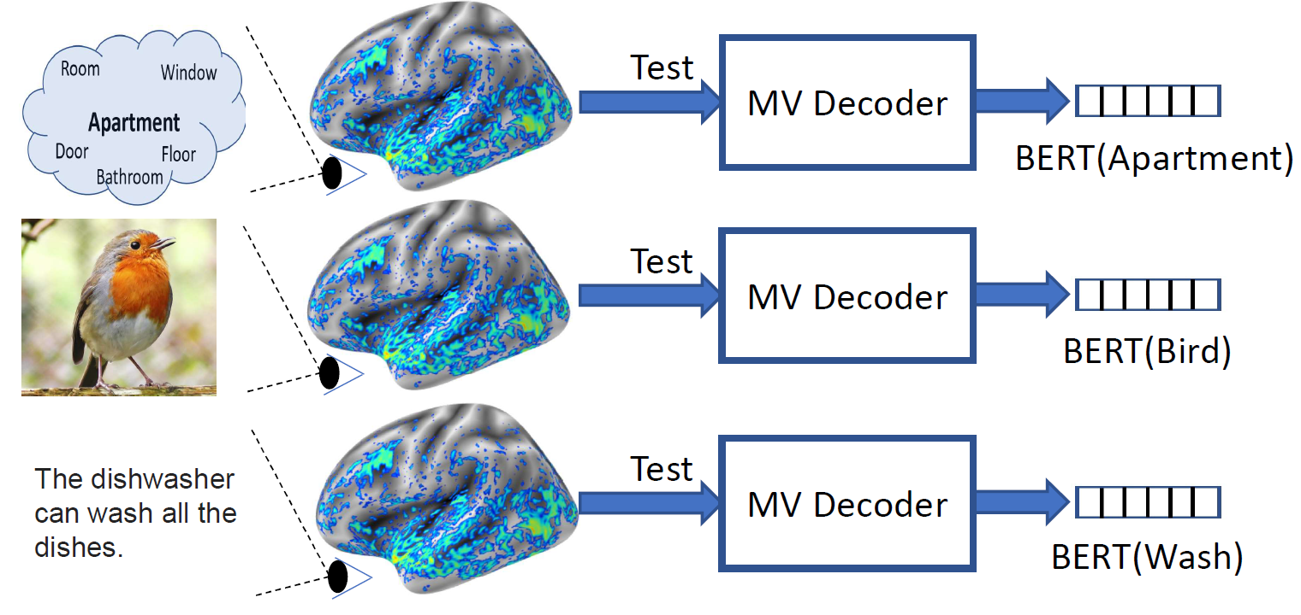
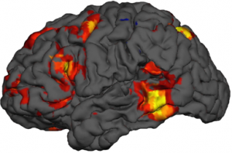
What is fMRI?
A vision-language task in the scanner
Concept + Picture
fMRI Brain Activity
https://www.biopac.com/events/fmri-psych/

Slide 3
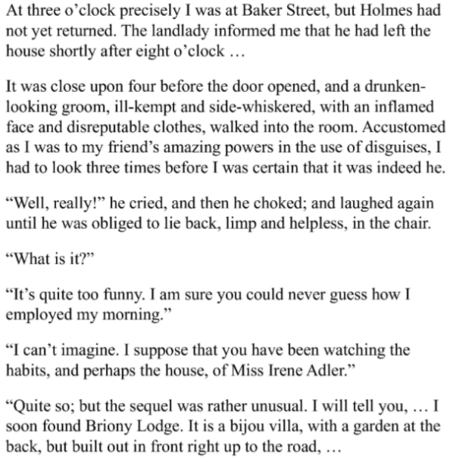
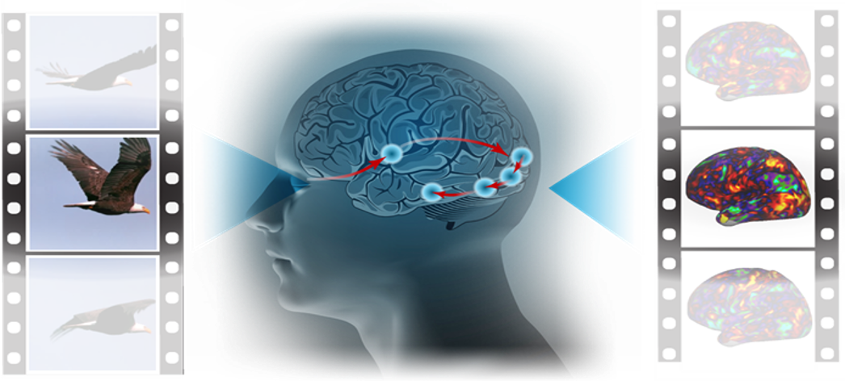
Encoding vs. Decoding
Stimulus
Representation
Encoding
fMRI
Stimulus
Representation
Decoding
fMRI
Haiguang Wen et al, 2017

Slide 4
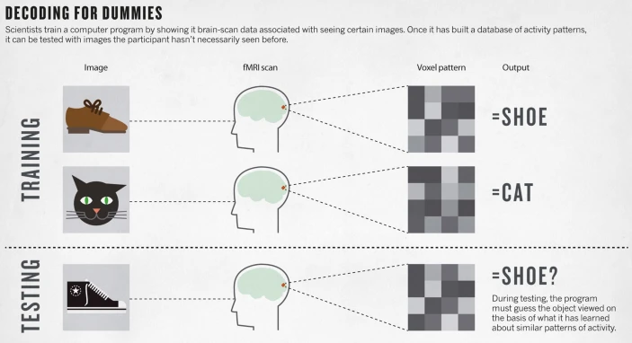
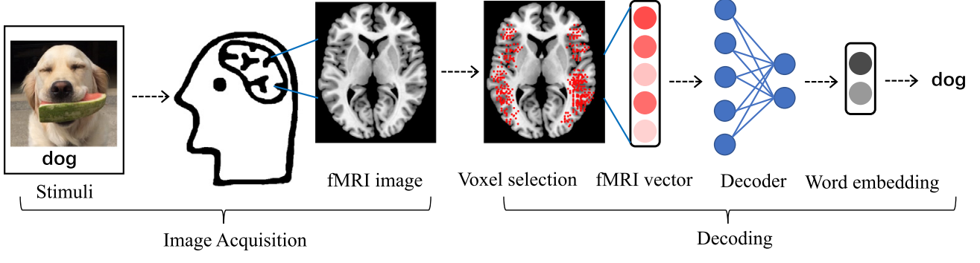
What is Brain Decoding?
Can you read the mind with fMRI?
Or at least tell what the person saw?
Visual Task
Language Task
Smith et al., 2011, Wang et al. 2019

Slide 5
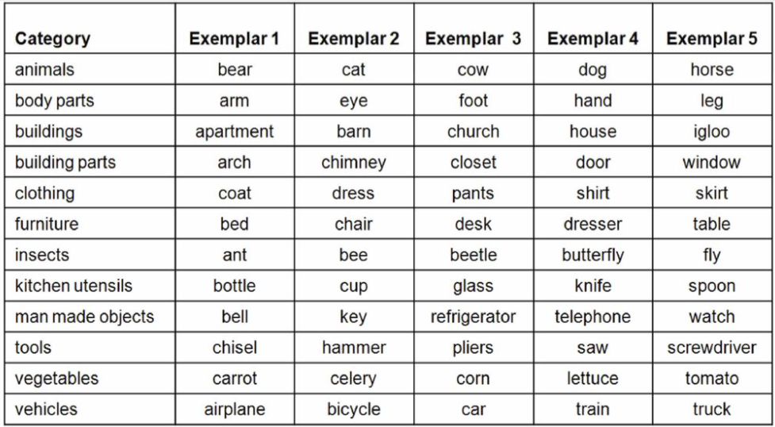
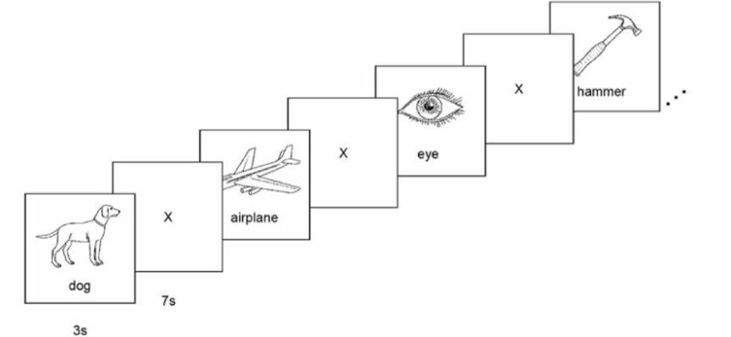
Classical Decoders
Classical decoding solutions extracting linguistic meaning from imaging data have been largely limited to
concrete nouns,
using similar stimuli for training and testing,
small number of semantic categories.
Mitchell et al. 2008

Slide 6
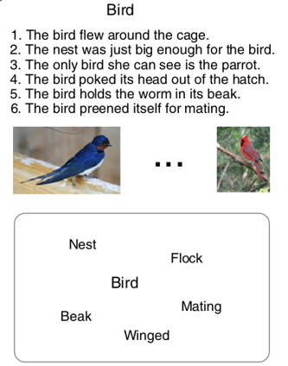
Multi-view and Cross-view Brain Decoding
Human brains have the unique capability of language acquisition:
the process of learning the language
understand the meaning of concepts from multiple modalities such as images, text, speech, and videos.
Prior works focus on single-view brain decoding using traditional feature engineering.
However, how the brain captures the meaning of linguistic stimuli across multiple views is still a critical open question in neuroscience.
Consider three different views of the concept bird:
(1) sentence using the target word,
(2) picture presented with the target word label, and
(3) word cloud containing the target word along with other semantically related words.
Earlier works have explored which of these three different views provides richer information to understand the concept.

Slide 7
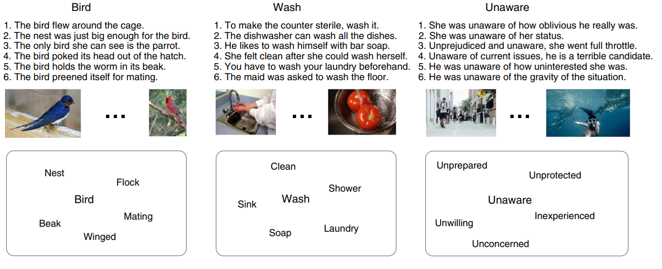
Dataset Details (Experiment-1)
Concept Word
Concept + Sentence View
Concept + Picture View
Concept + Wordcloud View
Periera et al. 2018

Slide 8
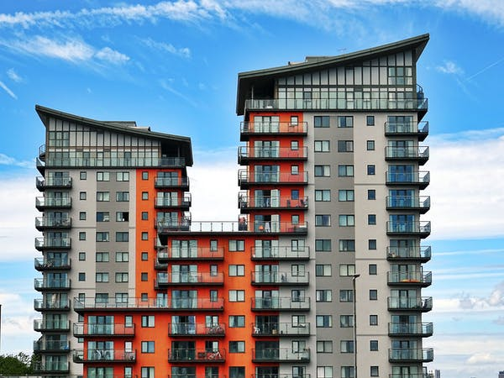
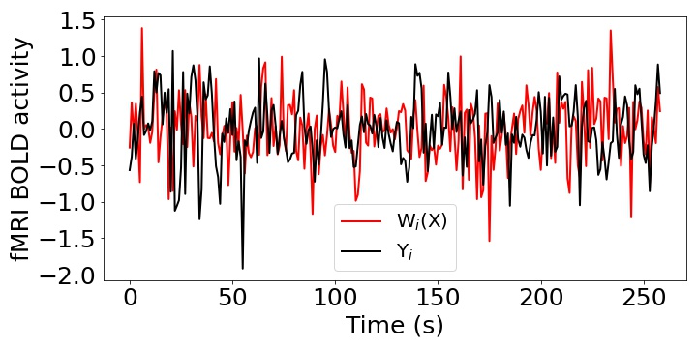
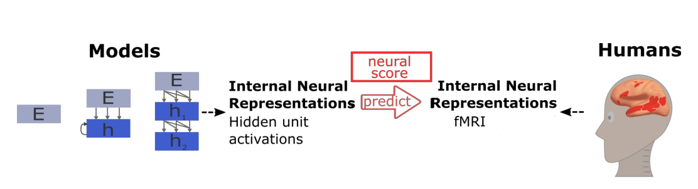
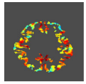
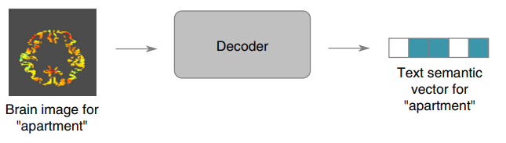
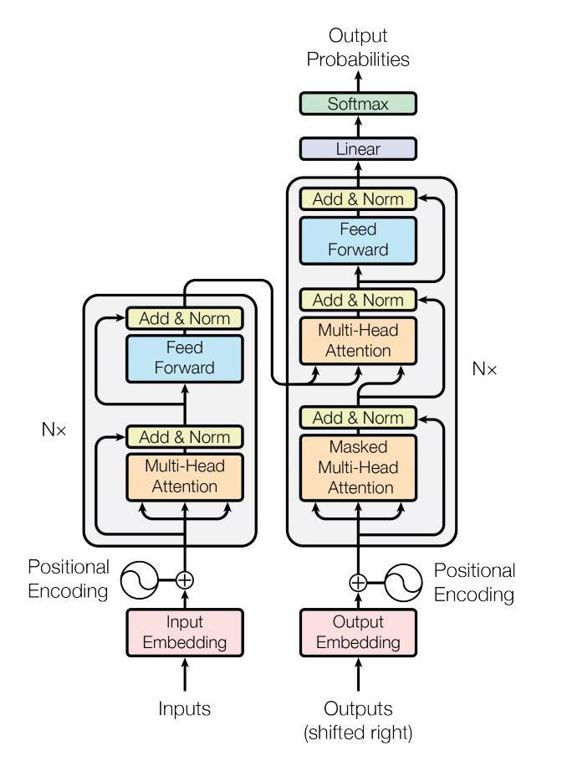
Informative Voxel Selection
Correlation across feature dimensions
Stimulus:
Apartment
Stimulus:
Apartment
Pearson Correlation (R) = Corr(Y, W(X))
Present
Present
3D Image
X
W
Y
Input
Ridge Regression
Output
Voxel + 26 neighbors in 3D
V₁ – R₁
V₂ – R₂
….
V_{n} – R₃
BERT
Select 5000 voxels based on top-5000 correlation scores

Slide 9

Brain Decoder Schematic? (concept+picture)
Stimulus:
Apartment
Stimulus:
Apartment
Present
Present
Ridge Regression
BERT
BERT
Periera et al. 2018, Devlin et al. 2018

Slide 10

Brain Decoder Schematic? (concept+sentence)
Stimulus:
Apartment
Stimulus:
Apartment
Present
Present
Ridge Regression
BERT
Periera et al. 2018, Devlin et al. 2018

Slide 11



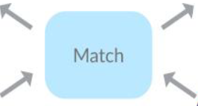
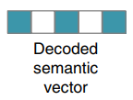
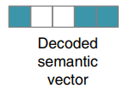
Evaluating Decoding Models: Pairwise Accuracy
i^{th} Concept Word
j^{th} Concept Word
Pairwise Accuracy = 1; corr(Y_{i}, ${\hat{y}}_{i}$) + corr(Y_{j}, ${\hat{y}}_{j}$) > corr(Y_{i}, ${\hat{y}}_{j}$) + corr(Y_{j}, ${\hat{y}}_{i}$)
Periera et al. 2018

Slide 12
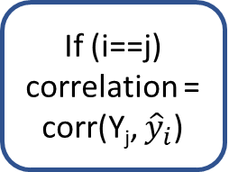

Evaluating Decoding Models: Rank Accuracy
Rank Accuracy = $1−\frac{\left(rank\right)−1}{n−1}$
i^{th} Concept Word
Y₁
Y₂
If (i==j)
correlation = corr(Y_{j}, ${\hat{y}}_{i}$)
Correaltion
rank = rsort(corr_scores).index(correlation)
Y_{n}
All the correlation scores in descending order
Periera et al. 2018

Slide 13
Multi-view decoding
Sentence View
Picture View
Wordcloud View
Train
Wordcloud View
Train
Picture View
Train
Sentence View

Slide 14
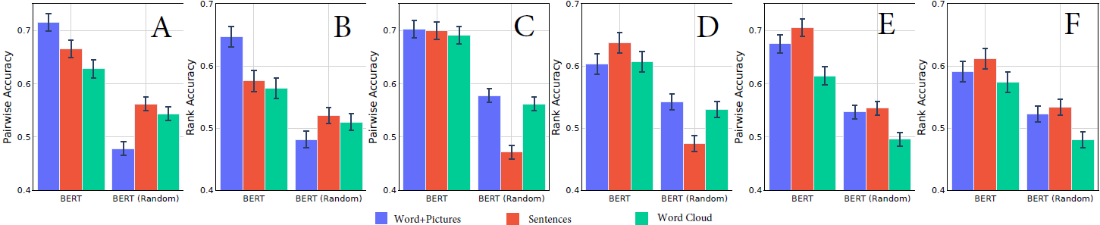
Multi-view decoding results
Train
Picture View
Train
Sentence View
Train
WordCloud View
Pictures Best Accuracy
Sentences Best Accuracy
BERT Representaions
Shuffled the Target Concepts
Test

Slide 15
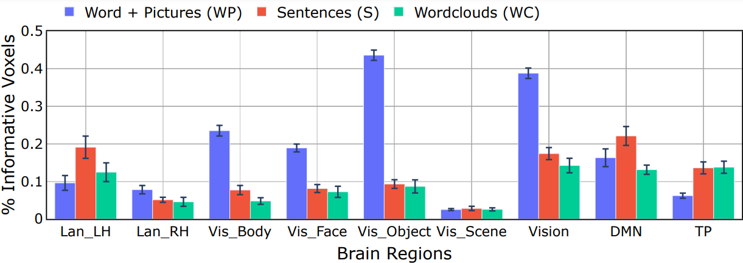
Distribution of Informative Voxels

Slide 16
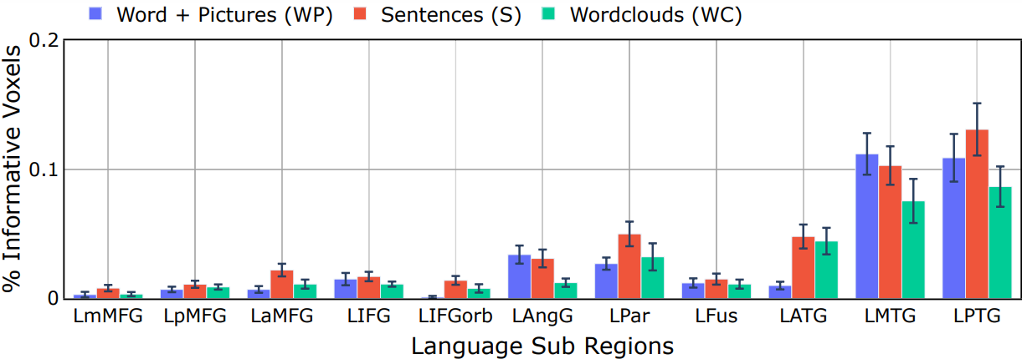
Distribution of Information Voxels: Language Network

Slide 17
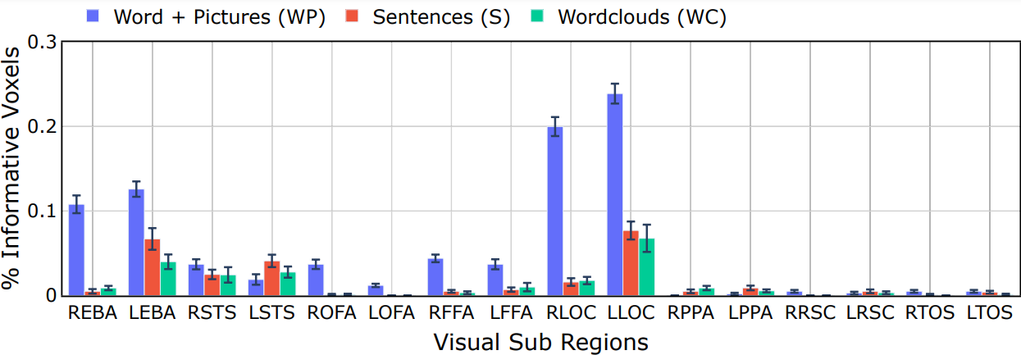
Distribution of Informative Voxels: Visual Network

Slide 18
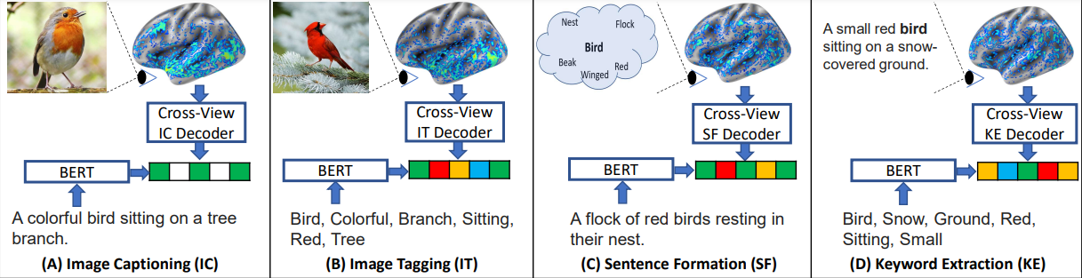
Cross-view Decoding
Train
Picture View
Train
Picture View
Train
Wordcloud View
Train
Sentence View
Test
Caption
Test
Visual words
Test
Sentence
Test
Keywords

Slide 19
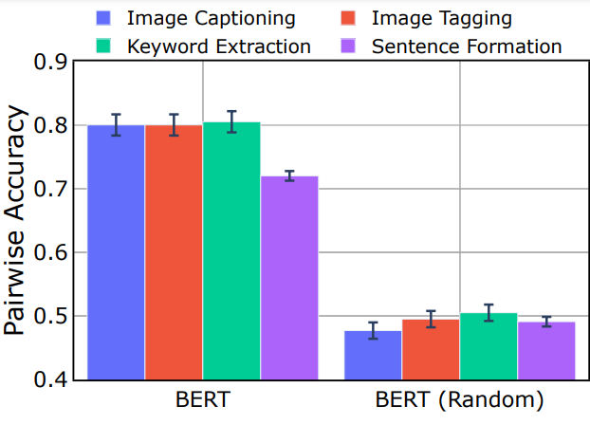
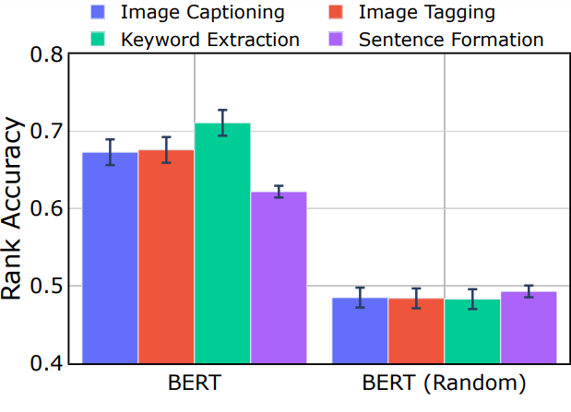
Cross-view Decoding results
BERT Representaions
Shuffled the Target Concepts

Slide 20
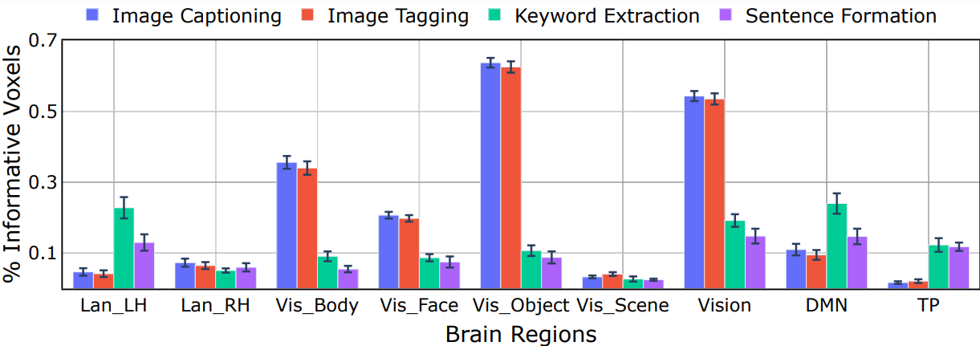
Distribution of Informative Voxels

Slide 21
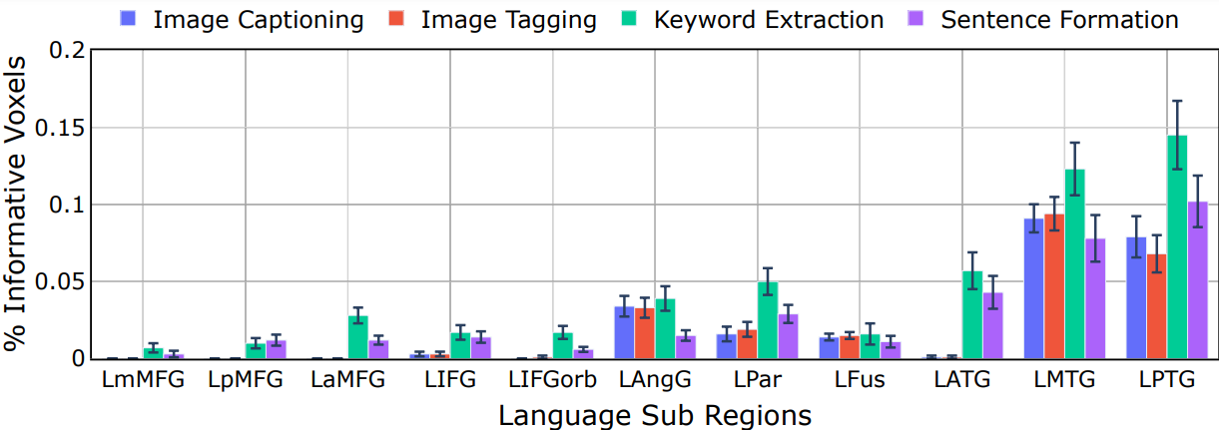
Distribution of Informative Voxels: Language Network

Slide 22
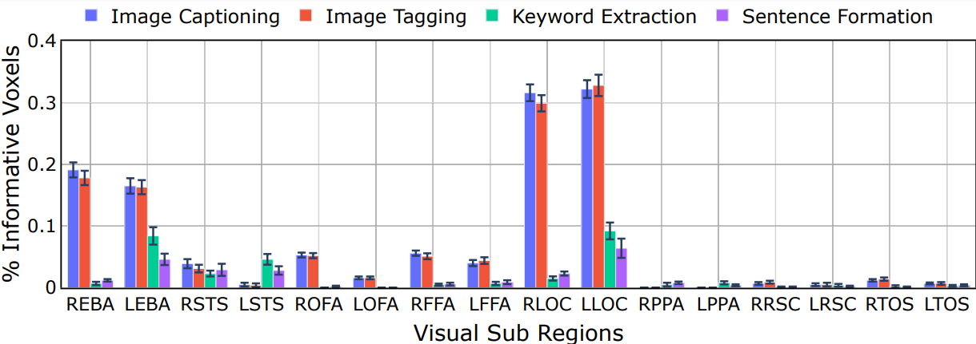
Distribution of Information Voxels: Visual Network

Slide 23
Insights
Without any apriori location constraints,
nearly half of the voxels selected by the models fall into the language atlas.
Conclusion: brain regions active in language processing also highly correspond to these representations.
Sun et al. 2019

Slide 24



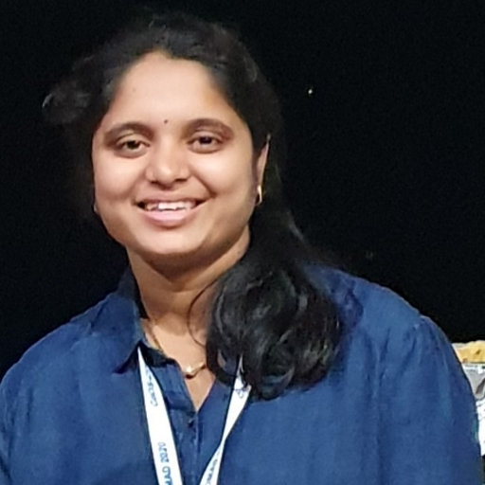
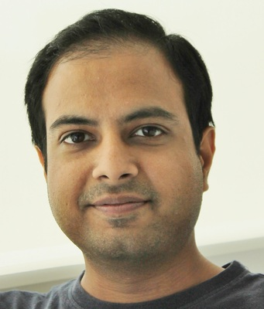

Collaborators
Subba Reddy Oota
Jashn Arora
Veeral Agarwal
Mounika Marreddy
Manish Gupta
Bapi Raju Surampudi

