Slide 1




Brain-Inspired AI 2.0: Aligning Language Models Across Languages and Modalities
Subba Reddy Oota¹, Tanmoy Chakraborty², Manish Gupta^{3,4}, Raju S. Bapi³
¹TU Berlin, Germany; ²IIT Delhi, India; ³IIIT Hyderabad, India; ⁴Microsoft, India
subba.reddy.oota@tu-berlin.de, tanchak@iitd.ac.in, gmanish@microsoft.com, raju.bapi@iiit.ac.in

Slide 2
Agenda
Introduction to the tutorial [10 min]
Introduction to Brain Encoding and Decoding [50 min]
Brain Encoding: Scaling Laws, Multilinguality, Multimodal and Instruction-tuned Models [60 min]
Coffee Break & Networking [30 min]
Brain-informed Fine-tuning of Language Models [30 min]
Brain-based Interpretability and Causal Testing of AI Models [20 min]
Brain Decoding [30 min]
Summary and Future Trends [10 min]

Slide 3
Agenda
Introduction to the tutorial [10 min]
Introduction to Brain Encoding and Decoding [50 min]
Brain Encoding: Scaling Laws, Multilinguality, Multimodal and Instruction-tuned Models [60 min]
Coffee Break & Networking [30 min]
Brain-informed Fine-tuning of Language Models [30 min]
Brain-based Interpretability and Causal Testing of AI Models [20 min]
Brain Decoding [30 min]
Summary and Future Trends [10 min]

Slide 4
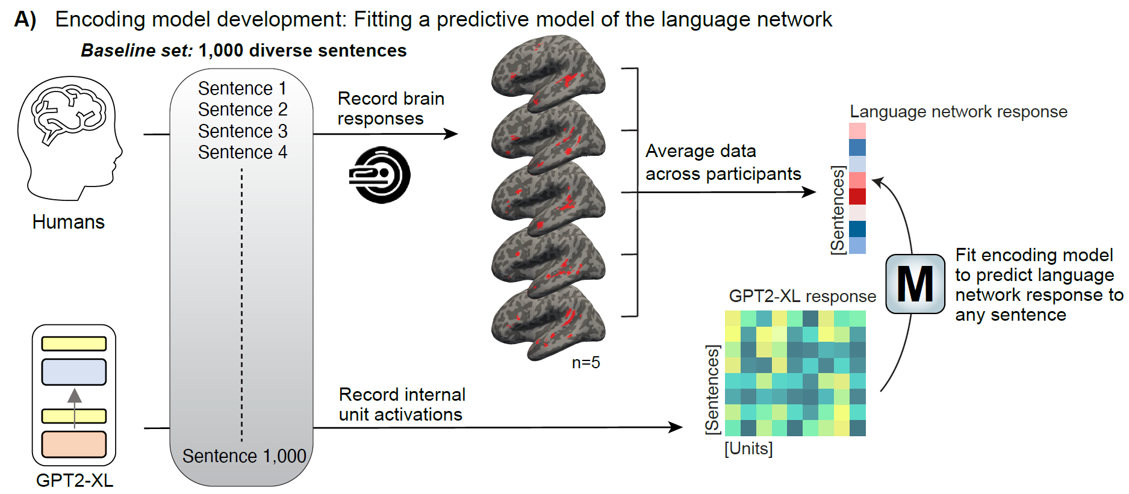
Model-selected sentences control language network responses
Encoding model development: Fitting a predictive model of the language network
Tuckute et al. Nat. Hum. Behav. 2024
Notes:
Figure 1. Overview of the procedure for encoding model development and stimulus selection for evaluation.
A) We developed an encoding model (M) of the left hemisphere (LH) language network in the human
brain with the goal of identifying novel sentences that activate the language network to a maximal or
minimal extent (Methods; Encoding model development). Five participants (train participants) read a large
sample (n=1,000) of 6-word corpus-extracted sentences, the baseline set (sampled to maximize linguistic
diversity; SI 1), in a rapid, event-related design while their brain activity was recorded using fMRI. Bloodoxygen-
level-dependent (BOLD) responses from voxels in the LH language network were averaged
within each train participant and averaged across participants to yield an average language network
response to each of the 1,000 baseline set sentences. We trained a ridge regression model from the
representations of the unidirectional-attention Transformer language model, GPT2-XL (identified as the
most brain-aligned language base model in Schrimpf et al. 43), to the 1,000 averaged fMRI responses.
Given that GPT2-XL can generate a representation for any sentence, the encoding model (M) can predict
the LH language network response for arbitrary sentences. To select the top-performing layer for our
encoding model, we evaluated all 49 layers of GPT2-XL and selected the layer that had highest
predictivity performance on brain responses to held-out baseline set sentences (layer 22; SI 6A).
B) To evaluate the encoding model (M), we identified a set of sentences to activate the language network
to a maximal extent (drive sentences) or minimal extent (suppress sentences) (Methods; Encoding model
evaluation). To do so, we obtained GPT2-XL embeddings for ~1.8 million sentences from diverse, large
text corpora, generated predicted language network responses, and ranked these responses to select the
sentences that are predicted to increase or decrease brain responses relative to the baseline set. Finally,
we collected brain responses to these novel sentences in new participants (evaluation participants).

Slide 5
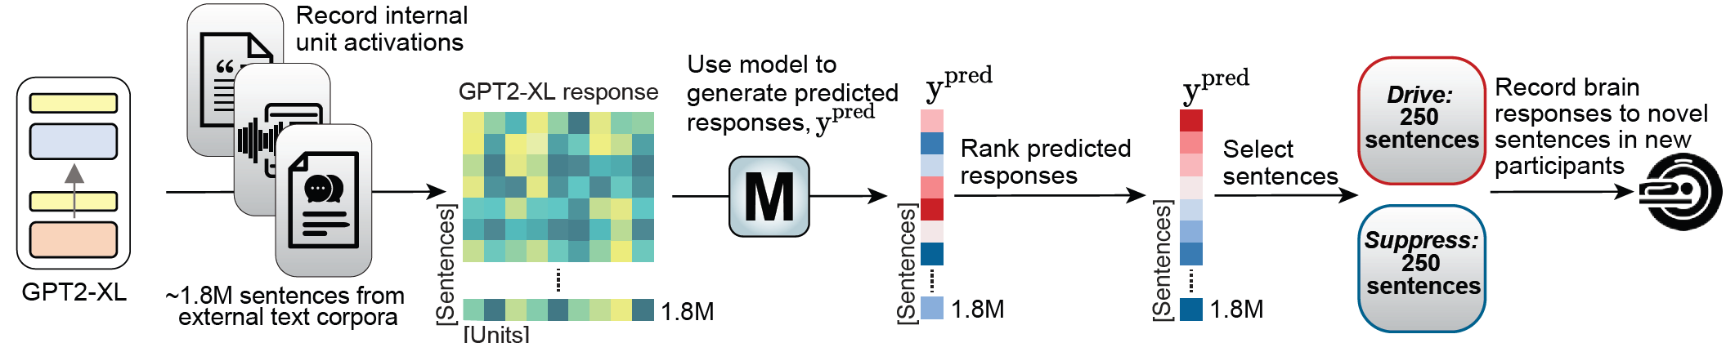
Model-selected sentences control language network responses
Encoding model evaluation: Selection of novel drive and suppress sentences
Tuckute et al. Nat. Hum. Behav. 2024
Notes:
Figure 1. Overview of the procedure for encoding model development and stimulus selection for evaluation.
A) We developed an encoding model (M) of the left hemisphere (LH) language network in the human
brain with the goal of identifying novel sentences that activate the language network to a maximal or
minimal extent (Methods; Encoding model development). Five participants (train participants) read a large
sample (n=1,000) of 6-word corpus-extracted sentences, the baseline set (sampled to maximize linguistic
diversity; SI 1), in a rapid, event-related design while their brain activity was recorded using fMRI. Bloodoxygen-
level-dependent (BOLD) responses from voxels in the LH language network were averaged
within each train participant and averaged across participants to yield an average language network
response to each of the 1,000 baseline set sentences. We trained a ridge regression model from the
representations of the unidirectional-attention Transformer language model, GPT2-XL (identified as the
most brain-aligned language base model in Schrimpf et al. 43), to the 1,000 averaged fMRI responses.
Given that GPT2-XL can generate a representation for any sentence, the encoding model (M) can predict
the LH language network response for arbitrary sentences. To select the top-performing layer for our
encoding model, we evaluated all 49 layers of GPT2-XL and selected the layer that had highest
predictivity performance on brain responses to held-out baseline set sentences (layer 22; SI 6A).
B) To evaluate the encoding model (M), we identified a set of sentences to activate the language network
to a maximal extent (drive sentences) or minimal extent (suppress sentences) (Methods; Encoding model
evaluation). To do so, we obtained GPT2-XL embeddings for ~1.8 million sentences from diverse, large
text corpora, generated predicted language network responses, and ranked these responses to select the
sentences that are predicted to increase or decrease brain responses relative to the baseline set. Finally,
we collected brain responses to these novel sentences in new participants (evaluation participants).

Slide 6
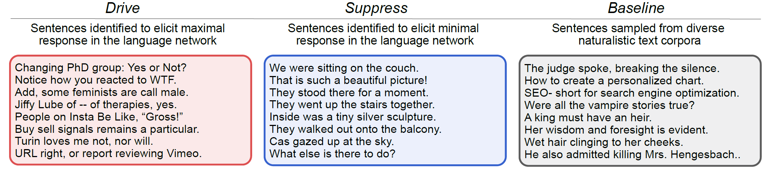
Model-selected sentences control language network responses
Sentence Examples from each condition
Tuckute et al. Nat. Hum. Behav. 2024
Notes:
Figure 2. Model-selected sentences successfully drive and suppress responses in the language
network.
A) We used our encoding model to select sentences that would elicit maximal response (drive sentences)
or minimal response (suppress sentences) in the functionally defined language network. To define
functional ROIs, we used demarcations (‘language parcels’; shown on the surface-inflated MNI152
template brain) within which most or all individuals in prior studies showed activity for the language
localizer contrast in large samples (e.g., 2,3). We defined the LH language network as regions within the
borders of these five parcels that were activated (top 10%) in the functional localizer acquired for each
participant (see brain visualizations in B and C).
B) The average language network fMRI response across, respectively, 250 drive, 250 suppress, and
1,000 baseline sentences for n=3 evaluation participants, collected in an event-related, single-trial fMRI
paradigm. In both B and C, individual points show the average of each condition per participant. fMRI
responses were z-scored session-wise (see SI 12A for responses without normalization; no key patterns
are affected). The evoked BOLD response was 85.7% higher for drive relative to baseline and 97.5%
lower for suppress relative to baseline (SI 12A). Error bars show within-participant standard error of the
mean. The brain illustrations show the functionally defined language network in the participants of interest
on the surface-inflated brain, visualized in Freeview. For surface projections, volumetric data (in MNI
IXI549Space; SPM12 197) were registered to FreeSurfer’s CVS35 (combined volumetric and surfacebased
(CVS)) in the MNI152 space using mri_vol2surf in FreeSurfer v7.3.2 198 with a projection distance
of 1.5mm and otherwise default parameters.
C) The average language network fMRI response across, respectively, 240 drive, 240 suppress, and 240
baseline sentences (randomly sampled from the superset of 250/250 drive/suppress sentences and 1,000
baseline sentences) for n=4 evaluation participants, collected in a blocked fMRI paradigm. The evoked
BOLD response was 12.9% higher for drive relative to baseline and 56.6% lower for suppress relative to
baseline (SI 12B).
D) Example sentences from each condition.

Slide 7
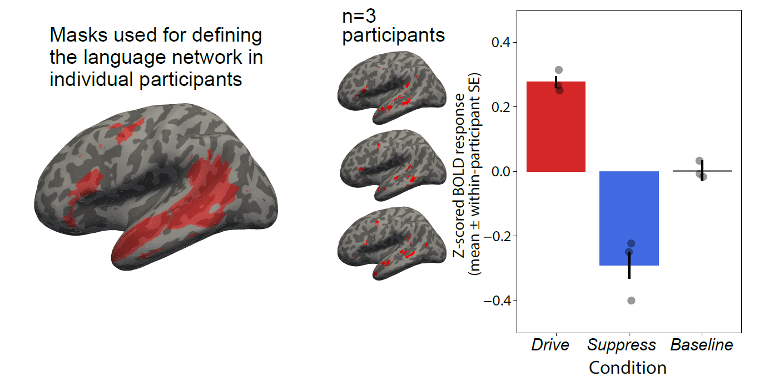
Model-selected sentences control language network responses
LLMs mimic human language (predict brain responses).
Also, enable noninvasive control of neural activity in the language network!
Tuckute et al. Nat. Hum. Behav. 2024
Notes:
Figure 2. Model-selected sentences successfully drive and suppress responses in the language
network.
A) We used our encoding model to select sentences that would elicit maximal response (drive sentences)
or minimal response (suppress sentences) in the functionally defined language network. To define
functional ROIs, we used demarcations (‘language parcels’; shown on the surface-inflated MNI152
template brain) within which most or all individuals in prior studies showed activity for the language
localizer contrast in large samples (e.g., 2,3). We defined the LH language network as regions within the
borders of these five parcels that were activated (top 10%) in the functional localizer acquired for each
participant (see brain visualizations in B and C).
B) The average language network fMRI response across, respectively, 250 drive, 250 suppress, and
1,000 baseline sentences for n=3 evaluation participants, collected in an event-related, single-trial fMRI
paradigm. In both B and C, individual points show the average of each condition per participant. fMRI
responses were z-scored session-wise (see SI 12A for responses without normalization; no key patterns
are affected). The evoked BOLD response was 85.7% higher for drive relative to baseline and 97.5%
lower for suppress relative to baseline (SI 12A). Error bars show within-participant standard error of the
mean. The brain illustrations show the functionally defined language network in the participants of interest
on the surface-inflated brain, visualized in Freeview. For surface projections, volumetric data (in MNI
IXI549Space; SPM12 197) were registered to FreeSurfer’s CVS35 (combined volumetric and surfacebased
(CVS)) in the MNI152 space using mri_vol2surf in FreeSurfer v7.3.2 198 with a projection distance
of 1.5mm and otherwise default parameters.
C) The average language network fMRI response across, respectively, 240 drive, 240 suppress, and 240
baseline sentences (randomly sampled from the superset of 250/250 drive/suppress sentences and 1,000
baseline sentences) for n=4 evaluation participants, collected in a blocked fMRI paradigm. The evoked
BOLD response was 12.9% higher for drive relative to baseline and 56.6% lower for suppress relative to
baseline (SI 12B).
D) Example sentences from each condition.

Slide 8
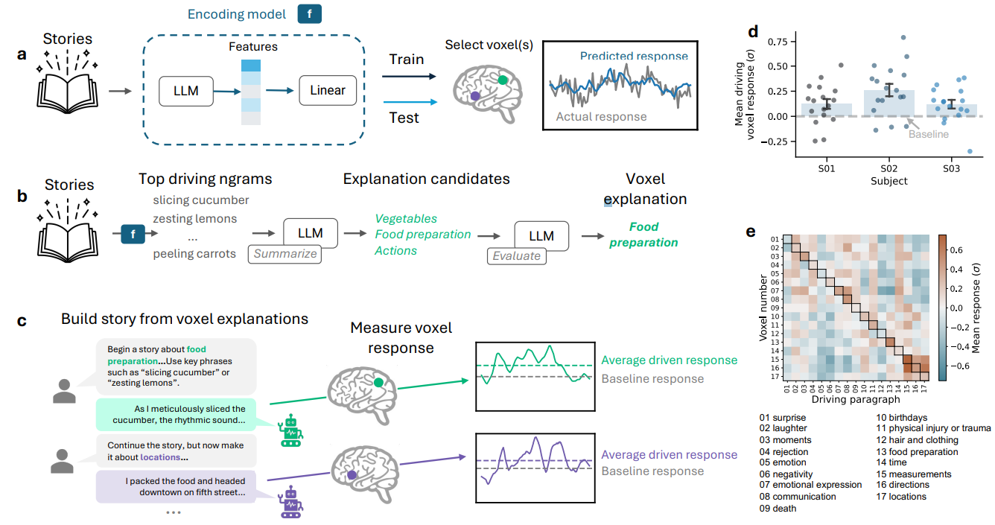
LMs are highly effective at predicting fMRI responses to language stimuli
What features of the language stimulus drive the response in each brain area?
Antonello et al. arXiv 2025 http://arxiv.org/pdf/2410.00812
Notes:
Fig. 1: Driving single-voxel response with generative causal testing. (a) Voxelwise BOLD responses were
recorded using fMRI as human subjects listened to 20 hours of narrative stories. An encoding model f was fit to predict
these responses from the story text. f consists of a linear model fit on representations extracted from an LLM, which are
not readily interpretable. Encoding models were tested by predicting responses on held-out fMRI data, and only wellperforming
models were selected for further analysis. (b) We used an automated procedure to find a verbal description
of the function that f computes for each voxel. First, we tested f on a large catalog of n-grams (n = 1, 2, 3) and found
those that maximally drove predicted responses. These n-grams were then summarized into stable explanation candidates
using a powerful instruction-tuned LLM. Finally, we evaluated each explanation candidate by generating corresponding
synthetic sentences and testing that these sentences yielded large predictions from f. (c) To test whether the generated
explanations were causally related to activation in the brain, we used an LLM to produce synthetic narrative stories
where each paragraph is designed to drive responses based on the generated explanation for one voxel. For each subject
we constructed stories to drive 17 well-modeled voxels with diverse selectivity. These stories were then presented to the
subjects in a second fMRI experiment. (d) Average BOLD response during its driving paragraph for each voxel, relative
to baseline, i.e. average response to all non-driving paragraphs. On average, driven responses were significantly higher
than baseline for each subject (p = 0.020 (S01), p < 10−5 (S02), p = 0.009 (S03); permutation test, FDR-corrected). For
well-driven voxels, this means that the generated explanation is causally related to activation of that voxel, and thus that
we have successfully translated the LLM-based encoding model into a verbal explanation. (e) Average BOLD response for
each selected voxel to each of the driving paragraphs in one subject (S02). Responses to the driving paragraph generated
using the explanation for that voxel appear along the main diagonal. Explanations that were used to construct the driving
paragraphs are shown below. BOLD responses were generally high for the driving paragraphs for each voxel as well as
semantically related paragraphs (e.g. directions and locations, emotional expression and laughter).

Slide 9
Methodological details
Data collection:
One set of fMRI data is for fitting encoding models
Second set is for selectively driving brain regions
LLMs:
LLaMA-30B – 18th layer for feature selection
OPT-30B – 33rd layer for feature selection
Encoding models performance:
LLaMA-30B – mean voxel correlation of about 0.132
OPT-30B – mean voxel correlation of about 0.128
Voxel selection for explanation:
Apply PCA on the learned ridge weights across all well-modeled voxels
Project all voxels to first 4 PCs and perform uniform sampling.
Antonello et al. arXiv 2025 http://arxiv.org/pdf/2410.00812
Notes:
Fig. 1: Driving single-voxel response with generative causal testing. (a) Voxelwise BOLD responses were
recorded using fMRI as human subjects listened to 20 hours of narrative stories. An encoding model f was fit to predict
these responses from the story text. f consists of a linear model fit on representations extracted from an LLM, which are
not readily interpretable. Encoding models were tested by predicting responses on held-out fMRI data, and only wellperforming
models were selected for further analysis. (b) We used an automated procedure to find a verbal description
of the function that f computes for each voxel. First, we tested f on a large catalog of n-grams (n = 1, 2, 3) and found
those that maximally drove predicted responses. These n-grams were then summarized into stable explanation candidates
using a powerful instruction-tuned LLM. Finally, we evaluated each explanation candidate by generating corresponding
synthetic sentences and testing that these sentences yielded large predictions from f. (c) To test whether the generated
explanations were causally related to activation in the brain, we used an LLM to produce synthetic narrative stories
where each paragraph is designed to drive responses based on the generated explanation for one voxel. For each subject
we constructed stories to drive 17 well-modeled voxels with diverse selectivity. These stories were then presented to the
subjects in a second fMRI experiment. (d) Average BOLD response during its driving paragraph for each voxel, relative
to baseline, i.e. average response to all non-driving paragraphs. On average, driven responses were significantly higher
than baseline for each subject (p = 0.020 (S01), p < 10−5 (S02), p = 0.009 (S03); permutation test, FDR-corrected). For
well-driven voxels, this means that the generated explanation is causally related to activation of that voxel, and thus that
we have successfully translated the LLM-based encoding model into a verbal explanation. (e) Average BOLD response for
each selected voxel to each of the driving paragraphs in one subject (S02). Responses to the driving paragraph generated
using the explanation for that voxel appear along the main diagonal. Explanations that were used to construct the driving
paragraphs are shown below. BOLD responses were generally high for the driving paragraphs for each voxel as well as
semantically related paragraphs (e.g. directions and locations, emotional expression and laughter).

Slide 10
Generating and evaluating natural-language explanations for single voxels (GEM-V)
Are the generated explanations causally related to brain activation?
Antonello et al. arXiv 2025 http://arxiv.org/pdf/2410.00812
Notes:
Fig. 1: Driving single-voxel response with generative causal testing. (a) Voxelwise BOLD responses were
recorded using fMRI as human subjects listened to 20 hours of narrative stories. An encoding model f was fit to predict
these responses from the story text. f consists of a linear model fit on representations extracted from an LLM, which are
not readily interpretable. Encoding models were tested by predicting responses on held-out fMRI data, and only wellperforming
models were selected for further analysis. (b) We used an automated procedure to find a verbal description
of the function that f computes for each voxel. First, we tested f on a large catalog of n-grams (n = 1, 2, 3) and found
those that maximally drove predicted responses. These n-grams were then summarized into stable explanation candidates
using a powerful instruction-tuned LLM. Finally, we evaluated each explanation candidate by generating corresponding
synthetic sentences and testing that these sentences yielded large predictions from f. (c) To test whether the generated
explanations were causally related to activation in the brain, we used an LLM to produce synthetic narrative stories
where each paragraph is designed to drive responses based on the generated explanation for one voxel. For each subject
we constructed stories to drive 17 well-modeled voxels with diverse selectivity. These stories were then presented to the
subjects in a second fMRI experiment. (d) Average BOLD response during its driving paragraph for each voxel, relative
to baseline, i.e. average response to all non-driving paragraphs. On average, driven responses were significantly higher
than baseline for each subject (p = 0.020 (S01), p < 10−5 (S02), p = 0.009 (S03); permutation test, FDR-corrected). For
well-driven voxels, this means that the generated explanation is causally related to activation of that voxel, and thus that
we have successfully translated the LLM-based encoding model into a verbal explanation. (e) Average BOLD response for
each selected voxel to each of the driving paragraphs in one subject (S02). Responses to the driving paragraph generated
using the explanation for that voxel appear along the main diagonal. Explanations that were used to construct the driving
paragraphs are shown below. BOLD responses were generally high for the driving paragraphs for each voxel as well as
semantically related paragraphs (e.g. directions and locations, emotional expression and laughter).

Slide 11
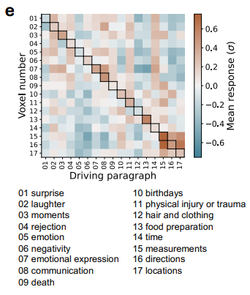
Build story from voxel explanations
For each subject, constructed stories using LLMs to drive 17 well-modeled voxels with diverse selectivity. These stories were then presented to the subjects in a second fMRI experiment.
Are the generated explanations causally related to brain activation?
Antonello et al. arXiv 2025 http://arxiv.org/pdf/2410.00812
Notes:
Fig. 1: Driving single-voxel response with generative causal testing. (a) Voxelwise BOLD responses were
recorded using fMRI as human subjects listened to 20 hours of narrative stories. An encoding model f was fit to predict
these responses from the story text. f consists of a linear model fit on representations extracted from an LLM, which are
not readily interpretable. Encoding models were tested by predicting responses on held-out fMRI data, and only wellperforming
models were selected for further analysis. (b) We used an automated procedure to find a verbal description
of the function that f computes for each voxel. First, we tested f on a large catalog of n-grams (n = 1, 2, 3) and found
those that maximally drove predicted responses. These n-grams were then summarized into stable explanation candidates
using a powerful instruction-tuned LLM. Finally, we evaluated each explanation candidate by generating corresponding
synthetic sentences and testing that these sentences yielded large predictions from f. (c) To test whether the generated
explanations were causally related to activation in the brain, we used an LLM to produce synthetic narrative stories
where each paragraph is designed to drive responses based on the generated explanation for one voxel. For each subject
we constructed stories to drive 17 well-modeled voxels with diverse selectivity. These stories were then presented to the
subjects in a second fMRI experiment. (d) Average BOLD response during its driving paragraph for each voxel, relative
to baseline, i.e. average response to all non-driving paragraphs. On average, driven responses were significantly higher
than baseline for each subject (p = 0.020 (S01), p < 10−5 (S02), p = 0.009 (S03); permutation test, FDR-corrected). For
well-driven voxels, this means that the generated explanation is causally related to activation of that voxel, and thus that
we have successfully translated the LLM-based encoding model into a verbal explanation. (e) Average BOLD response for
each selected voxel to each of the driving paragraphs in one subject (S02). Responses to the driving paragraph generated
using the explanation for that voxel appear along the main diagonal. Explanations that were used to construct the driving
paragraphs are shown below. BOLD responses were generally high for the driving paragraphs for each voxel as well as
semantically related paragraphs (e.g. directions and locations, emotional expression and laughter).

Slide 12
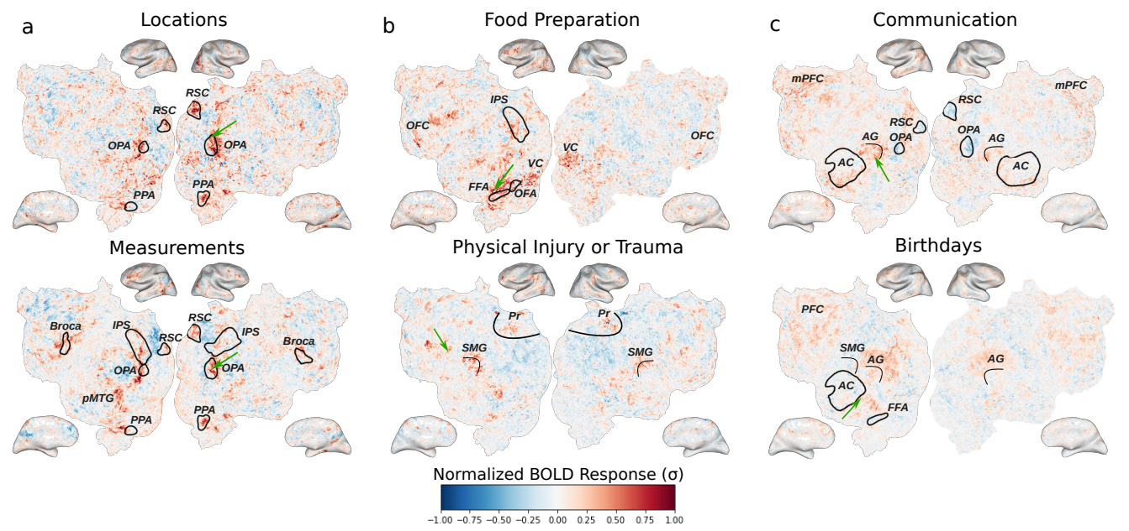
Responses to driving paragraphs reproduce known semantic contrasts
Antonello et al. arXiv 2025 http://arxiv.org/pdf/2410.00812
Are the generated explanations causally related to brain activation?
Notes:
Fig. 1: Driving single-voxel response with generative causal testing. (a) Voxelwise BOLD responses were
recorded using fMRI as human subjects listened to 20 hours of narrative stories. An encoding model f was fit to predict
these responses from the story text. f consists of a linear model fit on representations extracted from an LLM, which are
not readily interpretable. Encoding models were tested by predicting responses on held-out fMRI data, and only wellperforming
models were selected for further analysis. (b) We used an automated procedure to find a verbal description
of the function that f computes for each voxel. First, we tested f on a large catalog of n-grams (n = 1, 2, 3) and found
those that maximally drove predicted responses. These n-grams were then summarized into stable explanation candidates
using a powerful instruction-tuned LLM. Finally, we evaluated each explanation candidate by generating corresponding
synthetic sentences and testing that these sentences yielded large predictions from f. (c) To test whether the generated
explanations were causally related to activation in the brain, we used an LLM to produce synthetic narrative stories
where each paragraph is designed to drive responses based on the generated explanation for one voxel. For each subject
we constructed stories to drive 17 well-modeled voxels with diverse selectivity. These stories were then presented to the
subjects in a second fMRI experiment. (d) Average BOLD response during its driving paragraph for each voxel, relative
to baseline, i.e. average response to all non-driving paragraphs. On average, driven responses were significantly higher
than baseline for each subject (p = 0.020 (S01), p < 10−5 (S02), p = 0.009 (S03); permutation test, FDR-corrected). For
well-driven voxels, this means that the generated explanation is causally related to activation of that voxel, and thus that
we have successfully translated the LLM-based encoding model into a verbal explanation. (e) Average BOLD response for
each selected voxel to each of the driving paragraphs in one subject (S02). Responses to the driving paragraph generated
using the explanation for that voxel appear along the main diagonal. Explanations that were used to construct the driving
paragraphs are shown below. BOLD responses were generally high for the driving paragraphs for each voxel as well as
semantically related paragraphs (e.g. directions and locations, emotional expression and laughter).

Slide 13
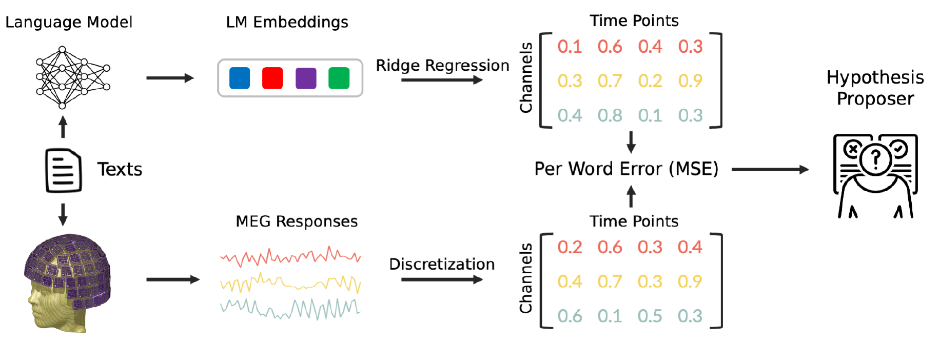
Divergences Between LMs and Human Brains
Participants either listened to or read narratives. LM embeddings from GPT-2 XL (1.5B) and Llama-2 7B. Ridge regression with cross-validation is used to compute prediction error per word.
NL hypotheses explaining the differences between two text corpora (D0, D1) are generated using a proposer (GPT-3) - verifier (FLAN-T5-XXL) system.
Zhou et al. NeurIPS 2024 https://arxiv.org/pdf/2311.09308
Notes:
Figure 1: Schematic of our experimental approach. The LM takes as input the current word along
with its preceding context to produce the current word’s LM embedding. This embedding is then
used as input to a ridge regression model to predict the human brain responses associated with the
word. The Mean Squared Error (MSE) between the predicted and actual MEG responses is calculated.
Finally, an LLM-based hypothesis proposer is employed to formulate natural language hypotheses
explaining the divergence between the predicted and actual MEG responses.

Slide 14
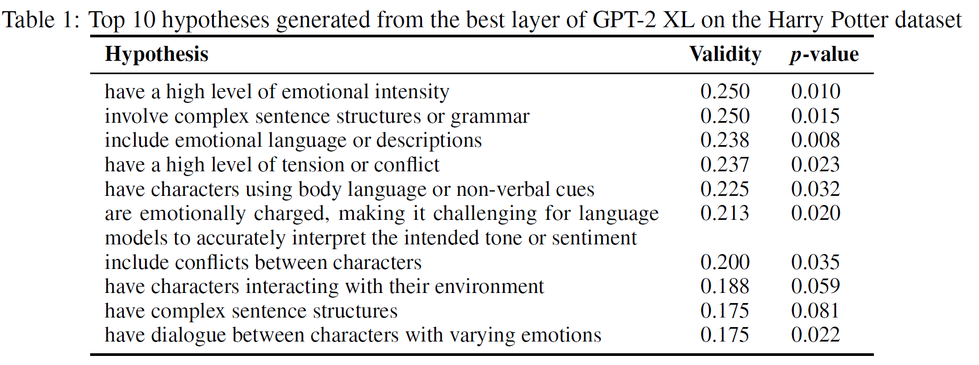
Divergences Between LMs and Human Brains
Validity measures the difference in certainty that the hypothesis is true between the two corpora.
Two topics chosen: Social/Emotional Intelligence and Physical Commonsense
Divergence between human brains and LMs:
Brain responses not well explained by LMs because of limited representations of these topics
Zhou et al. NeurIPS 2024 https://arxiv.org/pdf/2311.09308
Notes:
To discover subtle differences between MEG responses and LM predictions, we used a method that automatically describes differences between text corpora using proposer and verifier LMs [Zhong et al., 2023]. This system consists of first prompting an LLM (GPT-3; Brown et al. [2020b]) with a number of samples from two corpora (D0, D1) to generate many hypotheses on how the first corpus
differs from the second, and then using a fine-tuned validator model (FLAN-T5-XXL; Chung et al. [2022]) to validate how often each proposed hypothesis is true based on pairs from each corpus sampled from a held-out set. Specifically, the verifier is presented with a prompt containing two sentences from D0 and D1, and asked whether or not the hypothesis is true, and this is repeated
across the development set for each hypothesis. For the exact prompts used in the proposer and verifier, please refer to Appendix E. Sentences were then ranked based on their mean MSE. The top 100 least-predicted sentences constituted the D0 set, while the 100 well-predicted sentences constituted the D1 set. This process of hypothesis proposal and verification was repeated across 3
cross-validation folds.

Slide 15
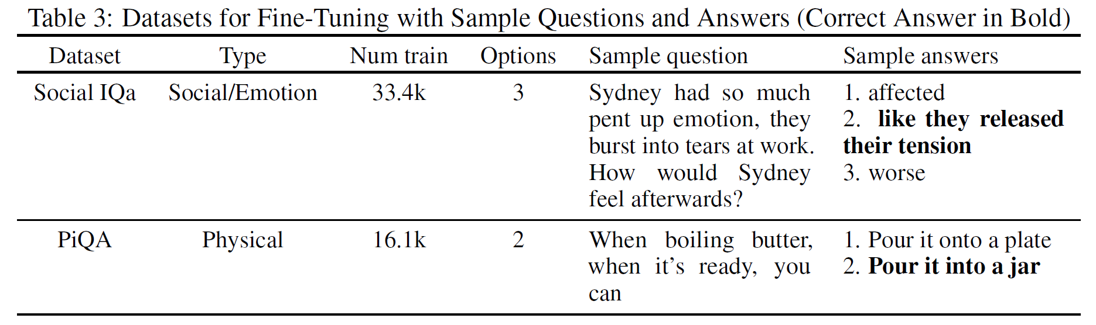
Divergences Between LMs and Human Brains
Each multiple-choice option is concatenated with the question to format it as a language modeling task.
Fine-tuning!
Zhou et al. NeurIPS 2024 https://arxiv.org/pdf/2311.09308
Notes:
Fine-tuning: we fine-tuned the GPT-2 XL model on datasets specific to the two phenomena to examine if targeted fine-tuning could enhance the model’s alignment with brain activity.
Furthermore, we examined whether domain-specific fine-tuning would specifically bolster the model’s
capability in predicting MEG responses associated with words from that domain, as compared to
words outside that domain.
Social/Emotional Intelligence We study social and emotional intelligence using the Social IQa
dataset [Sap et al., 2019]. This dataset contains questions about people’s feelings and their social
implications.
Physical Commonsense We study physical commonsense using the PiQA dataset [Bisk et al., 2020b].
This dataset contains goal-driven questions based on everyday situations. These questions were taken
from the website instructables.com, where people share DIY project instructions.
We also provide examples from each dataset in Table 3.

Slide 16
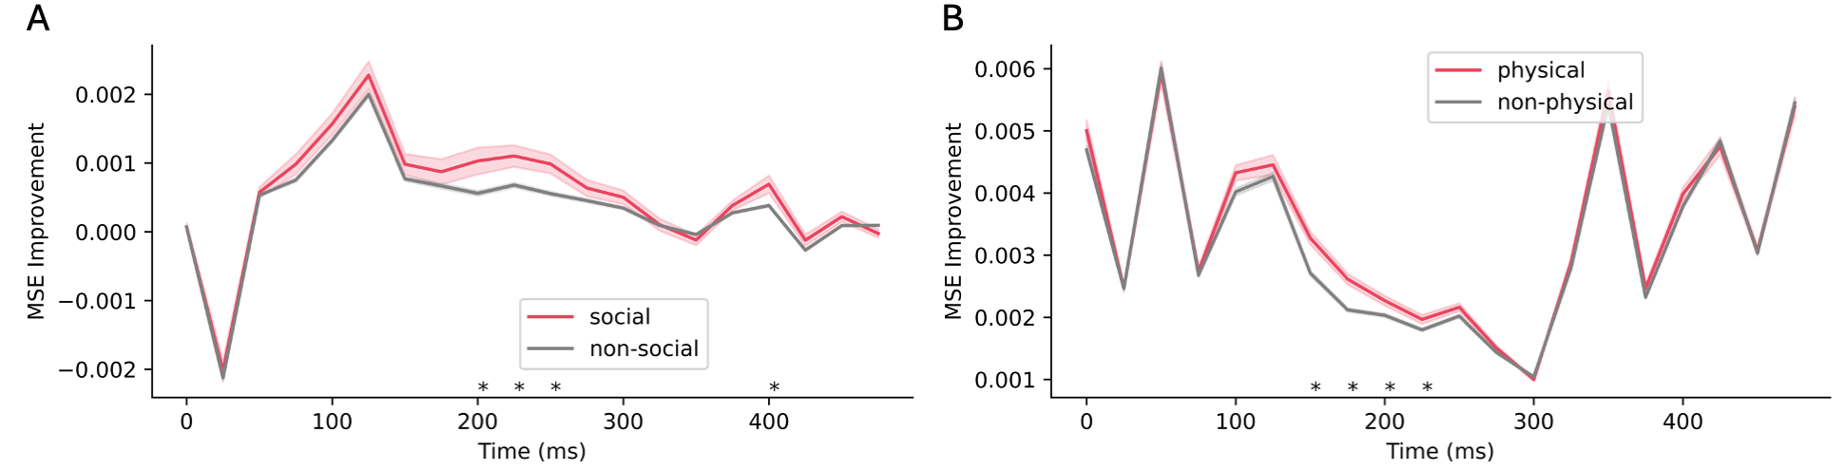
Divergences Between LMs and Human Brains
Can targeted fine-tuning improve LM-brain alignment?
Comparison of improved MSE between (A) social and (B) physical words and those outside each category evaluated on models fine-tuned on corresponding datasets. Positive values denote lower MSEs in the fine-tuned model.
LMs differ from human language processing in social/emotional intelligence and physical commonsense
Fine-tuning indeed improves alignment for words annotated with that category!
Zhou et al. NeurIPS 2024 https://arxiv.org/pdf/2311.09308
Notes:
Fine-tuning: we fine-tuned the GPT-2 XL model on datasets specific to the two phenomena to examine if targeted fine-tuning could enhance the model’s alignment with brain activity.
Furthermore, we examined whether domain-specific fine-tuning would specifically bolster the model’s
capability in predicting MEG responses associated with words from that domain, as compared to
words outside that domain.
Figure 6: Comparison of improved MSE between (A) social and (B) physical words and those outside
each category evaluated on models fine-tuned on corresponding datasets. Positive values denote lower
MSEs in the fine-tuned model. Shaded region indicates standard error. Asterisks denote time points
with significant differences between the two groups (Student’s t-test with FDR correction, p=0.05).

Slide 17
Agenda
Introduction to the tutorial [10 min]
Introduction to Brain Encoding and Decoding [50 min]
Brain Encoding: Scaling Laws, Multilinguality, Multimodal and Instruction-tuned Models [60 min]
Coffee Break & Networking [30 min]
Brain-informed Fine-tuning of Language Models [30 min]
Brain-based Interpretability and Causal Testing of AI Models [20 min]
Brain Decoding [30 min]
Summary and Future Trends [10 min]

Slide 18
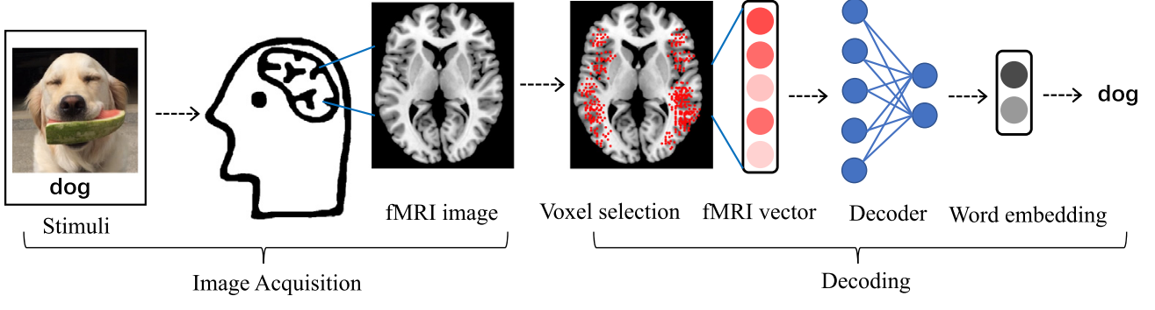
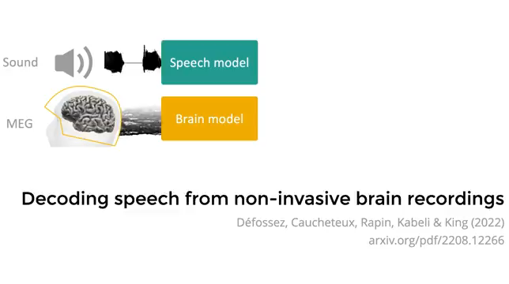
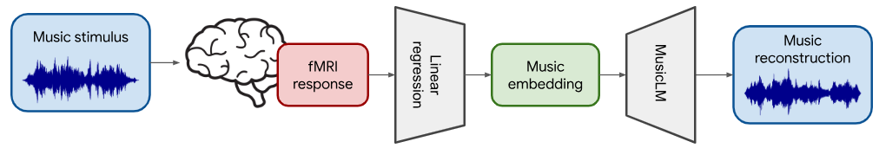

What is Brain Decoding?
Can we reconstruct the stimulus, given the brain response?
Can you read the mind from fMRI responses!
Or at least tell what the person saw?
Linguistic Decoding
Alexandre Défossez, Charlotte Caucheteux, Jérémy Rapin, Ori Kabeli & Jean-Rémi King. "Decoding speech perception from non-invasive brain recordings" Nature Machine Intelligence 2023.
Timo I. Denk, Yu Takagi, Takuya Matsuyama, Andrea Agostinelli, Tomoya Nakai, Christian Frank, Shinji Nishimoto. "Brain2Music: Reconstructing Music from Human Brain Activity" Arxiv 2024.

Slide 19
Outline
Semantic reconstruction of continuous language from non-invasive brain recordings
Generative Language reconstruction from non-invasive brain recordings
Notes:
Why is Decoding Continuous Language from fMRI So Challenging?
Imagine someone listening to the sentence:
“The cat jumped over the fence.”
With fMRI, the brain’s response to this sentence isn’t mapped word-by-word. Why?
fMRI is slow: it measures the blood-oxygen-level-dependent (BOLD) signal, which is very slow. A single burst of neural activity causes a BOLD response that unfolds over ~10 seconds.
Since natural English speech occurs at ~2 words per second, this means that each brain image (fMRI scan) can be influenced by 20 or more overlapping words.
This temporal smearing makes it extremely difficult to isolate the brain’s response to individual words—posing a major challenge for sentence-level decoding.
So the challenge becomes:
Given a low SNR of brain activity, can we guess the exact sentence the person heard or imagined?
This is an ill-posed inverse problem with many possible solutions.

Slide 20
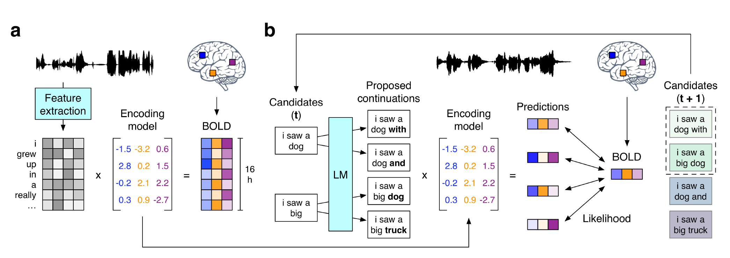
Continuous Language Decoder
Stimuli: Moth-Radio-Hour, Short-movie-clips
Stimulus representation: GPT2 language model
Brain recording & modality: fMRI, listening
Jerry Tang, Amanda LeBel, Shailee Jain & Alexander G. Huth "Semantic reconstruction of continuous language from non-invasive brain recordings" Nature Neuroscience 2023.
Notes:
Fig. 1. Language decoder. (a) BOLD fMRI responses were recorded while three subjects listened to 16 h of 100 narrative stories. An encoding model was estimated for each subject to predict brain responses from semantic features of stimulus words. (b) To reconstruct language from novel brain recordings, the decoder maintains a set of candidate word sequences. When new words are detected, a language model (LM) proposes continuations for each sequence and the encoding model scores the likelihood of the recorded brain responses under each continuation. The most likely continuations are retained.
(c) Decoders were evaluated on single-trial brain responses recorded while subjects listened to test stories that were not used for model training. Segments from four test stories are shown alongside decoder predictions for one subject. The decoder exactly reproduces some words and phrases, and captures the gist of many more. (d) Decoder predictions for a test story were significantly more similar to the actual stimulus words than expected by chance under a range of language similarity metrics (* indicates q(FDR) < 0.05 for all subjects, one-sided nonparametric test). To compare across metrics, results are shown as standard deviations away from the mean of the null distribution (see Methods). Boxes indicate the interquartile range of the null distribution; whiskers indicate the 5th and 95th percentiles. (e) For most time points, decoding scores were significantly higher than expected by chance (q(FDR) < 0.05, one-sided nonparametric test) under the BERTScore
113 metric. (f) Identification accuracy for one subject. The brightness at (𝑖, 𝑗) reflects the similarity between the 𝑖th second of the prediction and the 𝑗th second of the actual stimulus. Identification accuracy was significantly higher than expected by chance (p < 0.05, one-sided permutation test).

Slide 21
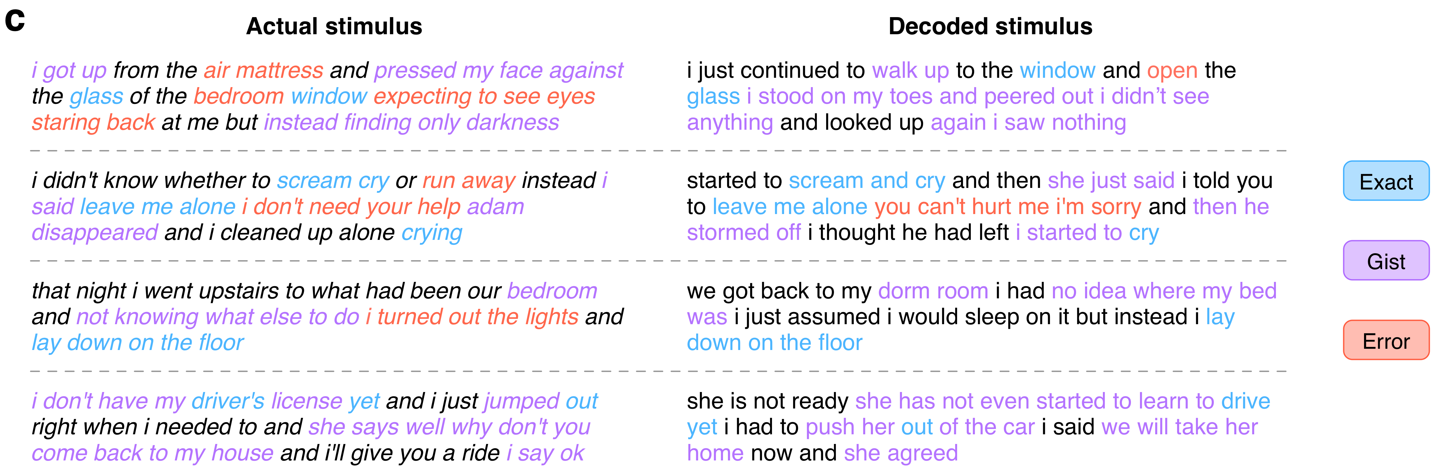
Continuous Language Decoder
Jerry Tang, Amanda LeBel, Shailee Jain & Alexander G. Huth "Semantic reconstruction of continuous language from non-invasive brain recordings" Nature Neuroscience 2023.
Notes:
Fig. 1. Language decoder. (c) Decoders were evaluated on single-trial brain responses recorded while subjects listened to test stories that were not used for model training. Segments from 105 four test stories are shown alongside decoder predictions for one subject. The decoder exactly reproduces some words and phrases, and captures the gist of many more.
(d) Decoder predictions for a test story were significantly more similar to the actual stimulus words than expected by chance under a range of language similarity metrics (* indicates q(FDR) < 0.05 for all subjects, one-sided nonparametric test). To compare across metrics, results are shown as standard deviations away from the mean of the null distribution (see Methods). Boxes indicate the interquartile range of the null distribution; whiskers indicate the 5th and 95th percentiles. (e) For most time points, decoding scores were significantly higher than expected by chance (q(FDR) < 0.05, one-sided nonparametric test) under the BERTScore
113 metric. (f) Identification accuracy for one subject. The brightness at (𝑖, 𝑗) reflects the similarity between the 𝑖th second of the prediction and the 𝑗th second of the actual stimulus. Identification accuracy was significantly higher than expected by chance (p < 0.05, one-sided permutation test).

Slide 22
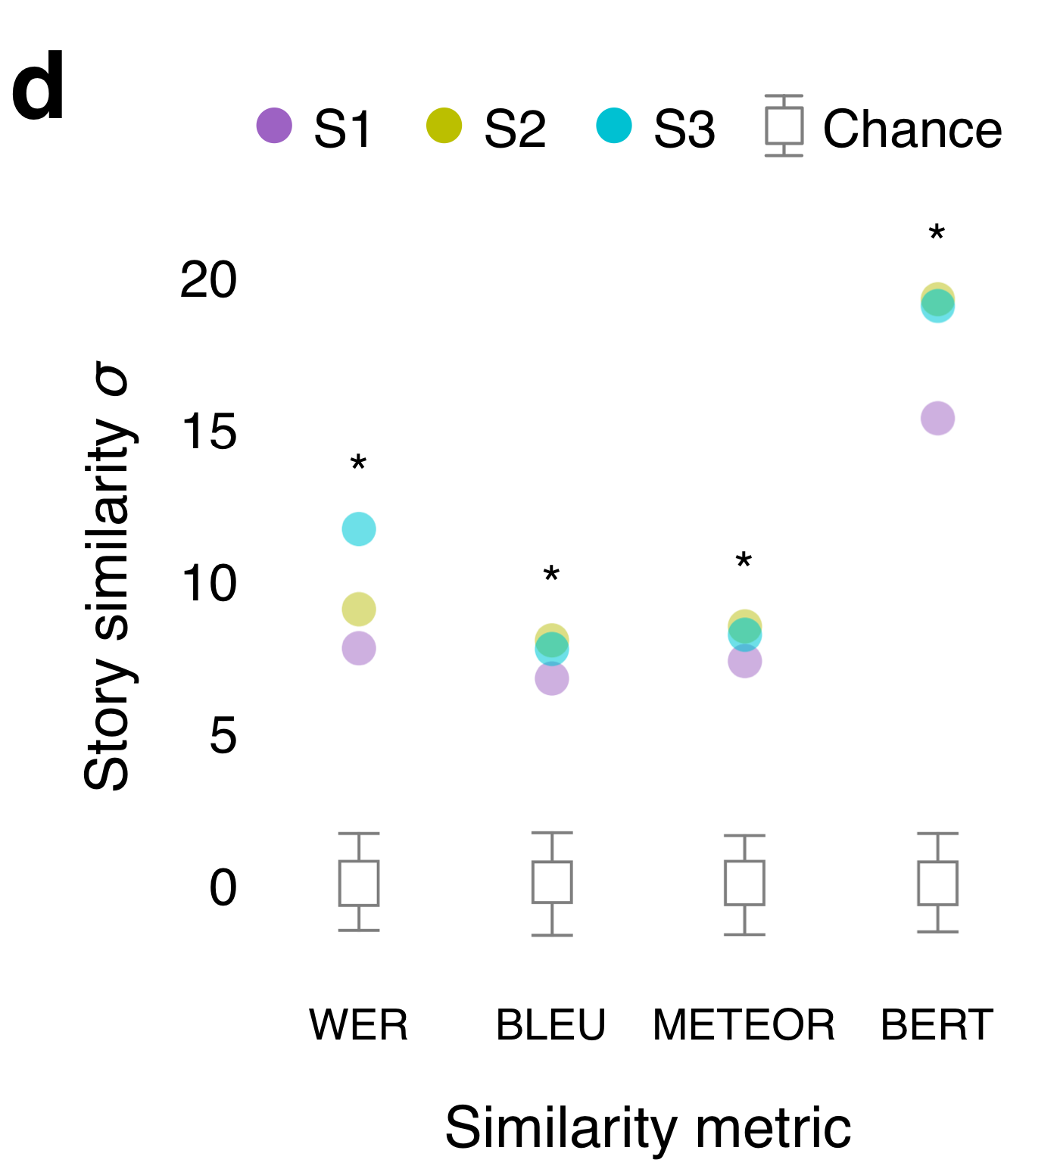
Continuous Language Decoder
Jerry Tang, Amanda LeBel, Shailee Jain & Alexander G. Huth "Semantic reconstruction of continuous language from non-invasive brain recordings" Nature Neuroscience 2023.
Notes:
Because different words can convey the same meaning—for instance “we were busy” and “we had a lot of work”—we also used BERTScore, a newer method which uses machine learning to quantify whether two sequences share a meaning.
Fig. 1. Language decoder. (d) Decoder predictions for a test story were significantly more similar to the actual stimulus words than expected by chance under a range of language similarity metrics (* indicates q(FDR) < 0.05 for all subjects, one-sided nonparametric test). To compare across metrics, results are shown as standard deviations away from the mean of the null distribution (see Methods). Boxes indicate the interquartile range of the null distribution; whiskers indicate the 5th and 95th percentiles.
(e) For most time points, decoding scores were significantly higher than expected by chance (q(FDR) < 0.05, one-sided nonparametric test) under the BERTScore metric.
(f) Identification accuracy for one subject. The brightness at (𝑖, 𝑗) reflects the similarity between the 𝑖th second of the prediction and the 𝑗th second of the actual stimulus. Identification accuracy was significantly higher than expected by chance (p < 0.05, one-sided permutation test).

Slide 23
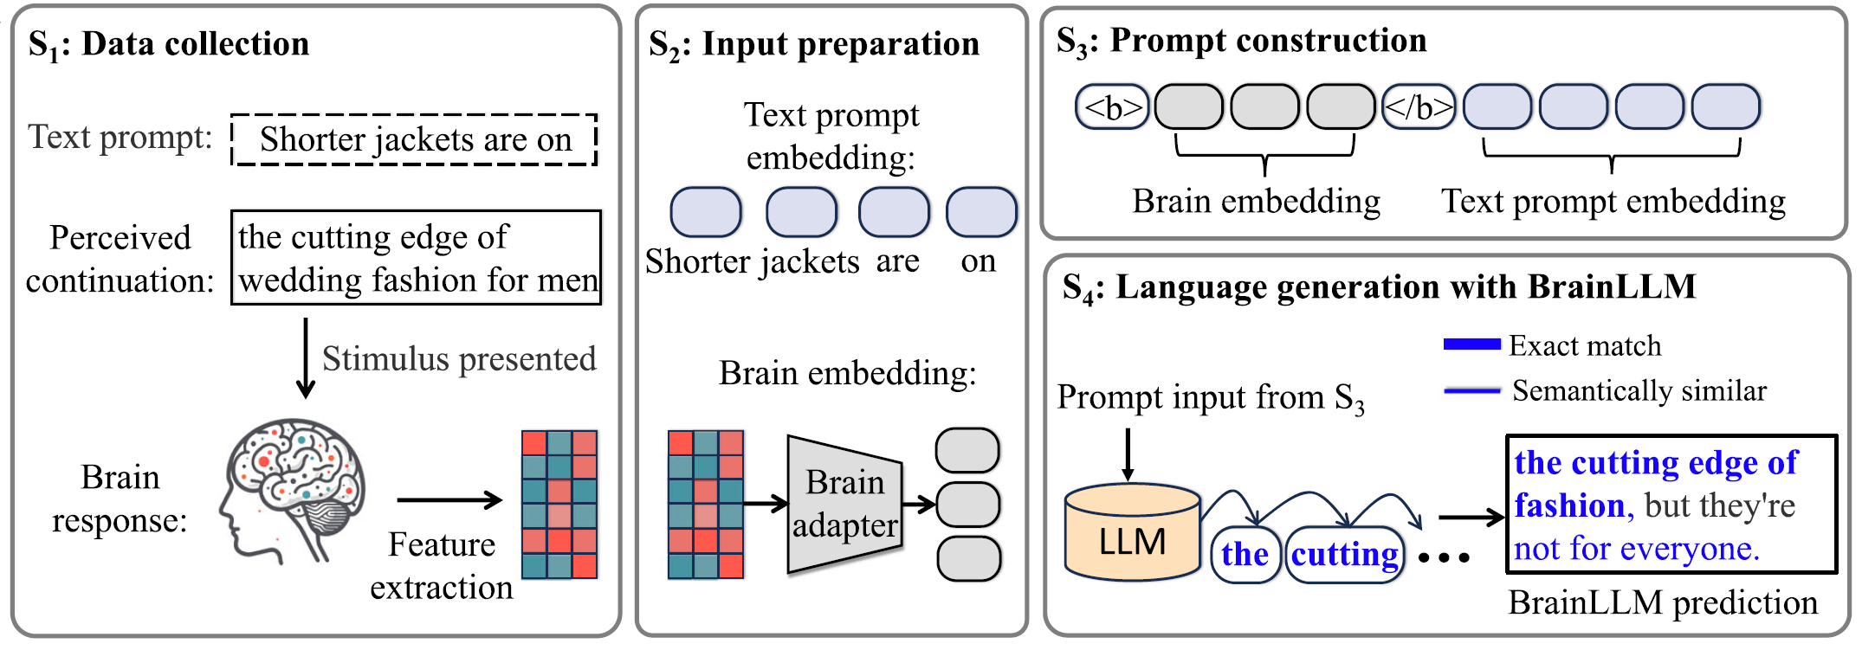
Generative Language Decoder
Four main Stages in Language Generation with brain recordings.
BrainLLM
Ye et al. (2025). Generative language reconstruction from brain recordings. Commun Biol.
https://doi.org/10.1038/s42003-025-07731-7
Notes:
Fig. 1 | Language generation with brain recordings (BrainLLM).
a The generation process has four main stages. S1: Brain recordings in response to the perceived continuation are collected.
S2: A brain adapter extracts features from brain recordings and transforms them into hidden vectors that match the shape of text embeddings in a standard LLM.
S3: Brain embeddings and text prompt embeddings are concatenated as a prompt input. S4: The prompt input is fed into the LLM for language generation. BrainLLM generates content that is an exact match ("the cutting edge of'') with, or semantically similar/gist match content ("not for everyone'')
to the perceived continuation.
b Examples of language generation with BrainLLM and its controls (PerBrainLLM). Text in blue and bold indicates that the generated content and the ground truth (perceived continuation) are manually
annotated as semantically similar and an exact match, respectively.

Slide 24
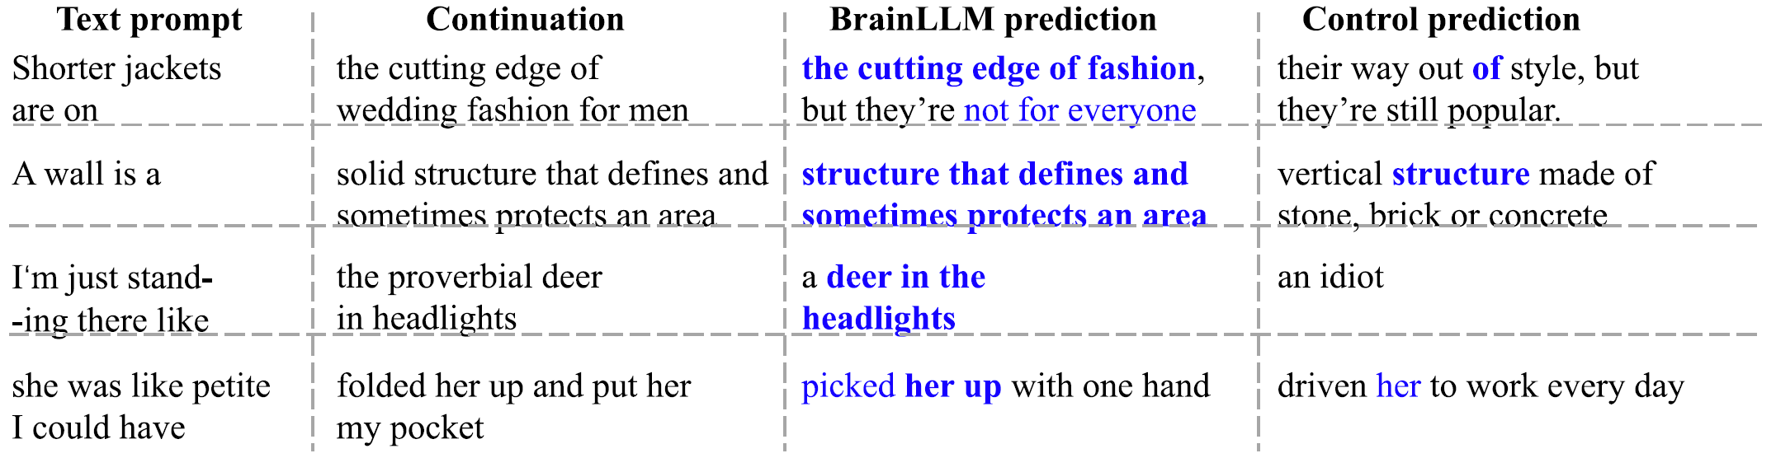
Generative Language Decoder
Examples of language generation with BrainLLM and its controls (PerBrainLLM).
Text in blue and bold indicates that the generated content and the ground truth (perceived continuation) are manually annotated as semantically similar and an exact match, respectively.
BrainLLM can be used in an auto-regressive manner to reconstruct a 10 min-long language stimulus!!
Brain language interfaces for mapping functional representations of language perception in the brain.
Ye et al. (2025). Generative language reconstruction from brain recordings. Commun Biol.
https://doi.org/10.1038/s42003-025-07731-7
Notes:
Fig. 1 | Language generation with brain recordings (BrainLLM).
b Examples of language generation with BrainLLM and its controls (PerBrainLLM). Text in blue and bold indicates that the generated content and the ground truth (perceived continuation) are manually annotated as semantically similar and an exact match, respectively.

Slide 25
Agenda
Introduction to the tutorial [10 min]
Introduction to Brain Encoding and Decoding [50 min]
Brain Encoding: Scaling Laws, Multilinguality, Multimodal and Instruction-tuned Models [60 min]
Coffee Break & Networking [30 min]
Brain-informed Fine-tuning of Language Models [30 min]
Brain-based Interpretability and Causal Testing of AI Models [20 min]
Brain Decoding [30 min]
Summary and Future Trends [10 min]

Slide 26
Summary & Future Directions
Exciting times: publicly accessible neuroimaging data of various tasks starting to be avaliable now!
Opportunities:
Data ahead of theory, so it’s an open field for theoretical and methodological innovation!
Encoding models can be interpreted as process models constraining brain-computational theories (Kriegeskorte and Douglas, 2019).
Decoding models serve as a test for the presence of information in neural responses (Karamolegkou et al., 2023)
Decoding is relevant for cognitive neuroscientists interested in how semantic information is represented in the brain.
Computational linguists are interested in the cognitive plausibility of distributional models. (Minnema & Herbelot, ACL 2019)
DL is helpful in uncovering patterns in brain responses and may lead to theories of information organization in the brain.
Challenges:
Neuroimaging data is more complex, noisy as compared to classical datasets used by DL researchers
The differences between the models in terms of architectural variability and variability in pretraining methods have an impact on the outcomes. More tightly controlled comparisons are required to better isolate the effects of these factors.
Disentangling contributions of multiple sources of info impacting brain predictions
Notes:
Overall, our work has several implications for neuro-AI
Speech models ARE useful

Slide 27
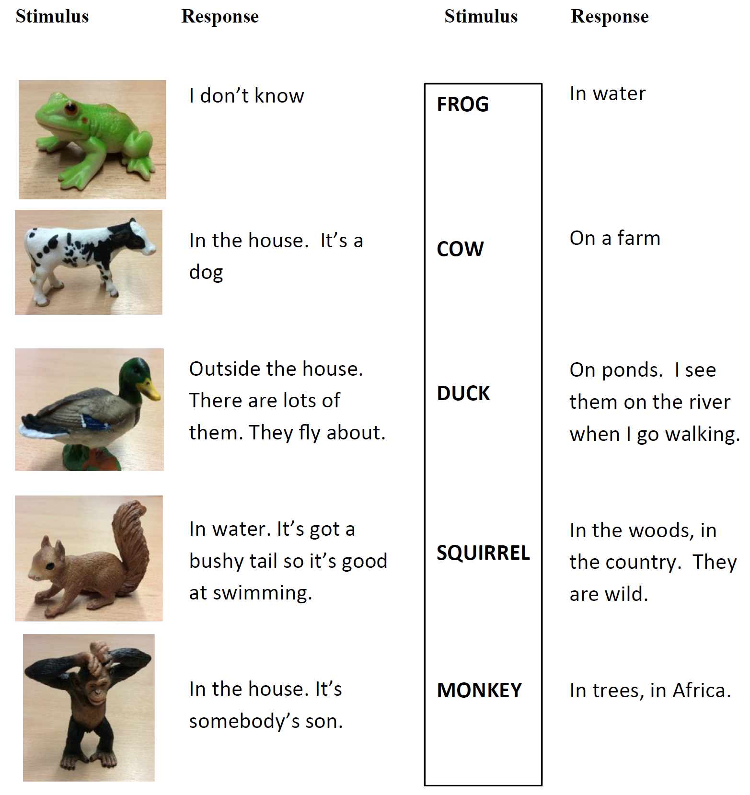
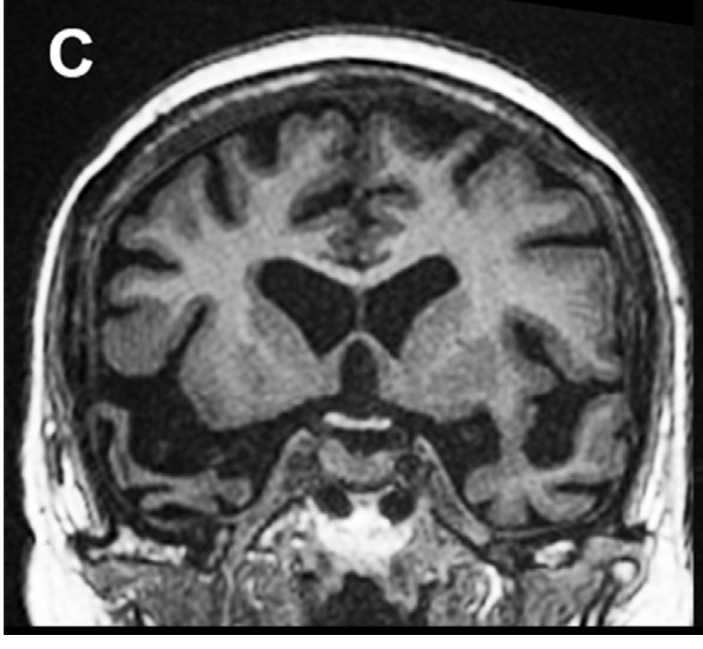
DNNs & Brain Damage
DL models of encoding and decoding have not yet been put through the brain-damage experiments. Ex. Semantic Dementia
Animal habitat task.
The patient is asked:
Where would you find this?
Do DL Models exhibit such degradation with damage to units?
Rt Ant Temporal Lobe Damage (Patient 8)
Snowden, Harris, Thompson, Kobylecki, Jones, Richardson, Neary (2018). Semantic dementia and the left and right temporal lobes, Cortex, 107(188-203).
https://doi.org/10.1016/j.cortex.2017.08.024.
Notes:
Semantic dementia is a disabling neurodegenerative disorder characterised by profound and widespread loss of conceptual knowledge. Semantic dementia, a circumscribed disorder of semantic knowledge, provides a unique model for understanding the neural basis for semantic representation.
Fig. 6 e Examples of patient 8's responses in Animal habitat task. The patient is asked: Where would you find this?
In the Animal task he was able to provide more specific identifying information from the animals’ name than from the three-dimensional model. Examples
of his responses to animal models and their corresponding names are shown in Fig. 6.

Slide 28
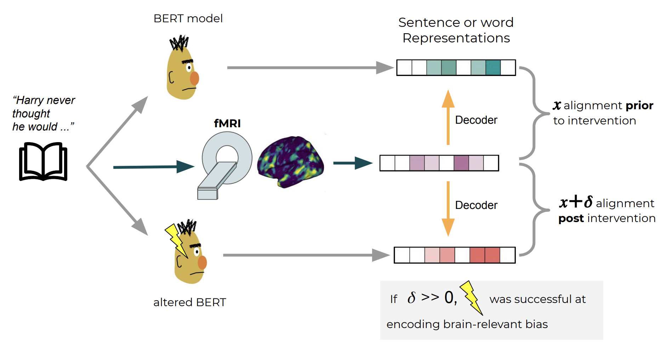
DNNs as a model organism
What information is necessary or sufficient to perform a task? To predict brain activity?
Model organism, and not simply a model, because DNNs have evolved separately from the human brain
Model organisms allow for direct interventions, which cannot be done in humans
Abdou, Mostafa, Ana Valeria González, Mariya Toneva, Daniel Hershcovich, and Anders Søgaard. "Does injecting linguistic structure into language models lead to better alignment with brain recordings?." arXiv preprint arXiv:2101.12608 (2021).

Slide 29
A big thank you!
Tutorial, Code and Material:
Material from AAAI 2026 Tutorial would be uploaded soon!
(Past): Deep Learning for Brain Encoding and Decoding, Cogsci-2022
https://tinyurl.com/DL4Brain
(Past): Language and the Brain: Deep Learning for Brain Encoding and Decoding, IJCNN 2023
https://tinyurl.com/DLBrainIJCNN2023
(Past): Deep Neural Networks and Brain Alignment: Brain Encoding and Decoding, IJCAI 2023
https://tinyurl.com/DLBrainIJCAI2023

Slide 30
References
Pereira, Francisco, et al. "Toward a universal decoder of linguistic meaning from brain activation." Nature communications 9.1 (2018).
Sun, Jingyuan, et al. "Towards sentence-level brain decoding with distributed representations." Proceedings of the AAAI Conference on Artificial Intelligence. Vol. 33. No. 01. 2019.
Affolter, Nicolas, et al. "Brain2word: decoding brain activity for language generation." arXiv preprint arXiv:2009.04765 (2020).
Abdou, Mostafa, et al. "Does injecting linguistic structure into language models lead to better alignment with brain recordings?." arXiv preprint arXiv:2101.12608 (2021).
Sun, Jingyuan, et al. "Neural encoding and decoding with distributed sentence representations." IEEE Transactions on Neural Networks and Learning Systems 32.2 (2020): 589-603.
Oota, Subba Reddy, et al. "Cross-view Brain Decoding." arXiv preprint arXiv:2204.09564 (2022).
Gauthier, Jon, and Roger Levy. "Linking artificial and human neural representations of language." EMNLP/IJCNLP (1). 2019.
Shen, Guohua, et al. "Deep image reconstruction from human brain activity." PLoS computational biology 15.1 (2019): e1006633.
Beliy, Roman, et al. "From voxels to pixels and back: Self-supervision in natural-image reconstruction from fMRI." Advances in Neural Information Processing Systems 32 (2019).
Shen, Guohua, et al. "End-to-end deep image reconstruction from human brain activity." Frontiers in Computational Neuroscience (2019): 21.

Slide 31
References
Nishimoto, Shinji, et al. "Reconstructing visual experiences from brain activity evoked by natural movies." Current biology 21.19 (2011): 1641-1646.
Anumanchipalli, Gopala K., Josh Chartier, and Edward F. Chang. "Speech synthesis from neural decoding of spoken sentences." Nature 568.7753 (2019): 493-498.
Schrimpf, Martin, et al. "The neural architecture of language: Integrative modeling converges on predictive processing." Proceedings of the National Academy of Sciences 118.45 (2021): e2105646118.
Wehbe, Leila, et al. "Simultaneously uncovering the patterns of brain regions involved in different story reading subprocesses." PloS one 9.11 (2014): e112575.

Slide 32
Thanks!
Questions
subba-reddy.oota@inria.fr
tanchak@iitd.ac.in
gmanish@microsoft.com
raju.bapi@iiit.ac.in
Connect with us:
https://www.linkedin.com/in/subba-reddy-oota-11a91254/
https://tanmoychak.com/
http://aka.ms/manishgupta, https://sites.google.com/view/manishg/
https://sites.google.com/view/bccl-iiith/home

