Slide 1

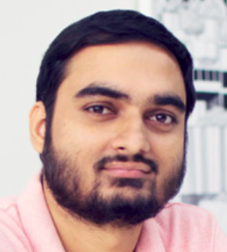
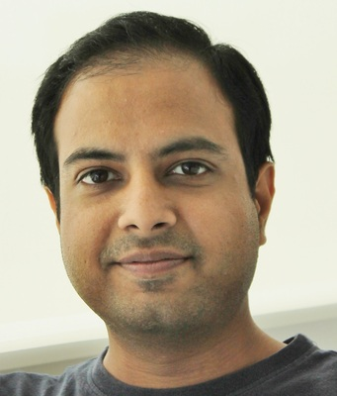

Brain-Inspired AI 2.0: Aligning Language Models Across Languages and Modalities
Subba Reddy Oota¹, Tanmoy Chakraborty², Manish Gupta^{3,4}, Raju S. Bapi³
¹TU Berlin, Germany; ²IIT Delhi, India; ³IIIT Hyderabad, India; ⁴Microsoft, India
subba.reddy.oota@tu-berlin.de, tanchak@iitd.ac.in, gmanish@microsoft.com, raju.bapi@iiit.ac.in

Slide 2
Agenda
Introduction to the tutorial [10 min]
Introduction to Brain Encoding and Decoding [50 min]
Brain Encoding: Scaling Laws, Multilinguality, Multimodal and Instruction-tuned Models [60 min]
Coffee Break & Networking [30 min]
Brain-informed Fine-tuning of Language Models [30 min]
Brain-based Interpretability and Causal Testing of AI Models [20 min]
Brain Decoding [30 min]
Summary and Future Trends [10 min]

Slide 3
Agenda
Introduction to the tutorial [10 min]
Introduction to Brain Encoding and Decoding [50 min]
Brain Encoding: Scaling Laws, Multilinguality, Multimodal and Instruction-tuned Models [60 min]
Coffee Break & Networking [30 min]
Brain-informed Fine-tuning of Language Models [30 min]
Brain-based Interpretability and Causal Testing of AI Models [20 min]
Brain Decoding [30 min]
Summary and Future Trends [10 min]

Slide 4
Agenda
Introduction to the tutorial [10 min]
Introduction to Brain Encoding and Decoding [50 min]
Brain Encoding: Scaling Laws, Multilinguality, Multimodal and Instruction-tuned Models [60 min]
Coffee Break & Networking [30 min]
Brain-informed Fine-tuning of Language Models [30 min]
Brain-based Interpretability and Causal Testing of AI Models [20 min]
Brain Decoding [30 min]
Summary and Future Trends [10 min]

Slide 5
Agenda
Introduction to the tutorial [10 min]
Introduction to Brain Encoding and Decoding [50 min]
Brain Encoding/Decoding and applications
Introduction to popular datasets
Text Stimulus Representations
Alignment Between AI Models and Human Brain Language Comprehension
Brain Encoding: Scaling Laws, Multilinguality, Multimodal and Instruction-tuned Models [60 min]
Coffee Break & Networking [30 min]
Brain-informed Fine-tuning of Language Models [30 min]
Brain-based Interpretability and Causal Testing of AI Models [20 min]
Brain Decoding [30 min]
Summary and Future Trends [10 min]

Slide 6
Agenda
Introduction to the tutorial [10 min]
Introduction to Brain Encoding and Decoding [50 min]
Brain Encoding/Decoding and applications
Introduction to popular datasets
Text Stimulus Representations
Alignment Between AI Models and Human Brain Language Comprehension
Brain Encoding: Scaling Laws, Multilinguality, Multimodal and Instruction-tuned Models [60 min]
Coffee Break & Networking [30 min]
Brain-informed Fine-tuning of Language Models [30 min]
Brain-based Interpretability and Causal Testing of AI Models [20 min]
Brain Decoding [30 min]
Summary and Future Trends [10 min]

Slide 7
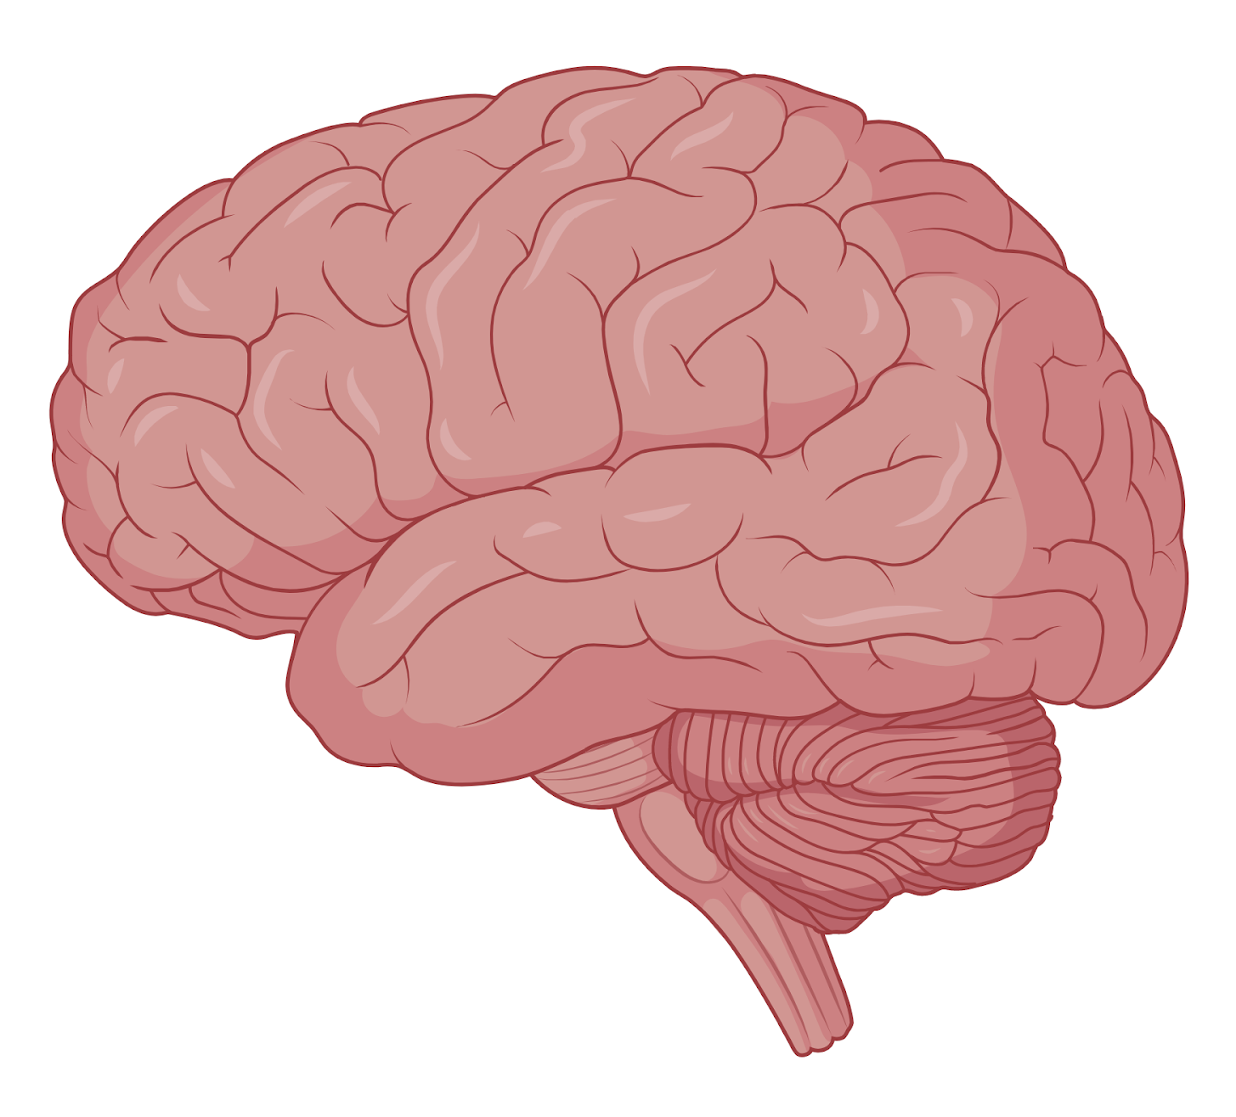
Neuroscience
Field of science that studies the structure and function of the nervous system of different species.
How is information represented and processed in the brain?
How does the brain integrate text, vision, sound, and touch?
How do abstract concepts (like numbers or language) get encoded?
How does the brain learn and change?
What are the neural mechanisms that allow learning, memory, and adaptation?
How are memories formed but not overwritten?
How does the brain learn from very few examples?
How does RL work biologically?
How do large-scale brain circuits coordinate behavior?
How do distributed brain regions work together to produce coherent behavior?
How does the brain decide when to act or inhibit action?
How do sensory inputs get transformed into motor outputs?

Slide 8
Neuroscience
What goes wrong in neurological and psychiatric disorders, and how can we fix it?
How do disruptions in brain structure or function cause diseases (Alzheimer’s, depression, Parkinson’s, autism, and schizophrenia), and how can we treat them?
Precision psychiatry: Can we predict which treatment will work for whom, when, and why?
How does the brain give rise to the mind and consciousness?
How do electrical and chemical signals in neurons produce subjective experiences like thoughts, emotions, awareness, and the sense of self?
Is consciousness localized or distributed?
Can machines ever be conscious?
What changes in the brain when consciousness is lost?
Brain-computer interfaces

Slide 9
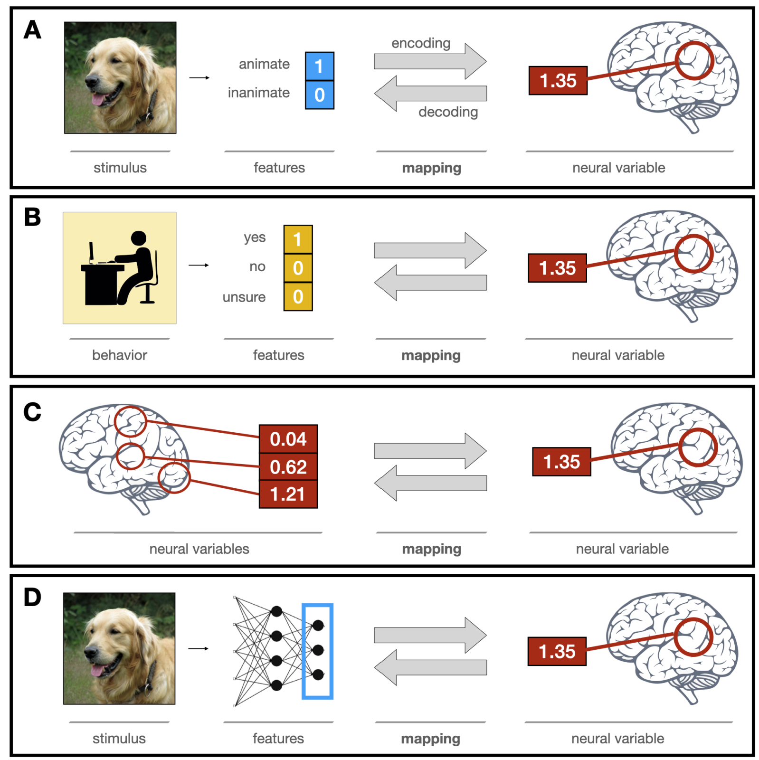
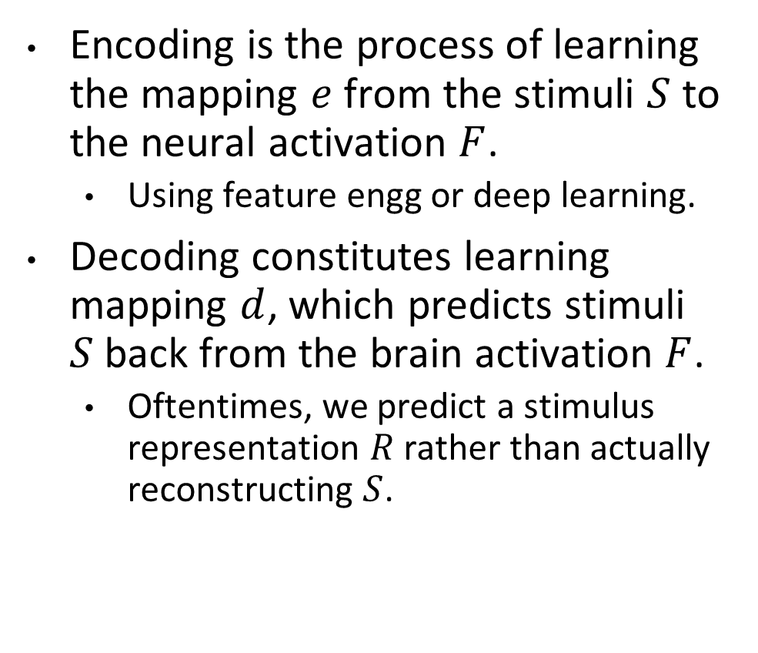
Brain encoding and decoding in cognitive neuroscience
Encoding is the process of learning the mapping $e$ from the stimuli $S$ to the neural activation $F$.
Using feature engg or deep learning.
Decoding constitutes learning mapping $d$, which predicts stimuli $S$ back from the brain activation $F$.
Oftentimes, we predict a stimulus representation $R$ rather than actually reconstructing $S$.
Ivanova, Anna A., Martin Schrimpf, Stefano Anzellotti, Noga Zaslavsky, Evelina Fedorenko, and Leyla Isik. "Is it that simple? Linear mapping models in cognitive neuroscience." bioRxiv (2021).

Slide 10
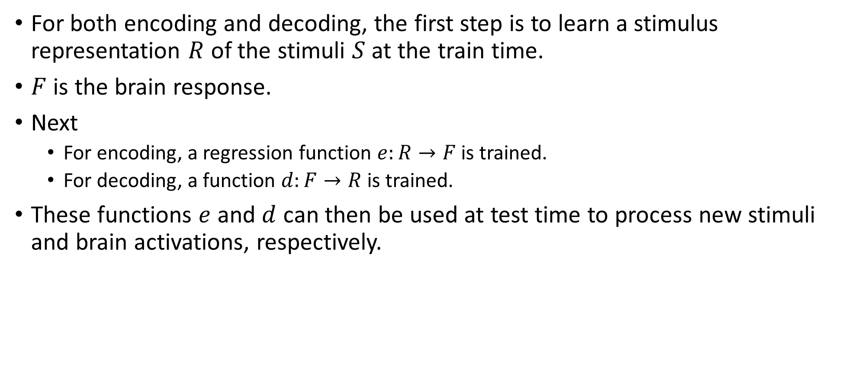
Brain encoding and decoding

Slide 11
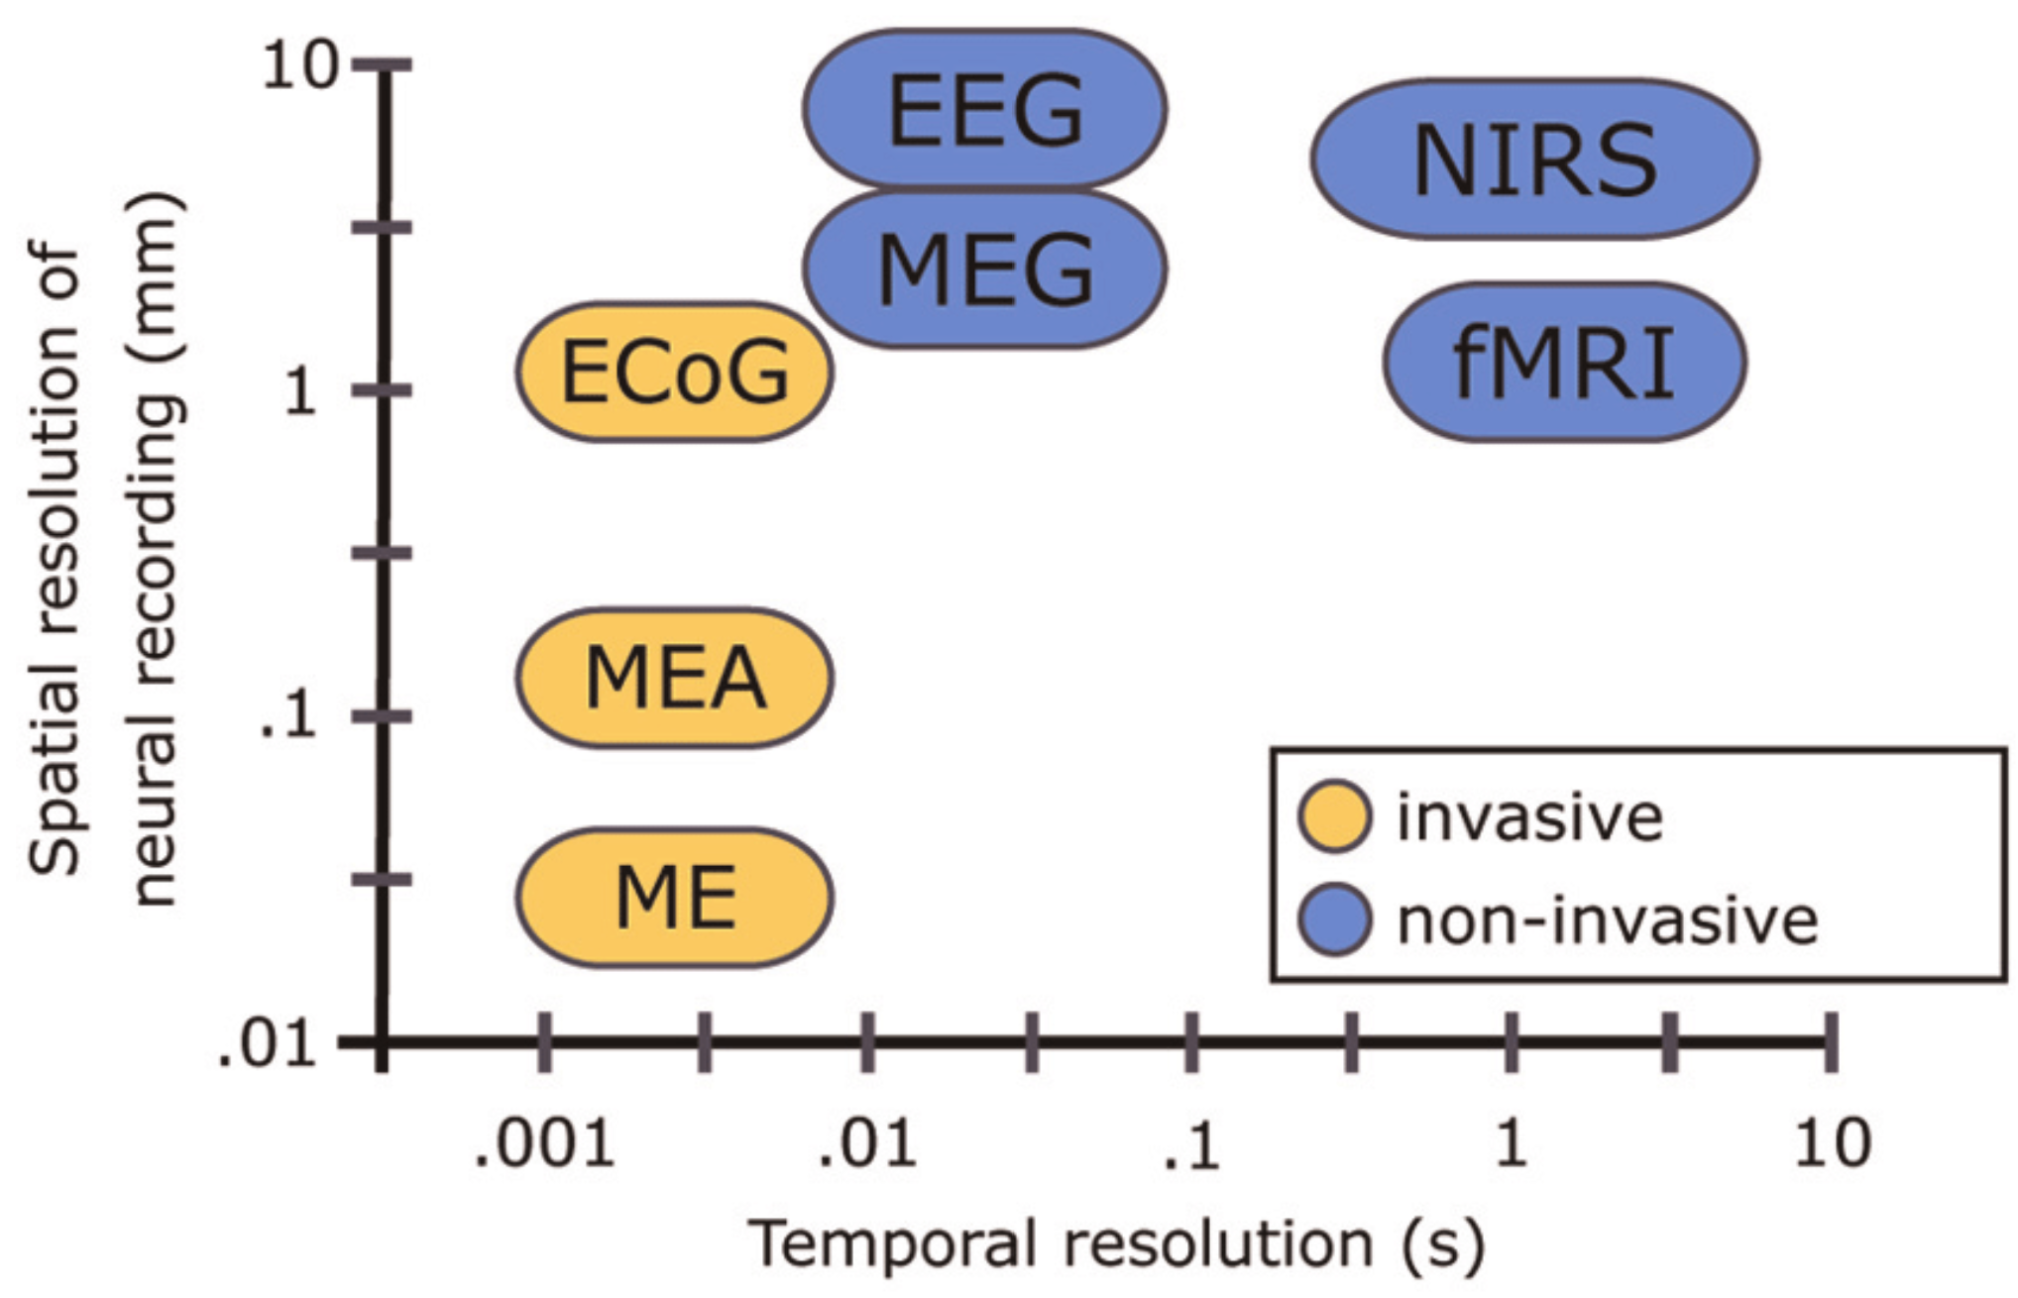
Techniques for studying the brain function
fMRI: high spatial but low time resolution.
Good to study a specific location in the brain
Unsuitable for sentence-level analysis. fMRI takes about two seconds to complete a scan. This is far lower than the speed at which humans can process language.
Cannot capture syntactic information (Gauthier and Levy, 2019)
EEG: high time but low spatial resolution.
Can preserve rich syntactic information (Hale et al., 2018)
But cannot use for source analysis.
fNIRS: compromise option
Time resolution better than fMRI
Spatial resolution better than EEG
Balance of spatial and temporal resolution may not be enough to compensate for the loss in both.
Single Micro-Electrode (ME), Micro-Electrode array (MEA), Electro-Cortico Graphy (ECoG), Positron emission tomography (PET), functional MRI (fMRI), Magneto-encephalography (MEG), Electro-encephalography (EEG), Near-Infrared Spectroscopy (NIRS)
Vogel, Jörn, Sami Haddadin, Beata Jarosiewicz, John D. Simeral, Daniel Bacher, Leigh R. Hochberg, John P. Donoghue, and Patrick van der Smagt. "An assistive decision-and-control architecture for force-sensitive hand–arm systems driven by human–machine interfaces." The International Journal of Robotics Research 34, no. 6 (2015): 763-780.
Notes:
FMRI scans use the same basic principles of atomic physics as MRI scans, but MRI scans image anatomical structure whereas FMRI image metabolic function. Thus, the images generated by MRI scans are like three dimensional pictures of anatomic structure. The images generated by FMRI scans are images of metabolic activity within these anatomic structures.

Slide 12
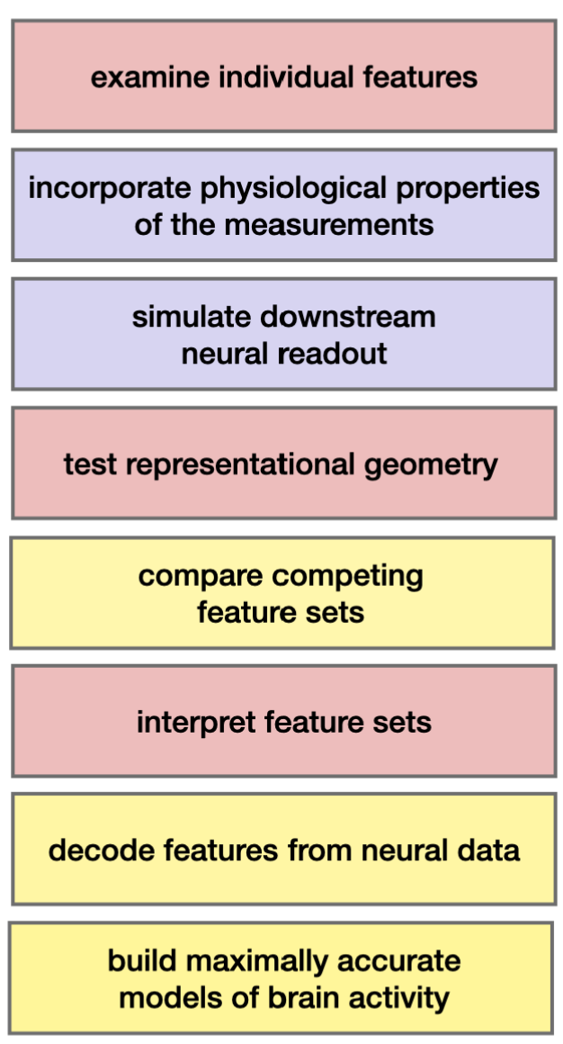
Computational Cognitive Science Research goals
Predictive Accuracy
Compare feature sets: Which feature set provides the most faithful reflection of the neural representational space?
Test feature decodability: “Does neural data Y contain information about features X?”
Build accurate models of brain data: Aim is to enable simulations of neuroscience experiments.
Interpretability
Examine individual features: Which features contribute the most to neural activity?
Test correspondences between representational spaces
“CNNs vs ventral visual stream” or “Two text representations”
Interpret feature sets
Do features X, generated by a known process, accurately describe the space of neural responses Y?
Do voxels respond to a single feature or exhibit mixed selectivity?
How does the mapping relate to other models or theories of brain function?
…
Ivanova, Anna A., Martin Schrimpf, Stefano Anzellotti, Noga Zaslavsky, Evelina Fedorenko, and Leyla Isik. "Is it that simple? Linear mapping models in cognitive neuroscience." bioRxiv (2021).

Slide 13
Agenda
Introduction to the tutorial [10 min]
Introduction to Brain Encoding and Decoding [50 min]
Brain Encoding/Decoding and applications
Introduction to popular datasets
Text Stimulus Representations
Alignment Between AI Models and Human Brain Language Comprehension
Brain Encoding: Scaling Laws, Multilinguality, Multimodal and Instruction-tuned Models [60 min]
Coffee Break & Networking [30 min]
Brain-informed Fine-tuning of Language Models [30 min]
Brain-based Interpretability and Causal Testing of AI Models [20 min]
Brain Decoding [30 min]
Summary and Future Trends [10 min]

Slide 14
Types of stimuli and popular datasets
Text (Words, Sentences, Paragraphs): Harry Potter Story, ZUCO EEG, Question-Answering MEG.
Visual: Binary visual patterns, Natural Images (Vim-1), BOLD5000, Algonauts and SS-fMRI.
Audio: Alice’s Adventures in Wonderland, Narratives, The Moth Radio Hour, Audio stories.
Videos: BBC’s Doctor Who, Japanese Ads, Pippi Langkous, Algonauts.
Other Multimodal Stimuli: Words + line drawing of concept named by each word, Pereira.

Slide 15
Forms of stimulus presentation and data collection
Type: fMRI, EEG, MEG, …
TR: Sampling time.
Fixation points: location, color, shape.
Form of stimuli presentation: text, video, audio, images.
Task: question answering, property generation, understanding, …
Time given to participants: 1 minute to list properties, …
Type of participants: males/females, sighted/blind, …
Number of times the response to stimuli was recorded.
Stimulus Language

Slide 16
Text Stimulus Datasets
Dataset | Type | Language | Stimulus | #Subjects | Paradigm | Size | Task
Wehbe et al., 2014 | fMRI | English | Chapter 9 of Harry Potter and the Sorcerer's Stone | 9 | Reading stories | 5000 word chapter was presented in 45 minutes. | Story understanding
Handjaras et al., 2016 | fMRI | Italian | Verbal, pictorial or auditory presentation of 40 concrete nouns | 20 | Reading, viewing or listening | 40 nouns * 4 times. | Property Generation
Anderson et al., 2017 | fMRI | Italian | 70 concrete and abstract nouns from law/music. | 7 | Reading | 70 nouns * 5 times. | Imagine a situation that they personally associate with the noun
Zurich Cognitive Language Processing Corpus (ZuCo): Hollenstein et al., 2018 | EEG and eye-tracking | English | Sentences from movie reviews or Wikipedia | 12 | Reading natural sentences | 21,629 words in 1107 sentences and 154,173 fixations | Rate movie quality, answer control questions, check for existence of a relation
Anderson et al., 2019 | fMRI | English | 240 active voice sentences describing everyday situations | 14 | Reading | 240 sentences seen 12 times (by 10 subjects) and 6 times (by 4 subjects) | Passive reading
BCCWJ-EEG: Oseki and Asahara, 2020 | EEG | Japanese | 20 newspaper articles | 40 | Reading | 1 time reading for ~30-40 minutes | Passive reading
Deniz et al., 2019 | fMRI | English | Subset of Moth Radio Hour. 11 stories | 9 | Reading | 11 10- to 15 min stories presented twice word by word | Passive reading and Listening

Slide 17
Visual Stimulus Datasets
Dataset | Type | Stimulus | #S | Paradigm | Size | Task
Thirion et al., 2006 | fMRI | Rotating wedges, expanding/contracting rings, rotating Gabor filters, grid | 9 | Viewing visual patterns | Wedges/rings for 8 times, 36 Gabor filters for 4 times, grid 36 times | Passive viewing, imagine one of the 6 domino stimuli when prompted to.
Vim-1: Kay et al., 2008 | fMRI | Sequences of natural photos | 2 | Viewing natural images | Each subject viewed 1750 (Stage 1)+ 120 (Stage 2) novel natural images | Passive viewing
Horikawa et al., 2017 | fMRI | Object images | 5 | Viewing and Reading | Each subject: (1) Image presentation: 1,200 images from 150 object categories and 50 images from 50 object categories; (2) Imagery: 10 times. | One-back repetition detection task, imagine object images pertaining to the category
BOLD5000: Chang et al., 2019 | fMRI | 5254 images depicting real-world scenes | 4 | Viewing natural images | ∼20 hours of MRI scans per each of four participants | Passive viewing
Algonauts: Cichy et al., 2019 | fMRI (EVC and IT)/MEG (early and late in time) | Object images | 15 | Viewing object images | 92 silhouette object images and 118 images of objects on natural background | Passive viewing
Natural Scenes Dataset: Allen et al., 2022 | fMRI | 73000 natural scenes | 8 | Viewing natural scenes | ~73000 distinct natural scene images from MSCOCO. | Passive viewing
THINGS: Hebart et al., 2023 | fMRI/EEG | 31188 natural images across 1,854 object concepts. | 8 | Viewing natural images | fMRI: 3 Participants. 8,740 unique images. 720 objects. MEG: 4 Participants. 22,448 unique images. 1,854 objects | oddball detection task (synthetic image).

Slide 18
Audio Stimulus Datasets
Dataset | Type | Language | Stimulus | #S | Paradigm | Size | Task
Handjaras et al., 2016 | fMRI | Italian | Verbal, pictorial or auditory presentation of 40 concrete nouns | 20 | Reading, viewing or listening | 40 nouns * 4 times. | Property Generation
Huth et al., 2016 | fMRI | English | Eleven 10-minute stories | 7 | Listening | 2 hours of stories from The Moth Radio Hour | Passive Listening
Brennan and Hale, 2019 | EEG | English | Chapter one of Alice’s Adventures in Wonderland as read by Kristen McQuillan | 33 | Listening | 2,129 words in 84 sentences. The entire experimental session lasted 1–1.5 h (including QA). | 8 MCQ Question answering concerning the contents of the story
Anderson et al., 2020 | fMRI | English | One of 20 scenario names | 26 | Listening scenario name | 20 scenario prompts displayed 5 times. | Imagine themselves personally experiencing common scenarios
Narratives: Nastase et al., 2021 | fMRI | English | 27 diverse naturalistic spoken stories | 345 | Listening | 891 functional scans, totaling ~4.6 hours of unique stimuli (~43,000 words) | Passive Listening
Natural Stories: Zhang et al., 2020 | fMRI | English | Moth-Radio-Hour naturalistic spoken stories | 19 | Listening | 5 h 33 m (repeated twice). Each story is 6 m 48 s avg or 2492 words. | Passive Listening
The Little Prince: Li et al., 2021 | fMRI | English, Chinese, French | Audiobook | 112 | Listening | English audiobook is 94 minutes long. Chinese: 99min. French: 97 min. | Passive Listening. 4 quiz questions.
MEG-MASC: Gwilliams et al., 2022 | MEG | English | 4 English fictional stories: Cable spool boy, LW1, Black willow, Easy money. | 27 | Listening | Two hours of naturalistic stories. 208 MEG sensors. | Passive Listening

Slide 19
Video Stimulus Datasets
Dataset | Type | Language | Stimulus | #Subjects | Paradigm | Size | Task
BBC’s Doctor Who: Seeliger et al., 2019 | fMRI | English | Spatiotemporal visual and auditory naturalistic stimuli (30 episodes of BBC’s Doctor Who) | 1 | Viewing episode videos | 120.830 whole-brain volumes (approx. 23 h) of single-presentation data, and 1.178 volumes (11 min) of repeated narrative short episodes (22 repetitions) | Passive viewing
Japanese Ads: Nishida et al., 2020 | fMRI | Japanese | 368 web and 2452 TV Japanese ad movies (15-30s) | 40 and 28 for web and TV ads. 16 were overlapped | Viewing Ads | 7200 train and 1200 test fMRIs for web; fMRIs from 420 ads. | Passive viewing
Pippi Langkous: Berezutskaya et al., 2020 | ECoG | The movie was originally in Swedish but dubbed in Dutch | 30 s excerpts of a feature film (in total, 6.5 min long), edited together for a coherent story | 37 patients | Viewing | 6.5 min movie. | Passive viewing
Algonauts: Cichy et al., 2021 | fMRI | English | 1000 short video clips | 10 | Viewing video clips | 1000 short video clips (3 sec each) | Passive viewing
Natural Short Clips: Huth et al., 2022 | fMRI | English | Natural short movie clips | 5 | Watching natural short movie clips | 3870 responses per subject. | Passive viewing

Slide 20
Other Multimodal Stimulus Datasets
Dataset | Type | Language | Stimulus | #Subjects | Paradigm | Size | Task
Mitchell et al., 2008 | fMRI | English | 60 different word-picture pairs from 12 categories. | 9 | Viewing word-picture pairs | 60 different word-picture pairs presented six times each | Passive viewing
Sudre et al., 2012 | MEG | English | 60 concrete nouns along with line drawings | 9 | Reading | 60 stimuli × 20 questions = 1200 examples | Question answering
Zinszer et al., 2017 | fNIRS | English | 8 concrete nouns (audiovisual word and picture stimuli): bunny, bear, kitty, dog, mouth, foot, hand, and nose | 24 | Viewing and listening | 12 blocks with the 8 stimuli per subject. | Passive viewing and listening
Pereira et al., 2018 | fMRI | English | 180 Words with Picture, Sentences, word clouds; 96 text passages; 72 passages | 16 | Viewing WP, sentences or word clouds | 180 WP, S and WC per subject; 96+72 passages shown 3 times | Passive viewing
Cao et al., 2021 | fNIRS | Chinese | 50 concrete nouns from 10 semantic categories | 7 | Viewing and listening | Each stimulus is presented 7 times. | Passive viewing and listening
Courtois Neuromod | fMRI | full-length movies and TV show | 6 | Viewing and Listening | ~100 hours of data per participant | Passive viewing

Slide 21
Agenda
Introduction to the tutorial [10 min]
Introduction to Brain Encoding and Decoding [50 min]
Brain Encoding/Decoding and applications
Introduction to popular datasets
Text Stimulus Representations
Alignment Between AI Models and Human Brain Language Comprehension
Brain Encoding: Scaling Laws, Multilinguality, Multimodal and Instruction-tuned Models [60 min]
Coffee Break & Networking [30 min]
Brain-informed Fine-tuning of Language Models [30 min]
Brain-based Interpretability and Causal Testing of AI Models [20 min]
Brain Decoding [30 min]
Summary and Future Trends [10 min]

Slide 22
Text Stimulus Representations
Basic NLP Representations
Corpus co-occurrence counts
Topic models
Linguistic: POS, dependencies, roles.
Discourse
Characters, motion, speech, emotions, non-motion verbs
Deep Learning based Representations
Embeddings
Longer context using LSTMs
Transformers
Experiential attributes
Rated on 0-6 scale
Binary

Slide 23
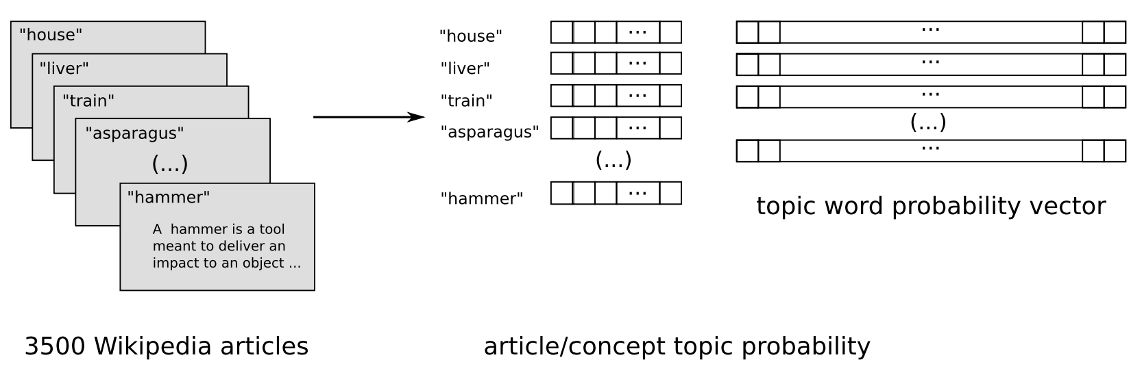
Basic NLP Representations for Word Stimuli
Corpus co-occurrence counts
25 verbs (Mitchell et al., 2008; Pereira et al., 2013)
Basic sensory and motor activities, actions per formed on objects, and actions involving changes to spatial relationships.
Verbs: see, hear, listen, taste, smell, eat, touch, nib, lift, manipulate, run, push, fill, move, ride, say, fear, open, approach, near, enter, drive, wear, break, and clean.
For each (verb, stimulus word w), feature value = normalized co-occurrence count of w with any of three forms of the verb (e.g., taste, tastes, or tasted) over the text corpus.
985 common English words (such as above, worry, and mother) in (Huth et al., 2016).
Topic models (Pereira et al., 2013)
Get relevant Wiki pages (e.g., “airplane” is “Fixed-Wing Aircraft”) and other linked pages (e.g. “Aircraft cabin”)
LDA topic modelling on 3500 pages with #topics from 10 to 100, in increments of 5, setting the α parameter to 25/#topics.
LSA topic modelling (Wang et al., 2017)

Slide 24
Basic NLP Representations for Word Stimuli
Word length
Is the word related to one of the 28 unique parts of speech and 17 unique dependency relationships?
Position of word in the sentence
Roles
Main verb
Agent or experiencer
Patient or recipient
Predicate of a sentence (The window was dusty)
Modifier (The angry activist broke the chair)
Complement in adjunct and propositional phrase, including direction, location, and time (The restaurant was loud at night).
Wehbe, Leila, Brian Murphy, Partha Talukdar, Alona Fyshe, Aaditya Ramdas, and Tom Mitchell. "Simultaneously uncovering the patterns of brain regions involved in different story reading subprocesses." PloS one 9, no. 11 (2014): e112575.
Wang, Jing, Vladimir L. Cherkassky, and Marcel Adam Just. "Predicting the brain activation pattern associated with the propositional content of a sentence: modeling neural representations of events and states." Human brain mapping 38, no. 10 (2017): 4865-4881.

Slide 25
Discourse features (for Harry Potter dataset)
Characters: Binary features to signal which of the 10 characters are mentioned.
Motions: Identify a set of motions that occurred frequently in the chapter (e.g. fly, manipulate, collide physically, etc.).
Speech: Indicate the parts of the story that correspond to direct speech between the characters. Used the presence of dialog as a feature.
Emotions: Identified a set of emotions that were felt by the characters in the chapter (e.g. annoyance, nervousness, pride, etc.).
Verbs: Identified a set of actions that occurred frequently in the chapter that were distinct from motion (e.g. hear, know, see, etc.).
Wehbe, Leila, Brian Murphy, Partha Talukdar, Alona Fyshe, Aaditya Ramdas, and Tom Mitchell. "Simultaneously uncovering the patterns of brain regions involved in different story reading subprocesses." PloS one 9, no. 11 (2014): e112575.
Wang, Jing, Vladimir L. Cherkassky, and Marcel Adam Just. "Predicting the brain activation pattern associated with the propositional content of a sentence: modeling neural representations of events and states." Human brain mapping 38, no. 10 (2017): 4865-4881.

Slide 26
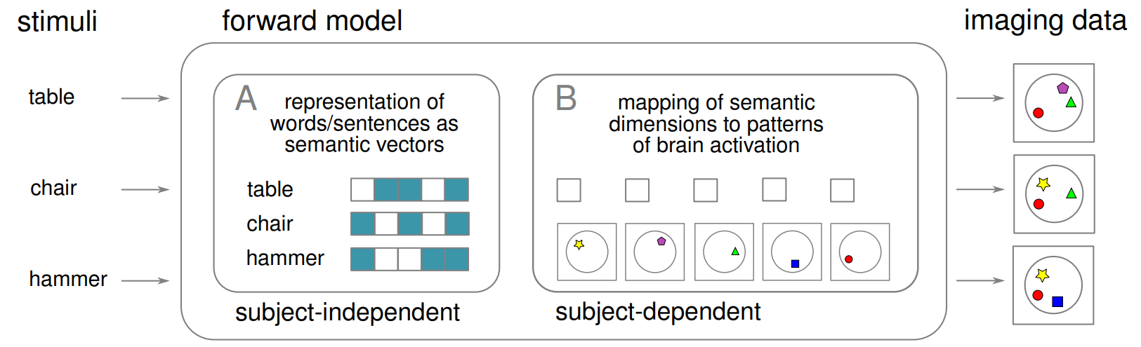
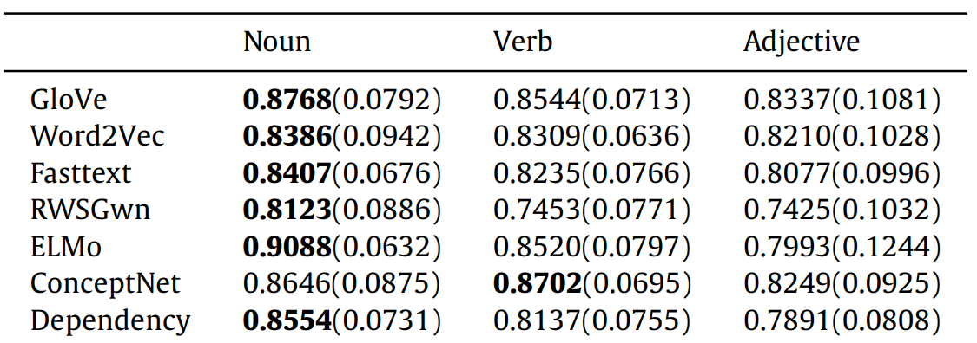
DL Representations: Using embeddings for word stimuli
GloVe 300D vectors (Pereira et al., 2016; Wang et al., 2017; Pereira et al., 2018; Anderson et al., 2019)
300D embeddings by training a skip-gram model using negative sampling (SGNS) on Italian and English Wikipedia dumps using Gensim. (Anderson et al., 2017a)
FastText (Berezutskaya et al., 2020)
Comparison across multiple embedding methods
GloVe, word2vec, WordNet2Vec, FastText, ELMo (Hollenstein et al., 2019)
word2Vec, fastText, GloVe, Dependency-based word2vec, RWSGwn, ConceptNet, ELMo, averaged and concatenated combinations (Wang et al., 2020)
Notes:
Dependency-based Word2Vec: The dependency-based Word2Vec introduced in [22] is a Word2Vec model in which the context of the words is computed based on the dependency relations.
fastText: fastText is a modification of Word2Vec that takes morphological information into account
GloVe is a count-based method that performs a dimensionality reduction on the cooccurrence matrix
RWSGwn: RWSGwn embeddings are computed on WordNet with random walks and dimensionality reduction techniques
ConceptNet: ConceptNet is a knowledge graph that connects words and phrases of natural language with labeled edges, representing the general knowledge involved in understanding language. The ConceptNet embeddings are computed on a ConceptNet graph using the PPMI (Positive Pointwise Mutual Information) method.

Slide 27
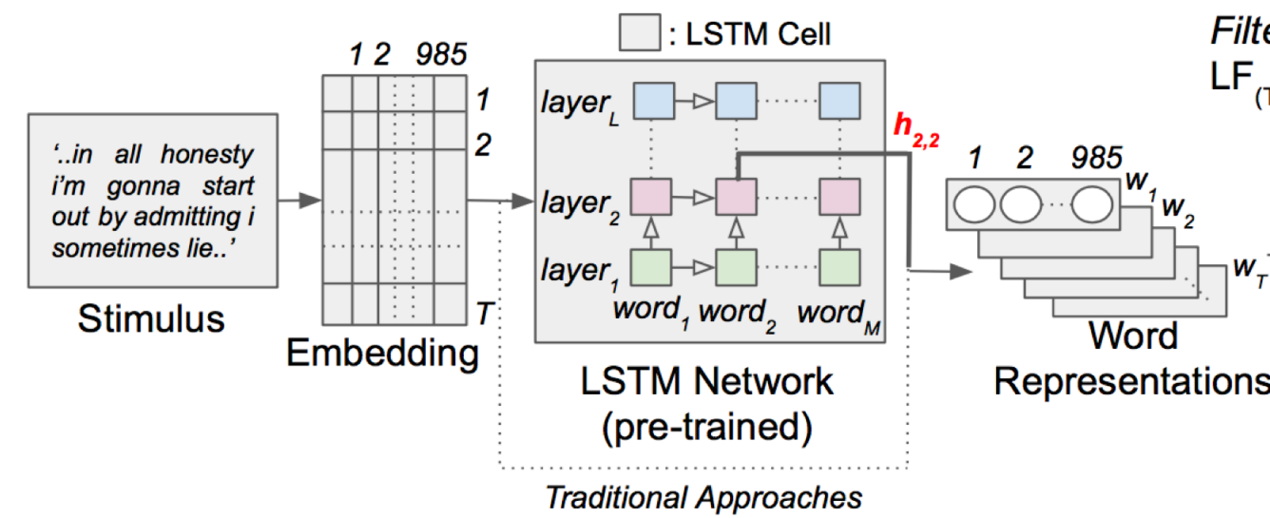
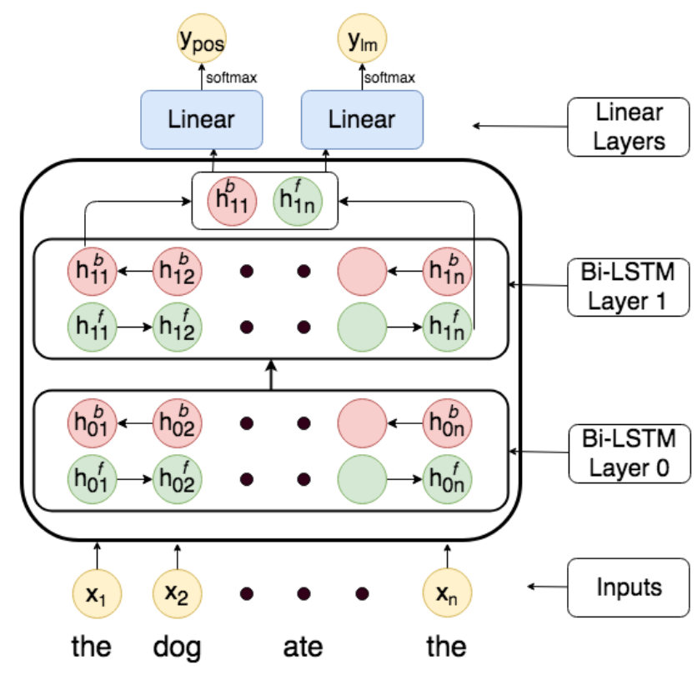
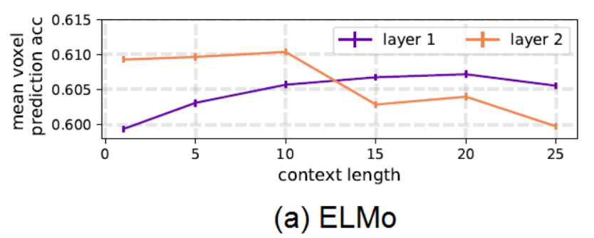
DL Representations: Using longer context for word stimuli
Multi-task LSTMs
Predict next word and POS of next word.
ELMo embeddings: LSTM based pretrained language model
Toneva, Mariya, and Leila Wehbe. "Interpreting and improving natural-language processing (in machines) with natural language-processing (in the brain)." Advances in Neural Information Processing Systems 32 (2019).
Jain, Shailee, and Alexander Huth. "Incorporating context into language encoding models for fMRI." Advances in neural information processing systems 31 (2018).
Jat, Sharmistha, Hao Tang, Partha Talukdar, and Tom Mitchell. "Relating simple sentence representations in deep neural networks and the brain." arXiv preprint arXiv:1906.11861 (2019).

Slide 28
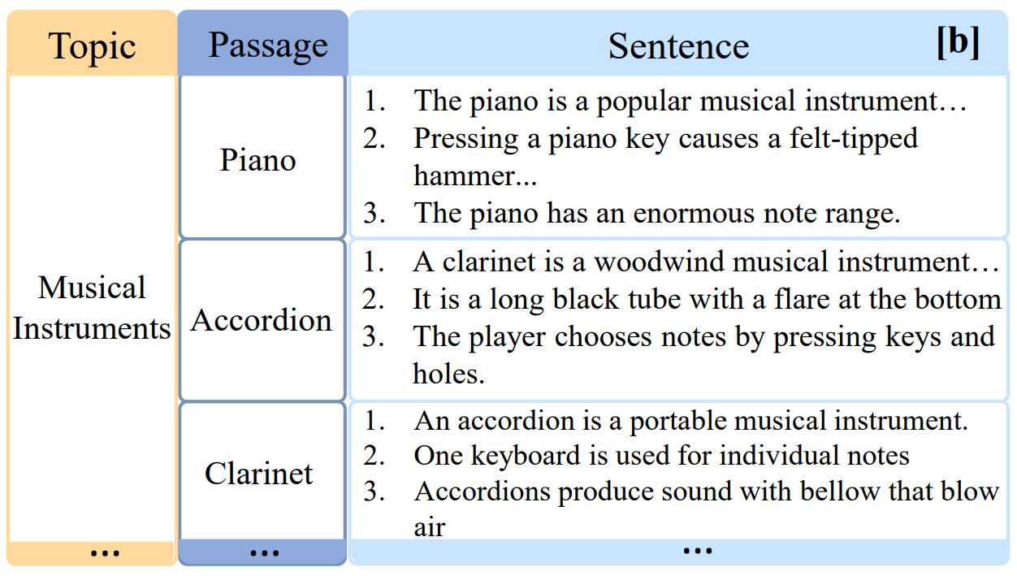
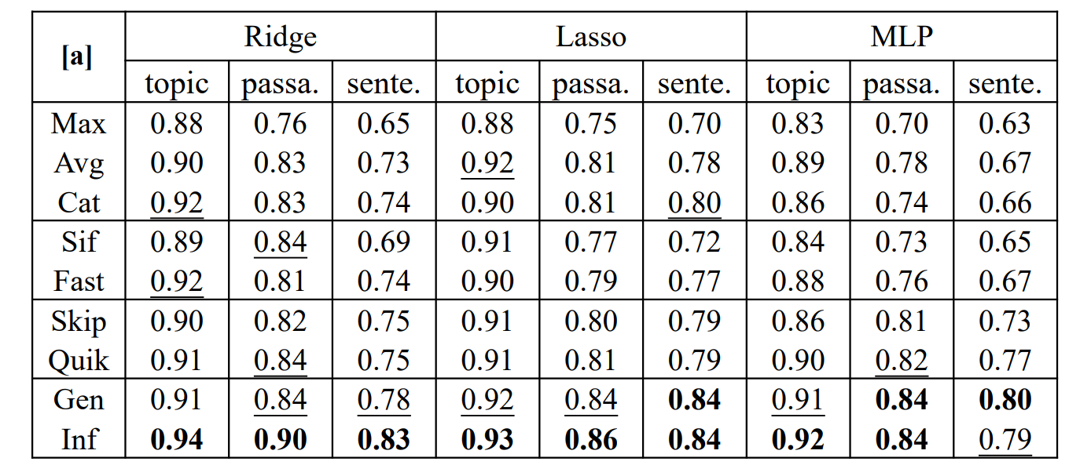
DL Representations: Using sentence embeddings
Unstructured Models: Ignore sentence structure
Simple Pooling Methods
Average/max/concat(max, avg) pooling over word embeddings.
Advanced Pooling Methods
FastSent (Hill, Cho, and Korhonen 2016)
SIF (Arora, Liang, and Ma 2016) adapts the naïve averaging of word embeddings to weighted averaging.
Structured Models
Unsupervised Methods: Skip-thought, QuickThought.
Supervised Methods: InferSent, GenSen (Subramanian et al. 2018), Universal Sentence Encoder
Toneva, Mariya, and Leila Wehbe. "Interpreting and improving natural-language processing (in machines) with natural language-processing (in the brain)." Advances in Neural Information Processing Systems 32 (2019).
Sun, Jingyuan, Shaonan Wang, Jiajun Zhang, and Chengqing Zong. "Towards sentence-level brain decoding with distributed representations." In Proceedings of the AAAI Conference on Artificial Intelligence, vol. 33, no. 01, pp. 7047-7054. 2019.

Slide 29
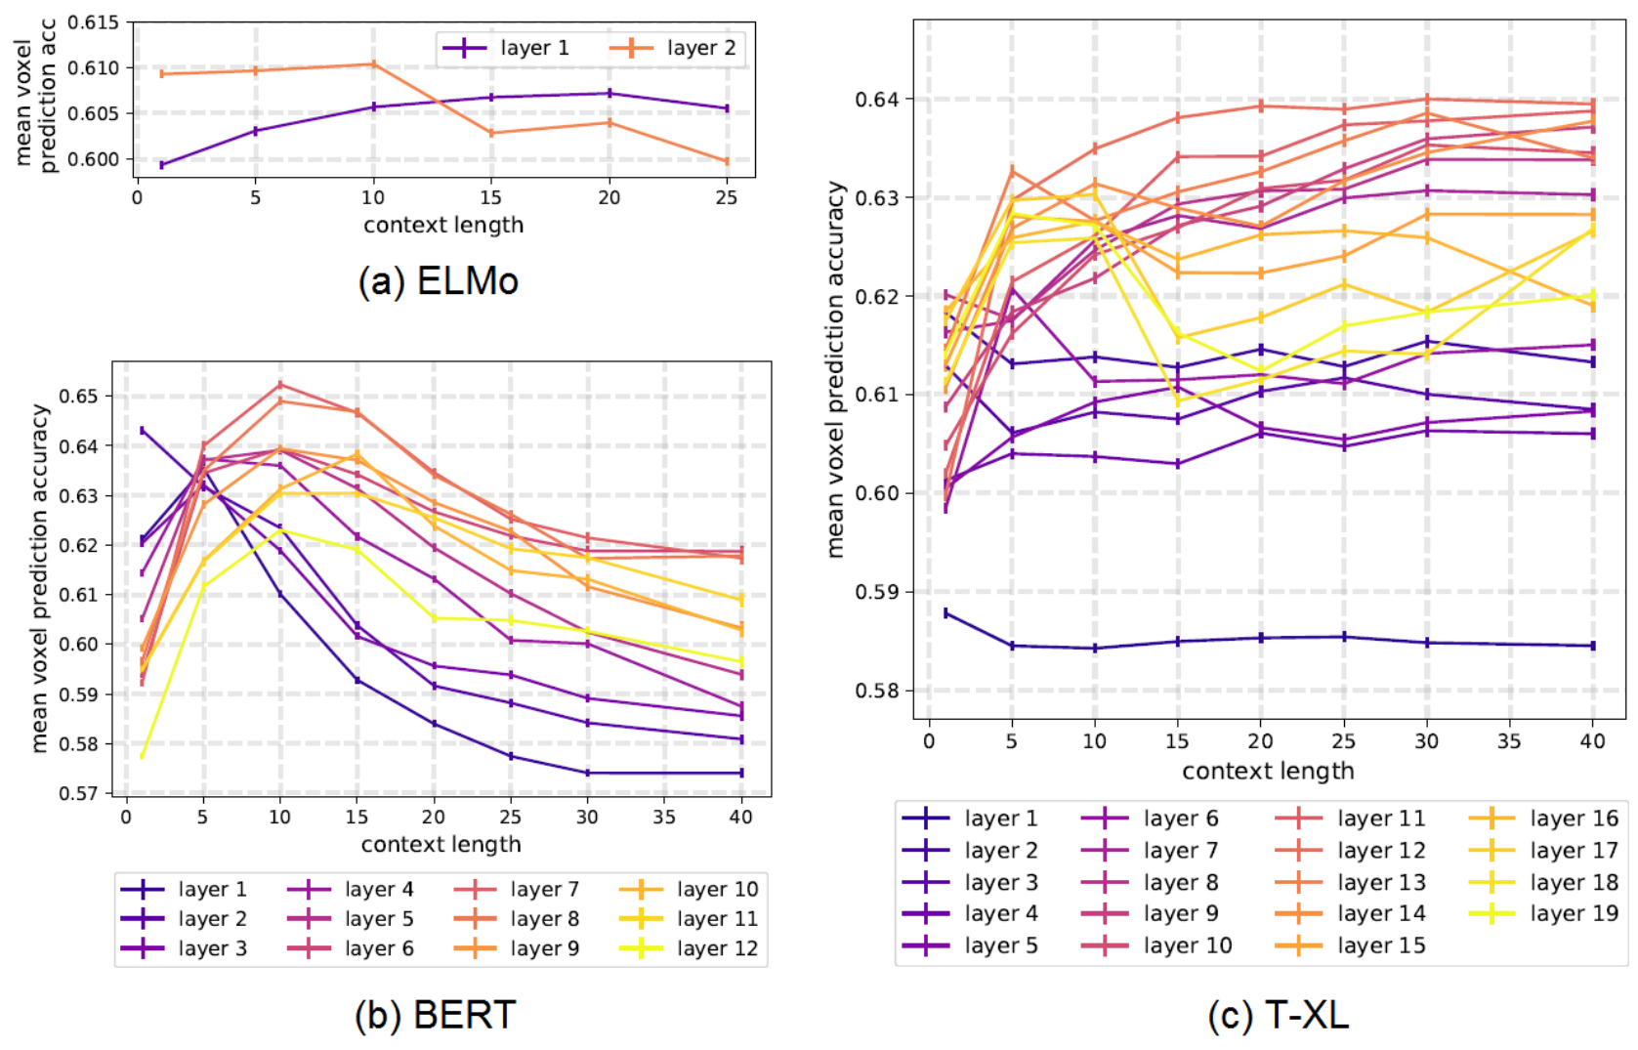
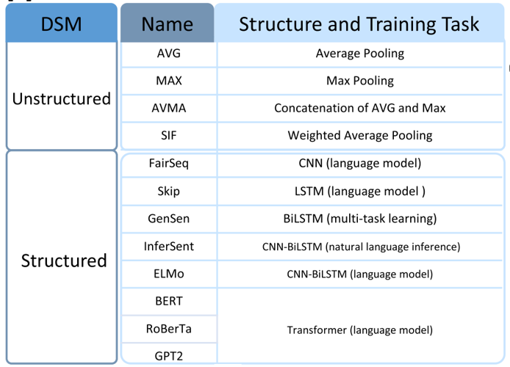
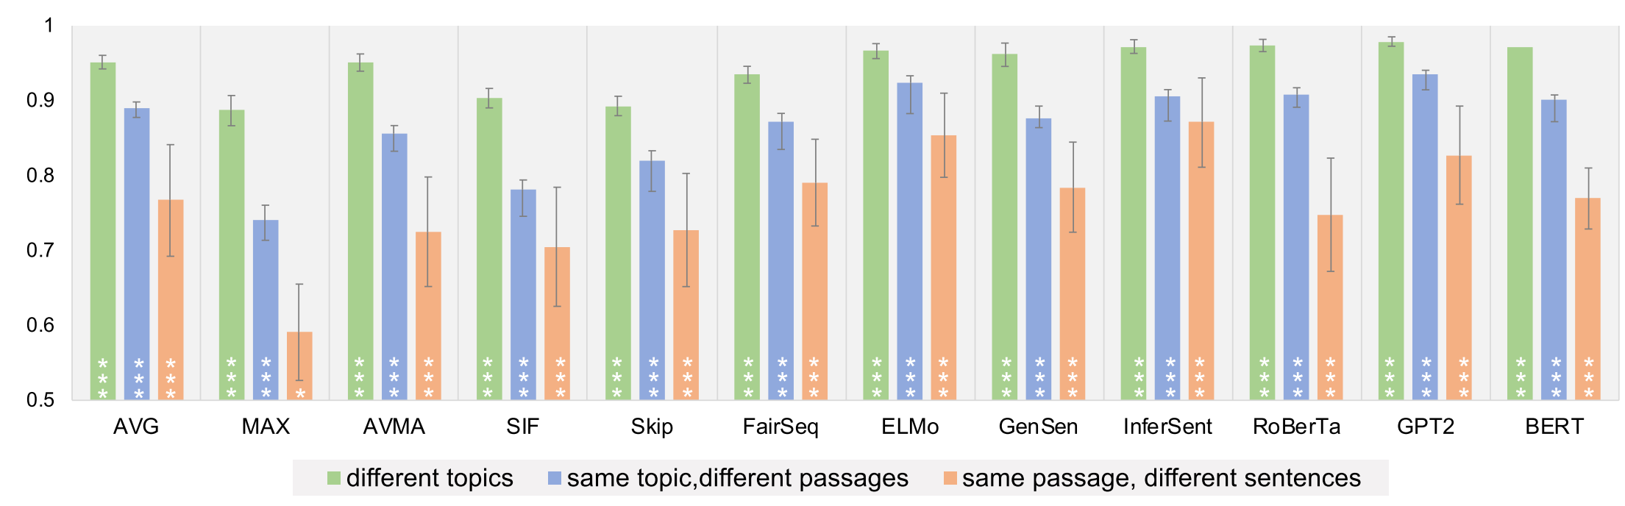
DL Representations: Transformer-based methods for text stimuli (Layer #, context length, architecture)
Transformer-XL is the only model that continues to increase performance as the context length is increased. In all networks, the middle layers perform the best for contexts longer than 15 words. The deepest layers across all networks show a sharp increase in performance at short-range context (fewer than 10 words), followed by a decrease in performance. [Toneva and Wehbe, 2019]
Toneva, Mariya, and Leila Wehbe. "Interpreting and improving natural-language processing (in machines) with natural language-processing (in the brain)." Advances in Neural Information Processing Systems 32 (2019).
Sun, Jingyuan, Shaonan Wang, Jiajun Zhang, and Chengqing Zong. "Neural encoding and decoding with distributed sentence representations." IEEE Transactions on Neural Networks and Learning Systems 32, no. 2 (2020): 589-603.

Slide 30
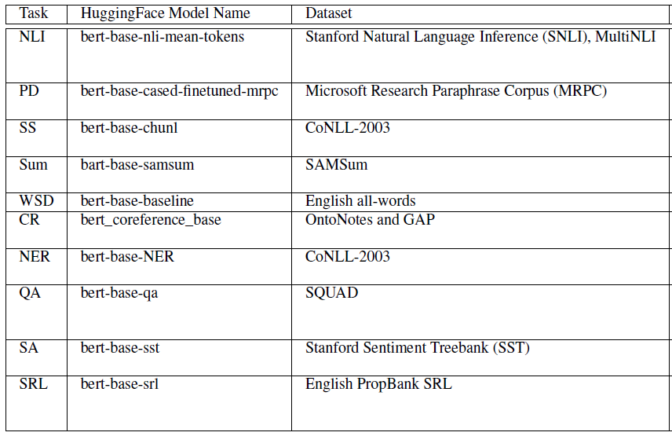
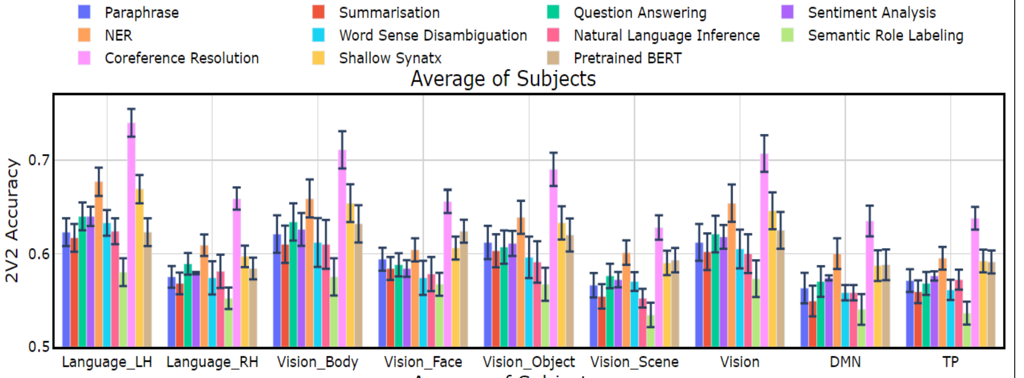
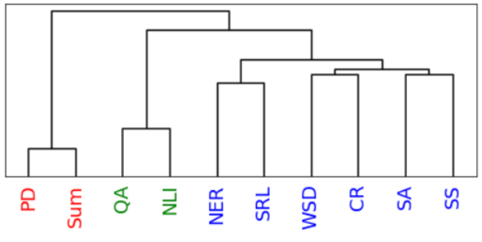
DL Representations: Transformer-based methods for text stimuli (NLP task finetuning)
Pereira dataset: CR, NER, and SS perform the best.
Tasks
Paraphrase, Summarization, Question Answering, Sentiment Analysis, NER, Word Sense Disambiguation, Natural Language Inference, Semantic Role Labeling, Coreference Resolution, Shallow Syntax Parsing
Dendrogram constructed using similarity on representations from task-specific Transformer encoder models with stimuli from the dataset passed as input.
Oota, Subba Reddy, Jashn Arora, Veeral Agarwal, Mounika Marreddy, Manish Gupta, and Bapi Raju Surampudi. "Neural Language Taskonomy: Which NLP Tasks are the most Predictive of fMRI Brain Activity?." arXiv preprint arXiv:2205.01404 (2022).

Slide 31
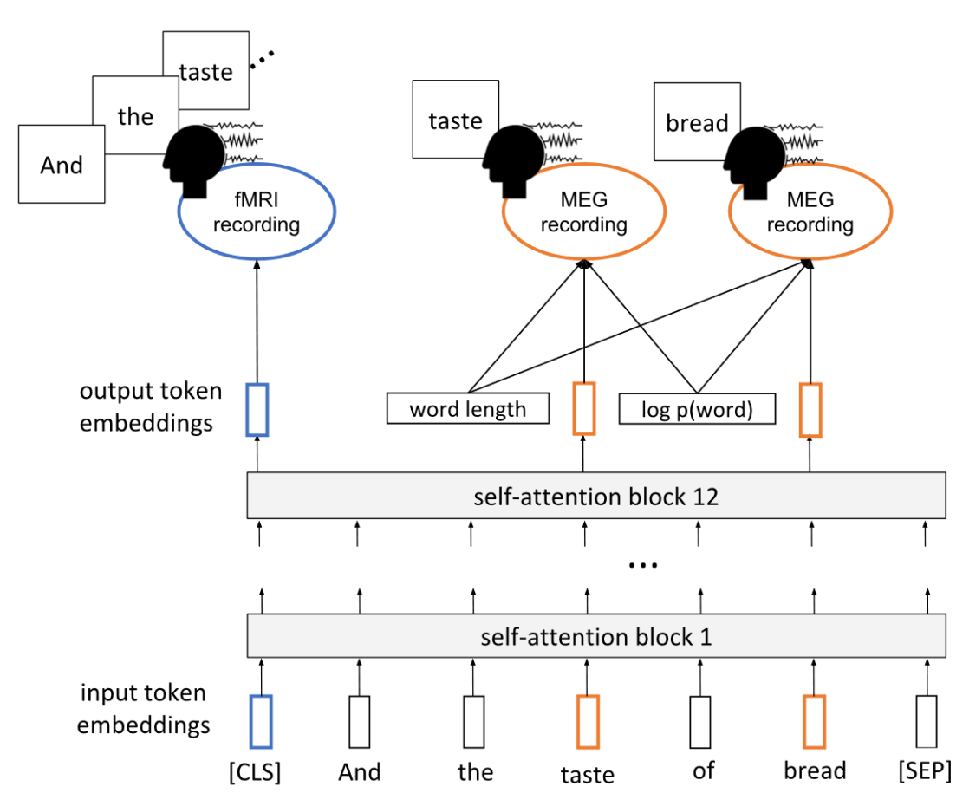
DL Representations: Transformer-based methods for text stimuli (Multi-task setup)
Settings
Finetune BERT vs not
Finetune BERT using one representative subject and train dense layer for each subject, vs finetune BERT for each subject.
Finetune BERT on MEG for all subjects, then finetune BERT on fMRI.
Multi-task finetune BERT for fMRI+MEG prediction task
Results
Fine-tuned models predict fMRI data better than vanilla BERT
Relationships between text and brain activity generalize across experiment participants.
Using MEG data can improve fMRI predictions.
A single model can be used to predict fMRI activity across multiple experiment participants.
Schwartz, Dan, Mariya Toneva, and Leila Wehbe. "Inducing brain-relevant bias in natural language processing models." Advances in neural information processing systems 32 (2019).

Slide 32
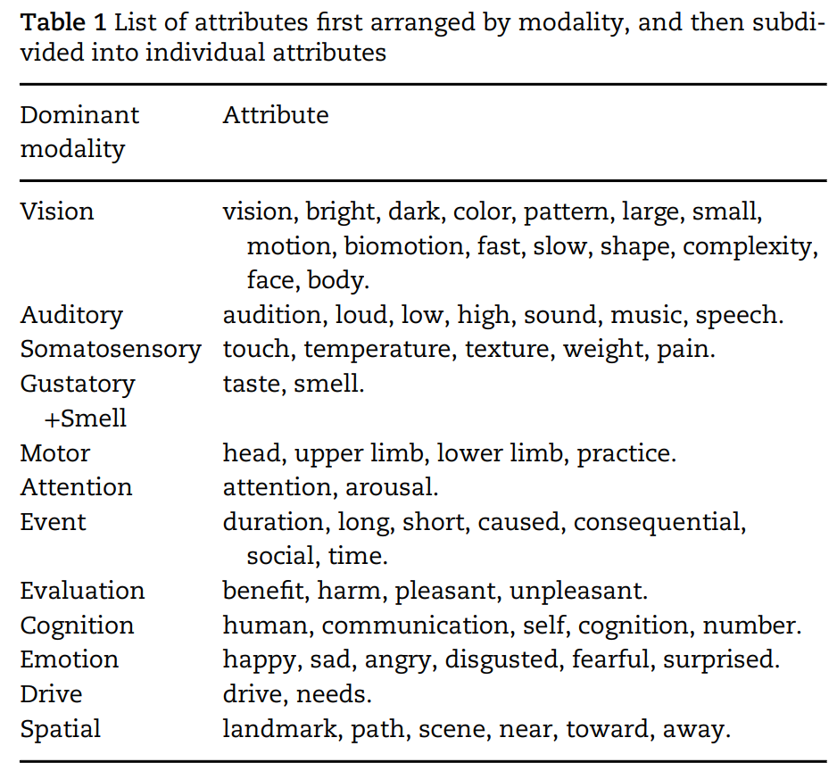
Experiential attributes model for text stimuli
Represents words in terms of human ratings of their degree of association with different attributes of experience
“On a scale of 0 to 6, to what degree do you think of a banana as having a characteristic or defining color?”
Anderson et al., 2019: 65 attributes spanning sensory, motor, affective, spatial, temporal, causal, social, and abstract cognitive experiences.
Value-add on top of text models: a lot of experiential information goes unstated in natural verbal communication.
E.g., it is rarely useful to communicate the color of bananas because it is obvious to all those with experience of bananas.
E.g., it would be unusual to specify that dropping things involves movement.
Nishida et al., 2020 use a subset of 20 attributes.
Anderson, Andrew James, Jeffrey R. Binder, Leonardo Fernandino, Colin J. Humphries, Lisa L. Conant, Rajeev DS Raizada, Feng Lin, and Edmund C. Lalor. "An integrated neural decoder of linguistic and experiential meaning." Journal of Neuroscience 39, no. 45 (2019): 8969-8987.
Anderson, Andrew James, Jeffrey R. Binder, Leonardo Fernandino, Colin J. Humphries, Lisa L. Conant, Mario Aguilar, Xixi Wang, Donias Doko, and Rajeev DS Raizada. "Predicting neural activity patterns associated with sentences using a neurobiologically motivated model of semantic representation." Cerebral Cortex 27, no. 9 (2017): 4379-4395.
Anderson, Andrew James, Kelsey McDermott, Brian Rooks, Kathi L. Heffner, David Dodell-Feder, and Feng V. Lin. "Decoding individual identity from brain activity elicited in imagining common experiences." Nature communications 11, no. 1 (2020): 1-14.

Slide 33
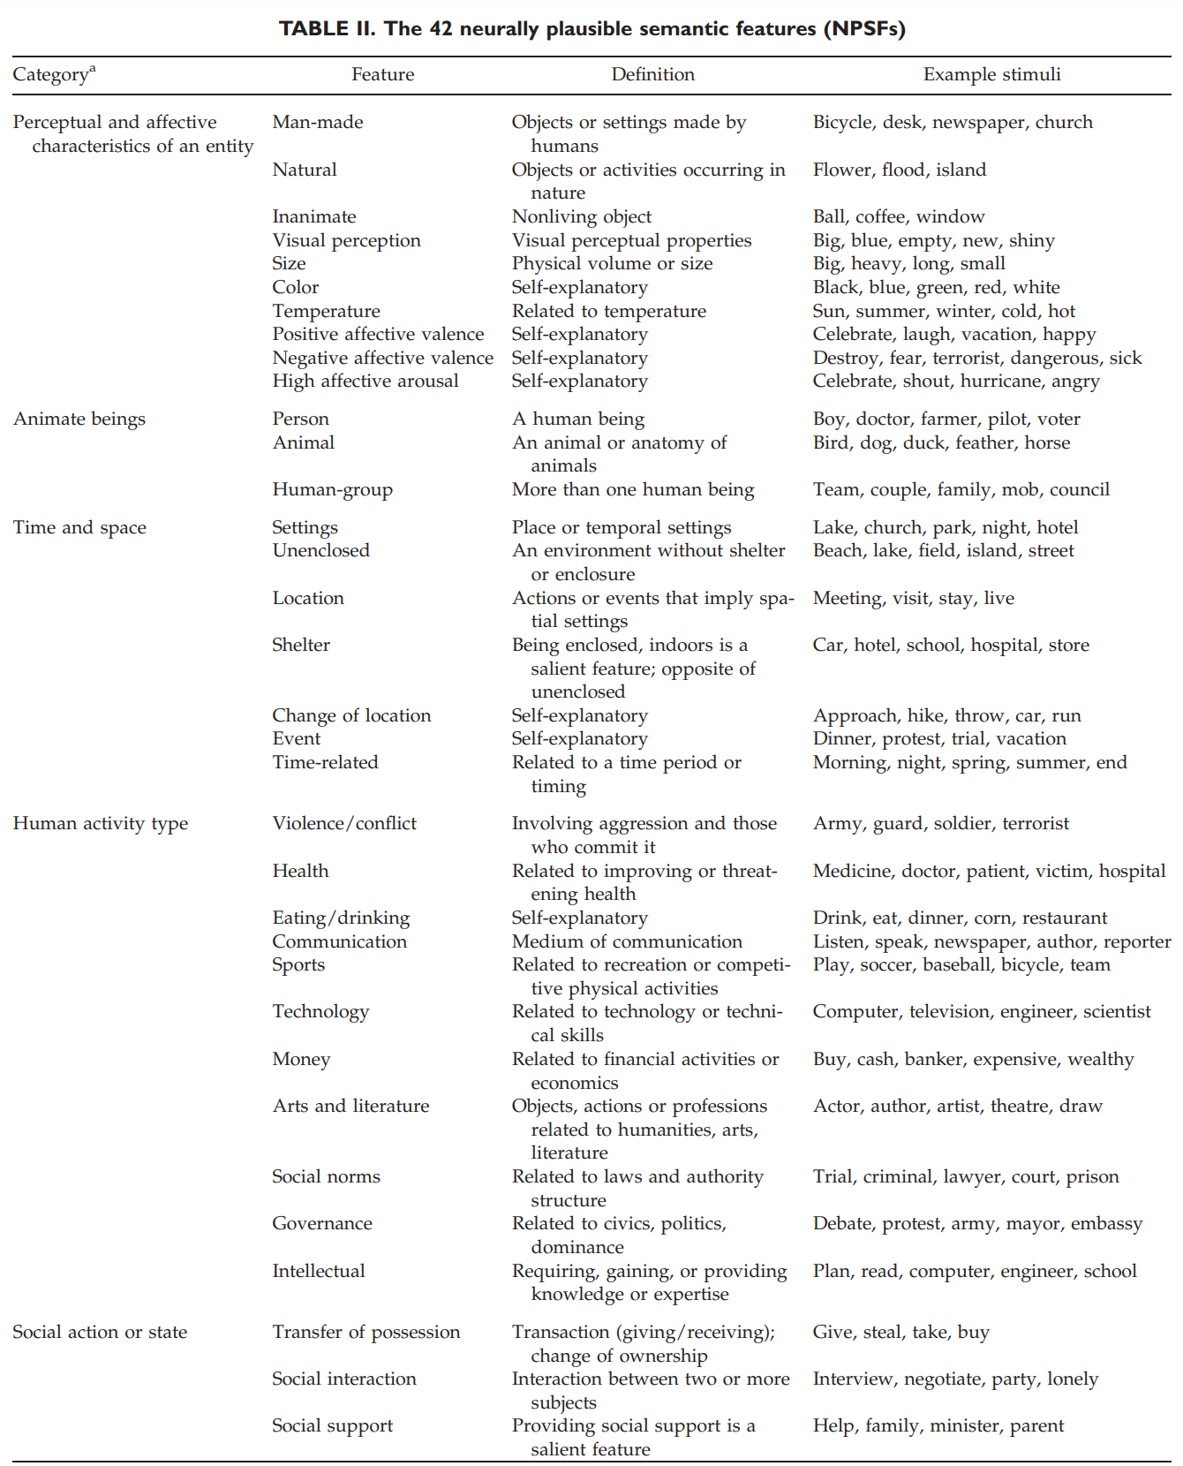
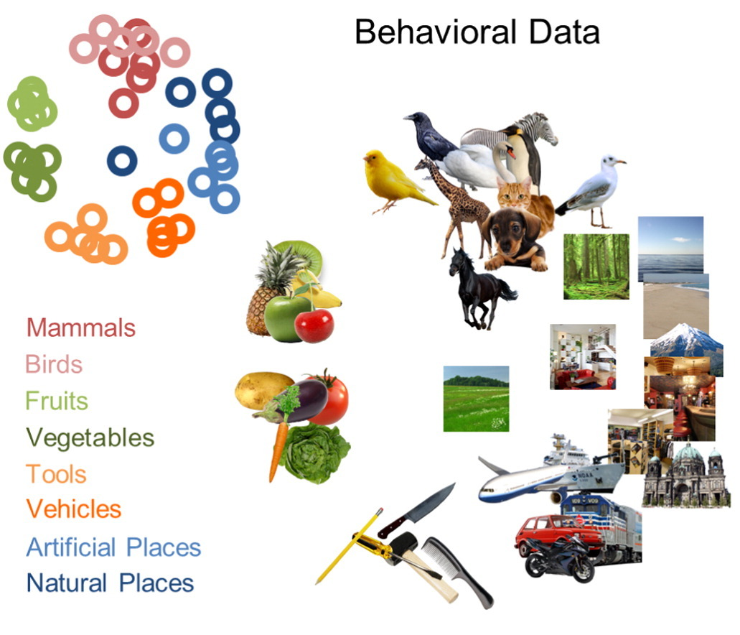
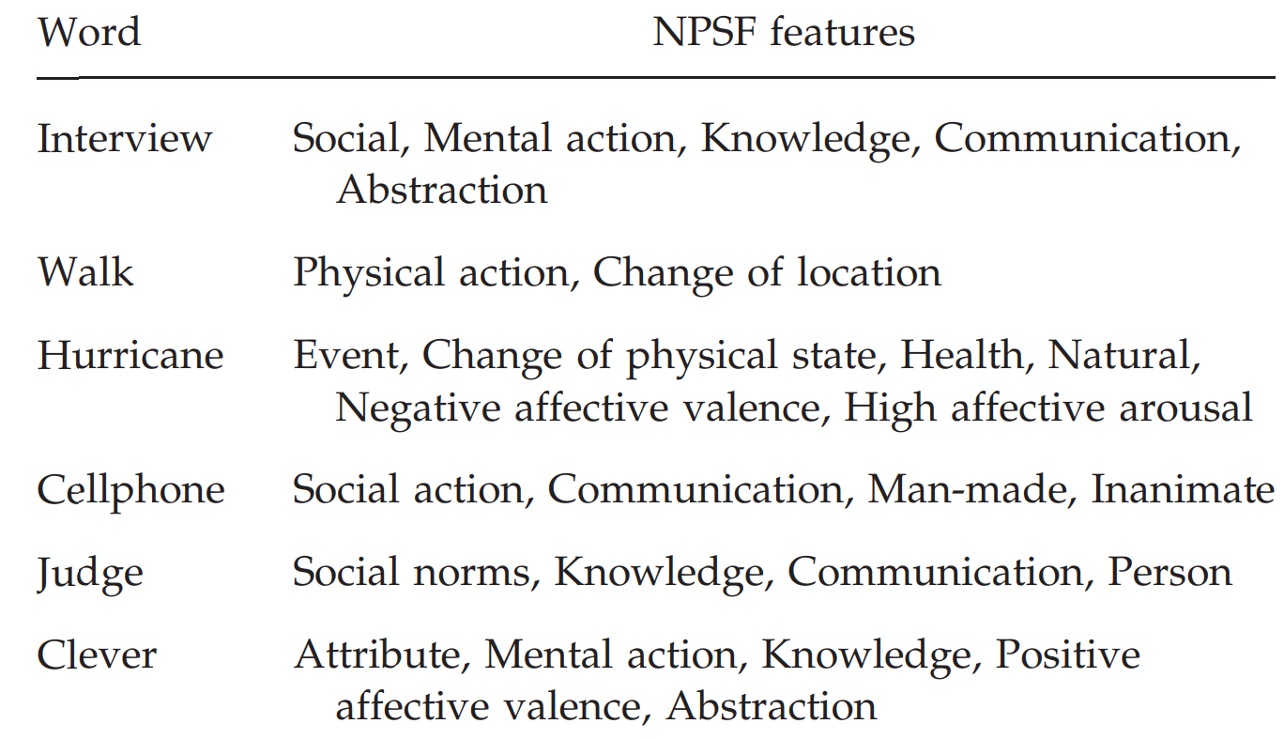
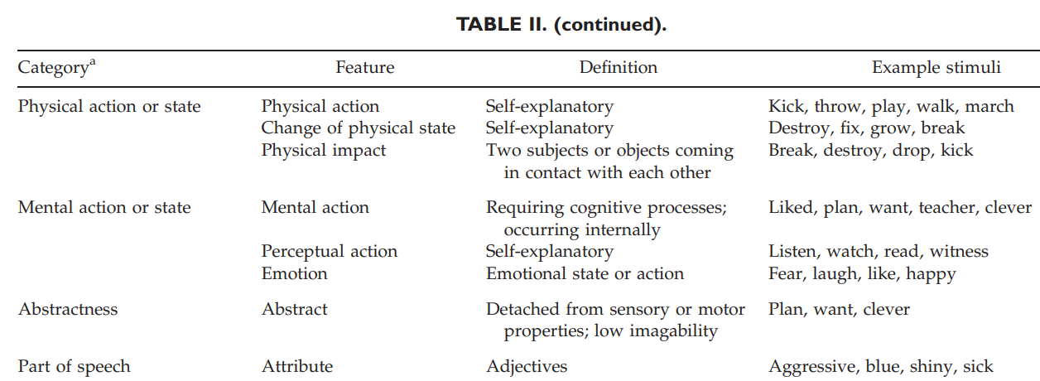
Binary attribute representations
Each stimulus is represented using a binary vector capturing membership to one of the eight semantic categories.
42 neurally plausible semantic features (NPSFs)
Perceptual and affective characteristics of an entity (10 NPSFs coded such features, such as man-made, size, color, temperature, positive affective valence, high affective arousal), animate beings (person, human-group, animal), and time and space properties (e.g. unenclosed setting, change of location)
Handjaras, Giacomo, Emiliano Ricciardi, Andrea Leo, Alessandro Lenci, Luca Cecchetti, Mirco Cosottini, Giovanna Marotta, and Pietro Pietrini. "How concepts are encoded in the human brain: a modality independent, category-based cortical organization of semantic knowledge." Neuroimage 135 (2016): 232-242.
Wang, Jing, Vladimir L. Cherkassky, and Marcel Adam Just. "Predicting the brain activation pattern associated with the propositional content of a sentence: modeling neural representations of events and states." Human brain mapping 38, no. 10 (2017): 4865-4881.

Slide 34
Agenda
Introduction to the tutorial [10 min]
Introduction to Brain Encoding and Decoding [50 min]
Brain Encoding/Decoding and applications
Introduction to popular datasets
Text Stimulus Representations
Alignment Between AI Models and Human Brain Language Comprehension
Brain Encoding: Scaling Laws, Multilinguality, Multimodal and Instruction-tuned Models [60 min]
Coffee Break & Networking [30 min]
Brain-informed Fine-tuning of Language Models [30 min]
Brain-based Interpretability and Causal Testing of AI Models [20 min]
Brain Decoding [30 min]
Summary and Future Trends [10 min]

Slide 35
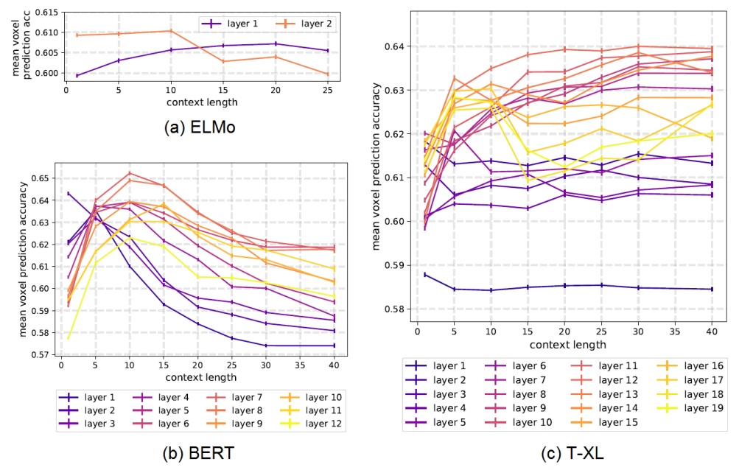
Does context size impact alignment?
ELMO, BERT, USE (Universal Sentence Encoder) and T-XL.
Transformer-XL continues to increase perf as the context length is increased.
Middle layers perform the best for contexts of 15+ words.
Deepest layers show a sharp increase in perf at short-range context (<10 words).
Toneva, Mariya, and Leila Wehbe. "Interpreting and improving natural-language processing (in machines) with natural language-processing (in the brain)." Advances in neural information processing systems 32 (2019).

Slide 36
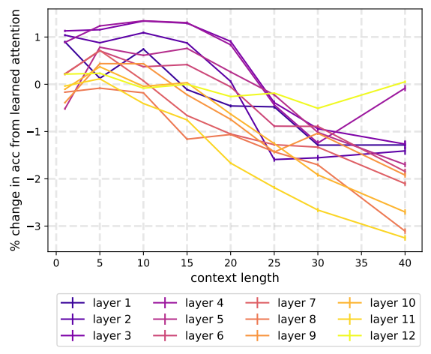
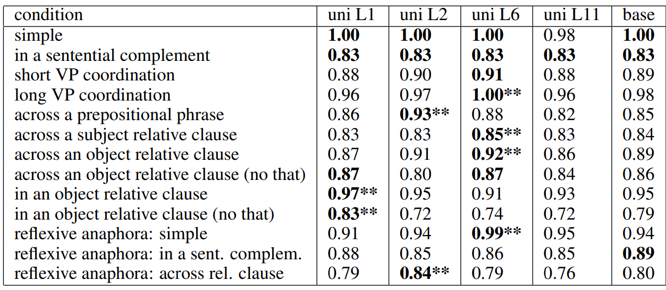
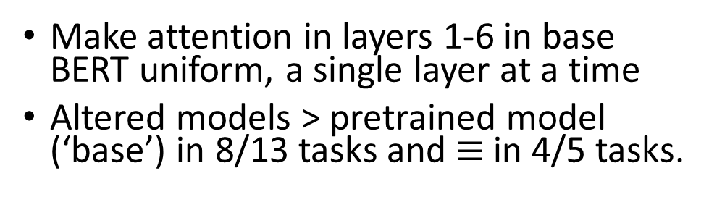
What if we use uniform attention in first few layers?
Shallow layers benefit from the uniform attention for context lengths up to 25 words.
Make attention in layers 1-6 in base BERT uniform, a single layer at a time
Altered models > pretrained model (‘base’) in 8/13 tasks and $≡$in 4/5 tasks.
Toneva, Mariya, and Leila Wehbe. "Interpreting and improving natural-language processing (in machines) with natural language-processing (in the brain)." Advances in neural information processing systems 32 (2019).

Slide 37
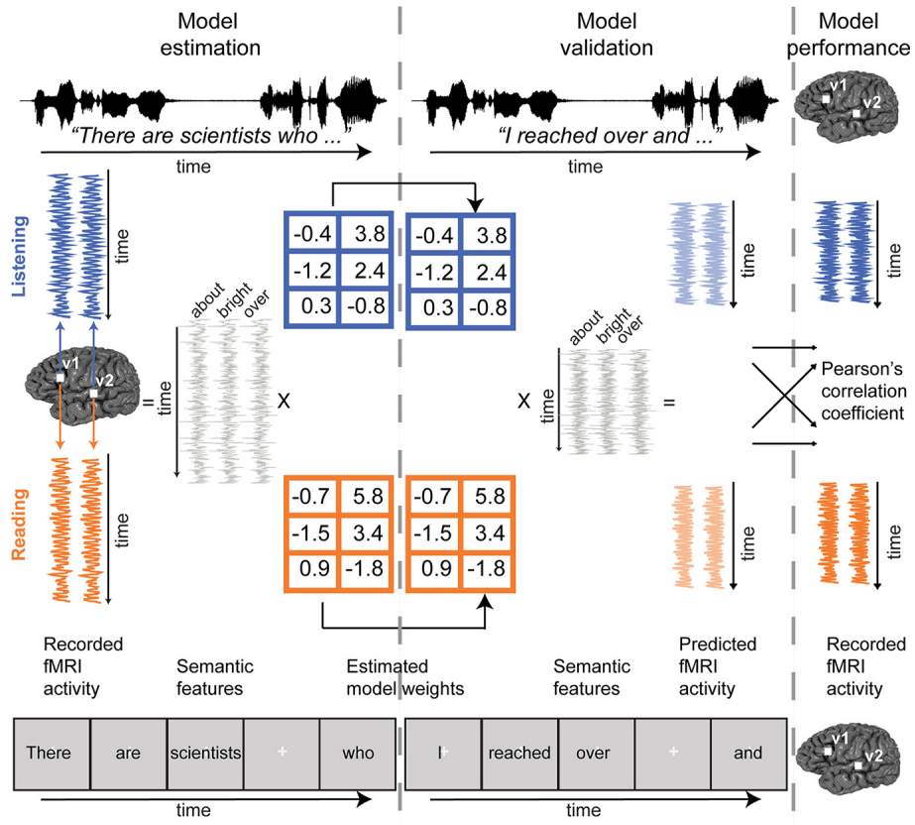
Is the representation of semantic information different when reading vs listening?
Train on fMRI for 10 narrative stories (from The Moth Radio Hour) while participants listened to or read several hours
Voxel-wise modeling with banded ridge regression
During reading, each word was presented for a duration=duration of that word in the spoken story.
Features
39 Motion-energy features using spatiotemporal Gabor pyramid
80 spectral audio features based on cochleogram.
Word rate, phoneme rate, letter rate, word length variation per TR
39 phoneme frequency
26 letter frequency
56 syntactic binary features: 12 POS and 44 dependency
985 co-occurrence semantics
Deniz, Fatma, Anwar O. Nunez-Elizalde, Alexander G. Huth, and Jack L. Gallant. "The representation of semantic information across human cerebral cortex during listening versus reading is invariant to stimulus modality." Journal of Neuroscience 39, no. 39 (2019): 7722-7736.

Slide 38
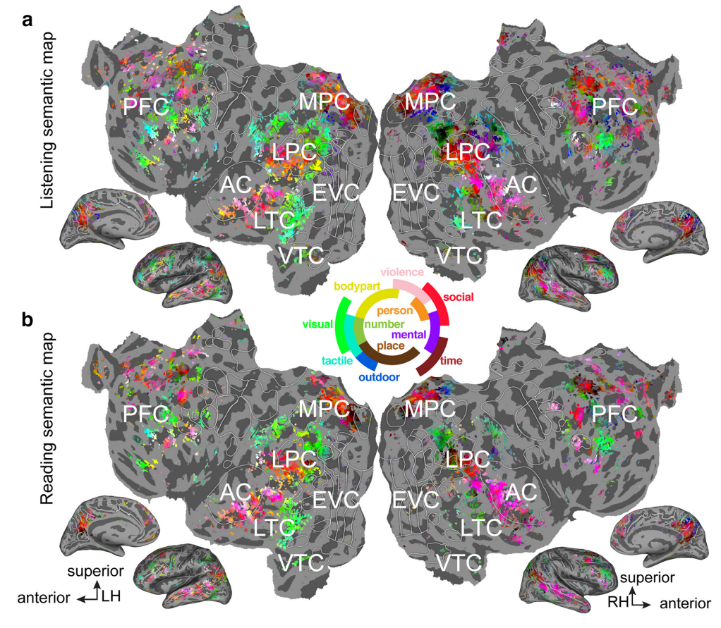
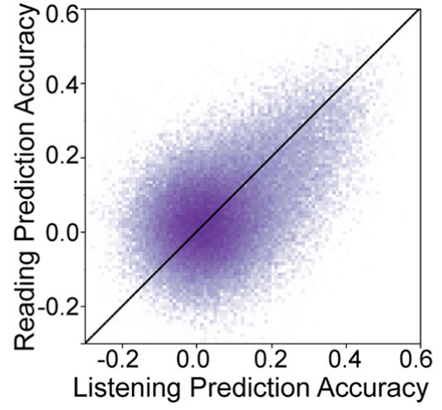
Is the representation of semantic information different when reading vs listening?
Semantic tuning during listening and reading are highly correlated in most semantically selective regions of cortex
Models estimated using one modality accurately predict voxel responses in the other modality.
Deniz, Fatma, Anwar O. Nunez-Elizalde, Alexander G. Huth, and Jack L. Gallant. "The representation of semantic information across human cerebral cortex during listening versus reading is invariant to stimulus modality." Journal of Neuroscience 39, no. 39 (2019): 7722-7736.

Slide 39
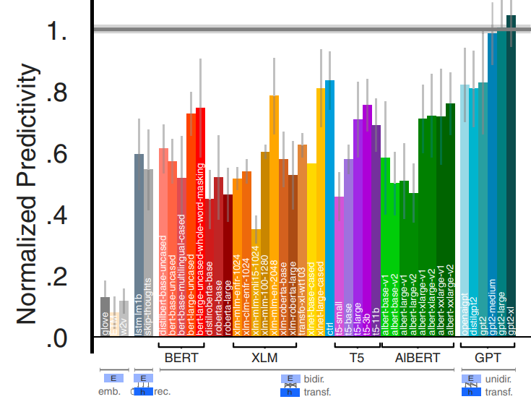
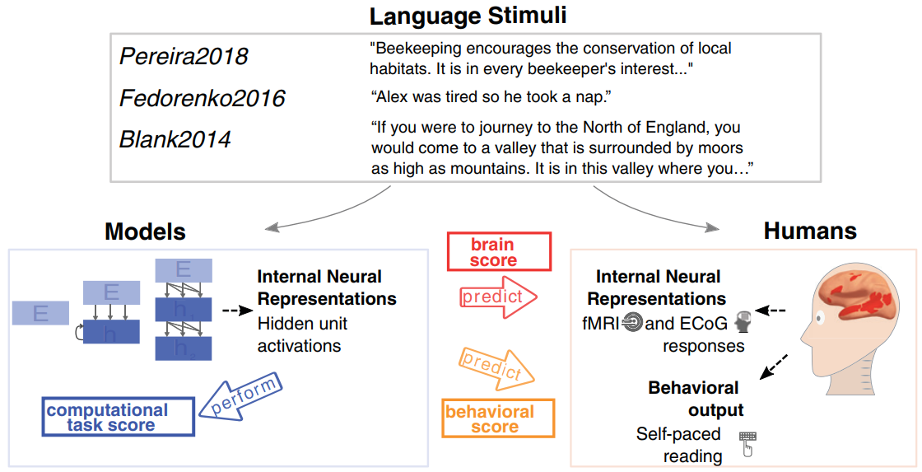
Do larger Transformer models lead to better brain‑encoding accuracy?
Transformer models predict nearly 100% of explainable variance in neural responses to sentences.
Larger models are better. GPT2-XL is the best.
Schrimpf, Martin, Idan Asher Blank, Greta Tuckute, Carina Kauf, Eghbal A. Hosseini, Nancy Kanwisher, Joshua B. Tenenbaum, and Evelina Fedorenko. "The neural architecture of language: Integrative modeling converges on predictive processing." Proceedings of the National Academy of Sciences 118, no. 45 (2021): e2105646118.

Slide 40
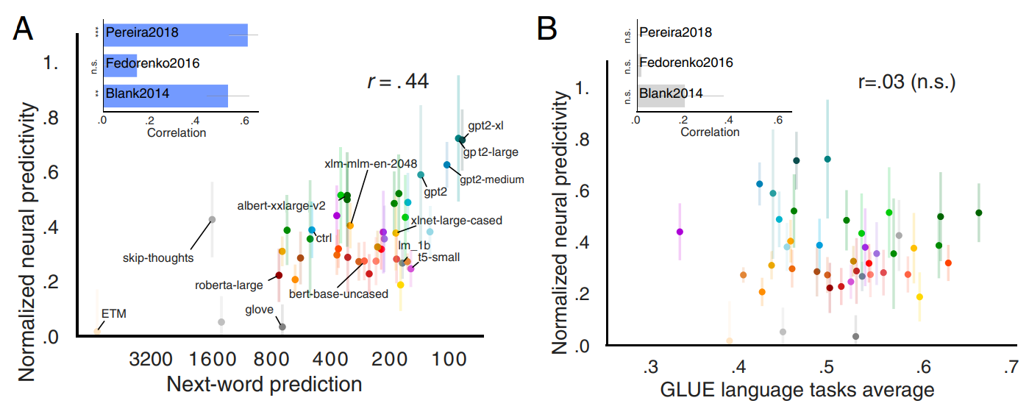
Does improved perf of Transformer models on NLP benchmarks translate to better brain‑encoding accuracy?
Next-Word-Prediction Task Performance Selectively Predicts Brain Scores.
Performance on GLUE tasks does not predict brain scores.
Schrimpf, Martin, Idan Asher Blank, Greta Tuckute, Carina Kauf, Eghbal A. Hosseini, Nancy Kanwisher, Joshua B. Tenenbaum, and Evelina Fedorenko. "The neural architecture of language: Integrative modeling converges on predictive processing." Proceedings of the National Academy of Sciences 118, no. 45 (2021): e2105646118.

Slide 41
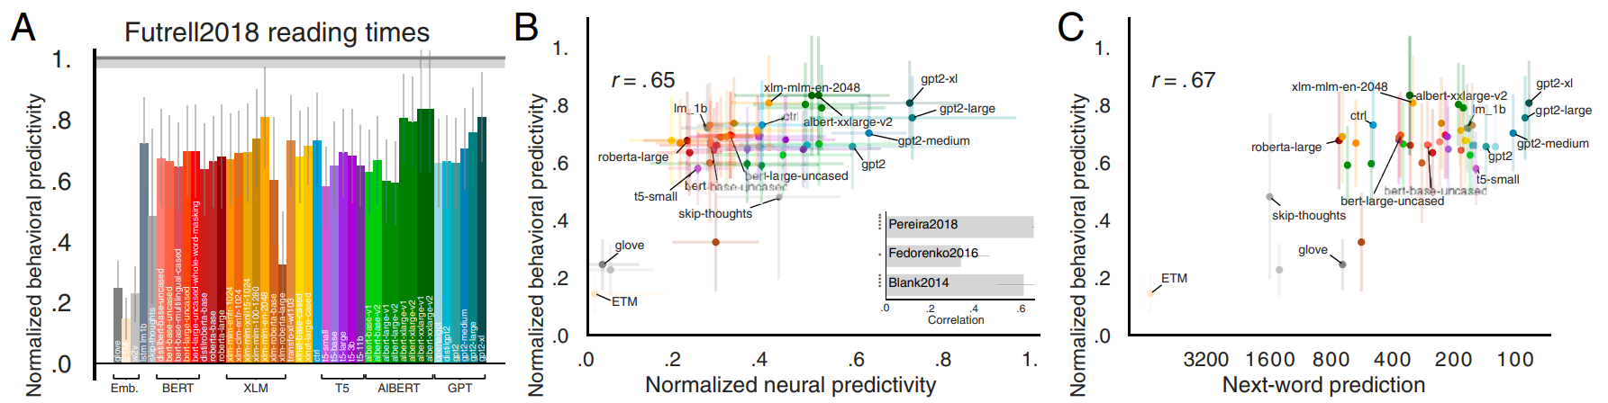
Does improved perf of Transformer models on NLP benchmarks translate to better brain‑encoding accuracy?
Behavioral scores (self-paced reading times), brain scores, and next-word-prediction task perf are pairwise correlated.
Perf on other GLUE tasks does not correlate with behavioral scores
Schrimpf, Martin, Idan Asher Blank, Greta Tuckute, Carina Kauf, Eghbal A. Hosseini, Nancy Kanwisher, Joshua B. Tenenbaum, and Evelina Fedorenko. "The neural architecture of language: Integrative modeling converges on predictive processing." Proceedings of the National Academy of Sciences 118, no. 45 (2021): e2105646118.

Slide 42
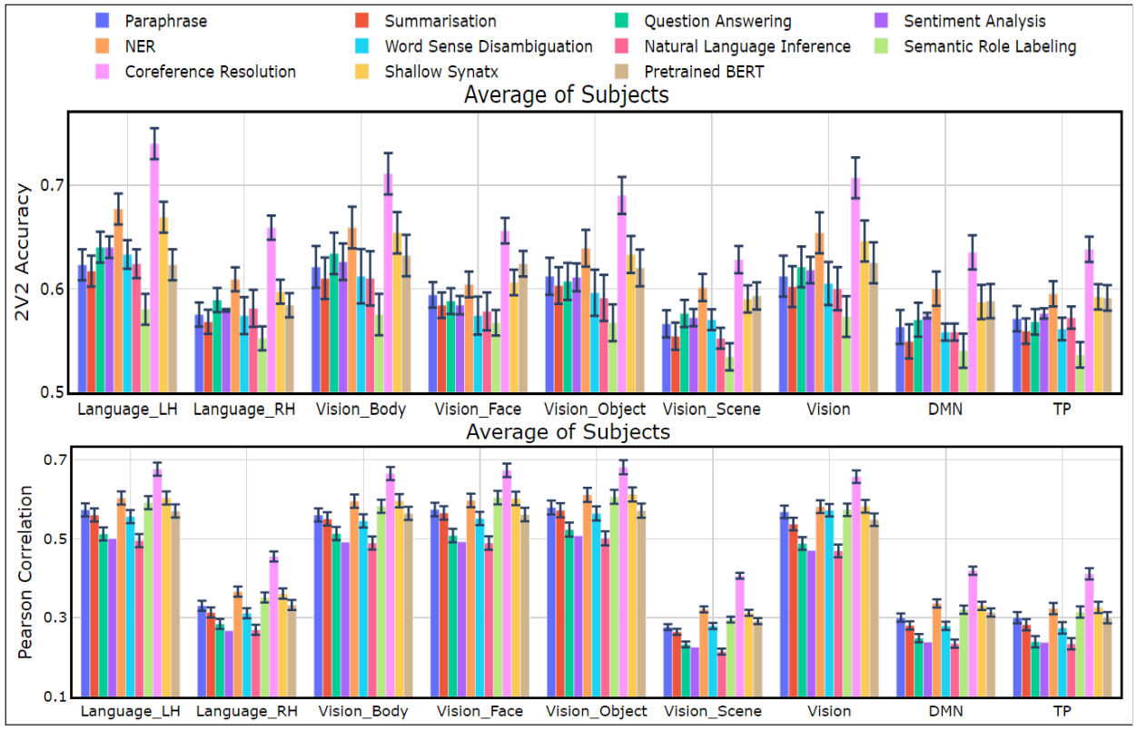
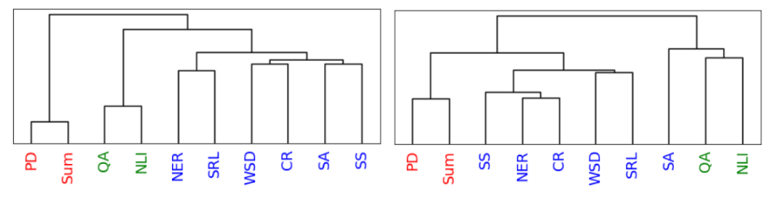
Which NLP Tasks are the most Predictive of fMRI Brain Activity?
Coreference resolution, NER, and shallow syntax parsing explain greater variance for the reading activity.
For the listening activity, paraphrase generation, summarization, and natural language inference show better encoding performance.
Tree derived from brain representation vs tree based on Transformer encoder embeddings.
Oota, Subba Reddy, Jashn Arora, Veeral Agarwal, Mounika Marreddy, Manish Gupta, and Bapi Surampudi. "Neural language taskonomy: Which NLP tasks are the most predictive of fMRI brain activity?." In NAACL-HLT, pp. 3220-3237. 2022.

Slide 43
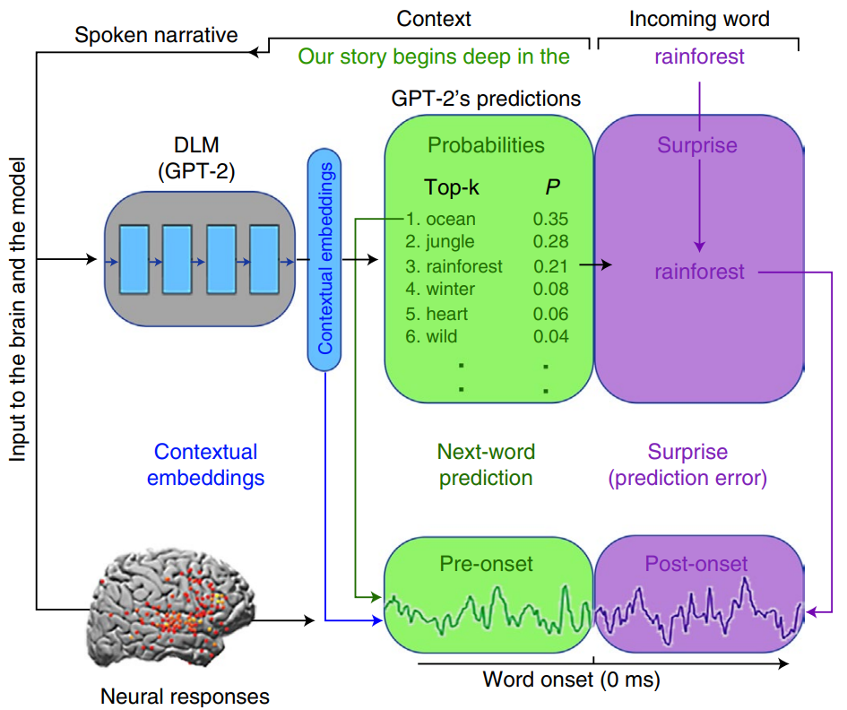
Does the brain also perform next word prediction and is surprised when next word does not match the prediction?
ECoG while listening to a 30-min podcast.
Human brains and DLMs
Both are engaged in continuous next-word prediction before word onset
Both match their pre-onset predictions to the incoming word to calculate post-onset surprise
Both rely on contextual embeddings to represent words in natural contexts.
Goldstein, Ariel, Zaid Zada, Eliav Buchnik, Mariano Schain, Amy Price, Bobbi Aubrey, Samuel A. Nastase et al. "Shared computational principles for language processing in humans and deep language models." Nature neuroscience 25, no. 3 (2022): 369-380.

Slide 44
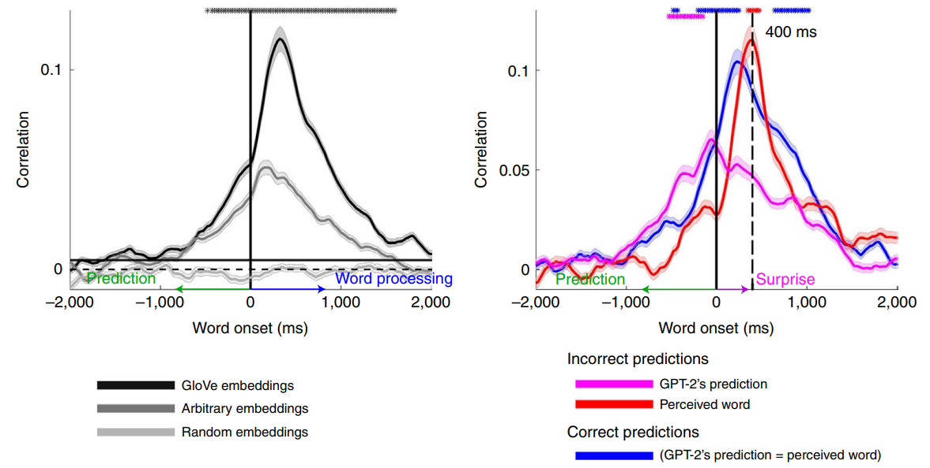
Does the brain also perform next word prediction and is surprised when next word does not match the prediction?
GloVe yielded significant correlations with predicted neural responses to upcoming words up to 800 ms before word onset.
Pre-onset activity associated with next-word prediction matches prediction content even when the prediction was incorrect.
Post-onset activity matches content of the incoming word, even if it was unpredicted.
Increase in encoding perf for surprising words compared to predicted words 400 ms after word onset.
Goldstein, Ariel, Zaid Zada, Eliav Buchnik, Mariano Schain, Amy Price, Bobbi Aubrey, Samuel A. Nastase et al. "Shared computational principles for language processing in humans and deep language models." Nature neuroscience 25, no. 3 (2022): 369-380.

Slide 45
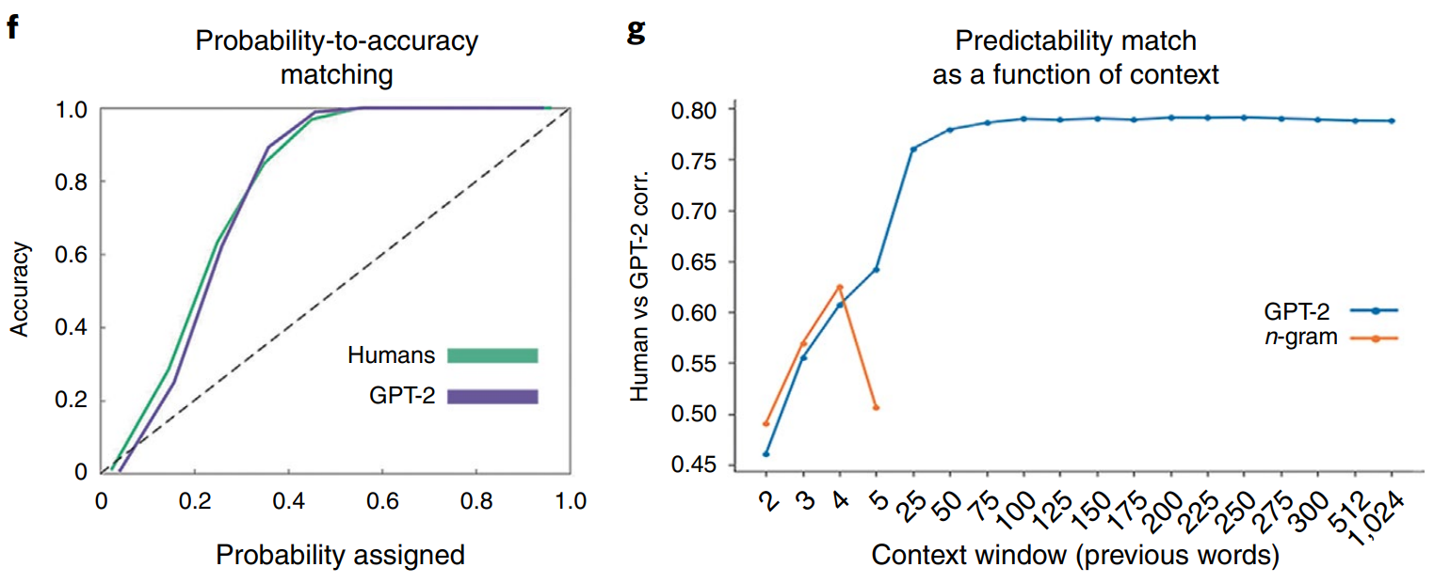
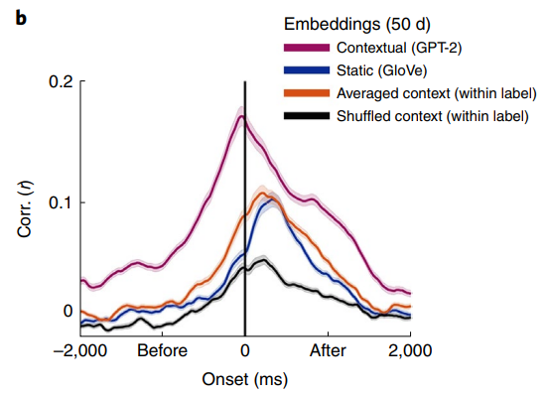
Does the brain depend on context for processing text?
Match between confidence level and the accuracy level of GPT-2 and human predictions
Under-confidence in their predictions and were above 95% correct when the probabilities were higher than 40%.
Correlation between human and GPT2 word predictions improved as the contextual window increased.
Contextual embeddings (GPT-2) > static embeddings (GloVe)
Contextual embeddings (GPT-2) > concatenated GloVe embeddings for 10 prev words
Avg context: Averaging all embeddings for each unique word (all occurrences of ‘monkey’) into 1 vector
Scramble the embeddings across different occurrences of the same word in the story (switch embedding of ‘monkey’ in sentence 5 with that in sentence 50).
Goldstein, Ariel, Zaid Zada, Eliav Buchnik, Mariano Schain, Amy Price, Bobbi Aubrey, Samuel A. Nastase et al. "Shared computational principles for language processing in humans and deep language models." Nature neuroscience 25, no. 3 (2022): 369-380.

Slide 46
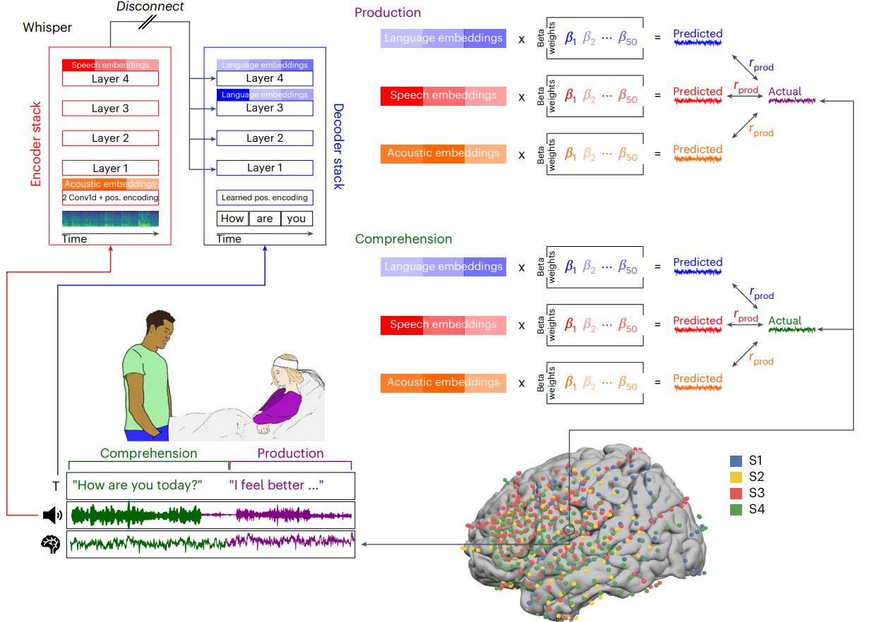
Do speech models align with language and speech ROIs during speech production and comprehension?
Extracted low-level acoustic, mid-level speech and contextual word embeddings from a multimodal speech-to-text model (Whisper).
Sensory and motor regions better align with the model’s speech embeddings
Higher-level language areas better align with the model’s language embeddings.
Goldstein, Ariel, Haocheng Wang, Leonard Niekerken, Mariano Schain, Zaid Zada, Bobbi Aubrey, Tom Sheffer et al. "A unified acoustic-to-speech-to-language embedding space captures the neural basis of natural language processing in everyday conversations." Nature human behaviour (2025): 1-15.

Slide 47
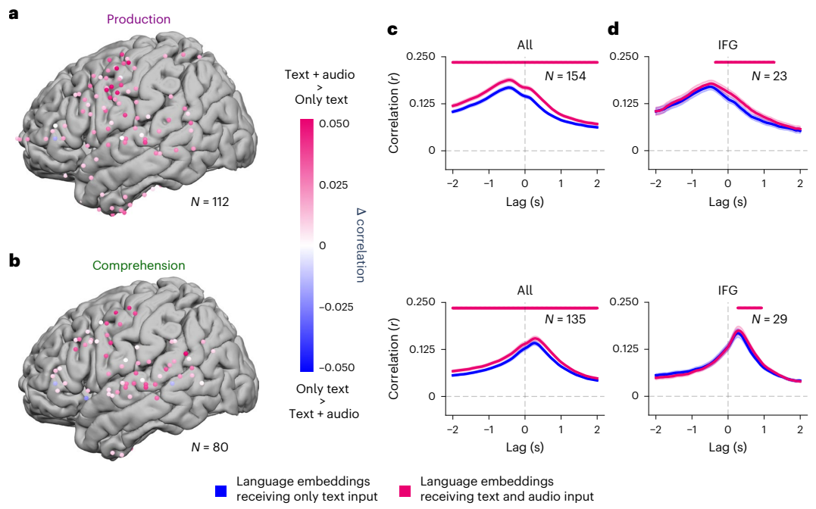
Are both text and audio needed for speech alignment?
Only text input (conversation transcripts) vs language receiving audio and text inputs (speech recordings and conversation transcripts)
Language embeddings fused with auditory features outperform text-only language embeddings in predicting neural activity across multiple electrodes.
Even though IFG is associated with linguistic processing, across multiple lags, the audio-fused language embeddings yield higher encoding performance during both production and comprehension.
Goldstein, Ariel, Haocheng Wang, Leonard Niekerken, Mariano Schain, Zaid Zada, Bobbi Aubrey, Tom Sheffer et al. "A unified acoustic-to-speech-to-language embedding space captures the neural basis of natural language processing in everyday conversations." Nature human behaviour (2025): 1-15.

Slide 48
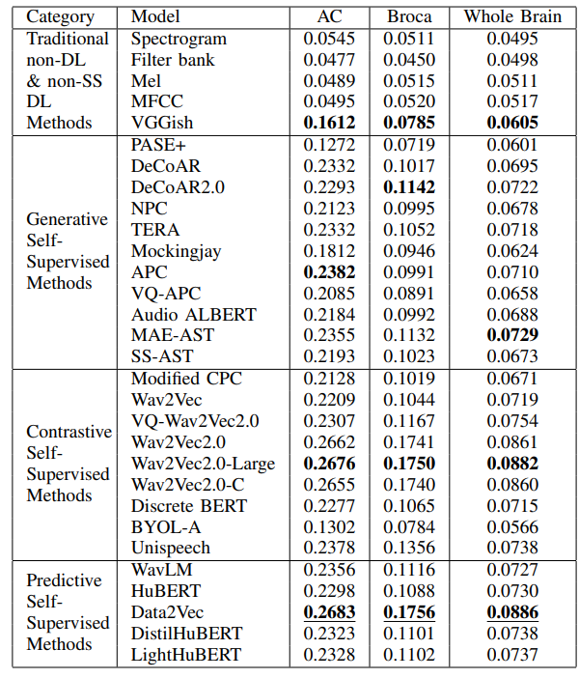
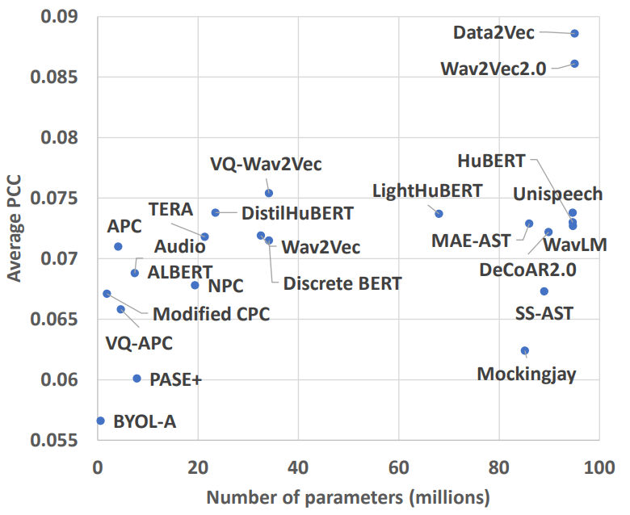
Which speech model aligns the best?
Wav2Vec2.0, HuBERT, Data2Vec align well.
Data2Vec aligns best with both language and auditory brain regions
Oota, Subba Reddy, Khushbu Pahwa, Mounika Marreddy, Manish Gupta, and Bapi S. Raju. "Neural architecture of speech." In ICASSP 2023-2023 IEEE International Conference on Acoustics, Speech and Signal Processing (ICASSP), pp. 1-5. IEEE, 2023.

Slide 49
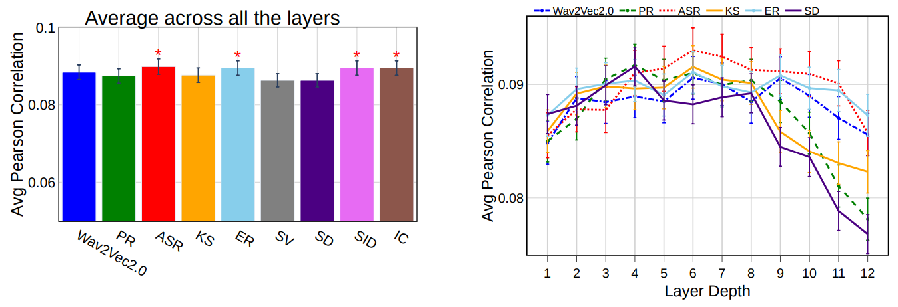
Which Speech Tasks are the most Predictive of fMRI Brain Activity?
8 tasks from Speech processing Universal PERformance Benchmark (SUPERB): Phoneme Recognition (PR), Automatic Speech Recognition (ASR), Keyword Spotting (KS), Intent Classification (IC), Speaker Diarization (SD), Speaker Verification (SV), Speaker Identification (SID), and Emotion Recognition (ER)
ASR finetuning (middle layers) yields the best encoding performance for the whole brain, language and auditory regions.
Finetuning on ER, SID and IC leads to the best alignment for the early auditory cortex.
Oota, Subba Reddy, Veeral Agarwal, Mounika Marreddy, Manish Gupta, and Raju Surampudi Bapi. "Speech taskonomy: Which speech tasks are the most predictive of fmri brain activity?." In INTERSPEECH 2023-24th INTERSPEECH Conference, pp. 5167-5171. 2023.

Slide 50
Agenda
Introduction to the tutorial [10 min]
Introduction to Brain Encoding and Decoding [50 min]
Brain Encoding: Scaling Laws, Multilinguality, Multimodal and Instruction-tuned Models [60 min]
Coffee Break & Networking [30 min]
Brain-informed Fine-tuning of Language Models [30 min]
Brain-based Interpretability and Causal Testing of AI Models [20 min]
Brain Decoding [30 min]
Summary and Future Trends [10 min]

Slide 51
Agenda
Introduction to the tutorial [10 min]
Introduction to Brain Encoding and Decoding [50 min]
Brain Encoding: Scaling Laws, Multilinguality, Multimodal and Instruction-tuned Models [60 min]
Coffee Break & Networking [30 min]
Brain-informed Fine-tuning of Language Models [30 min]
Brain-based Interpretability and Causal Testing of AI Models [20 min]
Brain Decoding [30 min]
Summary and Future Trends [10 min]

Slide 52
Agenda
Introduction to the tutorial [10 min]
Introduction to Brain Encoding and Decoding [50 min]
Brain Encoding: Scaling Laws, Multilinguality, Multimodal and Instruction-tuned Models [60 min]
Coffee Break & Networking [30 min]
Brain-informed Fine-tuning of Language Models [30 min]
Brain-based Interpretability and Causal Testing of AI Models [20 min]
Brain Decoding [30 min]
Summary and Future Trends [10 min]

Slide 53
Agenda
Introduction to the tutorial [10 min]
Introduction to Brain Encoding and Decoding [50 min]
Brain Encoding: Scaling Laws, Multilinguality, Multimodal and Instruction-tuned Models [60 min]
Coffee Break & Networking [30 min]
Brain-informed Fine-tuning of Language Models [30 min]
Brain-based Interpretability and Causal Testing of AI Models [20 min]
Brain Decoding [30 min]
Summary and Future Trends [10 min]

Slide 54
Agenda
Introduction to the tutorial [10 min]
Introduction to Brain Encoding and Decoding [50 min]
Brain Encoding: Scaling Laws, Multilinguality, Multimodal and Instruction-tuned Models [60 min]
Coffee Break & Networking [30 min]
Brain-informed Fine-tuning of Language Models [30 min]
Brain-based Interpretability and Causal Testing of AI Models [20 min]
Brain Decoding [30 min]
Summary and Future Trends [10 min]

Slide 55
Agenda
Introduction to the tutorial [10 min]
Introduction to Brain Encoding and Decoding [50 min]
Brain Encoding: Scaling Laws, Multilinguality, Multimodal and Instruction-tuned Models [60 min]
Coffee Break & Networking [30 min]
Brain-informed Fine-tuning of Language Models [30 min]
Brain-based Interpretability and Causal Testing of AI Models [20 min]
Brain Decoding [30 min]
Summary and Future Trends [10 min]

Slide 56
A big thank you!
Tutorial, Code and Material:
Material from AAAI 2026 Tutorial would be uploaded soon!
(Past): Deep Learning for Brain Encoding and Decoding, Cogsci-2022
https://tinyurl.com/DL4Brain
(Past): Language and the Brain: Deep Learning for Brain Encoding and Decoding, IJCNN 2023
https://tinyurl.com/DLBrainIJCNN2023
(Past): Deep Neural Networks and Brain Alignment: Brain Encoding and Decoding, IJCAI 2023
https://tinyurl.com/DLBrainIJCAI2023

Slide 57
Thanks!
Questions
subba-reddy.oota@inria.fr
tanchak@iitd.ac.in
gmanish@microsoft.com
raju.bapi@iiit.ac.in
Connect with us:
https://www.linkedin.com/in/subba-reddy-oota-11a91254/
https://tanmoychak.com/
http://aka.ms/manishgupta, https://sites.google.com/view/manishg/
https://sites.google.com/view/bccl-iiith/home

