Slide 1




WSNet: Towards An Effective Method for Wound Image Segmentation
Subba Reddy Oota , Vijay Rowtula, Shahid Mohammed, Minghsun Liu, Manish Gupta

Slide 2
Motivation
Automated segmentation of wound regions from patient images.
Can aid clinicians in measuring and managing chronic wounds and monitoring the wound healing trajectory.
Existing methods are limited to segmenting a smaller subset of ulcers, such as foot ulcers, with no special processing for wound images.
We build segmentation models for eight different types of wound images.
Impact of using segmentation for improving the accuracy of downstream tasks
E.g. wound area and volume prediction.

Slide 3
Challenges
Wound image analysis is a challenging due to lack of availability of extensive data.
AZH dataset has 1 wound type (foot ulcer) and 1K images
Medetec has 1 wound type (foot ulcer) and 600 images
Annotation is also challenging due to the shortage of well-trained wound care clinicians.
Complexity - the heterogeneous appearance of wound area across images of similar wound types.

Slide 4
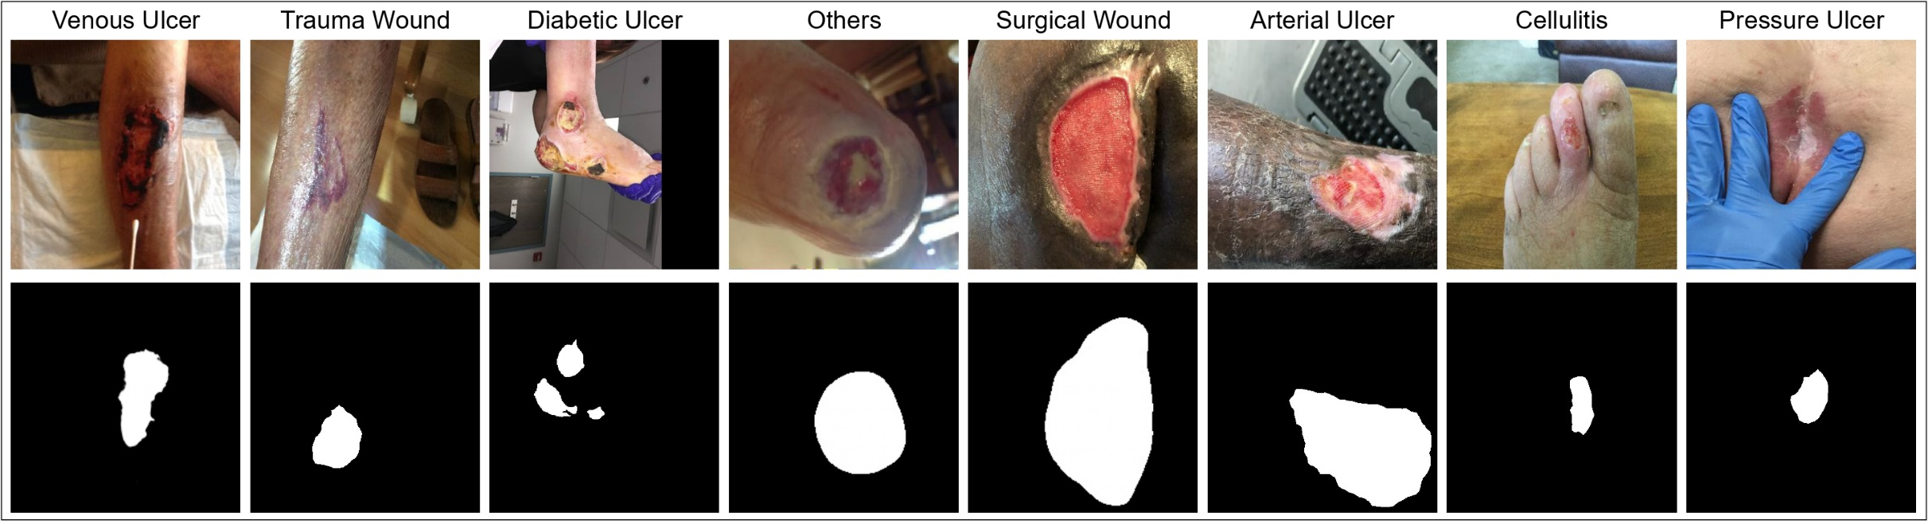
Different wound types from our WOUNDSEG dataset

Slide 5
Contributions
WOUNDSEG - a large and diverse dataset of segmented wound images.
8 wound types (diabetic, pressure, trauma, venous, surgical, arterial, cellulitis, and others)
2686 images
A novel image segmentation framework, WSNET, which leverages
wound domain adaptive pre-training on a large unlabeled wound image collection.
a global-local architecture that utilizes full image and its patches to learn fine-grained details of heterogeneous wounds.
On WOUNDSEG, we achieve a decent Dice score of 0.847.
On existing AZH Woundcare and Medetec datasets, we establish a new state-of-the-art.

Slide 6
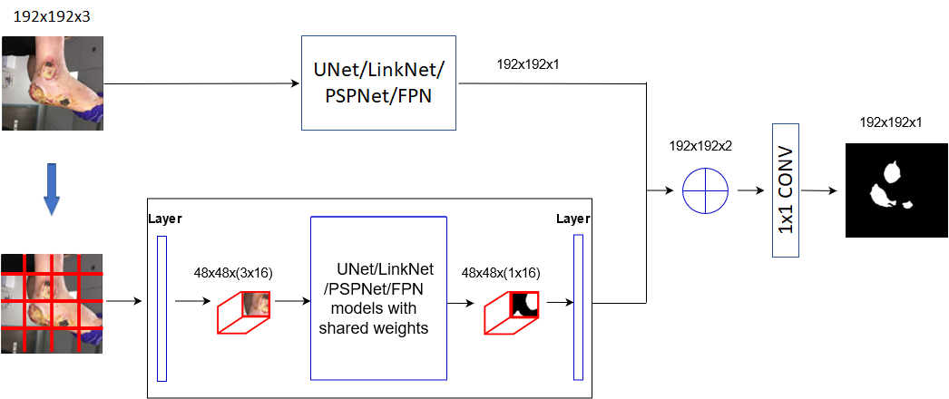
Model Architecture

Slide 7
WSNET Methodology
Wound Segmentation Models - We experiment with the following four popular segmentation architectures, and with 17 backbones to explore the accuracy versus model size trade-off .
Wound-Domain Adaptive Pre-training (WDAP) - we create pre-trained models specifically on the wound image dataset instead of using Imagenet pre-trained weights.
Fine-tuning – Pre-trained models are fine-tuned on labeled image segmentation data.
Data augmentation – we chose horizontal flip, random rotation, optical distortion, grid distortion, blur, random brightness contrast, and transpose to perform the data augmentation.
Global-Local Architecture - for effective segmentation, it is essential to obtain (global) signals from the entire image and (local) signals from individual patches extracted to capture the intricate details in wound images.

Slide 8
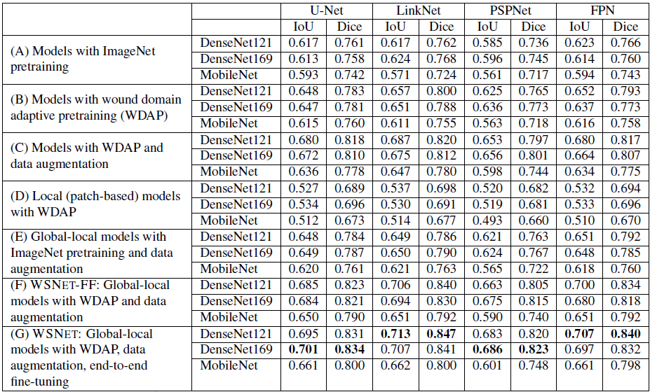
Performance results of image segmentation models on WOUNDSEG dataset.

Slide 9
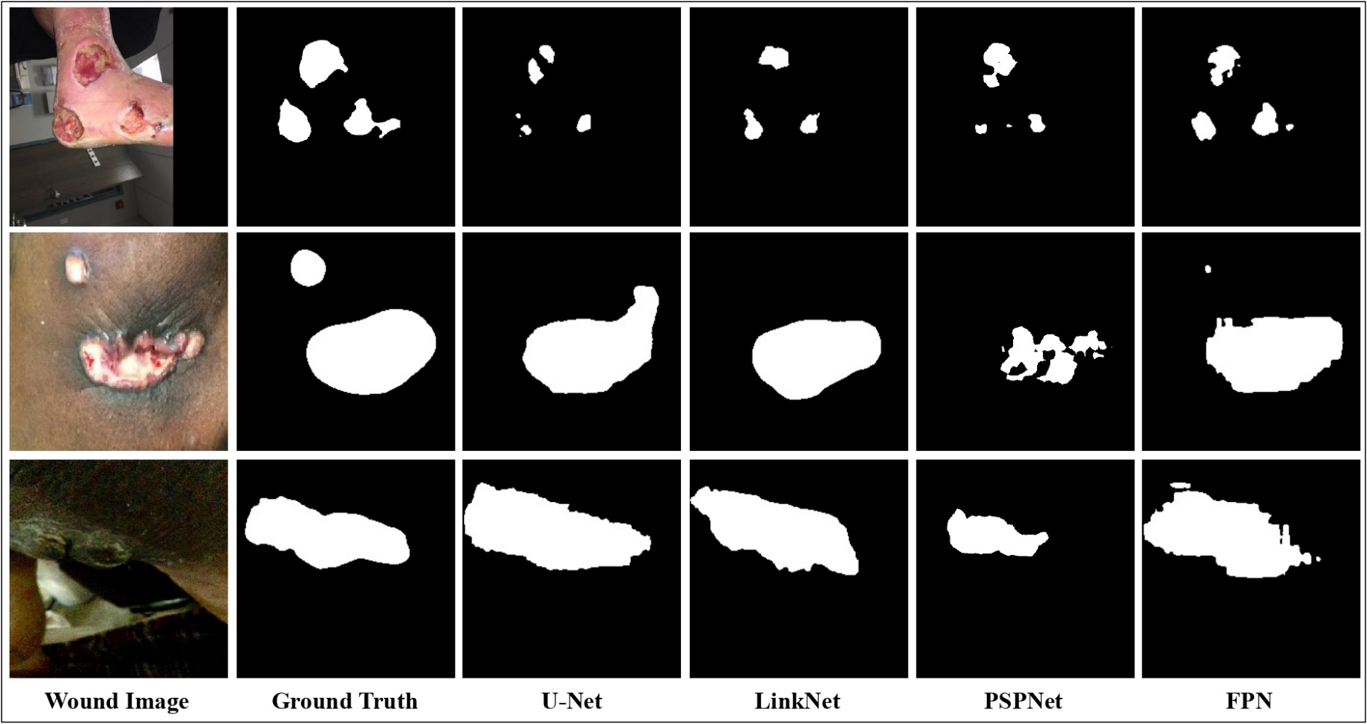
WSNET Predictions using the four global-local architectures.

Slide 10
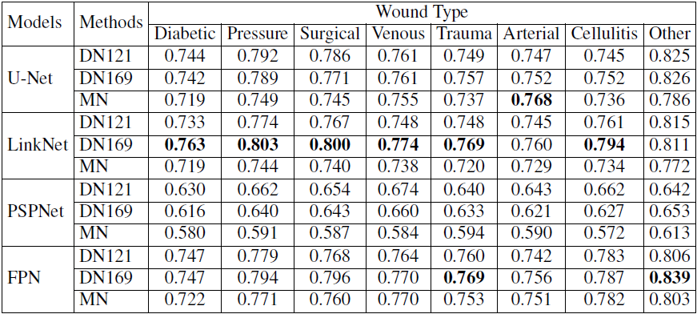
Dice-score comparison on the WoundSeg Dataset
Notes:
Dice-score comparison on the WoundSeg Dataset for our proposed WSNET methods. DN=DenseNet, MN=MobileNet

Slide 11
Wound Area and Volume Prediction Results
Method | Area MAE | Volume MAE
HealTech | 1.14 | 1.28
WSNET with U-Net | 0.66 | 0.78
WSNET with LinkNet | 0.65 | 0.78
WSNET with PSPNet | 0.71 | 0.82
WSNET with FPN | 0.66 | 0.78

Slide 12
Conclusions
We contribute a diverse dataset, WOUNDSEG, of 2686 images across eight wound types for the wound image segmentation task.
We experimented extensively with four CNN model architectures and 17 backbones.
We propose a novel WSNET framework that consists of wound-domain adaptive pretraining, data augmentation, global-local architecture, and end-to-end fine-tuning.
The proposed methods outperform baselines on existing benchmark datasets, show beneficial results on the WOUNDSEG dataset, and even establish a new state-of-the-art on wound area and volume prediction tasks.

Slide 13
Thanks!

