Slide 1
Data Analysis Project
Assignment

Slide 2
Overview of my approach
1. Data Loaded and Processed from Source
2. Key Metrics Analyzed Using SQL Queries
3. Visualizations Created to Highlight Trends
4. Insights Derived from Data Patterns

Slide 3
Key Insights and Takeaways
Optimization Opportunities:
After performing the analysis:
Google has the highest conversion rate at 78.95%(approx), making it the most effective campaign.
Newsletter drives the highest number of unique users and total time spent.
Takeaways:
Improve engagement on Facebook and LinkedIn to boost conversion rates.
Allocate more resources to Google campaigns to maximize ROI.

Slide 4
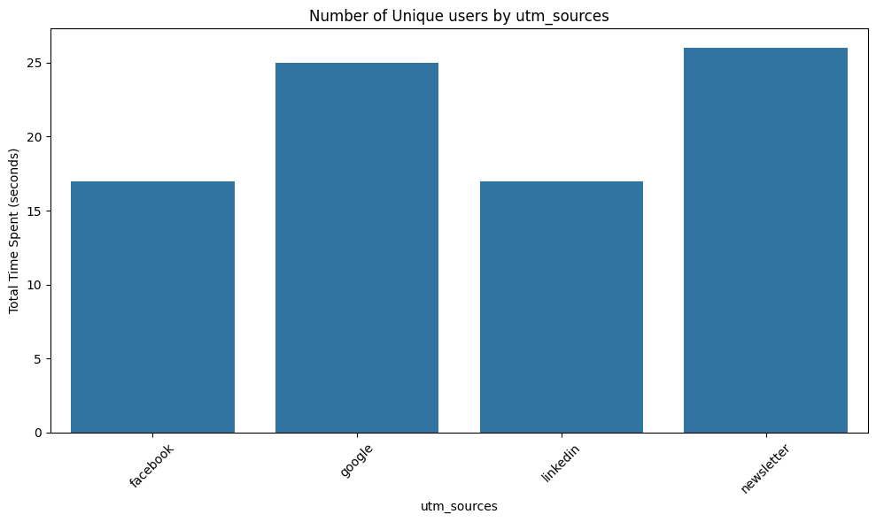
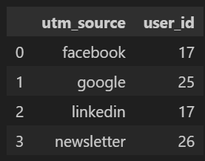
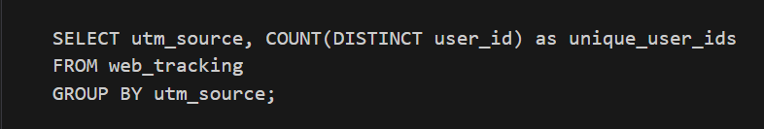
SQL and Visualizations
Top performing utm_source
Number of UNIQUE users

Slide 5
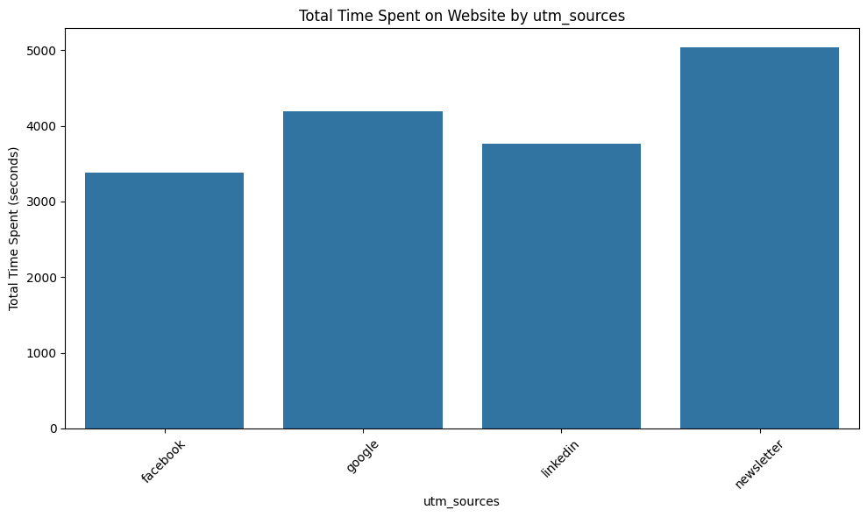
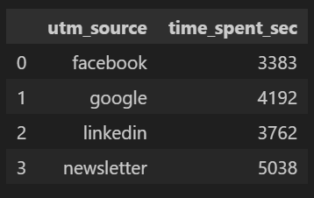
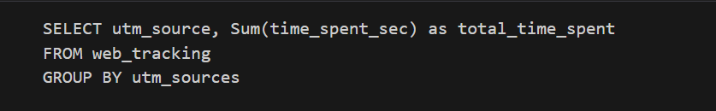
•By total time spent on the website

Slide 6
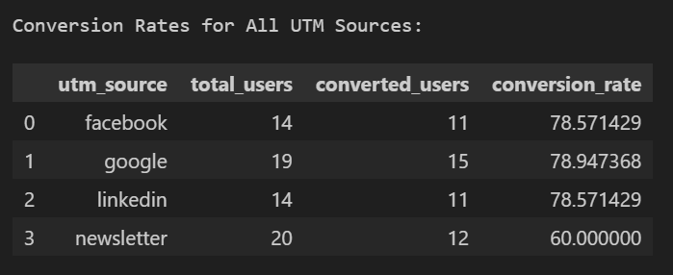
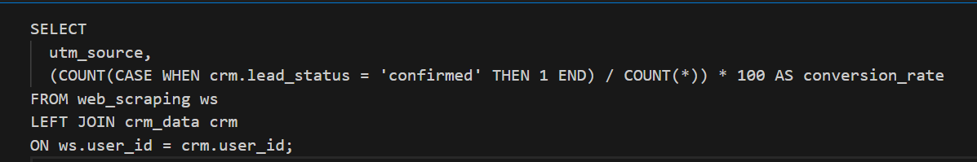
• By Conversion rate (from CRM → lead_status = "Converted")

Slide 7
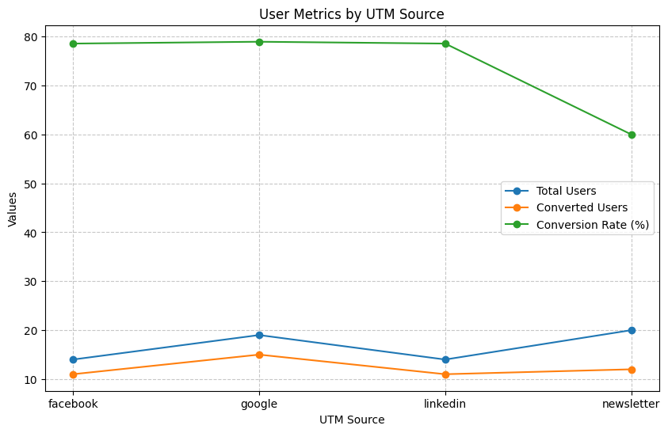

Slide 8
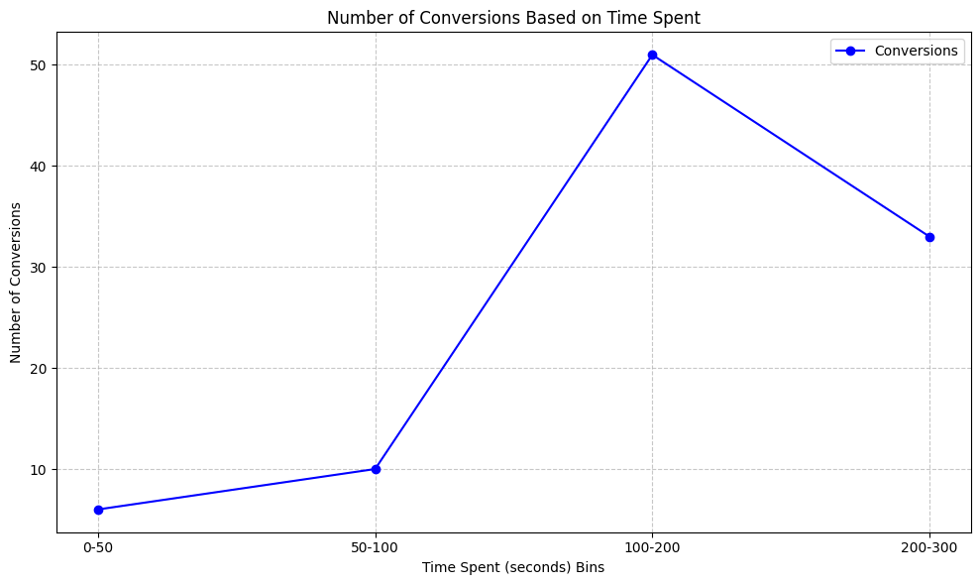

Slide 9
GitHub link:- https://github.com/subbham7007/Data_Analysis_Assesment

