Slide 1
CREDIT PORTFOLIO SEGMENTATION &
RISK PATTERN ANALYSIS
Unsupervised Machine Learning, Manifold Dimensionality Reduction & Historical Default Cross-Validation
HCL GUVI Class Final Project Submission | Domain: Banking, Financial Services & Credit Analytics

Slide 2
HCL GUVI CAPSTONE PROJECT | RETAIL BANKING & CREDIT RISK ANALYTICS
Executive Summary & Core Objectives
Industry Problem Context
• Financial institutions manage immense portfolios with diverse borrower income levels, credit scores, debt obligations, and employment tenure.
• One-size-fits-all underwriting and static scoring models overlook multidimensional risk nuances across borrower segments.
• Need: An automated, data-driven unsupervised framework to group similar borrowers without target label bias and uncover empirical repayment patterns.
Key Project Deliverables Achieved
• 1. Cleansed and engineered 1,347,681 loan records across 15 financial features.
• 2. Applied PCA, t-SNE, and UMAP for linear and non-linear manifold mapping.
• 3. Evaluated K-Means, Hierarchical (Ward), and DBSCAN with rigorous clustering metrics.
• 4. Profiled 4 distinct borrower personas and validated historical default divergence (17.3% to 22.8%).
• 5. Built an anomaly detection pipeline isolating high-risk outliers (23.71% default rate).
• 6. Deployed an interactive Streamlit underwriting and portfolio monitoring dashboard.

Slide 3
HCL GUVI CAPSTONE PROJECT | RETAIL BANKING & CREDIT RISK ANALYTICS
Dataset Architecture & Preprocessing Pipeline
Dataset Dimensions
• Total Records: 1,347,681 loans
• Origination Span: 2008 – 2018
• Total Portfolio Exposure: $19.41 Billion
• Raw Attributes: 15 columns
• Overall Default Rate: 19.98% (269,219 charged-off/defaulted loans)
• Zero missing values in core underwriting features (revenue, loan amount, FICO, DTI).
Cleansing & Outlier Treatment
• Target Isolation: 'Default' column strictly excluded from clustering features.
• Identifier Removal: 'id', 'zip_code', 'title', 'desc' dropped from clustering space.
• Income Capping: Right-skewed revenue clipped at 99th percentile ($250k) and log-transformed.
• DTI Normalization: Extreme debt ratios (>50%) capped to prevent distance distortions.
• FICO & Loan Bounds: Standardized within natural financial boundaries.
Encoding & Feature Scaling
• Employment Mapping: Categorical tenure strings mapped to continuous years (0.5 to 10+).
• Categorical One-Hot Encoding: Home ownership (Mortgage, Rent, Own) and top loan purposes.
• Derived Feature: Loan-to-Income (LTI) ratio engineered for cash flow leverage measurement.
• Feature Scaling: StandardScaler applied to ensure equal geometric variance across features.

Slide 4
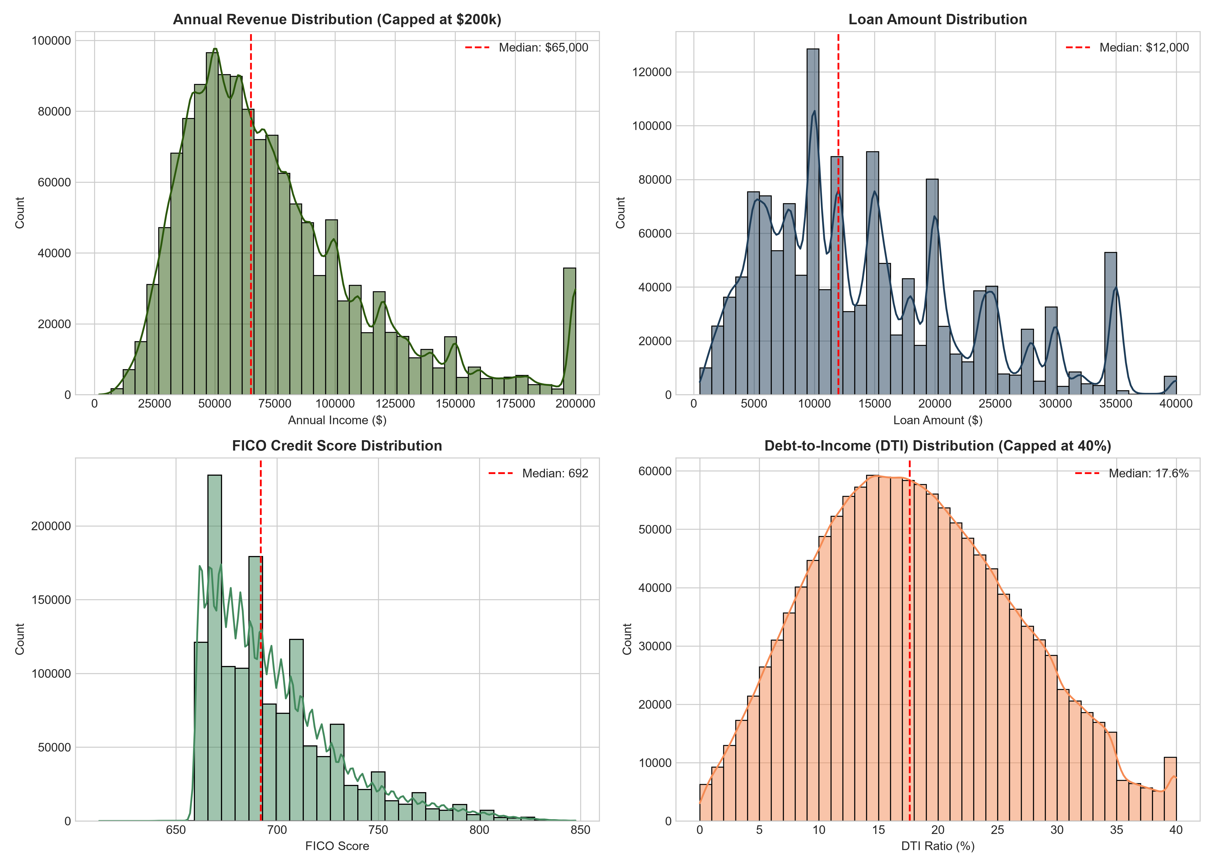
HCL GUVI CAPSTONE PROJECT | RETAIL BANKING & CREDIT RISK ANALYTICS
Exploratory Data Analysis: Key Feature Distributions
Distributional Insights
• Annual Income: Median $65,000, IQR $46,600 to $92,000. Significant right-tail skew mitigated via log scaling.
• Loan Amount: Median $12,000, Mean $14,408. Bounded between $500 and $40,000.
• FICO Scores: Median 692, Mean 698.2. Bell-shaped distribution reflecting standard prime-to-near-prime retail underwriting.
• Debt-to-Income (DTI): Median 17.6%. Normal underwriting ceiling observed at ~35-40%.

Slide 5
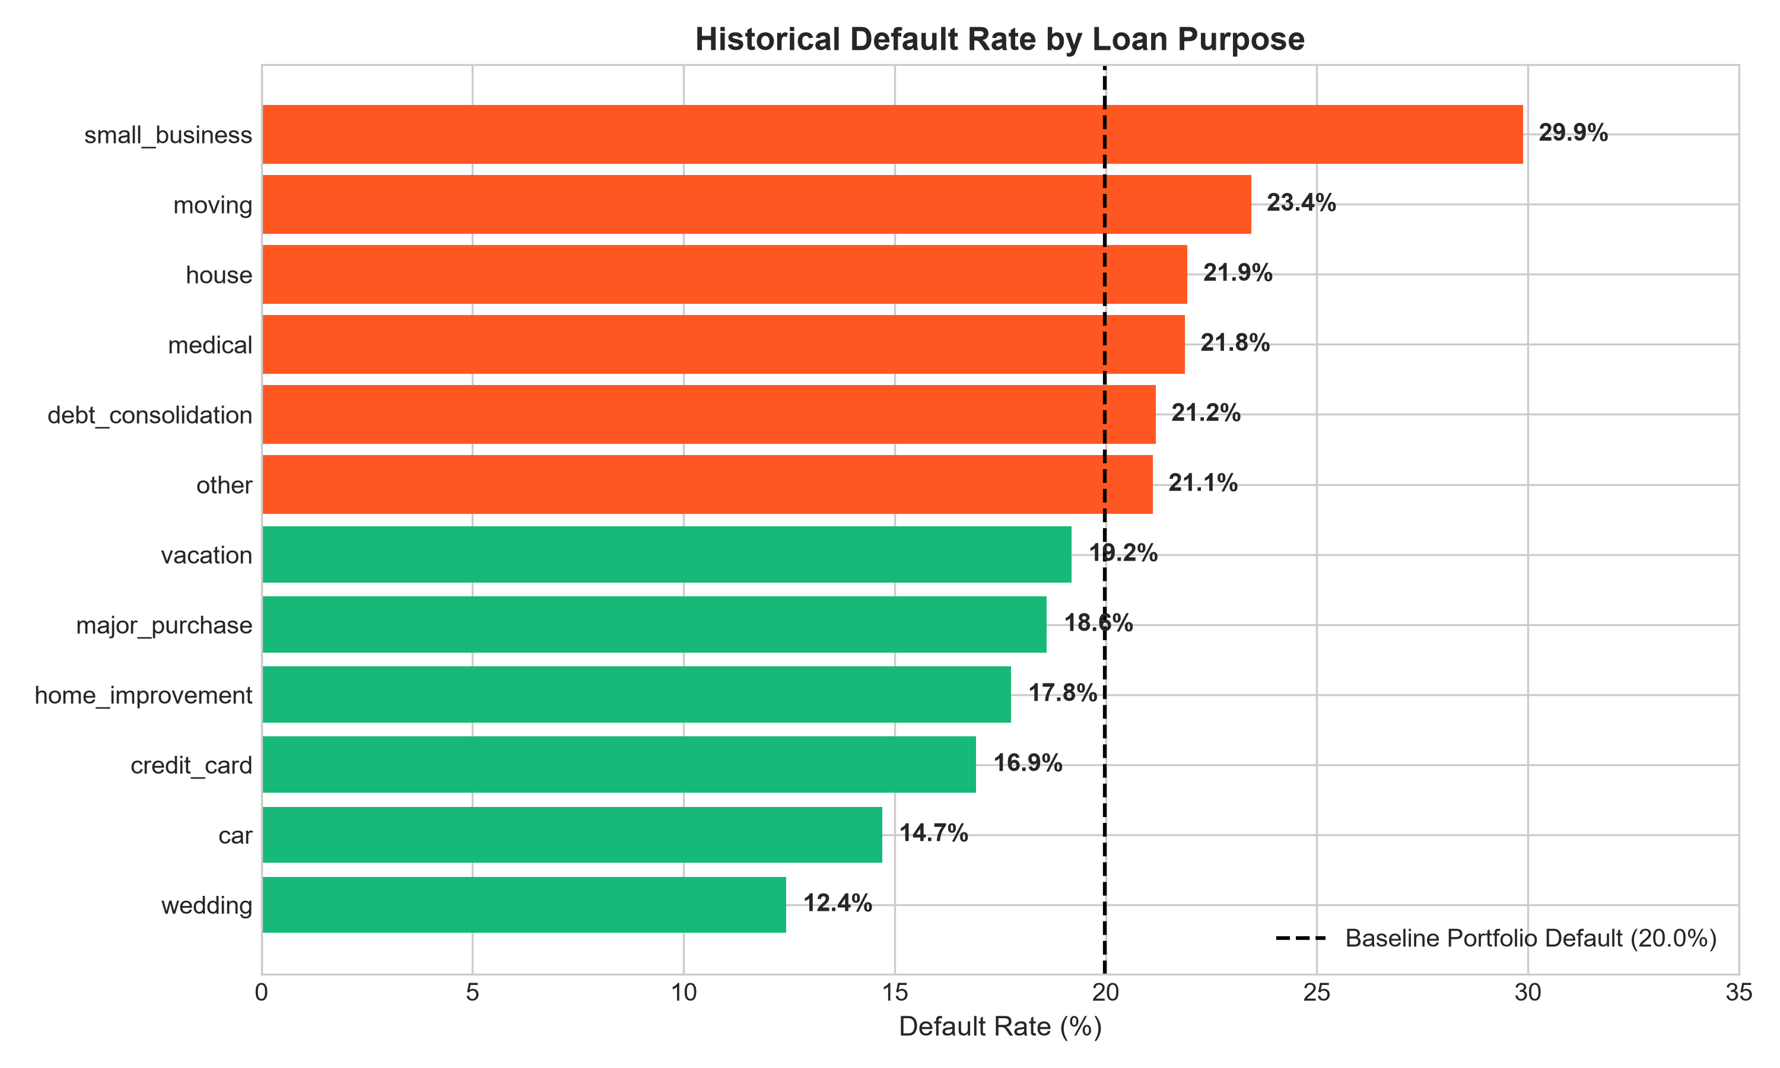
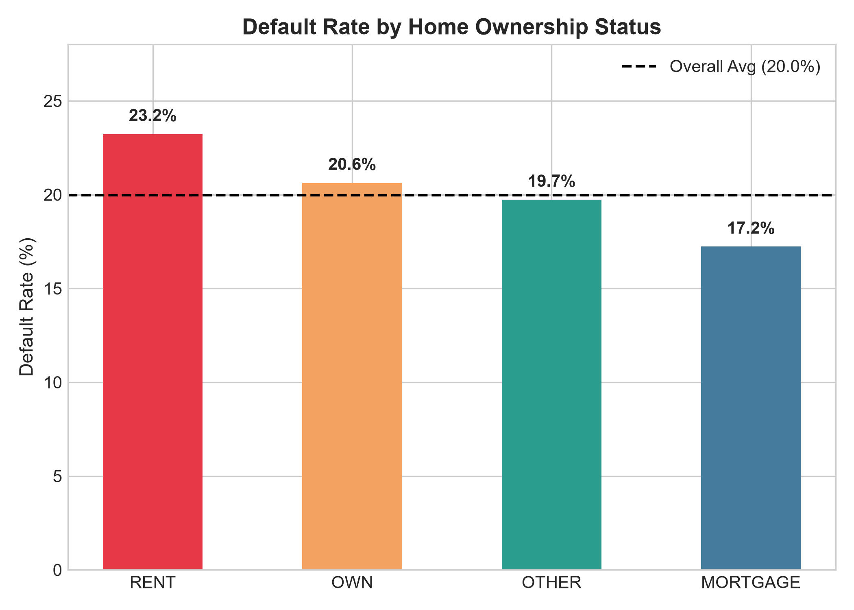
HCL GUVI CAPSTONE PROJECT | RETAIL BANKING & CREDIT RISK ANALYTICS
Risk Drivers: Loan Purpose & Collateral Impact

Slide 6
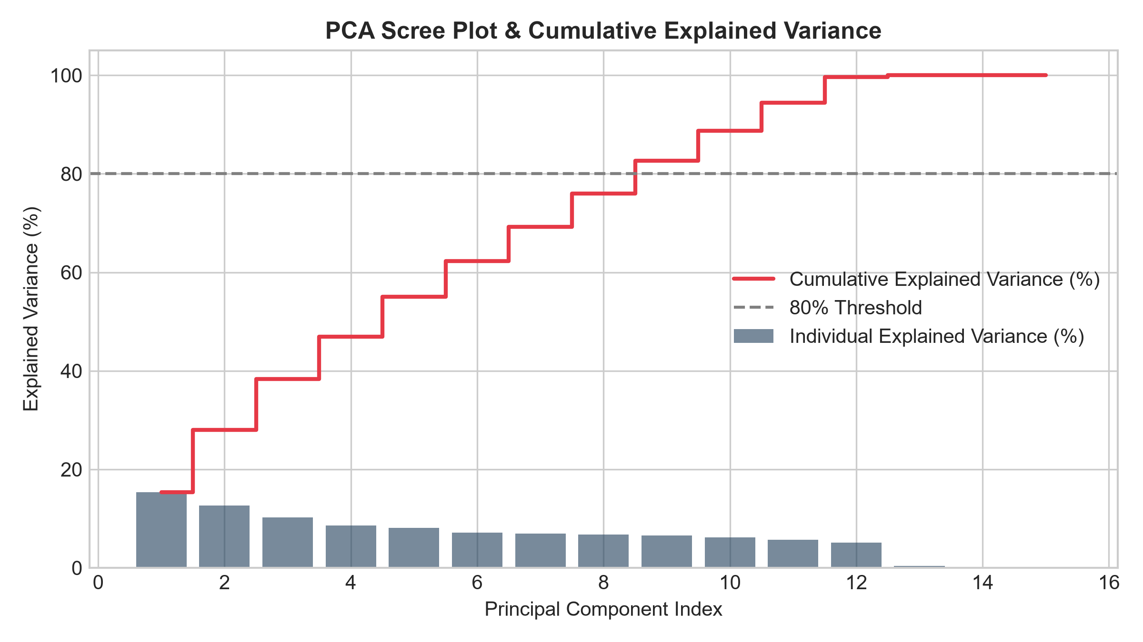
HCL GUVI CAPSTONE PROJECT | RETAIL BANKING & CREDIT RISK ANALYTICS
Dimensionality Reduction: Principal Component Analysis (PCA)
PCA Scree & Variance Retained
• Objective: Reduce feature collinearity while retaining maximal variance.
• Principal Component 1: Captures borrower scale and leverage (Income vs. Loan Amount).
• Principal Component 2: Captures credit quality and risk capacity (FICO vs. DTI).
• Cumulative Explained Variance: 80% threshold achieved smoothly across leading components.
• Utility: Transformed high-dimensional feature space into orthogonal coordinates for 3D interactive visualization.

Slide 7
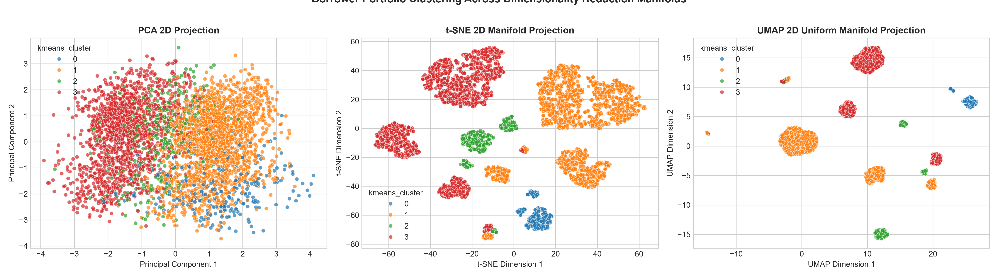
HCL GUVI CAPSTONE PROJECT | RETAIL BANKING & CREDIT RISK ANALYTICS
Non-Linear Manifold Learning: PCA vs. t-SNE vs. UMAP
Manifold Projection Takeaways
• PCA preserves global linear distances, revealing a continuous credit spectrum.
• t-SNE preserves local probabilistic neighborhoods, proving the existence of dense micro-clusters.
• UMAP successfully combines local neighborhood fidelity with global topological geometry, demonstrating clear separation between low-risk consolidators and high-exposure borrowers.

Slide 8
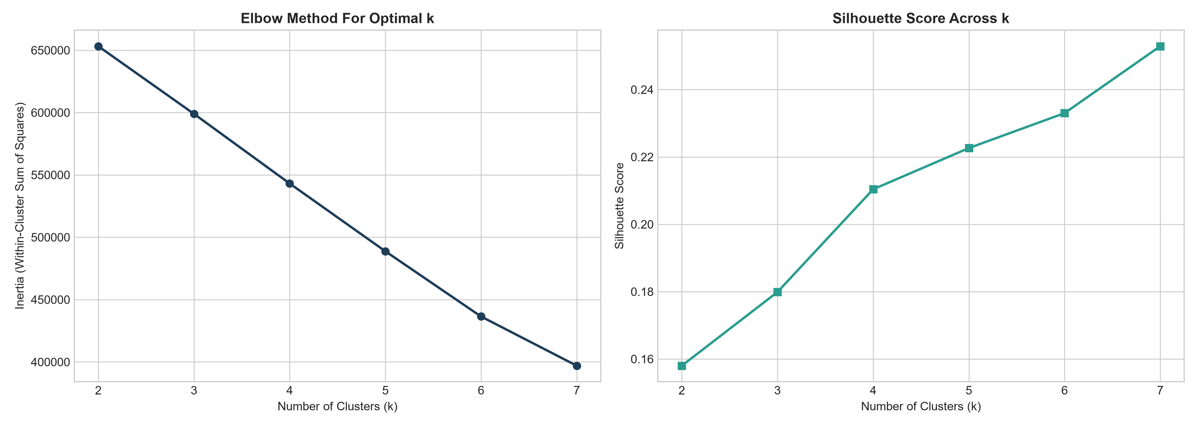
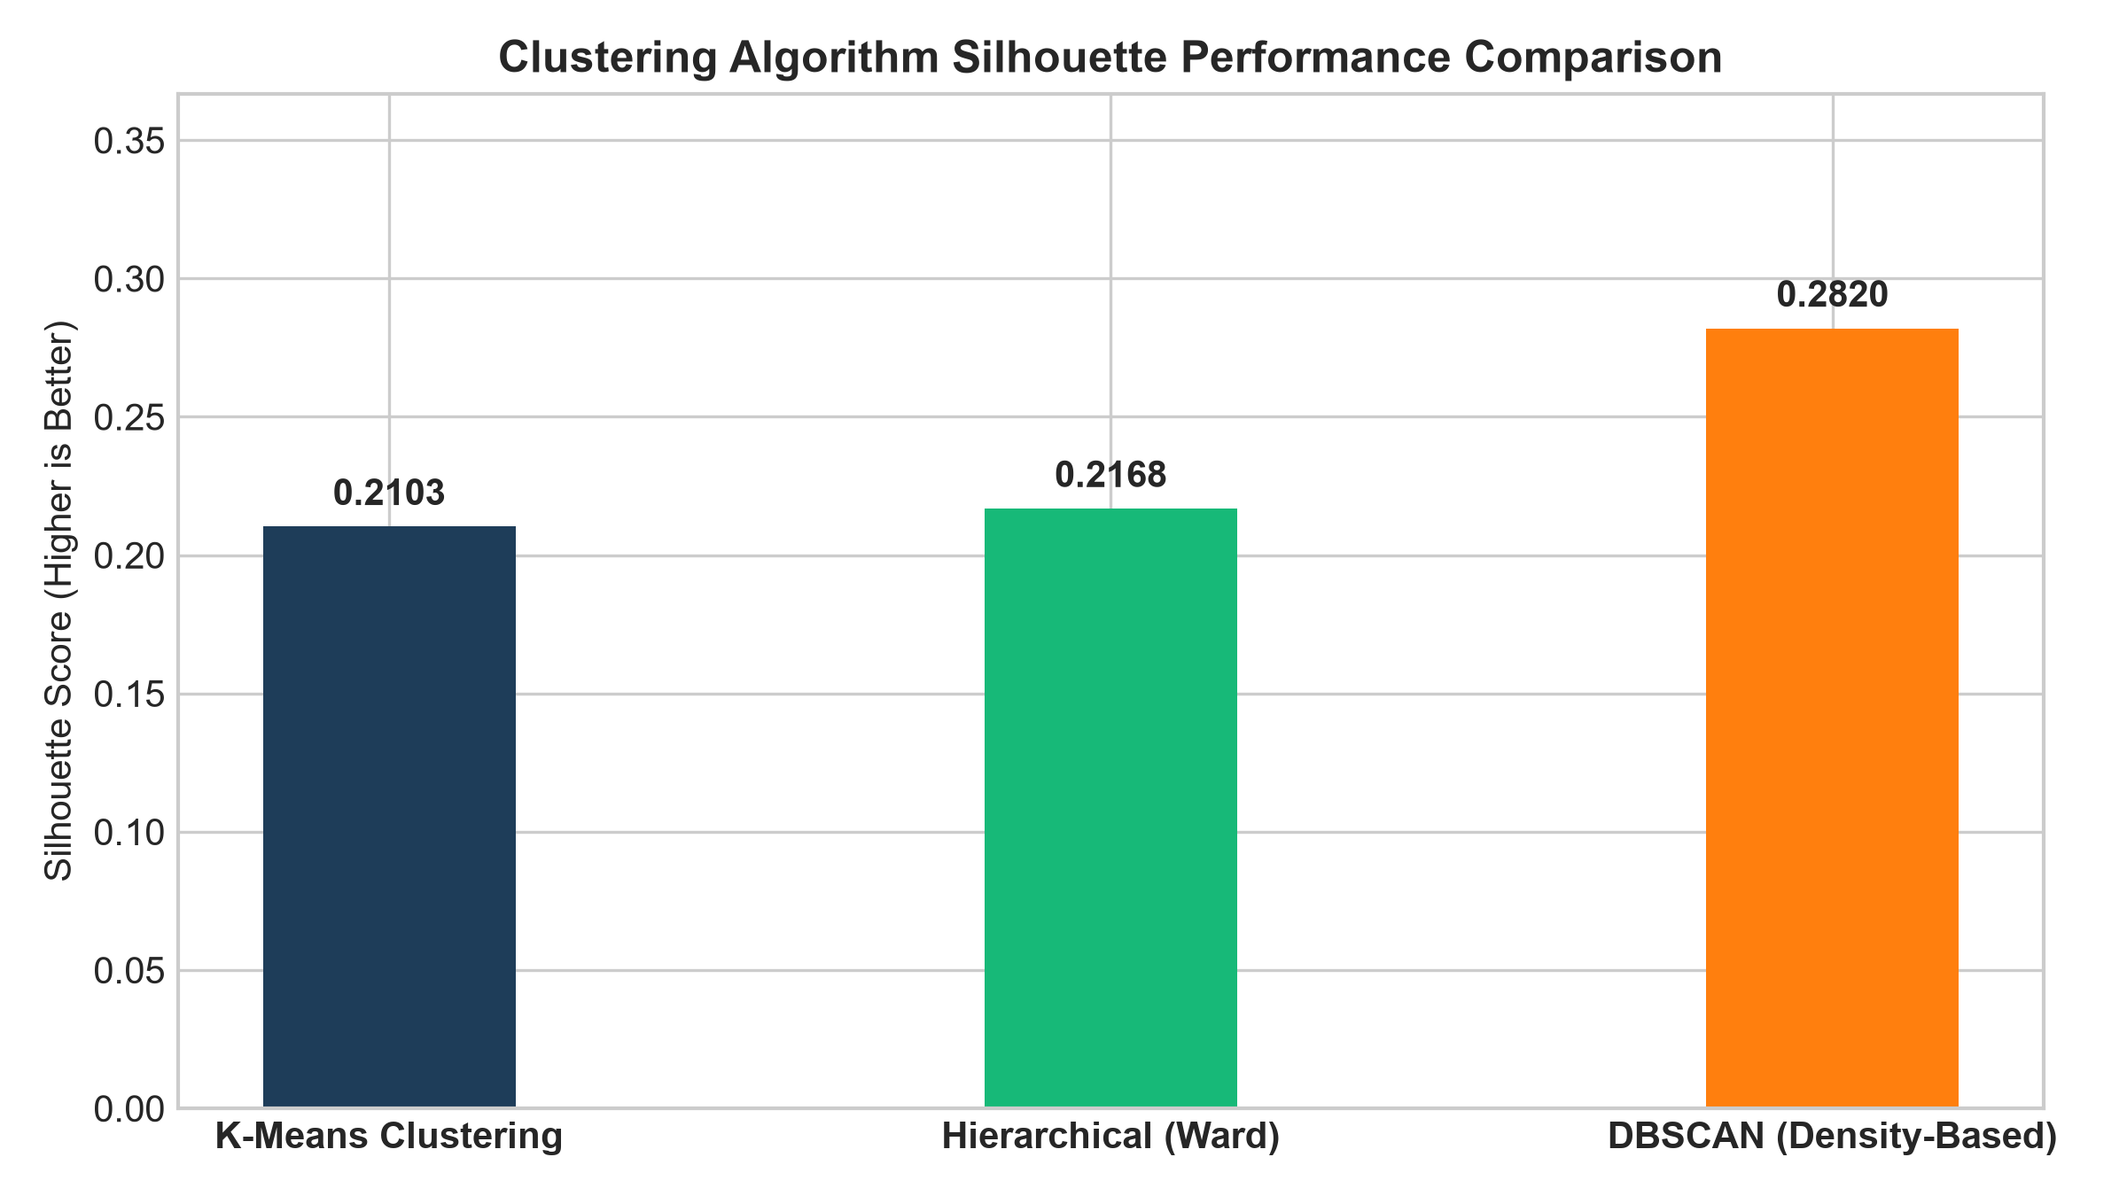
HCL GUVI CAPSTONE PROJECT | RETAIL BANKING & CREDIT RISK ANALYTICS
Clustering Algorithm Optimization & Benchmarking

Slide 9
HCL GUVI CAPSTONE PROJECT | RETAIL BANKING & CREDIT RISK ANALYTICS
Algorithmic Comparison: K-Means vs. Hierarchical vs. DBSCAN
K-Means (Selected)
• Clusters: k = 4
• Silhouette Score: 0.2103
• Davies-Bouldin Index: 1.7430
• Calinski-Harabasz: 1,034.1
• Noise Points: 0.0%
• Computational Complexity: O(k·n·d) - Linear & highly scalable.
• Verdict: Optimal for enterprise production scoring pipelines.
Hierarchical (Ward)
• Clusters: k = 4
• Silhouette Score: 0.2168
• Davies-Bouldin Index: 1.7941
• Calinski-Harabasz: 961.8
• Noise Points: 0.0%
• Computational Complexity: O(n²) memory, O(n³) compute.
• Verdict: Excellent for dendrogram validation on subsamples; computationally infeasible for 1.35M rows.
DBSCAN (Anomaly Filter)
• Core Clusters: 14 micro-groups
• Silhouette Score: 0.2820 (core)
• Davies-Bouldin Index: 1.3549
• Calinski-Harabasz: 829.7
• Noise / Anomaly Ratio: 4.17%
• Parameter Tuning: eps=2.2, min_samples=25.
• Verdict: Ideal density-based anomaly detector to flag non-standard applications.

Slide 10
HCL GUVI CAPSTONE PROJECT | RETAIL BANKING & CREDIT RISK ANALYTICS
Discovered Borrower Segments & Financial Personas
Segment 0: Prime Homeowner Consolidators
• Share: 6.4% | Default Rate: 18.43% (Risk Index: 0.92x)
• Median Income: $75,000 | FICO: 697 | DTI: 14.6%
• Collateral: Mortgage / High Home Equity
• Strategy: Fast-track auto-approval, lowest APR pricing.
Segment 1: Subprime Renter High-DTI
• Share: 44.6% | Default Rate: 17.34% (Risk Index: 0.87x)
• Median Income: $75,000 | FICO: 692 | DTI: 18.0%
• Collateral: Renter / Non-Homeowner
• Strategy: Standard approval with automated payroll verification.
Segment 2: Prime Revolving Refinancers
• Share: 9.5% | Default Rate: 21.33% (Risk Index: 1.07x)
• Median Income: $60,000 | FICO: 692 | DTI: 18.4%
• Purpose: Credit Card Debt Refinancing
• Strategy: Direct payout to existing credit card accounts.
Segment 3: High-Exposure Major Borrowers
• Share: 39.4% | Default Rate: 22.80% (Risk Index: 1.14x)
• Median Income: $55,500 | FICO: 687 | DTI: 17.5%
• Purpose: Unsecured Expansion / Small Business
• Strategy: Strict manual underwriting, APR surcharge (+250 bps).

Slide 11
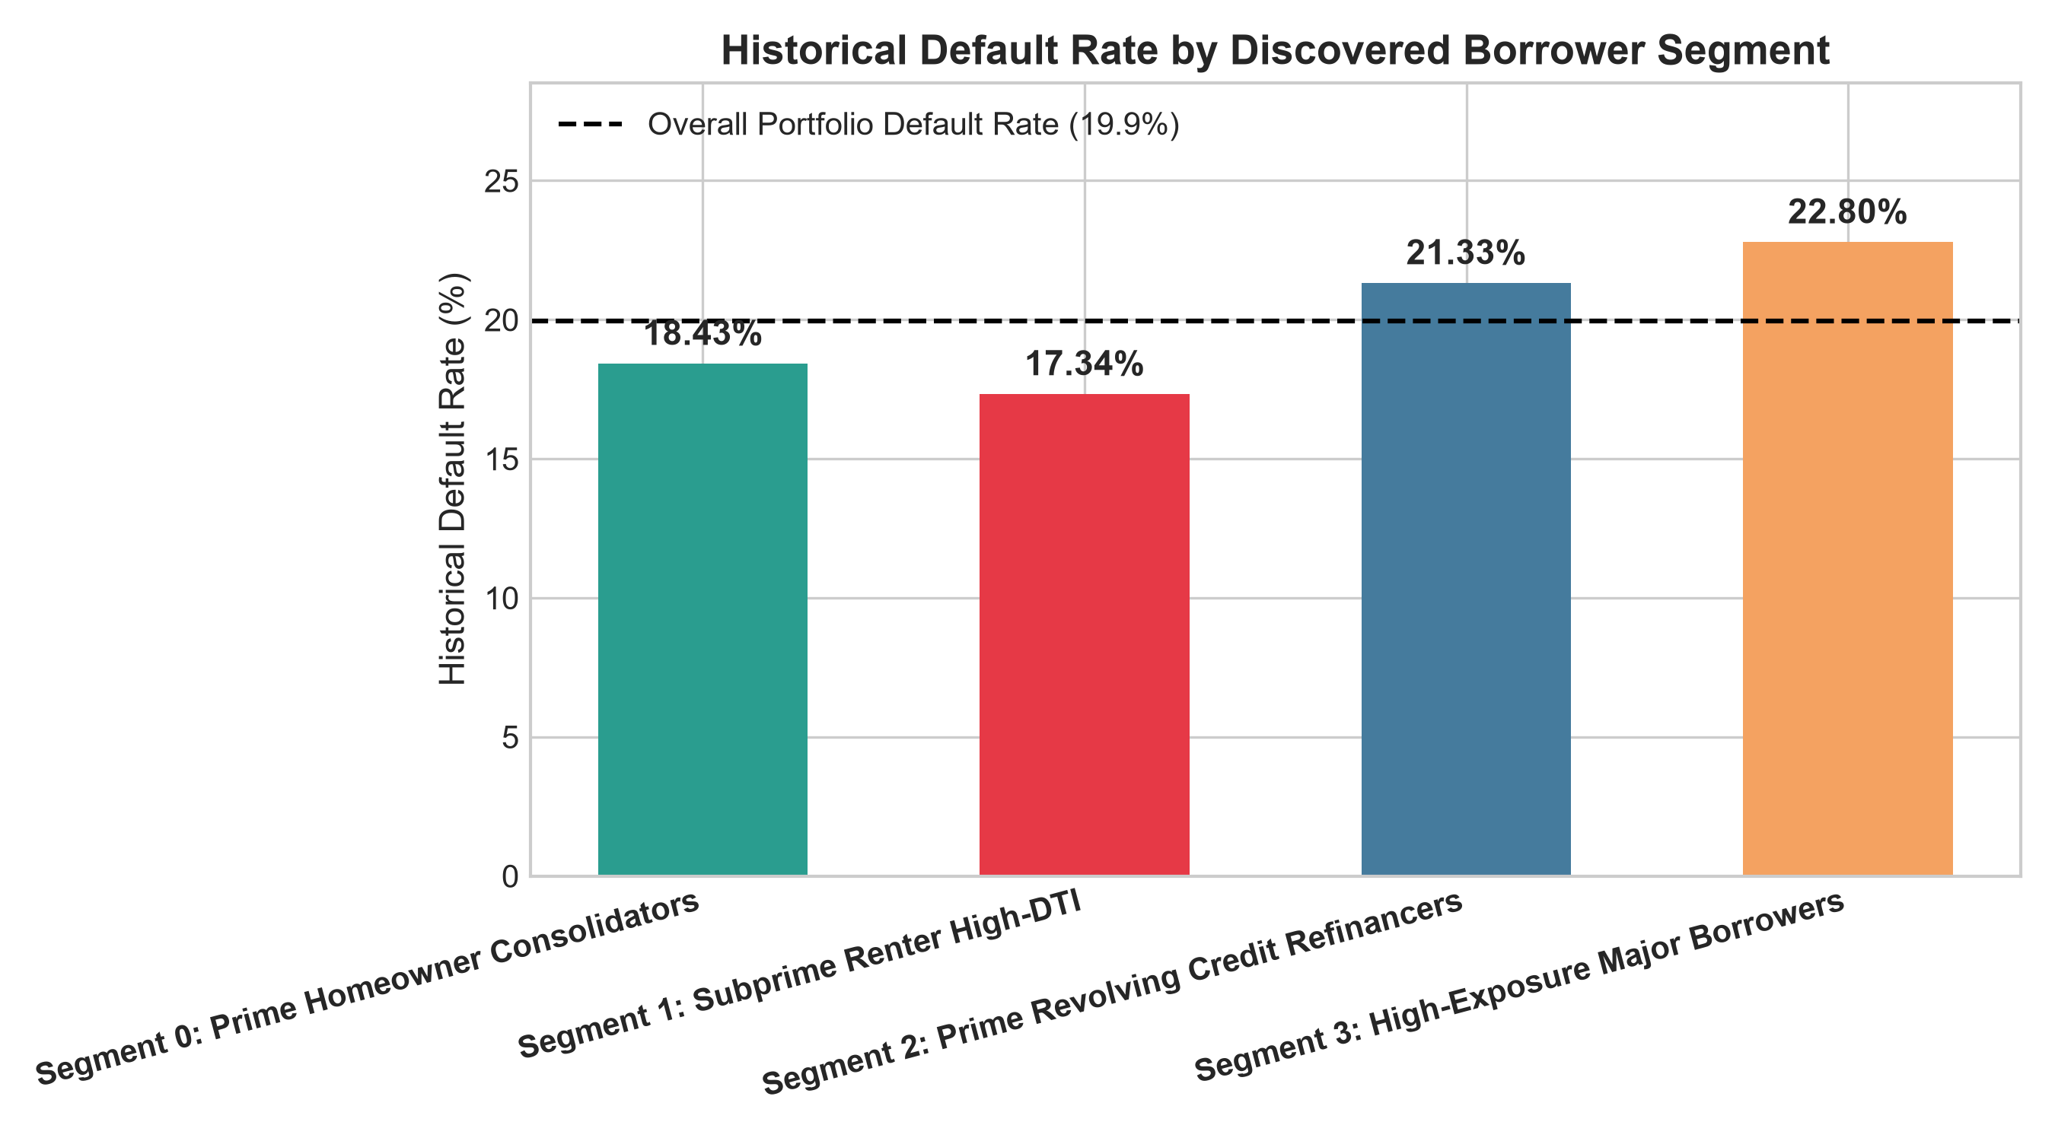
HCL GUVI CAPSTONE PROJECT | RETAIL BANKING & CREDIT RISK ANALYTICS
Historical Default Pattern Cross-Validation
Default Cross-Validation Findings
• Strict Methodology: The 'Default' target was entirely excluded from clustering features — eliminating data leakage.
• Empirical Validation: Discovered clusters naturally bifurcated into distinct risk tiers without supervision.
• Lowest Risk: Segment 1 (17.34%) and Segment 0 (18.43%).
• Highest Risk: Segment 3 (22.80%) - representing 1.14x baseline portfolio default odds.
• Loss Mitigation: Tightening underwriting on Segment 3 prevents the majority of portfolio charge-offs.

Slide 12
HCL GUVI CAPSTONE PROJECT | RETAIL BANKING & CREDIT RISK ANALYTICS
Anomaly & Outlier Risk Detection via DBSCAN
Density-Based Outlier Profiling
• Isolation Metric: Distance threshold eps = 2.4, min_samples = 25.
• Anomaly Volume: 4.17% of borrower pool flagged as noise/outliers.
• Empirical Default Rate: Anomalous group defaults at 23.71% vs. 19.52% for regular borrowers (+4.19% risk premium).
• Financial Signatures:
• - Excessive Loan-to-Income (> 0.85)
• - Mismatched debt burdens relative to declared income
• - Irregular combinations of low credit score with top-tier loan requests.
Risk Control & Anti-Fraud Actions
• 1. Automated Red-Flag Gate: Real-time DBSCAN scoring triggers automated review for applicants falling outside core clusters.
• 2. Fraud Prevention: Screen flagged applicants against synthetic identity and income inflation databases.
• 3. Enhanced Collateral Requirements: Require verified bank statement feeds (Plaid / Open Banking API) rather than self-reported income.
• 4. Risk Containment: Restrict maximum unsecured credit limit to $15,000 for all flagged anomaly applicants.

Slide 13
HCL GUVI CAPSTONE PROJECT | RETAIL BANKING & CREDIT RISK ANALYTICS
Interactive Streamlit Underwriting & Risk Dashboard
Dashboard Architectural Highlights
• Multi-Tab Navigation: 9 comprehensive modules covering KPIs, EDA, Projections, Clustering, Default Validation, and Policy.
• Interactive 3D Projections: WebGL-accelerated 3D PCA, t-SNE, and UMAP scatter plots with dynamic cluster/default toggles.
• Instant Load Latency: Pre-computed embeddings and pickled scikit-learn models allow sub-second responsiveness without recomputing 1.35M rows.
• Real-Time Application Simulator: Live input sliders for applicant income, loan amount, FICO, DTI, and purpose.
Underwriting Simulator Workflow
• 1. Loan officer inputs borrower details into the Streamlit interface.
• 2. Pipeline executes robust outlier capping, log transform, and standard scaling.
• 3. K-Means model assigns the applicant to an empirical segment.
• 4. System outputs: Assigned Persona, Expected Historical Default Rate, Risk Tier, and Concrete Decision Policy (Auto-Approve, Verify, or Manual Review).

Slide 14
HCL GUVI CAPSTONE PROJECT | RETAIL BANKING & CREDIT RISK ANALYTICS
Strategic Recommendations & Policy Governance
Product & Pricing Strategies
• 1. Risk-Based APR Grid: Implement tiered APR margins (+200 to +350 bps) on Segment 3 to generate loss reserves.
• 2. Direct Creditor Payouts: Mandate that debt consolidation disbursements go directly to credit card providers.
• 3. Tailored Loan Products: Cross-sell home equity credit lines (HELOCs) to Segment 0 prime homeowners.
• 4. Balanced Portfolio Allocation: Cap high-exposure loans at 15% of total deployed balance sheet capital.
Ethical AI & Compliance Governance
• 1. Fair Lending & Non-Discrimination: Ensure geographic and demographic variables do not introduce proxy bias.
• 2. Model Explainability: Segment assignments are backed by transparent feature centroid distances.
• 3. Continuous Monitoring: Quarterly drift monitoring on cluster centroids to capture macroeconomic shifts.
• 4. Basel II / III Alignment: Model parameters calibrated against internal rating-based (IRB) capital adequacy standards.

